Slide 1
1008 I&F Status
Overall Project Status
Remaining MIE items for PD-4, KPPs
Schedule, magnet mapping
USI plan
Status of IRR/ARR planning
Schedule for post magnet mapping installation activities (TPC, INTT,MVTX)

Slide 2
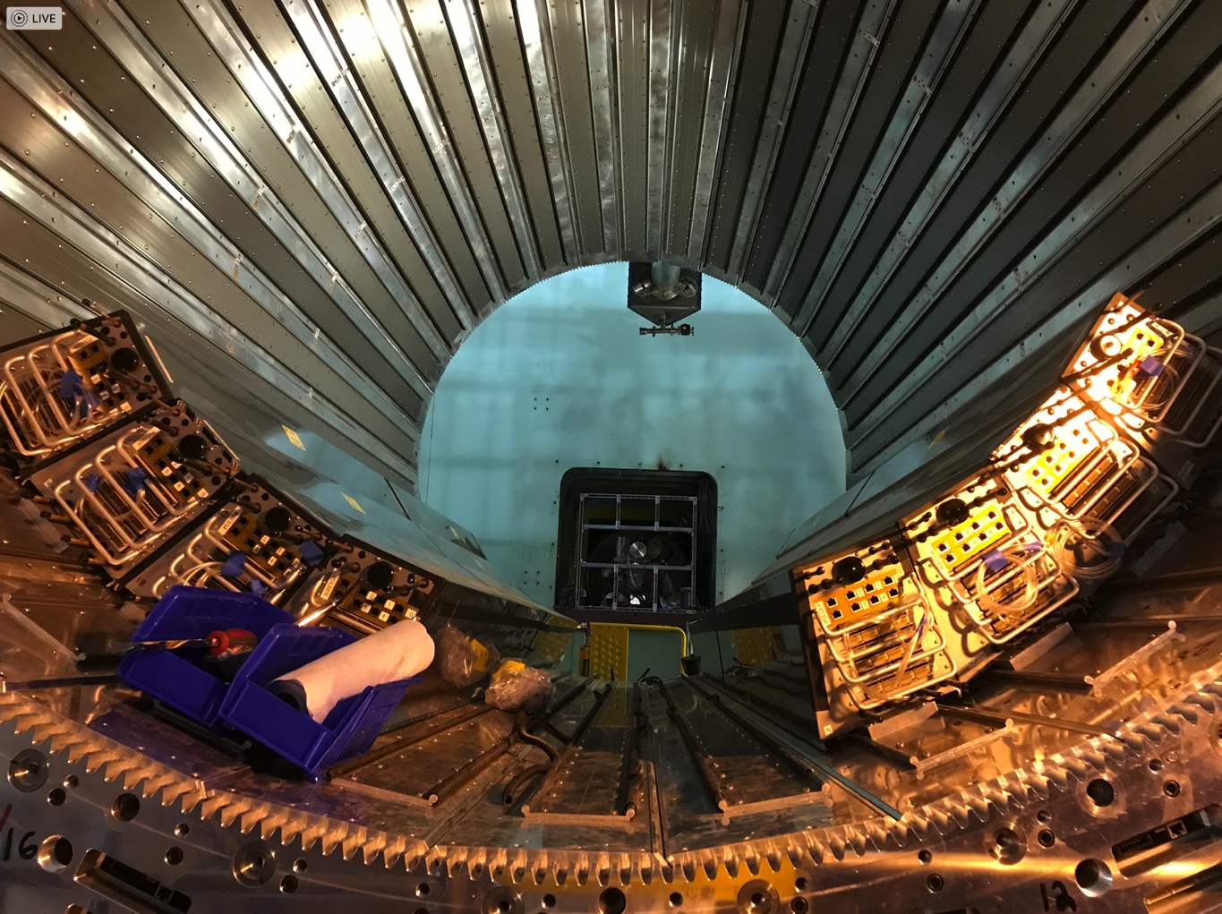
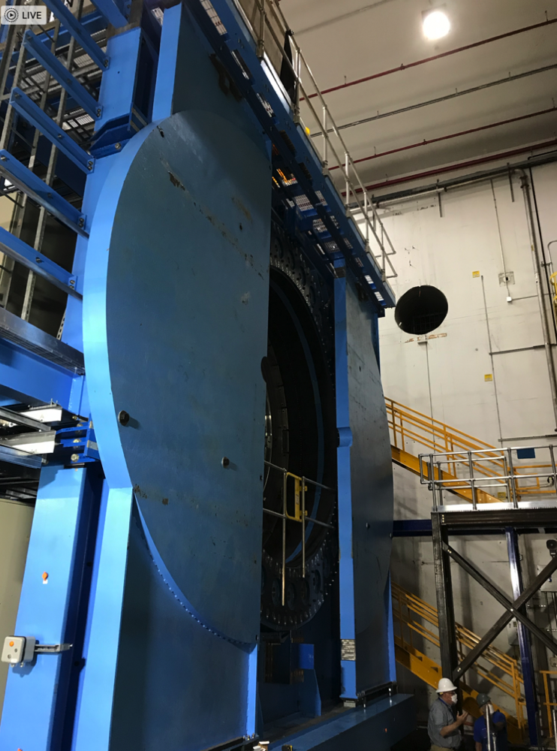
sPHENIX Installed at IP. EMCal Installation Ongoing
8 EMCal sector-pairs installed
As of 8/31/22
sPHENIX in the 1008 IR

Slide 3
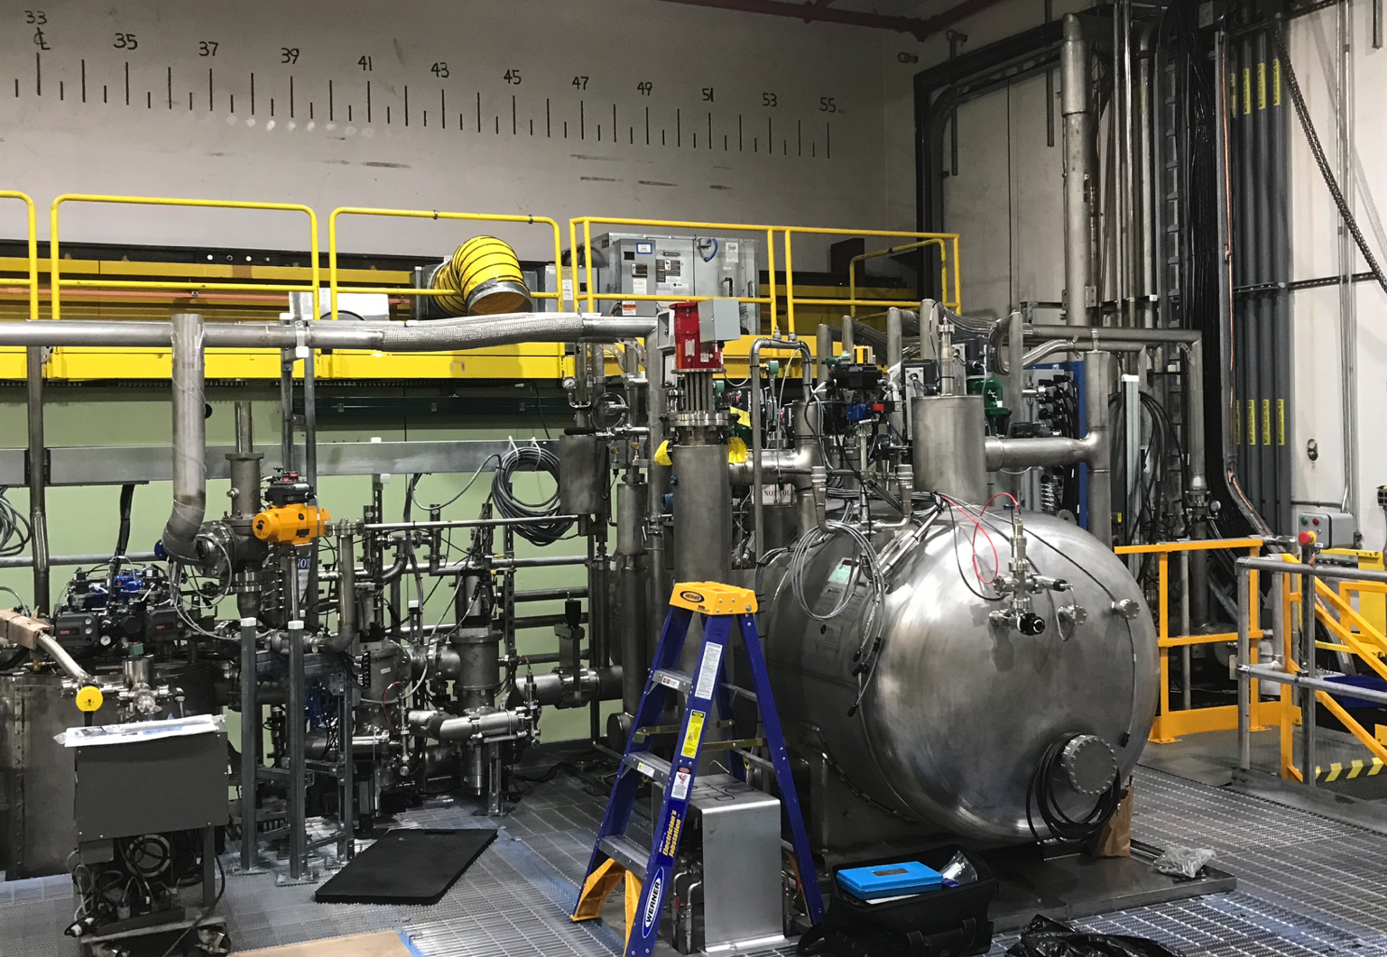
Cryo Installation on sPHENIX Carriage
Cryo jumper lines between sPHENIX Magnet/Platform and RHIC
Work of CAD cryo, SMD and BNL trades has been outstanding.
These groups have been critical to the completion of the platform, installing the magnet valve box, He cold box and cryo jumpers

Slide 4
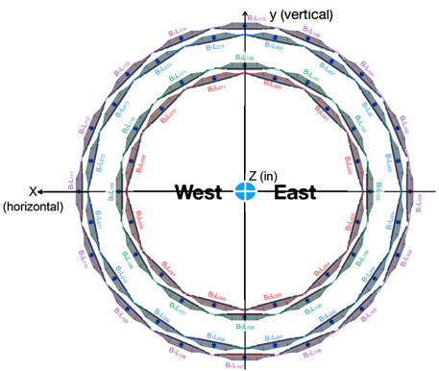
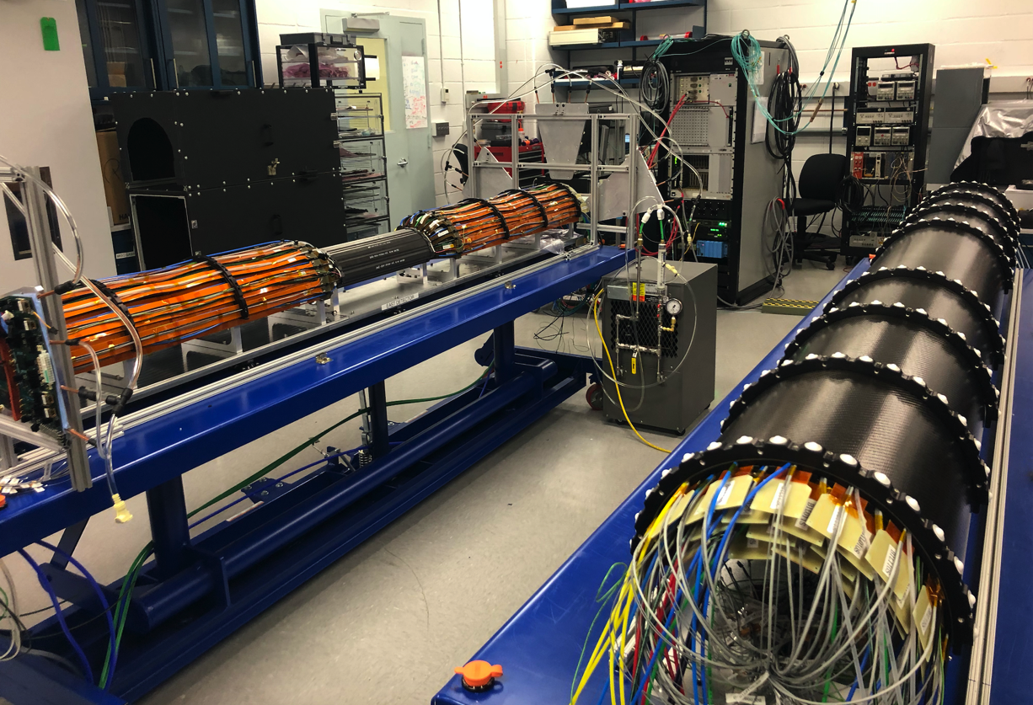
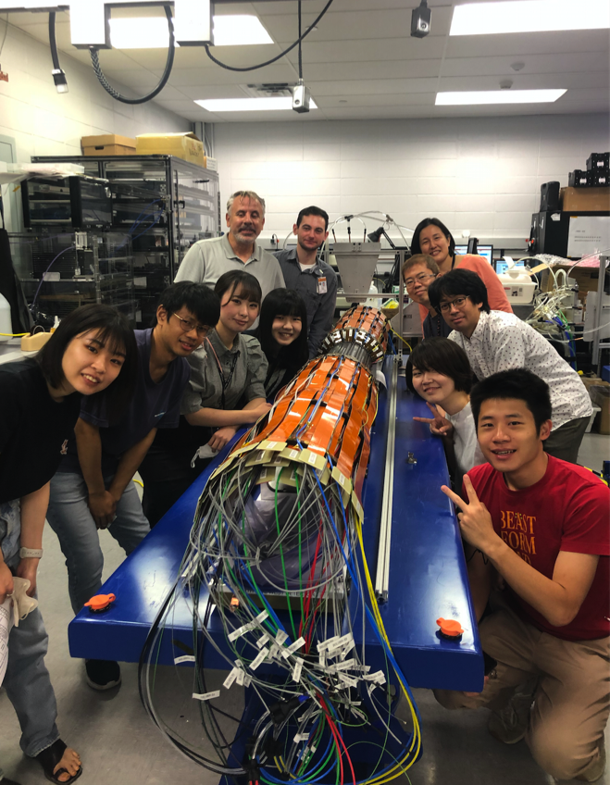
INTT Complete This Week
The INTT is two half-barrels (E & W) silicon strip detectors
The West half barrel is complete and tested.
The East half barrel is assembled, but needs cooling added plus testing
The East half barrel should be completed by Friday 9/2.

Slide 5
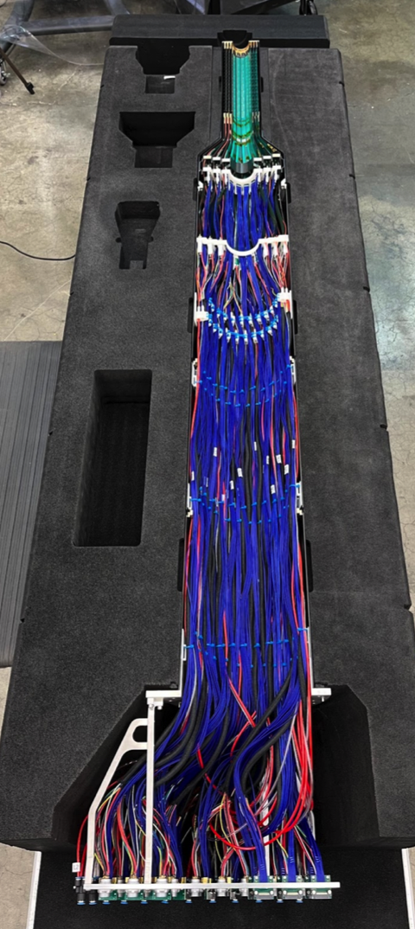
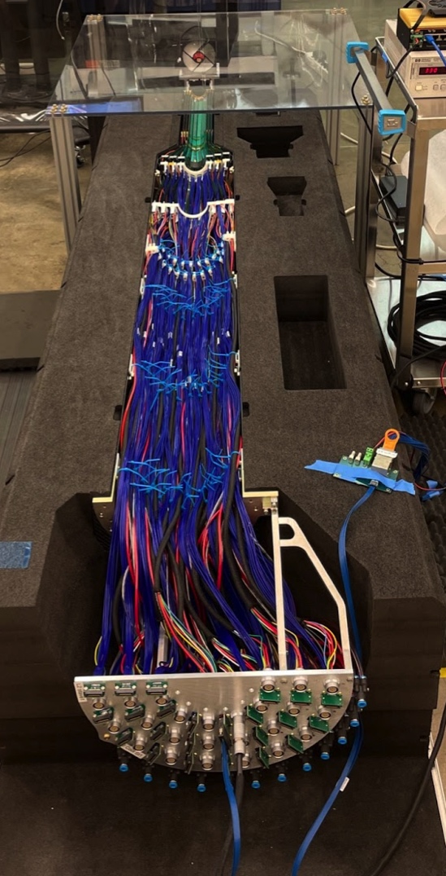
MVTX Complete and Ready to Ship
Both half-detectors complete at LBNL!
  Shipping to BNL next 3-4 weeks
Cooling systems
  Stave cooling system ready at BNL
  One rack cooling system arrived at BNL this morning
  2nd rack cooling in progress at LANL
Half-detector QA and commissioning at BNL
  Insertion system test at BNL in 2 weeks
Half-detector-1
Half-detector-2

Slide 6
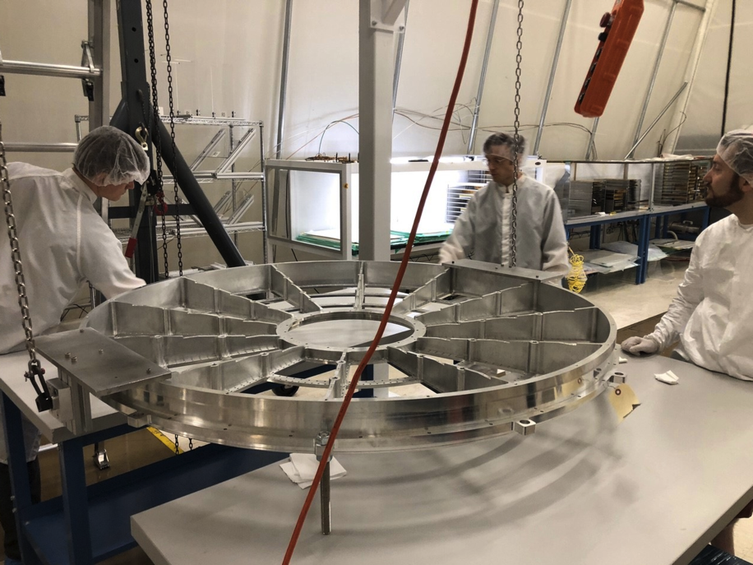
sPHENIX MIE Status
All OHCal sectors complete, installed, tested.
All IHCal sectors complete, installed, tested.
All EMCal sectors complete, tested, 16/64 installed
All Calorimeter electronics complete, tested.
All TPC det components at SBU/BNL
TPC assembly started
TPC electronics: Fee boards complete and tested. FELIX boards complete and tested.
JACK first article production board assembly started
DAQ/Trigger: Large switch, DAQ computers, Buffer boxes, GTM/GL1 complete.
1st article LL1 (3/18) production boards at Nevis
1st article MBD D/S (2/16) boards at Nevis
Expect balance of LL1 and MBD D/S boards in October
Prep for TPC assembly at SBU
.

Slide 7
High Priority Issues
Complete the MIE deliverables and write our KPPs report.
Complete Installation of 23 EMCal sector pairs prior to installation of mapping equipment.
Complete Installation of all cryo, power and controls jumpers from cryo deck to platform
Magnet mapping. Get mapping equipment shipped from CERN to BNL.
Get USI approved. Prep for IRR and ARR.
Install carriage racks and power.
Begin to cable the detector.
Maintain the sPHENIX technical work force. Need for ET’s for next few months.
Keep remaining electronics on schedule: LL1, MBD D/S, JACK
Assemble the TPC
Install remaining detectors.

Slide 8
Deliverables for MIE
Complete the remaining deliverables for the PMP
  TPC assembly
  LL1, JACK, MBD D/S
Complete KPP tests for deliverables and write up
  Most of the KPP’s can be written up as complete except TBC:
    DAQ 10 kHz throughput test
    TPC > 90% single hit efficiency/mip track

Slide 9
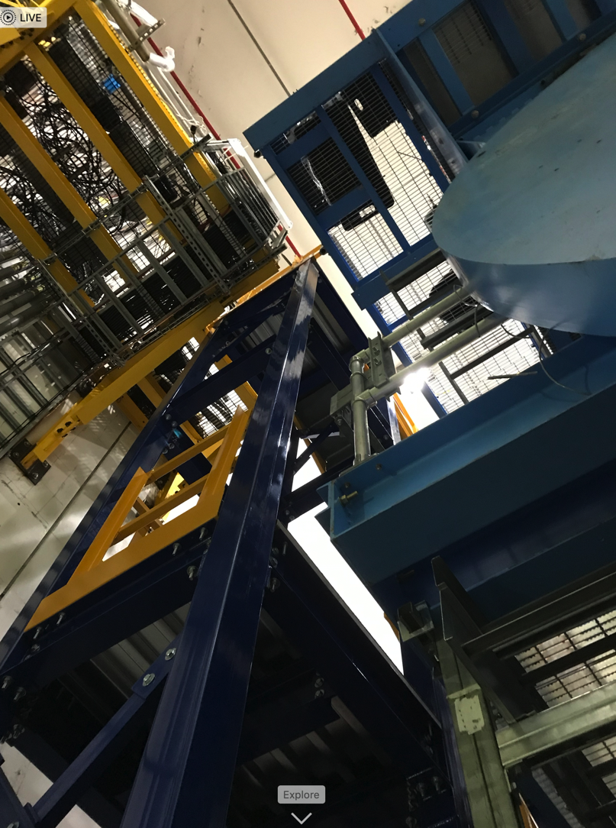
1008 Infrastructure & Facility Upgrade Status
Carriage/Cradle assembled in 1008
Carriage XY tables, hydraulics installed
SC- Magnet installed in 1008
IR track reinforcement complete.
Large Support Rings installed
All LHe cryo components delivered.
IHCal installed. EMCal ready to install.
Magnet pole tips at BNL installation complete
Rack Platform complete today
LN2 & warm piping parts delivered, installation partially complete
Chiller platform, TPC/MVTX/INTT installation fixtures/brackets in fab
Conventional beam pipe components, Beam pipe/MBD/sEPD support brackets
Magnet Mapping contract w/ CERN is being worked on by BNL PPM. PPM needs CERN to sign one more form before sending them the final contract to sign. Negotiation on contract with CERN began Oct 2021.
Platform assembly

Slide 10
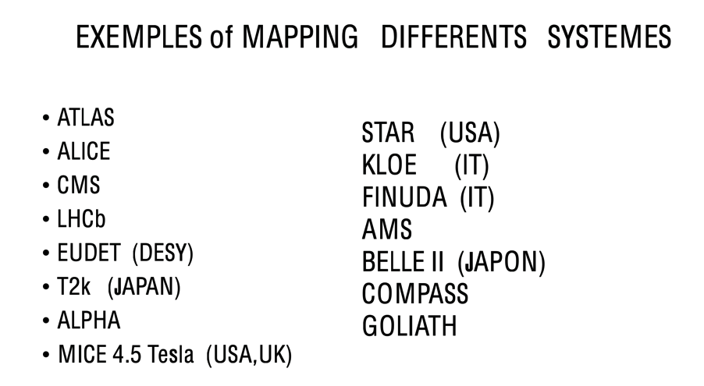
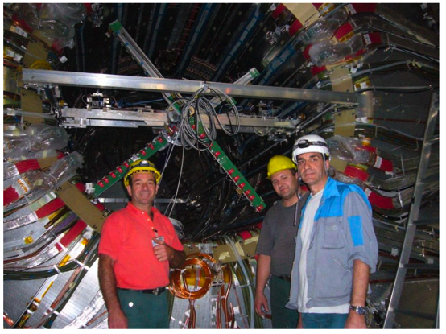
Magnet mapping
We have contracted with a very, very experienced group at CERN to map our magnet
Calibrated 3D Hall probes, pneumatic motors, precision position measurements, and analysis of raw data
This is our best opportunity to compare the calculations of the field carried out by Wuzheng Meng and Kin Yip with measurement

Slide 11
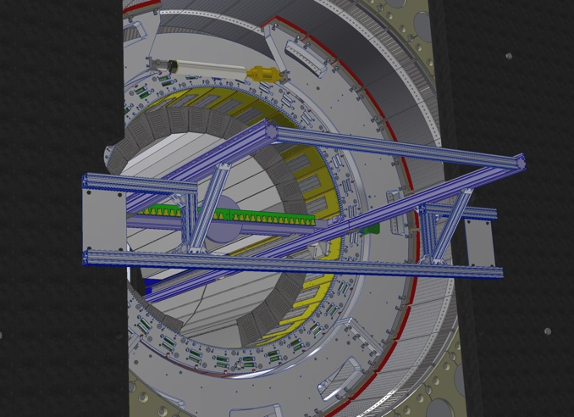
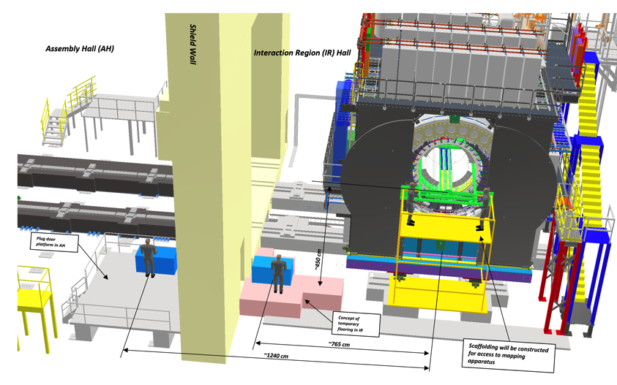
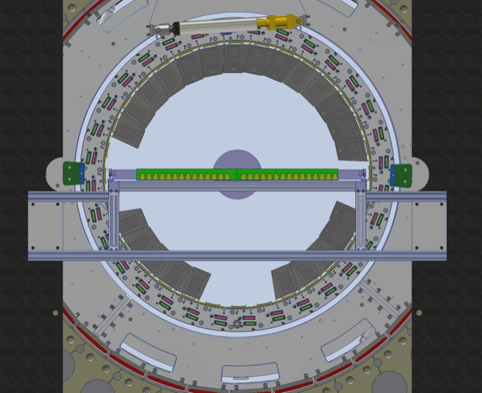
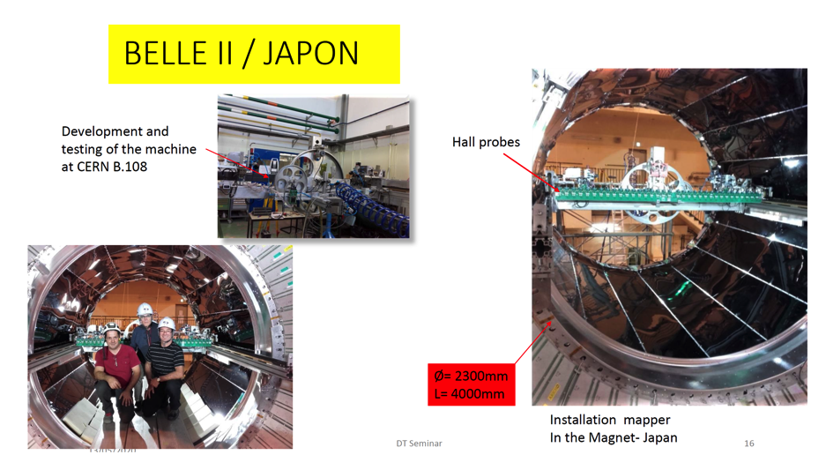
Magnet Mapping Plan
sPHENIX Magnet Mapping Rails Installation
Magnet mapping operations will take place on the north side of sPHENIX
Nine EMCAL rows are left out to install magnet mapper.
The sPHENIX mapping apparatus was used on several other detectors

Slide 12
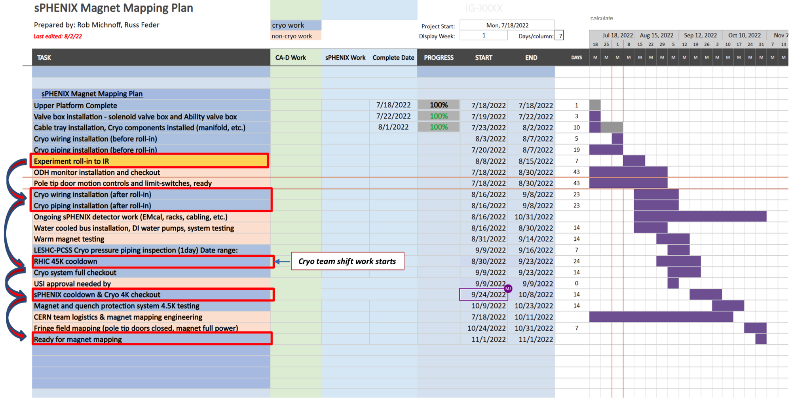
sPHENIX Near Term Schedule
Magnet Mapping begins 11/1 and will last 2 weeks.

Slide 13
sPHENIX Safety Approvals
BHSO has started reviewing the revised sPHENIX USI. Expect a response from BHSO by Sept 9.
ASE/SAD seems to me to be making good progress. I meet on average twice/week with the CAD safety team to work on it.

Slide 14
Installation Schedule Including Magnet Mapping
Tasks | Nov 22 | Dec 22 | Jan 23 | Feb 23 | Mar 23
Magnet Mapping
Install TPOT EMCal
Install TPC
Install/Bakeout Beampipe
Install MVTX/INTT
Install MBD
Ready for commissioning with beam
2 wks
3 wks
4 wks
2 wks
6-8 wks
2 wks

Slide 15
Risks and Challenges
Maintaining labor force for the next 7 months. Especially important are:
  Technicians and trades for fab and assembly and installation. Will likely need additional ETs/electricians for rack completion and cabling to keep to the aggressive schedule.
  Visiting students, postdocs and scientists for QA, testing and commissioning.
  We have been successful in borrowing techs from other parts of BNL.
Need BHSO USI approval by mid-September for Magnet Mapping to commence in Oct-Nov. Need BHSO ASE/SAD approval for sPHENIX Operations in RHIC Run-23 beginning Mar 2023.

Slide 16
Summary
sPHENIX installation is proceeding well.
  sPHENIX rolled-in to 1008 IP. Survey says that we’re at the data-taking point. Cryo hook-up to RHIC nearly complete.
  EMCal installation underway.
2.5 month float between MIE early completion date and PD-4. No float on I&F
KKPs nearly complete. One for TPC, one for DAQ/Trigger remaining.
Continued great progress in sPHENIX. Remaining deliverables: TPC assembly and test, LL1, MBD D/S, JACK board.
The TPC detector assembly is on the critical path.
Need to order one more electronics board (TPC JACK controller board). First article JACK board is ready to test.
We have been successful in securing technicians and engineers from other parts of BNL: CAD, IO, SMD, NSLSII
  Need to maintain this level of technical support until the start of RHIC run 2023.
  Will likely need additional ETs and continued support of trades to meet aggressive schedule.
With DOE agreement we have removed DCMIIs, diffuse laser and diffuse laser fibers from MIE P6 with PCR 34 . KPPs and PMP deliverables are not affected.
Challenges remain: USI approval for magnet mapping followed by ASE/SAD, overall installation schedule has no float to start up date of RHIC Run-2023.

Slide 17
Back Up

Slide 18
Future Review Schedule
MIE scope Review 1st half of Nov 2022
PD-4 Review 2nd half of Nov 2022
IRR Dec 2022
ARR Jan 2022

Slide 19
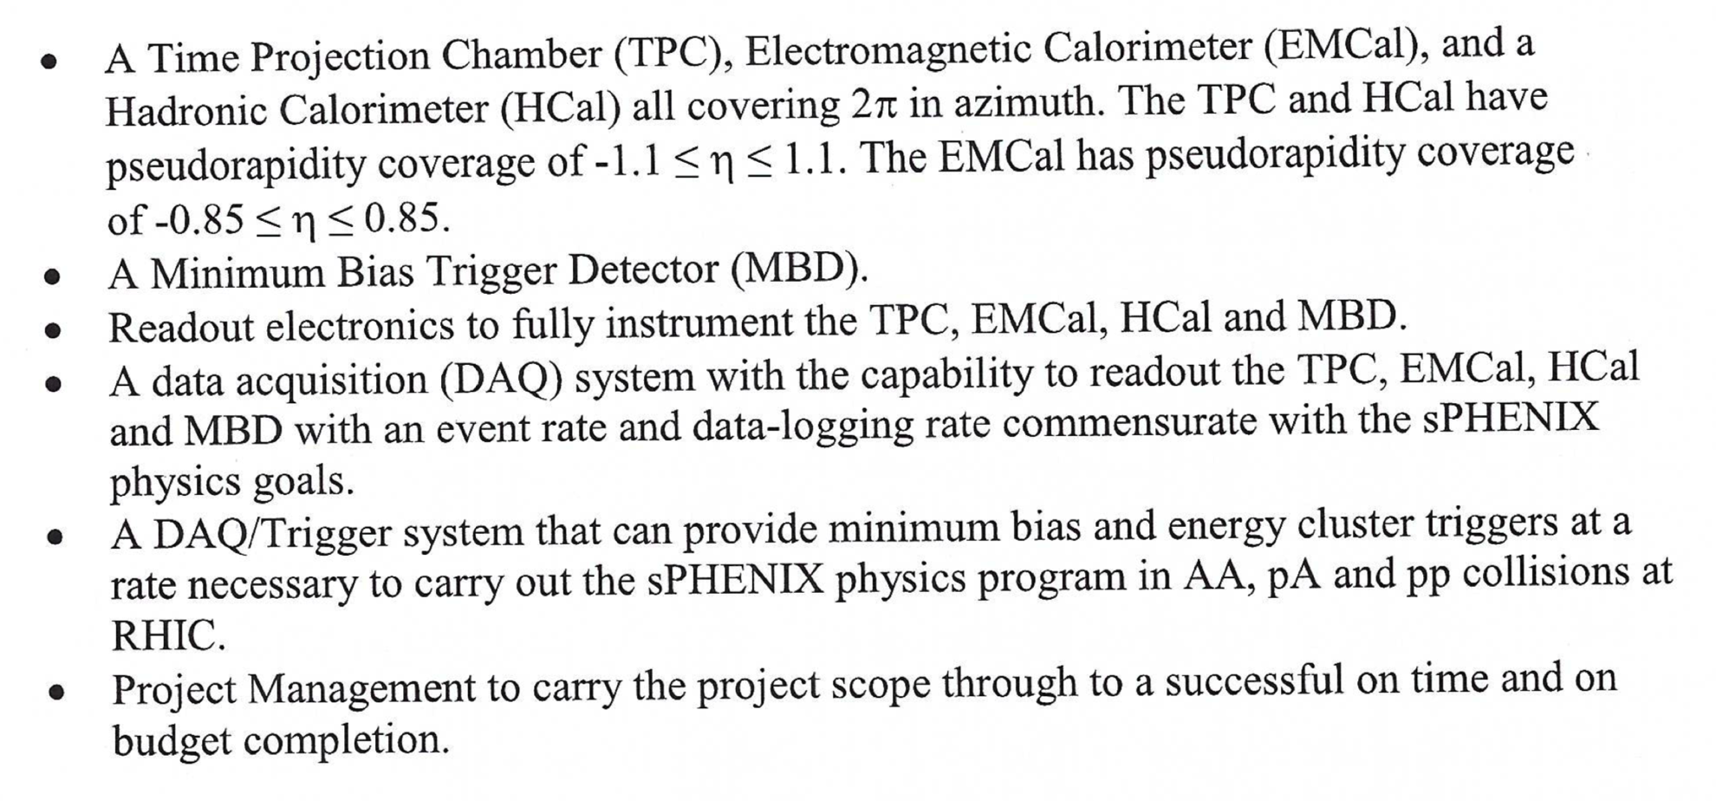
sPHENIX MIE Deliverables

Slide 20
sPHENIX MIE KPP’s
System | Demonstration or Measurement | Threshold KKP’s | Objective KPP’s
Time Projection Chamber | Preinstall, Bench tests | ≥ 90% live channels based on laser, pulser, cosmics | ≥ 95% live channels based on laser, pulser, cosmics
Time Projection Chamber | Preinstall, Bench tests | Ion back flow ≤ 2% per GEM module avgd over active area of ea GEM module | Same
Time Projection Chamber | Preinstall, Bench tests w/ cosmics | ≥ 90% single hit efficiency/mip track, averaged over active TPC volume | ≥ 95% single hit efficiency/mip track, averaged over active TPC volume
Time Projection Chamber Front End Electronics | Preinstall, Fee stand alone bench tests | Cross talk ≤ 2% per channel averaged over all channels | Same
EM Calorimeter | Preinstall, Bench tests | ≥ 90% live channels based on LED, cosmics | ≥ 95% live channels based on LED, cosmics
Hadronic Calorimeter | Preinstall, Bench tests | ≥ 90% live channels based on LED, cosmics | ≥ 95% live channels based on LED, cosmics

Slide 21
sPHENIX MIE KPP’s
System | Demonstration or Measurement | Threshold KKP’s | Objective KPP’s
EM Calorimeter | Preinstall, Bench tests | Each sector w/ an absolute energy precalibration of ≤ 35% RMS | Same
Hadronic Calorimeter | Preinstall, Bench tests | Each sector w/ an absolute energy precalibration of ≤ 20% RMS | Same
Min Bias Trigger Detector | Preinstall, Bench tests | ≥ 90% live channels based on laser. 120 ps/channel timing resolution w/ bench test | ≥ 95% live channels based on laser. 100 ps/channel timing resolution w/ bench test
DAQ/Trigger | Event rate | 10 kHz w/ random pulser | 15 kHz w/ random pulser
DAQ/Trigger | Data Logging rate | 10 Gbit/s with pulser | Same

Slide 22
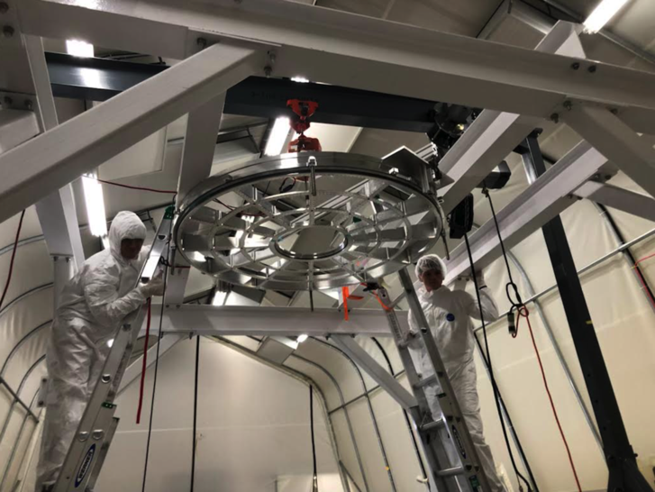
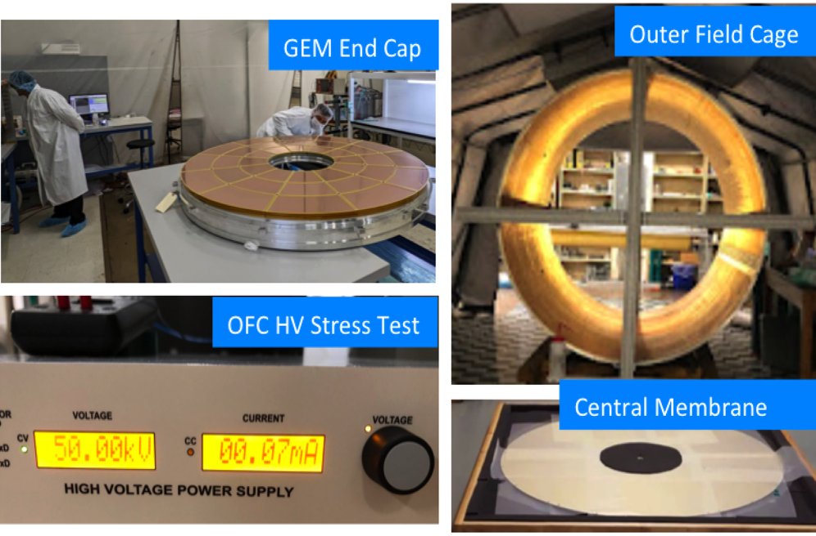
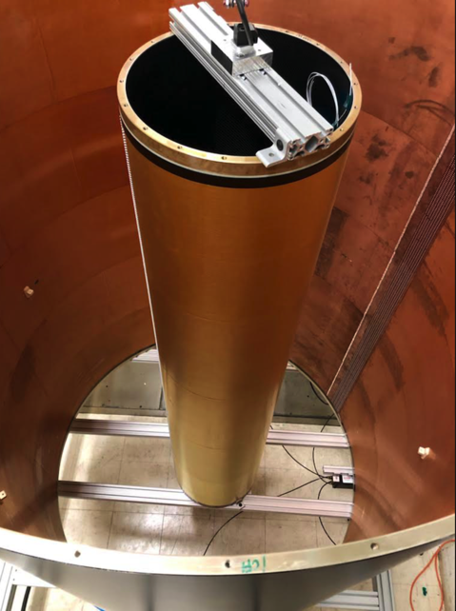
TPC Status
Outer and Inner field cages complete. Both have passed HV stress tests.
Central membrane complete. At SBU and ready to install.
All 72 quad GEM modules complete. HV tests good. Gain and IBF mapped good.
TPC End Caps (Wagon Wheels) are being populated with GEM Modules.
Initial testing of TPC Fee complete. Board by board performance testing underway.
FELIX board firmware continues to be developed.
TPC Assembly complete and testing to begin at SBU in September.
TPC Assembly
Outer & Inner Field Cage Together

Slide 23
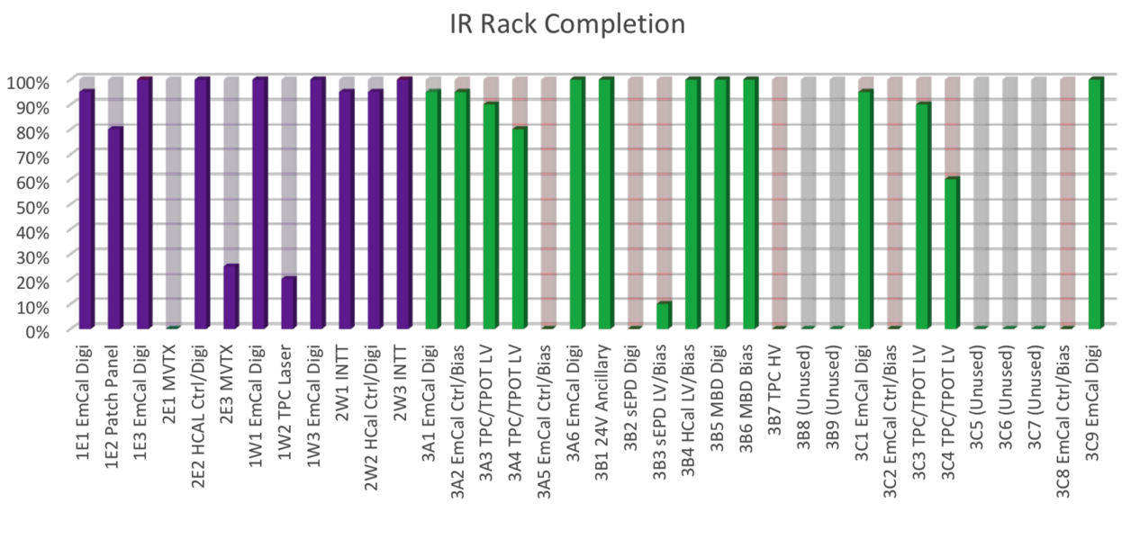
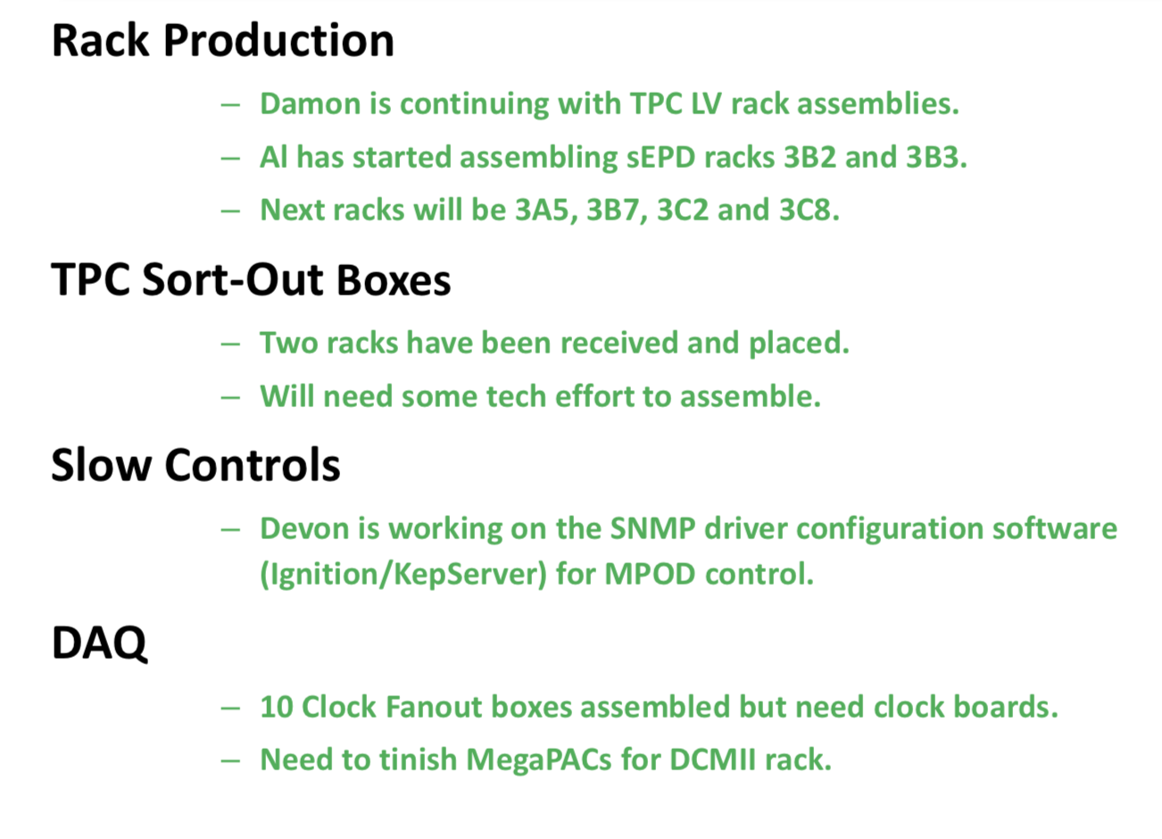
Rack Production Update
Rack Thermistor test
Need 31 racks. 26 racks started. 11 complete. Additional 8 just need water piping.

