Slide 1
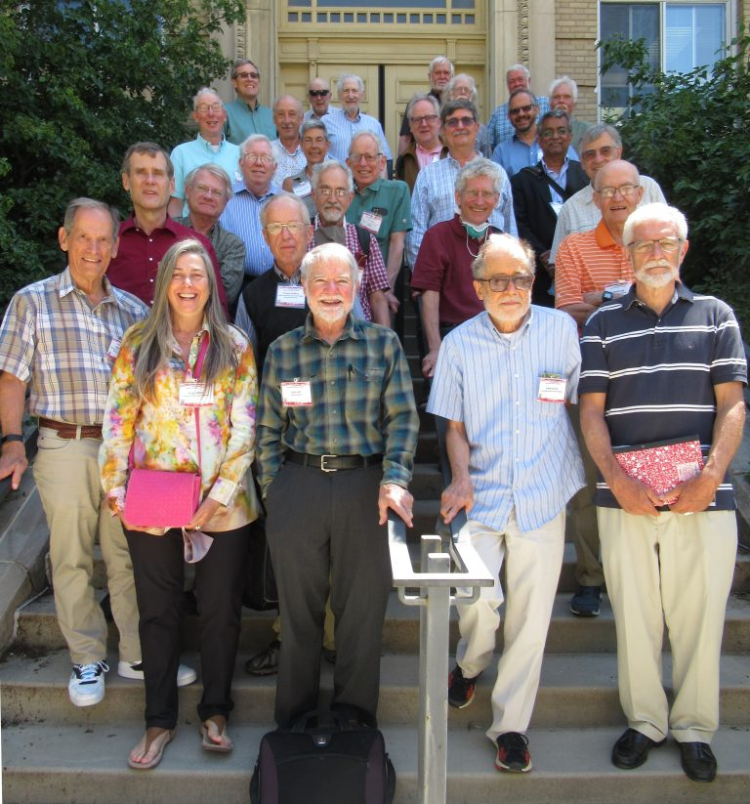
Thank you, Jim, for >40 years of productive collaboration!
Jim and I were both trained in nuclear spin physics at U. Wisconsin
At June 2022 Memorial Symposium for Willy Haeberli

Slide 2
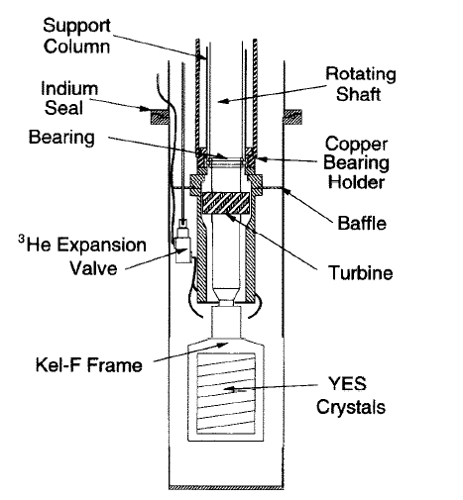
It started with a novel, but ornery, cryogenic polarized proton target (PPT)…
Jim was our YES (yttrium ethyl sulfate) man, wrangling the PPT to behave long enough to fuel precision measurements in the scattering of polarized neutrons from polarized protons at IUCF

Slide 3
Development of a Spin Refrigerator Polarized Proton Target.
Sowinski, James
Thesis (PH.D.)--THE UNIVERSITY OF WISCONSIN – MADISON
A spin refrigerator type polarized proton target has been developed for use in intermediate energy nuclear physics experiments. In this type of target a yttrium ethyl sulfate (YES) crystal doped with ~.01% ytterbium ions is rotated at 20-100 rps in a 7-11kG magnetic field. The polarizing mechanism relies on the highly anisotropic g -factor of the Yb ions to transfer the large electron polarization to hydrogen nuclei in the crystal.

Slide 4
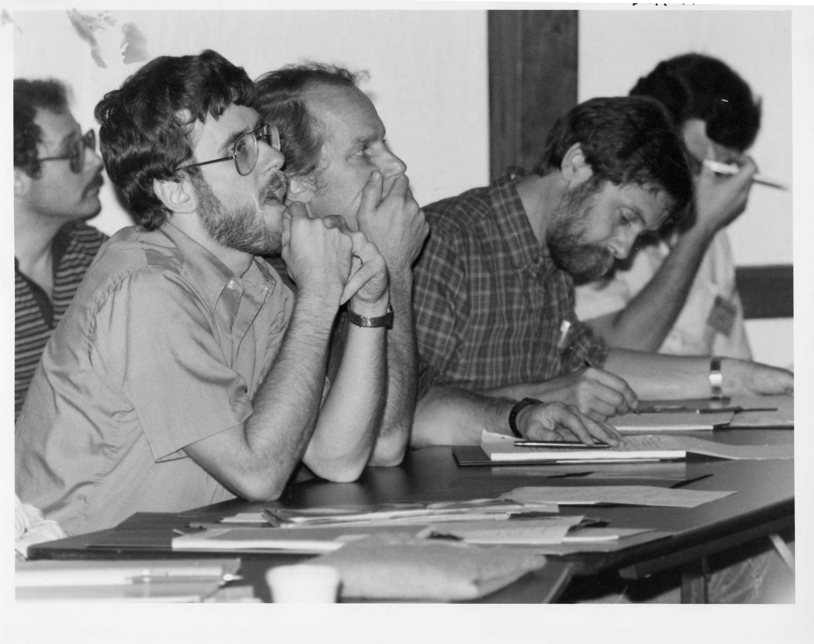
From graduate student to post-doc to Research Scientist at IUCF, Jim was often a highly valued member of a triumvirate…
Vigdor: “see no evil”
Jacobs: “speak no evil”
Sowinski: “all ears”

Slide 5
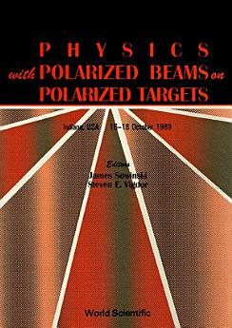
In 1983, Jim and I co-organized a workshop on Physics with Polarized Beams on Polarized Targets

Slide 6
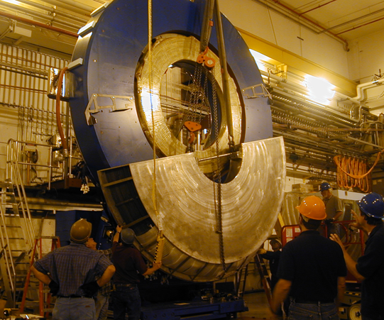
After we joined STAR, Jim was deputy PM, overseeing mechanical design/construction of endcap calorimeter

Slide 7
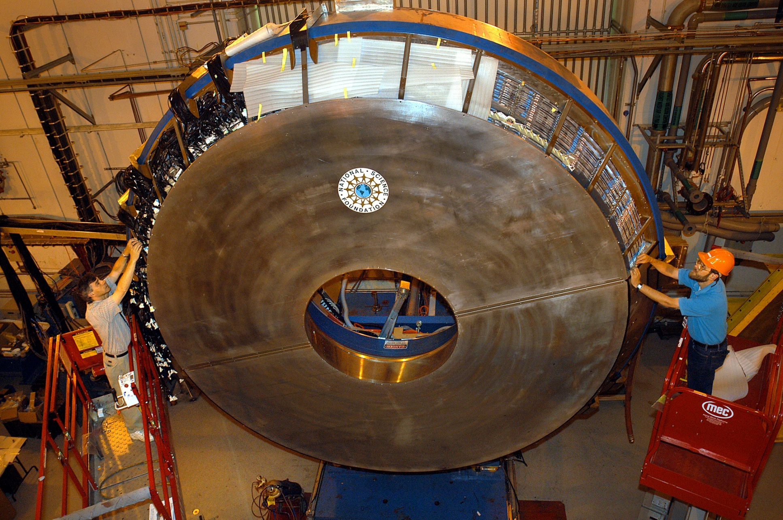
Shifting Effort to Spin Physics with STAR @ RHIC

Slide 8

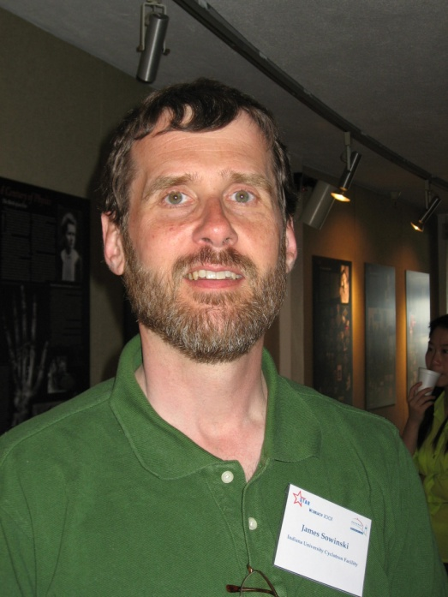
In 2010, Jim Joined a Rich RHIC Legacy at DOE ONP
Jim
Program Manager for Laboratory Operations, Office of Nuclear Physics
Former STAR Subsystem Deputy Manager, SPIN Working Group Co-Convenor
Tim Hallman
Associate Director of Science for Nuclear Physics
Former STAR Spokesman
Jehanne Simon-Gillo
Division Director for Facilities & Project Management, Office of Nuclear Physics
Former PHENIX Subsystem Manager
Also include Paul Sorensen and Jim Thomas among RHIC folk guiding NP funding agencies

Slide 9
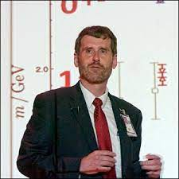
In all his roles, Jim has always been constructive, eager to learn new things, and truly effective at getting jobs done!
Congratulations on a great career, Jim, and welcome back to Bloomington!
(There’s probably still a place for you in the Community Band…)

