Slide 1
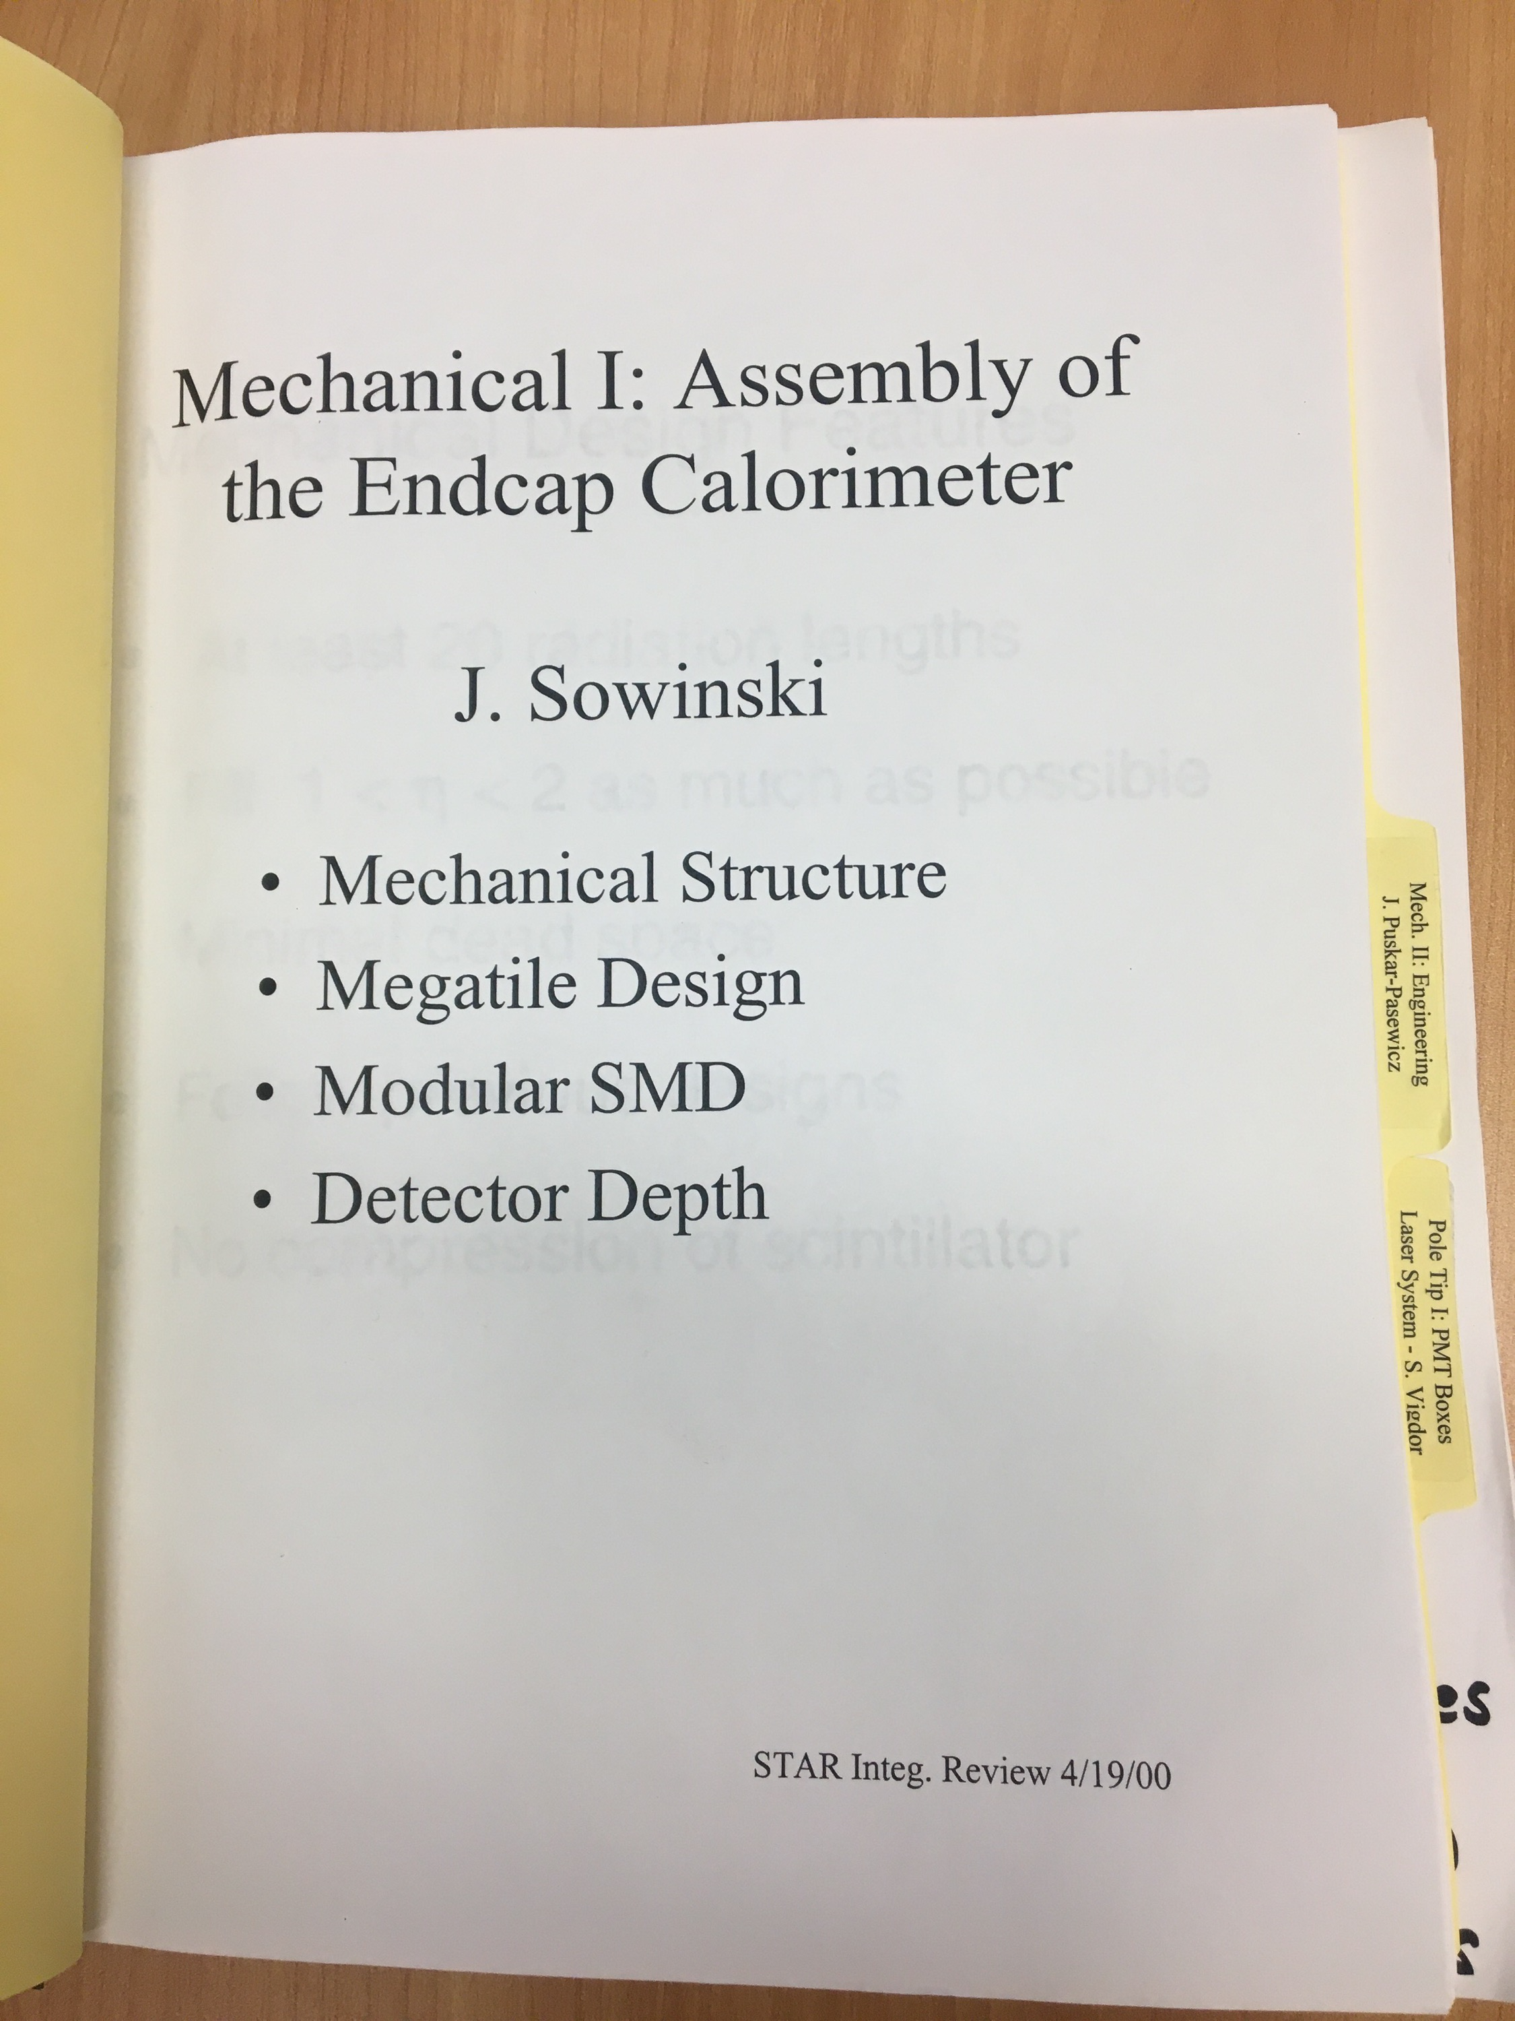
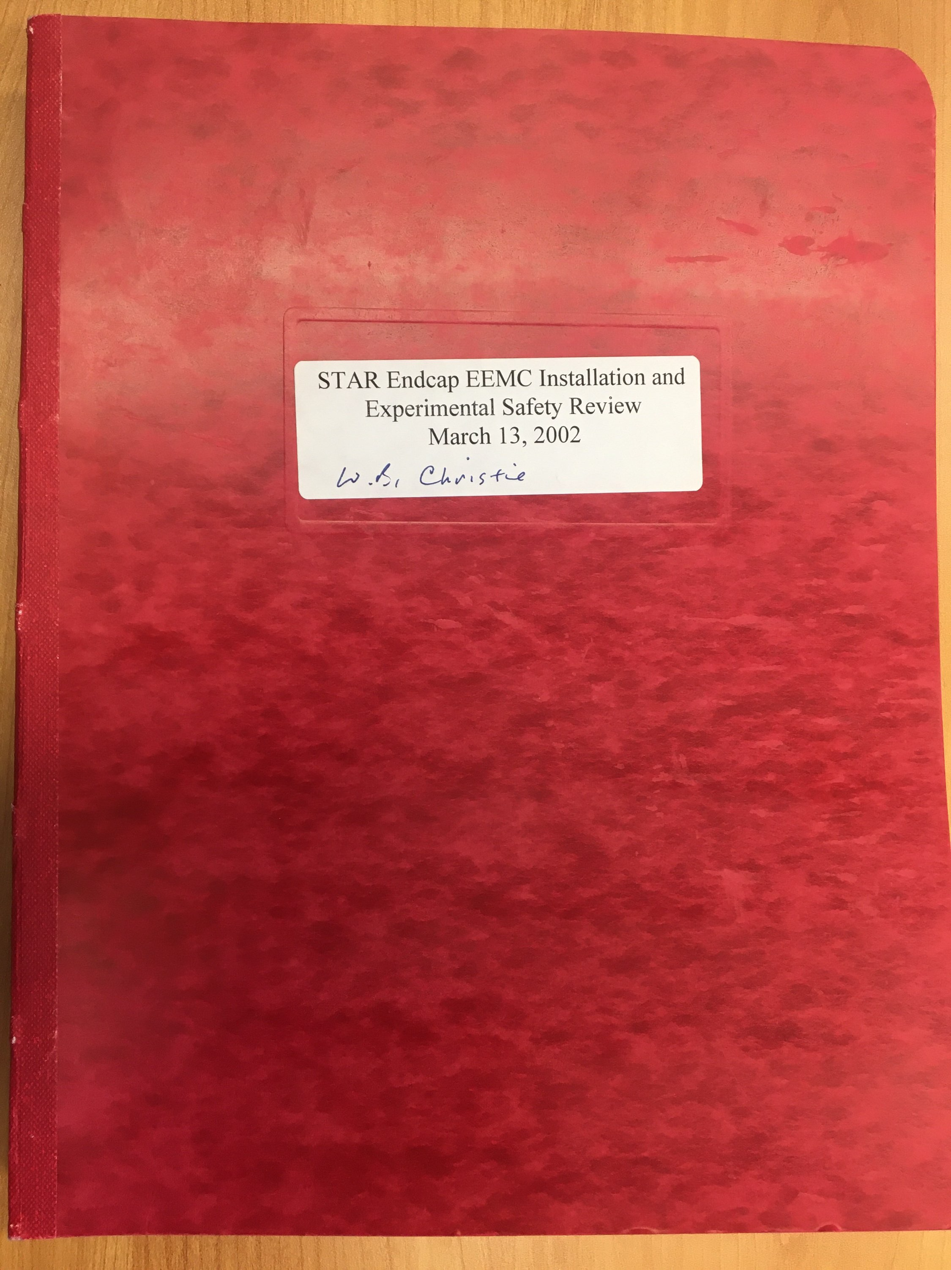
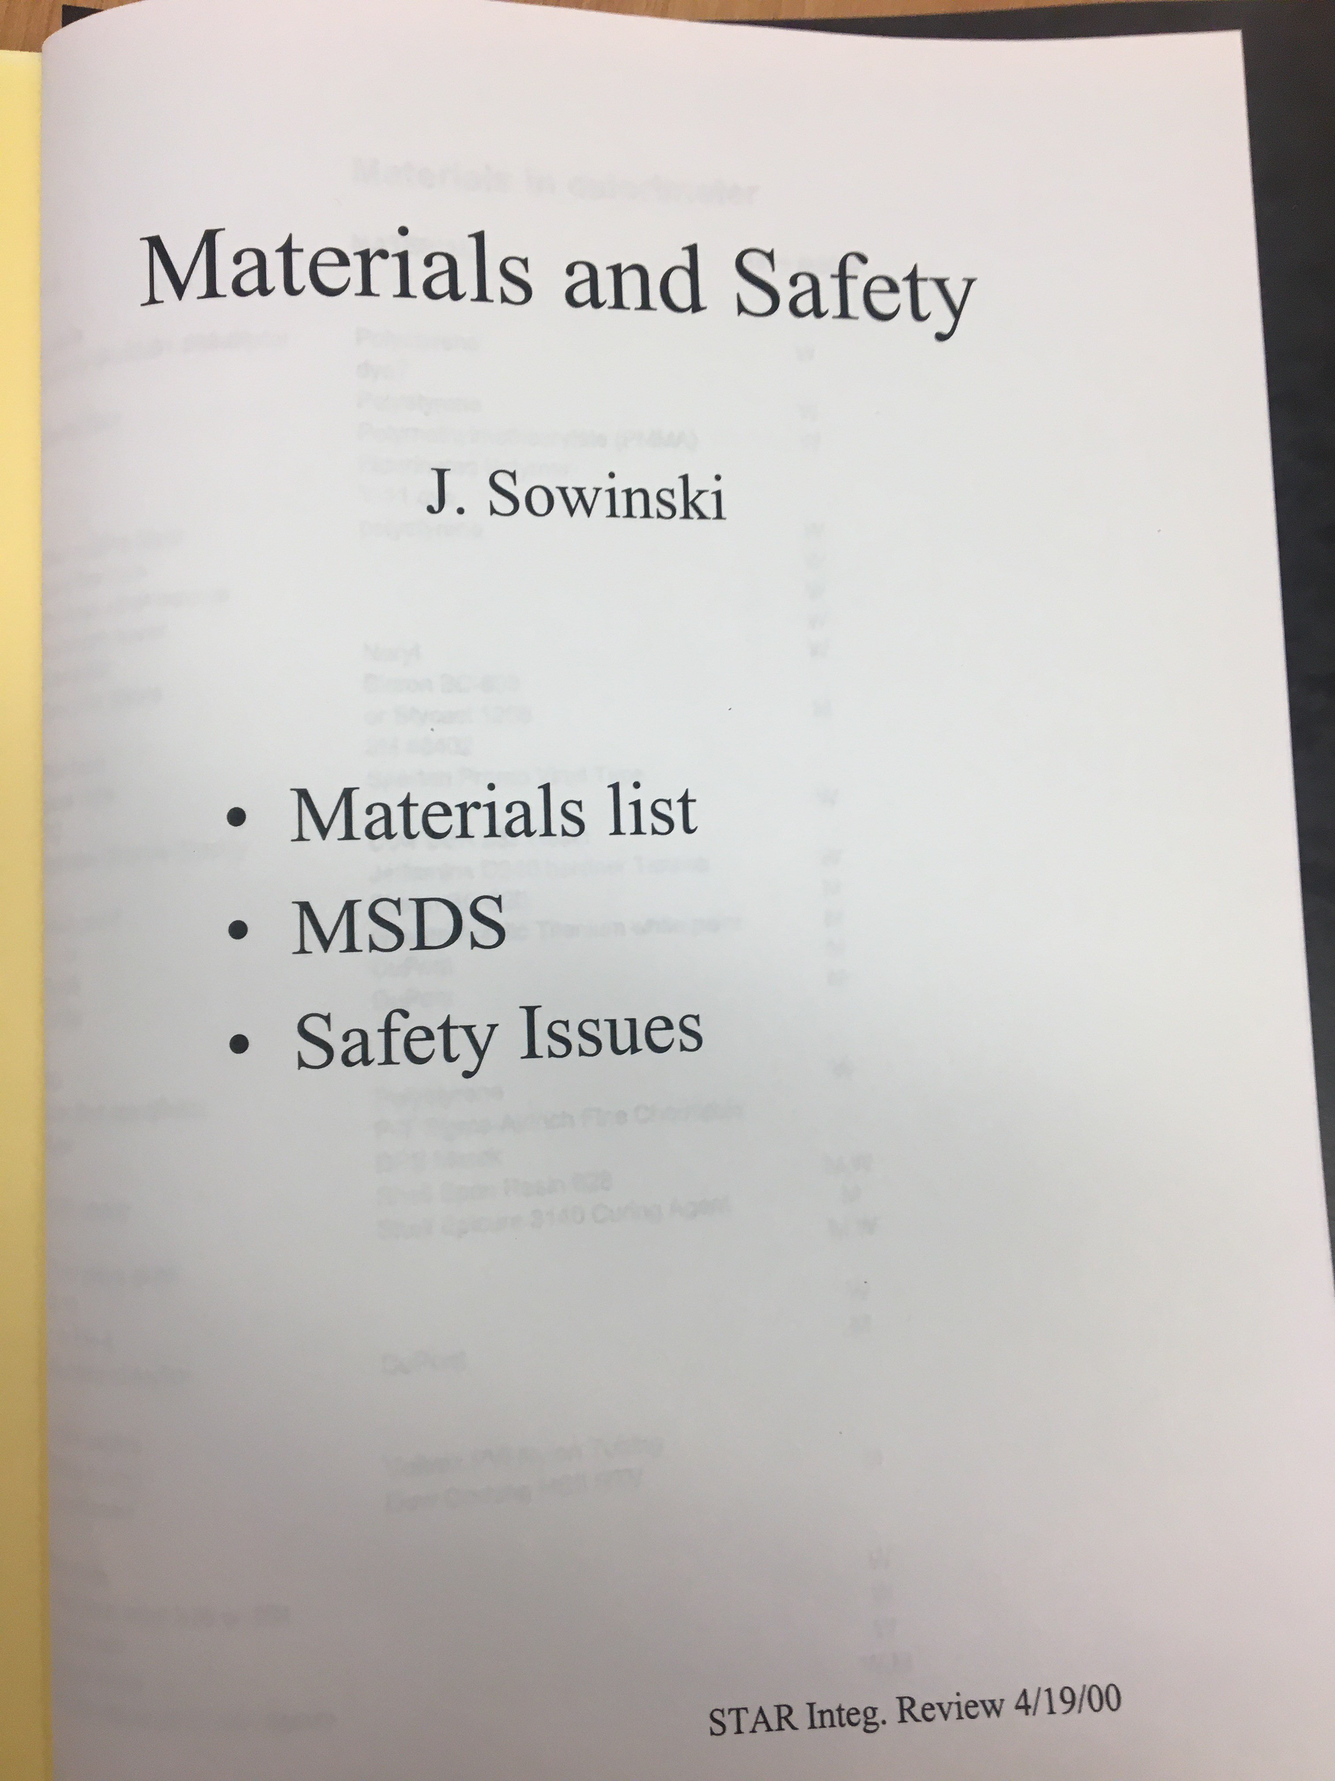
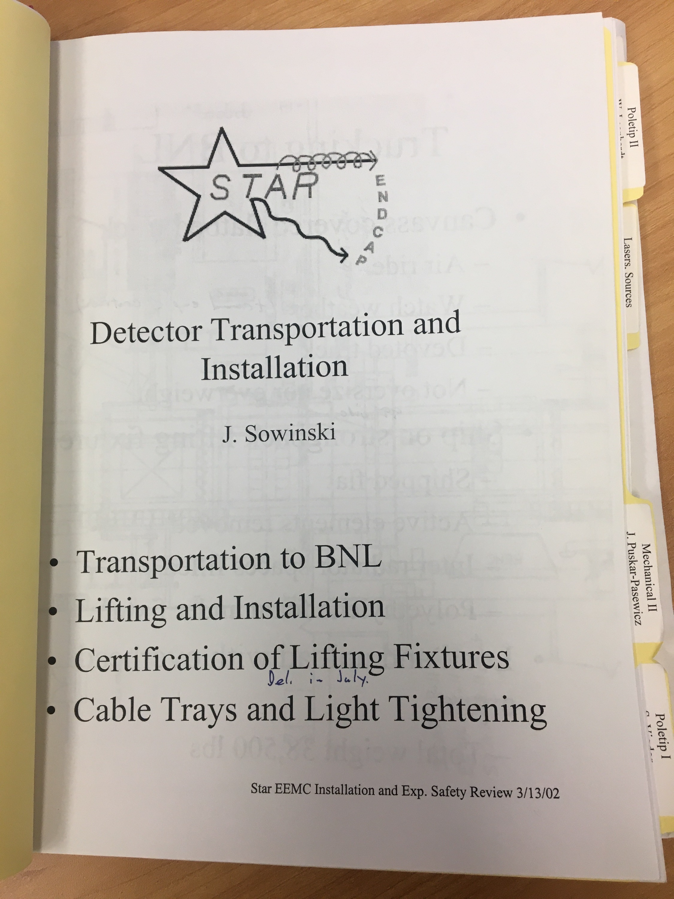
Dear Jim,
I can’t recall just exactly when you and the group from Indiana University joined the STAR Collaboration. It was clearly pre RHIC operations, as I found a few Endcap Calorimeter Review binders in my office, one from the year 2000, and one from 2002. Clearly IU had to be at it for some number of years to get the EEMC to the review stage. My conservative guess is that we’ve been colleagues for about 25 years or so.
A spoiler for the summary of these slides, it has been a pure pleasure to work with you all these years!
April 2000
April 2000
March 2002
March 2002

Slide 2
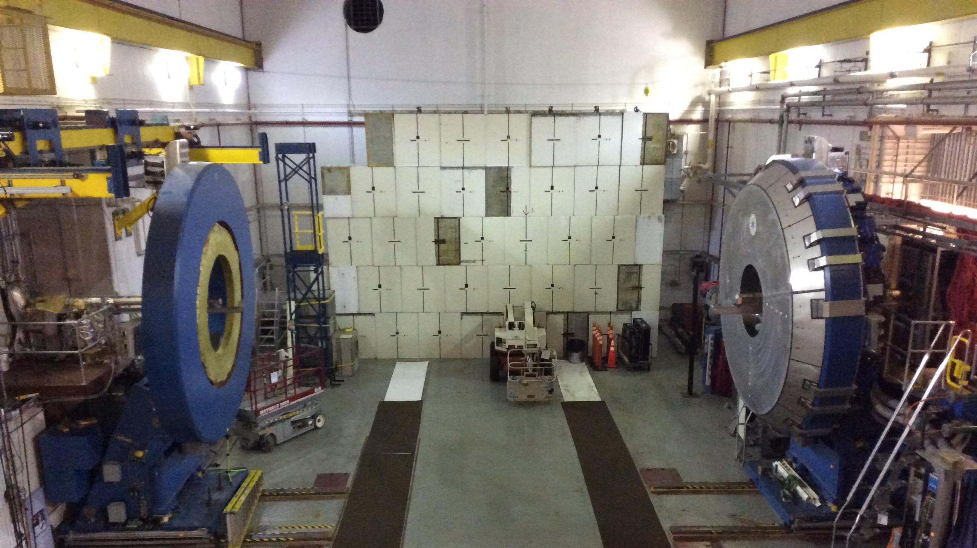
The Endcap Electromagnetic calorimeter was a difficult challenge for many reasons. Perhaps the most significant was the geometry where it had to cling on the face of the poletip, and the space puzzle of fitting all the electronics boxes on the back of the poletip. You, as a member of the Indiana group, and the others involved with the EEMC have a lot to be proud of in proposing, designing, getting funding, fabricating, and installing this impressive detector.
It was always a pleasure to work with and around you in STAR, both as a Physics collaborator and in your work and time as a sub system expert for the EEMC.
In all the years I’ve known you and worked with you Jim I can’t think of a single instance where I’ve seen you angry or mad. Your demeanor, even when the days got long at times, and the problems to be diagnosed and resolved were difficult, made any challenge and burden easier to bear when you were there.

Slide 3
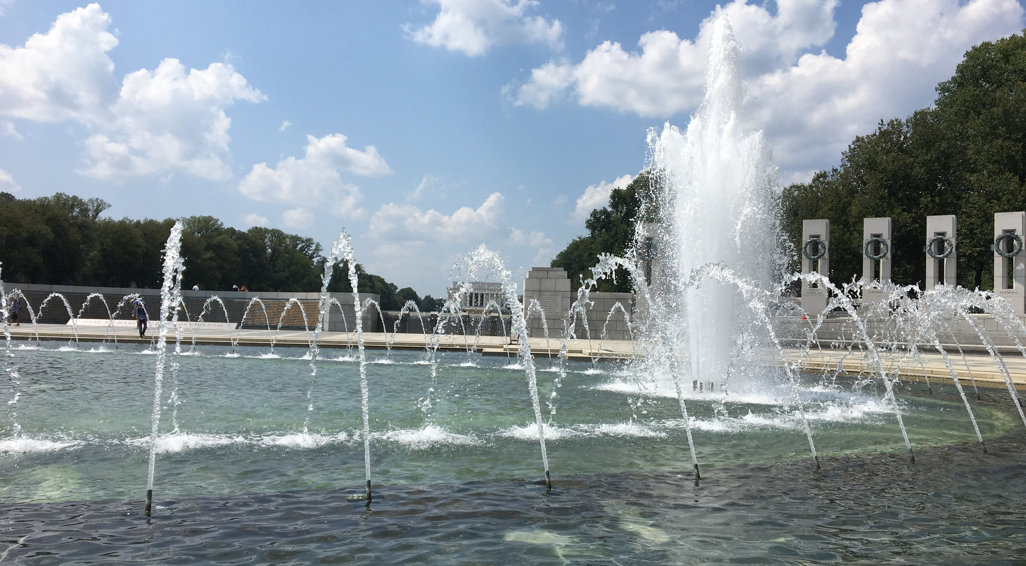
The ease and pleasure of working with you Jim, for me, didn’t change at all when you made the decision to move from Indiana U and join the Nuclear Science office down in Germantown.
With your deep, personal knowledge and experience about the challenges that come up in the course of a RHIC run, whether on the detector or the accelerator side, I never had any doubt that you understood what we were dealing with in our weekly RHIC Coordination meetings, and the approaches we were taking to deal with any challenges.
With your responsibilities in monitoring and overseeing the operation of the RHIC program the DOE Office of Nuclear Science had the right person in the right job. You’ve set the bar very high for your colleague that will be taking over the RHIC aspects of your responsibilities.

Slide 4
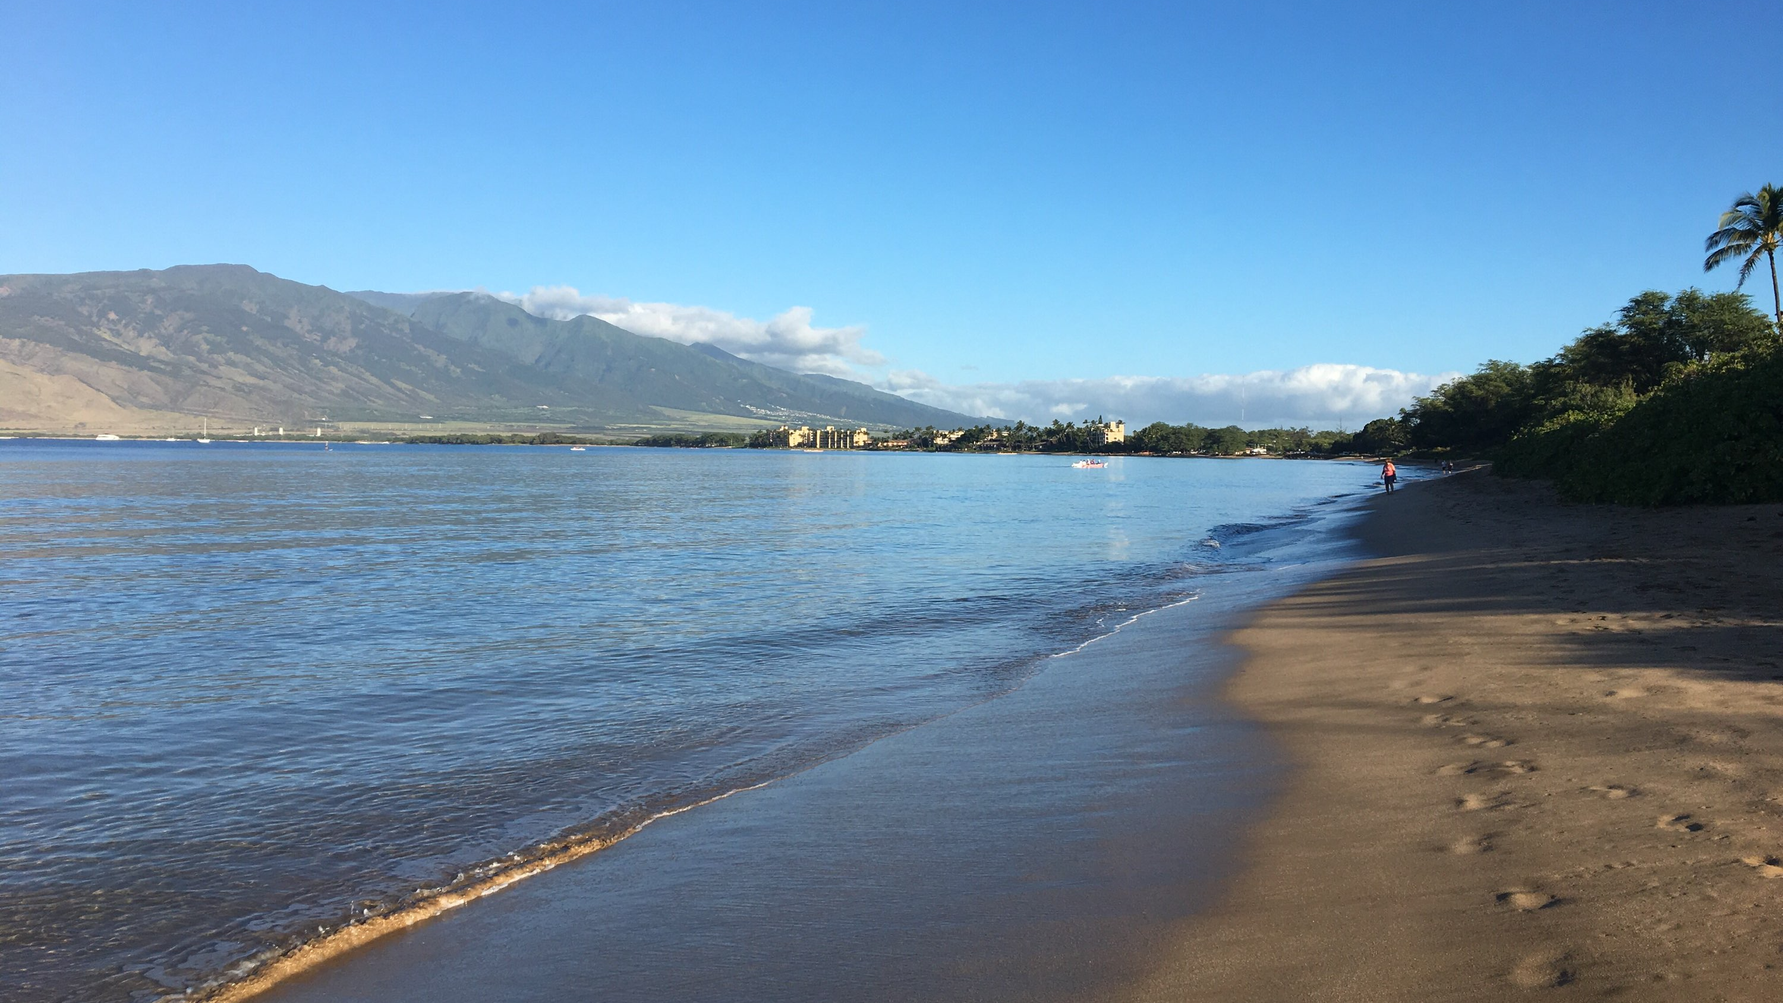
The typical final slide, and the viewpoint that many people have about retirement is that it is best represented by a picture of a sunset. I’d like to posit that this is the incorrect picture. It’s more like the sunrise at the start of the rest of your life.
One final picture on the next slide as your retirement draws near.

Slide 5
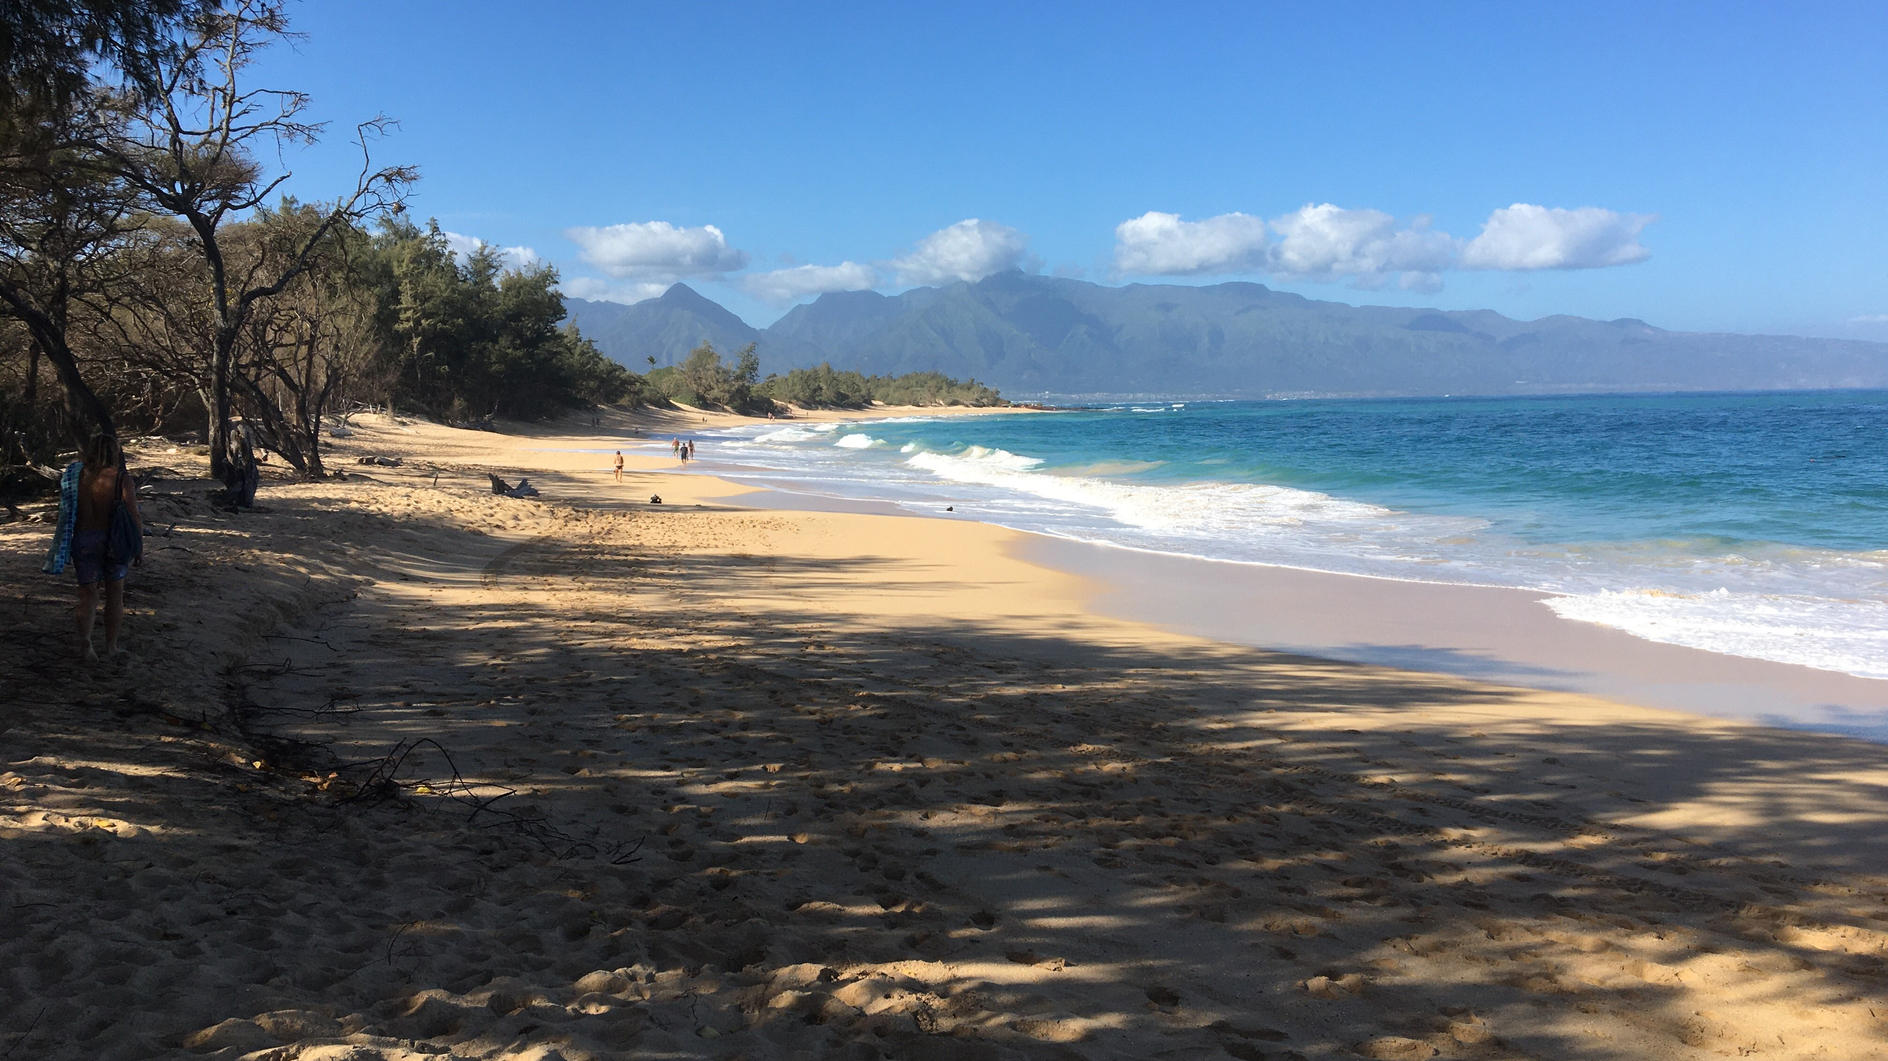
Jim, it has been a pure pleasure to work with you all these years!
Congratulations on your retirement and best wishes for the years to come!
Your colleague, Bill Christie

