Slide 1
EIC Bunch Structure T. Satogata, JLab/ODU EIC Accelerator Development/Pre-Ops L2 Deputy EIC Partner Project Associate Manager For the EIC Accelerator Design/Engineering Team
EPIC DAQ WB September 8, 2022

Slide 2
Up-front caveats
All parameters here are from CD-1 Conceptual Design Report (CDR)
Subject to (likely small) changes in baselining for CD-2
EIC design operating assumptions
Electron energy: ~5-18 GeV continuous
Design energy reference points are 5, 10, 18 GeV
Proton energy: 41, 100, 275 GeV, NOT continuous
Pathlength considerations create “no fly zone” in region between 41-100 GeV proton energies
Ion energies are similarly constrained, at Z/A ratio

Slide 3
EIC CDR Luminosity Curve and Limits
Beam-beam limited
beam size lumi scaling
e 10 MW SR limited
p space charge limited
5
5
10
10
e [GeV]
18
41
100
100
275
p [GeV]
275
N_{bunches} (timing) and bunch intensities modified at highest Ecm to optimize lumi

Slide 4
EIC CDR Bunch Timings at Store
 | ESR | HSR (N_{b}=290) | HSR (N_{b}=1160)
Circumference C [m] | 3833.940 | match T_{rev} | match T_{rev}
Revolution period T_{rev}=C/c [ms] | 12.7886
RF harmonic number h [-] | match HSR | 2520 | 7560
RF bucket spacing T_{b}=T_{rev}/h [ns] NOT bunch spacing!!! | match HSR | 5.075 | 1.692
Number of bunches N_{b} | match HSR | 290 | 1160
Bunch spacing T_{bun} [ns] | match HSR | 40.599 | 10.150
Gap length [ns] | match HSR | 1015 | 1015
T_{rev} dominated by electrons: ion energies constrained to match T_{rev}
HSR bunch spacing through cycle: 290 bunches injected into h=315 RF
1 T_{b} spacing, 25 T_{b} gap for h=315 (N_{b}=290)
1 T_{b} spacing (after 1st split), 50 T_{b} gap for h=630 (N_{b}=580)
1 T_{b} spacing (after 2nd split), 100 T_{b} gap for h=1260 (N_{b}=1160)
2 T_{b} spacing, 200 T_{b} gap for h=2520 (N_{b}=1160)
6 T_{b} spacing, 600 T_{b} gap for h=7560 (N_{b}=1160)
Notes:
290 bunches in h=315

Slide 5
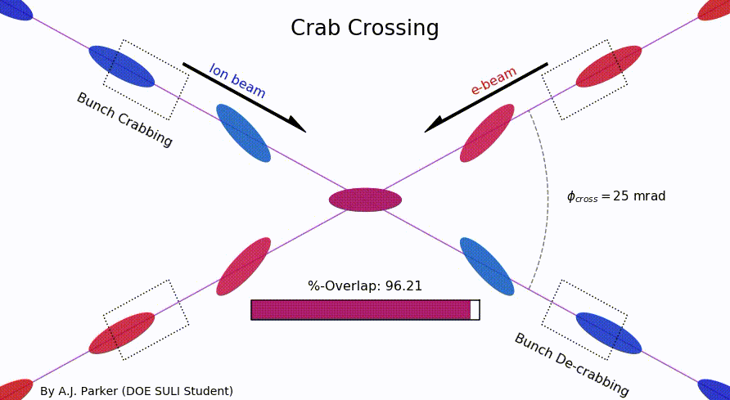
EIC CDR Bunch Sizes at Store
 | ESR | HSR
RMS bunch length σ_{z} [mm/ps] | 7-9/23-30 | 75-60/250-200
RMS momentum spread [10⁻⁴] | 5.8-10.9 | 10.3-6.8
RMS horiz beam size σ_{x} [um] | 100-250
σ_{z}/σ_{x} ratio [-] | 28-90 | 240-750
The oft-shown animation of crab crossing is a bit misleading on transverse beam sizes
There will be (small) timing correlations to lab frame vertex location as beams pass through each other
Along direction of electron motion
Approximate
actual bunch
x/z sizes

Slide 6
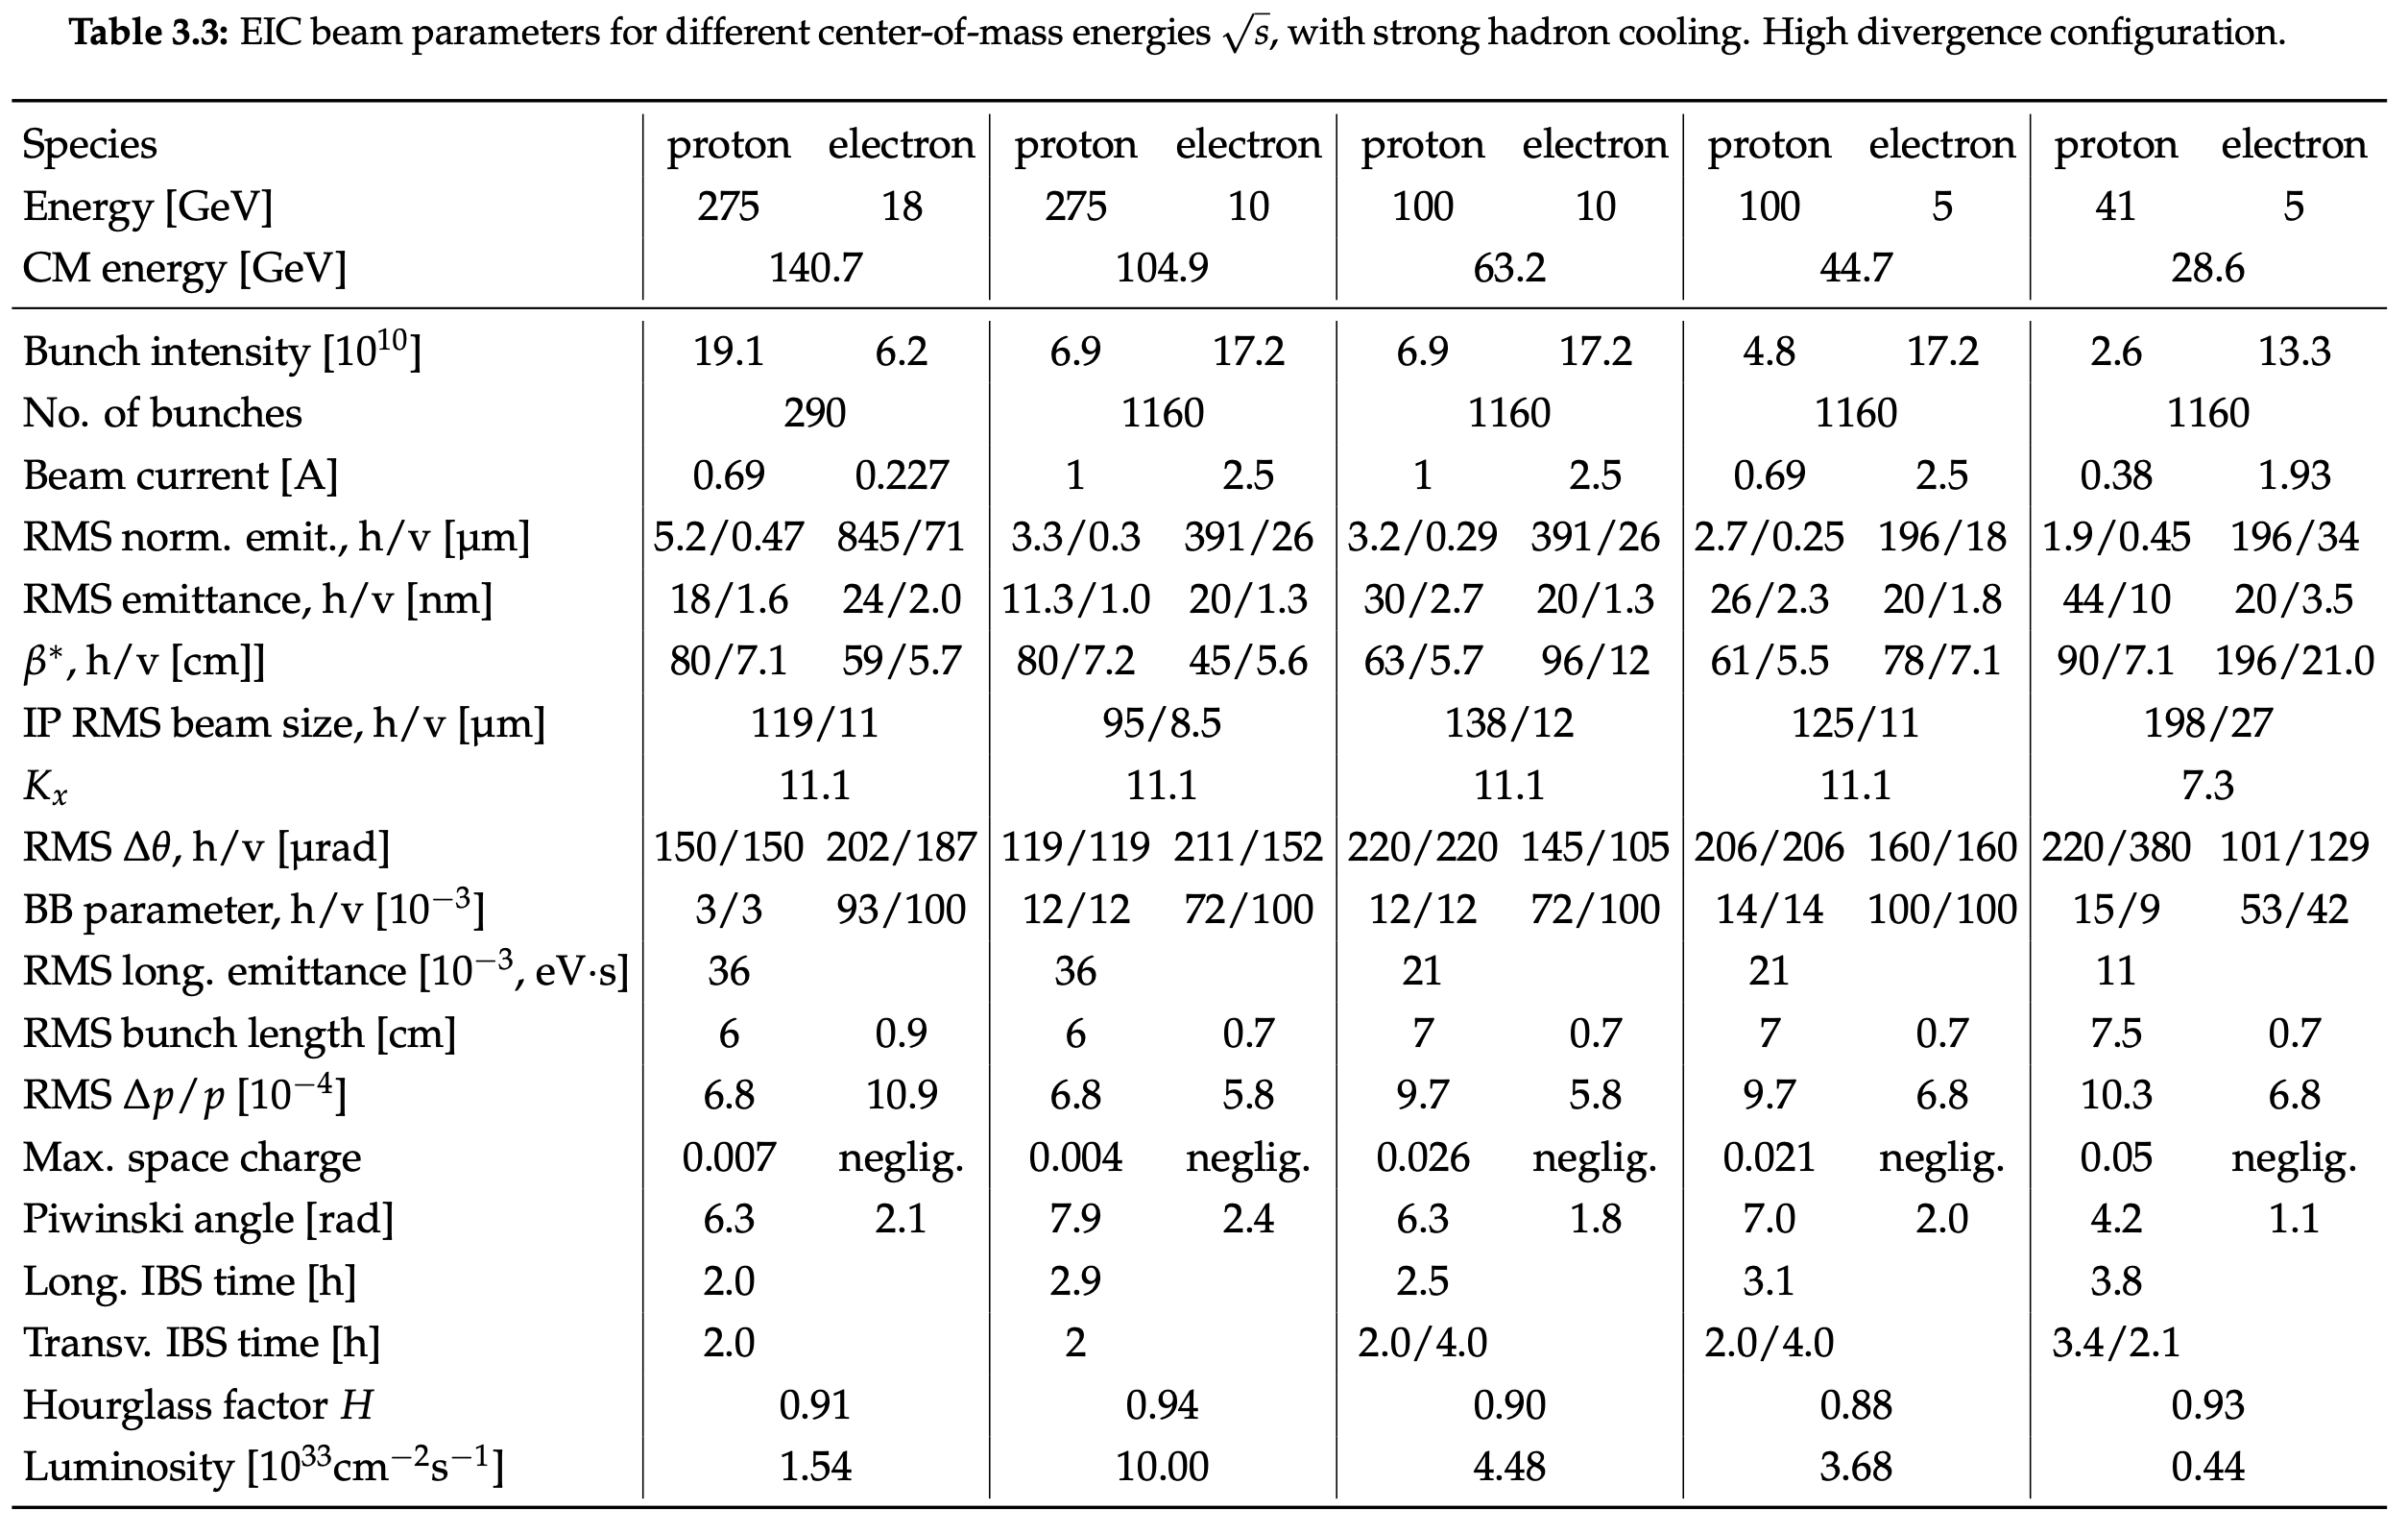
CDR Parameters: High Divergence e-p

Slide 7
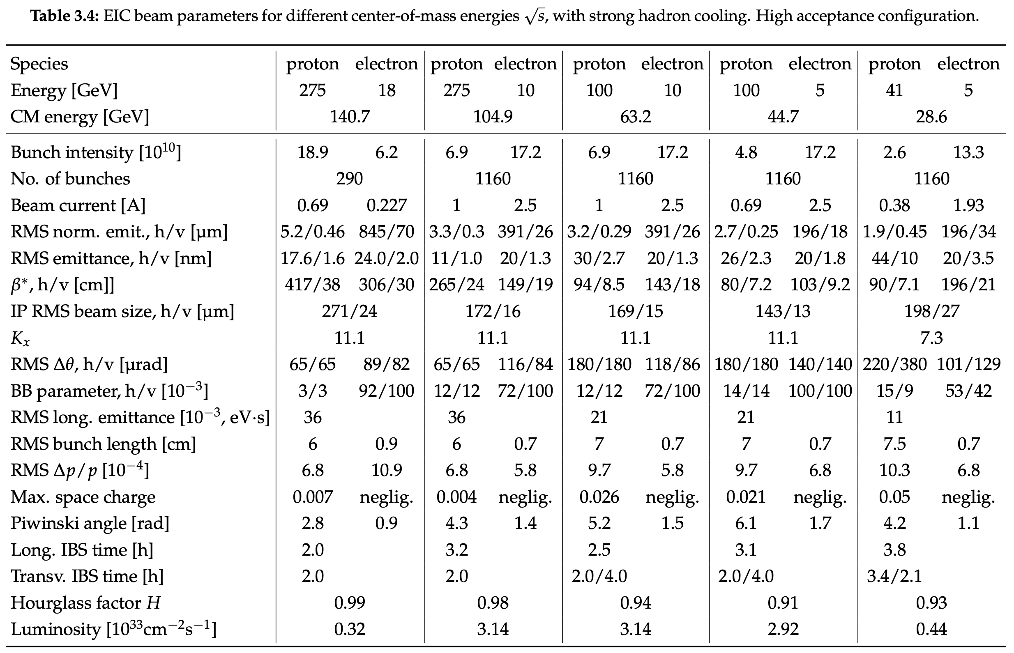
CDR Parameters: High Acceptance e-p

