Slide 1
EIC Common Platform Hardware
1 U chassis... larger variants under consideration
FEC/IOC in commercial 1U blades
Carrier provides all connections to control system / timing
Carrier comes in two flavors, standard and high performance
High speed edge mounted connector allows function / filter cards to be accessed thru front panel of chassis
Provides upgrade path for existing VME systems

Slide 2
Carrier Functionality
Single (dual) gigabit ethernet
Memory (8 GB of DDR4?)
8 SFPs – 1 dedicated to Timing/Data Link
External Clock, Clock Recovery Option, (Clean Up PLL)
On-board Beam Sync Clock generation
Available on each carrier using Direct Digital Synthesizers (DDS)
SD Card
RS-232 Interface
Voltage/Current/Temperature Monitoring
Two Daughter Sites
2 (4) Multi-Gigabit Serial Links to Carrier FPGA
Flexible connection to SFPs via cross-point switch
40 generic I/O connections
Real Time and Beam Synchronous Clocks
Site to Site Connections

Slide 3
FPGA Options
Part Number | XC5VFX70T-1FF1136C | XC7Z030-1FFG676C | XCZU4CG-1FBVB900E | XCZU5CG-1FBVB900E | XCZU7CG-1FBVB900E | XCZU7CG-1FFVC1156E | XCAU25P-1FFVA784E | XCAU10P-1FFVB484E
Family | Virtex 5 | Zynq-7000 | Zynq UltraScale+ | Zynq UltraScale+ | Zynq UltraScale+ | Zynq UltraScale+ | Artix UltraScale+ | Artix UltraScale+
Logic Cells | 71680 | 125000 | 192000 | 256000 | 504000 | 504000 | 308000 | 96000
Flip Flops | 44800 | 157200 | 176000 | 234000 | 461000 | 461000 | 282000 | 88000
LUTs |  |  | 88000 | 117000 | 230000 | 230000 | 141000 | 44000
Total Block Ram (Mb) | 5.3 | 9.3 | 4.5 | 5.1 | 11 | 11 | 10.5 | 3.5
Ultra RAM (Mb) | - | - | 13.5 | 18 | 27 | 27 | - | -
DSP Slices | 128 | 400 | 728 | 1248 | 1728 | 1728 | 1200 | 400
Transceivers (Max Data Rate) | 16 (6.5 Gbps) | 4 (12.5 Gbps) | 16 (16.3 Gbps) + 4 for PS (6 Gbps) | 16 (16.3 Gbps) + 4 for PS (6 Gbps) | 16 (16.3 Gbps) + 4 for PS (6 Gbps) | 20 (16.3 Gbps) + 4 for PS (6 Gbps) | 12 (16.3 Gbps) | 12 (16.3 Gbps)
Processor | PowerPC 440 | Dual ARM Cortex A9 | Dual ARM A53 / Dual ARM R5 | Dual ARM A53 / Dual ARM R5 | Dual ARM A53 / Dual ARM R5 |  | None | None
PS I/O Pins | - | 128 | 214 | 214 | 214 | 214 | - | -
HD I/O Pins | 640 | 100 | 48 | 48 | 48 | 48 | 96 | 48
HP I/O Pins | - | 150 | 156 | 156 | 156 | 312 | 208 | 156
External Memory Support | DDR2 | DDR2,DDR3 | DDR4, DDR3 | DDR4, DDR3 | DDR4, DDR3 | DDR4, DDR3 | DDR4 | DDR4
Notes | For Comparison | For Comparison | Footprint compatible. They are also compatible with the quad ARM A53 equivalent parts.
Quoted Cost
Cost (1-100 piece) |  |  | $503.24 | $796.72 | $986.24 | $1,094.80 | $174.00 | $77.00
Cost (101 -1000 piece) |  |  | $299.92 | $475.64 | $588.80 | $653.20 | $149.00 | $66.00
Zynq UltraScale+ provides many options
Dual or Quad ARM A53 Processors
Large range of Logic Cells / Flip Flops
Artix UltraScale +
Parts available Q2/Q3 this year
Cost effective
Silicon availability out to 52 weeks for almost all Xilinx parts

Slide 4
Daughter / Function Cards
Approximately 8-inch width, max
Both generic and system specific designs
Examples
Digital I/O – provides V202, V124 functionality (,scaler?)
Baseband ADC – 16 Channel, 1 MSPS
Baseband DAC – 16 Channel, 1 MSPS
RF ADC / DAC – 6 ADCs @ X00 MSPS, 2 DACs @ X00 MSPS
High Speed ADC (RFSoC based?)
8, 14 bit ADC @2.5 GSPS and 8, 14 bit DACs @9.85 GSPS
Quad ARM A53 + all other features of Zynq UltraScale+ devices
SFP breakout – 12+ SFPs – ARTIX UltraScale+ based
RF Cavity Controller
BPM Processor
PSC/PSI

Slide 5
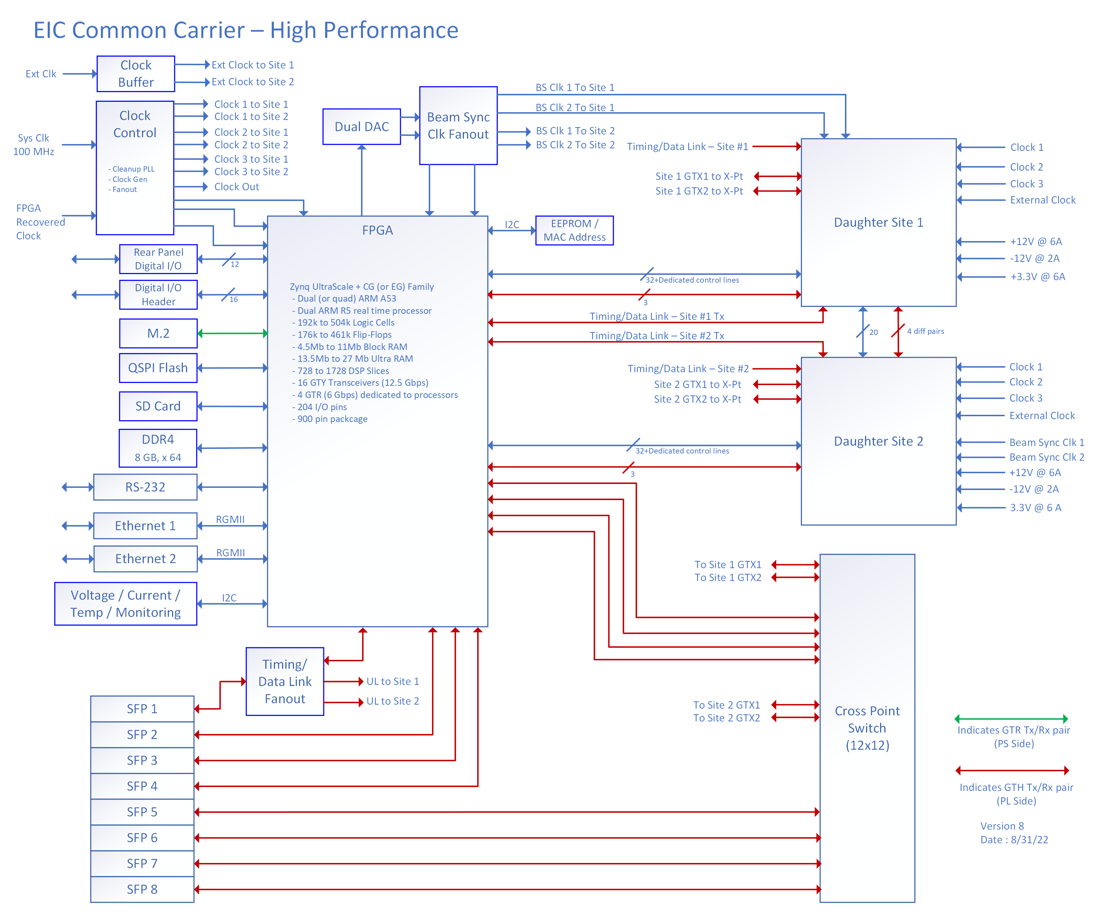
Common Platform Carrier

Slide 6
Filter / Signal Conditioning Cards
Optional
Provide easy means of customization
Signal Conditioning for generic function cards
Analog
Filtering
Signal Conditioning, Gain, DC Offset, etc.
Digital
Line drivers
Output levels – TTL, ECL, etc.
Connector options
Coax
Ribbon connectors to mate with existing VME based installations

Slide 7
EIC/Hadron Injector Timing

Slide 8
Open Issues
Additional Carrier Features
M.2 slot
USB3
???
Timing system details
Ensure functionality with timing to existing RHIC systems
Delay compensation on distribution for critical systems
Improved GTH receiver locking procedure over current LLRF implementation
Clock recovery details
Test and evaluate board to board connectors
Cooling
Chassis fans required?
Air flow front to back in temp controlled racks
Implications from AI/ML efforts
Power
Internal power supply
External (redundant?) dc power source
Power Delivery to daughter sites – how

Slide 9
Existing VME Boards
Name | Functionality | Operational
V102 | Delay Module | 147
V108 | Utility Module | 484
V113 | MADC controller | 142
V114 | A to D module | 140
V115 | Waveform generator | 592
V120 | RHIC permit module | 48
V124 | Beam sync trigger module | 70
V194 | Pulse fanout | 59
V202 | Delay module | 158
V233 | QFG | 71
V294 | General I/O module | 29
VMIVME-1160A | Digital input | 69
VMIVME-2170A | Digital output | 111
VMIVME 3122 | 64 ch, 16bit analog input (100kHz max) | 82
VMIVME 3123 | 16 ch, 16 bit analog input | 14
VMIVME 4122 | 8 ch, 12 bit analog output | 37
VMIVME 4140 | 16 or 32 ch, 12bit analog output | 35
VTR2535 | 8ch, 12bit, 10MSPS A/D | 4
VTR2537 | 8ch, 12bit, 1MSPS A/D | 8
VX-2 | Motion controller | 38

Slide 10
RHIC Beamsync Info
Separate Blue/Yellow generator boards and associated timing links, each using RF rev tick
Distributed on fiber/copper cables ("blue hose"), separate from other primary connections (ex. RHIC event link)
VME V124 modules decode one beamsync link and provide beam-synchronous timing with delay control capabilities
Originally designed for 360 bucket operations, with harmonic adjustment added in later
8 output channels per board
Differential ECL signal output
Jitter is ~ 8 ps
The hope is that the Common Platform equivalent trigger outputs will have smaller jitter with the newer generation of FPGAs

Slide 11
Any Questions?

Slide 12
Backup Slides

Slide 13
Beam Sync Timing Generation

