Slide 1
Introduction of Accelerator Science and Technology for
Early Career Scientist
Wolfram Fischer
Deputy ALD for Accelerators NPP, C-AD Chair
9 September 2022

Slide 2
C-AD mission
… develop, improve and operate the suite of particle / heavy ion accelerators used to carry out the program of accelerator-based experiments at BNL;
… to support the experimental program including design, construction and operation of the beam transports to the experiments plus support of detector and research needs of the experiments;
… to design and construct new accelerator facilities in support of the BNL and national missions. Department supports an international user community of over 1,500 scientists.
… perform all these functions in an environmentally responsible and safe manner under a rigorous conduct of operations approach.

Slide 3
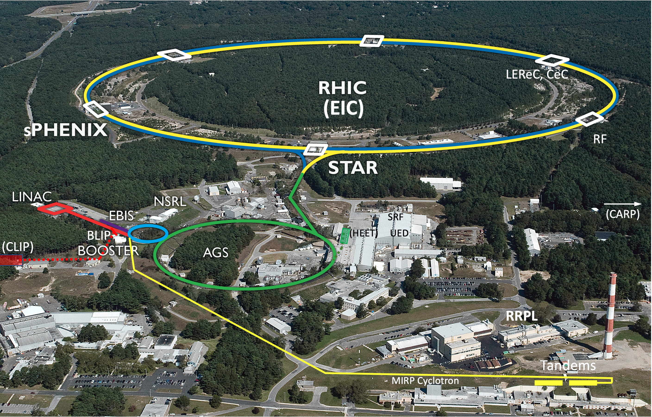
Collider-Accelerator Department facilities
Uniquely flexible and
only hadron collider in
US for exploration of
QCD phase diagram
and proton spin
Injectors also used for
application programs:
- Linac/BLIP for
isotope production
- Booster/NSRL for
space radiation studies
- Tandem for
industrial/academic users
R&D for future facilities
and application
sources, cooling, pol. beams, …

Slide 4
Accelerator Science and Technology: many subfields – in combination
Electrodynamics (guide and acceleration fields, diagnostics)
Classical mechanics (stability of chaotic hadron motion in storage ring)
Plasma physics (guns, cooling, discharge)
QED (heavy ion beam in collision losses dominated by bound-free pair production)
Superconductivity (magnets, RF, diagnostics)
Lasers (electron and ion sources)
Surface physics and chemistry (photo-cathodes, SRF surfaces)
Computing (accelerator controls, simulations of EM fields, particle motion, AI/ML)
Mechanical and electrical design, vacuum, cryogenics
…

Slide 5
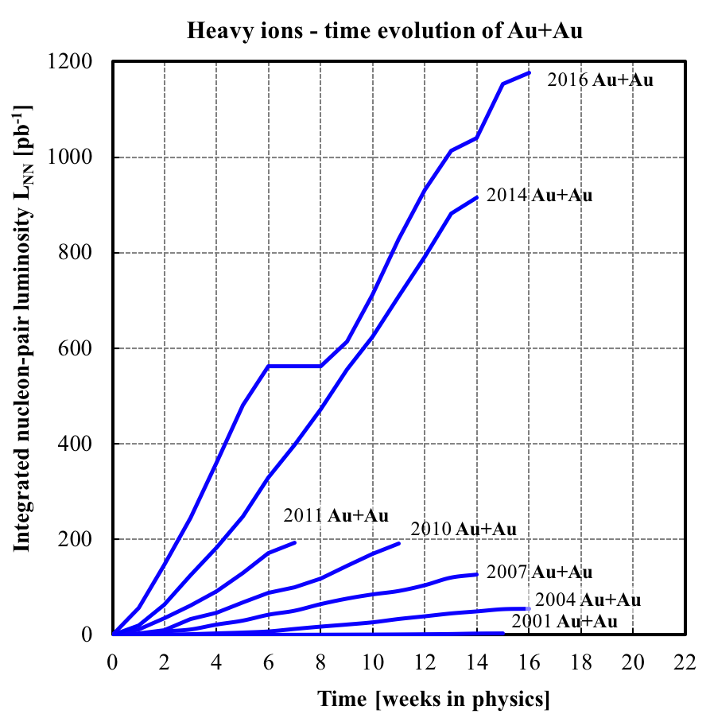
can now be done in 1/2 day
(200x faster)
RHIC Au+Au operation at full energy

Slide 6
Accelerator R&D at C-AD
Improvement of RHIC performance
  Improved polarized proton acceleration in AGS and RHIC (~10% increase)
  Maximize useful luminosity for sPHENIX in small (±10 cm) vertex region (2023 – 2025)
Transformational accelerator technologies in support of future NP facilities, including EIC
  Strong hadron cooling: CeC demonstration
  Polarized He-3 production, acceleration and polarimetry
  Development of high intensity high brightness electron source for strong hadron cooling
    High intensity, high brightness SRF e gun development (NP Accelerator R&D FOA, contributing)
    High intensity CW e gun, based on LEReC gun
  Photocathodes (ECA)
  Ion source developments
  Permanent magnet applications (LDRD)
Future possibilities:
  Polarized positron source for EIC and CEBAF
  High intensity ERL development (single pass CBETA) for strong hadron cooling
  FFA applications in CEBAF energy upgrade

Slide 7
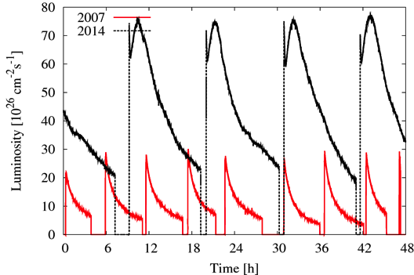
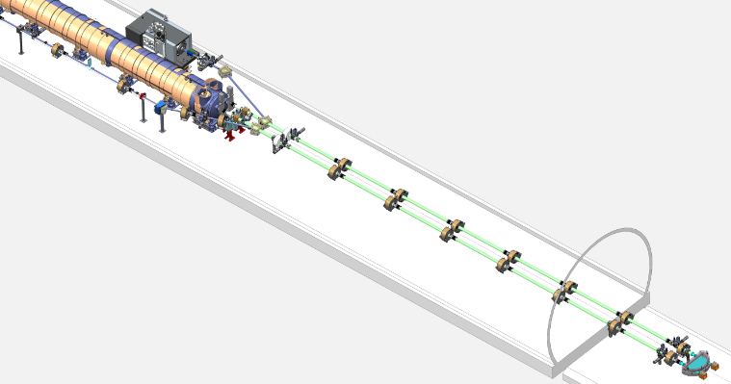
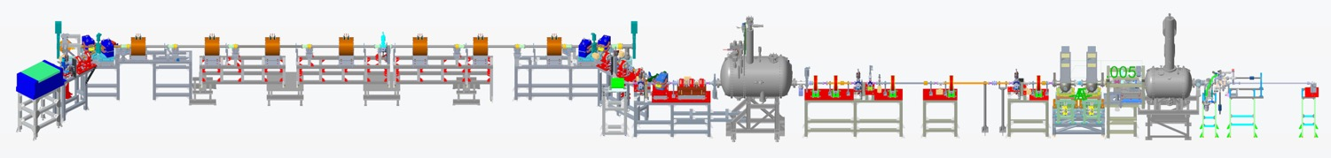
Beam cooling at RHIC
First high energy, bunched beam stochastic cooling gives record heavy ion collision rates (10 GHz microwave technology)
First bunched beam electron cooling for
luminosity upgrade of “low” energy
heavy ion collisions
Experimental demonstration of
Coherent electron Cooling,
(stochastic cooling with a 30 THz
bandwidth)
  Longitudinal cooling in FY2022?
  One year contingency FY2023
Kicker
Modulator
Plasma Cascade Amplifier

Slide 8
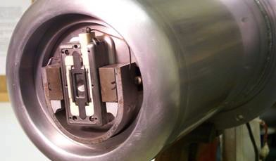
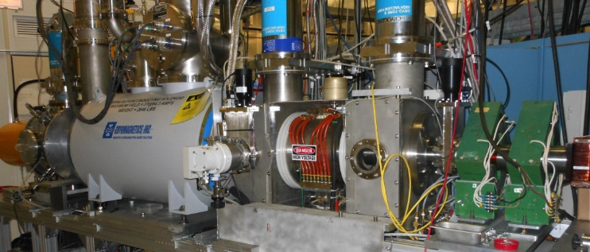
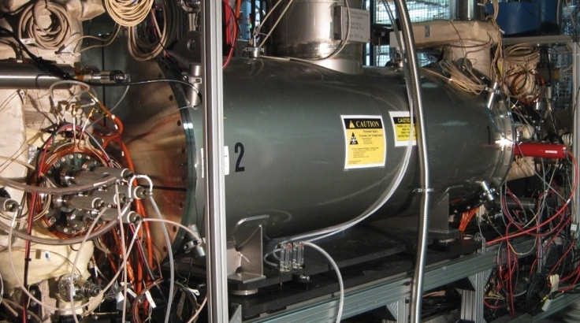
Ion Sources at BNL
BNL Magnetron H⁻ source
  Hydrogen plasma interacts with Cs-Mo surface
  Highest H⁻ peak current (100 mA)
BNL Optically Pumped Polarized Ion Source (OPPIS)
  Polarized electrons from optically pumped Rubidium are used to generate polarized H⁻ ions
  Highest intensity (1 mA) polarized (83%) H⁻ source
BNL Electron Beam Ion Source (EBIS)
  Intense electron beam inside high-field solenoid is used to stepwise ionize heavy ions. Reaches Au³²⁺ after about 40 ms.
  Highest intensity EBIS, polarized He-3

Slide 9
High intensity electron sources
Active photocathode development
  Bi-alkali antimonide cathodes with QE up to 9%
DC photo-electron gun for LEReC
  Built by Cornell and installed at RHIC IR2
  400 kV operation
  30 mA CW current demonstrated, plan for higher
SRF photo-electron gun for CeC
  High brightness: 1.56 MeV, 0.5 nC and 0.3 um
  High bunch charge: up to 10 nC
  CW operation at 80 kHz with little QE drop
  High current operation limited by FPC

Slide 10
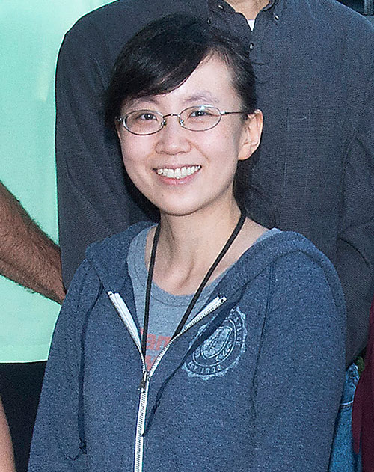
Early Career Award 2021
Mengjia Gaowei
“Cathode R&D for high-intensity electron source
in support of EIC”
Objectives:
Improve quantum efficiency with reproducible single crystal
photocathode material
Upgrade the cathode growth chamber with offline characterization
capabilities by incorporating a reflection high energy electron
diffraction (RHEED) system
Develop the capability to transfer cathodes between the initial growth chamber, the materials diagnostic tools and the chamber for high current damage analysis and emittance measurement
Test the traditionally grown and single crystal cathodes at high emission current ~ 100 mA
Evaluate various protective mechanisms including 2-D material encapsulation and nanostructure enhancement, for high current performance

Slide 11
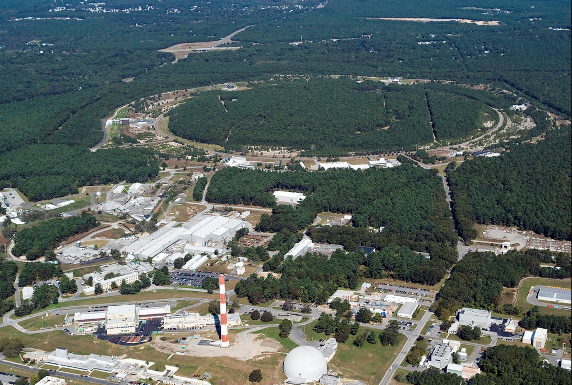
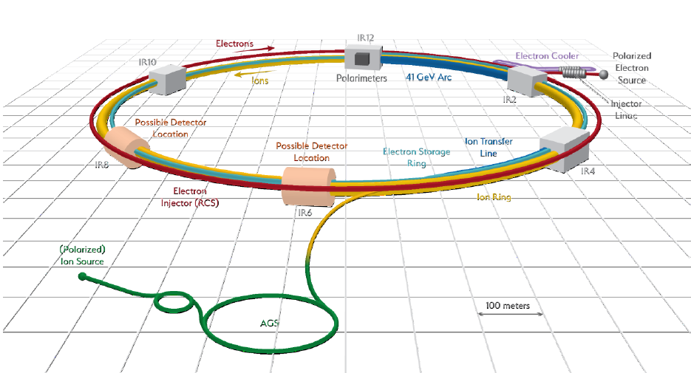
Electron-Ion Collider
Ferdinand Willeke et al.
BNL-JLab partnership with national and international contribution
sited at BNL - uses RHIC hadron complex
CD-1 June 2021 (Conceptual Design complete, cost range),
operation 2032 (planned)
Hadron storage Ring (RHIC Rings) 40-275 GeV (existing)
  1160 bunches, 1A beam current (3x RHIC)
  small vertical beam emittance 1.5 nm
  strong cooling (coherent electron cooling)
Electron storage ring 2.5–18 GeV (new)
  many bunches, large beam current, 2.5 A ➔ 9 MW S.R. power
  SC RF cavities
  Full energy injection of polarized bunches
Electron rapid cycling synchrotron 0.4–(new)
  1-2 Hz
  Spin transparent due to high periodicity
High luminosity interaction region(s) (new)
  L = 10³⁴ cm⁻²s⁻¹
  Superconducting magnets
  25 mrad full crossing angle with crab cavities
  Spin rotators (longitudinal spin)
  Forward hadron instrumentation
RHIC
EIC

