Slide 1
Nuclear Physics for Early Career Scientists
James (Jamie) Dunlop
Associate Chair for Nuclear Physics, Physics Department
September 9, 2022

Slide 2
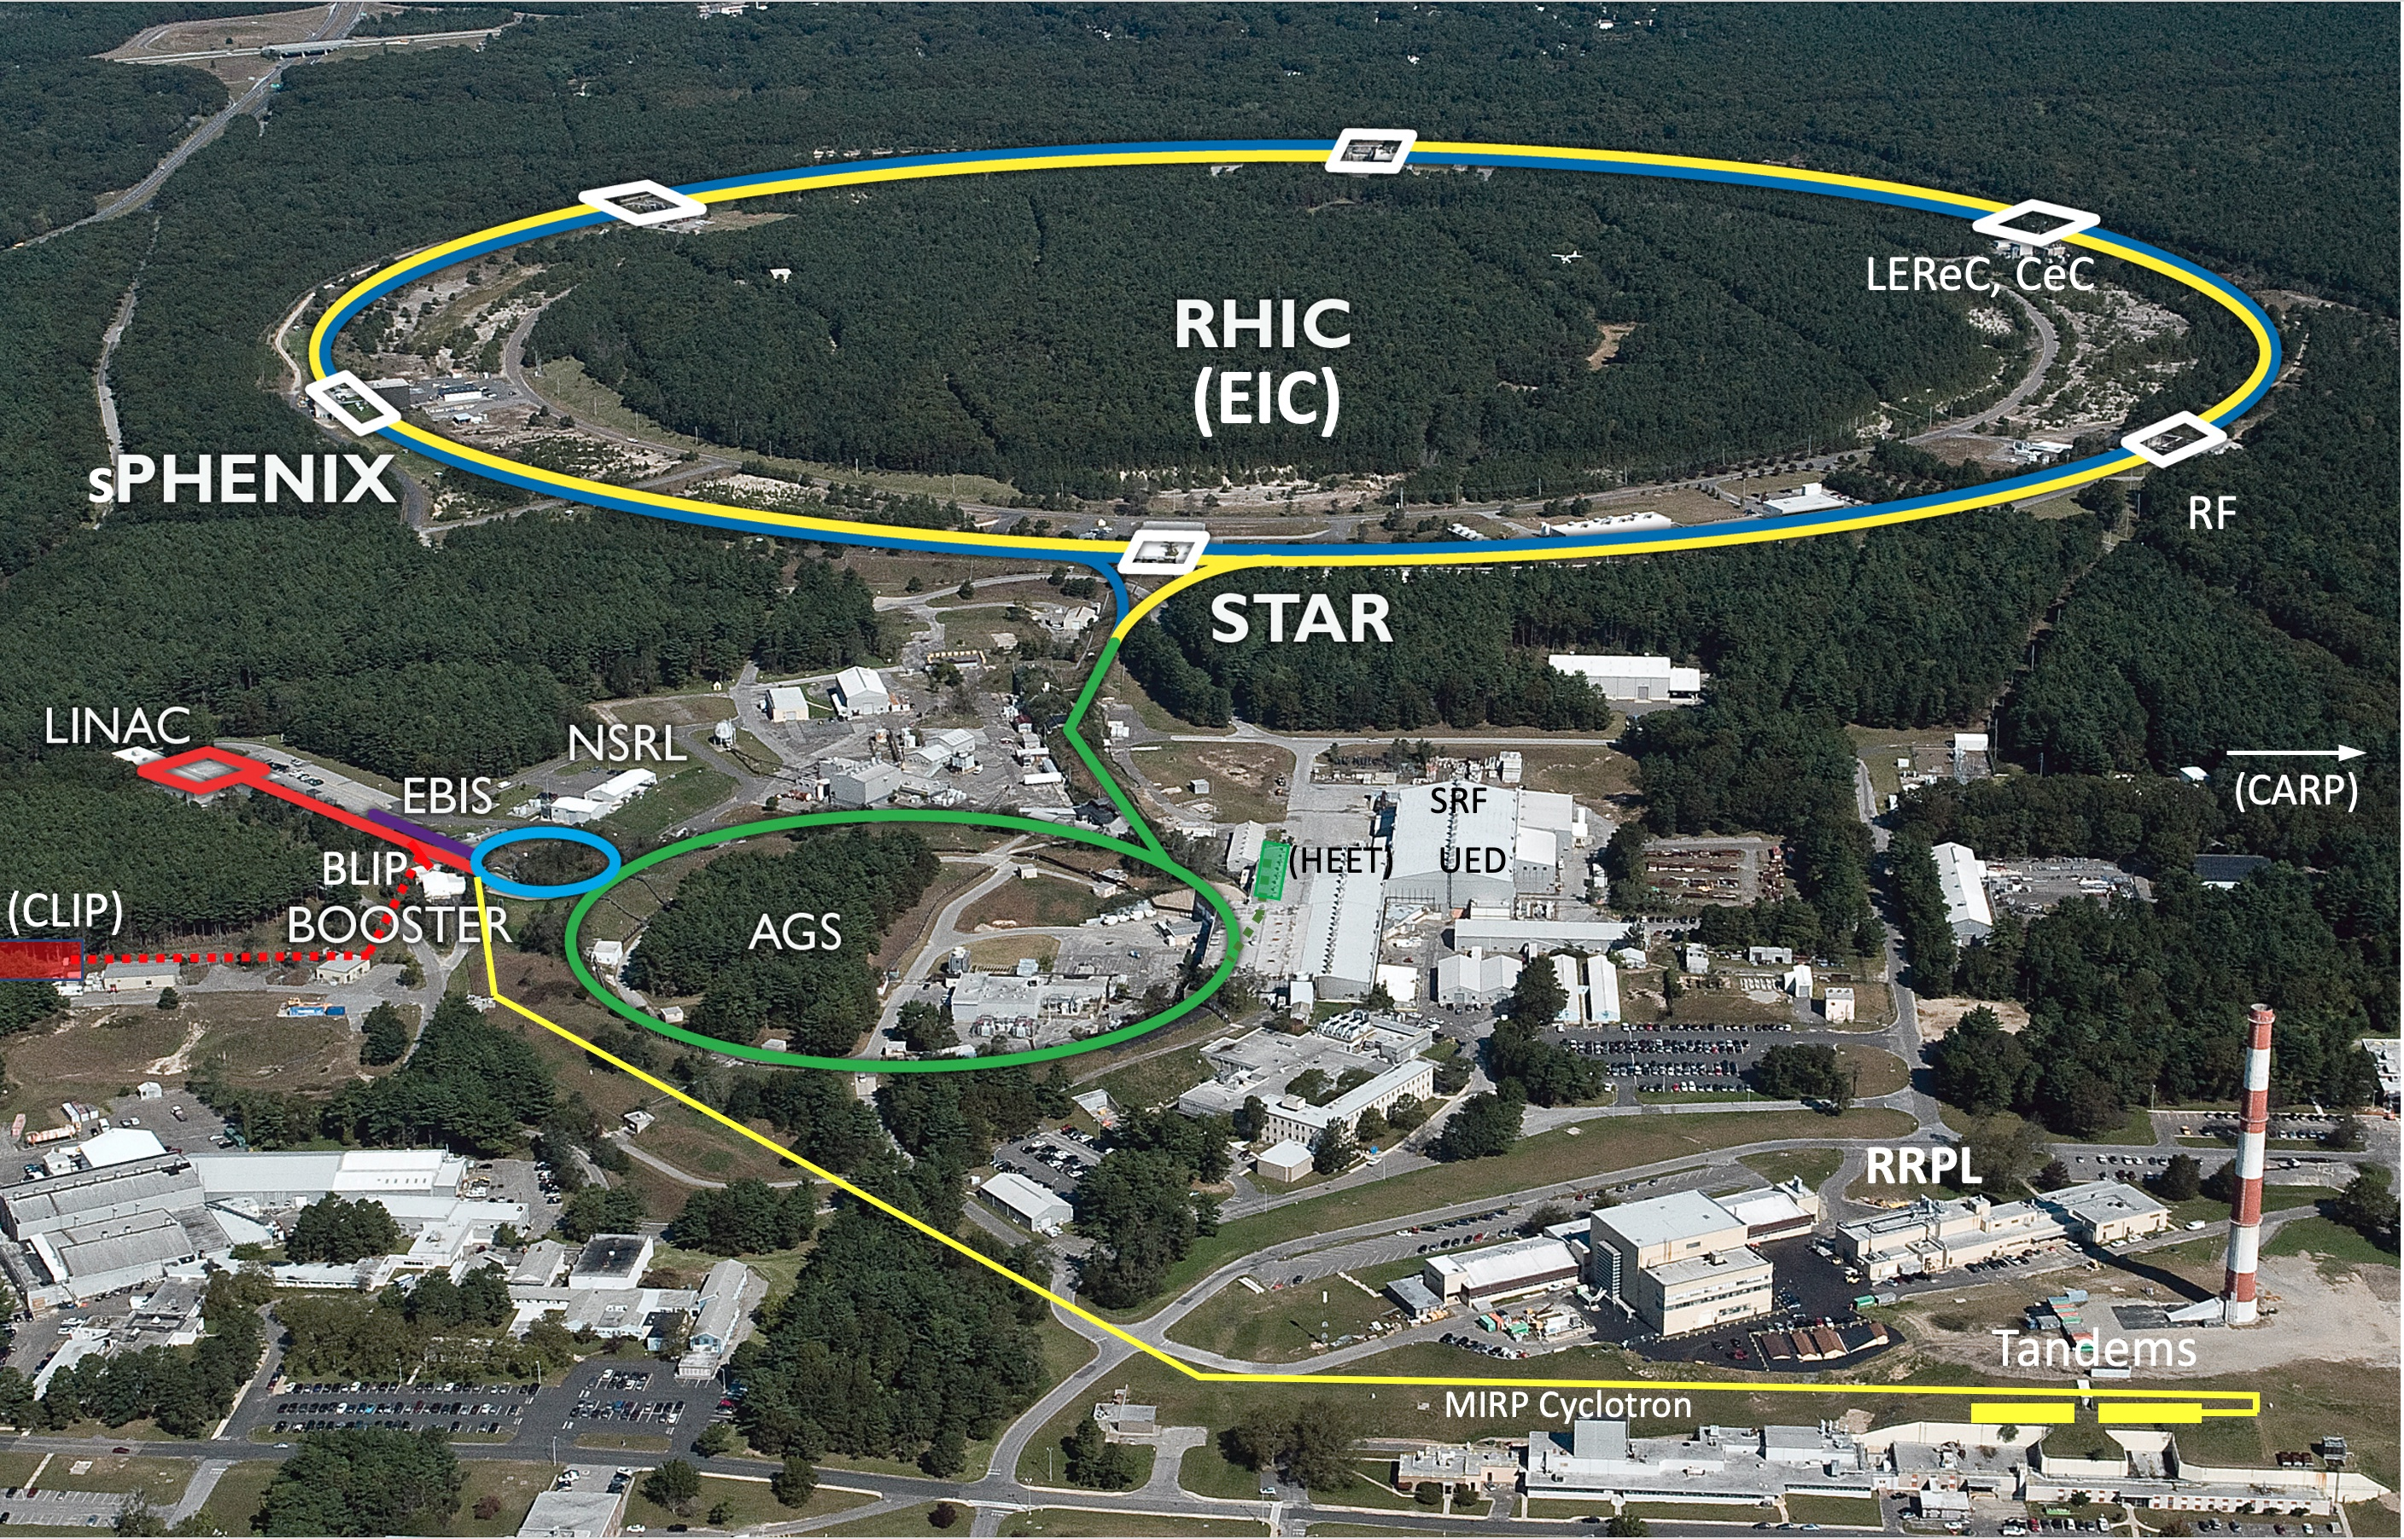
Nuclear Physics at BNL
Our mission is to lead and support discovery-based, innovation-driven research at the frontiers of the subatomic world.
We are world-leading in nuclear physics research, building and operating accelerator-based user facilities that serve international scientific communities.

Slide 3


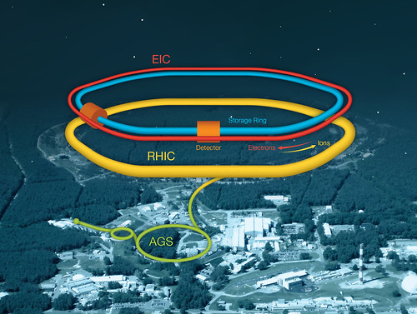
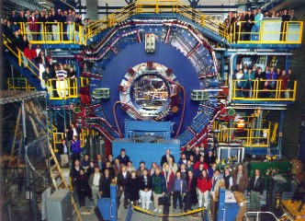
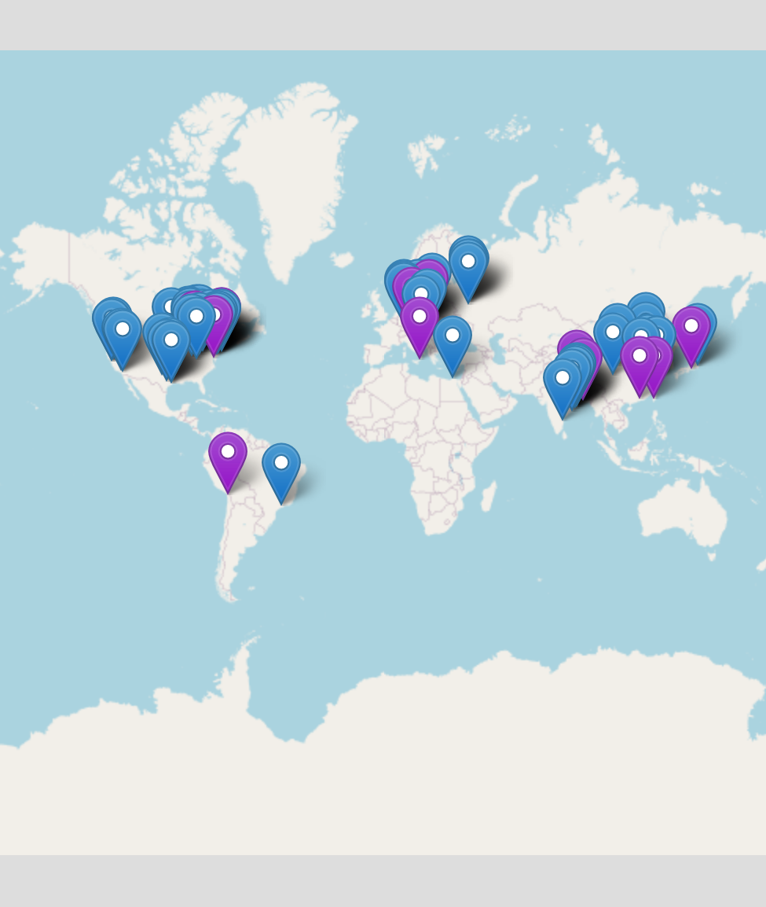
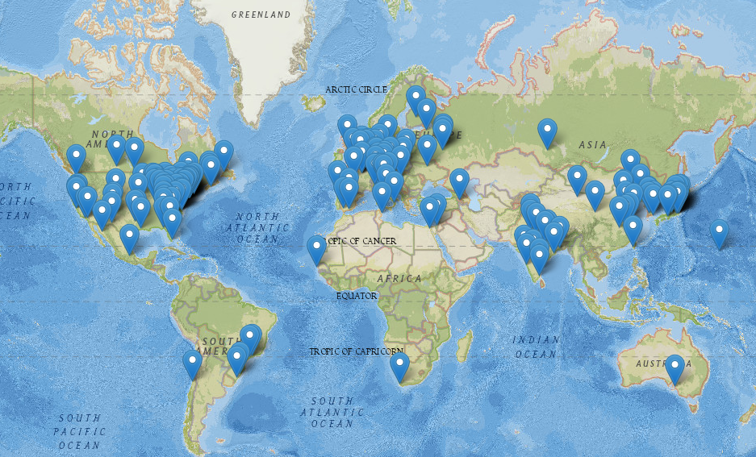
Serve International Scientific Communities
STAR: 72 Institutes
from 15 Countries,
736 Collaborators
EIC Users Group: 267 Institutes
from 36 Countries,
1358 members

Slide 4
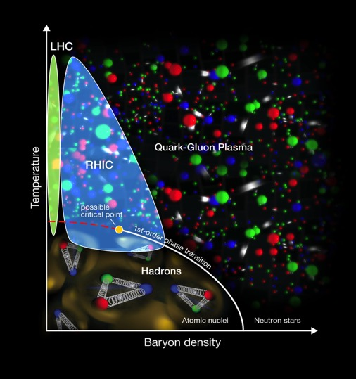
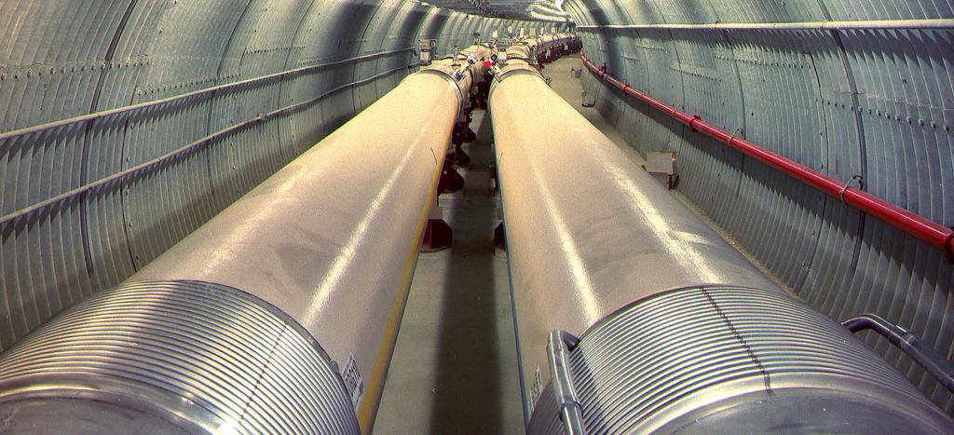
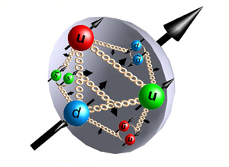
RHIC – a Unique Research Tool
Heavy ion collisions
  Explore new state of matter: Quark Gluon Plasma
  Highest collision rates and collide many different ion species
Polarized proton collisions
  Only collider of spin polarized protons to explore the internal spin structure of protons.
  Gluons carry part of proton spin

Slide 5
Quark-gluon plasma as “perfect liquid”
discovered at RHIC

Slide 6
RHIC in the 2015 Nuclear Science Advisory Committee Long Range Plan
“There are two central goals of measurements planned at RHIC, as it completes its scientific mission, and at the LHC: (1) Probe the inner workings of QGP by resolving its properties at shorter and shorter length scales. The complementarity of the two facilities is essential to this goal, as is a state-of-the-art jet detector at RHIC, called sPHENIX. (2) Map the phase diagram of QCD with experiments planned at RHIC.”
LEReC = Low Energy RHIC electron Cooling
First-ever electron cooling with bunched beams
Test case for electron cooling at EIC
Beam Energy Scan
What is the phase boundary of ordinary
nuclear matter?
Is there a critical point in the QCD phase
diagram? If so, where?
  BES-2 Completed as of June 7, 2021!

Slide 7
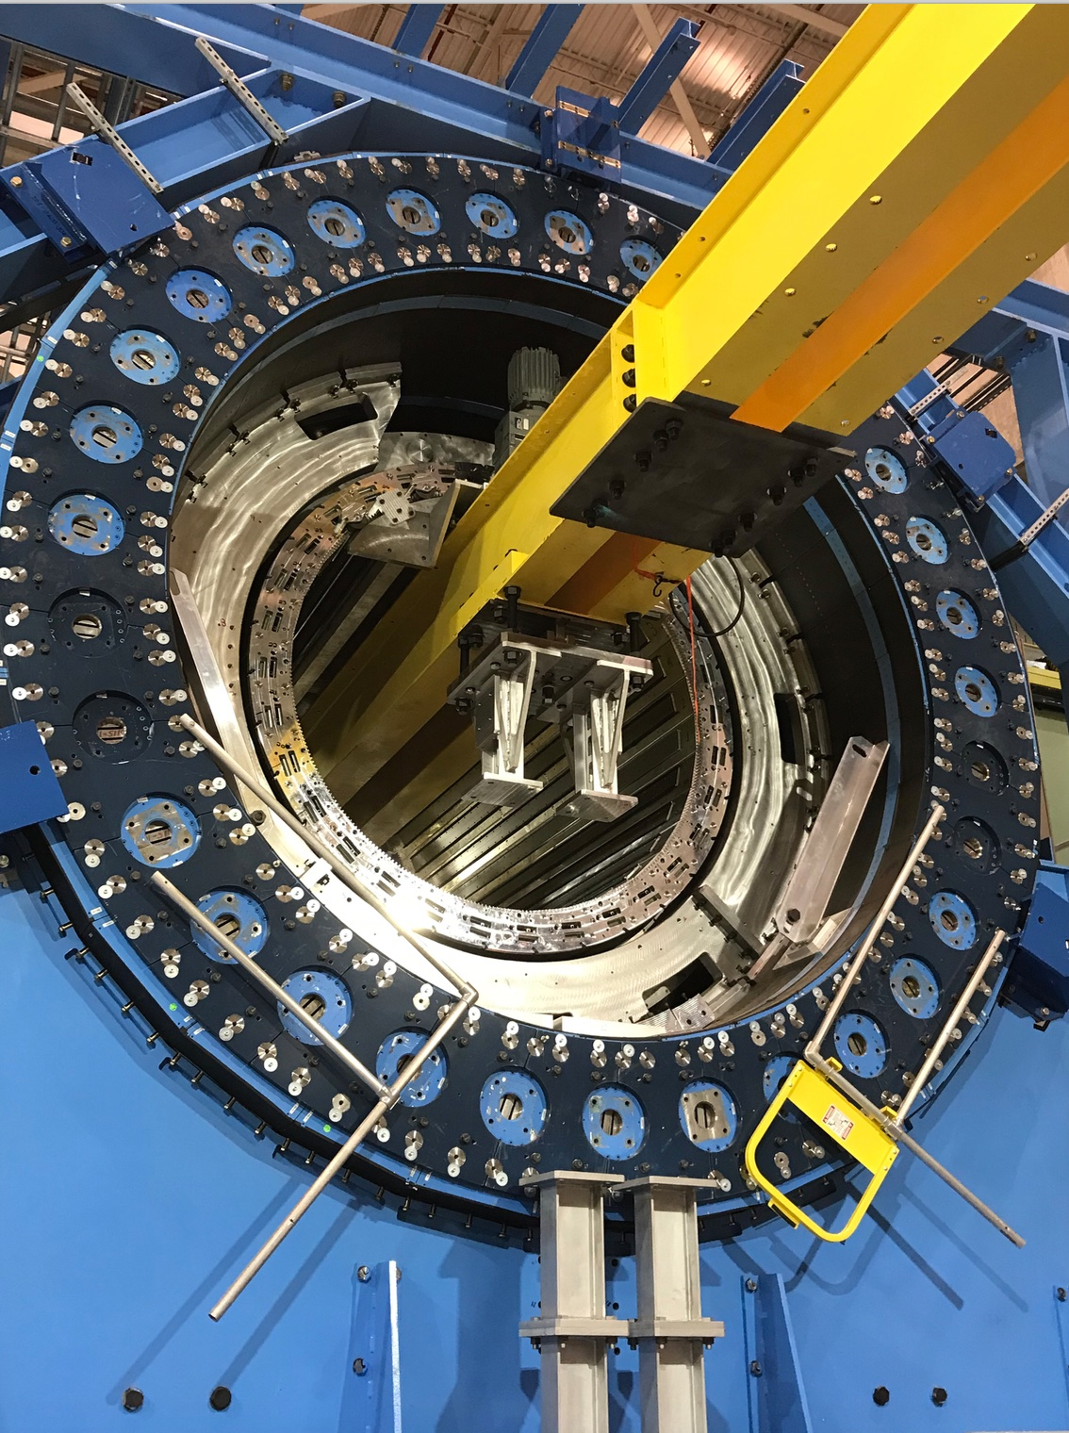

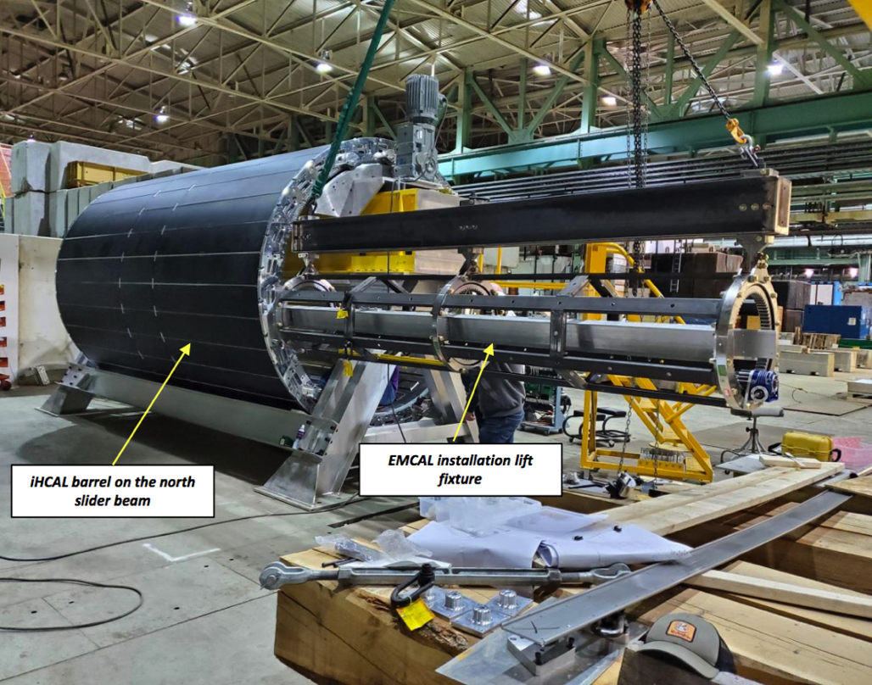
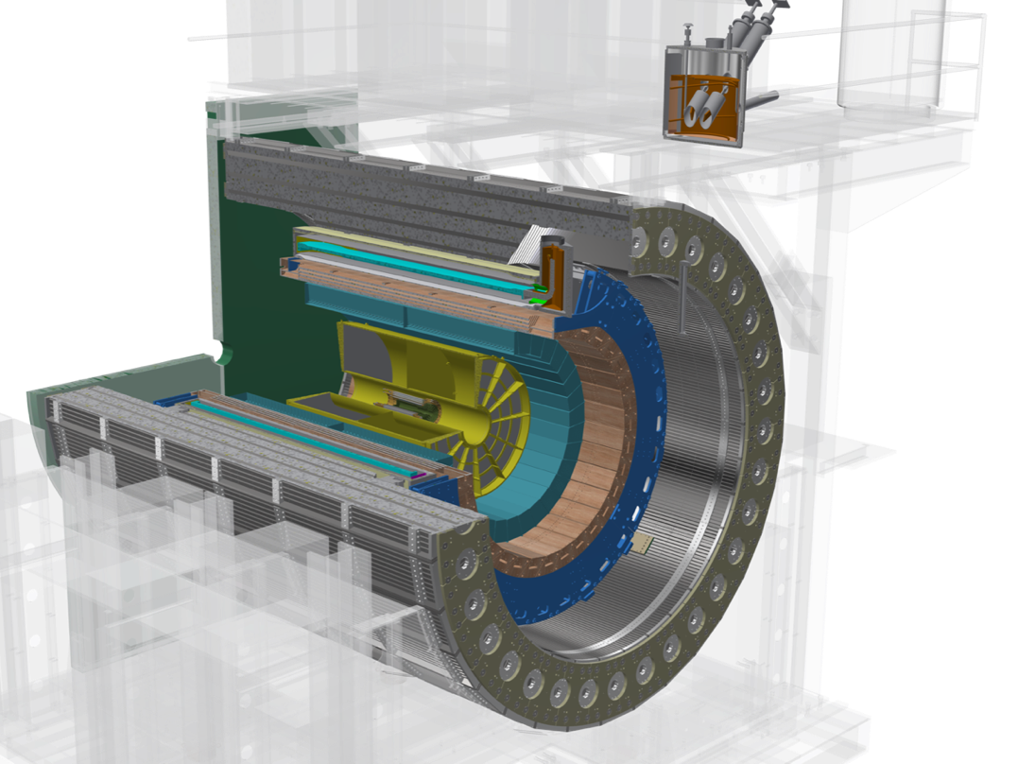
Completing the 2nd RHIC Goal in 2015 LRP
sPHENIX: Study QCD phenomena discovered at RHIC on different scales with unprecedented precision – How does the structureless “perfect fluid” emerge from the underlying asymptotically free gauge theory?
Extend RHIC kinematic reach and capabilities for direct comparison with
the LHC
Focus on hard probes (jets and heavy flavor)
RHIC data taking scheduled for 2023–2025
sPHENIX upgrade will fully utilize the enhanced
(~50 times AuAu design) luminosity of RHIC together with STAR

Slide 8
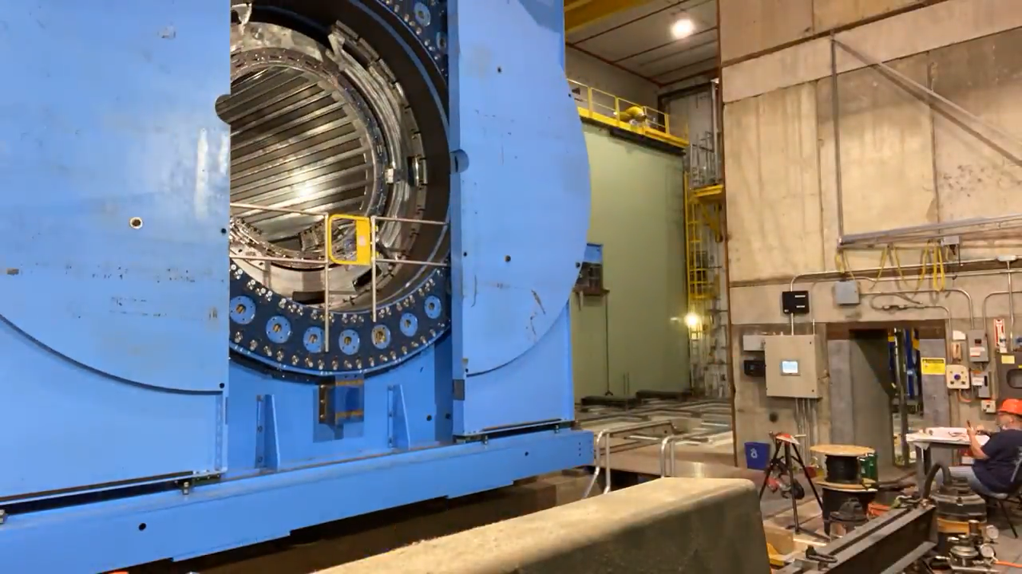
sPHENIX moving into its home

Slide 9
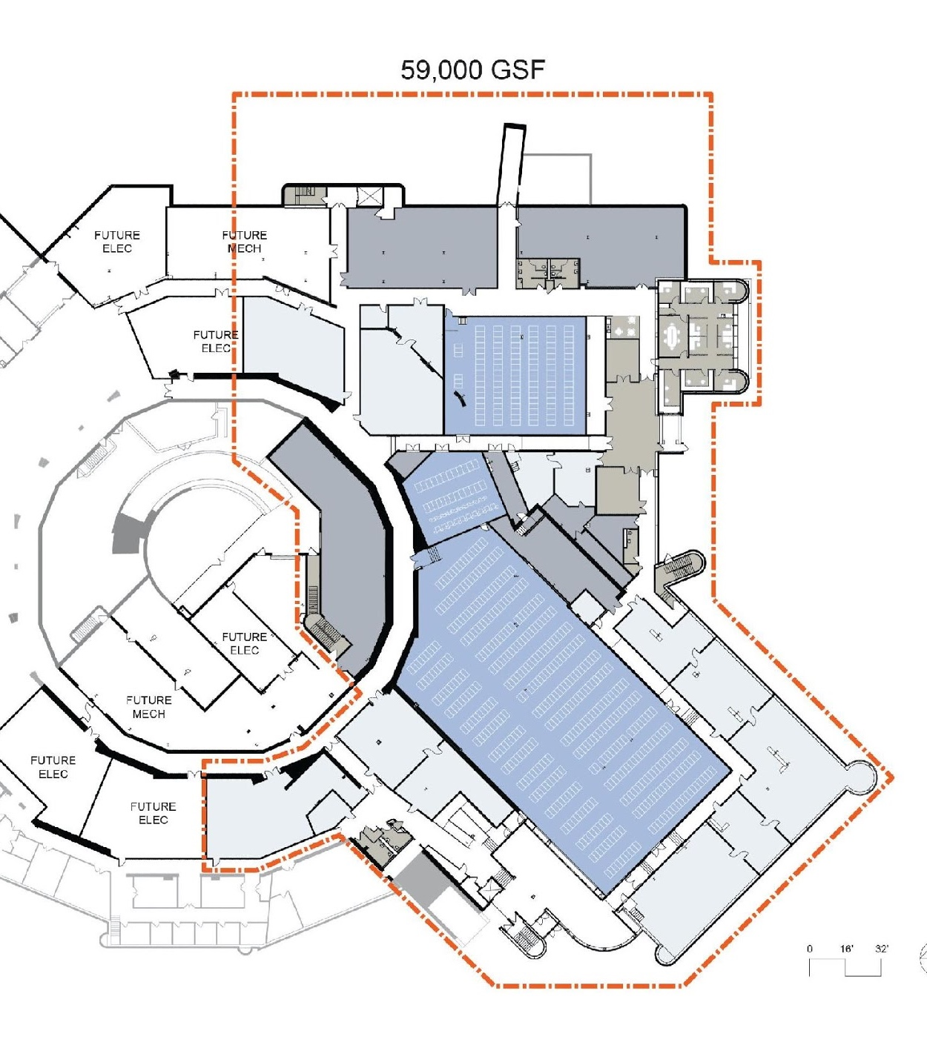

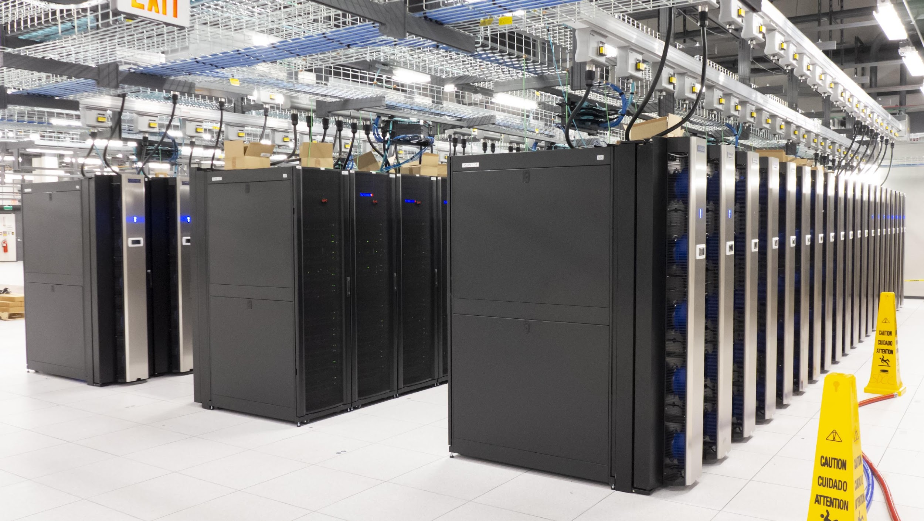
Scientific Data and Computer Center
Smooth operation of computing for RHIC
BIG Data: sPHENIX > 100 PB/year
Preparing for the Future
sPHENIX computing model commissioning
Installation of sPHENIX hardware
Support for EIC detector proposals
Coordinated effort with JLAB on EIC computing
Engagement in BNL’s AI/ML strategy and planning
Model to support BNL’s centralized computing being developed
New data center
Beneficial occupancy since July 2021 (3 months Covid-19 related delay)
New hardware deployed in new data center
New data center - main hall
24

Slide 10
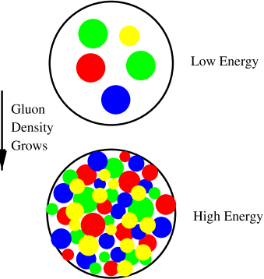
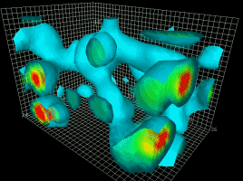
Nuclear Theory
BNL Nuclear Theory group: flagship group with deep expertise
Saturation physics: coined the “Color Glass Condensate”
Condensed matter of the QCD form:
Topological properties and phase transitions
Spin structure of the proton and nuclei
Lattice QCD: fundaments and advances in computation
Major contributor to BNL’s Quantum Computing effort (C²QA)

Slide 11
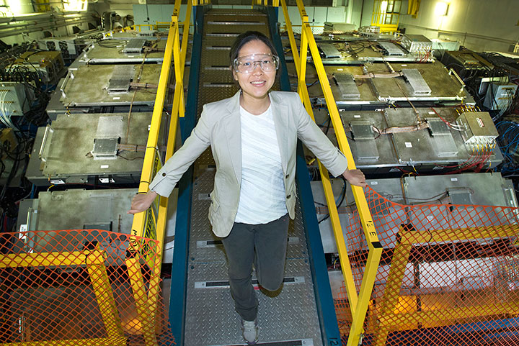
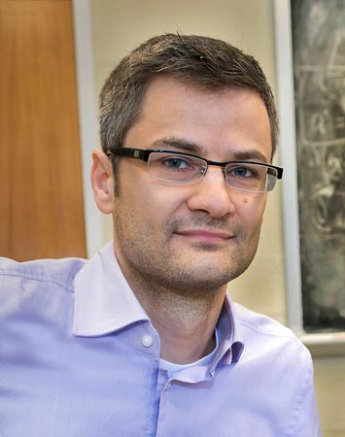
Early Career Awards
Lijuan Ruan (2013)
Mid‐rapidity Di‐lepton Measurements at RHIC with the Muon Telescope Detector at STAR
Bjorn Schenke (2014)
Development of a Comprehensive Description of High‐Energy Nuclear Collisions at RHIC and LHC and Electron‐Ion Collisions at a Future Electron‐Ion‐Collider

Slide 12
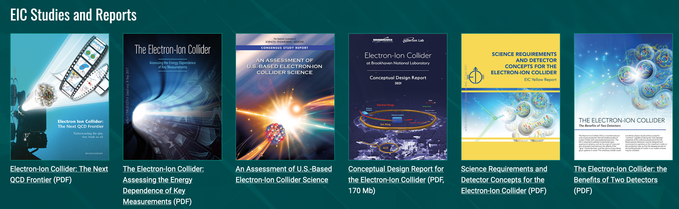
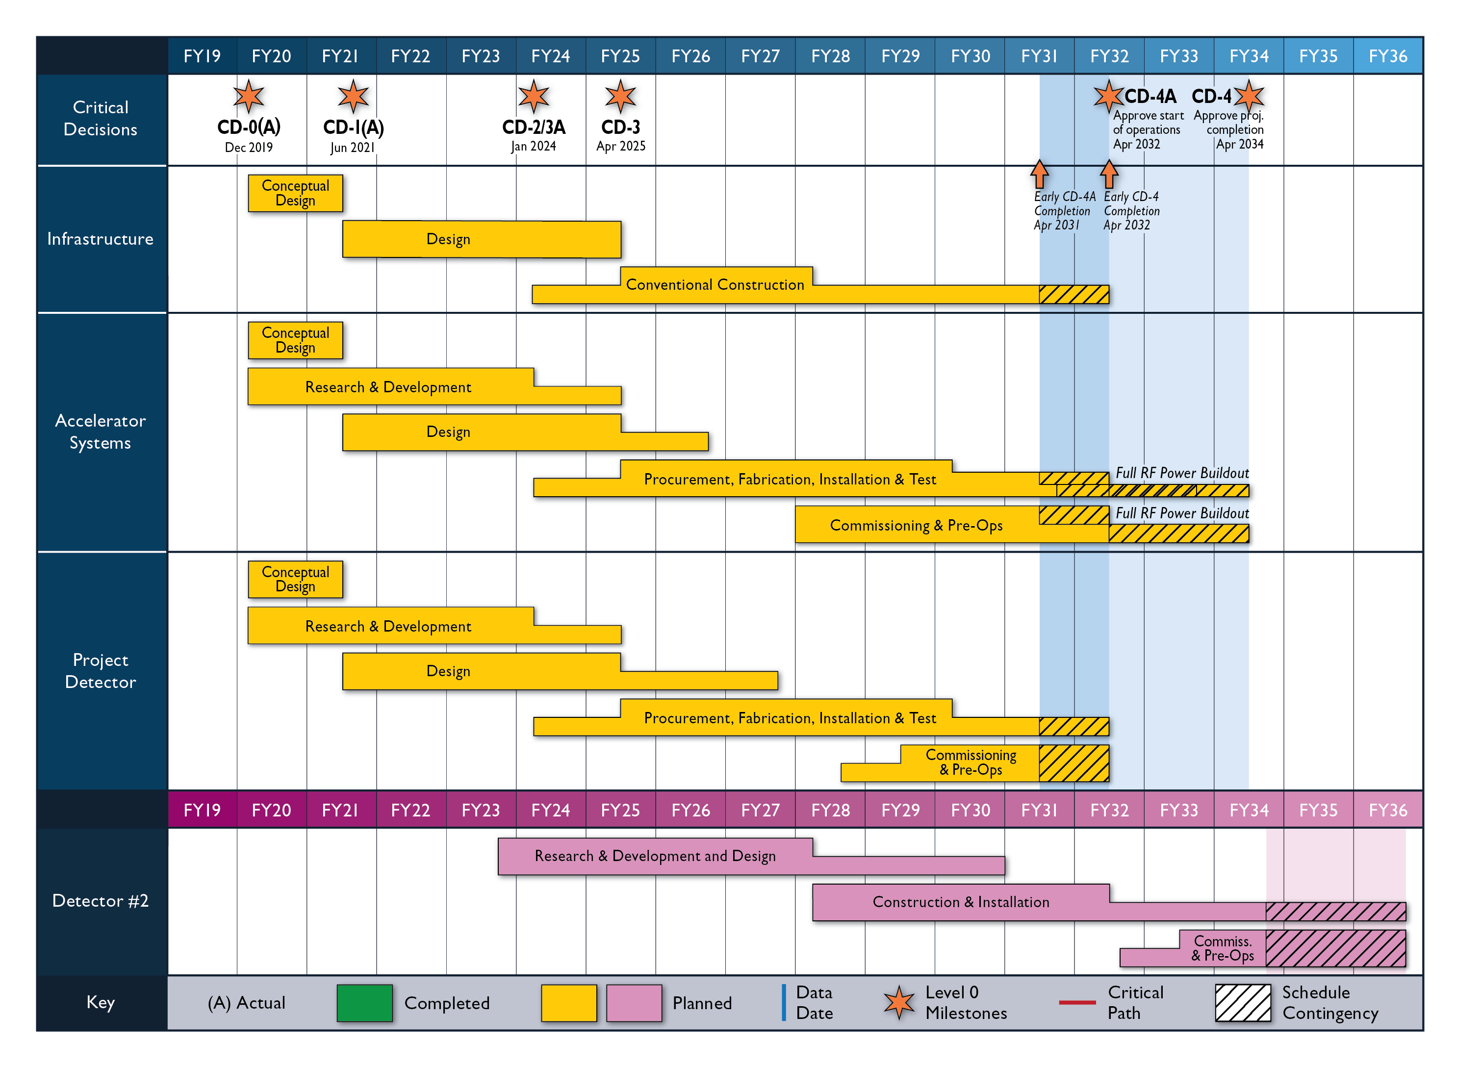
Electron Ion Collider
EIC is coming, soon
Plan: RHIC datataking ends June 2025
ePIC detector concept rapidly converging
  CD-2/3A Jan 2024
Many opportunities to make your mark

