Slide 1
BNL Medical Isotope Research and Production Program
Cathy S. Cutler
September 9, 2022

Slide 2
DOE Isotope Program Mission
Produce and/or distribute radioactive and stable isotopes that are in short supply; includes by-products, surplus materials and related isotope services
Maintain the infrastructure required to produce and supply priority isotope products and related service
Conduct R&D on new and improved isotope production and processing techniques which can make available priority isotopes for research and application. Develop workforce.
Ensure robust domestic supply chains. Reduce U.S. dependency on foreign supply to ensure National Preparedness.
Isotopes are forms of the same element that contain equal numbers of protons but different numbers of neutrons in their nuclei, and hence differ in relative atomic mass but not in chemical properties; in particular, a radioactive form of an element.

Slide 3

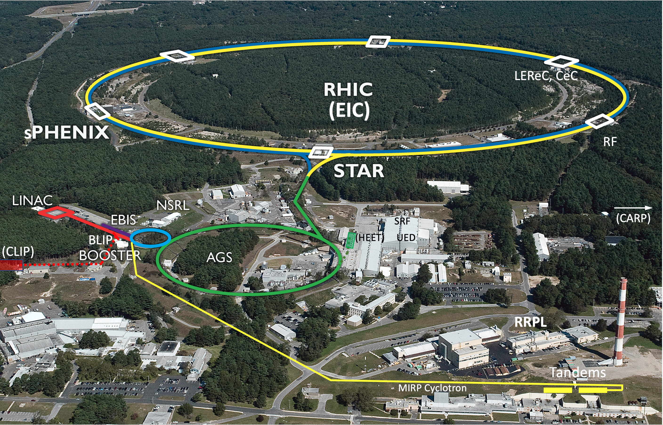
BNL Isotope Program –
Aerial View of Integrated Accelerator Facilities
*BLIP = Brookhaven Linac Isotope Producer, **RRPL = Radionuclide Research and Production Laboratory contains the TPL = Target Processing Laboratory and the AP Hot Cells

Slide 4
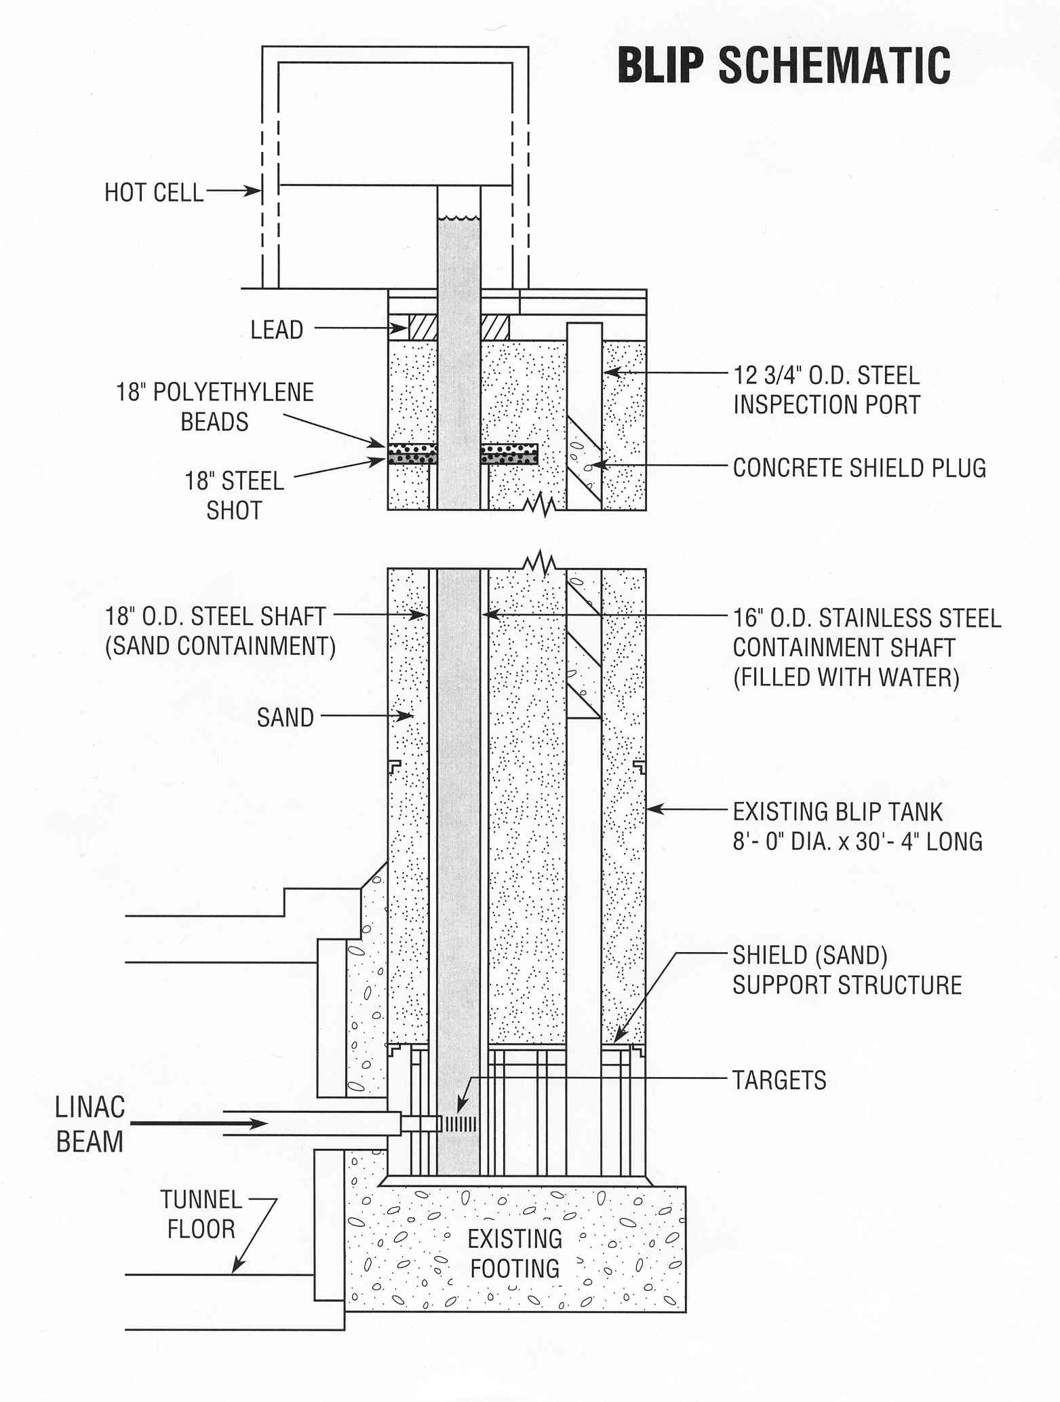
Brookhaven Linac Isotope Producer (BLIP) target station
BLIP target assembly
30 MeV (C-slot)
BLIP schematics
68 MeV
97 MeV
106 MeV
RbCl 2
RbCl 1
degrader
Proton beam
Target basket
Cooling water

Slide 5
Opportunities for Isotope Production and R&D
^{nat}Ga(p,xn)⁶⁸Ge
⁸⁶Sr(p,n)⁸⁶Y
¹⁸⁶W(p,n)¹⁸⁶Re
¹⁹²Os(p,2np)¹⁸⁹Re
⁴⁵Sc(p,2n)⁴⁴Ti
⁴⁸Ti(p,2p)⁴⁷Sc
^{nat}Rb(p,xn)⁸²Sr
⁸²Sr - API for Bracco’s Cardiogen-82® generator
⁷⁵As(p,4n)⁷²Se
²³²Th(p,2p6n)²²⁵Ac
⁶⁸Zn(p,2p)⁶⁷Cu
Notes:
Capable of producing high energy protons (up to 200 MeV)
High current (up to ~173 µA)
New raster magnet installed to more uniformly distribute the beam

Slide 6
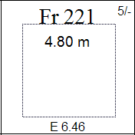
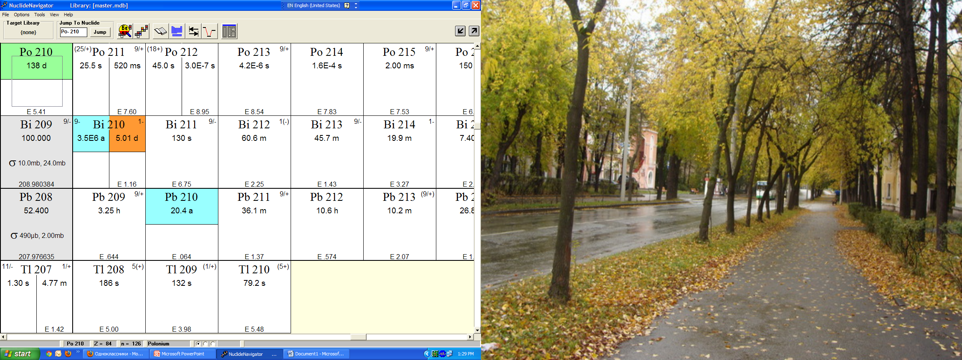
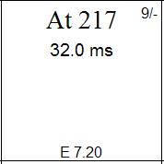
Actinium-225 nuclear data
Ac-225 is an alpha emitter, T_{1/2}=10 d, whose decay produces 4 alpha particles – potent nuclide for alpha therapy
α
α
β⁻
α
α
β⁻
α
β⁻
Ac-225 is a parent nuclide for Bi-213 (T_{1/2}=45.7 min) in a Ac-225/Bi-213 generator pair. Bi-213 an alpha emitter; also emits gamma ray suitable for SPECT imaging Eγ=440 keV, 27.3%

Slide 7
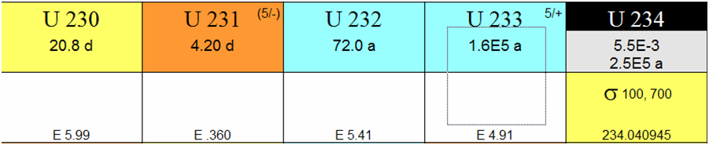
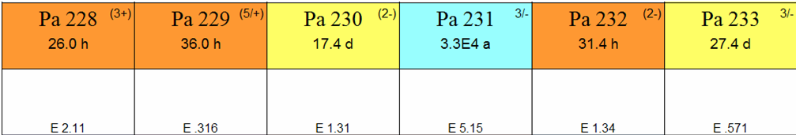
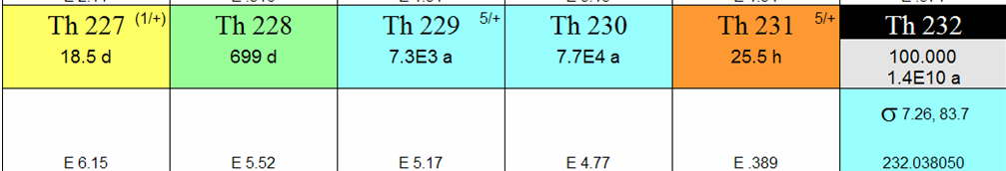
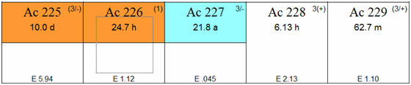
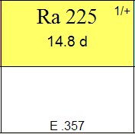
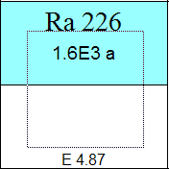
Pre-2013 Ac-225 production routes
Decay from Th-229
  ~100 mCi of Ac-225 is separated from 130 mCi of Th-229 stock at ORNL every 8 months (Ball
et al, 2005, JARI. 62(5) p 667)
  ~40 mCi available from the Institute for Transuranium Elements, Karlsruhe, Germany
(Apostolidis et al, J.Label.Compd. Radiopharm. 2001, 44(S1), p S806)
Cyclotron production through the Ra-226(p,2n)Ac-225 reaction
  Radioactive target material (Apostolidis et al, 2005, JARI, 62(3), p383)
²²⁶Ra(p,2n)²²⁵Ac
D. Medvedev. 2019 MIRP Science and Tech targetry update
nology revi
ew, Thoriu
m
3

Slide 8
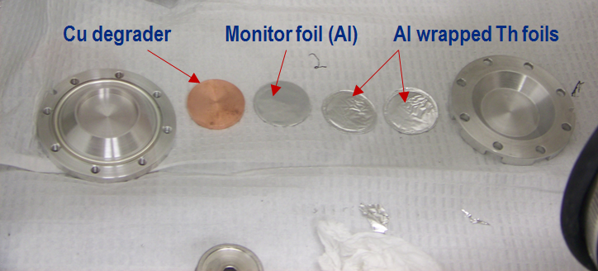
High energy proton spallation reaction on ²³²Th
²³²Th(p,x)
Can size d×h=6.985×1.25 cm
Well diameter 2.921 cm
Th disk foils (d×h=2.8×0.0125 cm, 0.8 g each, Goodfellow)
Disk foils were wrapped in 0.0254 mm Al foil
Can was sealed under Helium in a glove box and leak-checked
*parent and daughter nuclides are color coded

Slide 9
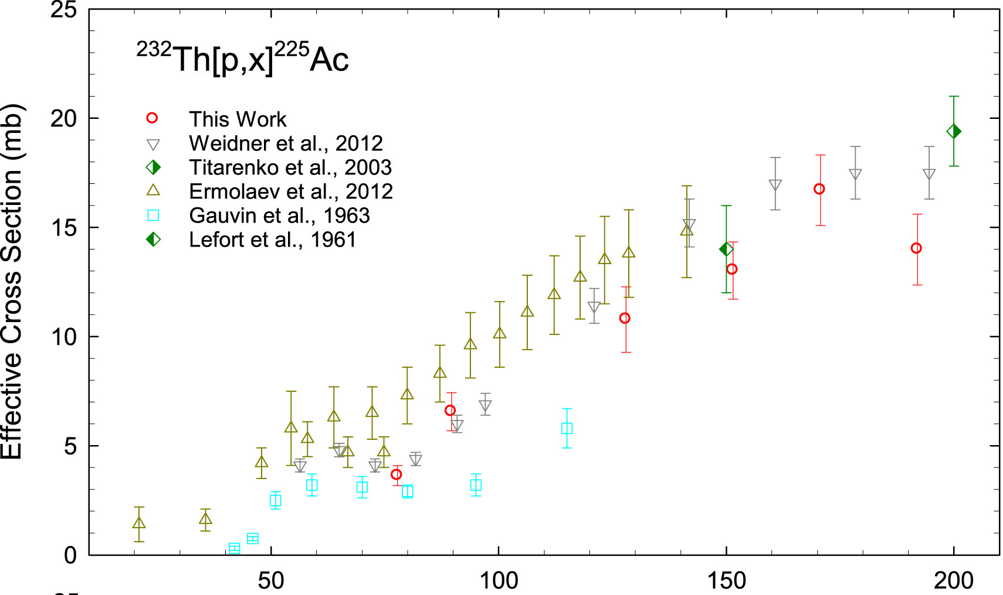
Cross sections for Ac-225 production*
J.R. Griswold et. al. Appl. Radiat. Isot. 118 (2016 ) 366. Work is part of Tri-Lab collaboration between BNL, LANL, and ORNL on a large scale production of Ac-225 from Th

Slide 10
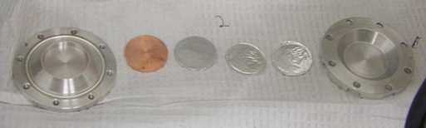
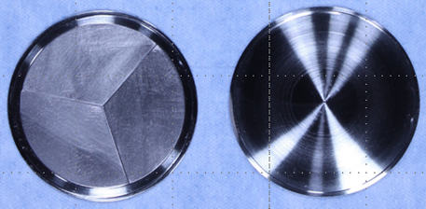
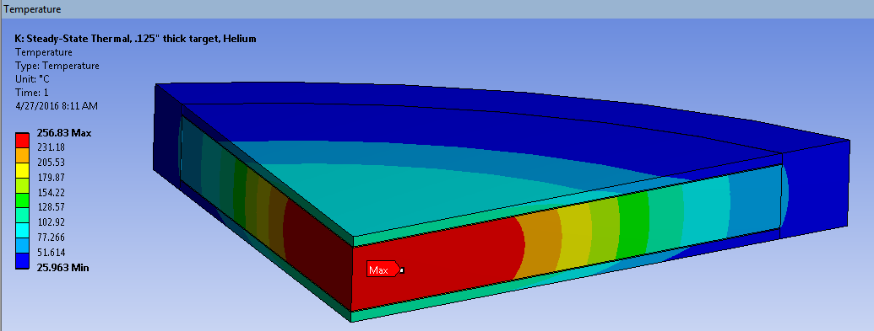
Target Challenge: develop thick Th targets for clinical scale production
Initial targets were thin Th foils (0.127mm, 0.9g) encapsulated in Al. Used to support small scale production for chemistry development and for ²²⁵Ac cross section determinations.
Recent larger diameter (0.38mm thick,13g )BNL targets to support new rastered beam at BLIP were sealed in inconel by electron beam welding.
Primary risk associated with Ci-Scale targets (~100g) is overheating. Capsule MP (1290°C) is lower than thorium MP (1755°C).
Thermal behavior at Th/capsule interface is key.
Thermal calculation for 165μA at 191 MeV incident energy assuming ideal thermal contact for a 3 mm thick target (105g) predicts low peak temperature but actual thermal contact conductance will be lower.

Slide 11
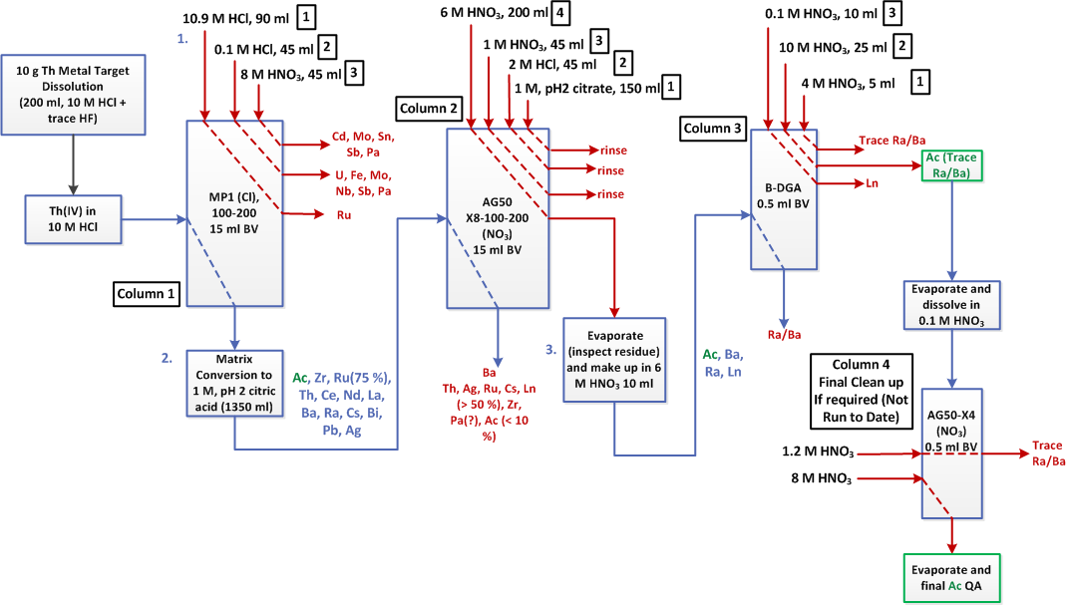
Preliminary chemistry flowchart

Slide 12

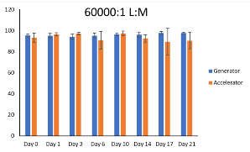
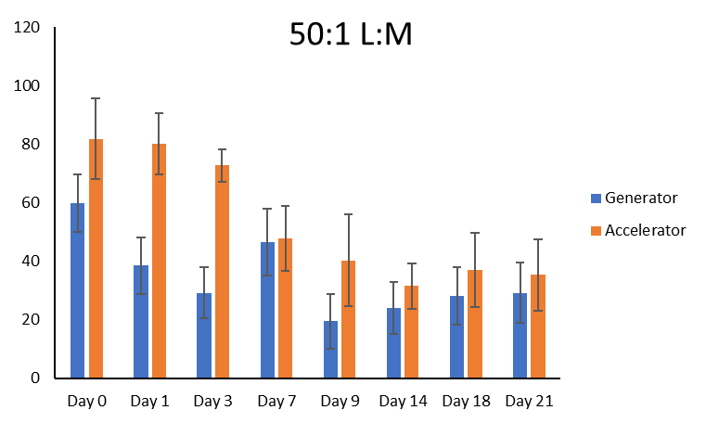
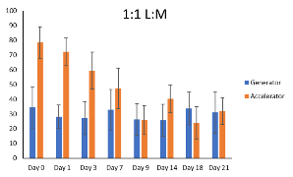
Ac-225/227 Radiolabeling
Motivation
  To determine if there are any differences in radiolabeling yield over time when comparing accelerator material to generator (cow) material
Protocol
  50 μCi per reaction
  100 °C for 30 minutes
  Timepoints
    0, 1, 3, 6, 10, 14, 17, 21 days post delivery.
  ITLC
    Solvent 50/50 NH₄OAc/Methanol

Slide 13
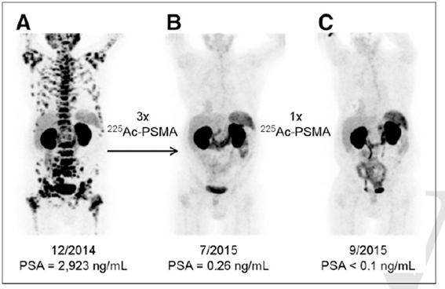
Prostate Cancer Therapy
J. Nucl. Med., 2016; 57 (12); 1941 DOI: 10.2967/jnumed.116.178673 C. Kratochwil

Slide 14
Summary
BLIP routinely receives proton beam from LINAC at 117 MeV and average current 165 µA
A total of 160 mm of target space is available both for research and production
Beam is rastered for production targets; can be focused for cross section measurements and enriched targets’ irradiations
Evaluating different generator systems for remote supply of imaging and therapeutic radionuclides
Developing new production methods to supply alpha emitters to support clinical evaluation

