Slide 1
Barrel TOF Layout (v0)
Zhenyu Ye
University of Illinois at Chicago

Slide 2

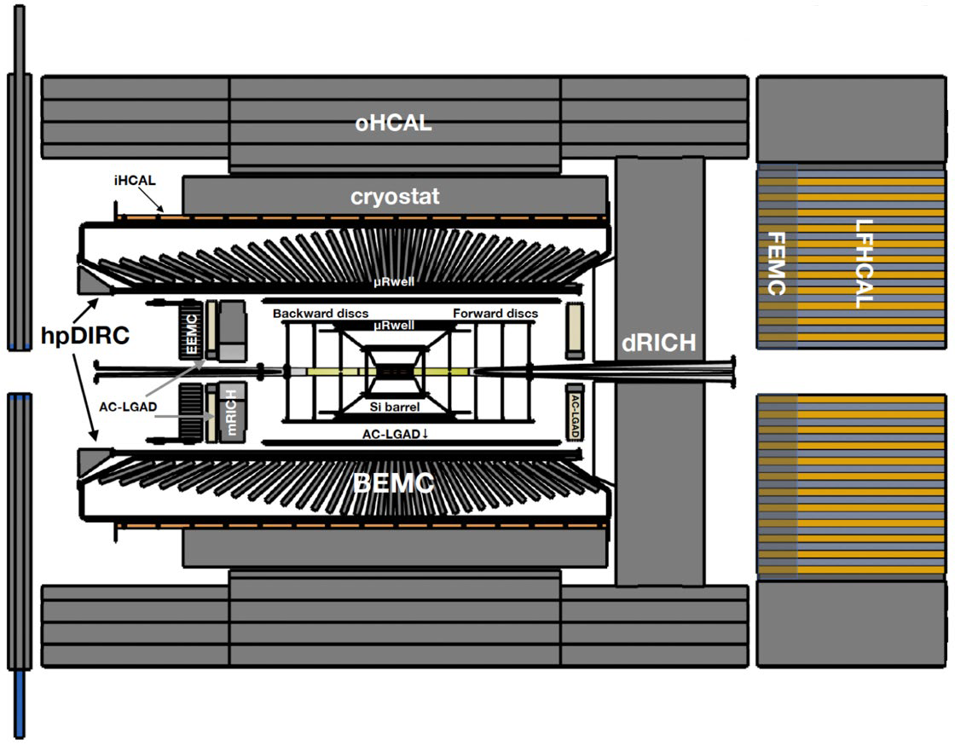
EIC Detector-1 Reference Design
Tracking:
Si MAPS
AC-LGAD
μRWELL
PID:
hp-DIRC
mRICH
dRICH
AC-LGAD
Calorimetry:
SciGlass Barrel EMCal
PbWO EEMCal
Longitudinally separated EM+Hcal
Inner HCal (instrumented frame)
Outer HCal (sPHENIX re-use)
p/A beam
electron beam
Backward-h
Forward-h
5.34 m
Different to LHC
lower momentum
lower occupancy
less irradiation
$$η=0$$
8.5 m

Slide 3
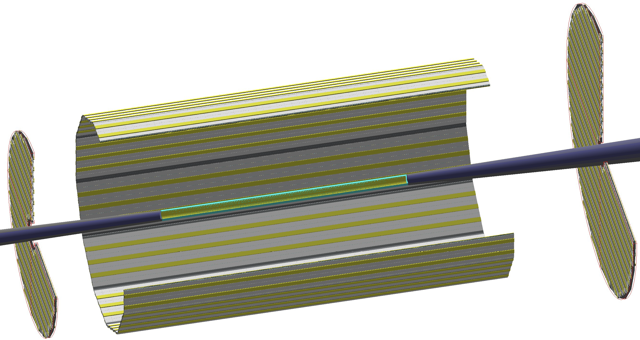
AC-LGAD Layer for TOF PID + Tracking
The goal is to conceive a reference layout and technical design (v0) as inputs to GD/I group to advance the detector integration (service routing etc.)
However, there are still on-going studies to investigate the optimal channel granularity based on physics performance so by no means this is a proposal for final design.
CTTL
For v0 design, we propose:
Barrel: 0.5x10 mm² strips
Endcap: 0.5x0.5 mm² pixels (same as RPs) [1]
FTTL
ETTL
[1] Wei Li, TOF-PID WG Meeting Aug 29, 2022
 | acceptance | Z (m) | Radius (m) | Area (m²) | Channel size (mm²) | # of Channels
ETTL | -3.7<𝜂<-1.74 | -1.61 to -1.71 | 0.12 to 0.63 | 1.20 | 0.5*0.5 | 4.8M
CTTL | |𝜂|<1.4 | -1.2 to 1.5 | 0.625 to 0.655 | 10.9 | 0.5*10 | 2.4M
FTTL | 1.5<𝜂<3.5 | 1.555 to 1.705 | 0.12 to 0.85 | 2.22 | 0.5*0.5 | 8.8M

Slide 4
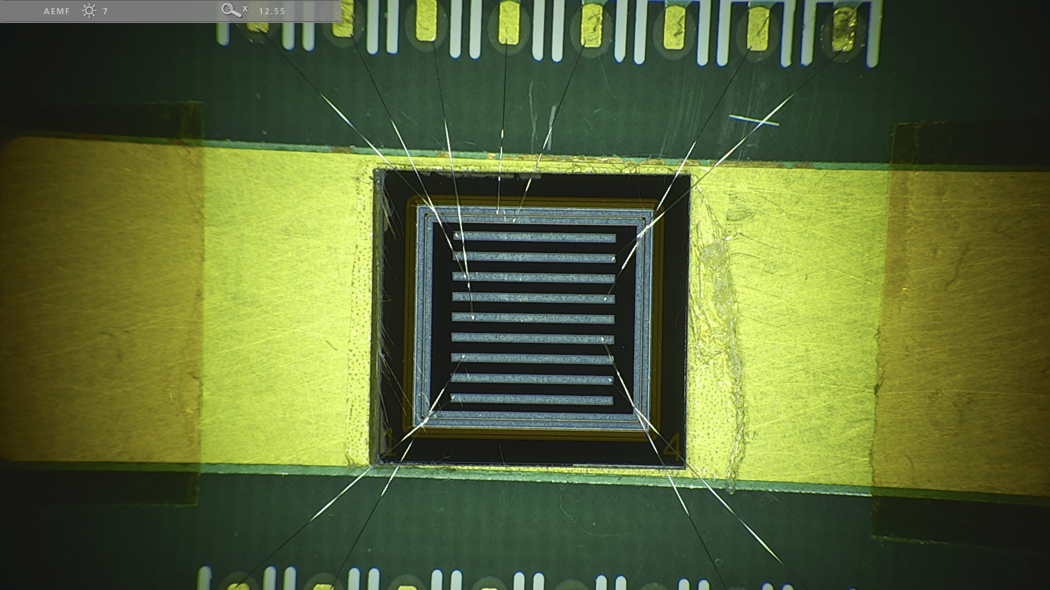
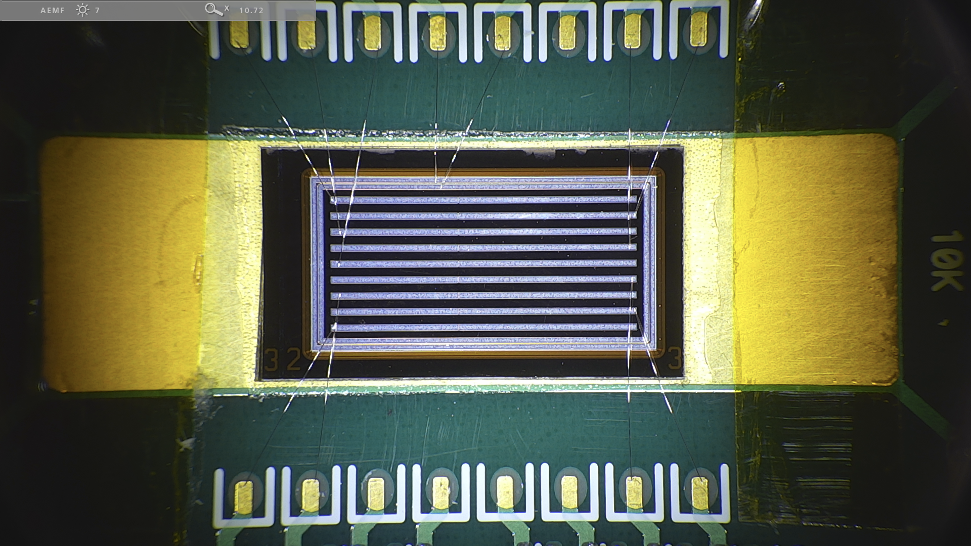
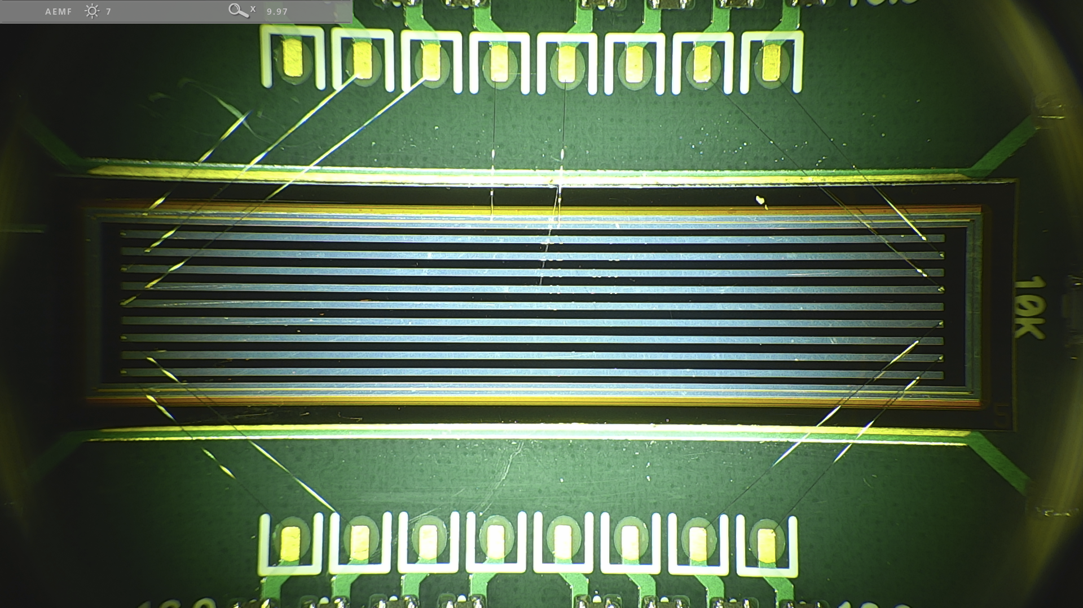
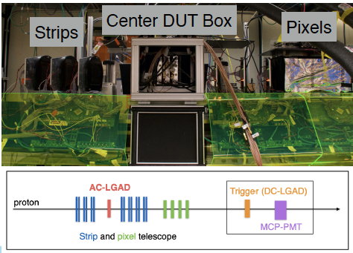
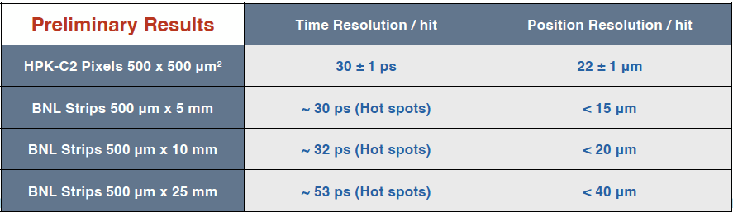
Test Beam Results of Strip AC-LGAD Sensors
0.5*5 mm²
0.5*10 mm²
0.5*25 mm²
eRD112/LGAD Consortium meeting 8/3/2022 by Chris Madrid (FNAL) https://indico.bnl.gov/event/16500/

Slide 5
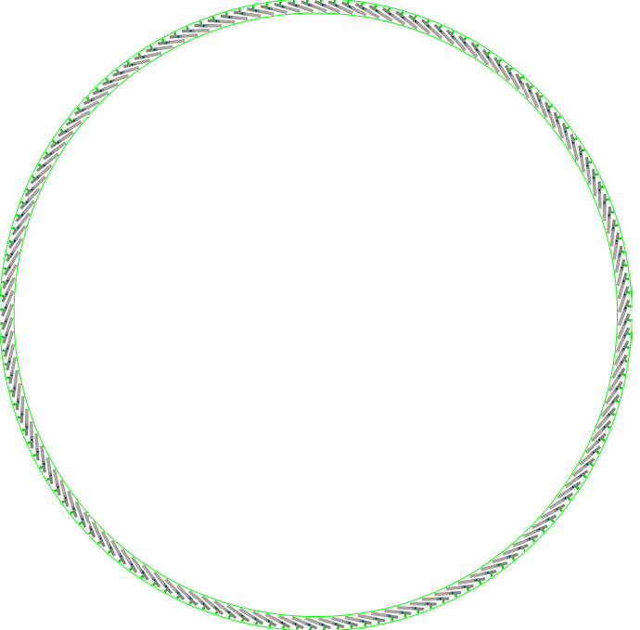
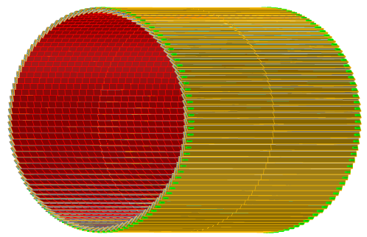

Barrel TOF Layout and Specification
Single layer of strip AC-LGAD sensors
  62<R<65 cm, 2.7 m long, ~11 m² area
Strip metal electrodes, with 500 $μm$ pitch in $rφ$ and 1 cm* in z
  Minimal material budget and power consumption compared to pixels
  * Will look into longer strips with sensor R&D
144*2 modules
Inner radius 62 cm
Outer radius 65 cm

Slide 6
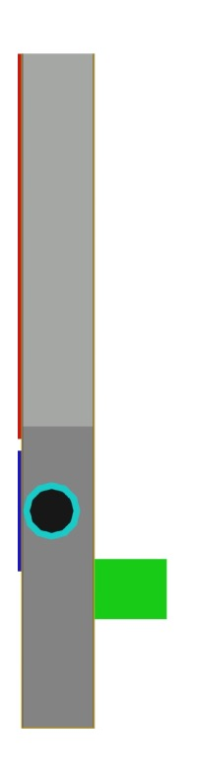
EPIC Barrel TOF Module
>95% coverage in Z
h=0.642 cm
w = 5.6 cm
l =½ L = 1.35 m
32 AC-LGAD sensors, each 3.2*4 cm² read out by 2 ASICs
Low mass flexible Kapton PCB distributes power and I/O signals from a low mass connector(s) at the edge
Liquid coolant in Al cooling tube takes away heat from the ASICs
H=1.242 cm

Slide 7
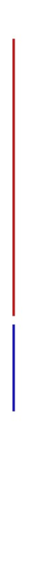




EPIC Barrel TOF Module
h=0.642 cm
AC-LGAD sensor
Frontend ASICs
Carbon foam+
Carbon honeycomb+
CF skins
Al cooling tube
Liquid coolant
Kapton PCB
Connector
w = 5.6 cm

Slide 8
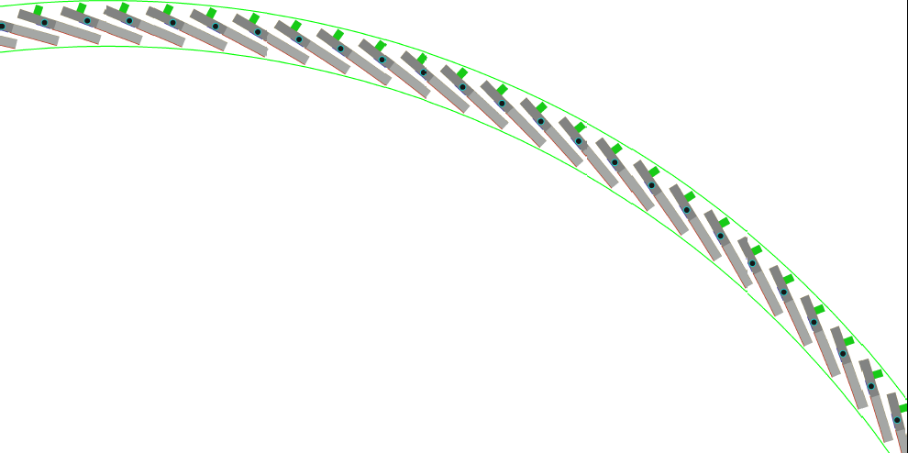
EPIC Barrel TOF Detector Layout
Full azimuthal coverage
3 mm overlap
18 º tilted angle
R=65 cm
R=62 cm

Slide 9
Barrel TOF Material Budget
Average material budget ~1% X₀

Slide 10
Services
In total 288 modules,
  9216 sensors, 18,432 ASICs, 2.4 M channels
  70 kG, ~4 (6) kW
On each module:
  32 sensors, 64 frontend ASIC
  Powered and read out by 1 service board
  1 fiber to DAQ
  1 LV+HV cable
  1 liquid cooling line

Slide 11
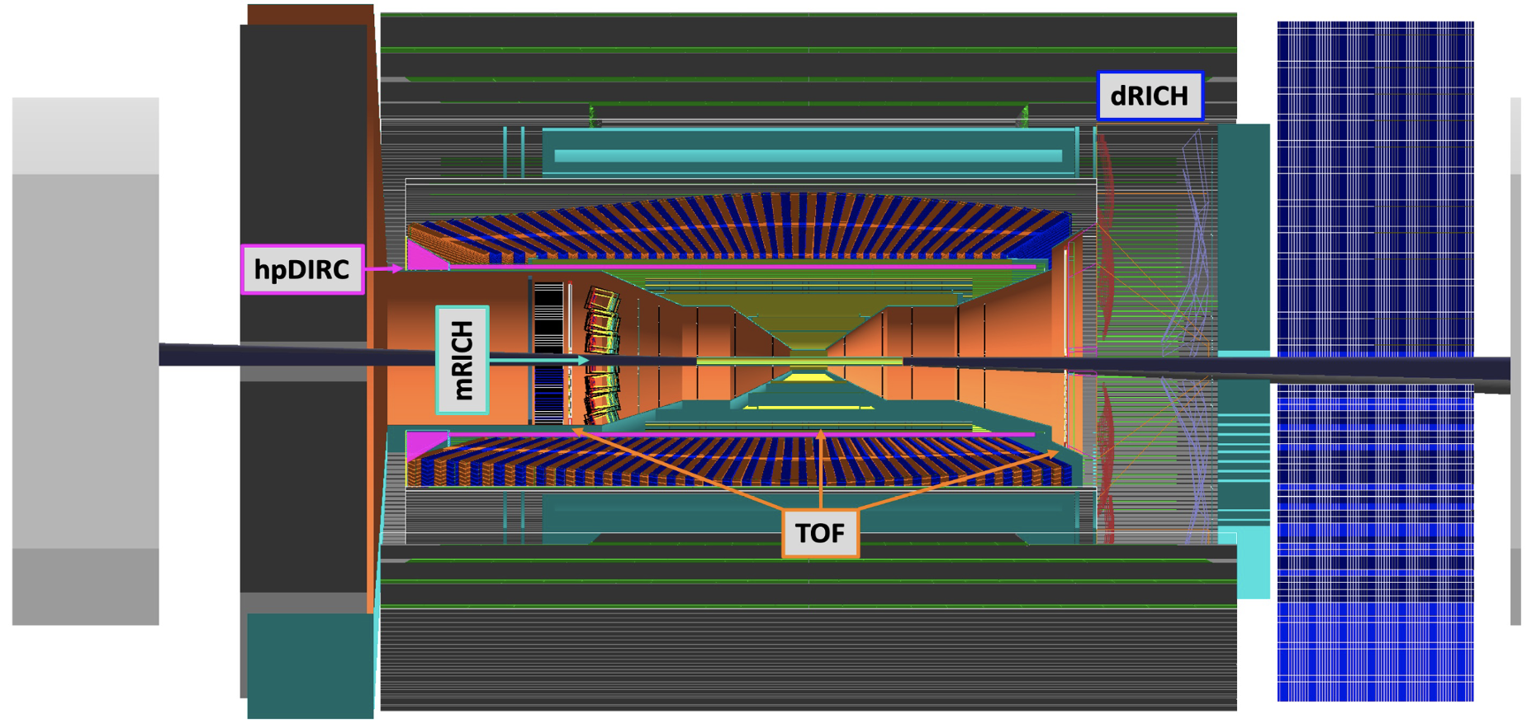
Backup

Slide 12
STAR Intermediate Silicon Tracker

Slide 13
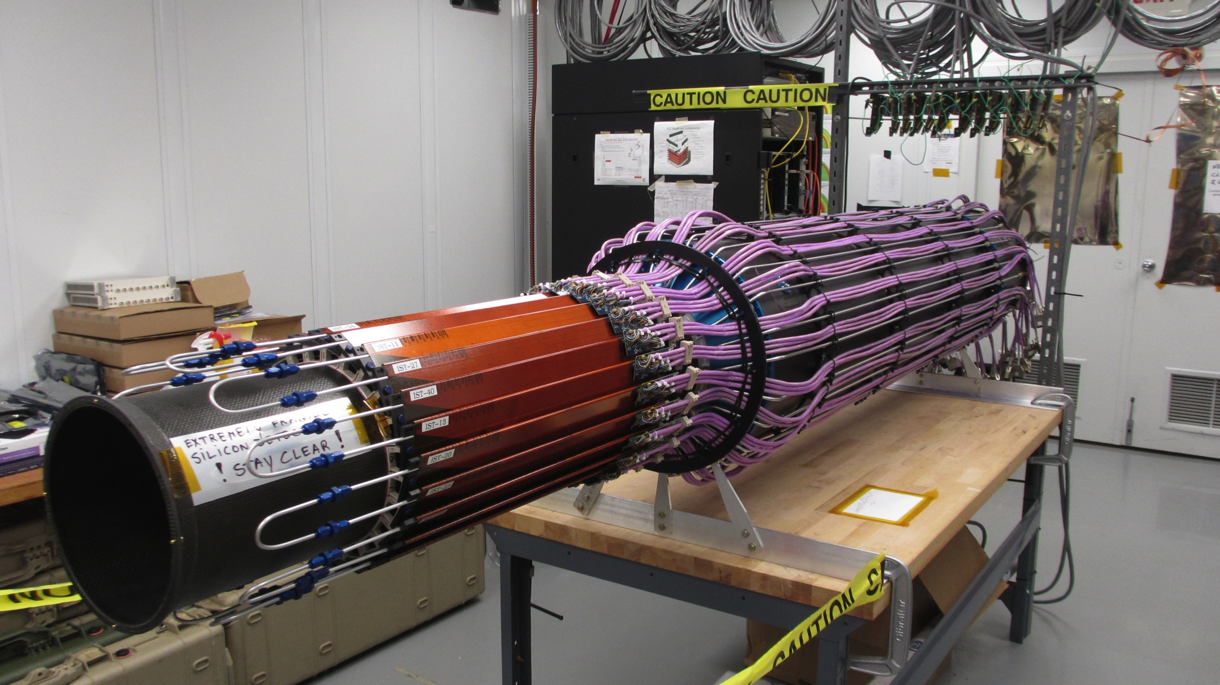
STAR Intermediate Silicon Tracker

Slide 14
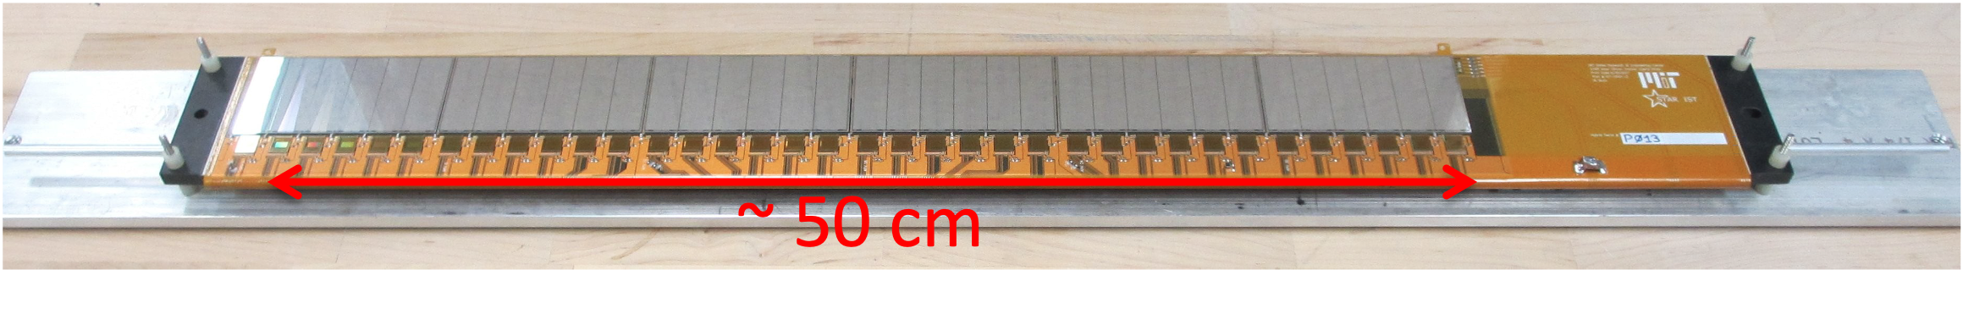
STAR Intermediate Silicon Tracker
0.6 mm * 6 mm strip sensors

Slide 15
STAR Intermediate Silicon Tracker
Material budget <1% X₀

