Slide 1
Facts about IP-8@EIC
Elke Aschenauer
Co-Associate Directors for the Experimental Program
1st 2nd IR EIC-UG WG Meeting
Many figures thanks to Walt Akers

Slide 2
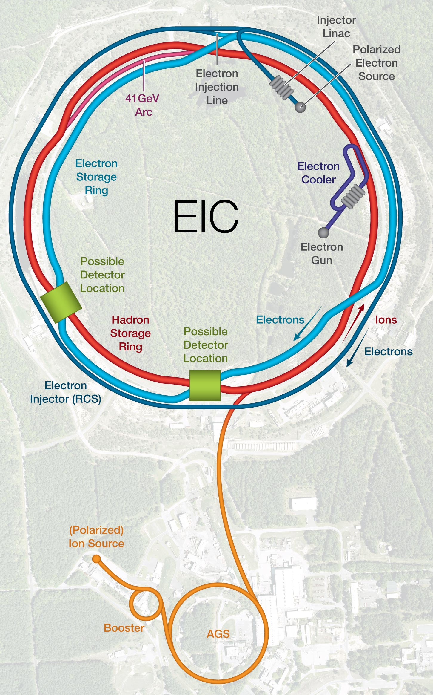
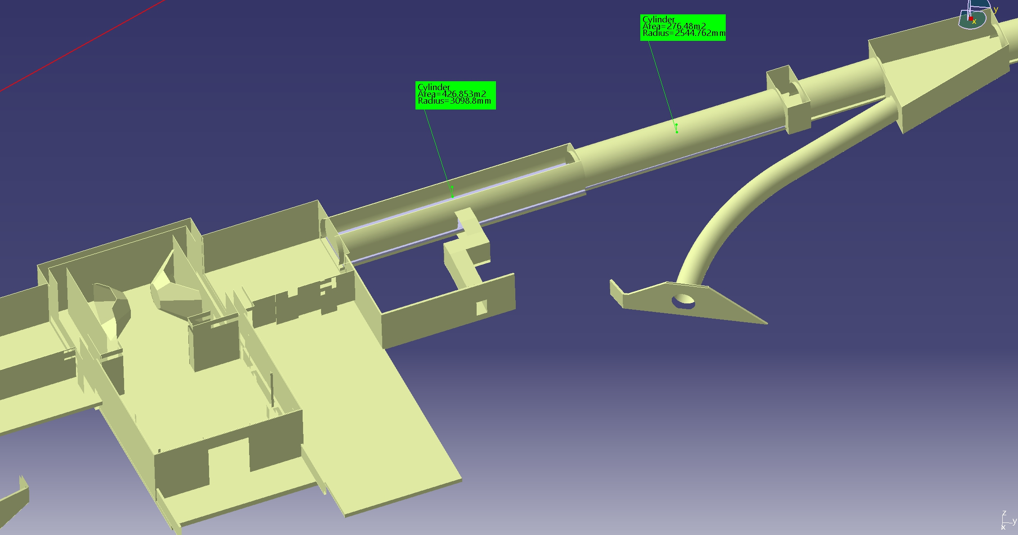
Detector Locations
Some facts:
Beams cross differently in IP-8 and IP-6
IP-8-hadron beam ring outside to ring inside
→ impact on IP location and crossing angle
IR designs are NOT interchangeable with each other
EIC IP @ IP-8:
y: 523.24 cm
shifted 65 cm to ring inside
shifted 27.5 cm longitudinal away from IP-6
all relative to current RHIC IP
Layout and space of Halls at both IRs are quite different
IP-8
IP-6
IP-8
60m
IR8: Tunnel dia. 6.3m to 60m
(then 5.3m dia)
IR6: 7m dia. +/- 140m

Slide 3
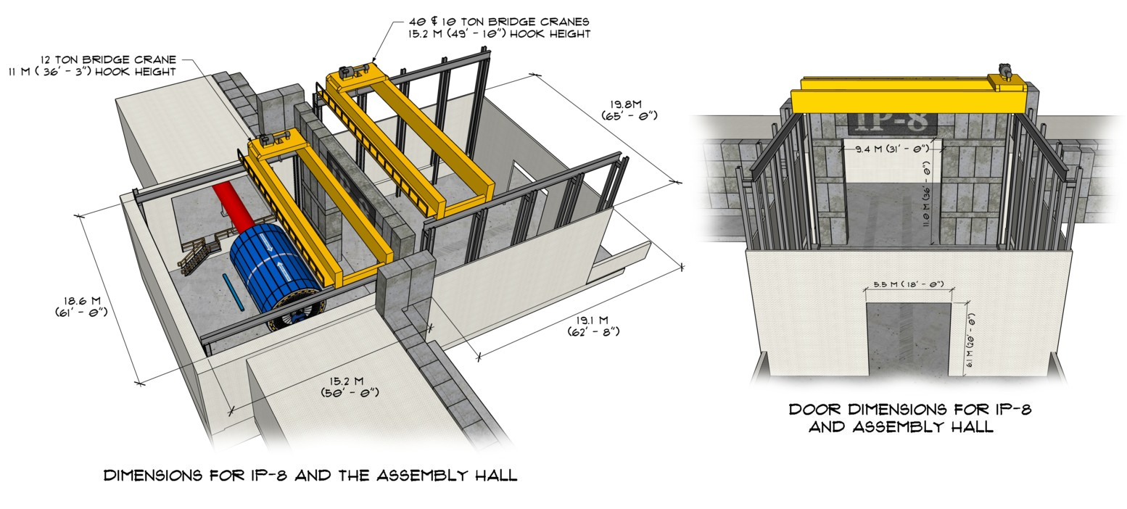
IP-8: Space Constrains
The experimental hall in IP-8 is wider than IP-6, however detector access is still limited by the accelerator systems.
Disassembly of the detector and removal of sub-systems in the IP-8 assembly area will require special considerations.
The assembly area for IP-8 is significantly smaller than that of IP-6.

Slide 4
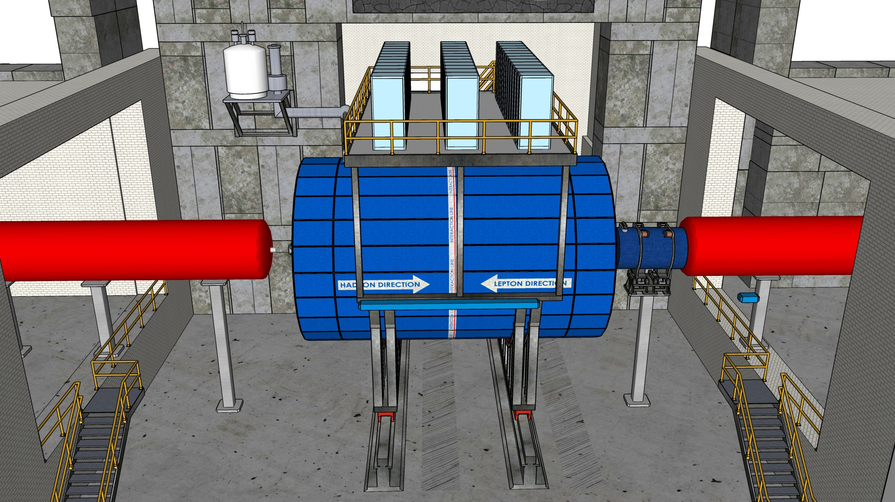
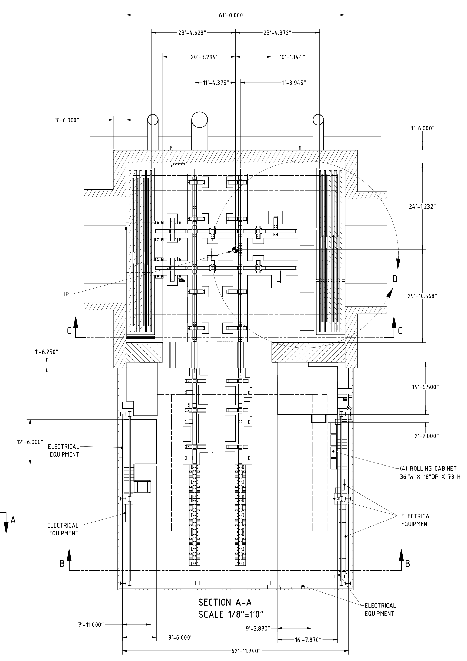
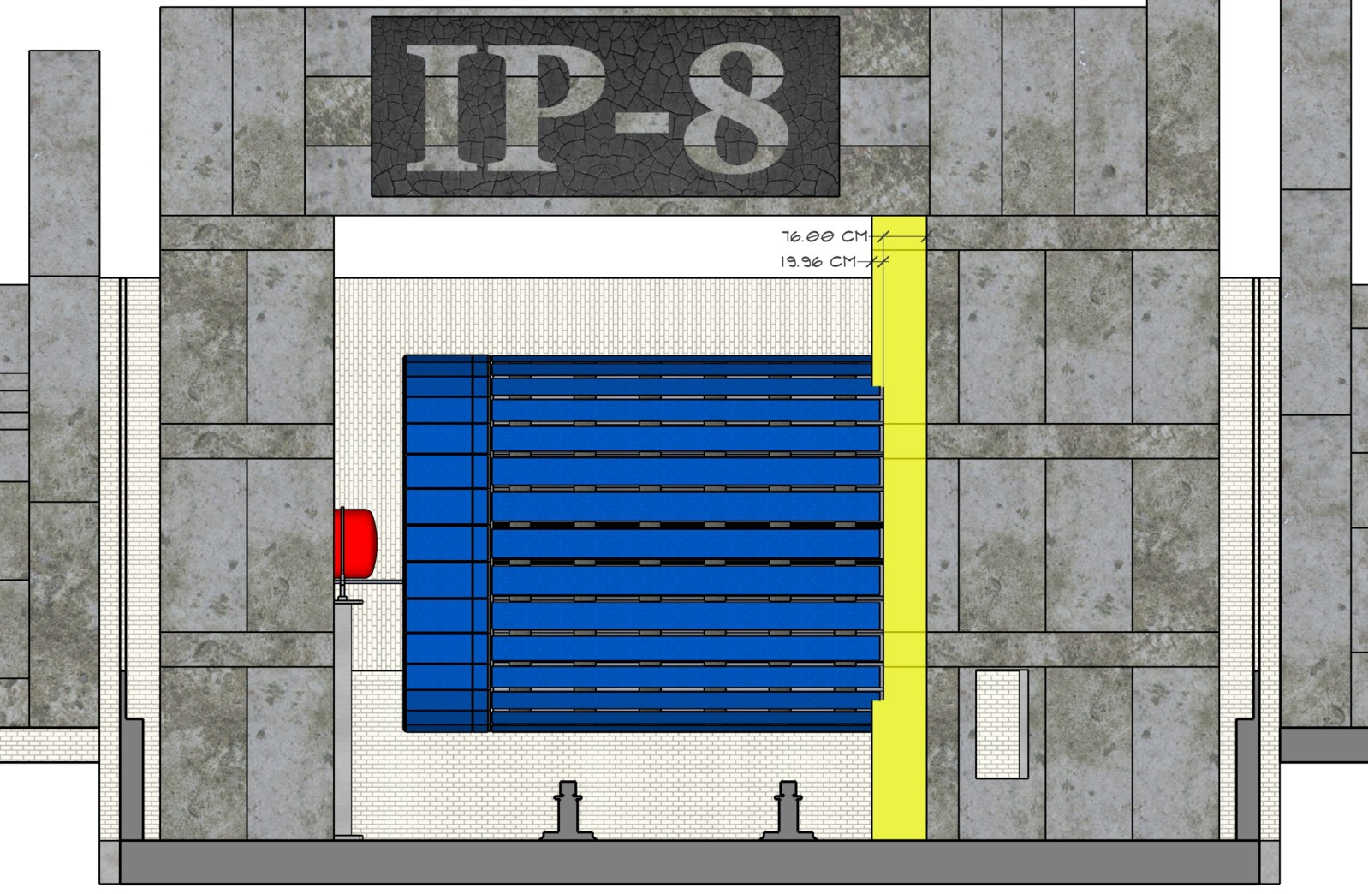
IP-8 Needed Modifications
Remove remainders of the PHENIX muon arms
Rail system needs to be modified to be centered around EIC-IP
But most importantly door not centered around EIC-IP either
electrons
hadrons
Ring Outside
RCS
RHIC-IP
EIC-IP
Ring Outside
old rail location
Ring Inside
Ring Inside

Slide 5
IP-8 Needed Modifications
Door can be modified

Slide 6
IR-Integration Requirements
Space constrains for 2nd Detector:
-4.5 m – IP – +5m not negotiable
50 cm space to 1st IR-magnet occupied by vacuum pumps, valves, …..
IP moved 65 cm towards ring inside relative to RHIC-IP;
Hadrons
RCS
Electrons
9.5 m long detector does not fit through the door
endcap hadron calorimeters need to stay in collider hall, if detector rolls in
assembly hall for maintenance
RCS to IP: radial distance 337 cm & 97 cm below HSR-ESR plane at 523 cm of the floor
Maximum outer radius ~ 325 cm
Detector Solenoidal axis must be aligned with electron beam → reduce SR
electron beam angle: 11 mrad Hadron beam angle: 24 mrad
Fringe field requirements for solenoid will be the same or very similar to IP-6 < 10 Gauss

Slide 7
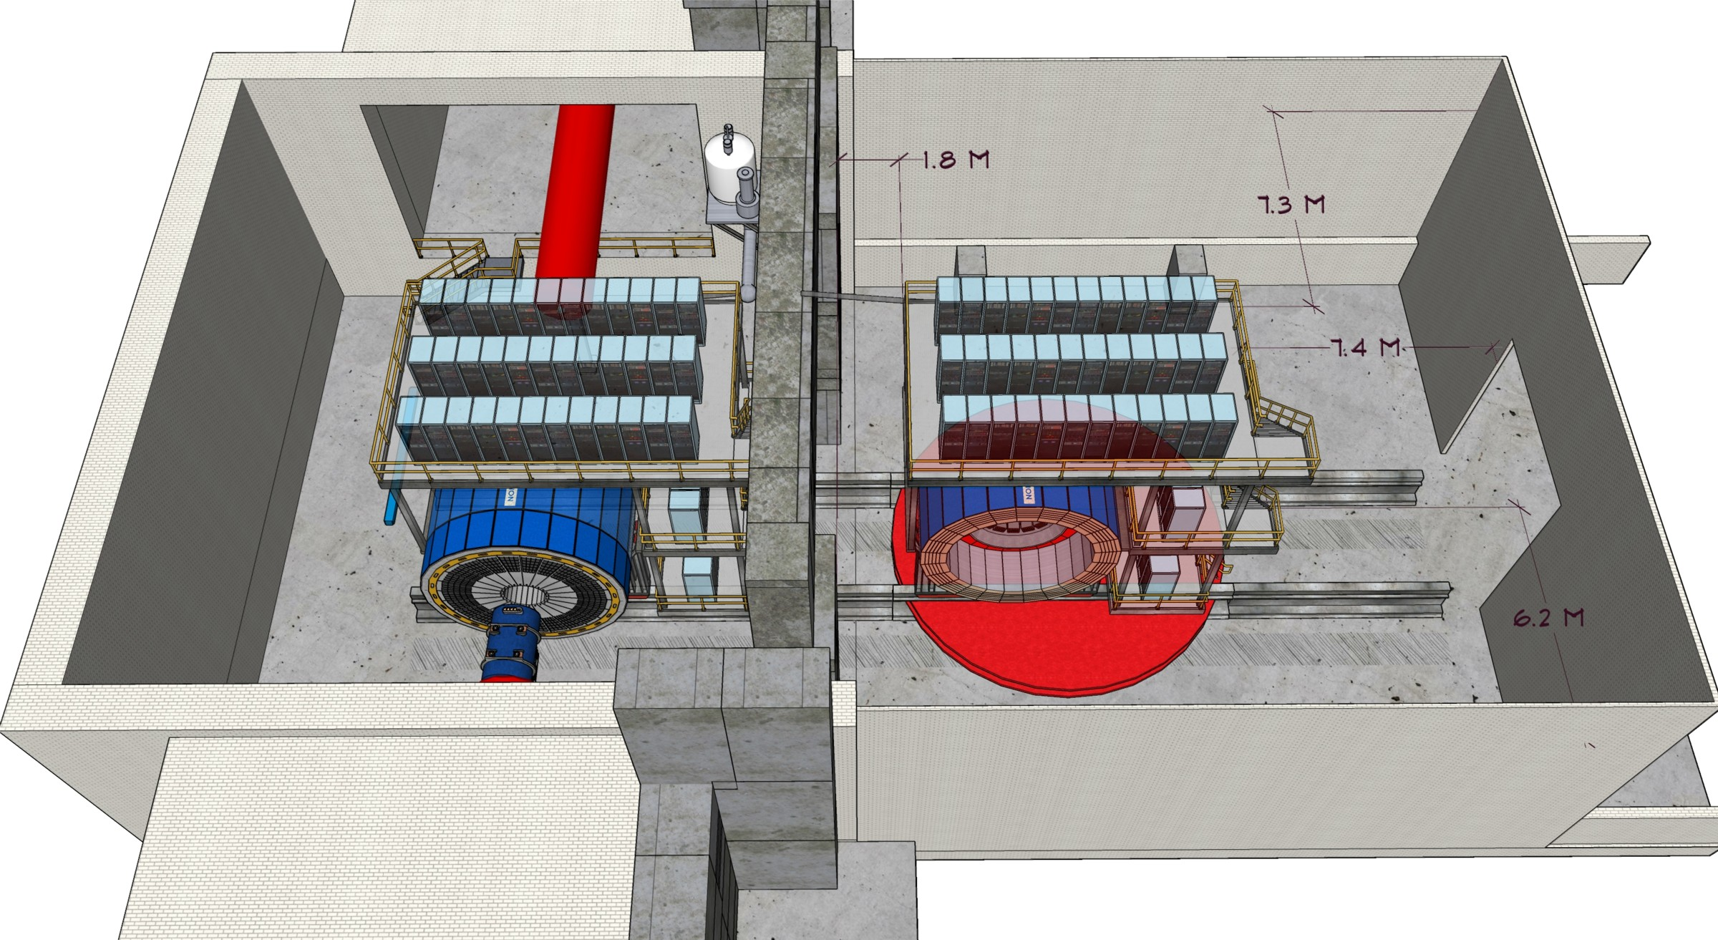
Detector Maintenance
The unrotated central detector assembly does not have sufficient space to unpack sub-detectors on either side.
To accommodate unpacking the sub-detectors, it will be necessary to install a turn-table or significantly expand the assembly hall.

Slide 8
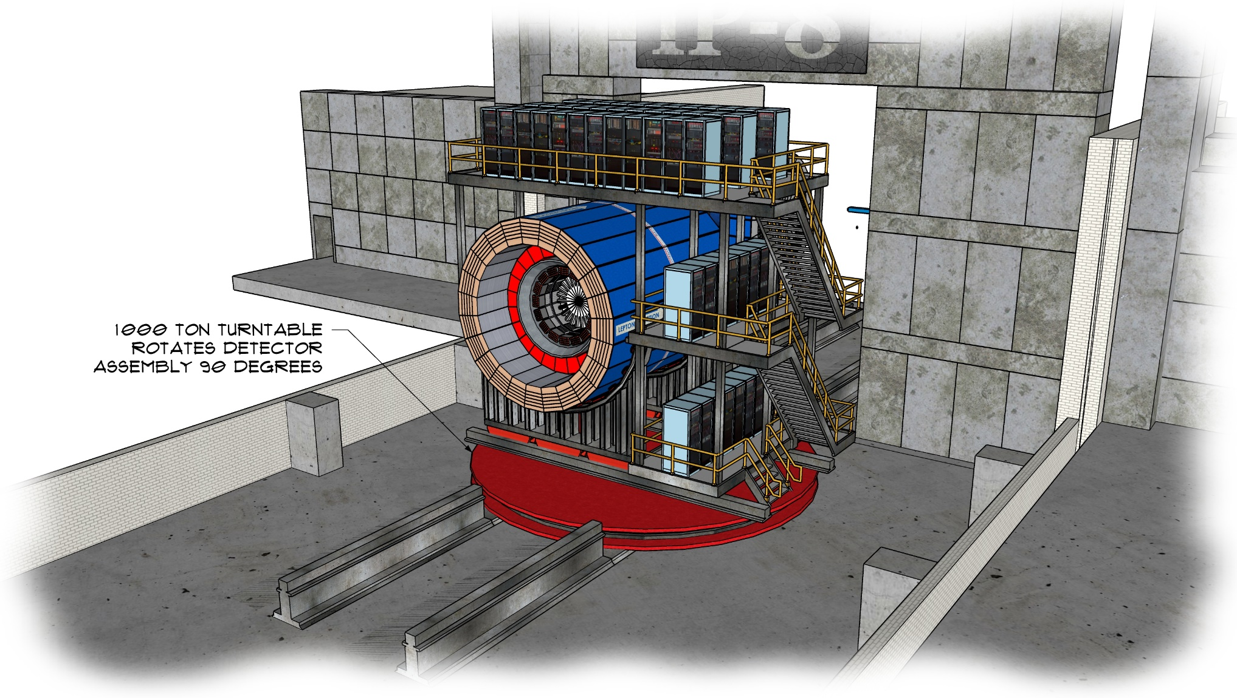
Detector Maintenance
Because of the space constraints in the assembly hall of IP-8, a 1000 ton turn-table is being considered.
This turn table would rotate the entire assembly and service cart 90 degrees – allowing front access to the sub-detectors in the barrel.
In this configuration, there would be 9.7 meters (31’ – 9”) of free space in front of the detector for disassembly.

Slide 9
Detector Maintenance - Fun

