Slide 1
HCAL
- Rahul Sharma

Slide 2
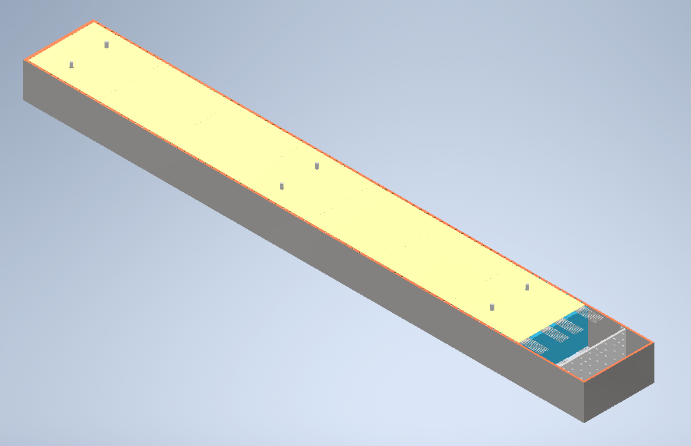
HCAL Towers
Each 8M tower weighs about 230kg

Slide 3
Structural Issues
Since plates are just stacked and nothing is holding them to one another, the plates will tend to slide when the module is lifted using the crane. Some ideas to prevent that:
All plates can have holes on all 4 corners and 4 threaded rods can be put through the metal and scintillator plates making it one assembly able to hold its own weight.
The shell can be made thick enough so that it can hold the weight of whole stack without deforming plastically and prevent plates from sliding
The whole stack can be epoxied together (I know that no one will go for it, but just had to write it as I’ve seen it done).

Slide 4
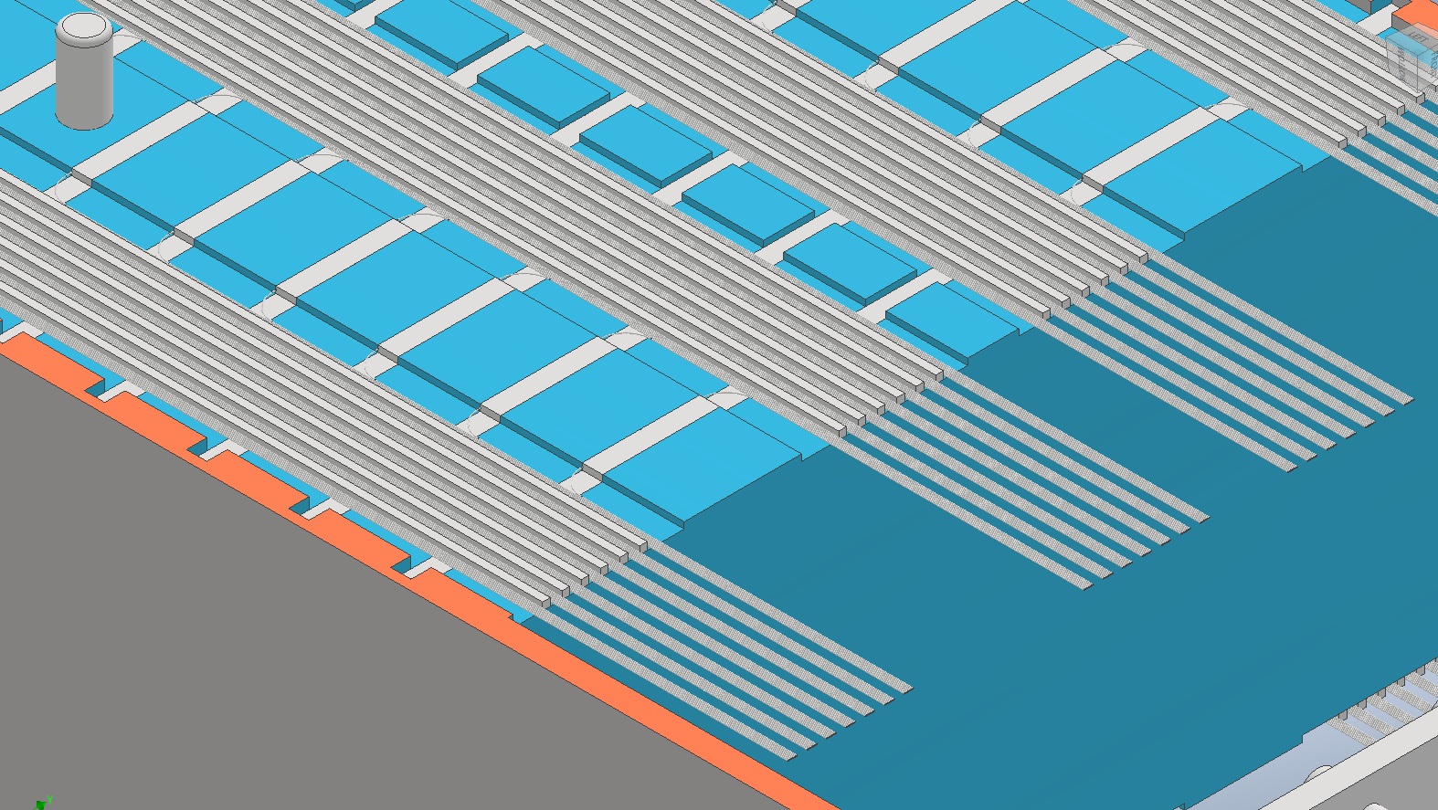
In current design spacers between fibers and cables are taller then the groove depth in plates. This should be fixed as in current design they will take load from the whole stack.
It will be better to run fibers from the sides rather than top or bottom.

Slide 5
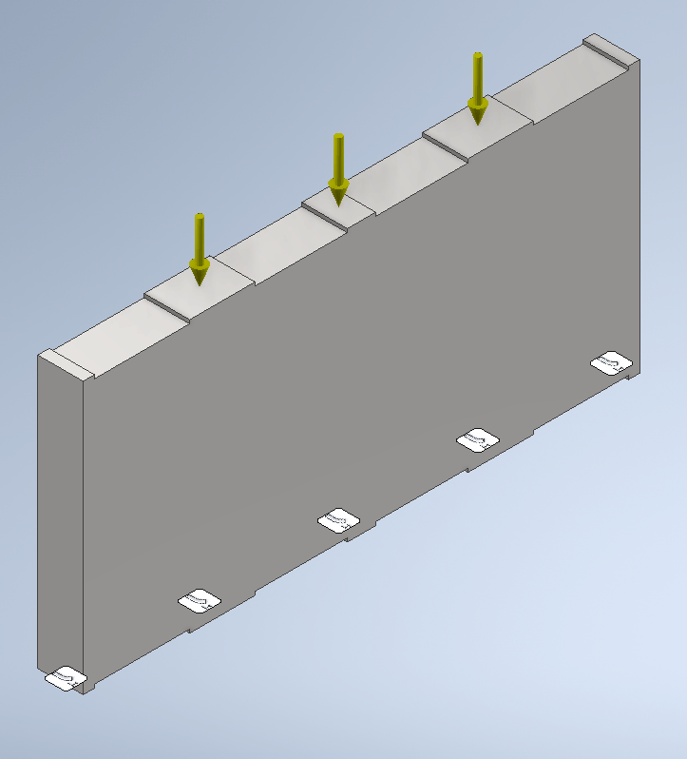
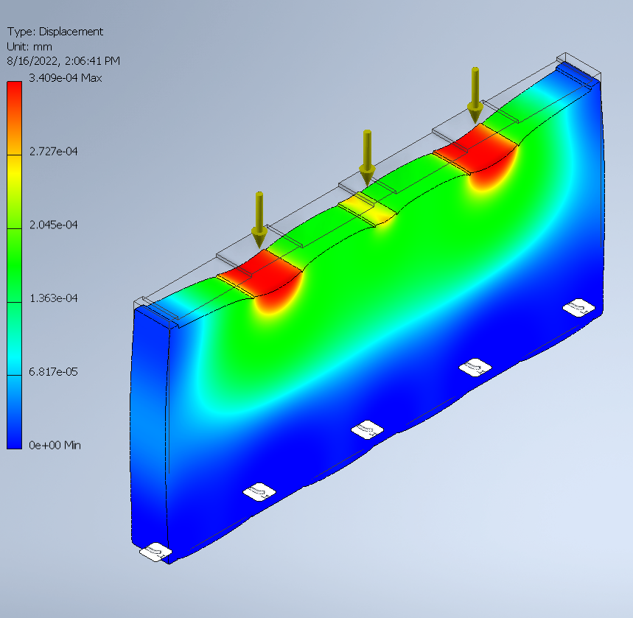
Analysis of Steel Plate

Slide 6
Tolerance Stackup Issues
Tolerance of individual plates will stack up causing pin hole positions to be inaccurate.
If possible, stack should be created first and pin holes can be drilled after.
Also the individual tower width dimension will have a tolerance that will cause stackup problems in the assembly.
Even though metal plate deflection is very small, as metal plates and scintillator plates are same height, +ve Tolerance variation of a Scintillator plate can cause scintillator plate to carry load and be under stress.
Scintillator plates should be slightly undersized than Metal Plates.

Slide 7
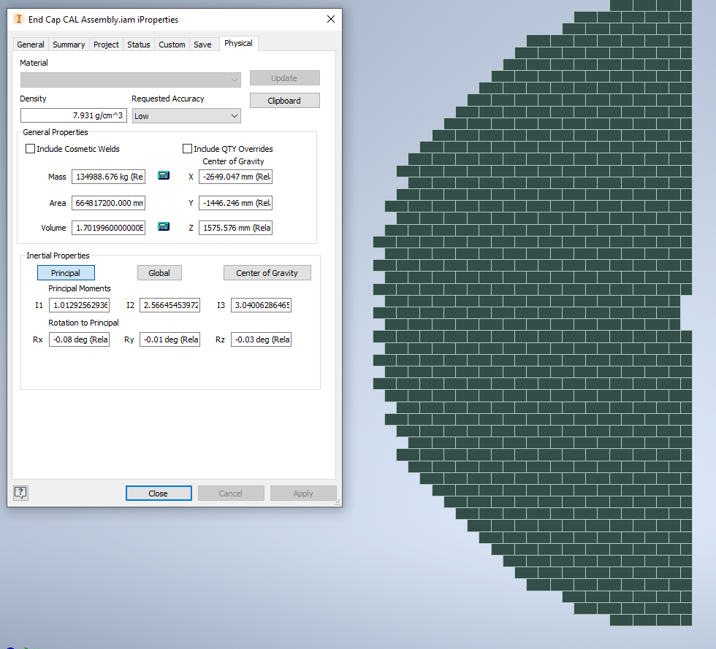
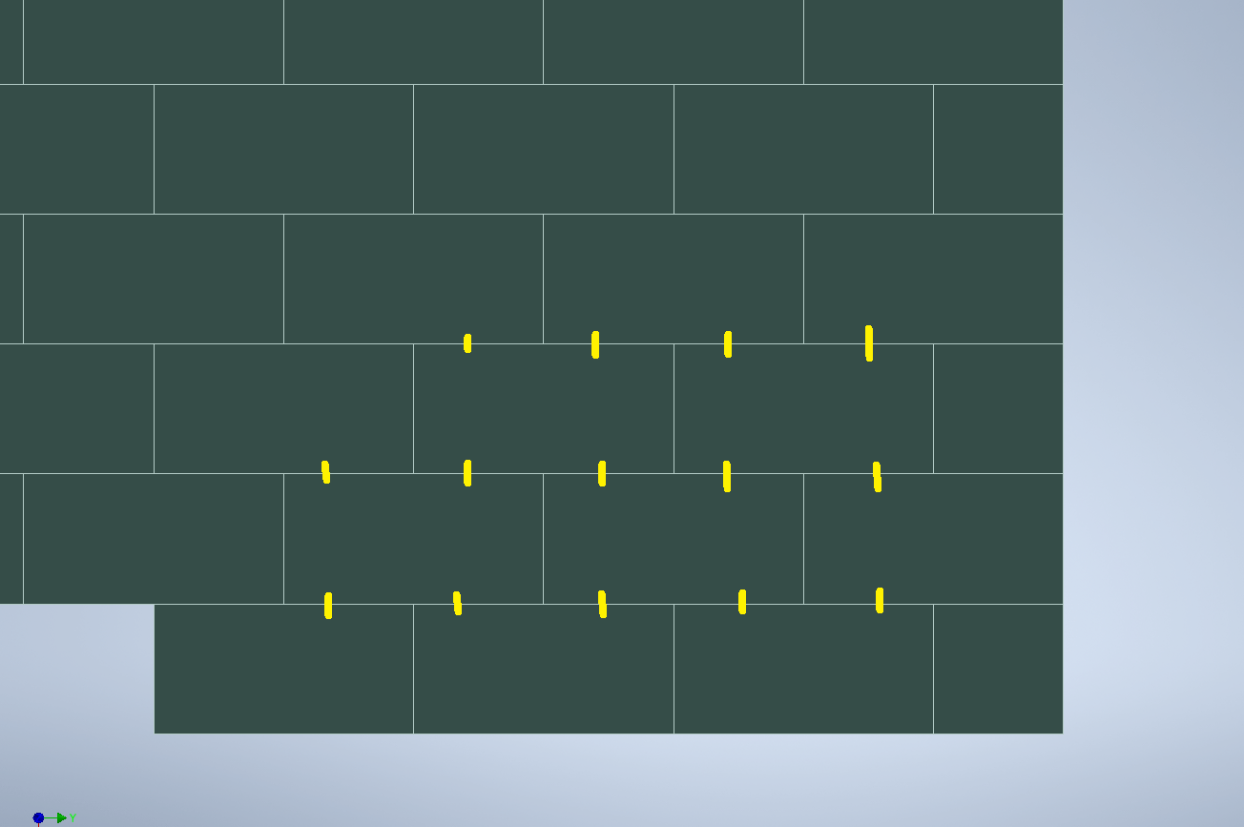
Tolerance Stackup Issues for End Cap Assembly
Width, Flatness and straightness tolerance needs to be compensated by providing clearance between the towers.
Pin alignment and installation is blind installation and is not possible. Alternate scheme is needed.

Slide 8
Seismic Analysis
Seismic Analysis is needed

