Slide 1
SR Calculations and the Polarimeter v2
Mike Sullivan
Sep. 7, 2022

Slide 2
Outline
Introduction and status
Parameters used
Some power numbers
Next steps
Summary

Slide 3
Introduction and status
I have been working on the polarimeter area in IR6
I have gotten great help from Zhengqiao and Elke
Zhengqiao sent me an elements list file for the 18 GeV design
Using the file, I have updated my geometry program and my beta function program
I have hit a stumbling block with setting up the synchrotron generation program
I use the above two programs to help me set up the synchrotron program
So, I do not yet have any information on the quadrupole radiation in this region
But I do have a drawing of this region from the geometry information

Slide 4
Parameters
Energy (GeV) 10 18
Beam current (A) 2.5 0.0277
β*x/β*y (cm/cm) 43/5 59/5.7
Emittance ε_{x}/ε_{y} (nm-rad) 20/1.3 24/2.0
Energy spread (δE/E) 5.8×10⁻⁴ 10.9×10⁻⁴
Beam trans. range (σ_{x}/σ_{y}) 14/23 14/23
BSC (σ_{x}/σ_{y}) 13.5/23 13.5/23

Slide 5
Total bend SR power numbers
kW
D3eF 3.286
D2eF 2.865
D1eF 1.054
Total 7.204

Slide 6
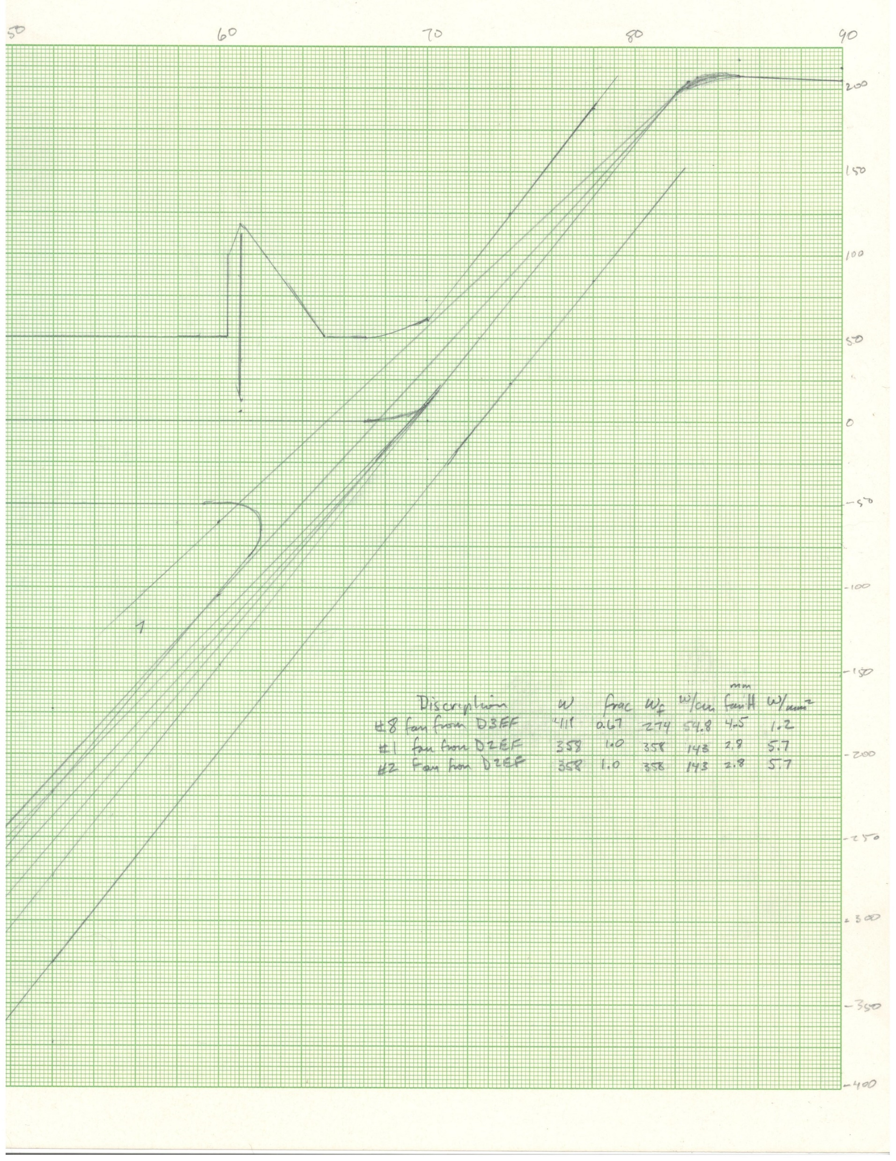
Drawing
Electron detector
D3
D1 and IP
D2
Photon detector

Slide 7
SR power on the photon detector window
Estimate of the bend radiation power
5 cm of photon detector window
W fan ht (mm) W/mm² Kc (keV) E/bun (keV) #γ/bun #γ>20 keV
From D3 274 4.5 1.2 67 1.7e11 1.7e10 5.1e9
From D2 716 2.8 5.7 63 4.5e11 2.3e10 6.1e9

Slide 8
Next steps
Work on getting the synchrotron program input file made up
This should give us a more complete picture of the total SR photon rate on the photon detector window
The quad radiation should not be much more (10-20%?)
Also, probably softer photons on average
Look more carefully at the electron detector
In vacuum Si detector?
Would need to be shielded from the beam
The image currents will generate arcing over the Si surface
HOM power heating is another concern – might be mitigated by nearby HOM absorbers (blocks of water cooled SiC)
Want to get detector to within 5 mm of beam (is this to the beam-stay-clear?)
Beam lifetime becomes an issue if too close

Slide 9
Some questions
Are there thoughts about what the photon detector window is?
How much energy can leak through before contaminating the detector with too much energy?
Are there thoughts about how thick a rf shield in front of the electron detector can be?
Is what I have drawn approximately correct?
Is there to be a long vacuum pipe stub for the photon detector? (yes?)

Slide 10
Summary
Making good progress on a model of the polarimeter region for SR study
Significant amount of bend radiation hitting the photon detector window
Perhaps a study (cross-check) of SR photon penetration through the window
Electron detector will be challenging
SR from D2 looks to be minimized. Very good.
As always, more to do.

