Slide 1
Institutional board
WG3 EPIC CC
Barbara, Pietro,Olga, Zein-Eddine

Slide 2
Methods
Noted initial questions from Olga and commented based on ATHENA charter as first reference, but also STAR/ALICE/sPHENIX (Gluex not readable)
Added extra-items for discussion (including IB name!)

Slide 3
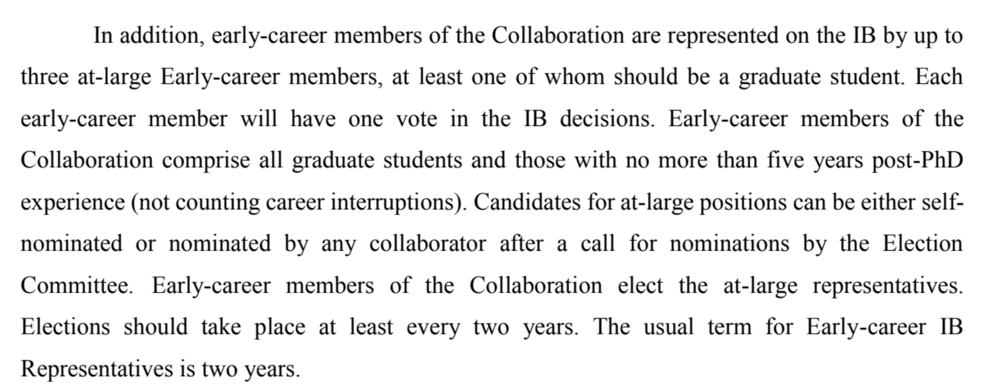
1. Membership / composition
by Institution
add correction based on number of collaborators in the instituion. Set a minimum: 3 members? otherwise make clusters + moderate proportionality with cap (weighted votes or more than one rep?). Proposal: 3<=1<20, 20<2<30,3>30 BE MORE LINEAR. --> DO HOMEWORK
weighted votes or more than one rep?
early career membership → ok ATHENA scheme? (handle the case if you get elected at 4th year after PhD…)
ex-officio members: Spokesperson/Deputy
2. Note on IB name:
ALICE (and LHC) → Collaboration Board
STAR → Collaboration Council
sPHENIX → IB
the name "Council" best captures the nature of the body it is not a board
but a top decision/governing body. Views? → Council seems OK

Slide 4
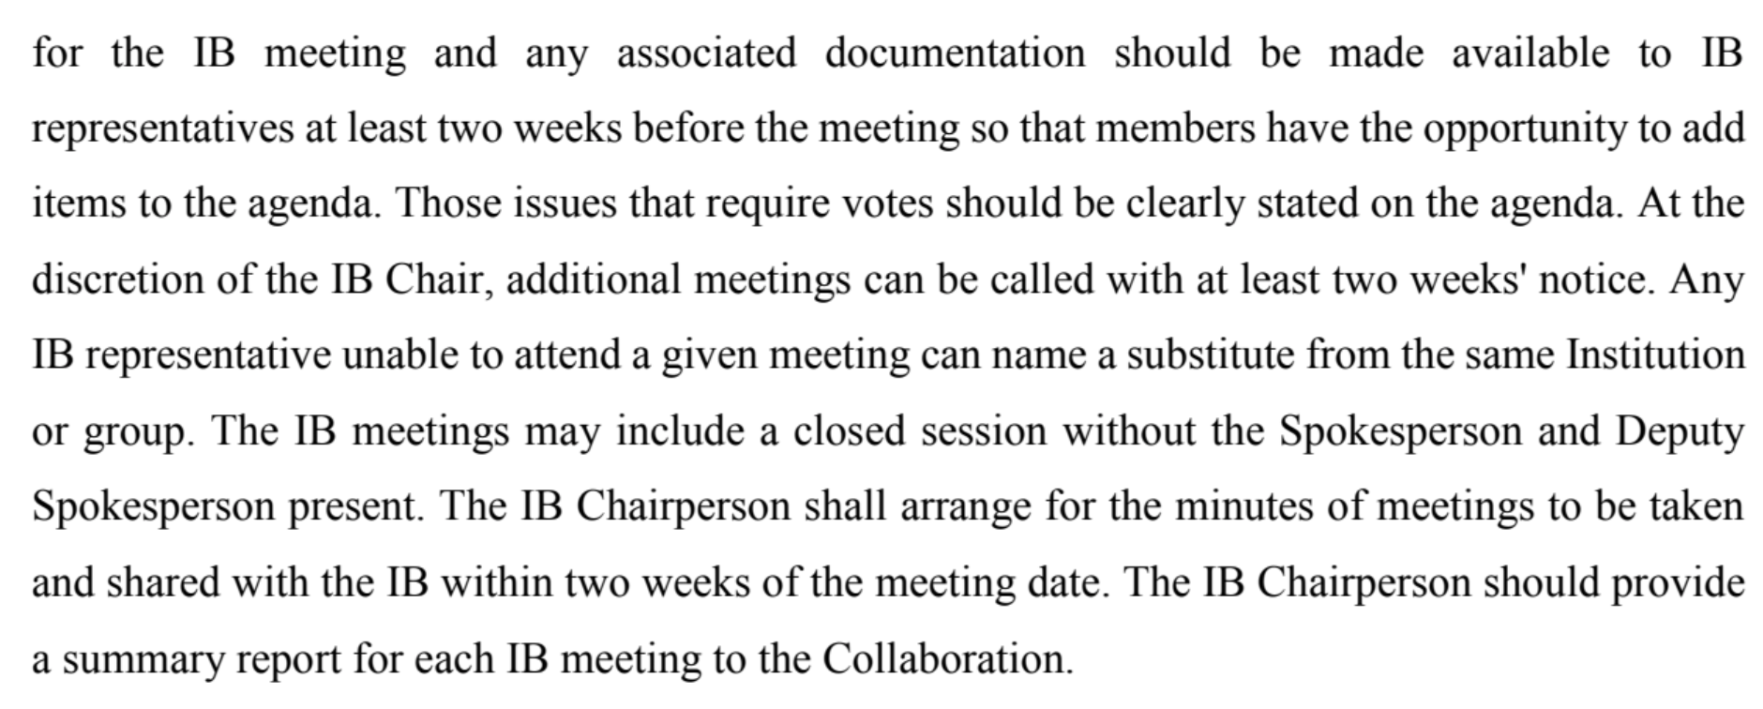
3. Role and responsibilities → have initial list in Charter
ultimate decision body, approval of charter modifications and Collaboration policies, major policies decisions
admission/expulsion of members
election/dismissal of spokersperson
election of some members of management board (Collaboration at large). [ note about executive/management board]
endorsement of Physics Coordinator, Technical Coordinator, PWG conveners, committee members upon proposal of Management Board. Likely vague wording initially “Major roles including… “
4. IB functions & procedures (Robert’s Rules??)
- ATHENA policy looks ok (with some caveat?) - Roberts' rule as general reference. Can be invoked by each member upon request
- agenda owning : the chair gathering input from the Collaboration
- Member can put thing on agenda on due time
- guarantees on circulation of documents
- normally open to everyone in the Collaboration but Always possibility to call in-camera meetings (“open unless a sensitive issue”) [closed session is normal, but can be empty]
(ATHENA excerpt lasrgely based on STAR)

Slide 5
5. Leadership (chair, chair/co-chair, chair/vice-chair (DNP style)
Three possible schemes:
elect a chair. S/he then proposes a Deputy chair (to be endorsed by IB)
elect a chair, the second in election is the Deputy
→ Elect two co-chairs (we elect the team/ticket) or a person can run alone (in that case we have just one chair)
DNP ensures continuity but not necessarily complementarity (views?)
6. Leadership elections and terms
Proposal: two years term renewable only once <- (note: in ATHENA every year for IB chair, 2 for spoke, ALICE 3-not renewable, STAR 2, SPHENIX?)
7. Leadership responsibilities and action items
running meeting, prepare agenda, minutes, delivery of documents etc. (as in ATHENA doc basically)
convening power (but some protection in case of full dysfunction + spokesperson can ask chair to convebe)
first consultation point for Spokesperson Office regarding Collaboration matters
8. Voting procedures (closed/open, etc.) ATHENA opted for separate Voting Policy, but normally voting procedures are in bylaws
- 2/3 for Charter modification, policies adoption
- majority of votes cast
- minimum attendance for making deliberation valid: 2/3
- proxy?
- election via IB rep not by individuals: ok?
For SP/ Deputy SP see other WG, leaning for no ”co-spokesperson”
WE DIDN’T DISCUSS THIS POSTPONED TO WG5

Slide 6
9. Standing /any other committees (and how those appointed or elected)
We can keep it open and make reference to a policy. Normally we would expect Editorial Board (managing publications) and Conference Commitee (managing talks) to be appointed by IB upon management proposal (so "endorsements"). Nominations will be solicited to the whole collaboration + principle of DEI kept in mind
10. Reporting
make explicit statement spokesperson must report on status of Collaboration at least twice per year and line of accountability. Spokesperson is accountable to the IB!
The Council should report to the full Collaboration, report on Council activities, make available minutes …

