Slide 1
TPOT Status
Hugo Pereira Da Costa (LANL),
for the TPOT team
PMG meeting, Sept. 22, 2022

Slide 2
Updates since PMG 2022/09/01
Micromegas detectors
8/10 modules HV tested in nominal gas at SBU
all drift electrodes work (8/8, 100% yield)
59 out of 64 resistive strip channels work (92% yield). They were all working at Saclay. Saclay experts are at BNL this week and the next, to recover the remaining 5 channels
remaining 2 detectors will be tested this week and the next
we only need 8 fully working modules out of the available 10 modules
Mechanics
TPOT support structure has been fully assembled at BNL, on transportation cart.
Detector installation on support strucure has started. Will happen this week and the next
Next: cable detectors to patch panel (all parts available at BNL), until end October, system test until end November
TPOT installation mechanics: Rich Ruggiero is working with Walter Sondheim to finalize the design. lifting fixtures built at MIT/BATES
Contract between BNL and LANL is signed and money is available at LANL to place remaining orders for installation mechanics
Others
All FEE boards for TPOT readily available and tested
All orders for TPOT detector placed (including HV cables from patch panel to CAEN mainframe)
Remaining items: remaining TPOT installation mechanics, beyond lifting fixtures, most of it which is common with TPC

Slide 3
High level milestones and risk
Milestone | date | Status | risk
Number of TPOT modules produced | Today | 10 | done
FEA analysis finished and reviewed | 18/05/22 | FDR happened. more FEA analyses requested. Agreed with TC to move forward | done
First batch of 5 TPOT Modules assembled & tested (Saclay) | 07/06/22 | 6 modules assembled, test ongoing | done
FEE to detector fabricated and tested | 07/23/22 | cables/boards received on 6/21 | done
HV system tested | 06/16/22 | happened on Week 21 (May 23) | done
Second batch of 5 TPOT modules assembled & tested (Saclay) | 07/22/22 |  | done
Characterization of all TPOT modules at SBU | 09/09/22 | 80% done. Two more modules to test, and 5 channels to recover | low
Gas system designed, ES&H reviewed and tested | 07/07/22  ? | designed and ESRC reviewed on 6/21 | low
TPOT mechanical support assembled | 09/16/22 | delayed due to last minute modifications | done
installation of modules on support structures | 09/23/22 | First 5 modules will be assembled this week. Remaining modules the next, pending validation | low
End of TPOT assembly | 10/21/22 |  | low
Installation of TPOT in sPHENIX | early December 2022 | also depends on sPHENIX schedule | moderate

Slide 4
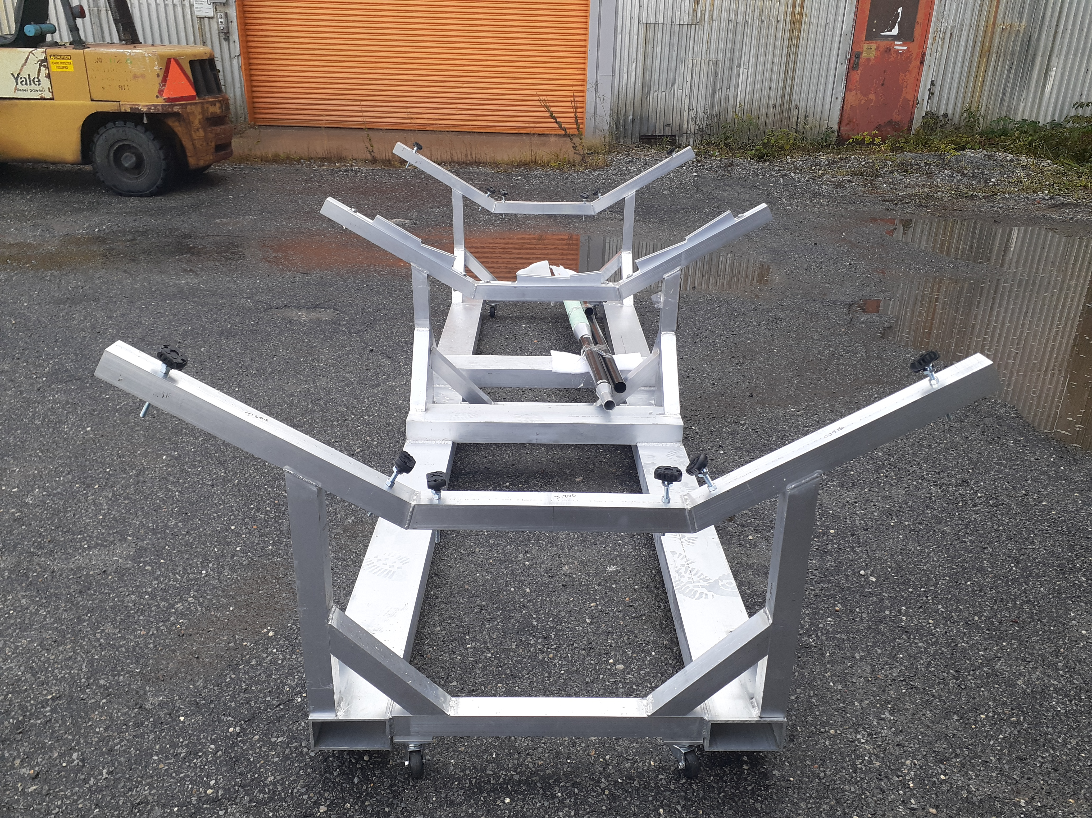
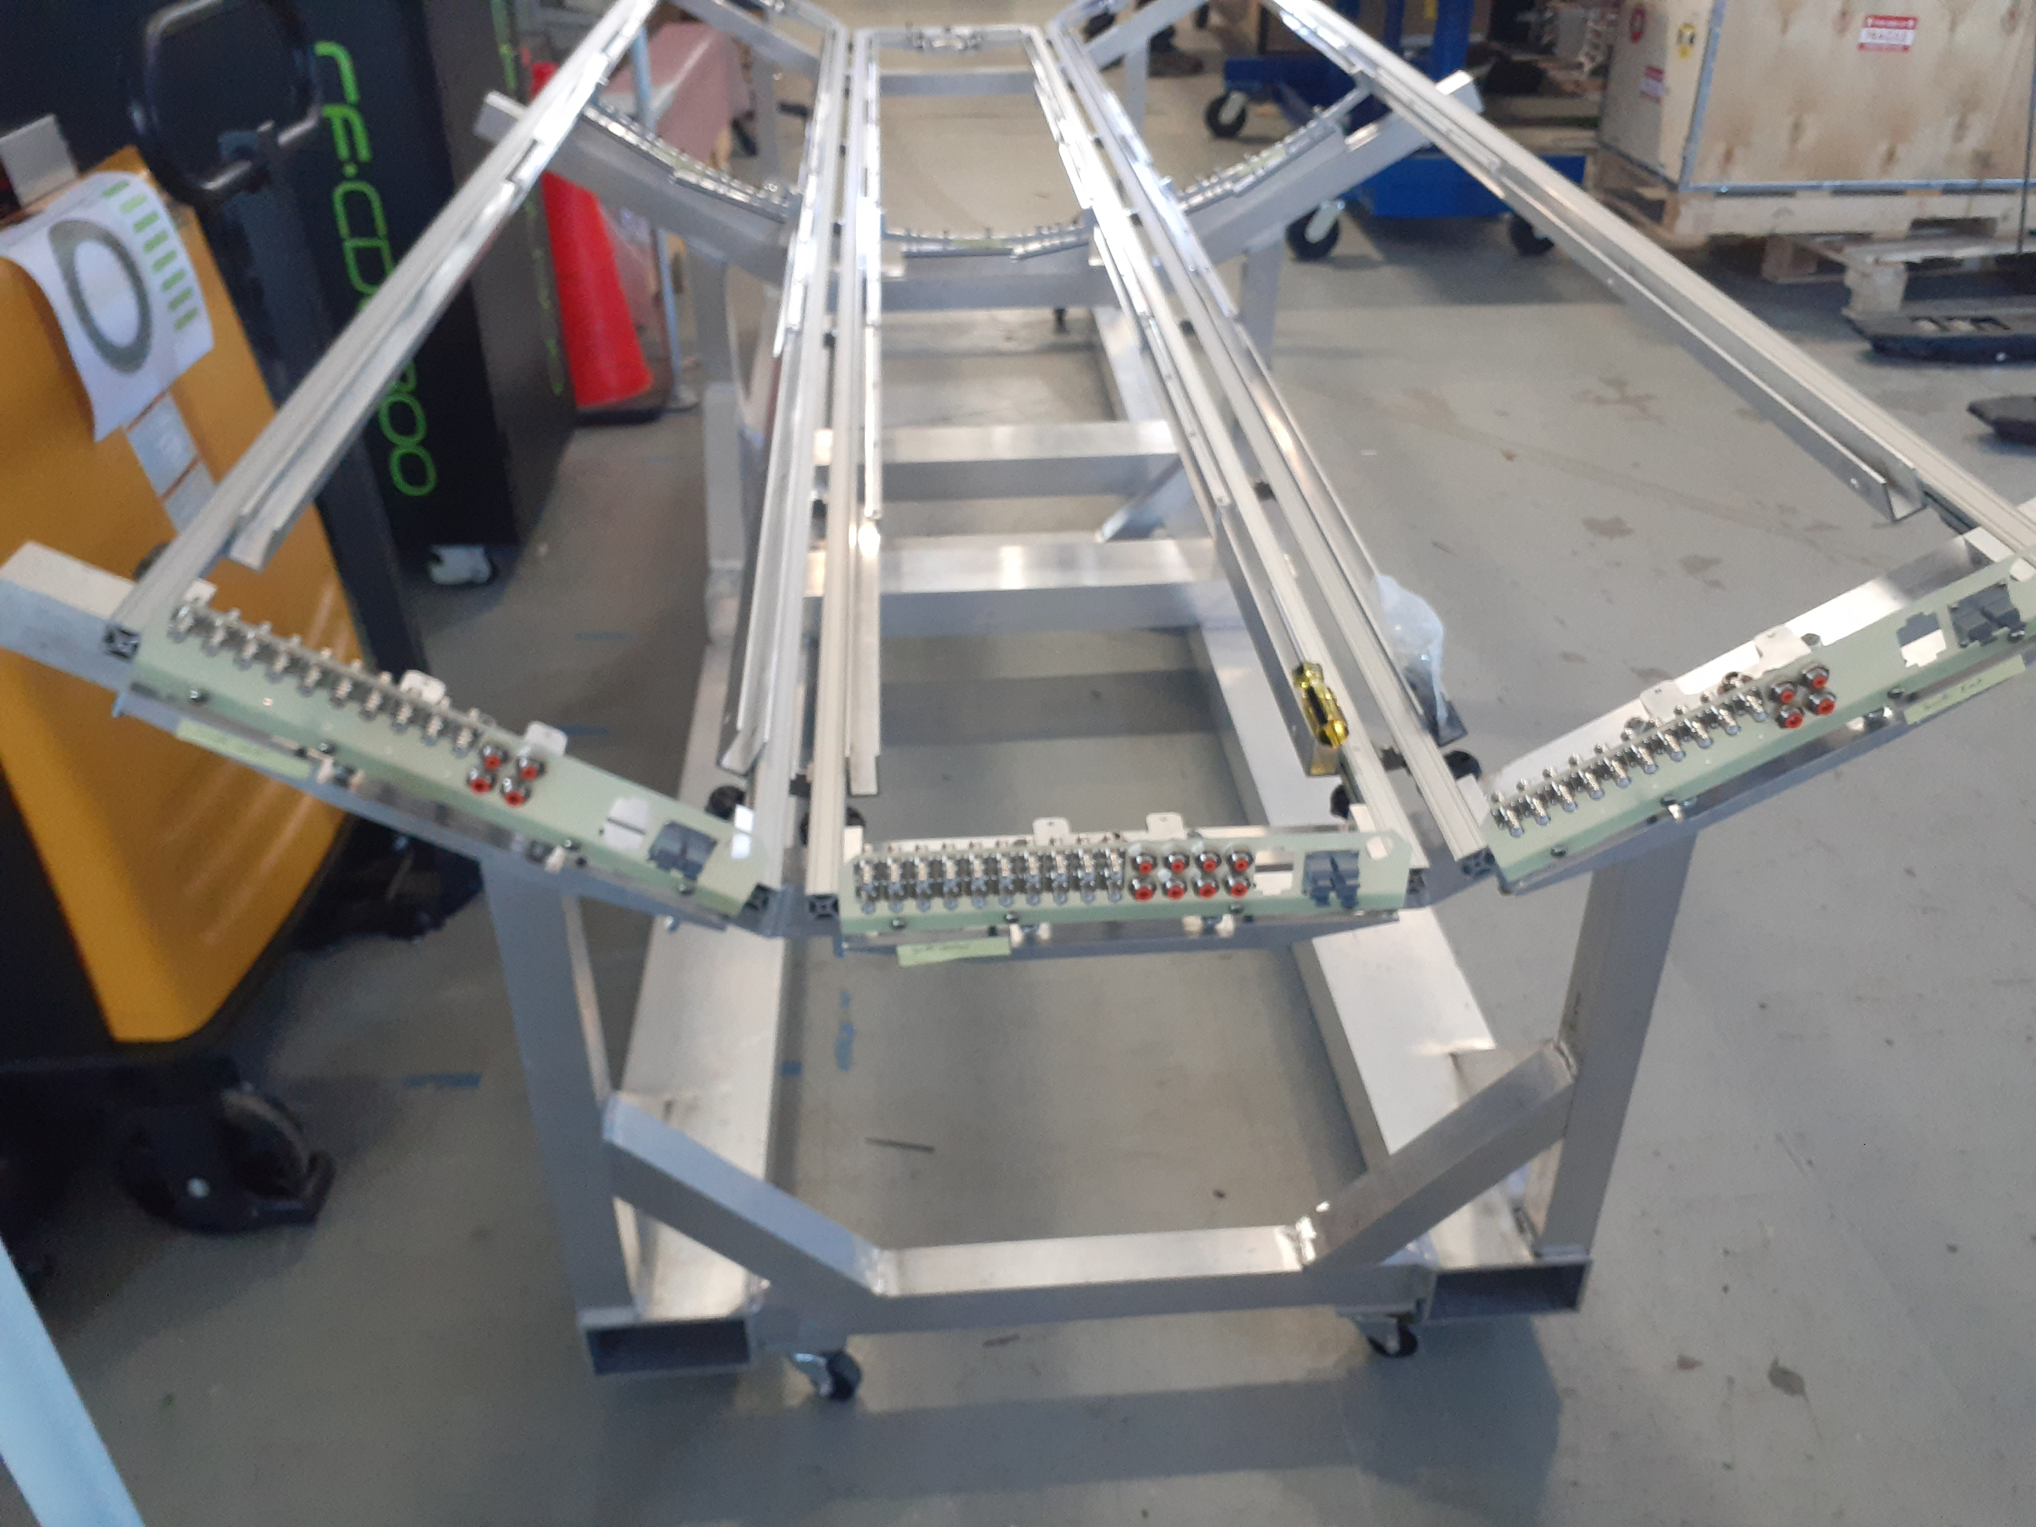
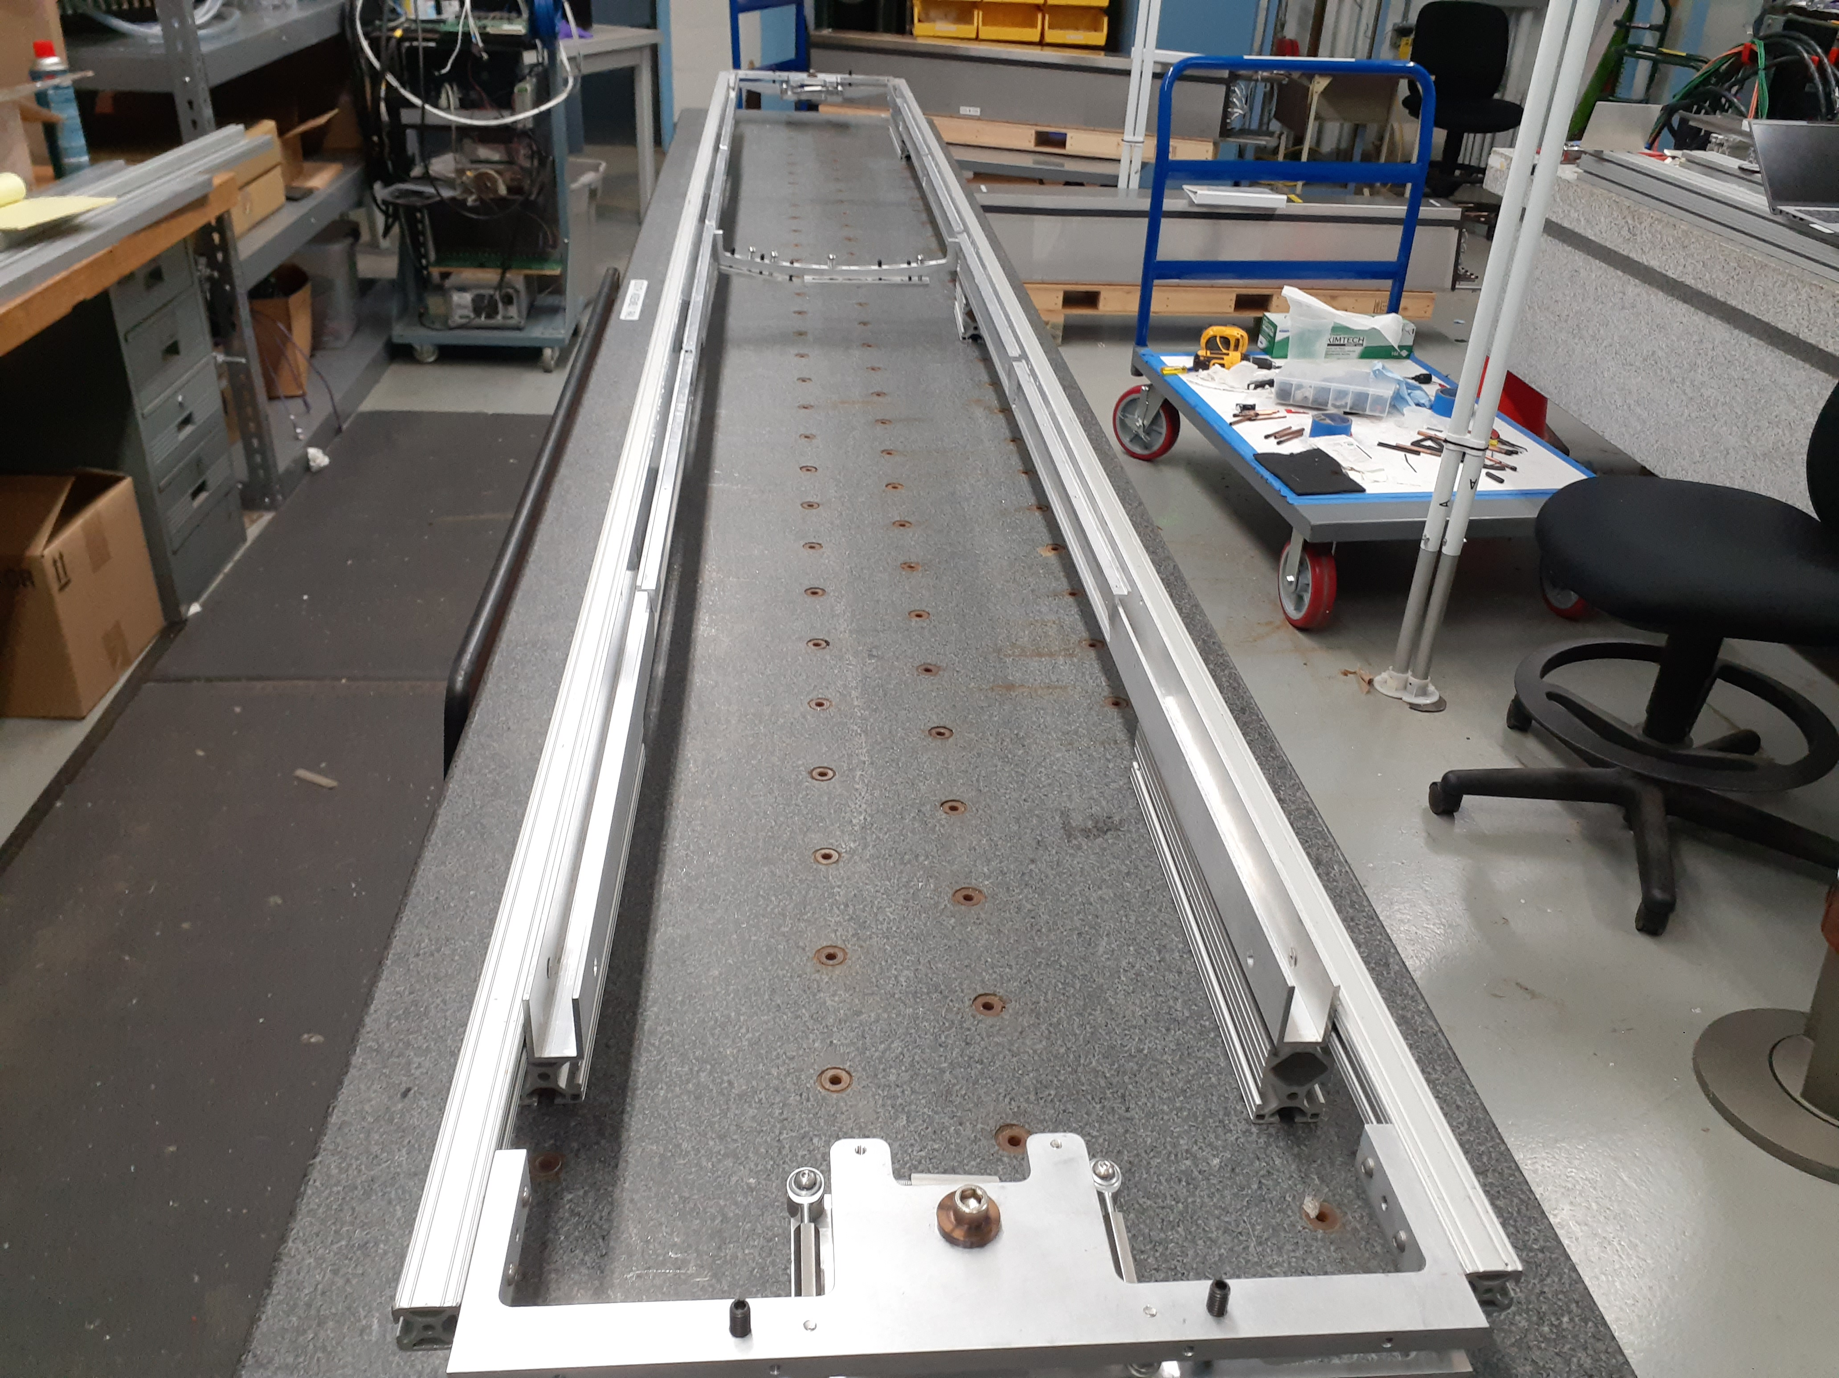
Pictures
Transportation Cart at BNL
First sector of TPOT support structure
Fully assembled support structure + patch panel on transportation cart (high bay, BNL)

Slide 5
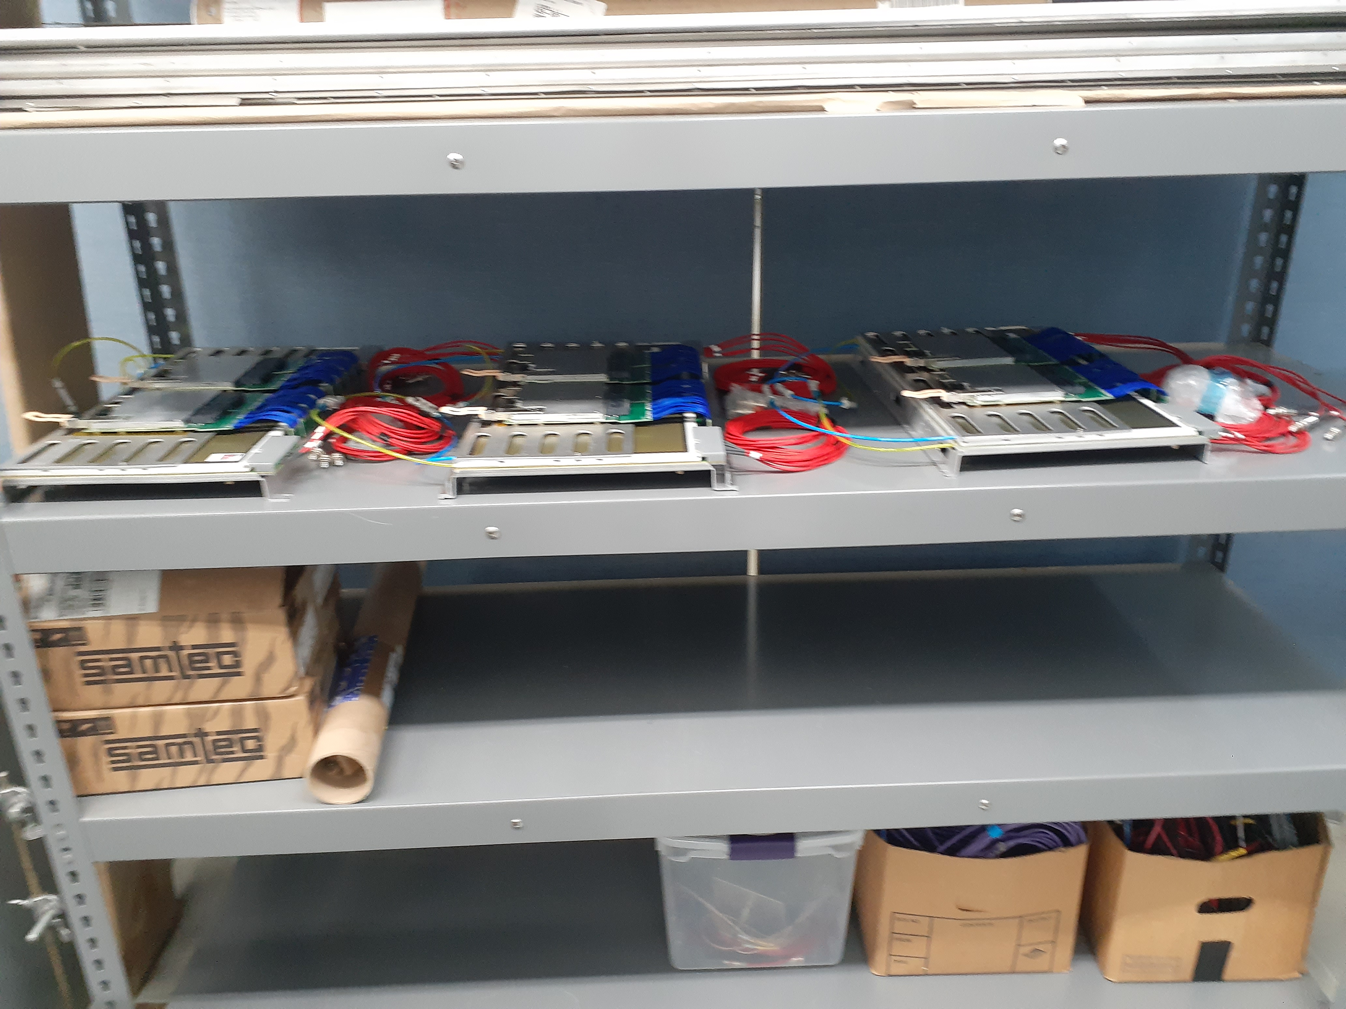
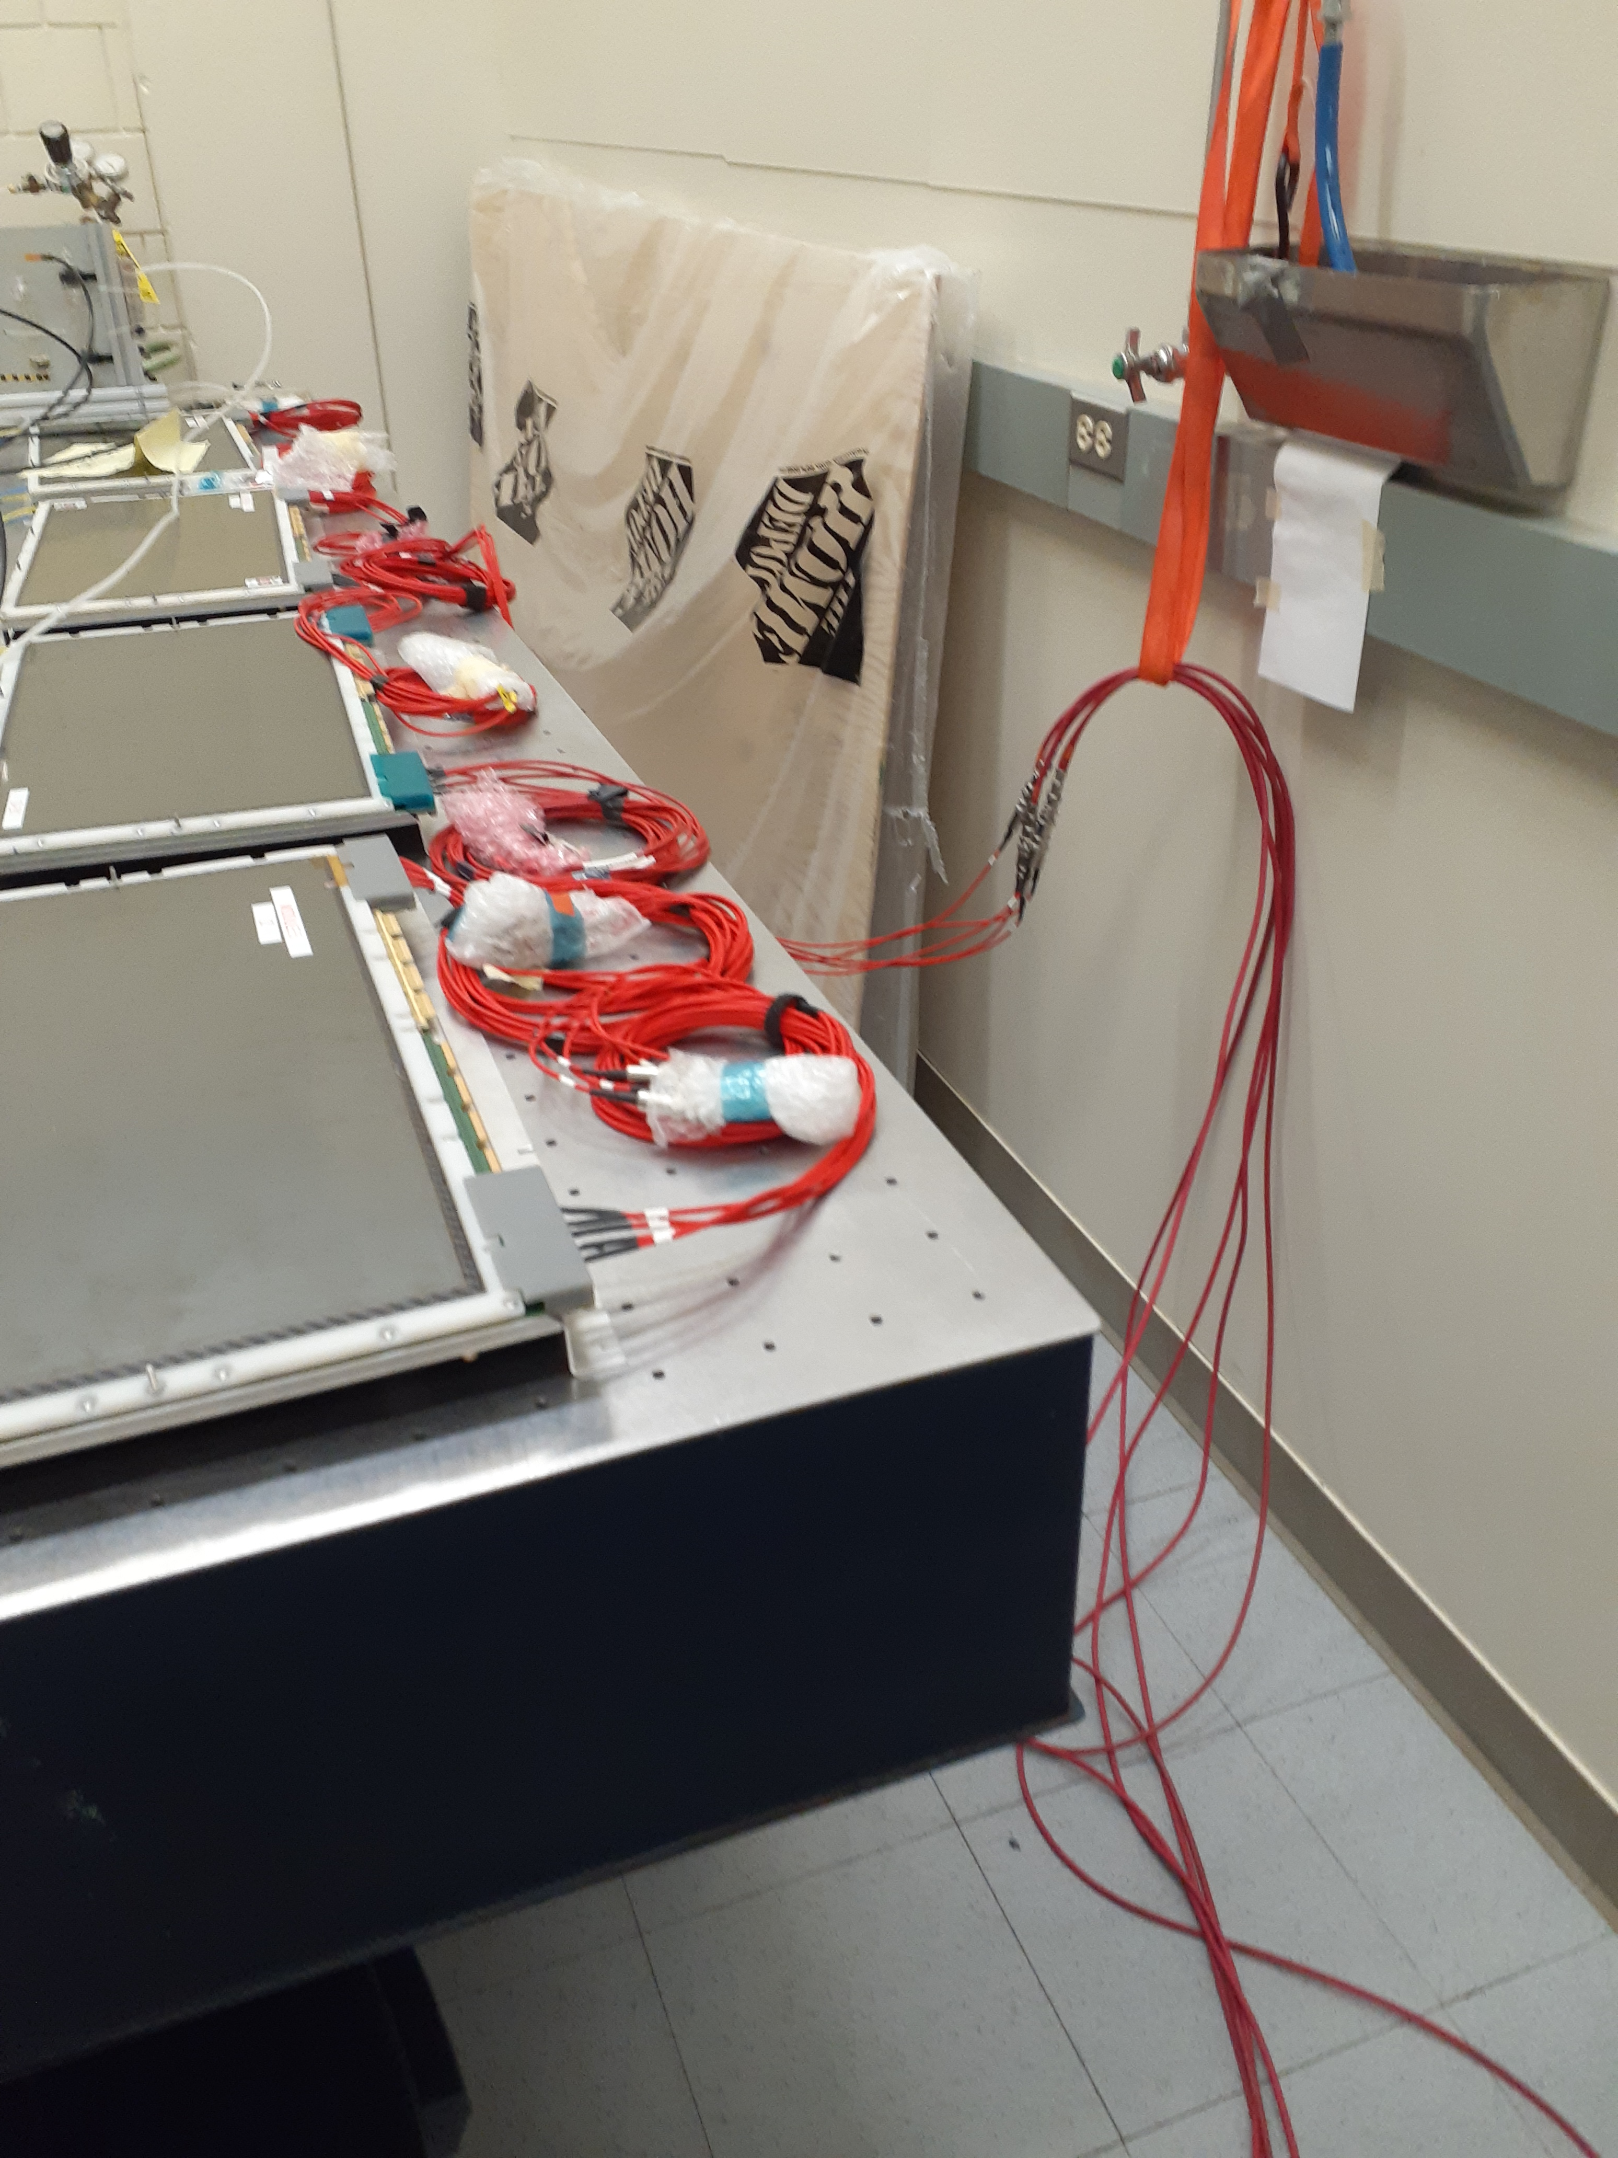
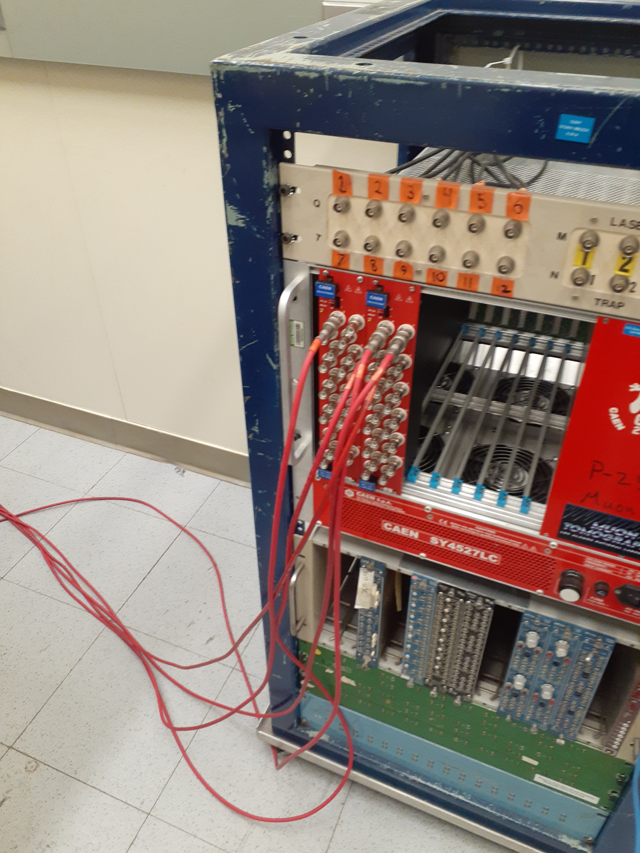
Pictures (cont.)
Micromegas modules and FEE ready to be mounted on support structure (high bay, BNL)
Micromegas HV test at SBU

Slide 6
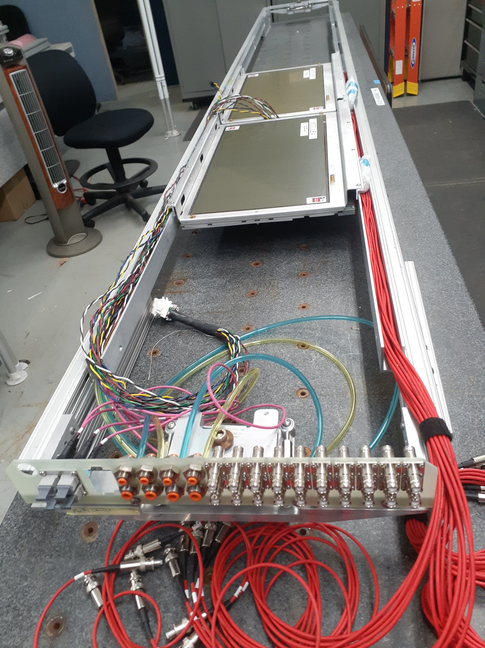
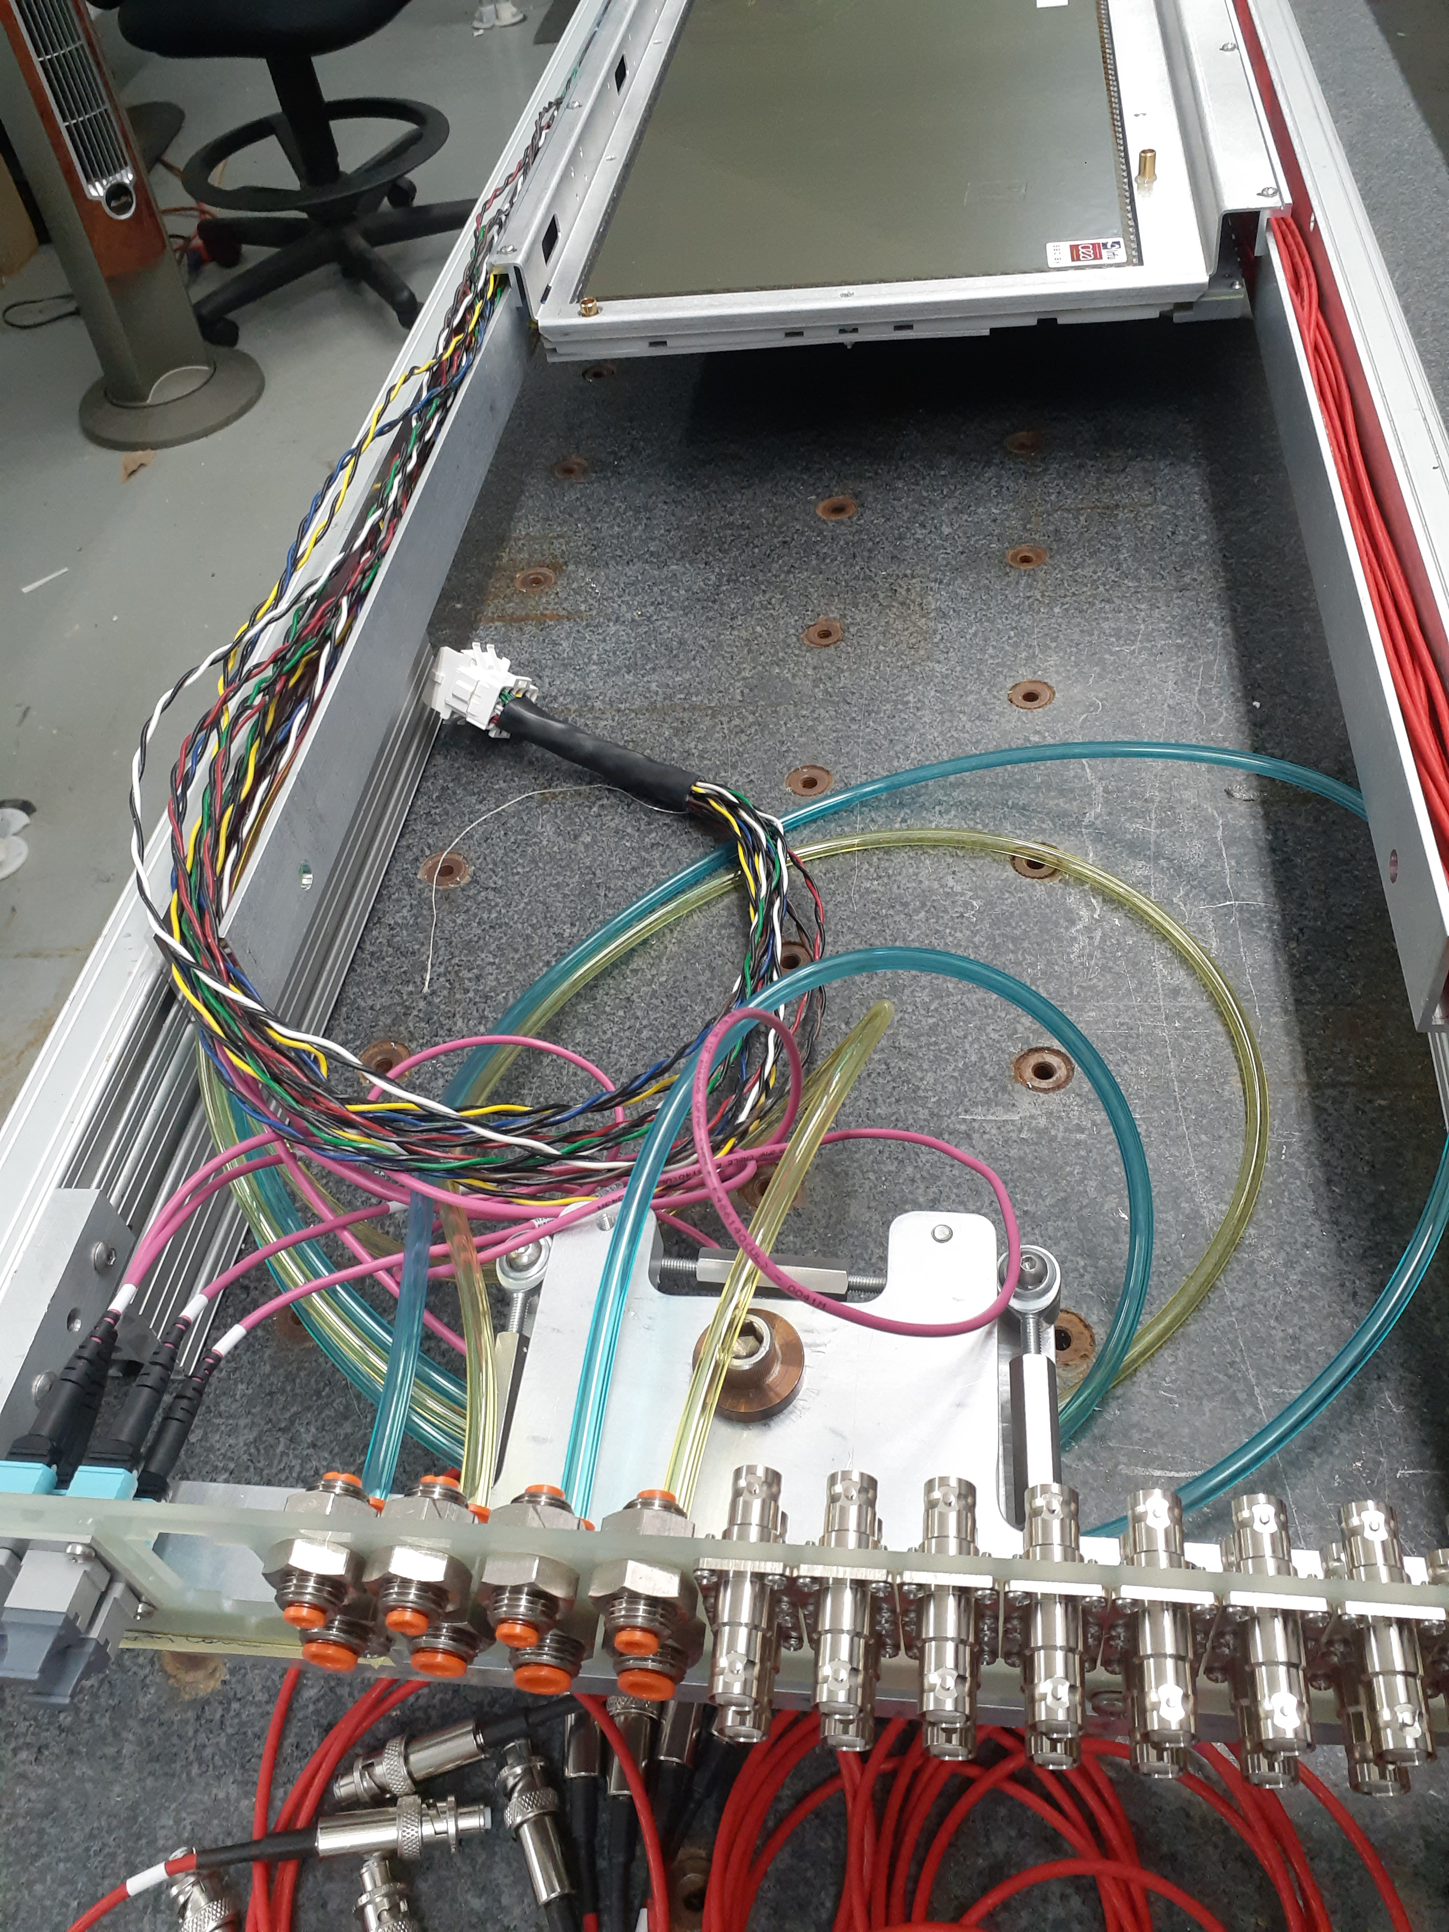
Pictures (cont.)
Two modules being assembled and cabled om the 4-modules sector

