Slide 1
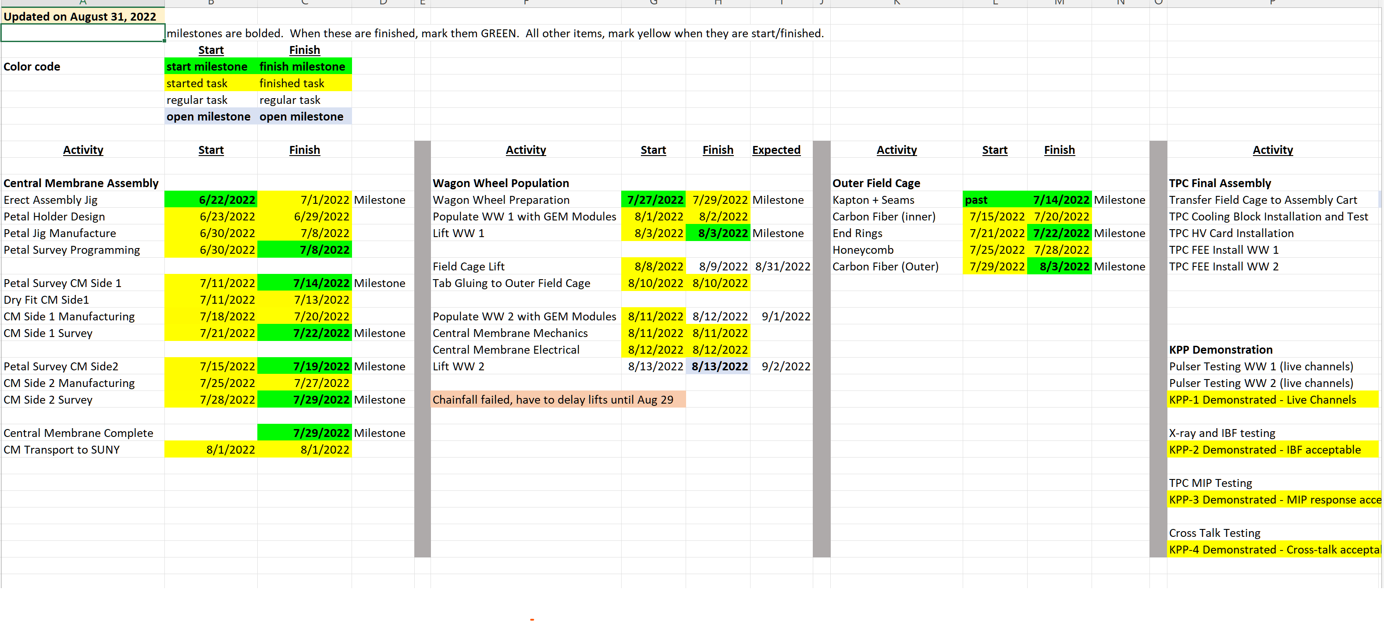

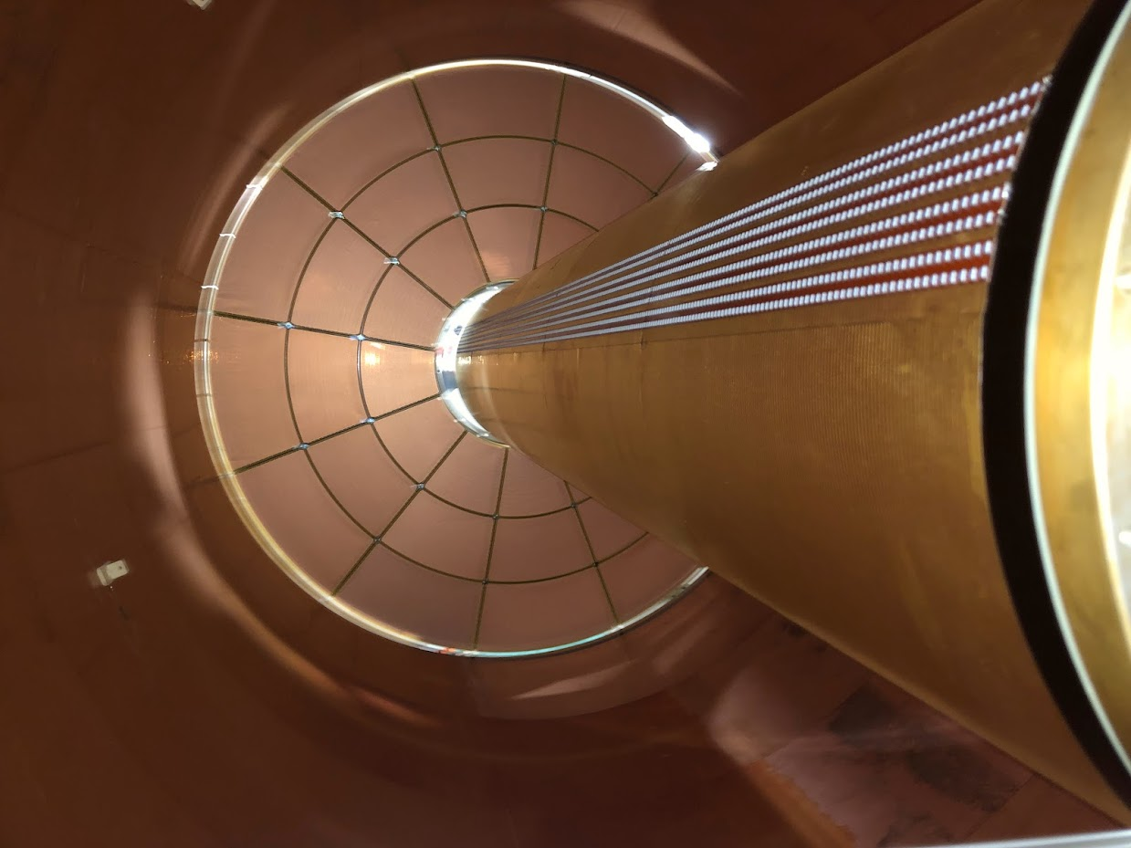
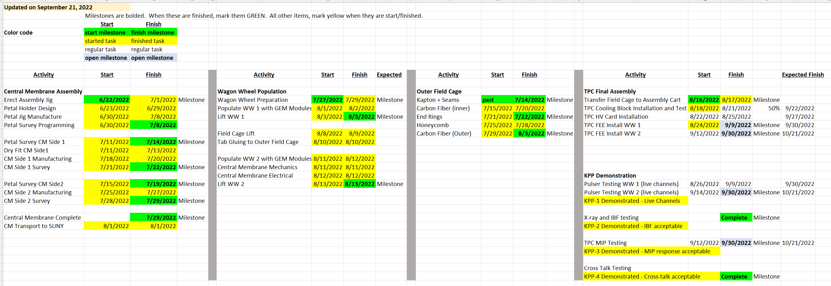
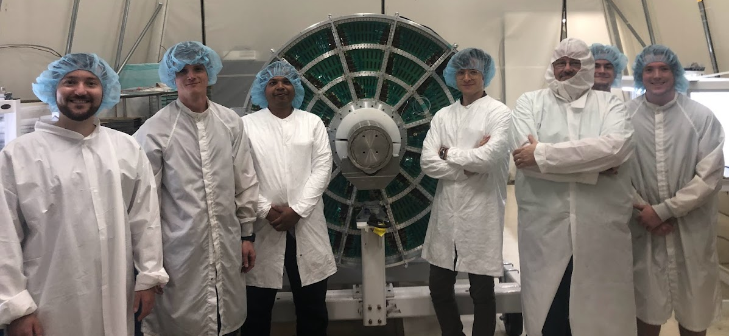
TPC Completion Schedule
Done
Done
Done
Done
Done
TK Hemmick

Slide 2
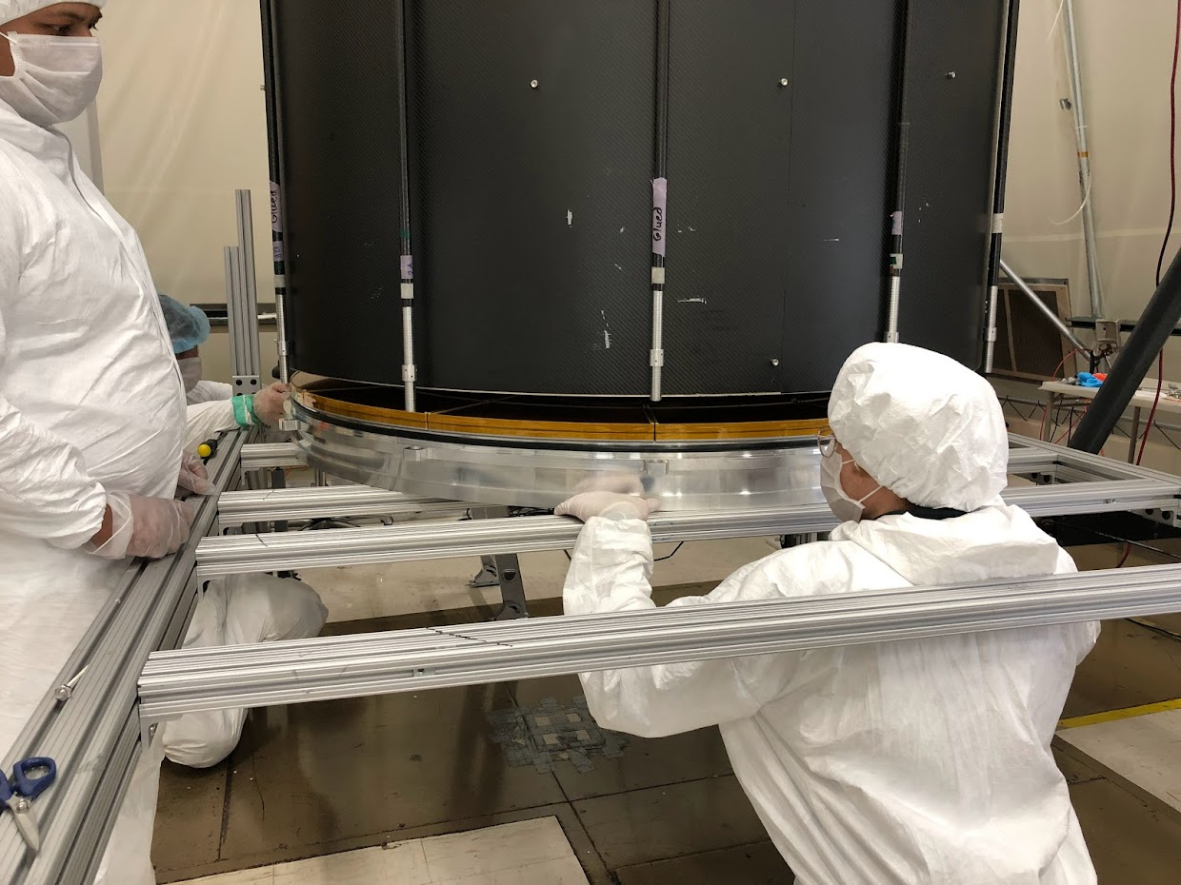
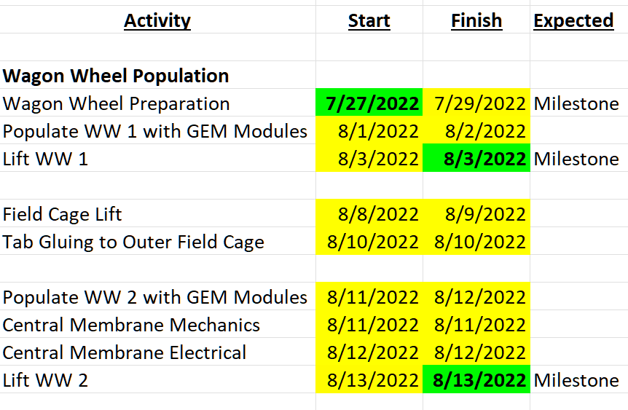
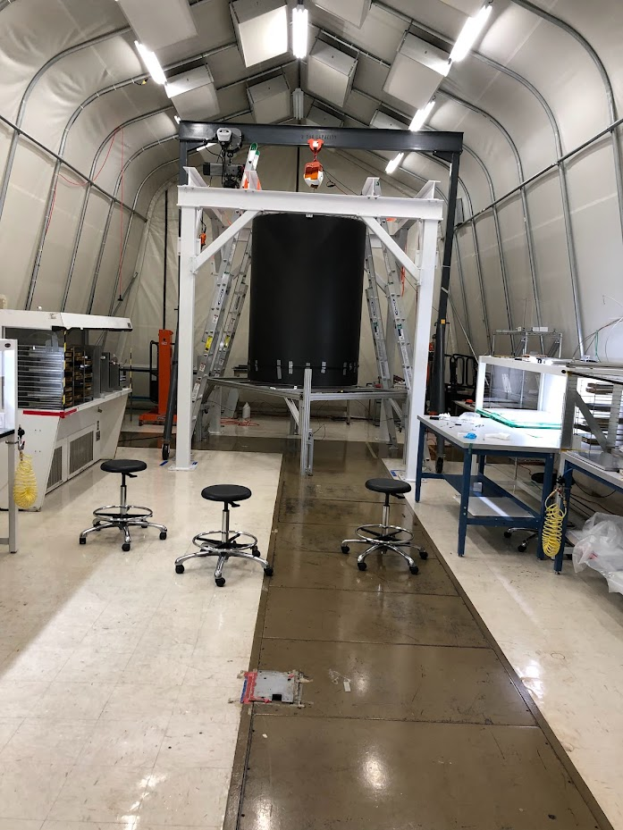
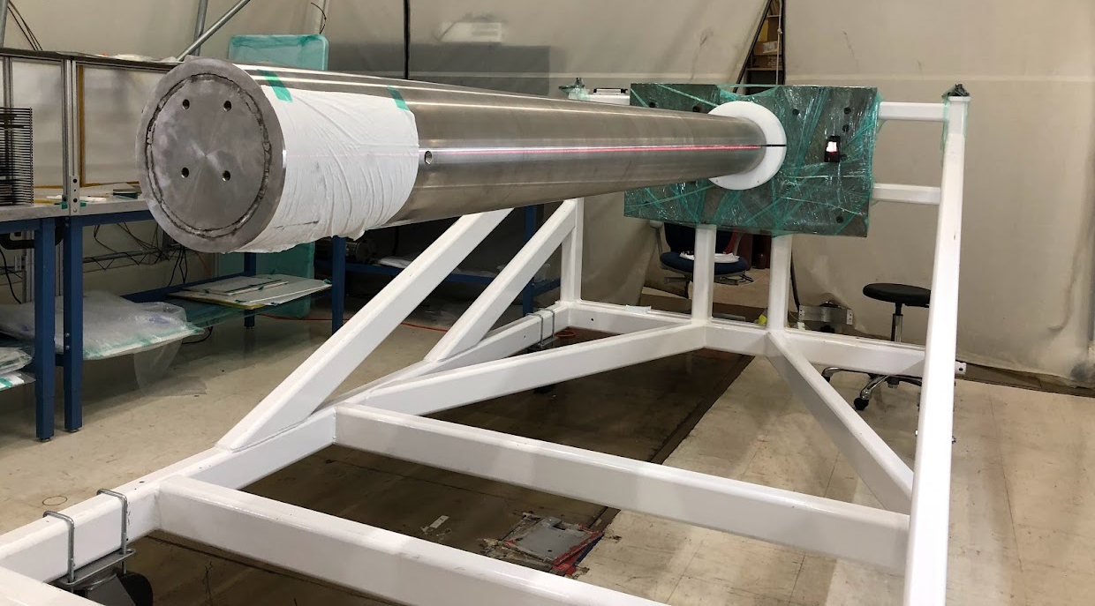
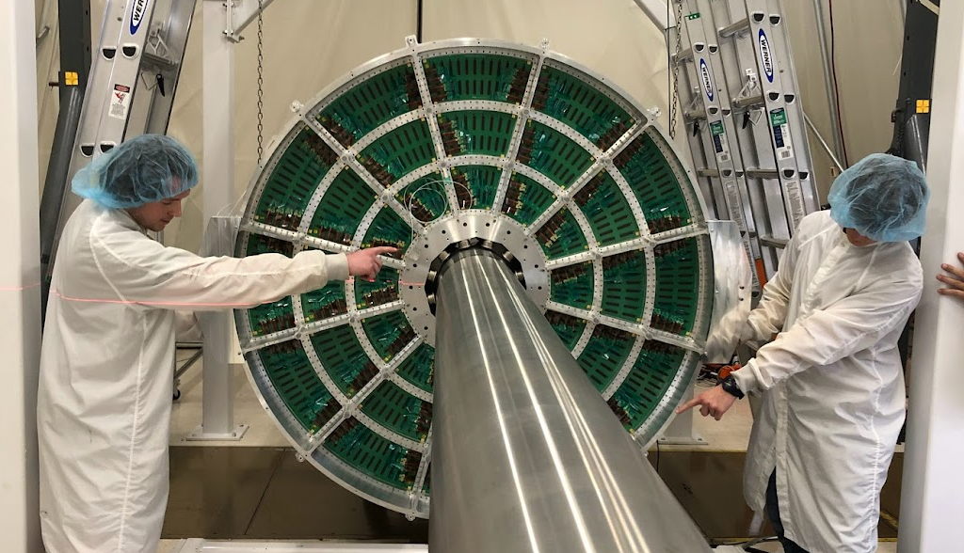
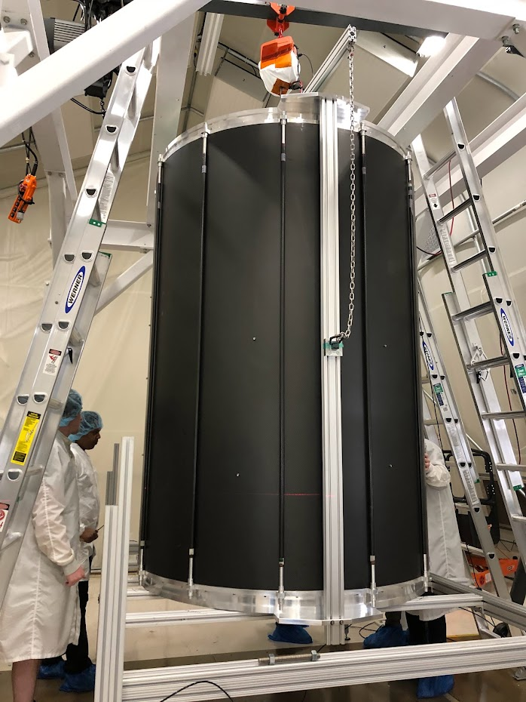
TPC Mechanical Completion
WW2 Installation
Where we left off…
TPC Mechanically Complete
TPC Assembly Cart
The Happy Crew (photo by C. Biggs)
Skewer the TPC
CM Lift Pt.

Slide 3
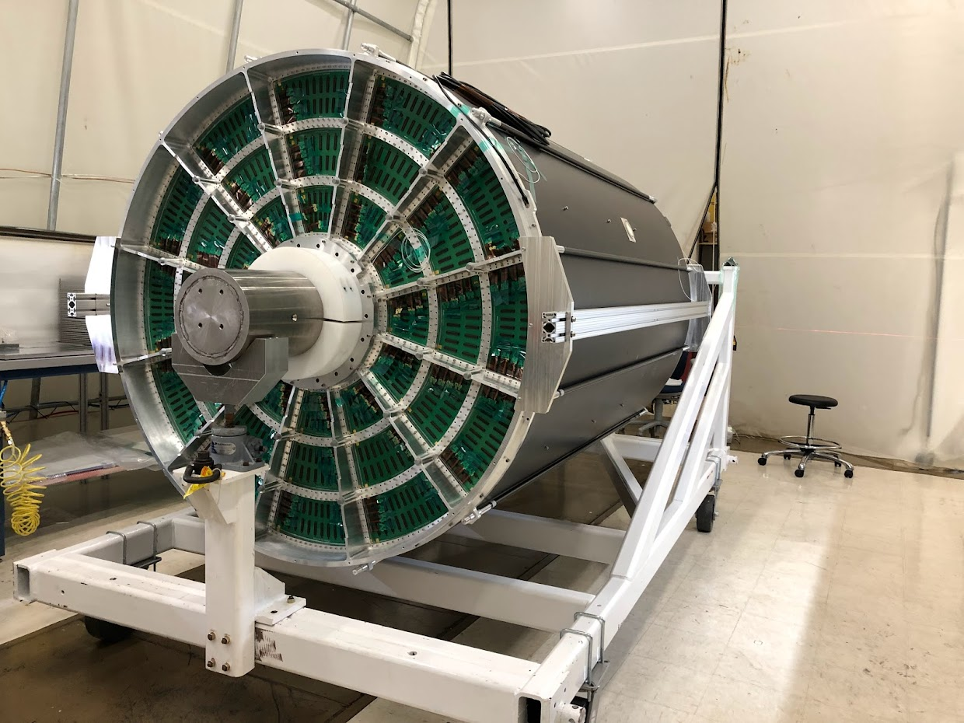

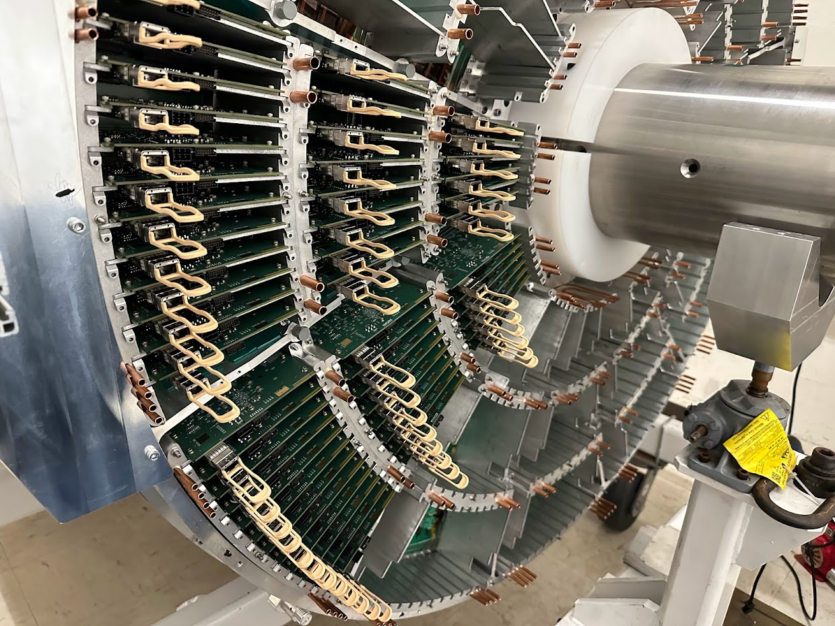
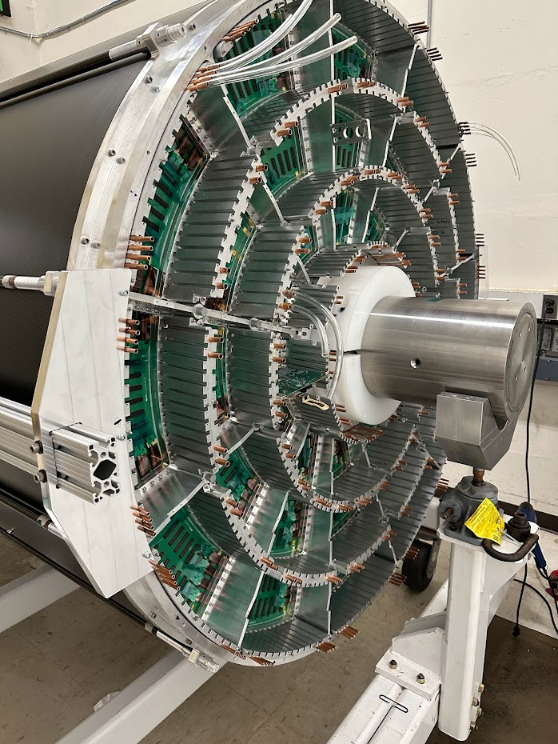
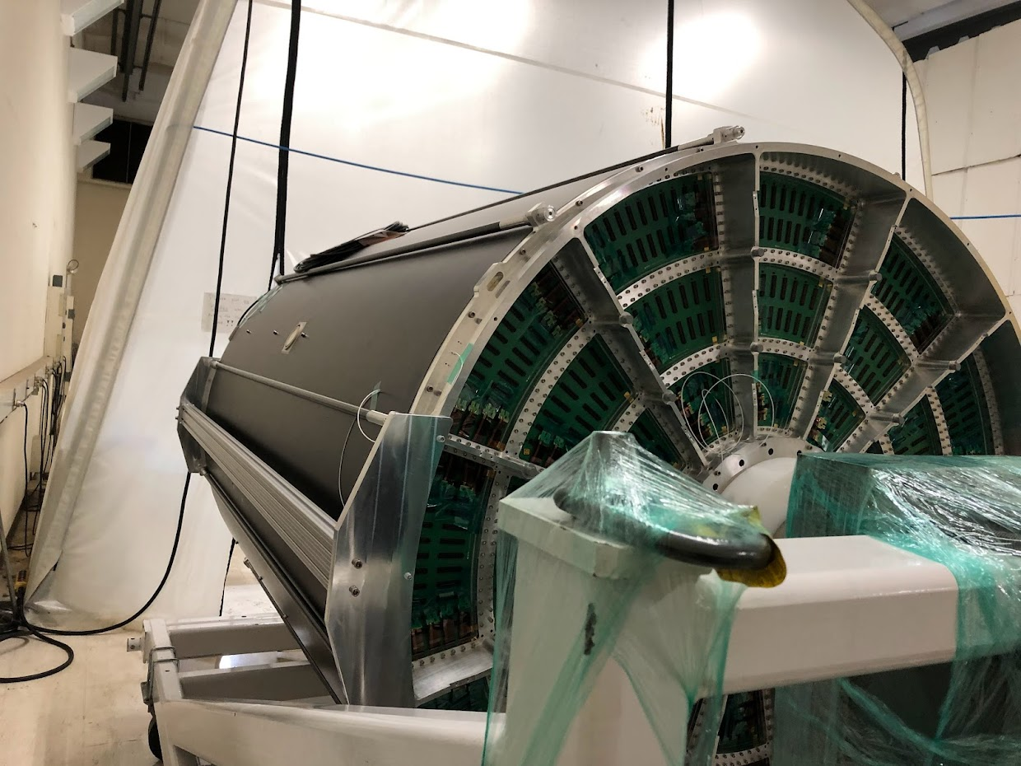
Instrumentation & Testing
South: 30% cooling blocks.
Driving factor: Equipment loan for readout next Monday.
TPC in the clean tent
N: 2/12 Sectors w/ FEE cards
N: 100% Cool Block
TPC in the Foyer

