Slide 1
Use of Diamond Sensors for High Radiation, Flux and Repetition Rate Applications
Mohammad Nizam
(Postdoc with Prof. Bruce Schumm at SCIPP, UCSC)
(On behalf of the Advanced Accelerator Diagnostic (AAD) Collaboration)
December 1st 2022
CPAD Workshop 2022
Stony Brook University

Slide 2
Outline:
AAD introduction
Motivation
Fast pass-through diagnostic for next generation XFEL
50 MHz position and intensity pass-through diagnostic
Submerged Imaging Wireless Monitor (SWIM)
Summary

Slide 3
Advanced Accelerator Diagnostics (AAD) Collaboration
A consortium funded by the University of California Office of the President
UC-National Laboratory Fees Research Program grant ID #LFR-20-65323
E. Prebys, C. Rowling
University of California, Davis
P. Freeman, D. Stuart
University of California, Santa Barbara
E. Gonzalez, S. Kachiguine, M. Kennedy, F. Martinez-McKinney, S. Mazza, N. Nagel, M. Nizam, E. Potter, R. Padilla, E. Ryan, B. Schumm, M. Wilder
University of California, Santa Cruz
C. Grace, T. Prakash
Lawrence Berkeley National Laboratory
J. Bohon, D. Kim, J. Smedley
Los Alamos National Laboratory
B. Jacobson, I.S. Torecilla, D. Zhu
SLAC National Accelerator Laboratory

Slide 4
Motivation: AAD Studies and application of Diamond sensors
Upgraded and next generation XFELs envisioned mJ scale pulses delivered at repetition rates up to 10 GHz.
Need to understand intrinsic charge collection limitations of diamond.
Need to develop high bandwidth (10 GHz) readout of ionising particle sensor.
Cavity based XFEL R&D
Precise intensity and position measurement at 10 - 20 MHz
Pass-through diagnostic with minimal wavefront distortion

Slide 5
Position and profile monitors for intense proton beam.
Need to understand diamond radiation tolerance
Wireless operation
Why CVD diamond?
Superior radiation tolerance
Fast saturated drift velocity( ~ 200 um/nm compared to 100 um/nm for Si)
Superior thermal conductivity (2200 W/m-K)
Charge collection time for a 30 um thick diamond sensor ~ 150 ps
low X-ray absorption

Slide 6
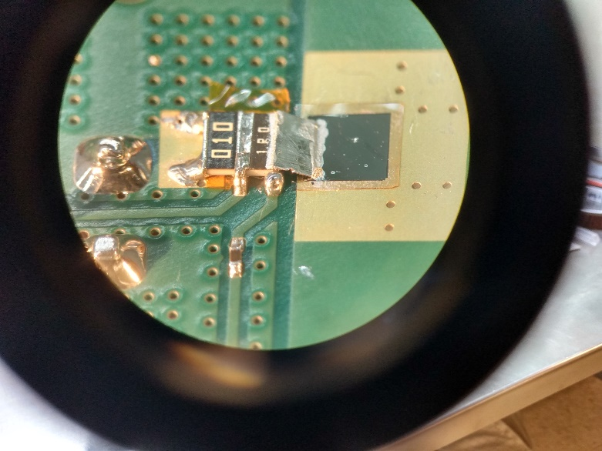
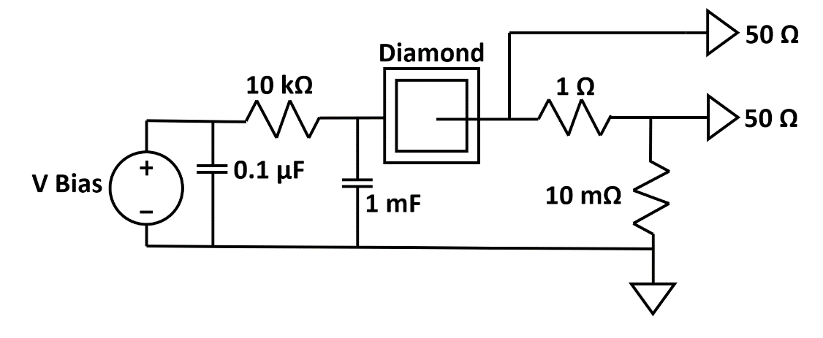
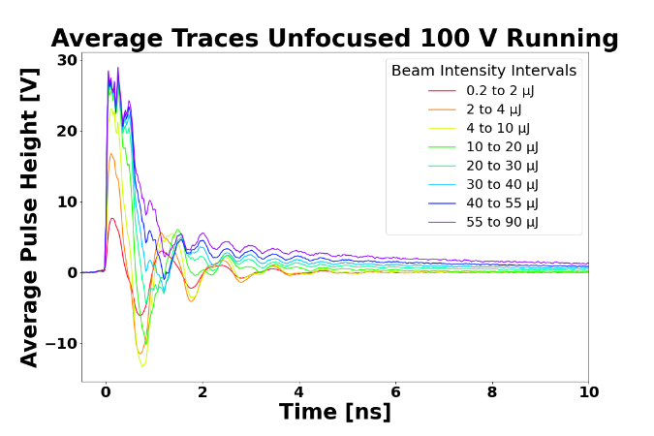
A FAST (MULTI-GHz) PASS-THROUGH DIAGNOSTIC FOR THE NEXT GENERATION OF XFELS
Shunt R
Paper: J. Bohon et al.
Signal Pickoff
Readout PCB signal path of the SCIPP assembly.
Element Six monocrystalline diamond sensor thinned to a thickness of 37 ± 10 µm by the Applied Diamond Corporation.
Initial Attempt at Low-Impedance Signal Path, April 2021
Sensor connected to the readout path through an Indium band
A series array of 1 Ω and 10 mΩ shunt the signal current directly to ground.
50 Ω pick-off traces connected to the sensor side of both the 1 Ω and 10 mΩ resistors.

Slide 7
Plasma Density
Collection time and collection efficiency may be characterized in terms of plasma density.
$ρ_{P}=\frac{1}{2}\frac{Q_{dep}}{V_{dep}}$
Q_{dep} Electron-hole pairs generated in the diamond bulk.
V_{dep} = πT(d/2)² is the volume occupied by the plasma.
T Sensor thickness
d Full-width at half-maximum

Slide 8
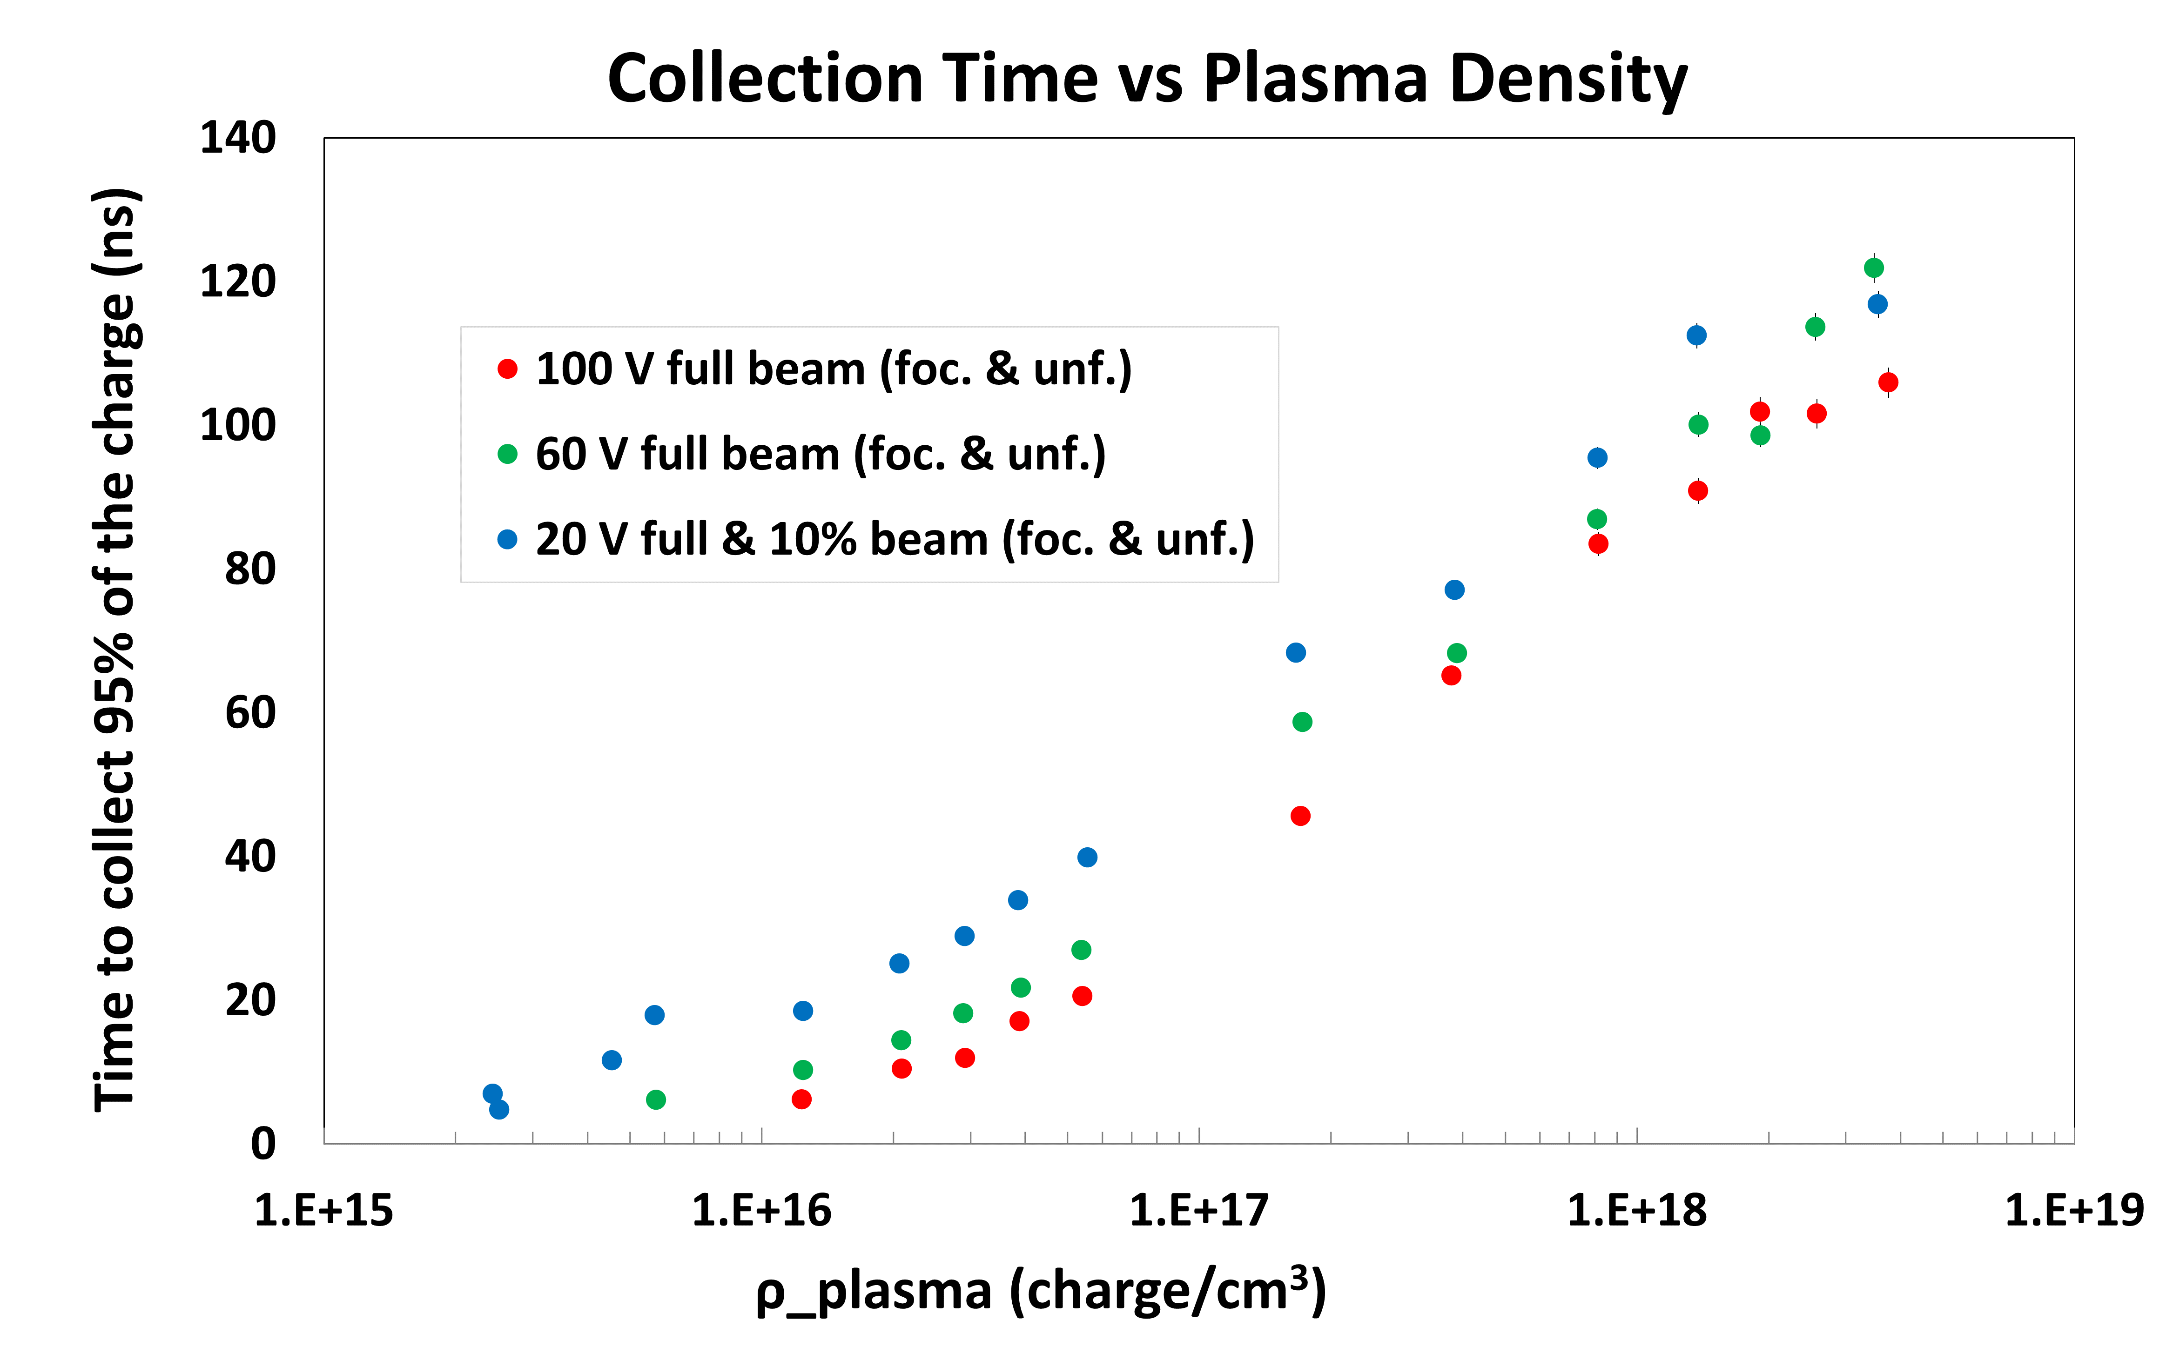
Charge collection time
The time required for full collection (~ 95%) of the signal charge increases with total delivered charge.
Significantly larger when the beam is focused.
The charge collection time, characterized in this way, depends strongly upon both plasma density and applied bias field, and approaches 100 ns even for the highest bias field (2.7 V/µm)

Slide 9
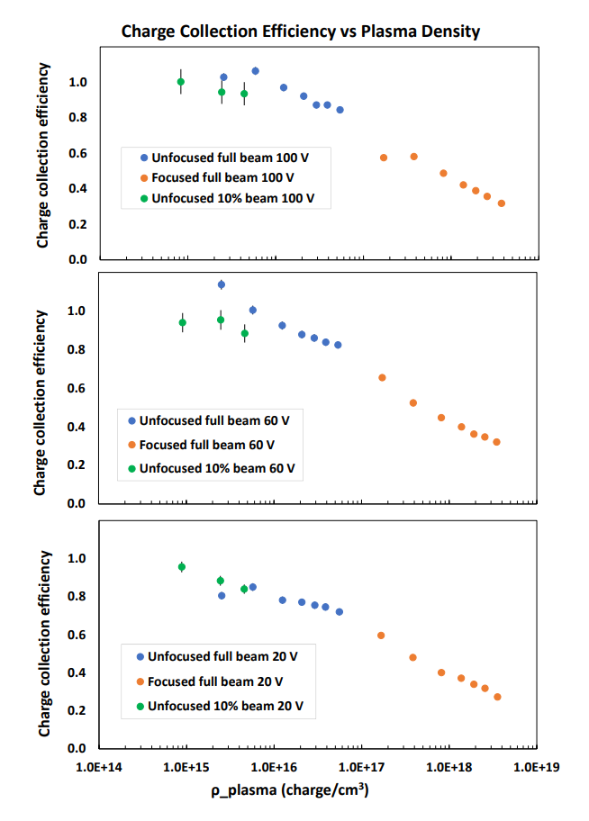
Charge collection efficiency
The estimated charge collection efficiency as a function of plasma density for the three bias voltages.
The charge collection efficiency is near 100% for the plasma density associated with the lowest energy bin for the case of unfocused and unattenuated beam.
The charge collection efficiency improves for higher sensor bias.
Charge collection efficiency loss occurs for plasma densities above 10¹⁶ charges/cm³
Estimated charge collection efficiency

Slide 10
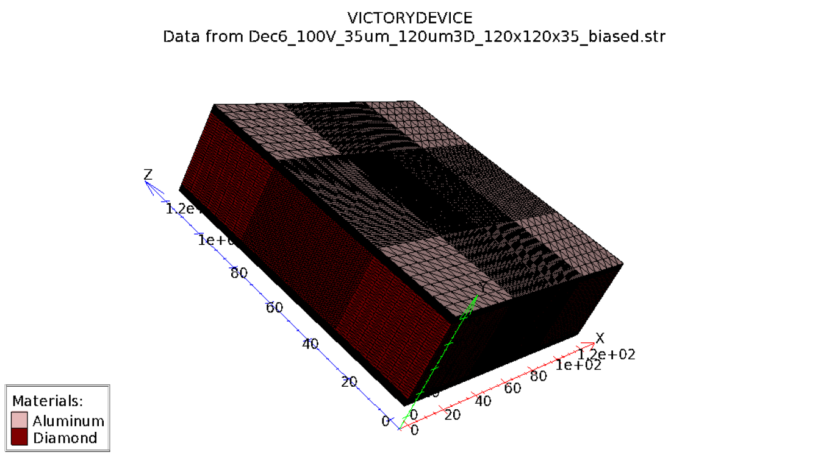
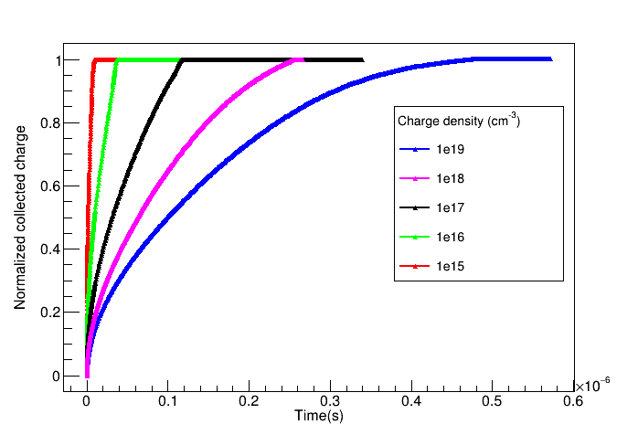
TCAD Simulation
Tool: 3D Silvaco VICTORYDEVICE (Non-mixed mode)
Sensor: 120 x 120 um² and 35 um thick diamond
100 V bias
Charge injected using SINGLEEVENTUPSET method in 43 um diameter along the full thickness of the diamond.

Slide 11
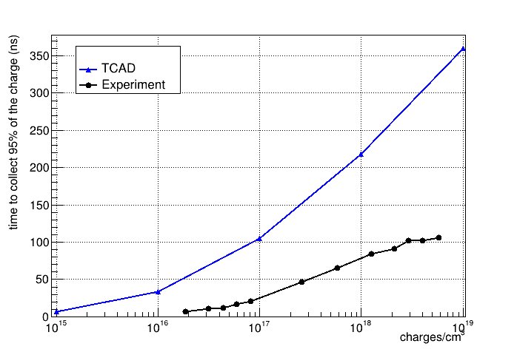
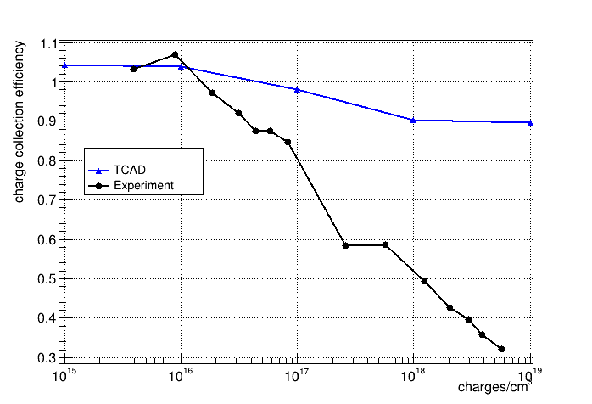
Data vs TCAD Simulation

Slide 12
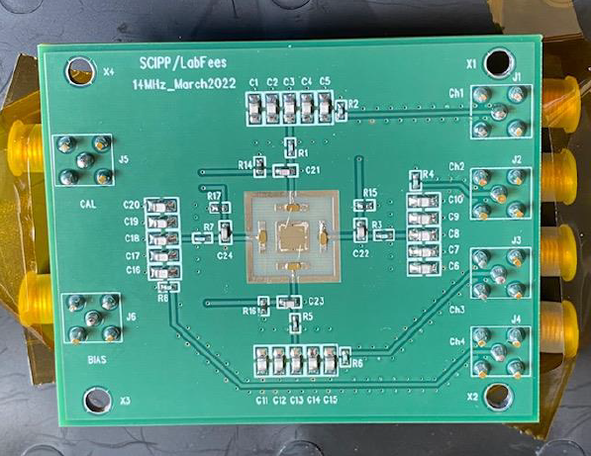
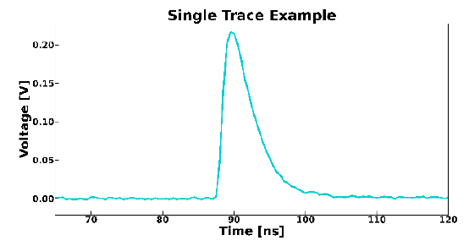
50-MHz POSITION & INTENSITY PASS-THROUGH DIAGNOSTIC
A pass-through diagnostic that measures intensity and position of the circulating beam at every pass for Cavity-based X-ray free electron laser (CBFEL) .
A new readout system capable of achieving repetition rates up to 50 MHz was built at SCIPP.
Use of a 43 μm thin planar diamond sensor to reduce the beam absorption and wave-front distortion.
8 parallel 0.2 μF capacitors to provide signal return path that bypasses the voltage supply.
4-channel readout board
4x4 mm² quadrant sensor

Slide 13
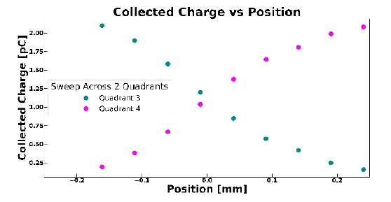
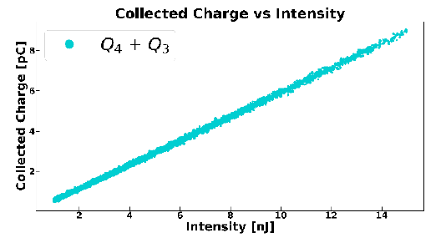
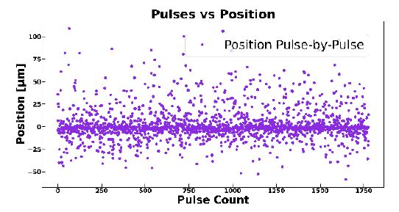
Charge collection and position resolution
A sweep across two quadrants of the diamond sensor.
The average collected charge measured as the XPP beam was moved in intervals of 50 μm across quadrant 3 and 4 for an intensity interval of 3.1 nJ to 4.7 nJ.
The combined collected charge from Q4 and Q3 was characterized as a function of delivered beam intensity.
The linear correlation between these two parameters, showing that a pass-through diagnostic is achievable for repetition rate as large as 50 MHz
3 um spatial uncertainty (for a 300 um wide beam)

Slide 14
SUBMERGED WIRELESS IMAGING MONITOR (SWIM)
To benchmark Diamond Profile Monitors with a proton beam while simultaneously upgrading the beam diagnostic capability at the Isotope Production Facility (IPF) at Los Alamos National Lab (LANL).
IPF wants to image beam at the interaction site.
Currently, IPF sends down plastic films 40 ft down a water filled shaft, blasts it with beam and then brings it back up to analyze.
Problems:
Process takes ~1 hour, really slow
Method collects beam average
Submerged Wireless Imaging Monitor (SWIM) will provide real time beam monitoring and better/faster tuning of the beam resulting in more efficient Isotope production.
The lifetime dose of the diagnostic is about 10^16 p/cm² of 100 MeV protons.
We need to understand the radiation tolerance of diamond to this level.

Slide 15
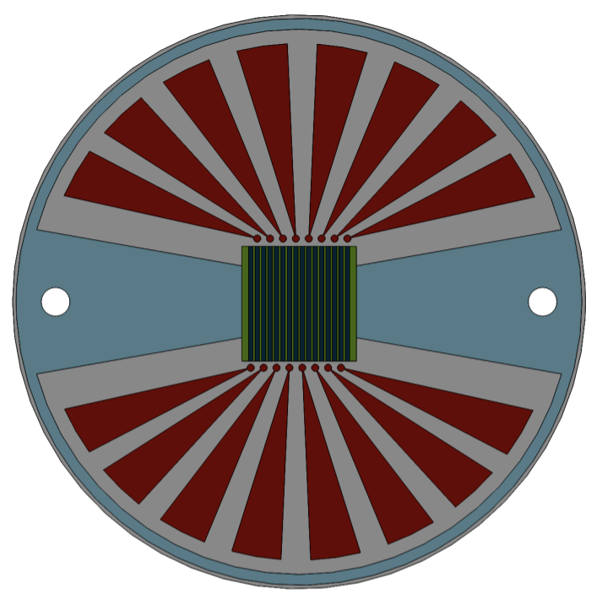
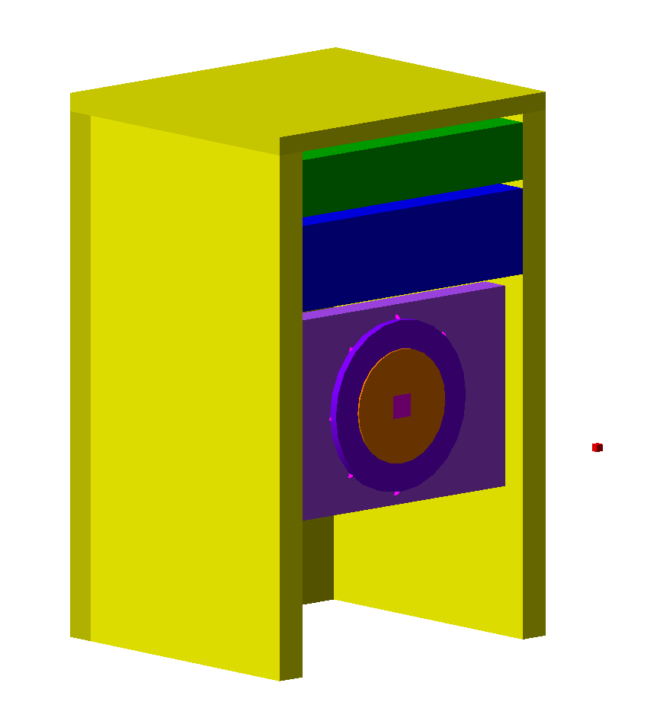
SWIM Overview
Diamond array is 1.2x1.2 cm² strip array with a pitch of 800 um, with two views (total 30 channels)
Diamonds
Blue = Shielding
Green = Electronics
Pink = Diamond PM
Yellow = Iron Carrier
Red = Beam Stop

Slide 16
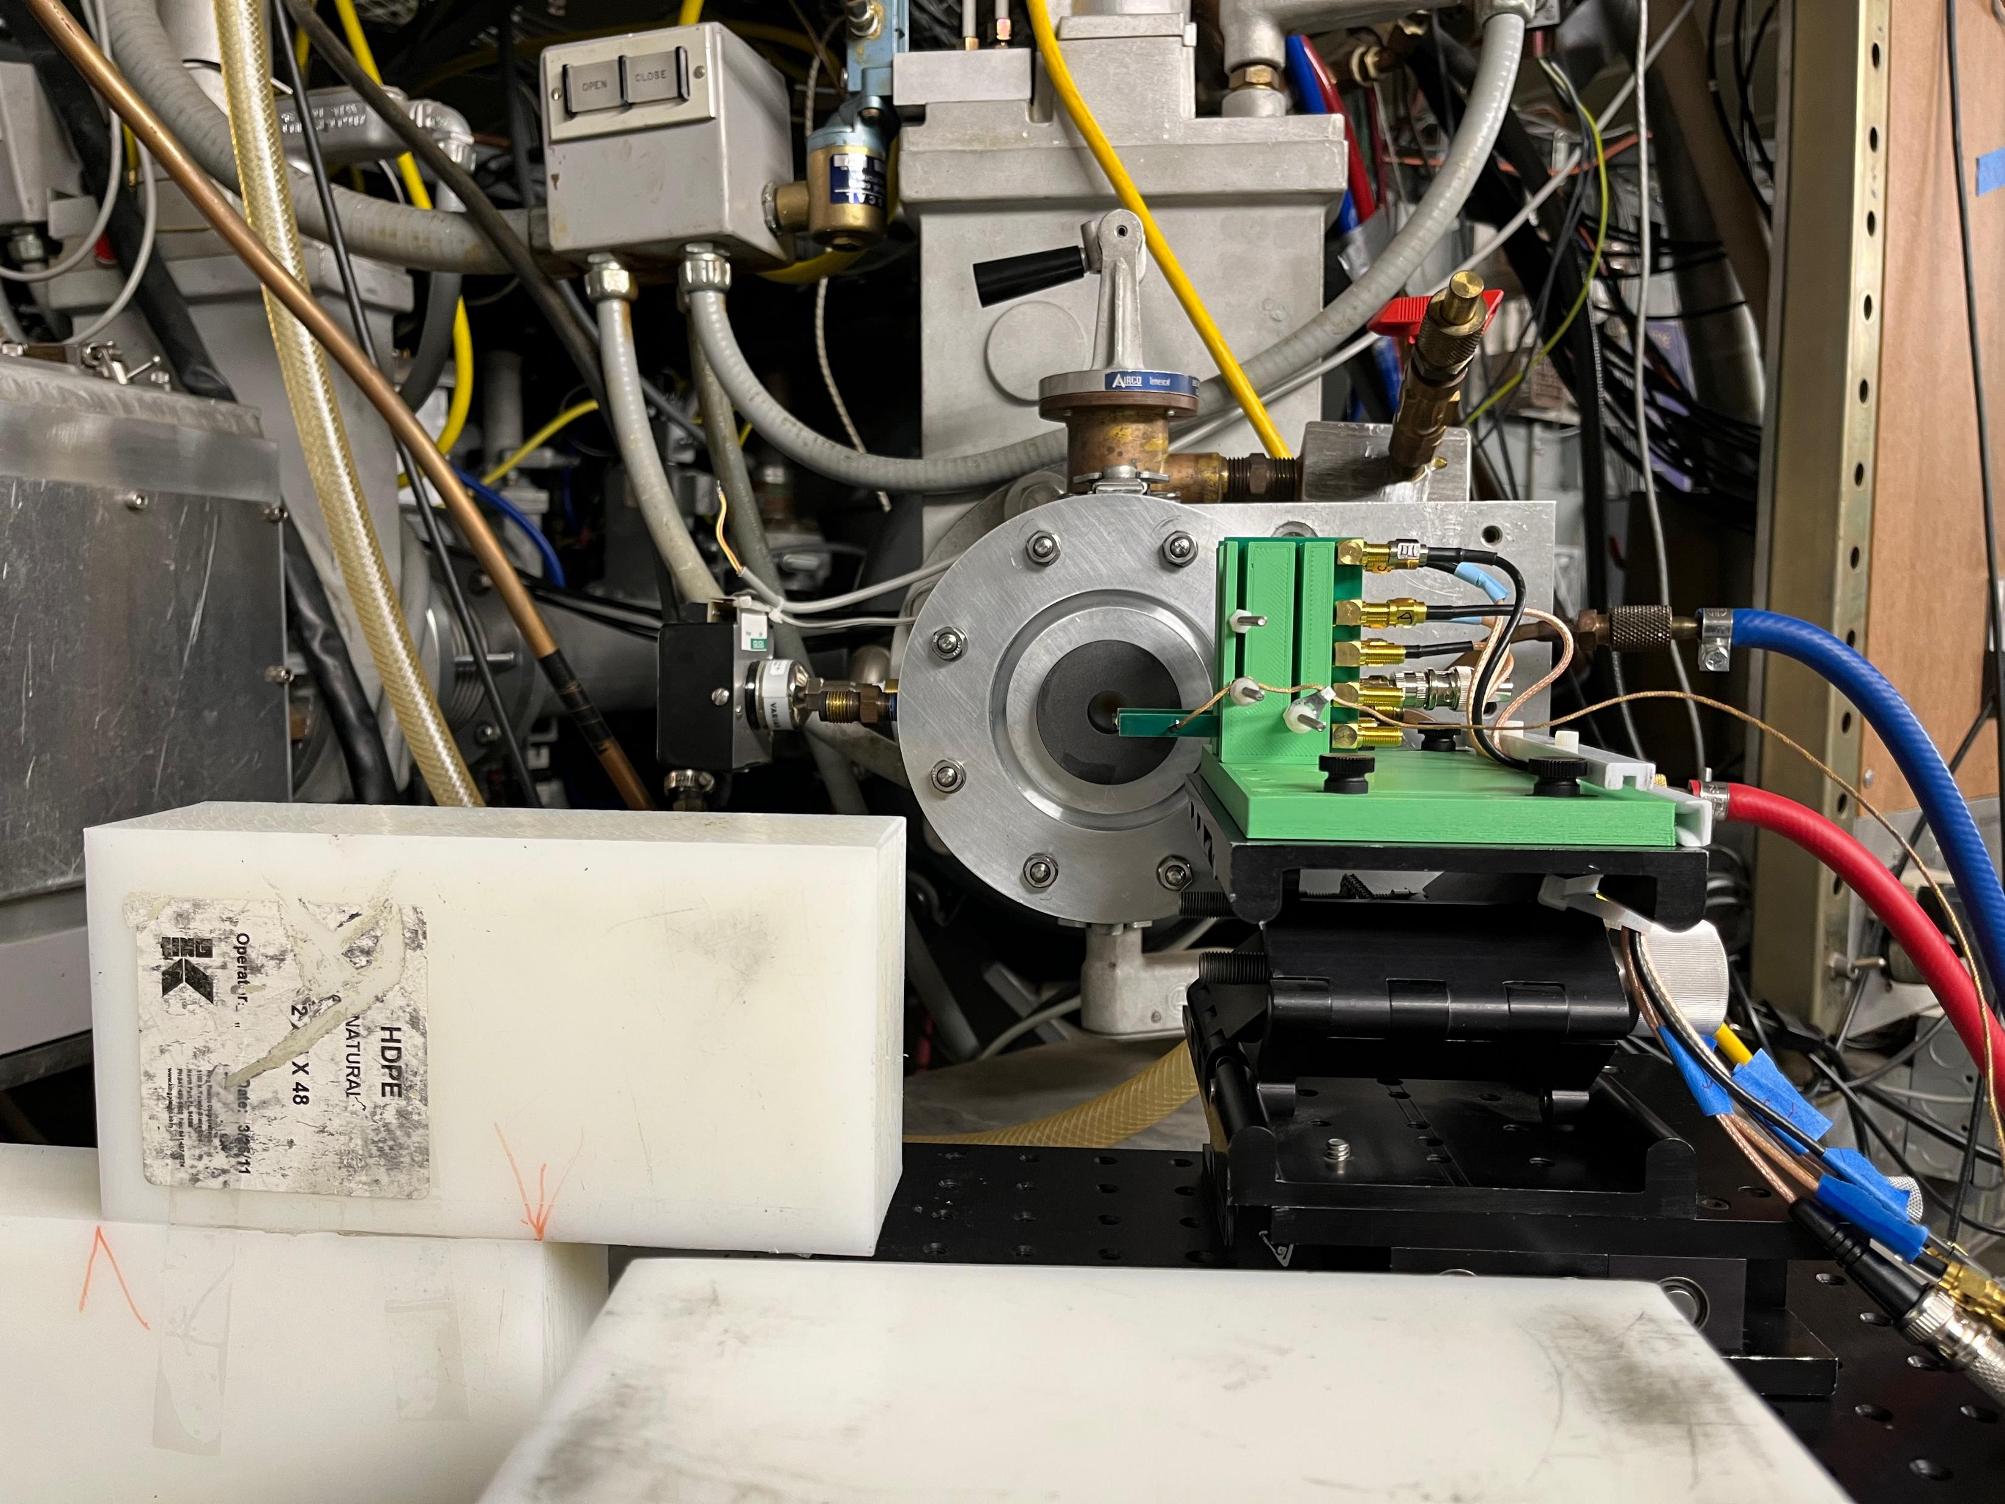
Crocker Experimental Setup
The experiment was done at the Crocker Nuclear Lab, UC Davis in February 2022 where a 4mm x 4mm x 0.030 mm diamond and a Silicon sensor with similar dimensions were mounted in parallel on two four-channel readouts board designed at SCIPP. The proton beam energy was 67.5 MeV and the total fluence was ~ 4 x 10¹⁶ .
Sensors
Beam current = 1 uA
Beam Diameter = 1.5 cm
Fluence = 3.54e12 p/s/cm^2
Maximum Frequency = 22 MHz
Both Silicon and Diamond sensors mounted
Total number of events collected = 11367
Trigger rate = 1Hz
Bias voltage for diamond = 10 V – 50 V

Slide 17
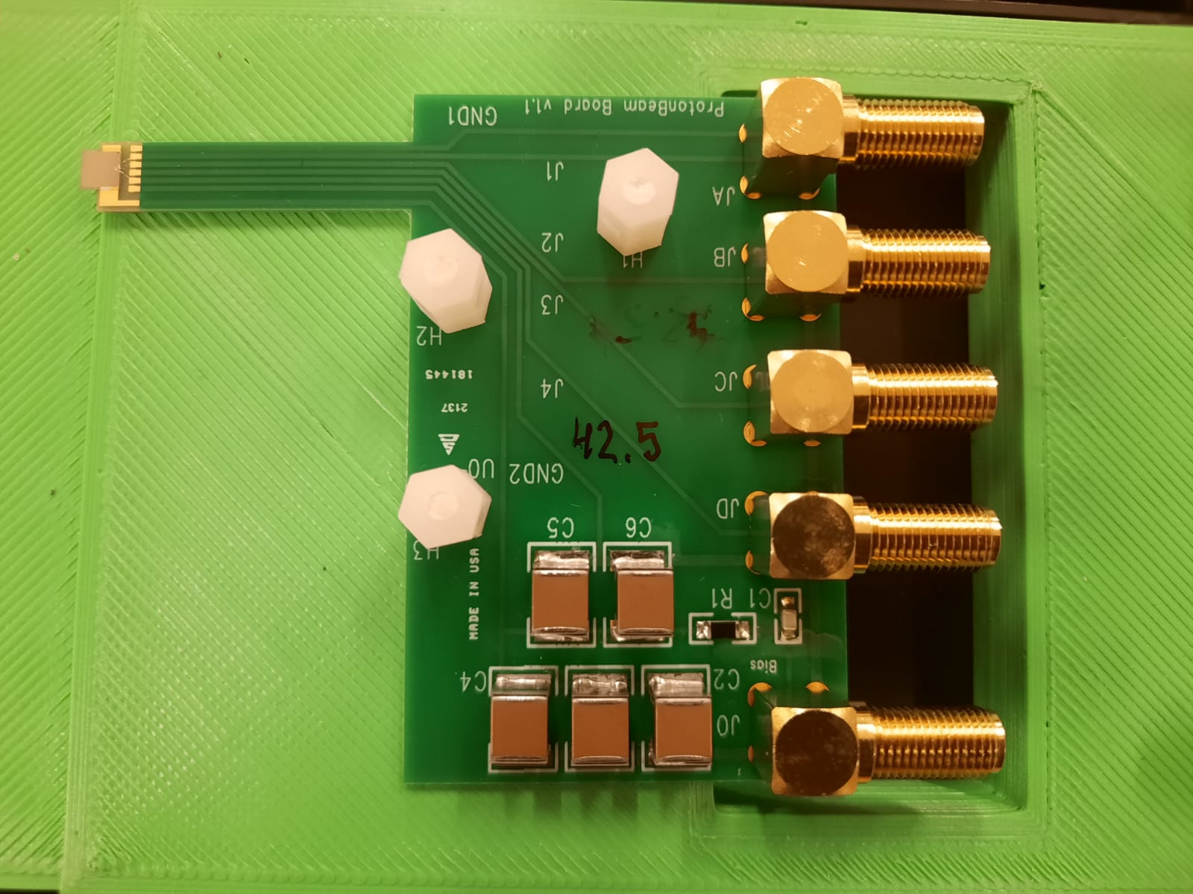
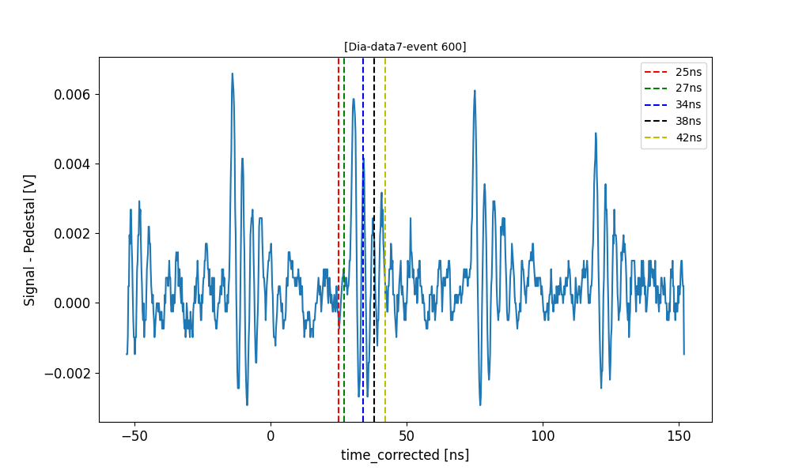
Experimental Setup
4 channel readout SCIPP board
We monitored the response of diamond as a function of time
Determining the pedestal created a dominant source of error
We determined the overall scale of degradation after-the-fact by comparing the response of a new and the damaged sensor in the LCLS beam.

Slide 18
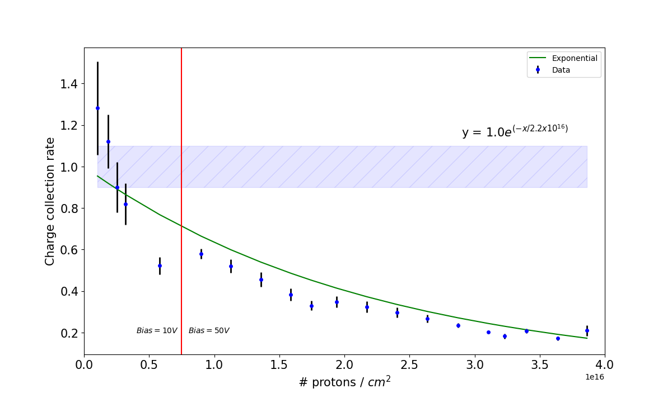
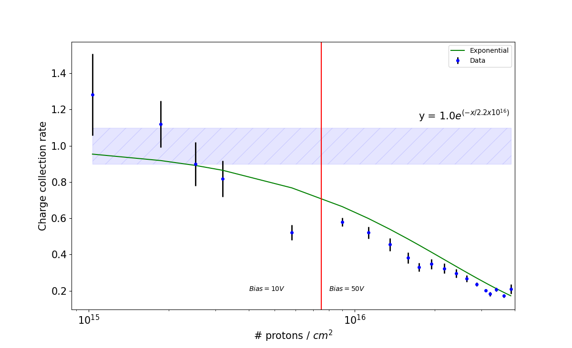
Overall charge collection rate as a function of fluence
The diamond sensor was irradiated with ~ 4 times the lifetime dose of the IPF.
10% error band from LCLS data

Slide 19
Summary and Future:
A customized signal readout device designed with a low impedance signal path.
Charge collection efficiency improves with applied bias voltage and found to be maintained for plasma densities as high as 10¹⁶ charges/cm³.
Charge collection time (95 % of the asymptotic value) also strongly depends on plasma density and the bias voltage.
The 4-quadrant system provides a pass-through di-agnostic for frequencies as high as 50 MHz repetition rate.
The pulse-by-pulse position resolution was measured to be approximately 3 μm.
Radiation damage in diamond was tested at the Crocker Nuclear Lab, UC Davis.
Diamond was exposed to ~ 4 times the life time dose of the Isotope Production Facility (IPF).
The charge collection efficiency of the irradiated diamond was compared to an un-irradiated diamond at LCLS and it was found to be ~ 21%.
We are exploring ideas that will allow for the processing of signal charge in the 100-200 ps range.
Developing compact signal-path geometries that we hope to use to push signal-path resonances as high as possible by minimizing signal-path inductance.

Slide 20
Backup

Slide 21
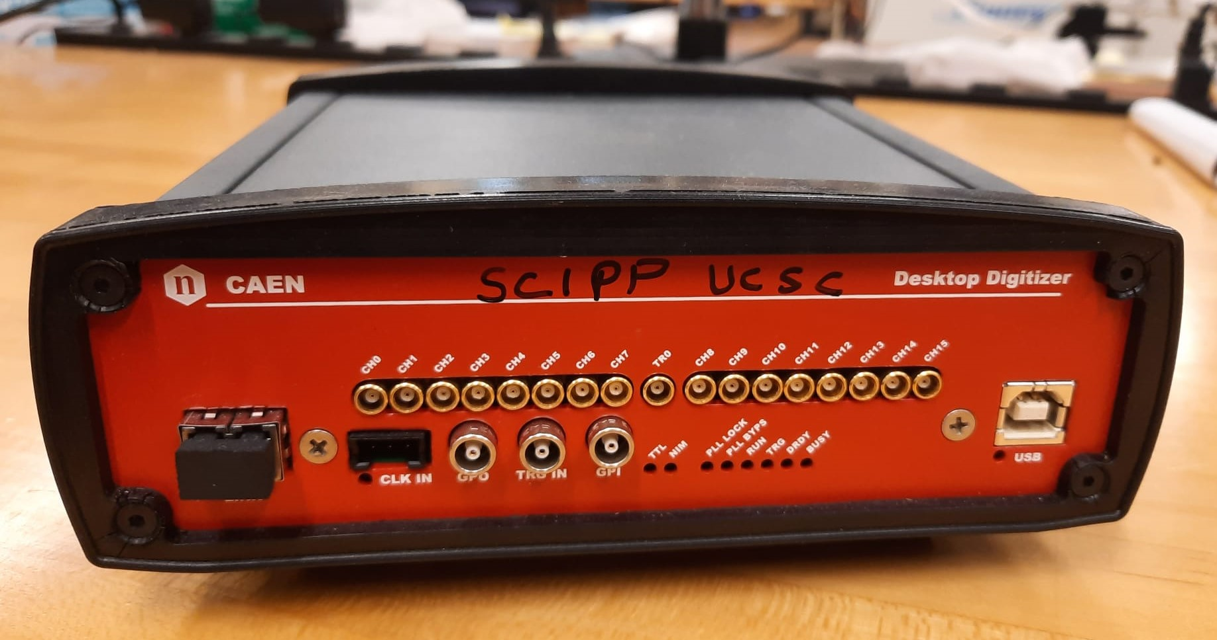
Data Acquisition
5 GS/s
16 analog input channels on MCX coaxial connectors
1 Vpp input dynamic range
USB and Optical Link communication interfaces
Dead-time due to conversion: 110 µs
1 additional analog input (TR0): fast (low latency) trigger, digitizable for high resolution timing (up to 50 ps)
CAEN DT5742

Slide 22
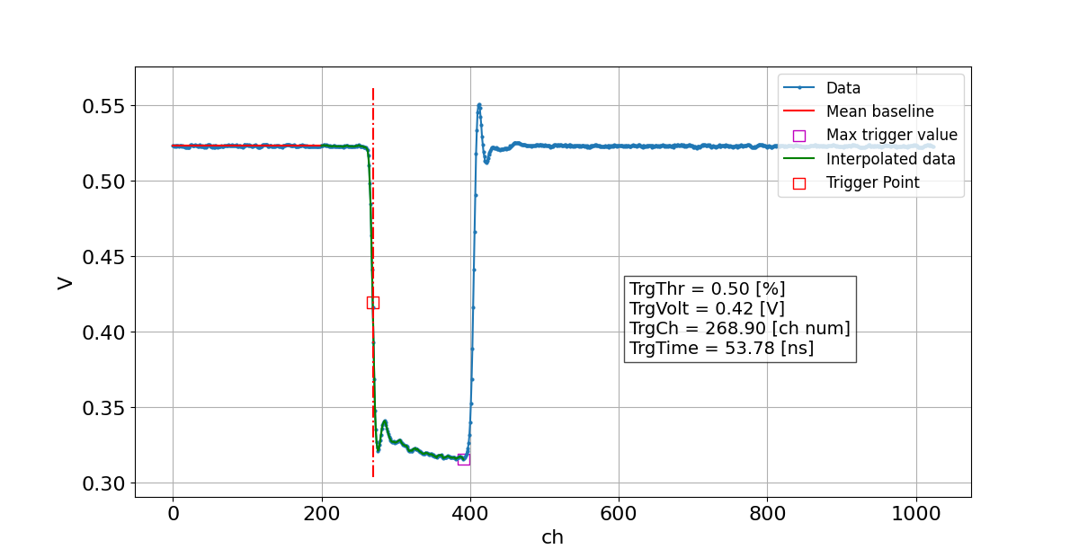
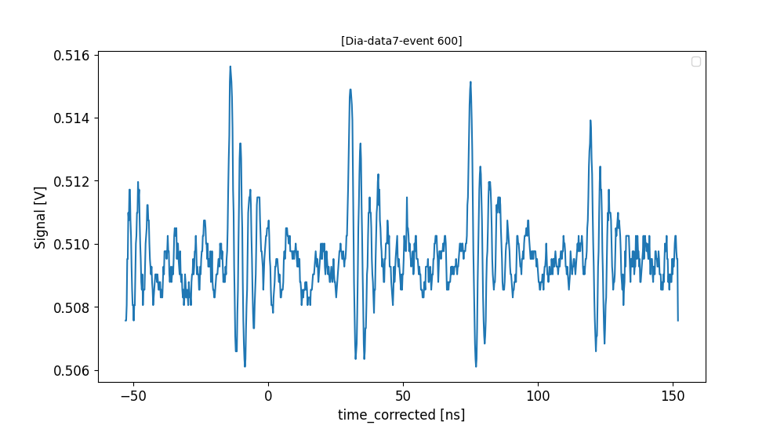
Trigger Correction
50% level of the trigger pulse is taken as the start to minimize jitter in the trigger.
Trigger Pulse
Diamond Signal

Slide 23
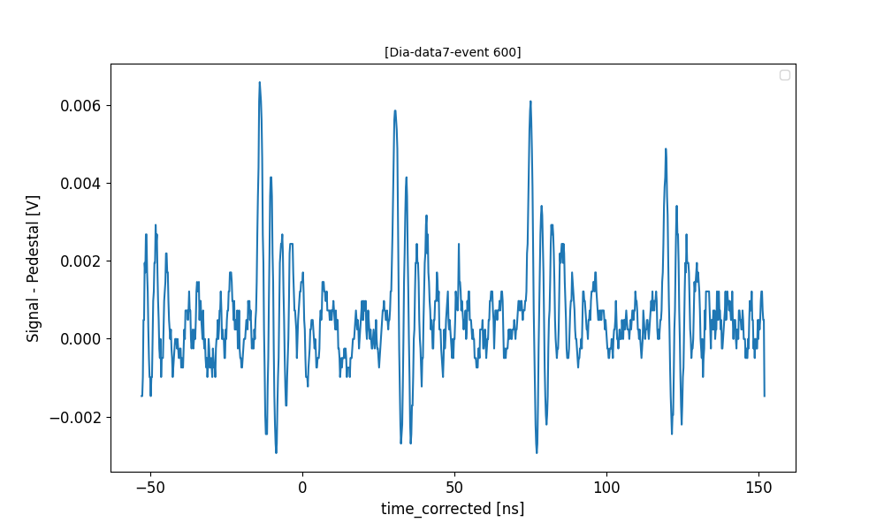
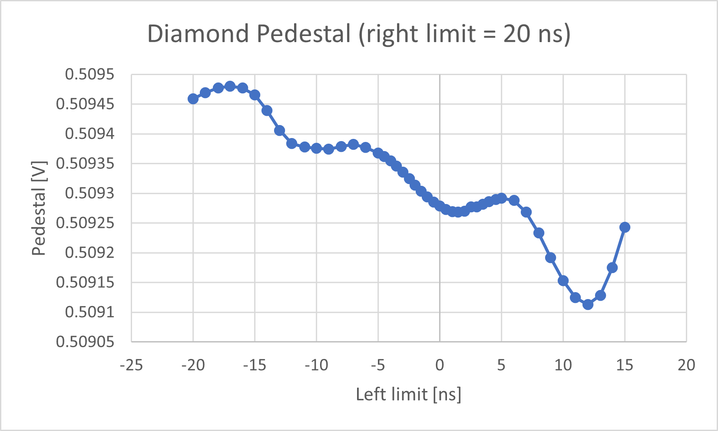
Pedestal Correction
Pedestal window: 9 – 20 ns (Considering the third peak only)

Slide 24
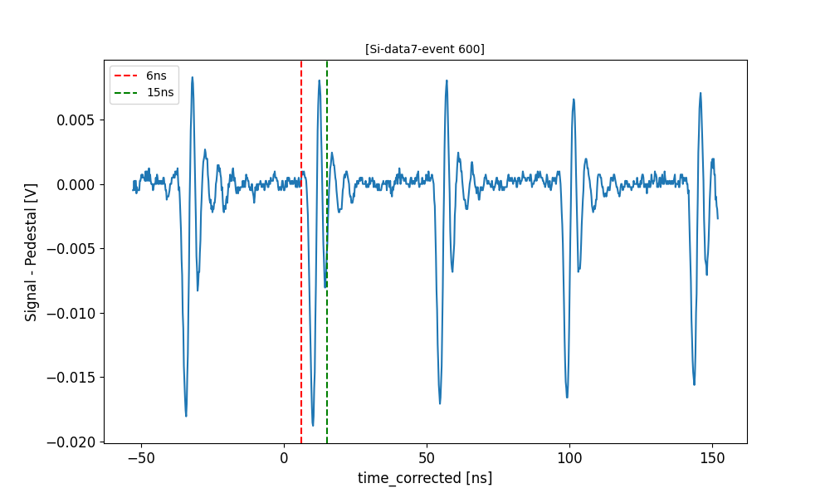
Integration Windows
Pedestal Corrected Silicon signal
Pedestal Corrected Diamond signal

Slide 25
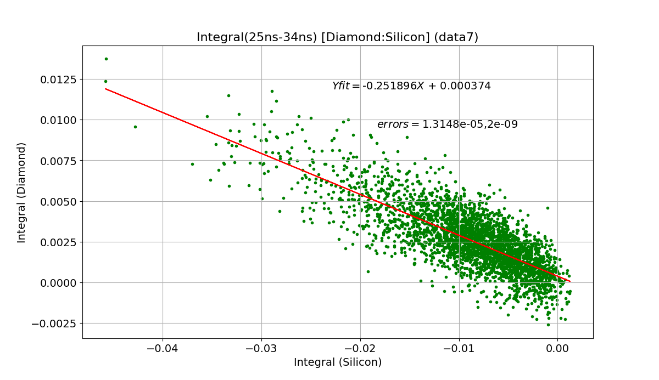
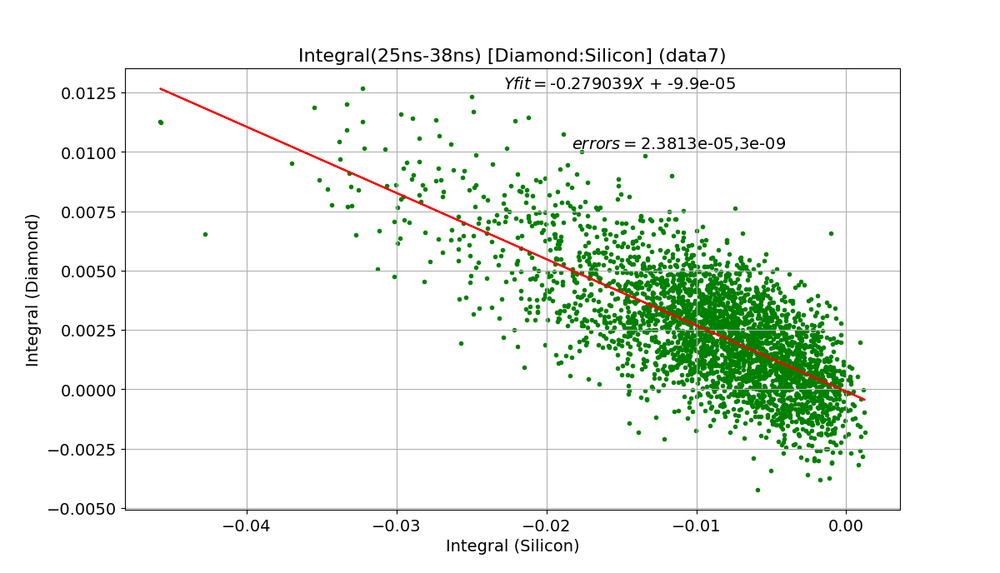
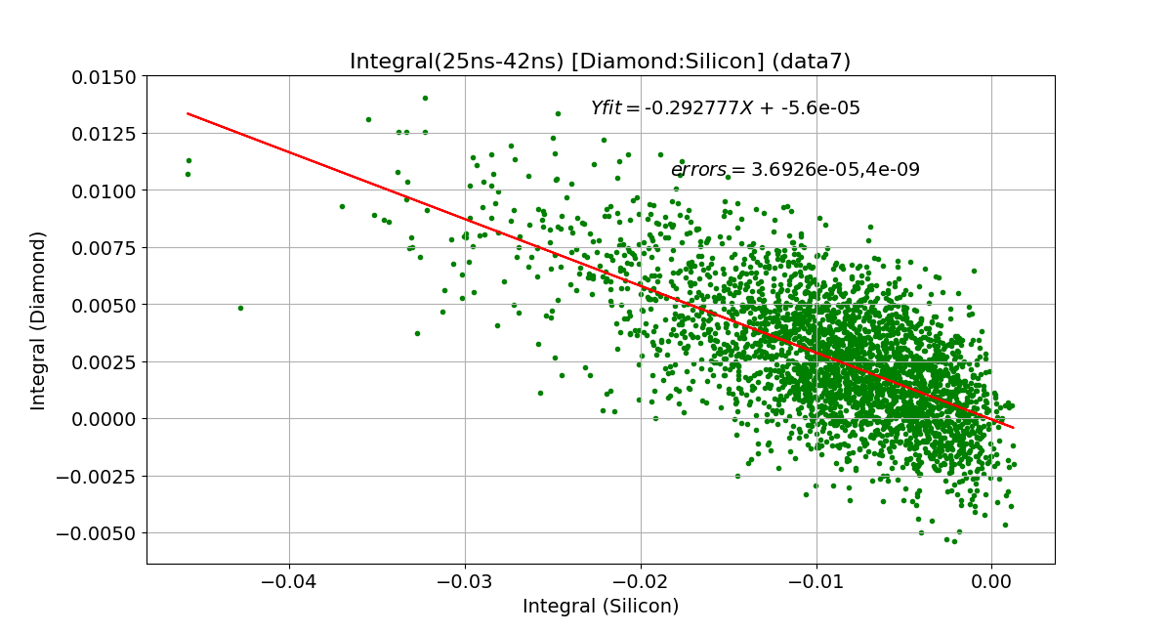
Diamond vs Silicon correlations with different integral windows

Slide 26
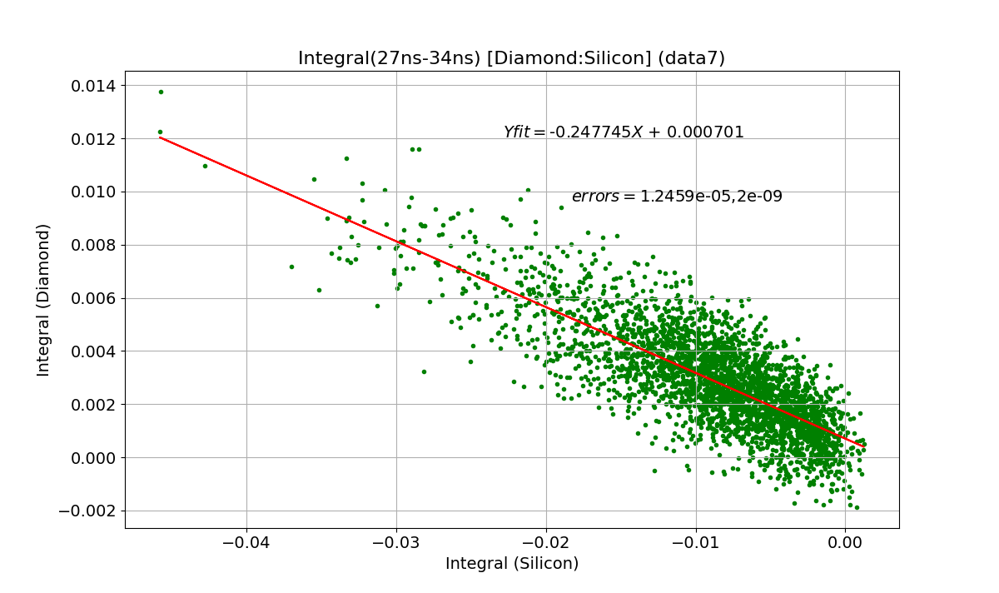
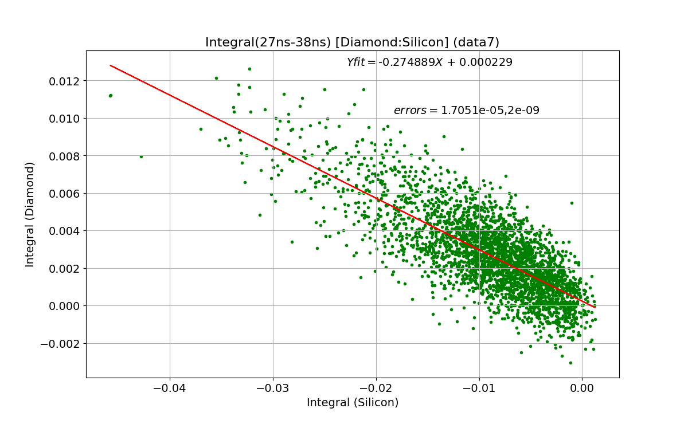
Diamond vs Silicon correlations with different integral windows

Slide 27
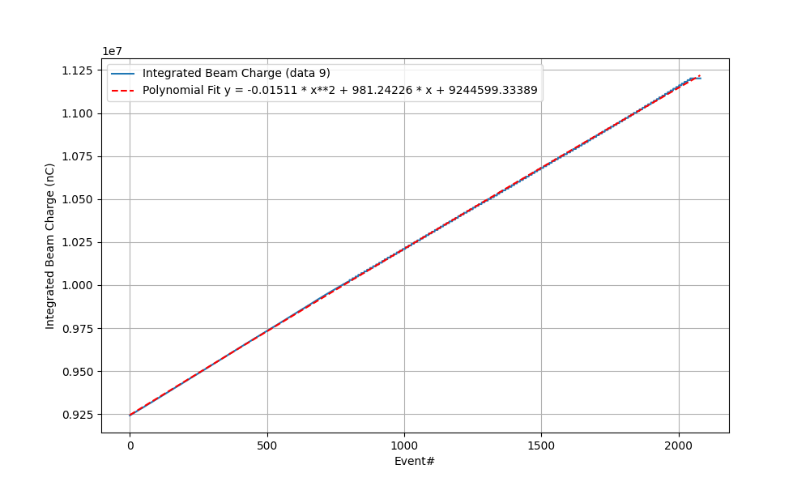
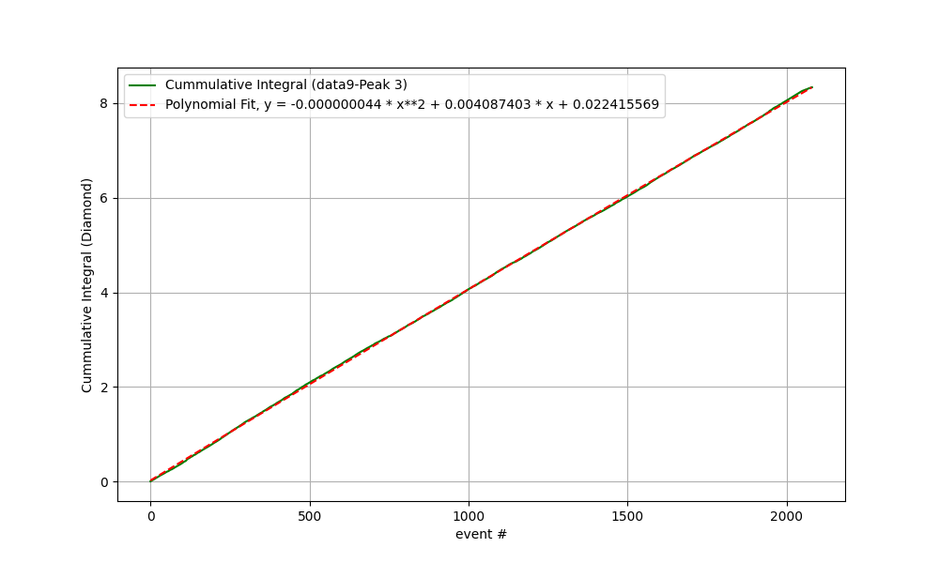
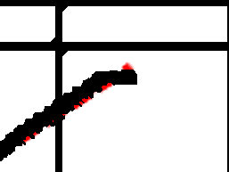
Integral offset when the beam is off

Slide 28
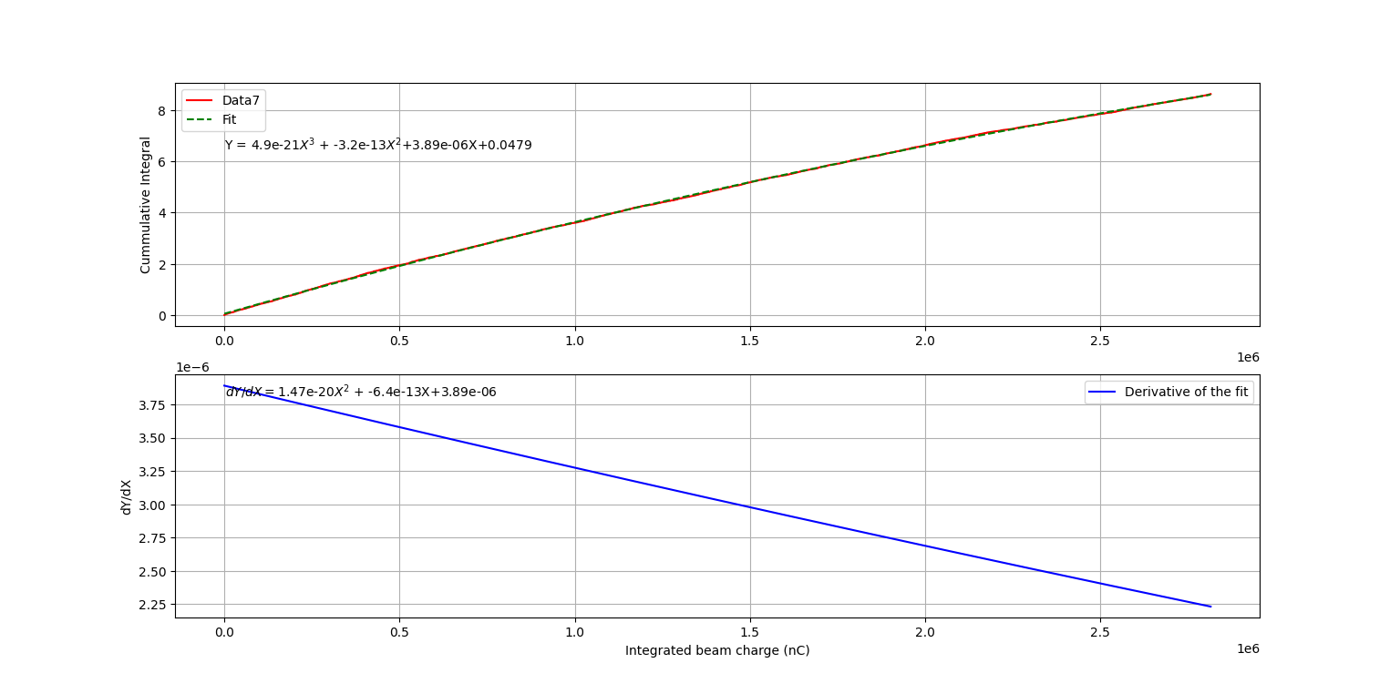
Charge collection rate as a function of Integrated beam charge for a sub-dataset

Slide 29
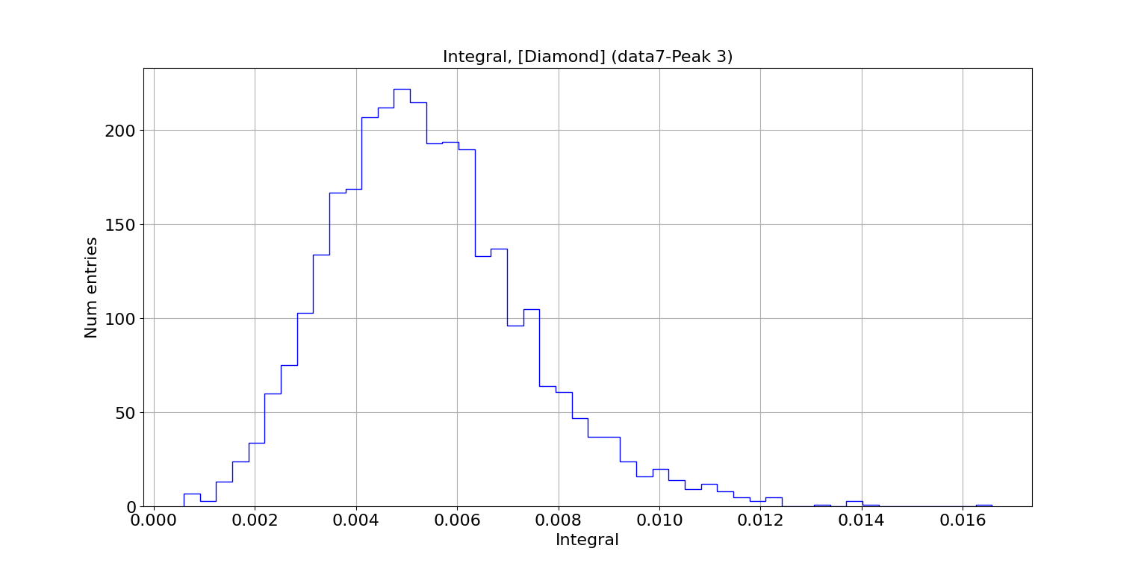
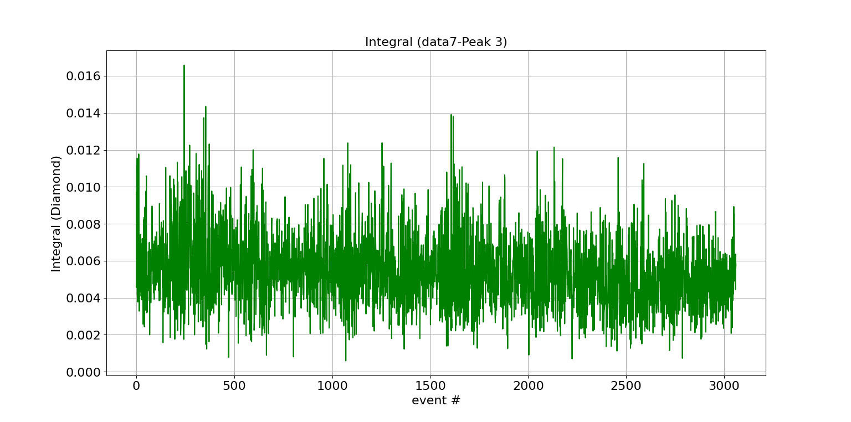
Integral distribution

Slide 31
3D TCAD Simulation
Dimensions: 120x120x35 um^3
Beam Diameter = 43 um
Bias: 100 V
Non-mixed mode: Only device simulation without any electronic circuit.
The currents are collected on the electrodes under the assumption that their potentials are fixed.

Slide 32
Comparison between TCAD simulation and the experimental data
Data was taken with different beam foci, only the highest plasma density points are a direct comparison. The lower density points are compared under the assumption that the plasma density and not the total charge is the characterizing quantity.

Slide 33
Why Diamond?
Monocrystalline diamond
Superior radiation tolerance
Fast saturated drift velocity ( ~ 200 um/nm)
Superior thermal conductivity (2200 W/m-K)
Charge collection time for a 30 um thick diamond sensor ~ 150 ps
low X-ray absorption
A promising candidate material for developing a fast (multi-GHz) pass-through diagnostic for the next generation of XFELs

Slide 34
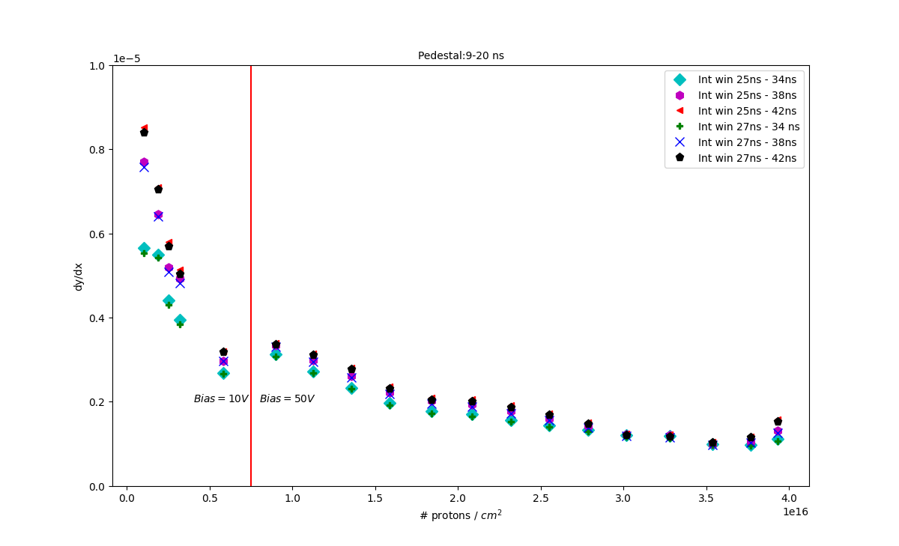
Charge collection rate as a function of fluence

Slide 35
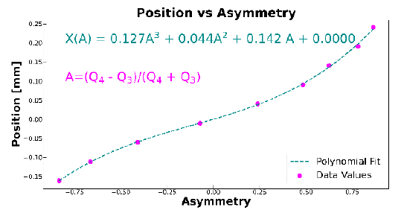
One-dimensional position resolution
Asymmetry A of the Q4 and Q3 signals:
$A=\frac{Q4−Q3}{Q4+Q3}$
Position resolution σ_{P} :
$σP=\frac{dP}{dA}σA$
$σA=\frac{σQ}{Q}\sqrt{(1}+A2)$
σ_{Q}: Uncertainty in the measured collected charge at any given quadrant.
Q : Average collected charge from the sum Q₄ + Q₃
$σP$ ~ 3 μm for a 4 nJ pulse
Measured XPP beam jitter with a 3 μm position resolution

Slide 36
Cumulative Integral vs Integrated beam charge
Cumulative integral vs the Integrated beam charge fitted with 3rd order polynomial.
Derivative of the fit function gives the charge collection rate as a function of the integrated beam charge.
The data is divided into equal parts of ~ 700 events and average of the derivative is plotted as a function of total fluence.
Data for the Fluence range 0 – 7.5x10¹⁵ protons/cm² is taken at 10 V and has larger error 5 – 10 %.
50 V bias after 7.5x10¹⁵ protons/cm² fluence.
The sensor irradiated at the Crocker and a similar unirradiated sensor were exposed to an X-ray beam at LCLS and the charge collection efficiency of the irradiated sensor with respect to unirradiated sensor was obtained ~ 21 %

