Slide 1
Secondary Emission Ionization Calorimeters
    Burak Bilki, Yasar Onel - University of Iowa
    David Winn* – Fairfield University
    winn@Fairfield.edu
1

Slide 2
Why Secondary Emission Ionization Calorimeters?
Secondary Emission: Rad-Hard + Fast (Damn Fast!)
  Metal-Oxide/Cs SE PMT Dynodes survive > 500 GigaRad
  SEM Beam Monitors survive 10²⁰ mip particles/cm²
SEe signal: SE surfaces inside Hadron Showers:
  SE yield δ: Scales with particle momentum ~dE/dx
  e⁻: 3 < δ <100, per 0.05 <e⁻<100 KeV (material depnt)
  δ~1.05 -1.1 or 0.05-0.1 SEe⁻ per MIP
  Ex: ~6-24 MIP equiv per GeV(Calice et al)sampling calorimeters - a lower limit on hadron shower SE signals
  > ~60-240 SEe⁻ per 100 GeV pion shower w/ MIPs alone
  BUT SEe⁻ Must be Amplified!

Slide 3
Why Secondary Emission Ionization Calorimeters? - I
Secondary Emission (SE) signal originates from SE surfaces inside electromagnetic/hadronic showers:
  SEe⁻ yield (δ) scales with particle momentum
  e⁻: 3 < δ <100, per 0.05 <E<100 keV (material dependent)
  δ ~ 0.05 - 0.1 SEe⁻ per MIP
SE is rad-hard and fast
  a) Metal-Oxide SE PMT Dynodes survive > 100 GigaRad
  b) SE Beam Monitors survive 10²⁰ MIPs/cm²

Slide 4
Why Secondary Emission Ionization Calorimeters? - II
  Example: ~60-240 SEe⁻ per 100 GeV pion shower w/ MIPs alone
  Normally the secondary electrons are subsequently amplified by a set of dynodes to a suitable level for data acquisition.
➔ The SEe are treated exactly like PEs in a scintillator calorimeter.
In a scintillator calorimeter, many photons are created, but typically 0.1-1% are collected and converted to PEs by a PMT or SiPM. By contrast, in an SE calorimeter, relatively few SEe are created, but almost all are collected and amplified by the dynode stacks.
A set of SE cathodes and dynodes (SE sensors) may serve as active media in a sampling calorimeter.

Slide 5
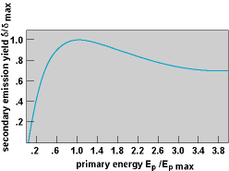
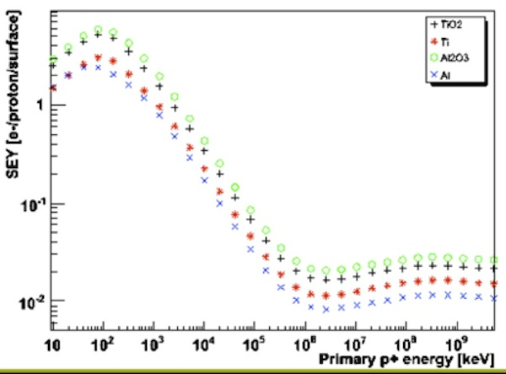
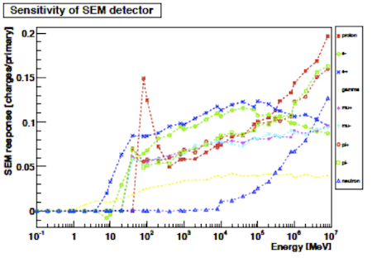
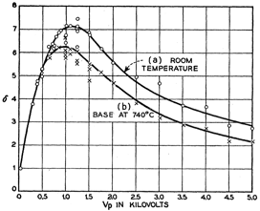
SE Yield/Semi-empirical Sternglass formula: the universal curve of SE emission: SE yield normalized to maximum yield vs particle energy normalized to the energy of max yield.
MgO
CERN beam monitor e, µ, π, p, n
Entrance
Window
cutoff

Slide 6
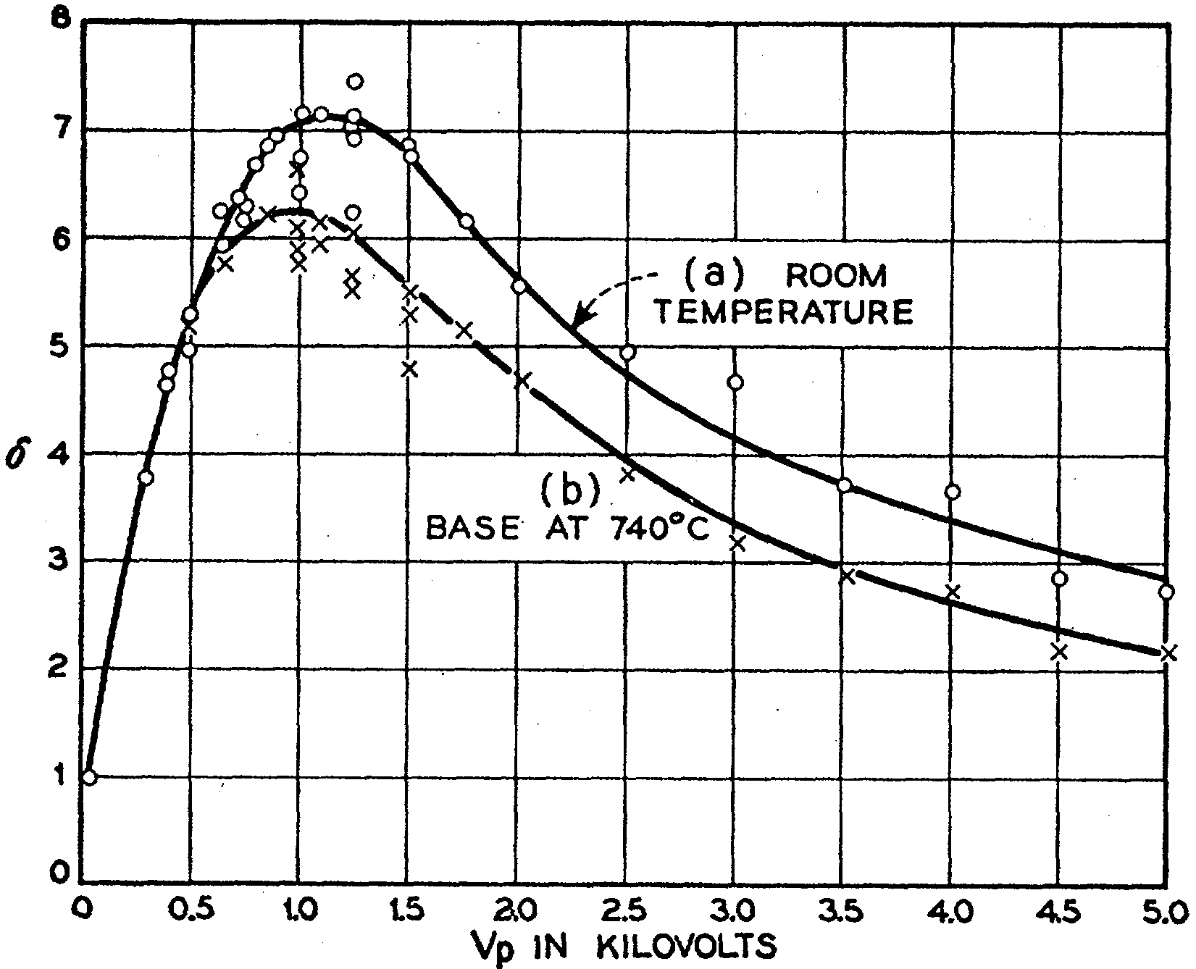
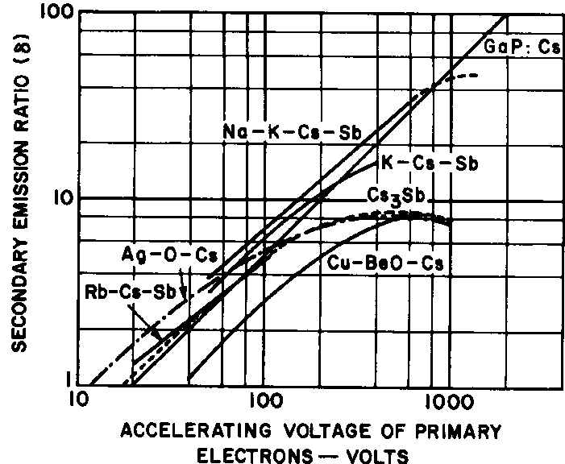
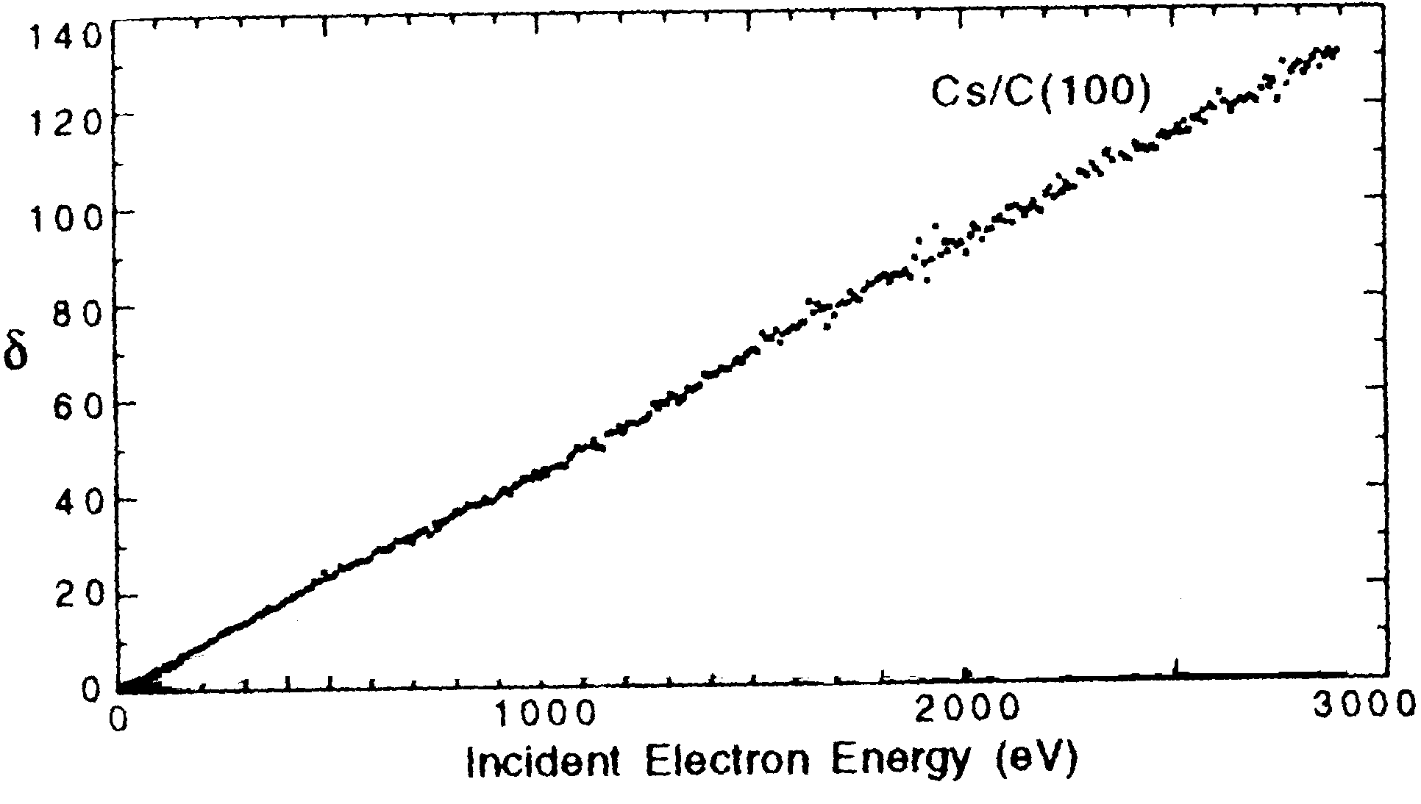
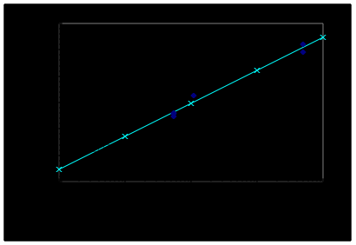
High SE Yield Materials
Peak Yields~5-10+; Alumina Easy
MgO
Electrons on MgO
Diamond
SE Yield
Stable in air!
Diamond Gain 300 V vs B Doping Level

Slide 7
Secondary Emission Sensor Modules
The SE sensor modules need to have sufficiently large areas of dynode to uniformly sense the charged shower particles. Such large and uniform dynodes include electrochemically etched, micromachined or laser-cut metal mesh dynode sheets.
The construction is far easier than a PMT since the entire final assembly can be done in air. There are no critical controlled thin film depositions nor vacuum activation. The module is sealed by welding or brazing or other high temperature joinings with a simple final heated vacuum pump-out and tip-off.
The modules envisioned are compact, high gain, high speed, exceptionally radiation damage resistant and cost effective.
The SE sensor module anodes can be segmented transversely to sizes that are appropriate to reconstruct electromagnetic cores with high precision.

Slide 8
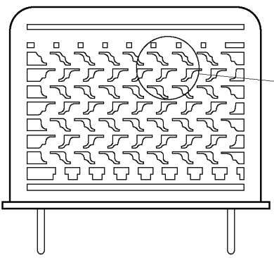
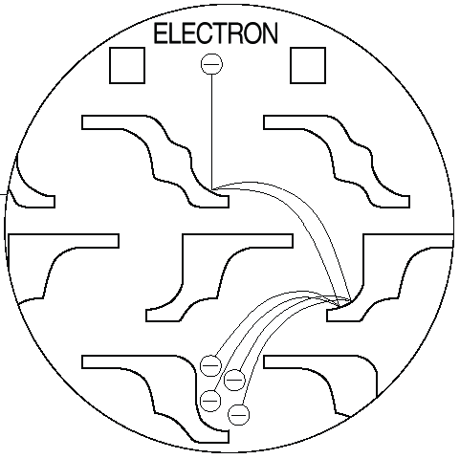
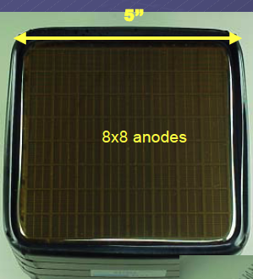
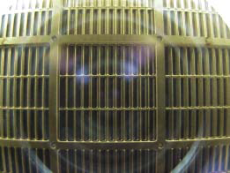
SE Dynodes: a) Etched Metal Sheets
Hamamatsu Dynodes
15 cm now → ~50 cm
Already diced from large
sheets

Slide 9
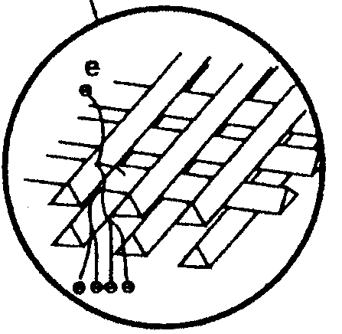
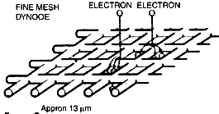
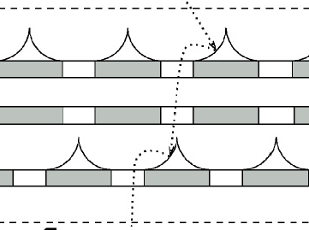
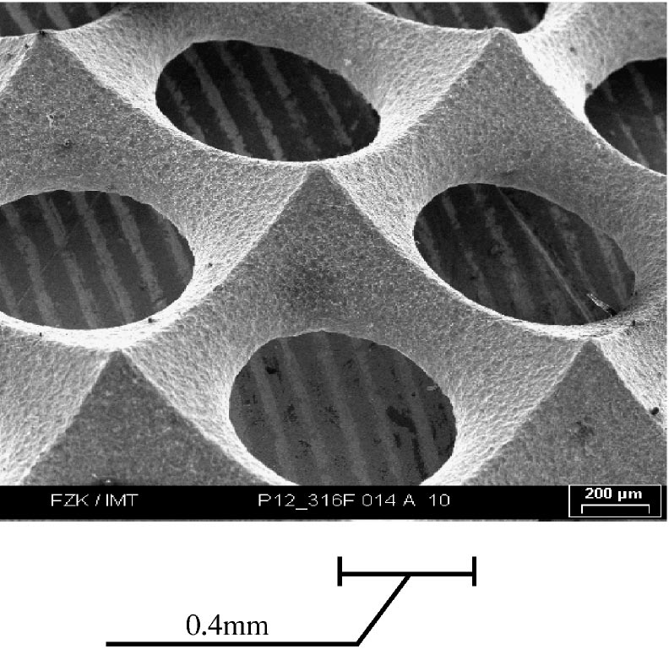
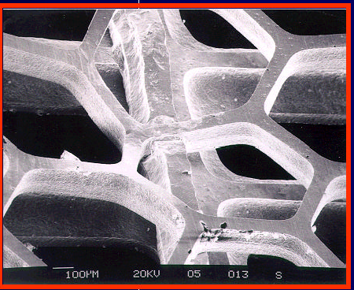
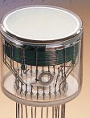
SE Dynodes: b) Metal Screen Dynodes: 15D - g~10⁵
MESH DYNODE VARIANTS
D_{n}-D_{n+1}: 0.9 mm
C-C mesh: 13 µm
Wire diameter: 5 µm

Slide 10
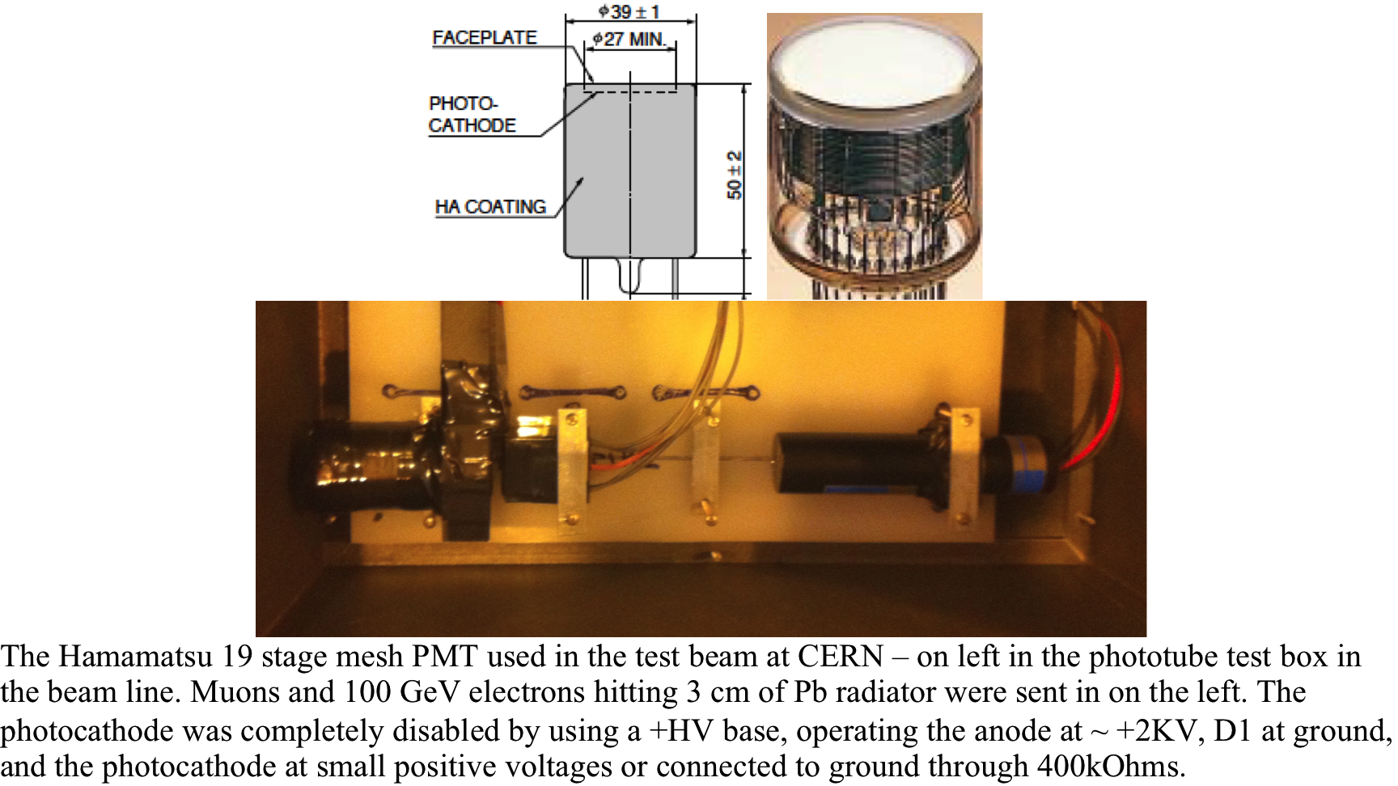
Beam Tests of SE Sensor
CERN SPS, Oct. 2011
Mesh PMT and Base
Facing Downstream
Photocathode Reverse Bias
or turned off
19 Stage Mesh
3 cm Pb
100 GeV e-
We Expect ~500 Shower electrons to Cross Mesh
→ ~25-50 SEe assuming all shower e = MIPs

Slide 11
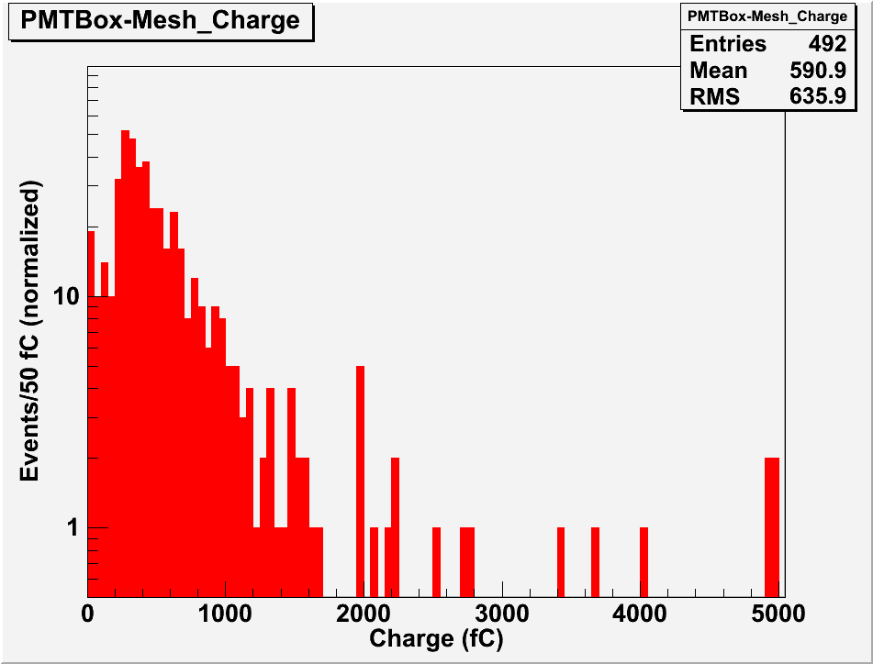
BEAM TEST: 100 GeV electrons
3 cm Pb ~ 5 X₀ Radiator ~ Shower Max
Mesh PMT w/ photocathode turned off and downstream
CERN SPS, Oct. 2011
PRELIMINARY!
Fluctuations High!
PMT Dia ~ Shower Dia
Beam not centered
NOTE µ MIP:
Detection Eff ~10%
Response ~1-2 “SEe”
Peak corresponds to ~40 SE electrons

Slide 12
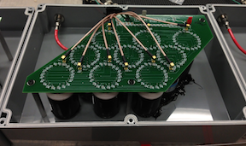
SE Module Beam Test
2-cm iron absorbers:
X₀ = 1.75 cm
Molière Radius: 1.72 cm
80 GeV e⁻ Beam
Variable absorbers
0 – 9 X₀
SE
SE
SE
SE
Shower not contained laterally or longitudinally
→ Results require estimates and approximations

Slide 13
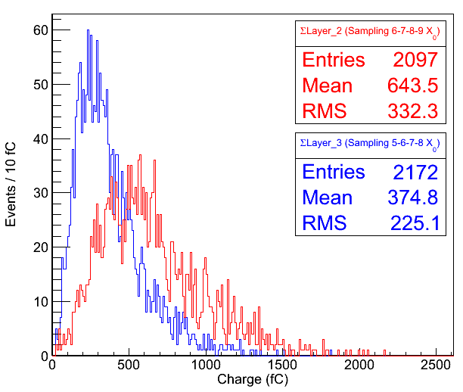
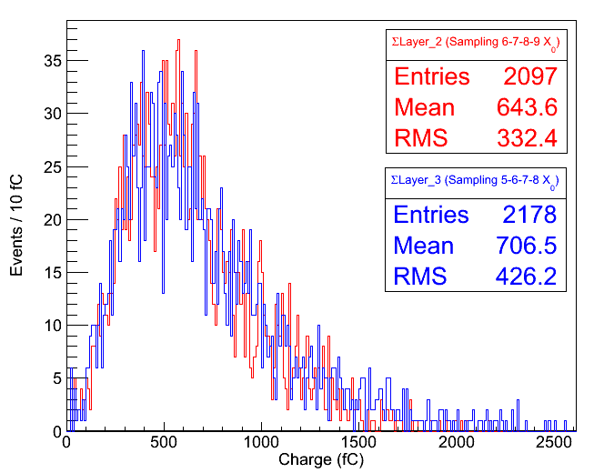
SE Module Tests – Preliminary Results
Normalizing responses of different layers
Example: Normalization of Layer 3 response to Layer 2 response using 7X₀ sampling
(Also works in the reverse order → next slide)
Charge > 20 fC

Slide 14
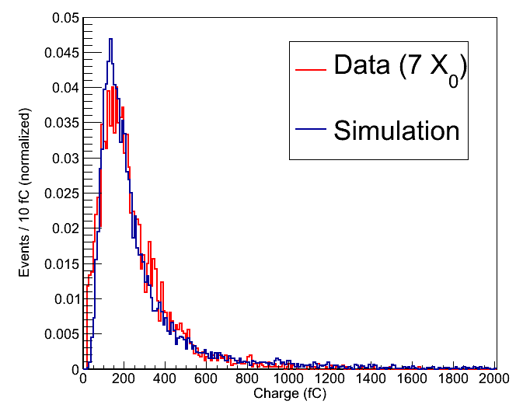
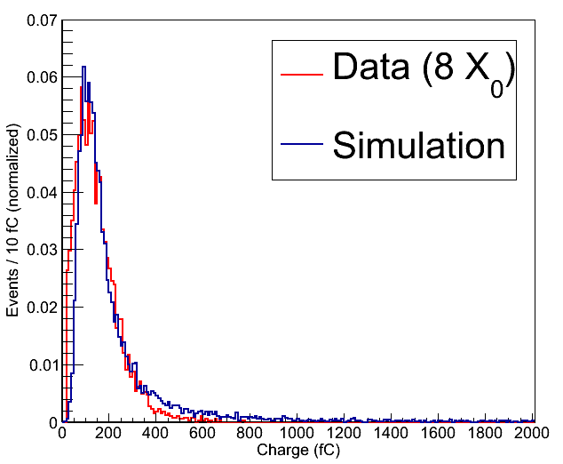
SE Module Simulation
Geant4 simulation of the SE module test beam setup:
80 GeV e⁻ beam
19 stage mesh dynodes generate SE electrons (dynodes ~ sheets)
Gain is simulated offline (10⁶)
Landau fluctuations are implemented offline

Slide 15
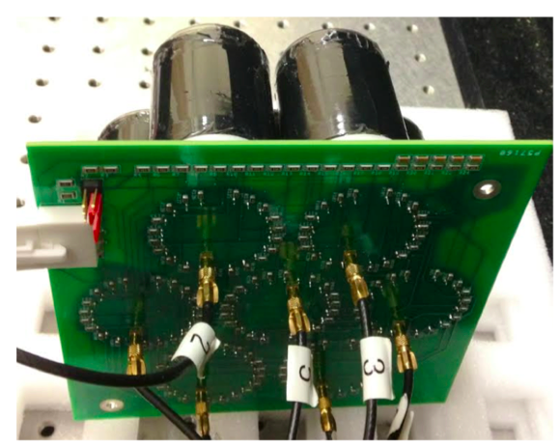
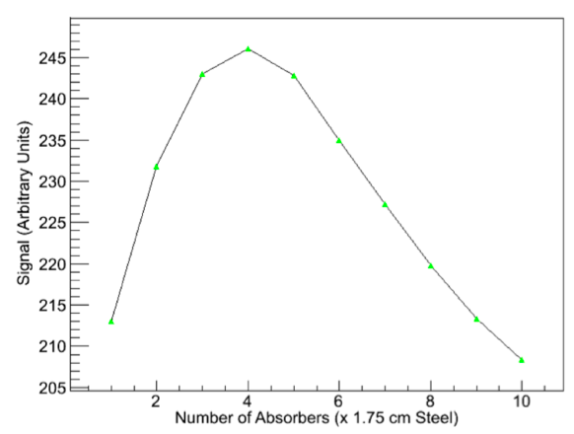
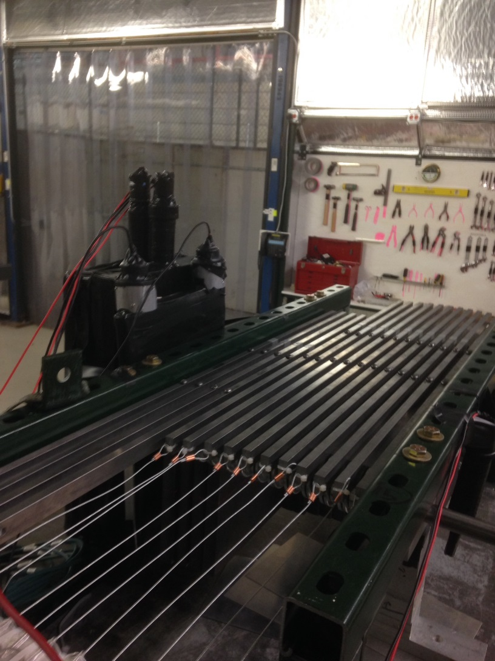
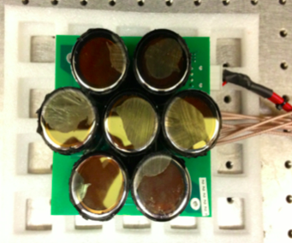
Second Generation SE Module - I
7 closest-packed PMTs with photocathodes turned off
4 GeV shower profile
20 cm x 20 cm x 1.75 cm steel absorbers

Slide 16
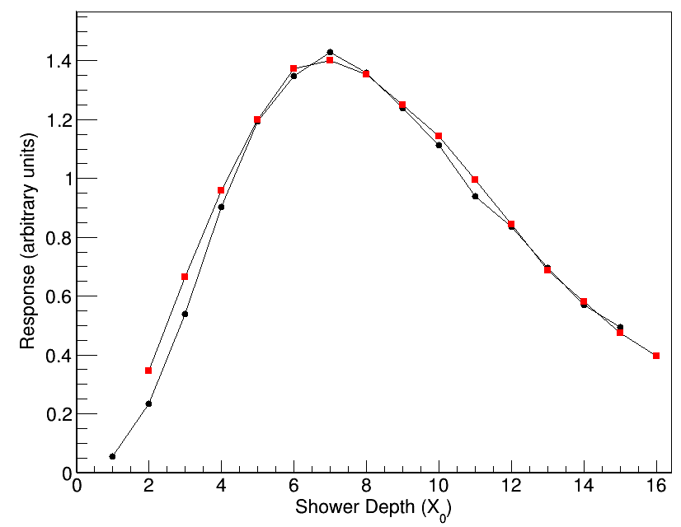
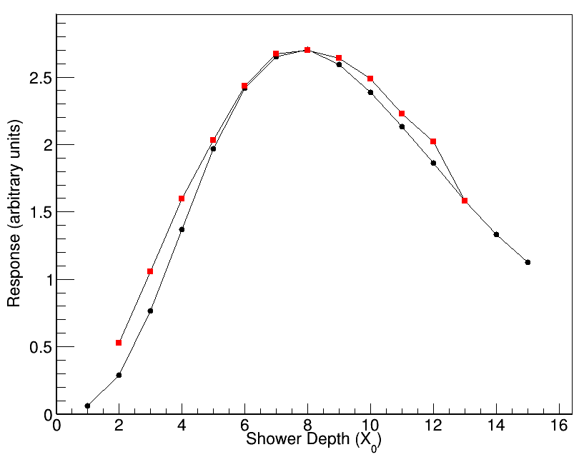
Second Generation SE Module - II
Tests with single SE sensor and up to 15 3 cm x 3 cm x 0.35 cm W plates
Data taken with wire chamber i.e. the leakage is a bit more under control (but still there)
8 GeV shower profile
16 GeV shower profile
Data
MC
Data
MC

Slide 17
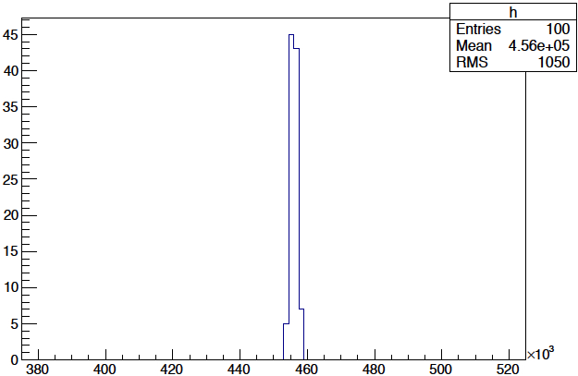
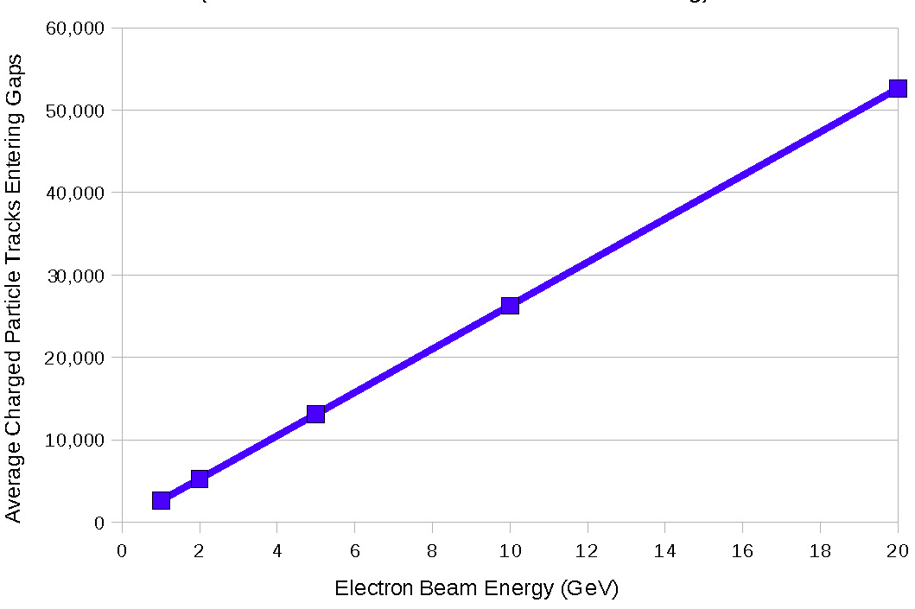
SE Calorimetry Projections
MC: monotonous quasi-homogeneous 10 µm W mesh,30% open;10µm spacing (Xo~1mm); SE yield max 3 @ 100V. 100 events, 100 GeV electrons; Histogram of collected charge in SEe (10⁵ electrons); Linearity 1-20 GeV.
RMS/E at 100 GeV = 0.0022 -> Stochastic σ_{E}/E ≤ 2.2%/√E
High Yield SE materials

Slide 18
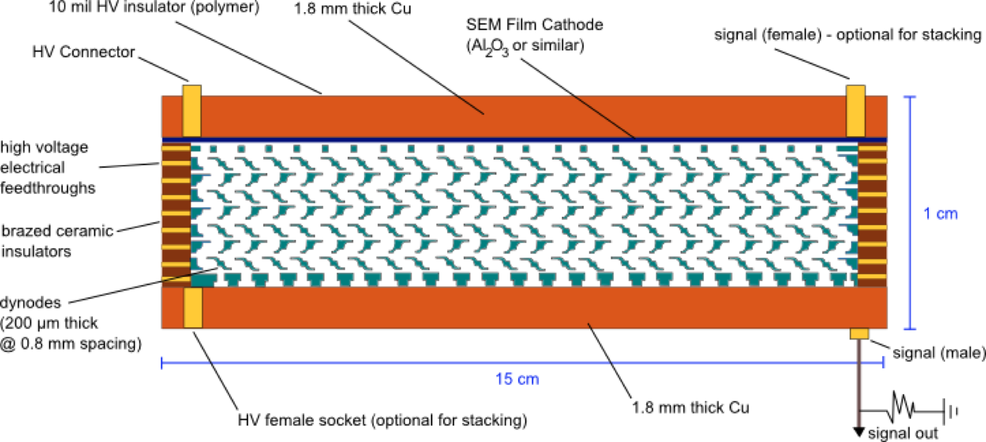
SEe Detector Module -II
3D Stackable x,y,z

Slide 19
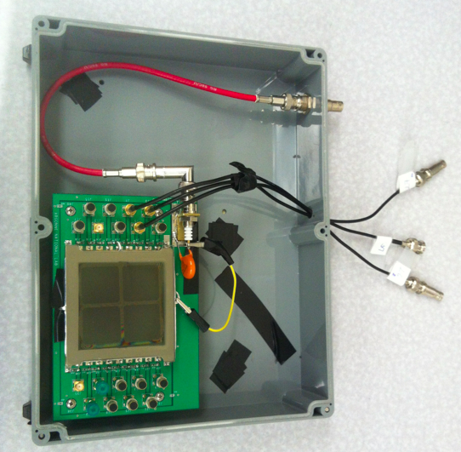
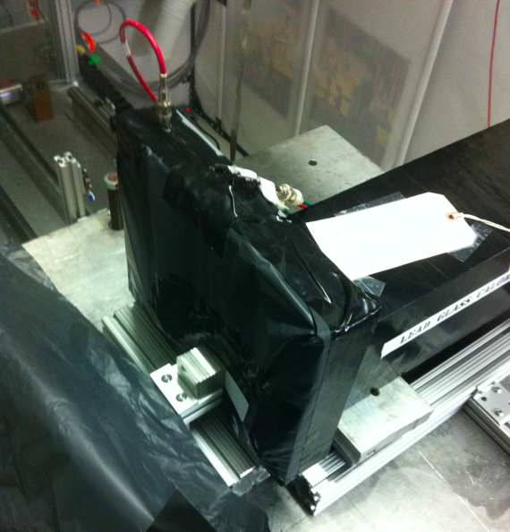
MCPs As Secondary Emitters
Should work effectively
Have simpler design
Should be very fast
Previously studied by A. Rhonzin et.al. and currently by Fermilab and Caltech (next talk).
No dedicated SE test module yet. But…
We had the Argonne LAPPD (Large Area Picosecond PhotoDetector) MCP to study some (very) preliminaries.
Fermilab test beam Nov 12-18 2014
W absorbers
MCP
beam

Slide 20
Secondary Emission (SE) Calorimetry with MCPs
Ideal SE module utilizing MCPs
anode
A thin cathode, possibly a secondary emitter layer of high yield material
Insulator
MCP
Argonne MCP comes as a complete photodetector box with a relatively thick glass window. Newer production allows the turning off of the photocathode.
Nevertheless, it is worth trying it as a secondary emission module
→ a reasonable shower profile is an indicator of potential performance.

Slide 21
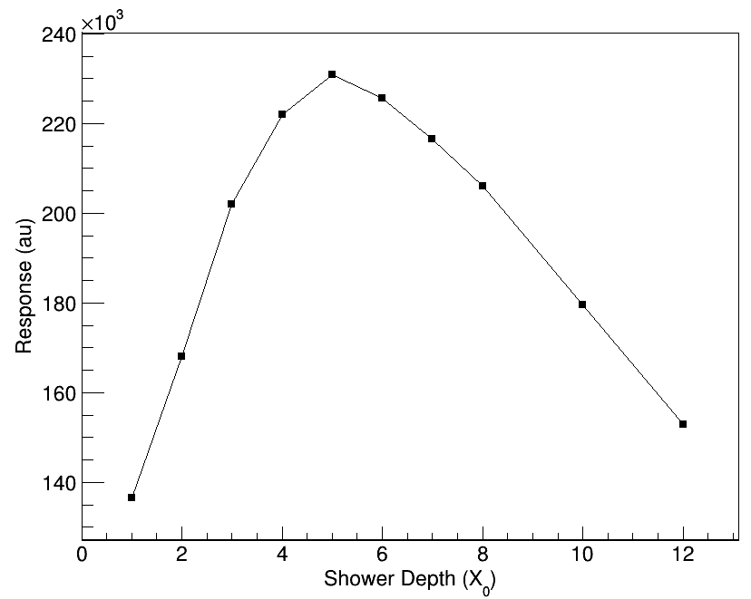
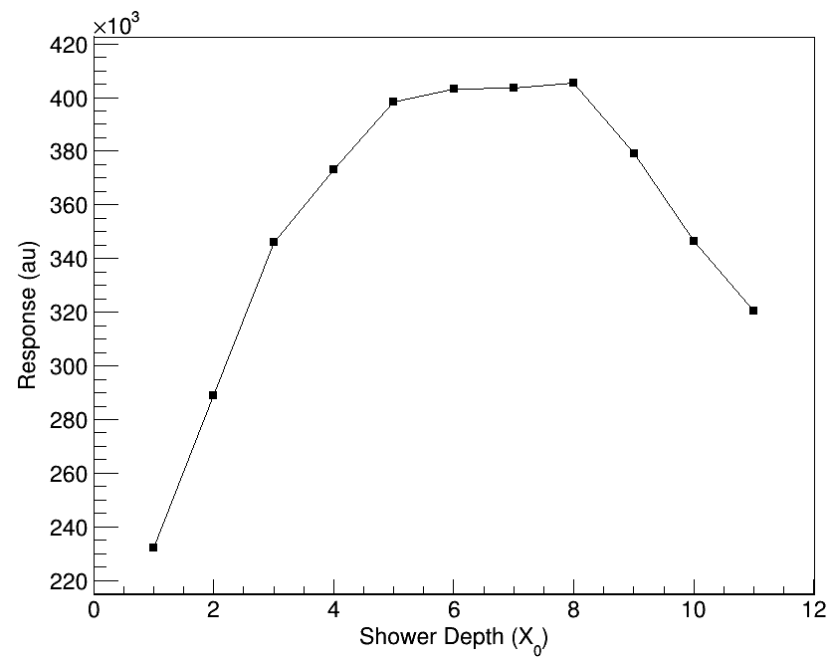
Secondary Emission (SE) Calorimetry with MCPs
Tested the LAPPD with up to 12 3 cm x 3 cm x 0.35 cm W plates
4 GeV and 8 GeV secondary beams were used triggering with positrons (i.e. with the Čerenkov counter signal in the trigger decision)
Two strips were read out at one end (smaller than the shower size)
Results quite encouraging!
4 GeV
W absorbers
MCP
8 GeV
beam

Slide 22
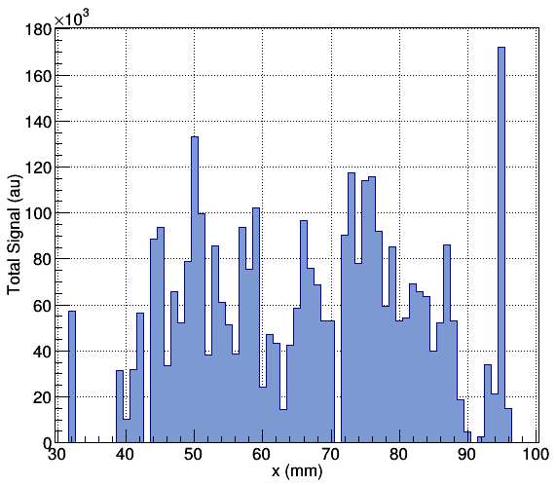
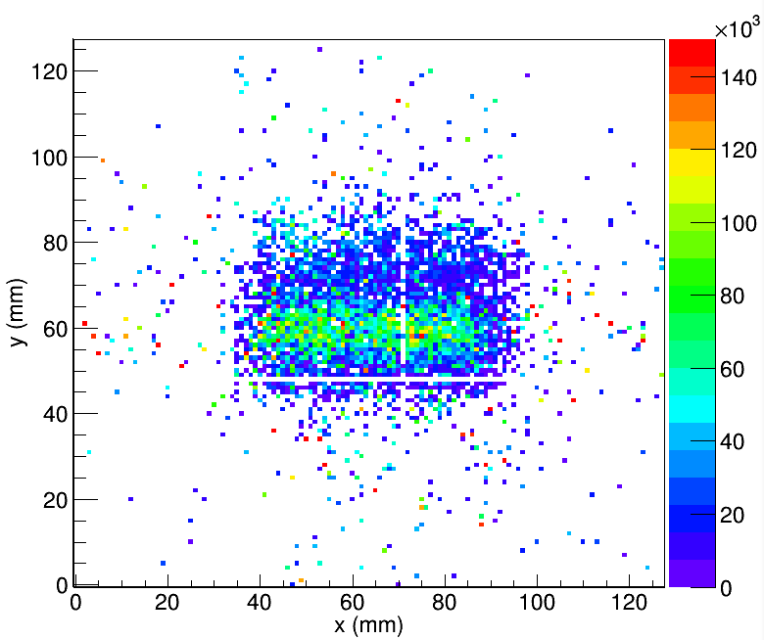
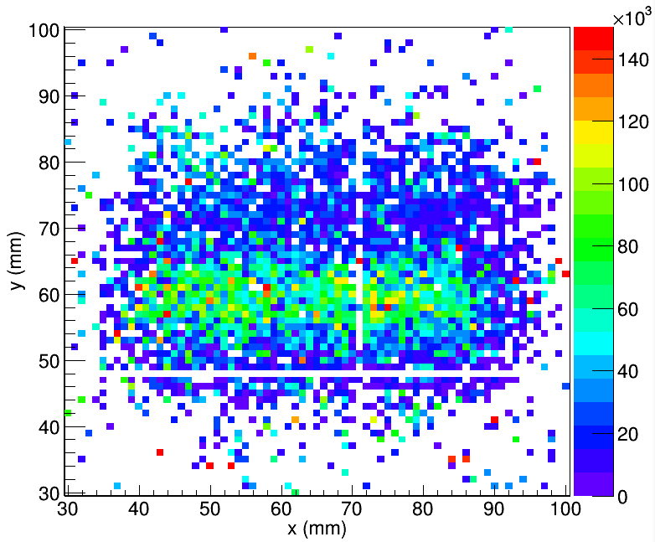
Position Reconstruction with LAPPD
Total signal (R+L) profile
~ window boundary
Trigger area ~ 5 cm x 3 cm
One strip read out at both ends
Select the events with particles traversing the strip:
X: 40 – 85 mm
Y: 56 – 62 mm

Slide 23
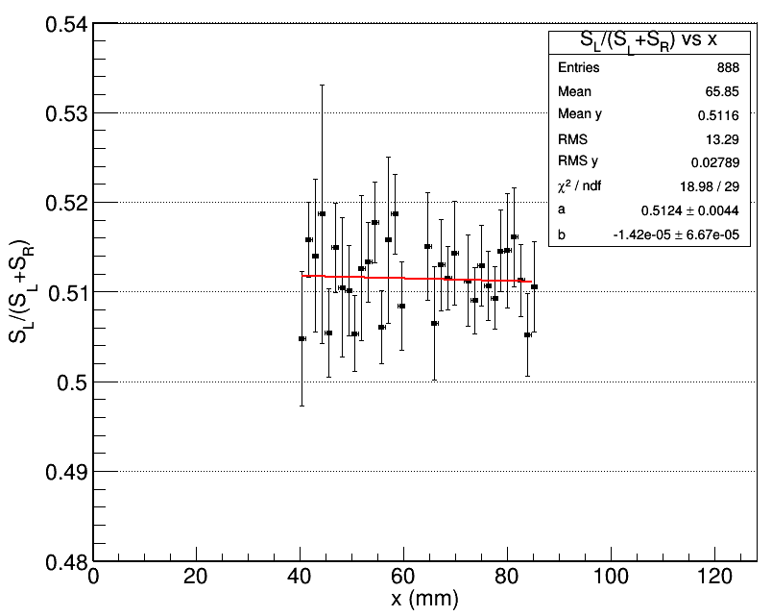
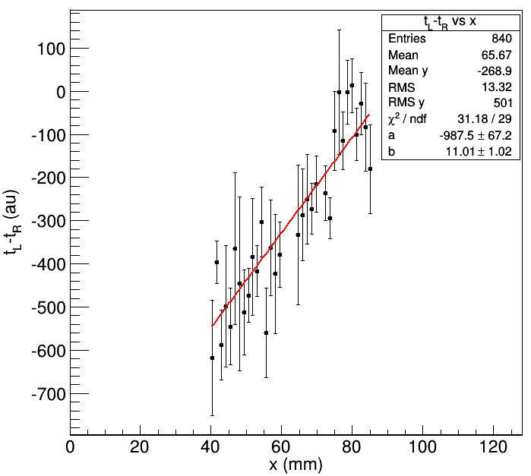
Position Reconstruction with LAPPD
Fraction of the L signal as a function of x along the strip
Time difference between L and R signals
a+bx
a+bx
Very small correlation, not quite significant.
Strong correlation!
Event position can be reconstructed with timing techniques. → More on this in the next talk.

Slide 24
Conclusions
Secondary Emission calorimeter is radiation-hard and fast.
Progressive beam test results are encouraging.
SE calorimetry is feasible for large-scale applications.
SE calorimetry is suitable for fine readout segmentation hence imaging calorimetry.
There are many implementation areas for SE calorimetry:
  Forward calorimetry for hadron/lepton/ion colliders
  Beam monitors
  Compton polarimetry for lepton colliders

Slide 25
Outlook
A dedicated Secondary Emission module is needed for complete validation: Identify a secondary emitter as the cathode. Then use either dynodes of the same type or MCPs as multipliers.

