Slide 1
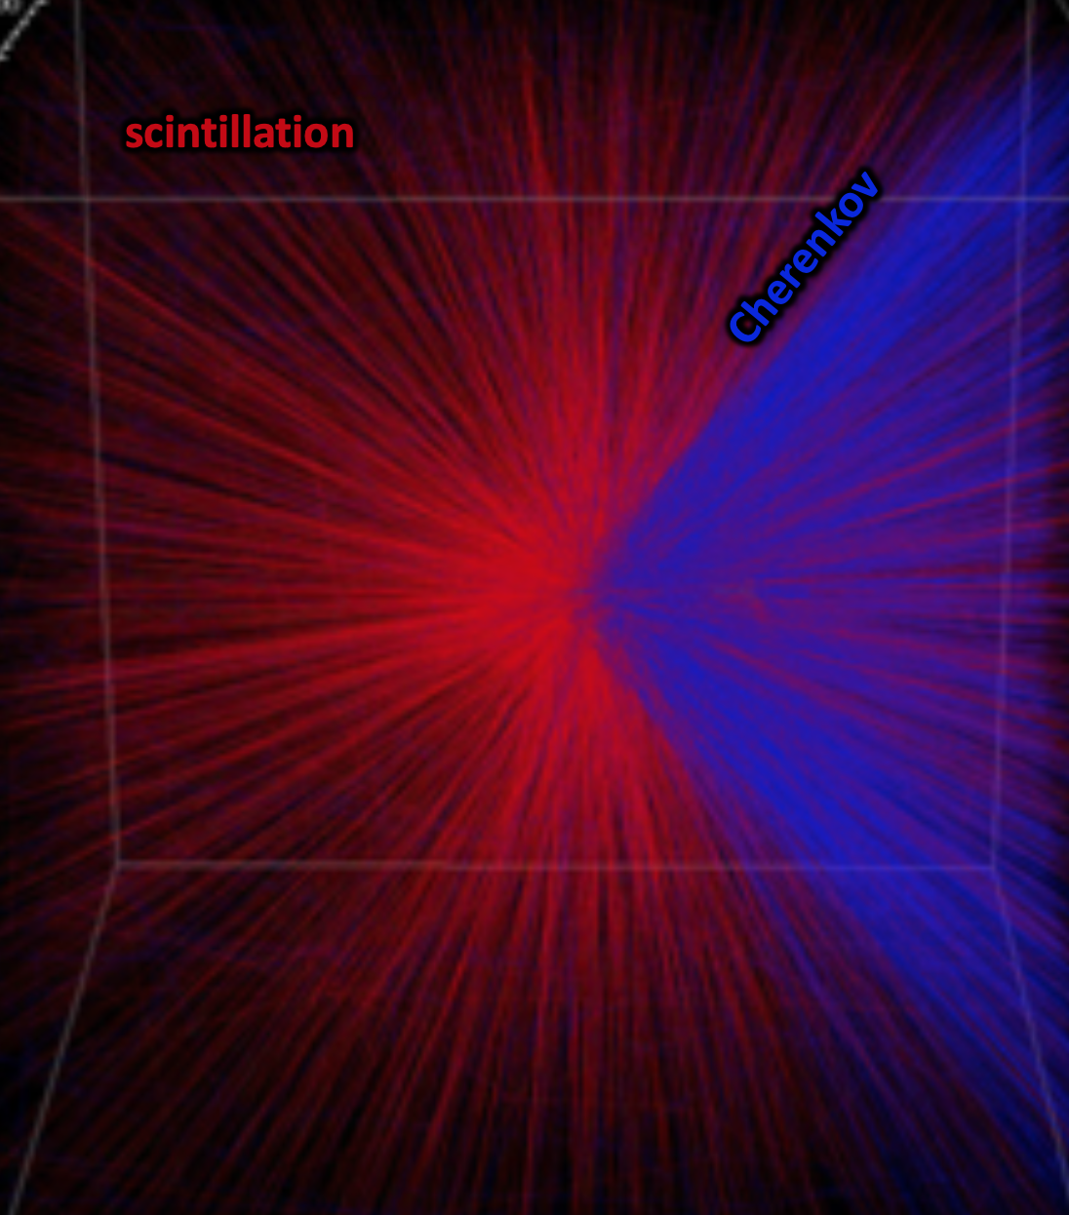
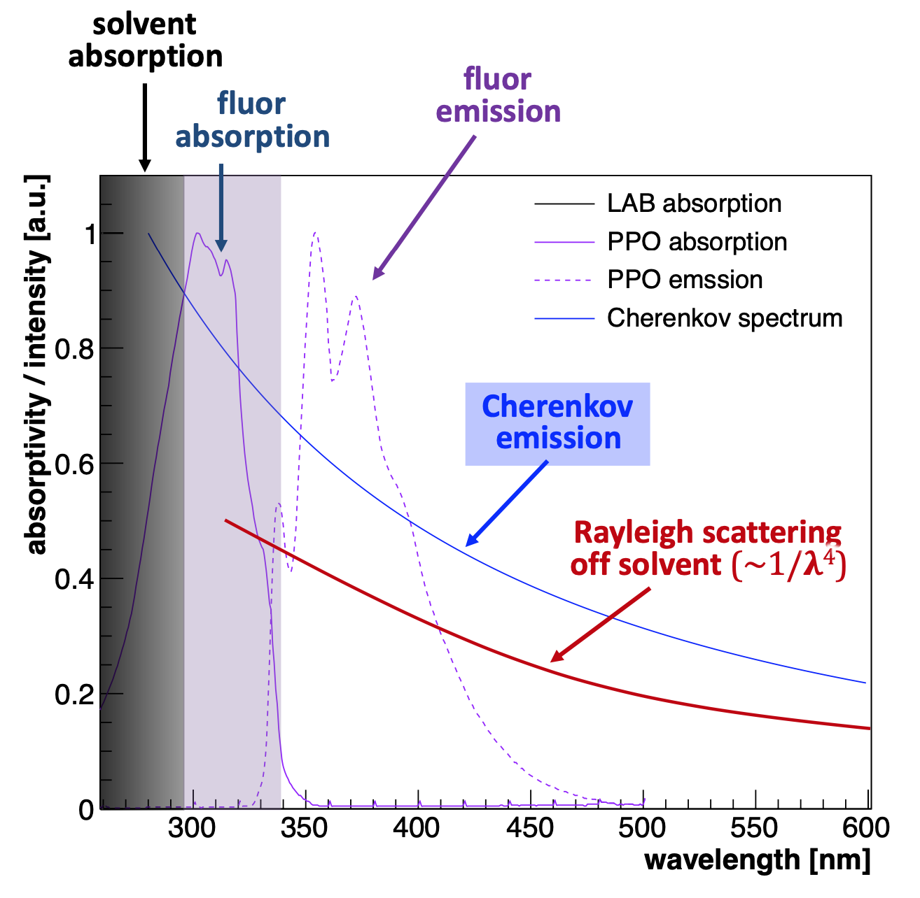

Removing Optical and Radiological Contaminants from Water-based
Liquid Scintillator

Slide 2
How Does WbLS Work?
Typically, any aromatic solvent can scintillate
Some are hazardous materials due to either toxicity, flammability, or both
hazardous
solvents
LAB is now popular
due to high flash point
and use in soap industry
less hazardous
solvents

Slide 3
How Does WbLS Work?
In order to avoid self absorption of the light produced by scintillation, a fluor (e.g. PPO) is needed.
unless a PPO molecule can absorb the energy, it will eventually be lost to heat. Thus, increasing the PPO
concentration increases the light yield in general
For many years it was assumed
that water and oil could never mix
and since this mechanism will not
work in water all LS must be organic
The time it takes to transfer energy
to the PPO gets shorter as concentration increases.

Slide 4
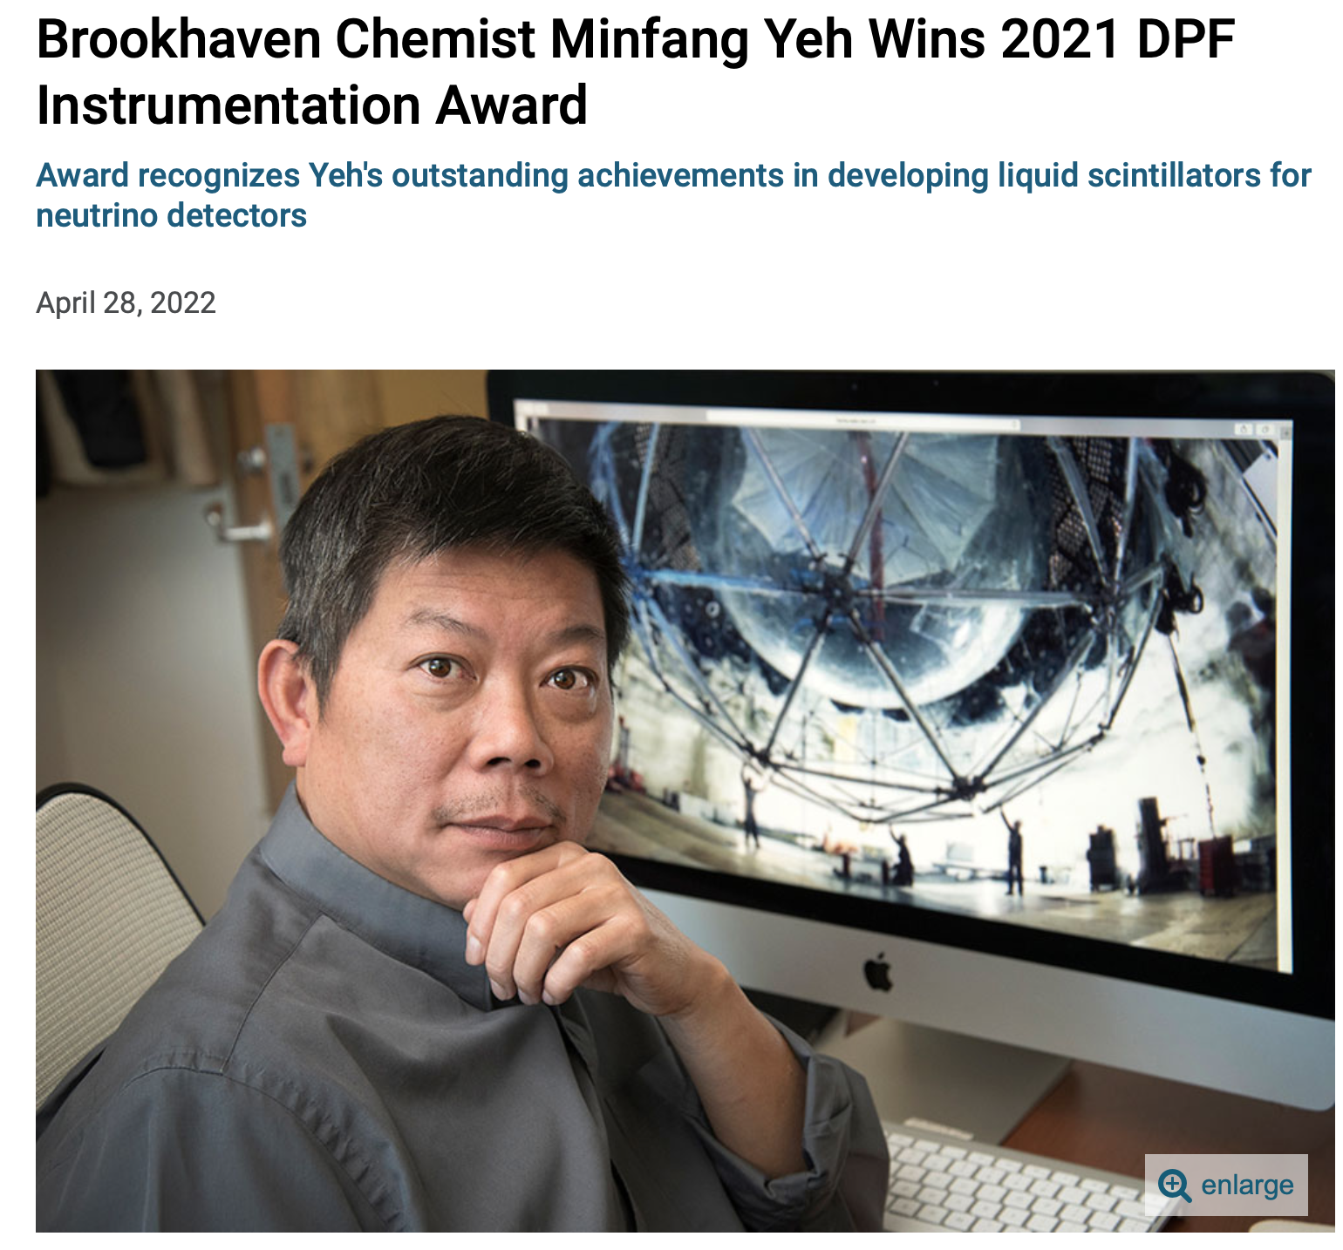
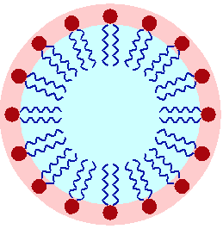
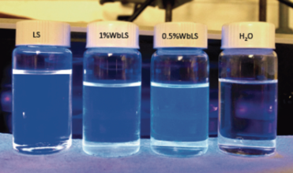
Water-based Liquid Scintillator
Liquid scintillator forms small (~10 nm scale) droplets called micelles in water that are stabilized by surfactant molecules with a hydrophilic head and hydrophobic tail. Micelles form under controlled chemical conditions and are shown to be stable over year time scales.
surfactant
molecules
Advantages: Disadvantages
Cheaper than LS Radiological cleanliness more difficult
Non-combustible Lower light yield than pure LS
Ease of loading Li, Te, etc
Environmentally friendly
Oxygen nuclei instead of Carbon
~10 nm
LS

Slide 5
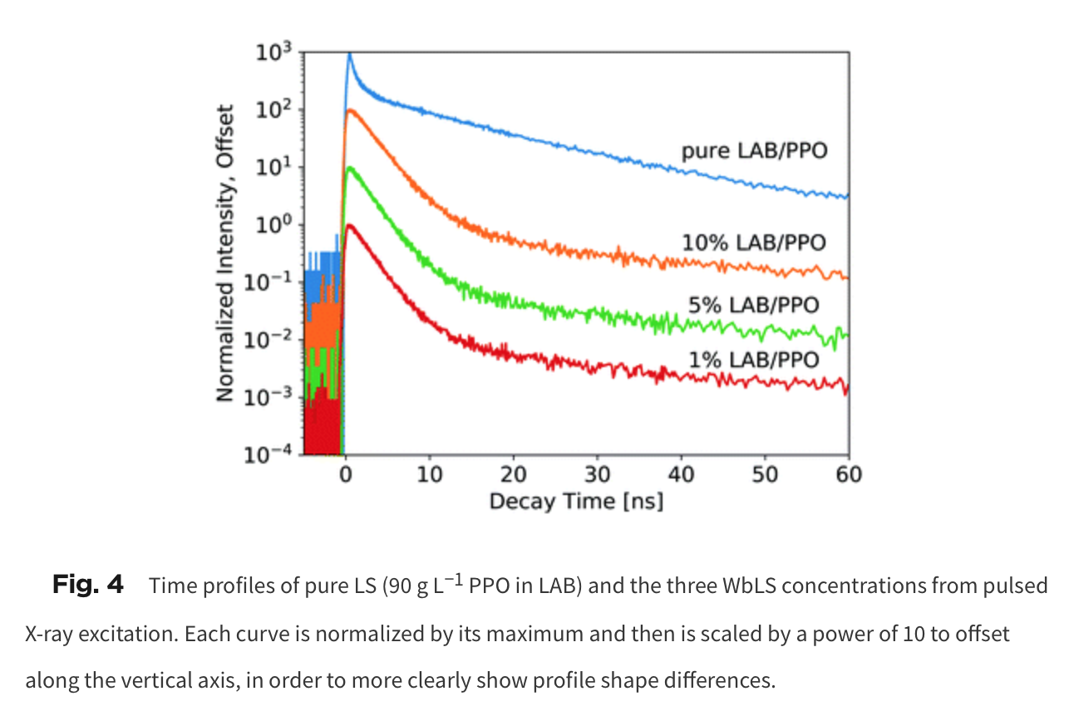
What can WbLS Do?
WATER
WATER
LS
Li, Te, Gd, …
put the ion of
your choice here
WATER
Onken, Moretti, Caravaca, Yeh, Orebi Gann, Bourret Mat. Advances 1 (2020)
Instead of trying to dissolve desirable ions
in liquid scintillator, one can dissolve them
in water (much easier) to open up
new areas of physics
Ch/LS light separation, tunable LY
at low cost, environmentally safer than LS, non-combustible, …

Slide 6
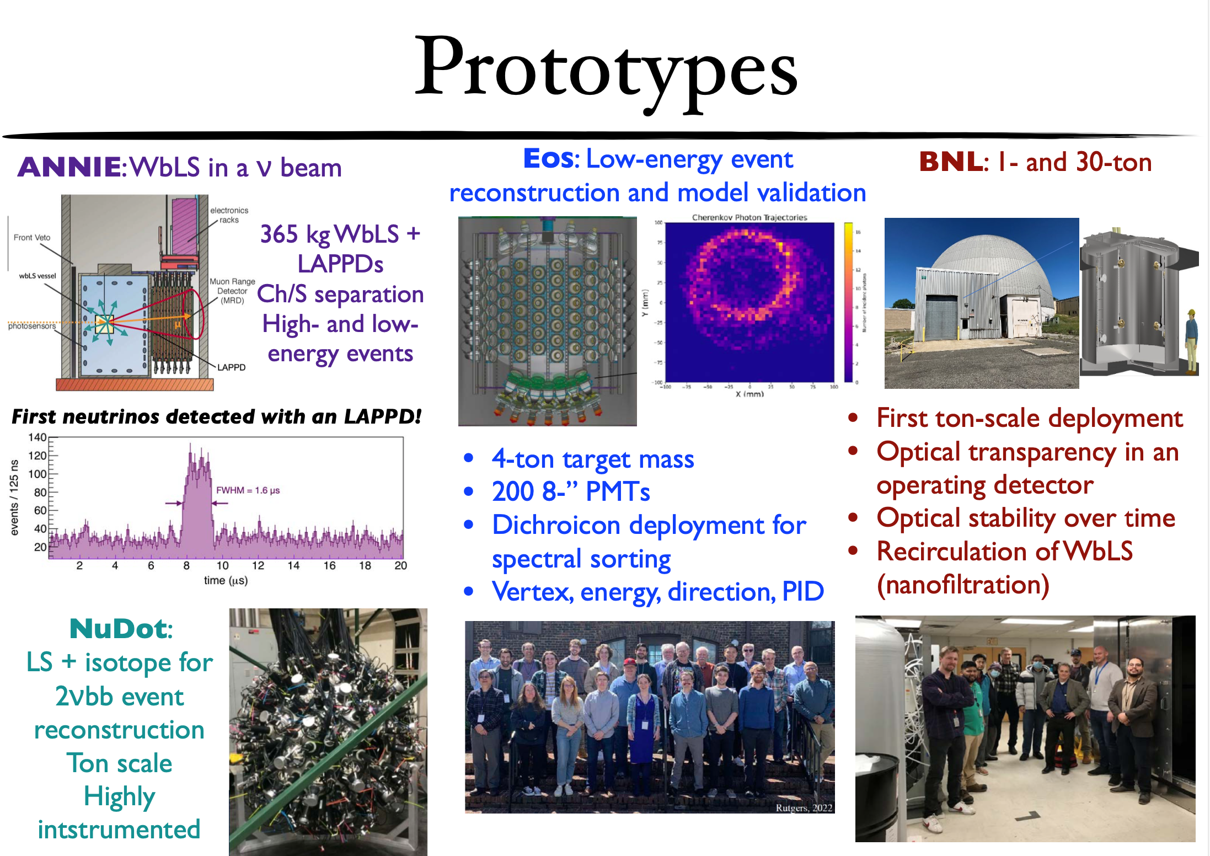
Large Scale Demonstrators being constructed now
The development of hybrid optical
detectors is now beyond the “R&D stage”
A coherent program of prototyping is already well underway. Expect completion by end of FY25.
These prototypes will allow us
to make final decisions on most
remaining technical options, including
initial fill media down select, photosensor array composition and scope, liquid purification system parameters, and specifications for radiological purity and cleanliness

Slide 7
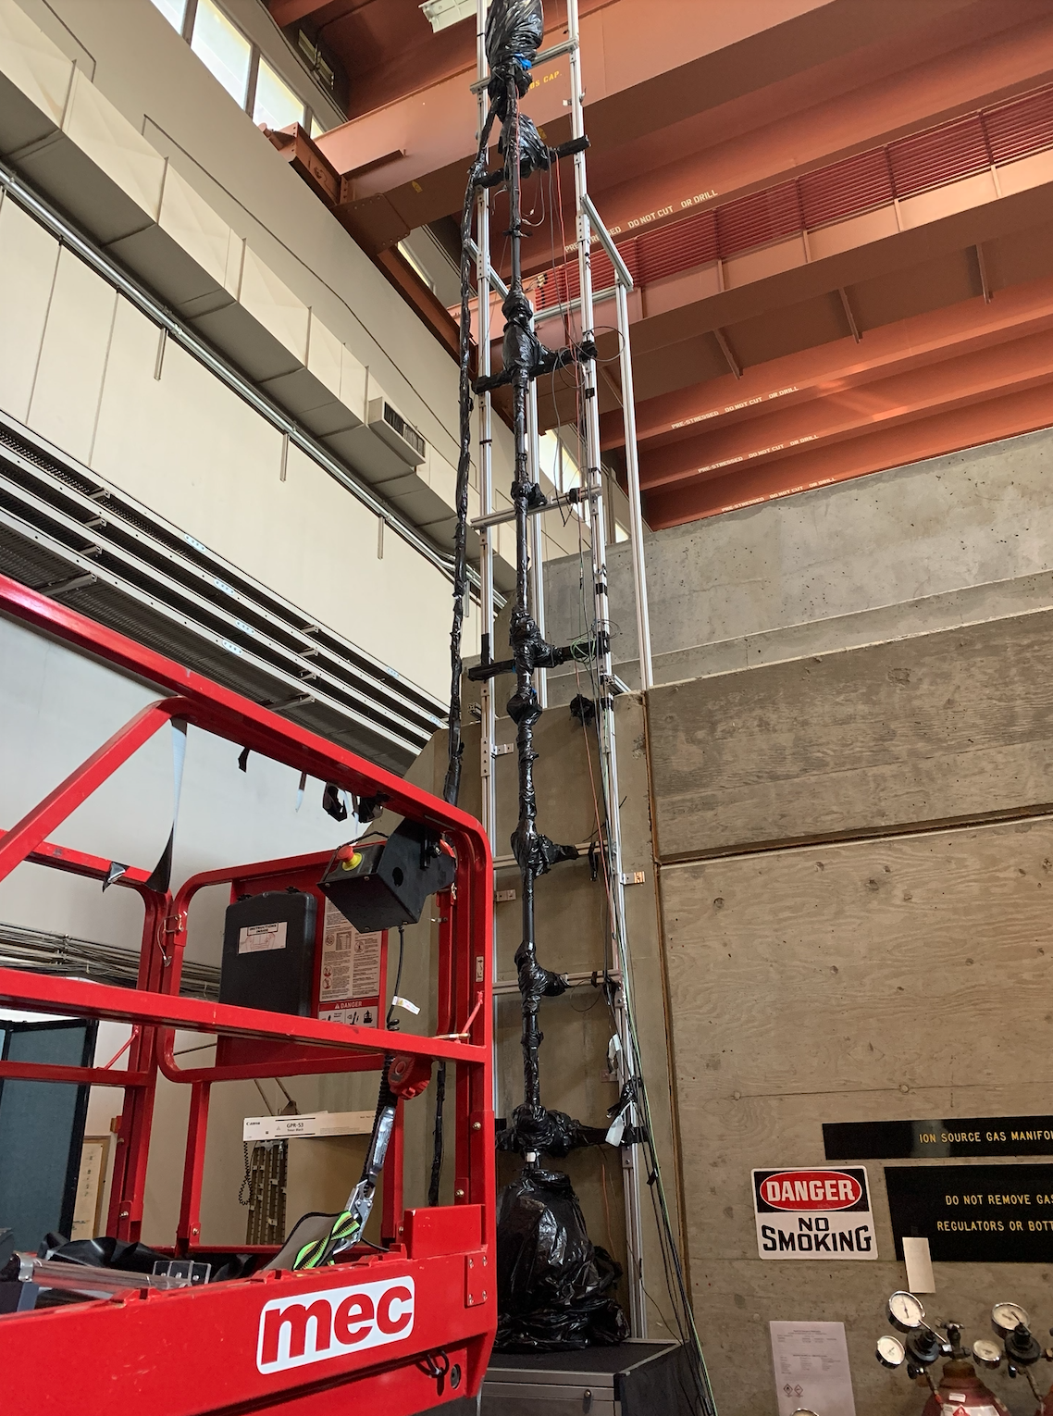
30-ton Purification Demonstrator
Funded by DOE for FY22-FY24, this project is to scale up the purification processes that have been developed for WbLS
  Fully-functional recirculation and WbLS purification system. This system can also handle purification even with ion doping of the WbLS
  Demonstrator has instrumentation to determine effectiveness of recirculation and allow for spike tests of known optical and radiological contaminants (e.g. iron ions)
This project is a follow-on to the existing 1-ton Demonstrator, now running at BNL
Scattering and Attenuation
Monitoring Device (SAMD)
for measuring WbLS optical
properties

Slide 8
Why Do We Need This?
Leaching products from detector materials can absorb or scatter light
  Iron ions, colloids, compounds
  UV absorbers from plastics
  other possible ions (e.g. nitrates)
Can also contain radioactive contaminants
  238-Uranium g 222-Rn g 214-Bi (among others) g 210-Pb (22 year half life) g 210-Bi (Q=1.2 MeV)
  232-Th g 208-Tl (2.6 MeV gamma)
  40-K (1.4 MeV gamma)
  other ions like Co and Ag can also be present at low levels – maybe not important for IBD
Radon (to a lesser extent)
  hard to remove from detector in short time scale, but leads to 214-Bi and 210-Pb
All large liquid detectors built to date require some form of in situ purification

Slide 9
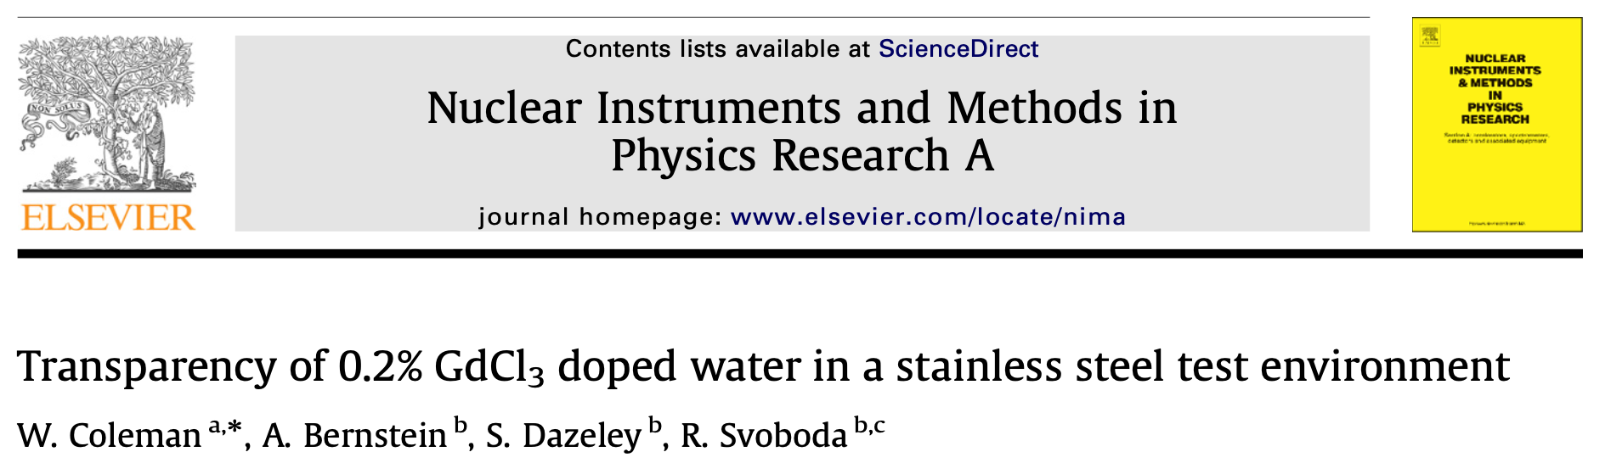
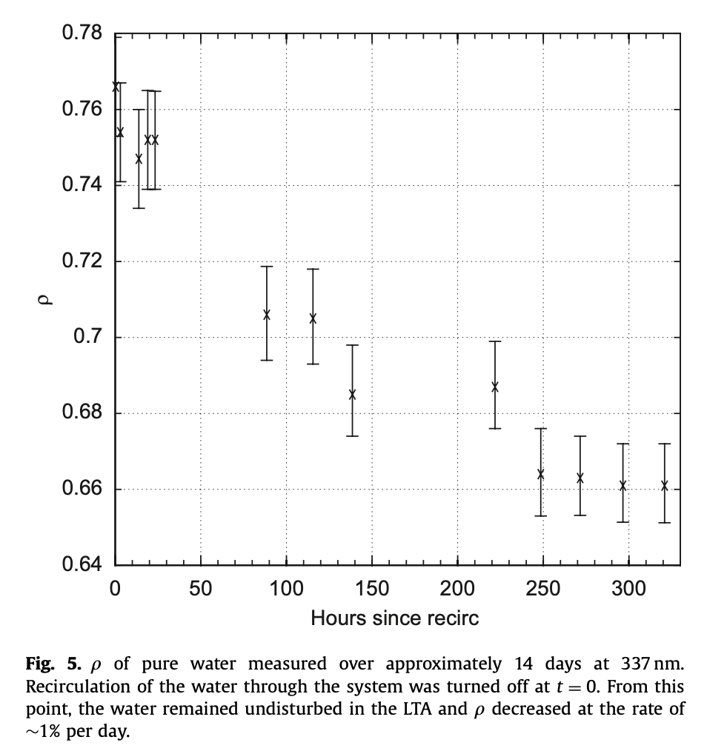
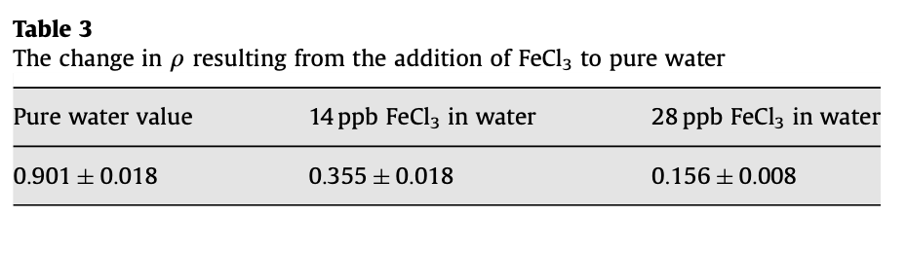
Quantitative tests using a 19 meter
attenuation arm show that even clean
stainless steel exposed to ultrapure
water will leech impurities into the water
that absorb UV light.
It was also shown that this could be due
to iron ions going into solution even
at ppb levels.
relative transparency
Hours since recirculation stopped

Slide 10
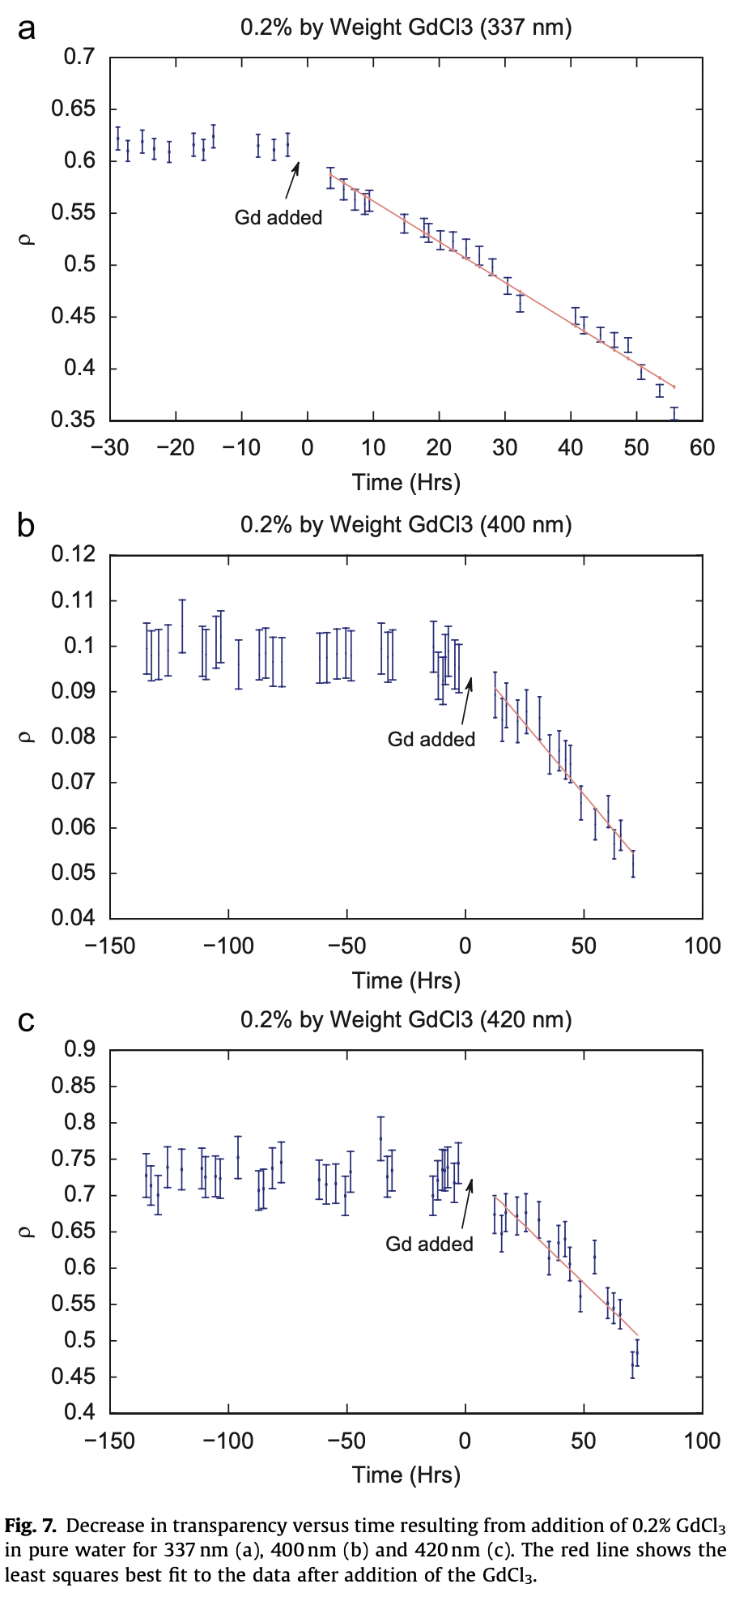
loss of transparency
is broad spectrum, not
just Gd absorption lines
337 nm
Several of the potential physics topics
that could be addressed involve the
addition of dissolved ions: Gd, Li, Te
These same tests showed that for Gd
the ion itself did not cause a loss of
transparency - it was just that fact that
the liquid can now conduct charge that
accelerated the leeching of steel
contaminants
400 nm
420 nm
Must solve this problem to make WbLS
detectors practical

Slide 11
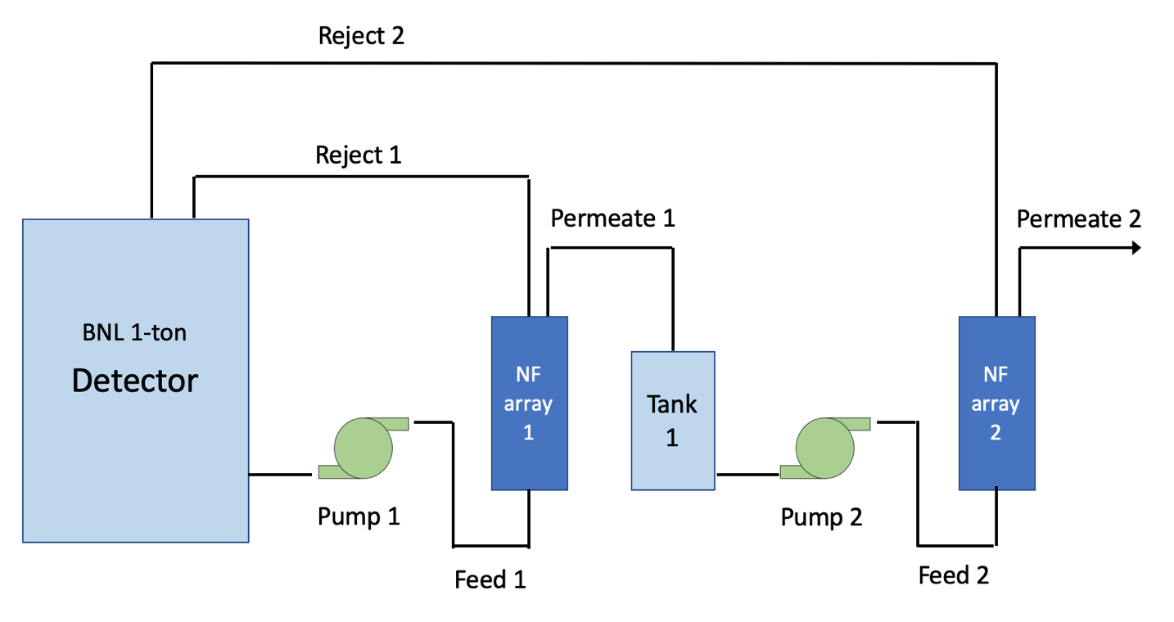
How to do this?
Separate the organic components from the water in order to clean the water
Contaminants must pass through however - this was a challenge now solved!
Actual tests for contaminants need to be done with spike tests for individual ions, molecules, and iron colloids
(university
physicist)
(BNL engineer)

Slide 12
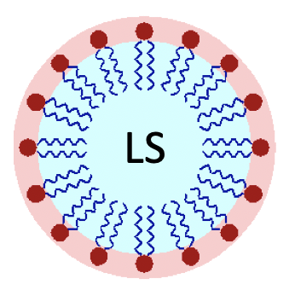
The basic idea
Step 1: remove the micelles from the
liquid without disrupting them
use nanofiltration
to remove the
large (~10 nm)
micelles

Slide 13

The basic idea
Step 2: remove ”free” (i.e. non-micellized)
surfactant from the permeate of NF array 1
free surfactant
use nanofiltration
to remove free
surfactant ~500 Da

Slide 14
The basic idea
Step 3: pass the “bad” ions to a standard water purification system for removal
bad ion
both nanofiltration
arrays must pass
bad ions

Slide 15

The basic idea
Step 4: but keep the good ions!
good ion
both nanofiltration
arrays must pass
bad ions

Slide 16
The basic idea
ALL TOGETHER NOW!
good ion
both nanofiltration
arrays must pass
bad ions

Slide 17
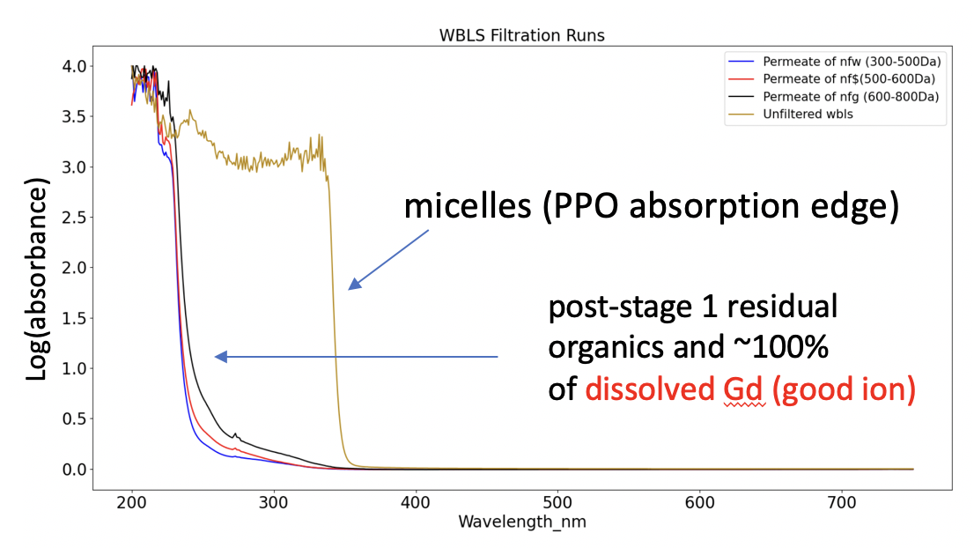
Step 1: Separate micelles from the WbLS

Slide 18
Steps 2&3: Pass the bad ions through and keep the good ions
iron soak water
Gd⁺³ optical
absorption peaks
retentate
permeate
This filter does not pass optical contamination from 316 steel leeching into water - BAD!
Filter does not pass good Gd
ions - GOOD!
Not a great candidate…why?

Slide 19
Iron in solution is not an isolated ion…
Iron is usually surrounded by
6 OH₂ radicals, giving it an effective
molecular weight of 164 Da
The NF shown on the previous
slide has a MWCO of 150, so iron tends
not to go through much
To be compared with WbLS free
surfactants which have MW in the
range of 400-600

Slide 20
A good candidate for Steps 2&3 has been identified
MWCO 200 passes
nearly all “iron soak”
water
..but still not dissolved
Gd - a ”good” ion
good ion “bare” MW coordinated MW
Gd⁺³ 157 301-320
Te⁺³ 128 210-230
Li⁺¹ 7 79
(Fe⁺³ is 164)
Note: MW is not the only consideration. Filter materials also make a difference, as it can interact with the ions.

Slide 21
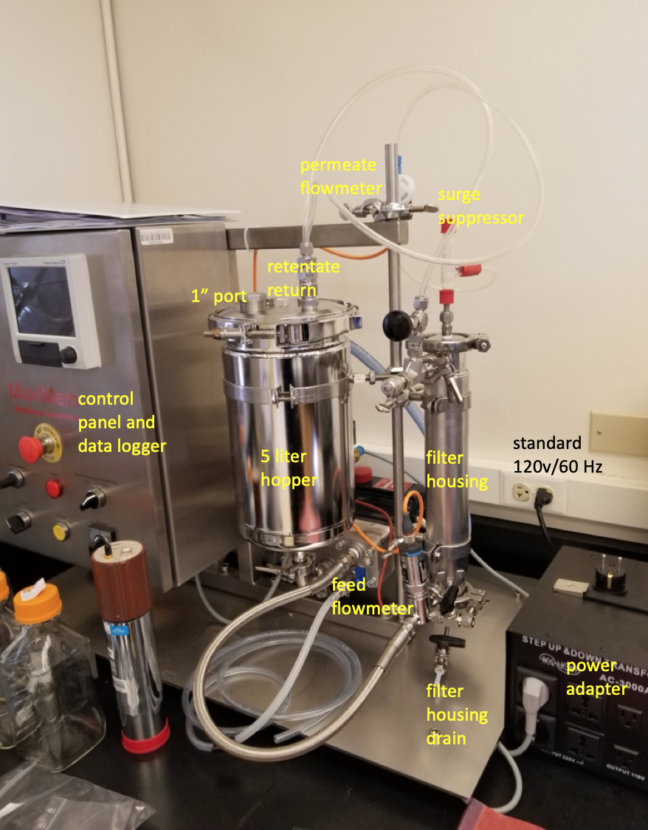
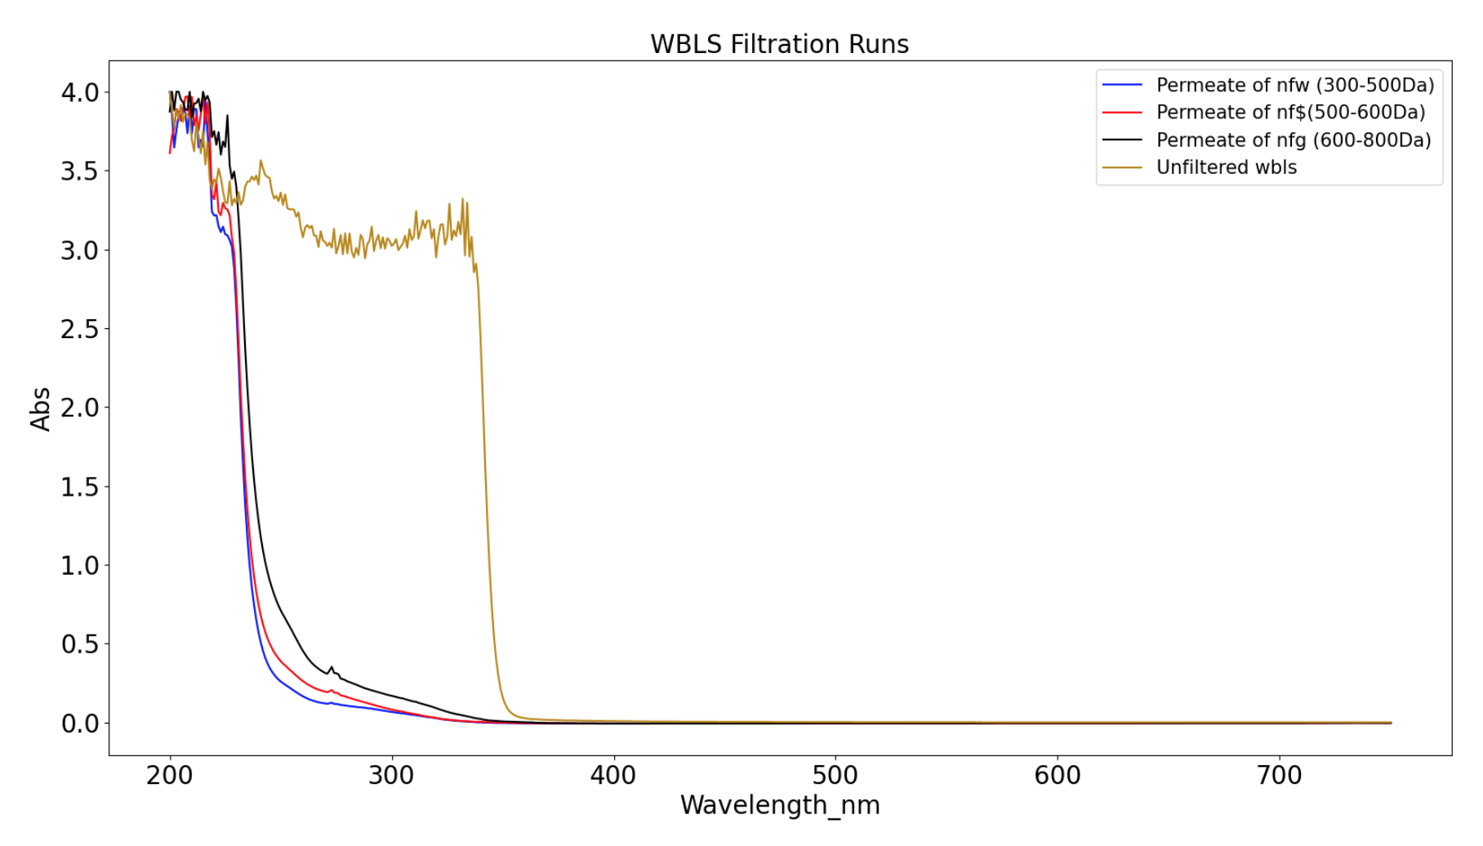
Nanofiltration process
development testbench
Array 1: removes
(without disruption)
the LS-filled
micelles. Test show
LY in not affected
micelles (PPO absorption edge)
Log(absorbance)
post-stage 1 residual
organics and ~100%
of dissolved Gd (good ion)
water from a SS316 3-year exposure before and after the stage 2 system
Array 2 passes
dissolved iron
through to the
“standard”
water purification
system but removes
residual organ
Log(absorbance)
MWCO 200
We are now ready to build a
scaled-up version of this!
wavelength (nm)

Slide 22
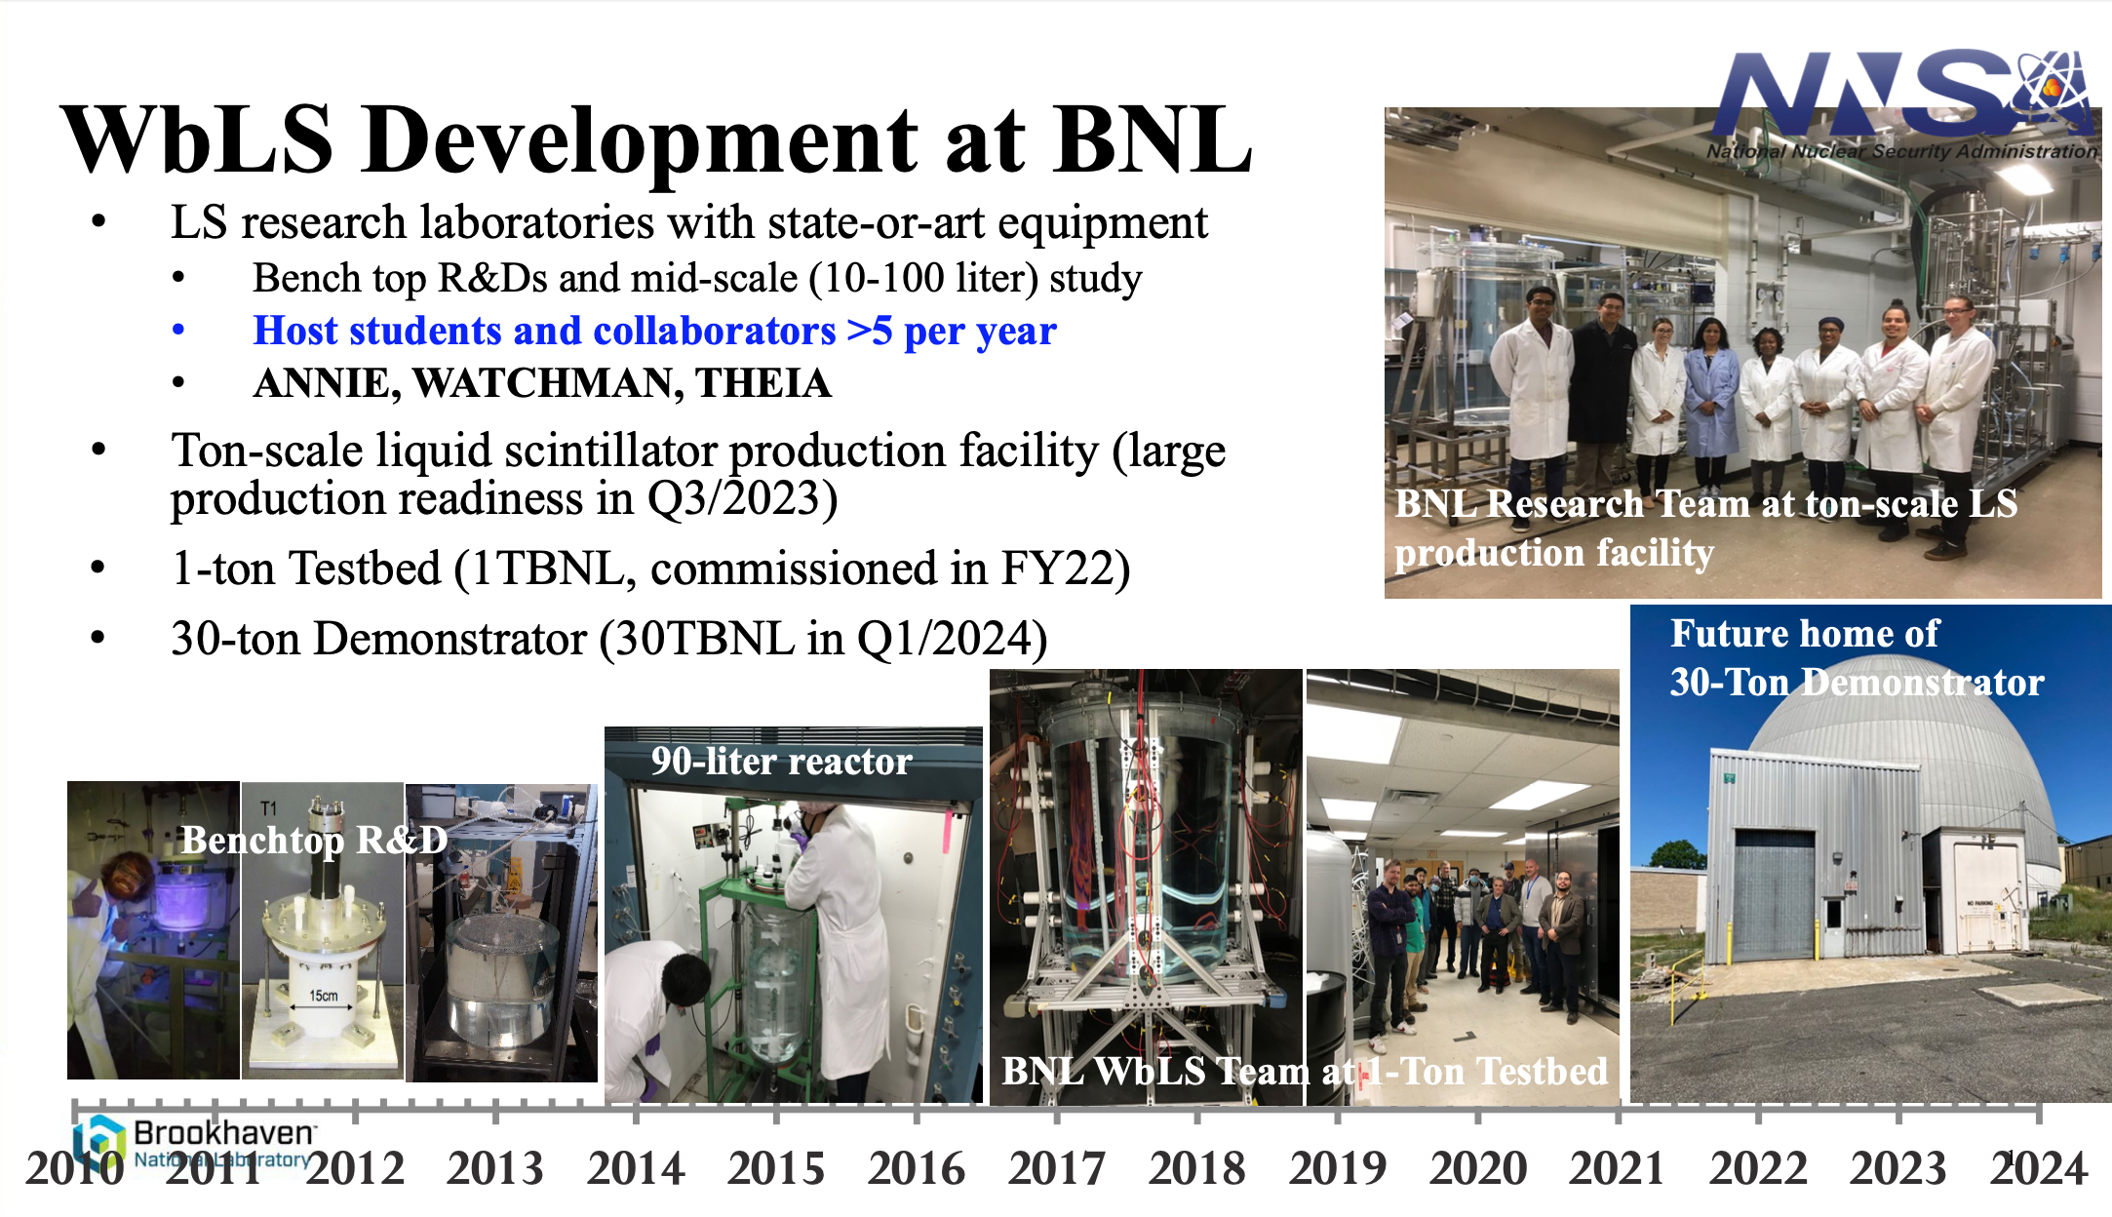
BNL 30-ton Demonstrator

Slide 23
Summary
A major international effort has developed the the needed technology to build the first multi-kiloton scale Optical Hybrid Detector. Such a detector has a wide range of potential scoence opportunities - as discussed in other talks and in the published Theia White Paper.
A number of large-scale prototypes are now under construction to investigate technical alternatives. These will be completed in the over the next two years, providing date to optimize designs for unloaded WbLS in these large detector(s).
The R&D to load and purify WbLS with “good ions” has now started. A successful Gd-loaded WbLS has already been developed, and the first steps are being taken to load with Te and Li are just getting underway.

