Slide 1
High Energy Physics Detector R&D Program
2022 CPAD Workshop, Stony Brook, NY
November 28 – December 2, 2022
Helmut Marsiske Program Manager – Detector R&D Office of High Energy Physics

Slide 2
Outline
HEP Mission and Research Program
Detector R&D Program
Goals/Guidance/Process/Funding/Efforts
Budgets
Funding Opportunities

Slide 3
HEP Mission
Understand how the universe works at its most fundamental level:
Discover the elementary constituents of matter and energy
Probe the interactions between them
Explore the basic nature of space and time
In pursuit of its mission HEP enables discovery science by
Building Projects
Operating Facilities
Conducting a Research program

Slide 4
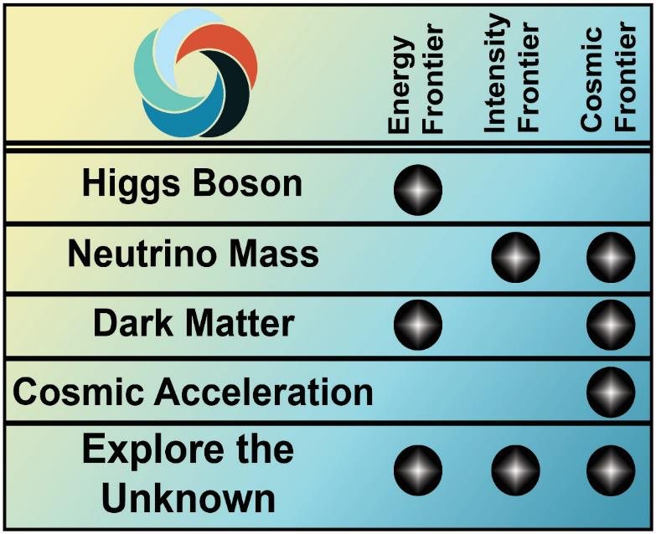
HEP Research Program
P5 Science Drivers identify the scientific motivation
Research Frontiers are useful categorization of experimental techniques and serve as the basis of the budget process
Research Frontiers are complementary
No one Frontier addresses all science drivers
Each Frontier provides a different approach to address a science driver
Enables cross-checking scientific results
Detector R&D Program overarches/undergirds Research in all three Frontiers
R
e
s
e
a
r
c
h
F
r
o
n
e
r
s
s
r
e
v
i
r
D
e
c
n
e
i
c
S
s
c
i
s
y
h
P
e
l
c
r
a
P

Slide 5
HEP Detector R&D Program

Slide 6
Detector R&D Program Goals
Support research leading to fundamental advances in the science of particle detection, and develop the next generation of instrumentation for HEP
Properly balanced between…
…incremental, near-term, low-risk and transformative, long-term, high-risk R&D;
…universities and labs, etc.
Focus on strategic areas
Future promise and (potential for) U.S. leadership
Engage researchers from other fields and from industry

Slide 7
Detector R&D Program Goals, cont.
Provide (under)graduate and post-doctoral research training in instrumentation
Next generation of detector experts
Support “infrastructure”—technical personnel, equipment, “facilities”, and test beams
Crucial resources for experimental detector R&D and fabrication

Slide 8
Program Guidance
P5 science drivers and high-priority projects
In 2015/206, near-term focus was on
LHC phase-II upgrade projects
Short- and long-baseline neutrino program
Dark Matter, Dark Energy, CMB projects
Since then, refocus on long-term, high-risk, high-reward efforts: Blue-Sky R&D
Basic Research Needs (BRN) Study in 2019/2020
Strategic technology areas, aligned with the strengths of the US community, that future long-term R&D efforts should focus on to provide/enhance science capabilities
Priority Research Directions to push well beyond the current state of the art, potentially leading to transformative technological advances with broad-ranging applicability
“Key Challenges” where technological breakthroughs could lead to game-changing experimental capabilities for HEP
Community input via CPAD, Snowmass, etc.

Slide 9
Program Process
Process to determine funding/effort:
Labs: annual budget briefings, field work proposals (FWPs), and lab comparative review every few years (last in September 2022)
Universities: annual funding opportunity announcement (FOA)—university comparative review (since 2012)

Slide 10
Program Process, cont.
Targeted lab calls/FOAs Detector R&D program participates in:
Early Career Research Program
U.S.-Japan Science and Technology Cooperation Program In High Energy Physics
Instrumentation Traineeship
Microelectronics Co-design
AI/ML
SBIR/STTR

Slide 11
Program Funding/Effort
Funding (in round numbers) was $29M in FY 2022
Research funding is $22M, ~70-75% at labs
Including Microelectronics, AI/ML, US-Japan, Early Career Awards, Traineeship, special FOAs
Facilities/test beam operations is $7M
Efforts at labs and universities:
50-60 FTEs at 8 labs: ANL, BNL, FNAL, LBNL, LLNL, ORNL, PNNL, and SLAC
20-30 FTEs at ~25 universities w/ ~30 PIs

Slide 12
HEP Budgets

Slide 13
Federal Budget Cycle
Typically, three budgets are being worked on at any given time:
Executing current Fiscal Year (FY; October 1 – September 30)
White House Office of Management and Budget (OMB) review and Congressional Appropriation for next FY (FY+1)
Agency internal planning for next-to-next FY (FY+2)
FY 2023 Budget | Spend the Fiscal Year Budget
FY 2024 Budget | OMB Review |  |  |  | Budget Release | Congressional Budget and Appropriations |  |  |  |  |  |  | Spend the Fiscal Year Budget
FY 2025 Budget | DOE Internal Planning with OMB and OSTP Guidance |  |  |  |  |  |  |  |  |  |  |  | OMB Review |  |  |  | Budget Release | Congressional Budget and Appropriations |  |  |  |  |  |  | Spend the Fiscal Year Budget
 | Oct | Nov | Dec | Jan | Feb | Mar | Apr | May | Jun | Jul | Aug | Sep | Oct | Nov | Dec | Jan | Feb | Mar | Apr | May | Jun | Jul | Aug | Sep | Oct | Nov | Dec | Jan | Feb | Mar | Apr | May | Jun | Jul | Aug | Sep
 | CY 2022 |  |  | Calendar Year 2023 |  |  |  |  |  |  |  |  |  |  |  | Calendar Year 2024 |  |  |  |  |  |  |  |  |  |  |  | Calendar Year 2025
You are here

Slide 14
HEP Budgets FY 2012-2022
HEP Funding ($ in k) | FY 2017 Actual | FY 2018 Actual | FY 2019 Actual | FY 2020 Actual | FY 2021 Actual | FY 2022 Enacted | FY 2023 President’s Request
TOTAL | 825,000 | 908,000 | 980,000 | 1,045,000 | 1,046,000 | 1,078,000 | 1,122,020

Slide 15
HEP Research FY 2014-2022
Research Growth: Driven by QIS, AI/ML,
Microelectronics, and Adv. Computing
QIS +$49.9M
AI/ML
+$34.5M
+$14.7M
Other Research Initiatives, incl.
Adv Comp ($4.0M), Microelec. ($6.7M),
& RENEW ($4.0M)

Slide 16
Funding Opportunity Announcements
SEE PLENARY PRESENTATION BY WILLIAM KILGORE

Slide 17
University Comparative Review
FY 2023 Research Opportunities in High Energy Physics [DE-FOA-0002832]
Primary HEP FOA for research at universities
Includes Detector R&D subprogram
Letters of Intent are strongly encouraged and may be submitted before Wednesday, November 16, 2022, at 5 PM Eastern Time
Applications are due on Wednesday, December 21, 2022, at 11:59 PM Eastern Time
Talk to the HEP program manager you plan to submit to!

Slide 18
Other Funding Opportunities
SC “Open Call”: Continuation of Solicitation for The Office of Science Financial Assistance Program [DE-FOA-0002844]
HEP uses this primarily for supplemental proposals, experimental operations support, and conferences
SC Workforce Development (WDTS) programs
Office of Science Graduate Student Research fellowships (SCSGR)
Supports graduate student research at a DOE lab, 3 to 12 months
Convergence Research Topical Areas
(a) Microelectronics (ASCR, BES, HEP)

Slide 19
Other Funding Opportunities, cont.
U.S.-Japan Science and Technology Cooperation Program In High Energy Physics
Detector R&D for HEP – laboratory led
DOE Traineeship in HEP Instrumentation
Microelectronics Co-design
Multi-program efforts – laboratory led
AI/ML R&D at the High Energy Physics Frontiers
AI/ML on the Detector

Slide 20
Early Career Research Program
2023 DOE Office of Science Early Career Research Program [DE-FOA-0002821]
SC-wide program with HEP component; HEP component includes Detector R&D subprogram
Pre-applications are mandatory and are due on Thursday, January 5, 2023, at 5:00 PM Eastern Time
Applications are due on Thursday, March 23, 2023, at 11:59 PM Eastern Time
Only those applicants that receive notification from DOE encouraging a formal application may submit full applications
Talk to the HEP program manager you plan to submit to!
Don’t give up after an unsuccessful try!
40

Slide 21
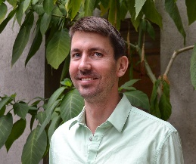
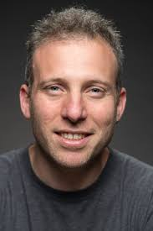
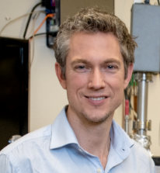
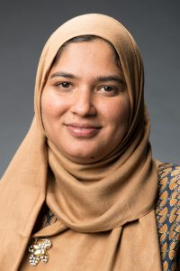
Early Career Awards in Detector R&D
FY 2017
Ahmed Zeeshan, SLAC
Multiplexing CMB detectors
FY 2018
Aritoki Suzuki, LBNL
Producing CMB detectors
Javier Tiffenberg, FNAL
Skipper-CCD development
FY 2019
Peter Sorensen, LBNL
Crystalline Xenon TPC
Jingke Xu, LLNL
Low-noise liquid Xenon detectors
FY 2020
Jonathan Asaadi, UT Arlington
Multi-modal pixel-based noble element TPCs
FY2021
Farah Fahim, FNAL
Frontend Implementation of AI-Machine Learning Neural Networks for On-Detector Radiation-Hard Edge Computing
FY 2022
Matt Pyle, UC Berkeley
Developing TES with Sensitivity to meV Scale Excitations for Light Mass Dark Matter Searches and other Applications
Noah Kurinsky, SLAC
Superconducting Qubit-Based Sensors for meV-Scale Particle Detection
41

Slide 22
HEP Detector R&D Summary
Need to preserve/invigorate innovation in Detector R&D within constrained budgets and make a compelling case for growing the budget
Near-term priority had been to support P5 projects
Long-term priority is to support research into potentially transformational, broad-impact, high-risk “Blue Sky” technology advances
Community input for identifying strategic Detector R&D opportunities—CPAD, Basic Research Needs Study, Snowmass 2022 planning exercise, P5, etc.
Need to optimize the program across the whole lab/ university landscape, nationally and internationally, using cost-effective, collaborative models

Slide 24
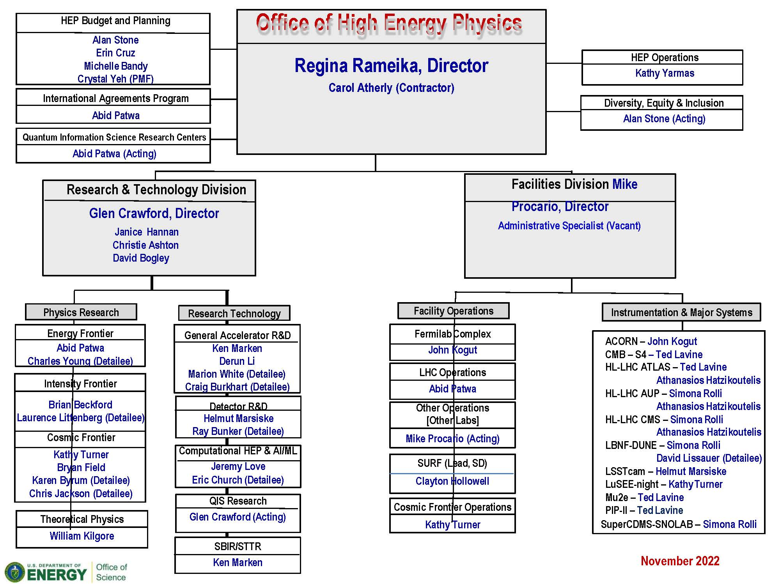
DOE Office of High Energy Physics

Slide 25
FY 2023 HEP Budget Request
HEP Funding Category ($ in K) | FY 2021 Actual | FY 2022 Enacted | FY 2023 Request | FY 2023 vs. FY 2022
Research | 398,203 | 410,000 | 420,000 | +10,000
Facilities/Operations | 314,297 | 302,000 | 310,000 | +8,000
Projects | 333,500 | 366,000 | 392,000 | +26,000
Total | 1,046,000 | 1,078,000 | 1,122,000 | +44,000
FY 2023 President’s Budget Request is overlay of Administration, SC, P5 priorities
SC: interagency partnerships, national laboratories, accelerator R&D, QIS, AI/ML, microelectronics
HEP: continue successful P5 execution, advance Administration and DOE/SC initiatives
FY 2023 HEP Budget continues support for P5-guided investments
Research: Continue U.S. leadership in LHC, muon experiments, international neutrino experiments at Fermilab, dark matter, dark energy, and vibrant theory program; QIS; AI/ML; Microelectronics (with ASCR, BES, and FES); Accelerator Science and Technology Initiative; Traineeships in accelerator science, instrumentation, high-performance scientific computing
Operations: Support HEP user facilities and running P5-recommended experiments
Projects and Line Item Construction: Project support for HL-LHC Accelerator and ATLAS & CMS Detectors, CMB-S4, and ACORN (new start); LIC support for LBNF/DUNE, PIP-II, and Mu2e

Slide 26
Detector R&D Research Consortia
University Comparative Review FOA language:
Multi-institutional (consortium) proposals are encouraged as a way to address significant technology R&D challenges beyond the scope of typical single-investigator awards
Single proposal developed by multiple institutions
One member of the consortium serves as the prime recipient/consortium representative (lead organization)
May result in one award to the prime recipient with subawards to the other consortium members
Consortia must have appropriate management structures and processes

