Slide 1
Development of LArTPCs
Bo Yu
Instrumentation Division
Dec. 1, 2022

Slide 2
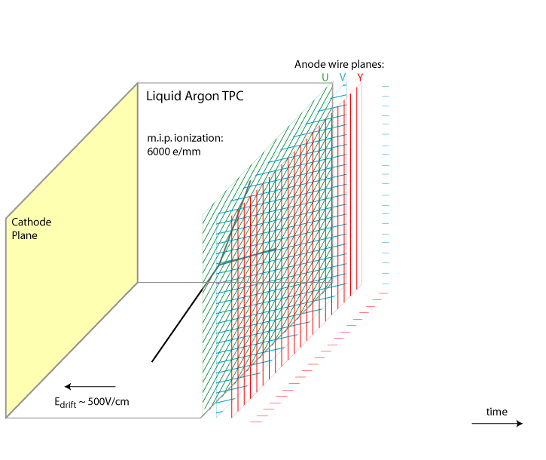
Why LArTPC
Single phase ionization mode with multi-view projective charge readout → pixel readout
Integrated photon detectors provide event timing and energy information
3D-imaging: full event topology reconstruction
Higher sensitivity to ν physics and for some of the proton decay channels (e.g. p -> Kν)
Scale to multi-kiloton (~10kt) detectors – the challenges:
Drift distance (LAr purity, cathode HV)
Wire length and detector performance (S/N issues)
Number of readout channels, multiplexing factor, cable routing and cryostat penetrations
Stored energy in the HV system, and risk in a HV discharge
Enabling Technology: Cold monolithic multiplexed electronics

Slide 3
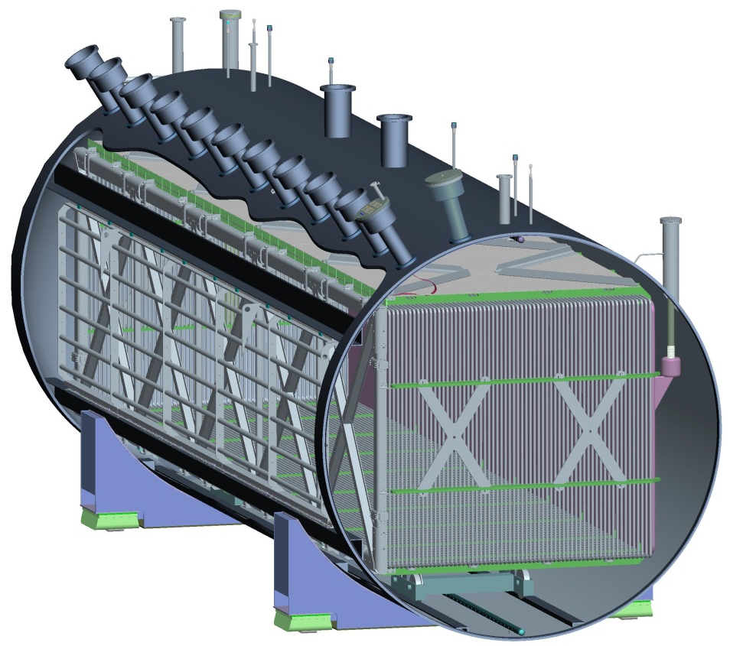
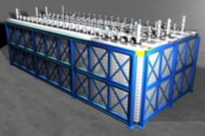
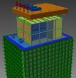
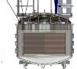
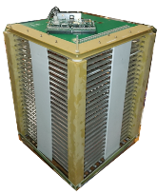
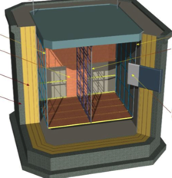
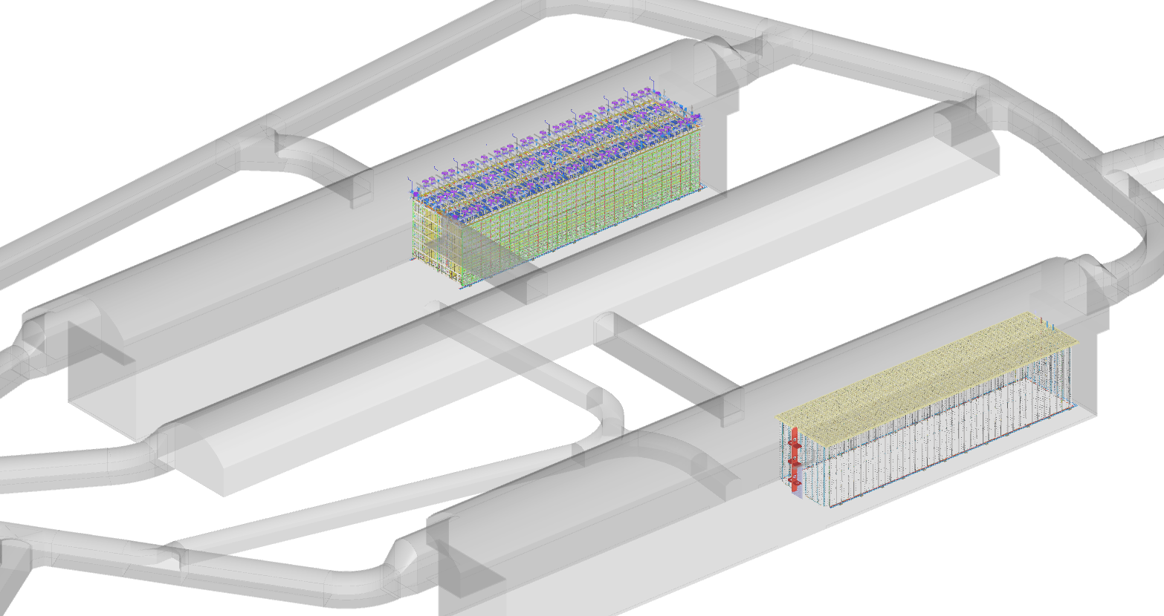
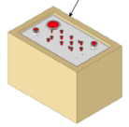
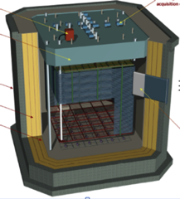
The Landscape of LArTPCs (past/current/planned)
MicroBooNE, 80t
ICARUS 600t
SBND, 110t
BNL’s contributions:
Supply cold electronics
TPC + electronics design
& construction
SBN
Program
Bo TPC
LAPD ArgonTube
LArIAT, 0.3t
CAPTAIN, 5t
ArgonCube
CERN 50L
Detector R&D
Program
LBNE 35ton, 10t
CERN NP04, 400t
DUNE
10kt x 4
FD1
LBN
Program
CERN 50ton, 2 phase
CERN NP02, 2 phase
FD2
2016
2026

Slide 4
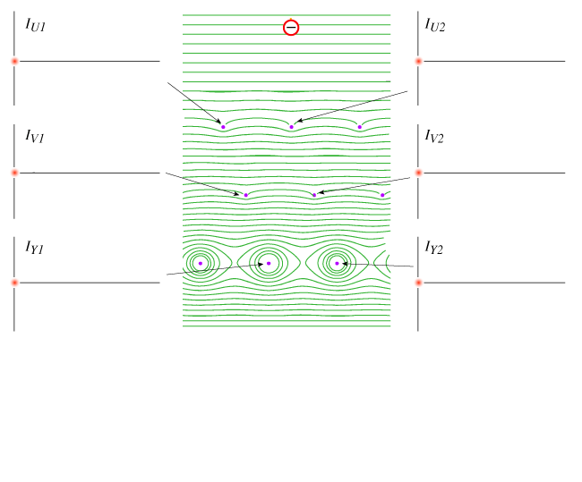
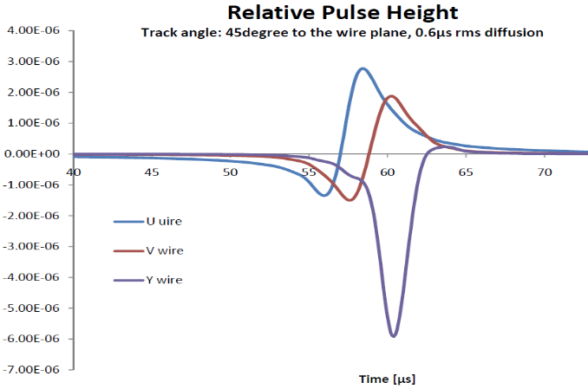
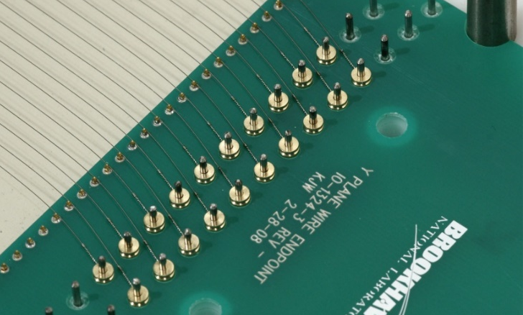
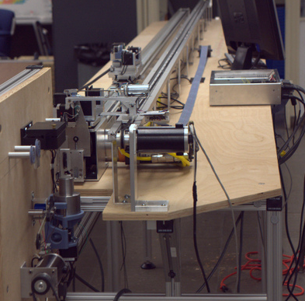
The MicroBooNE TPC
TPC active volume:
Length: 10.37m
Height: 2.33m
Width(drift length): 2.56m
Number of Wires:
Y: 3456, vertical, collection
U, V: 2400 each, ±60°induction
Total: 8256 readout channels
Innovative Features:
Passive insulation on cryostat, no vacuum evacuation
Cold front end analog electronics in LAr
Laser calibration system
Wire carrier board
Wire termination machine

Slide 5
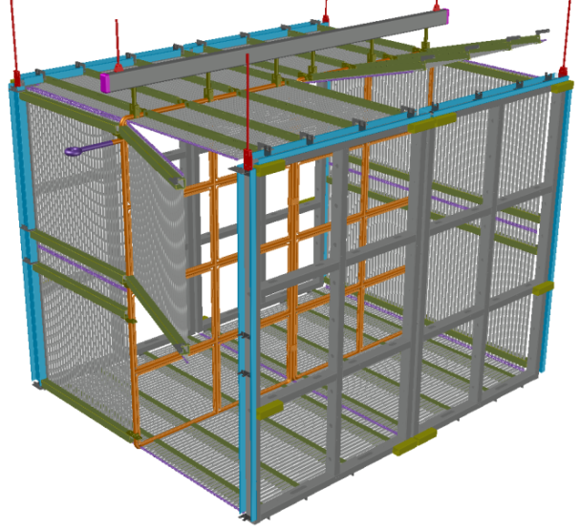
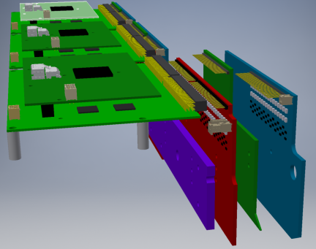
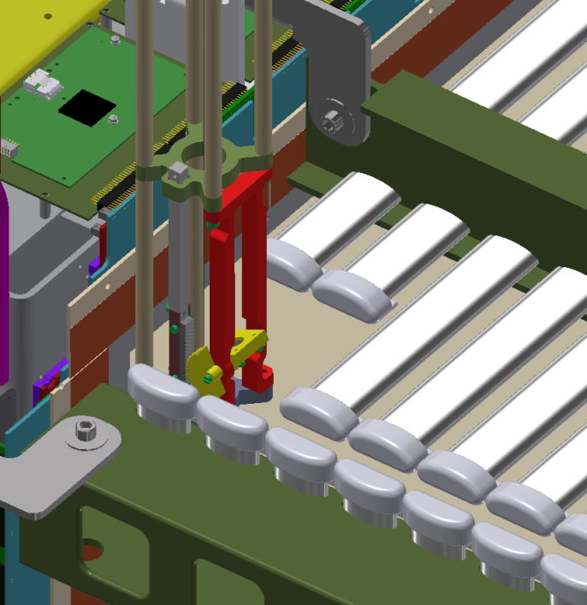
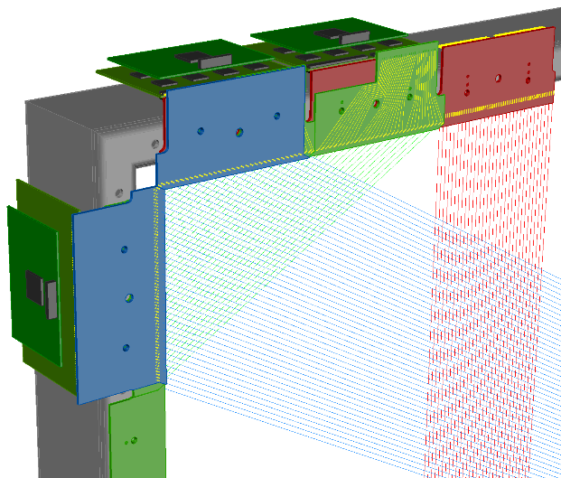
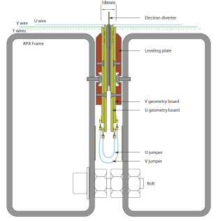
The SBND TPC
4 APAs, 2 CPAs, 16 field cage modules, 11k readout channels
Active volume: W: 2x2m, H: 4m, L: 5m,
Active mass: 110ton
Suspended at 6 points under the cryostat ceiling
Innovative Features:
Membrane cryostat
Cold analog and ADC ASICs and FPGAs
Induction wires interconnected across APAs
Modular field cage with metallic profiles
Cathode plane compatible with TPB coated reflector
New calibration lasers periscope design
SBND wire geometry boards to FEMBs interface
SBND cross section at the joint of two APAs, and the interconnect scheme across the APAs
A new laser periscope design enables nearly full coverage of the TPC active volume.

Slide 6
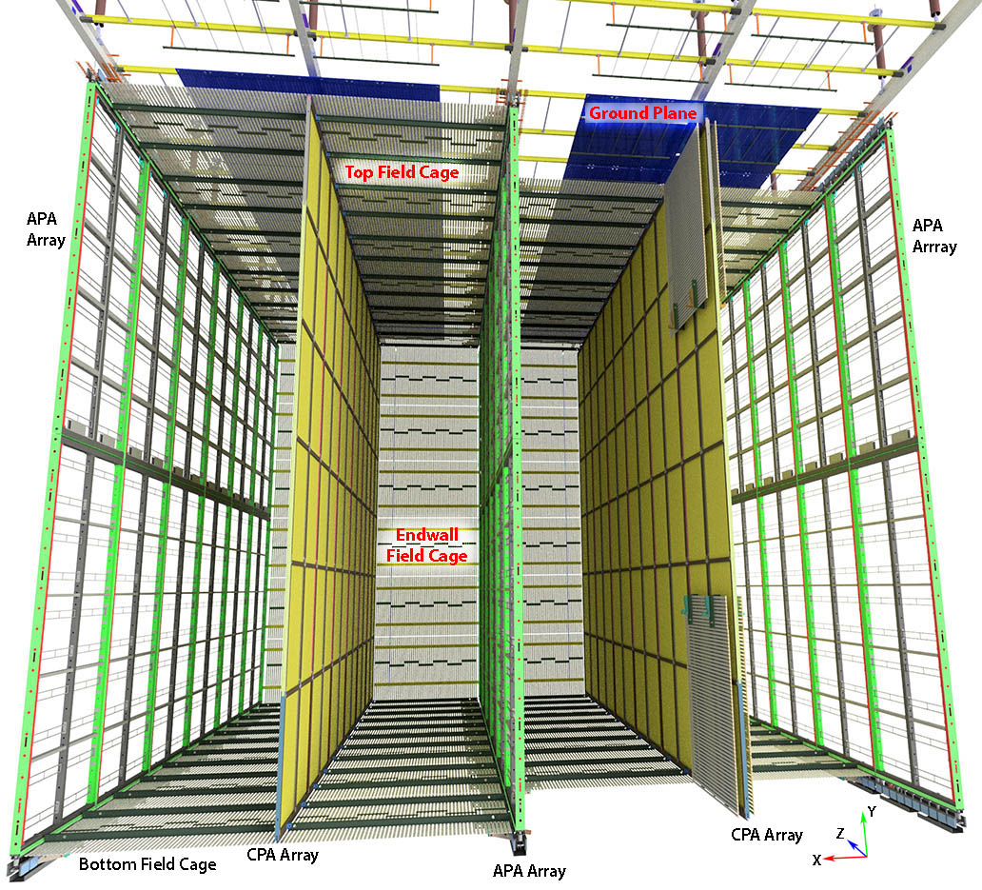
DUNE FD1 HD (Horizontal Drift) TPC
10 kton fiducial cryostat has:
150 APAs, 100 CPAs
2000 m² field cage modules
385k readout channels
Active volume:
W: 14m, H: 12m, L: 58m
Installed under 5 mounting rails suspended under the cryostat ceiling
Innovative features:
Membrane cryostat
Cold analog, ADC and digital multiplexer ASICs
Double sided APA readout with electronics on one end only
2 APAs connected end to end for a 12m active height
Photon detectors integrated inside the APAs
All resistive cathode planes
Modular field cage modules with metallic profiles

Slide 7
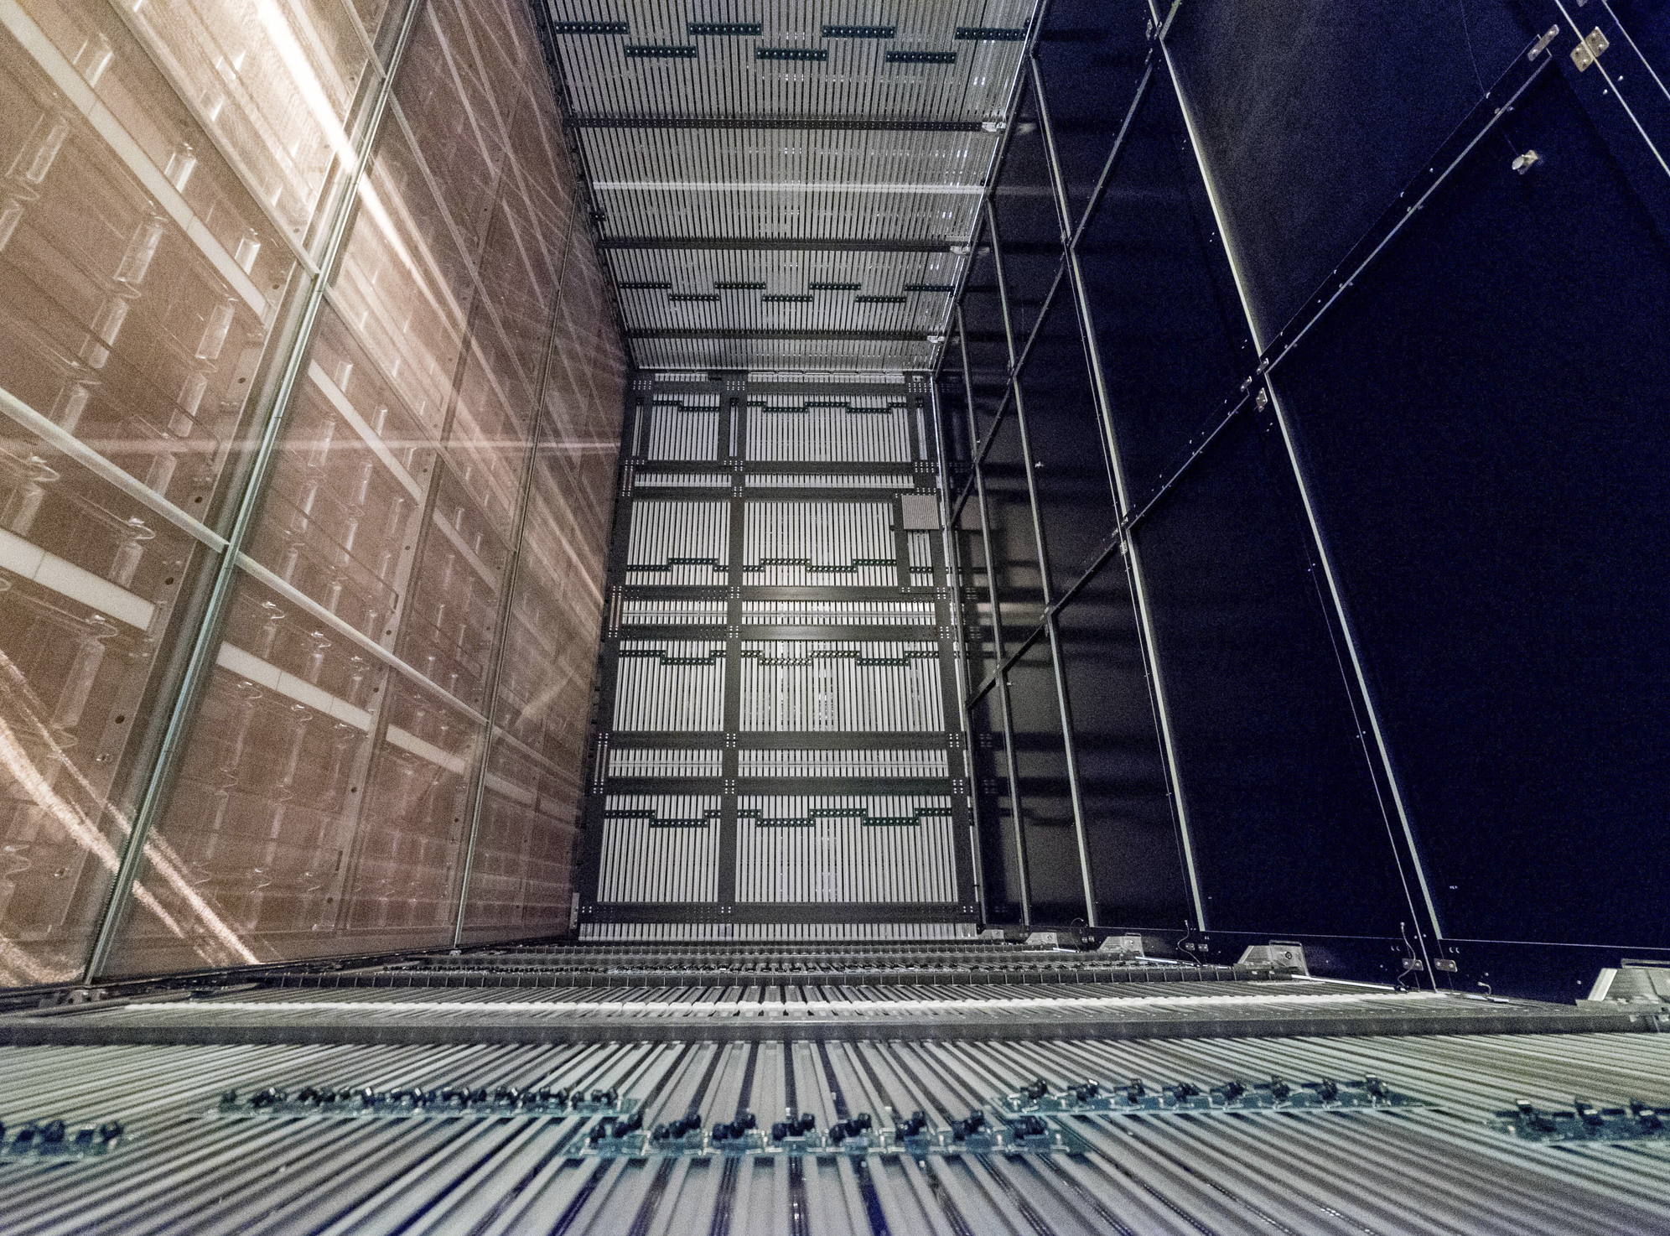
NP04 (ProtoDUNE I HD) TPC
Prototype of the single phase far detector. One APA high, 400 ton active volume
The TPC has 6 APAs, 18 CPAs, 28 field cage modules, 15k readout channels
Active volume:
W: 3.6mx2, H: 6m, L: 7m
Installed under 3 mounting rails suspended under the cryostat ceiling
Innovative features:
Membrane cryostat
Cold analog and ADC ASICs and FPGAs
Double sided APA readout with electronics on one end only
All resistive cathode plane
Modular field cage with metallic profiles
APAs with integrated photon detectors
Field cage modules with ground plane
CPA modules
APAs
End wall field cage modules
Field cage modules
One of the two drift volumes of the ProtoDUNE I TPC

Slide 8
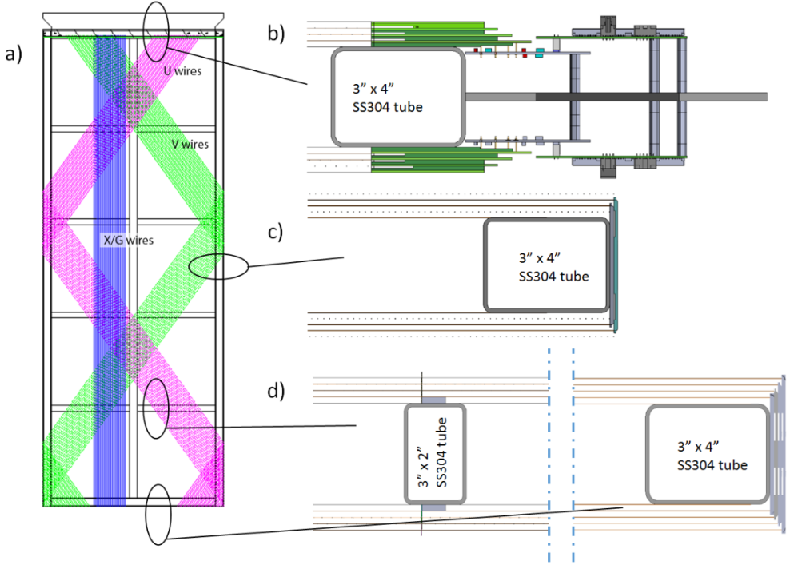
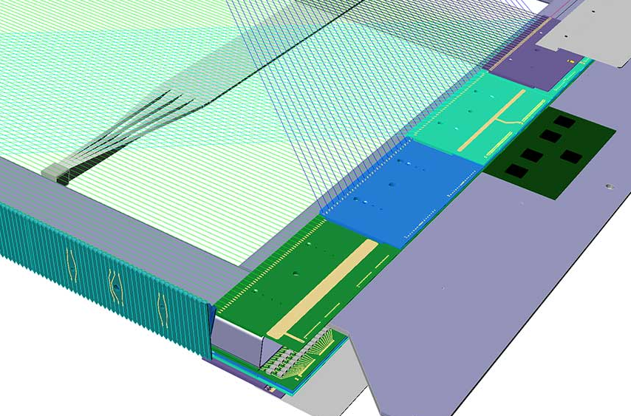
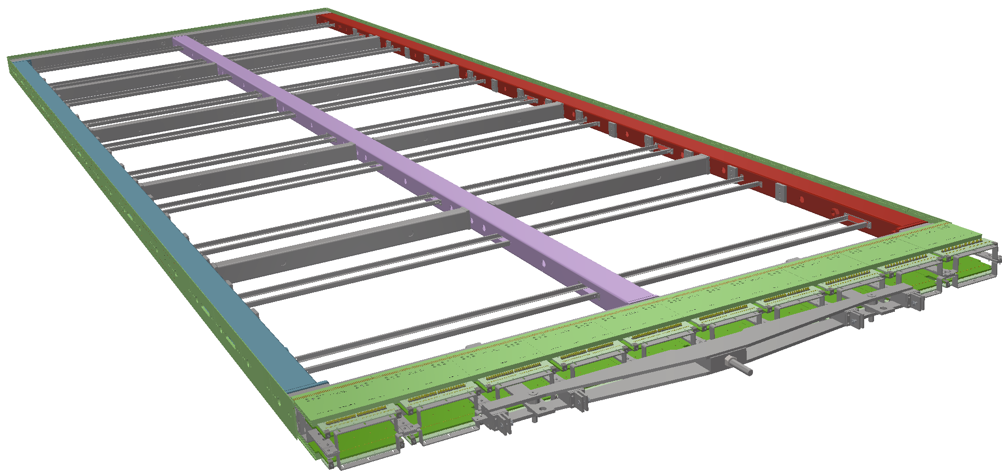
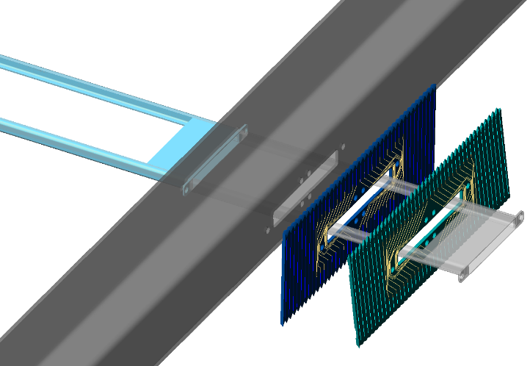
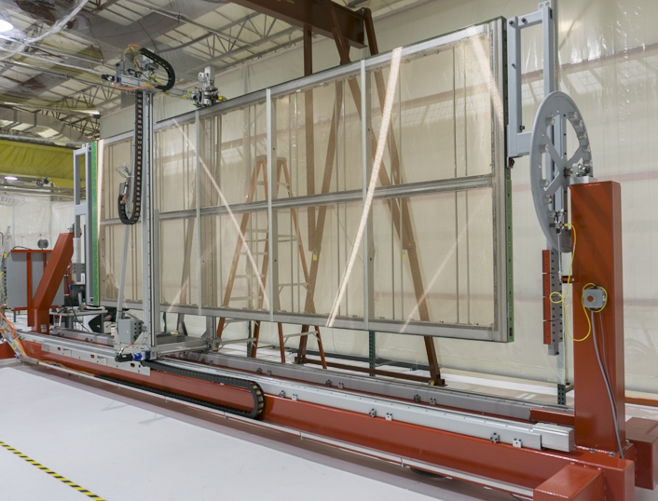
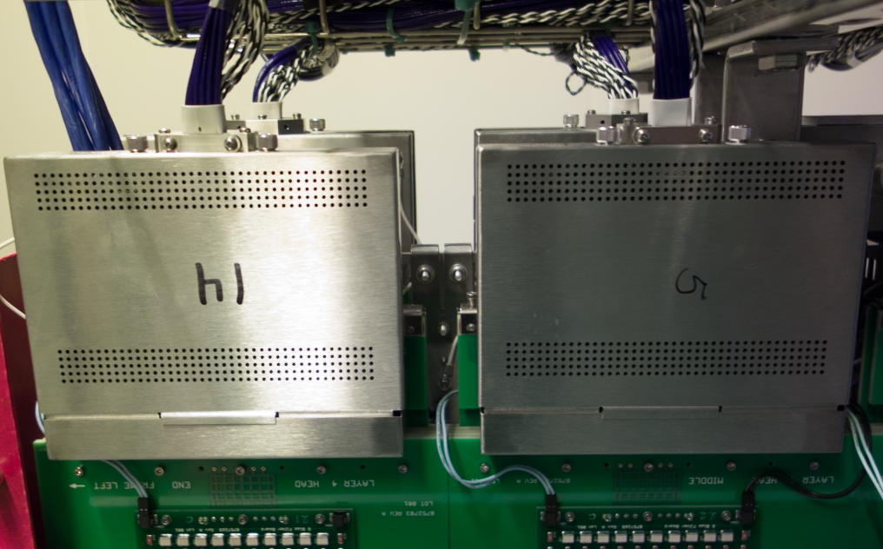
Modular APA Design for Mass Production
The original wrapped APA concept for LBNE leads to the production modules for ProtoDUNE
FEMBs are enclosed in metal boxes to improve performance and ease handling and installation.
Slots are added to the APA side frames to allow installation of PDs just before APA installation.
APA winding machine developed at U. Wisc. PSL

Slide 9
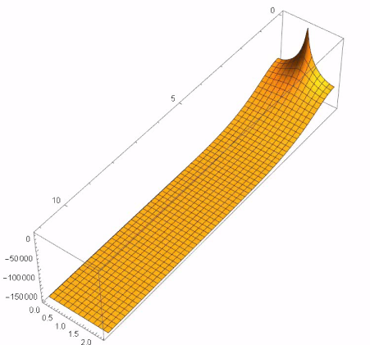
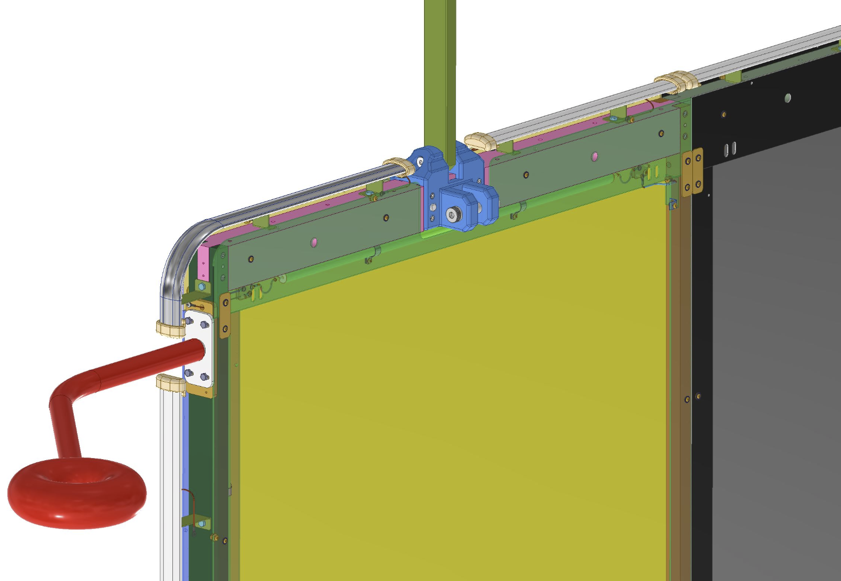
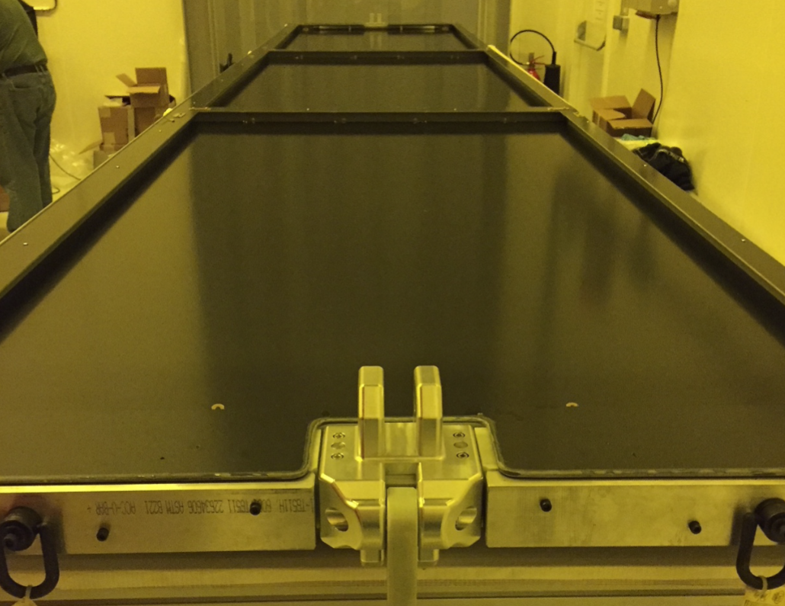
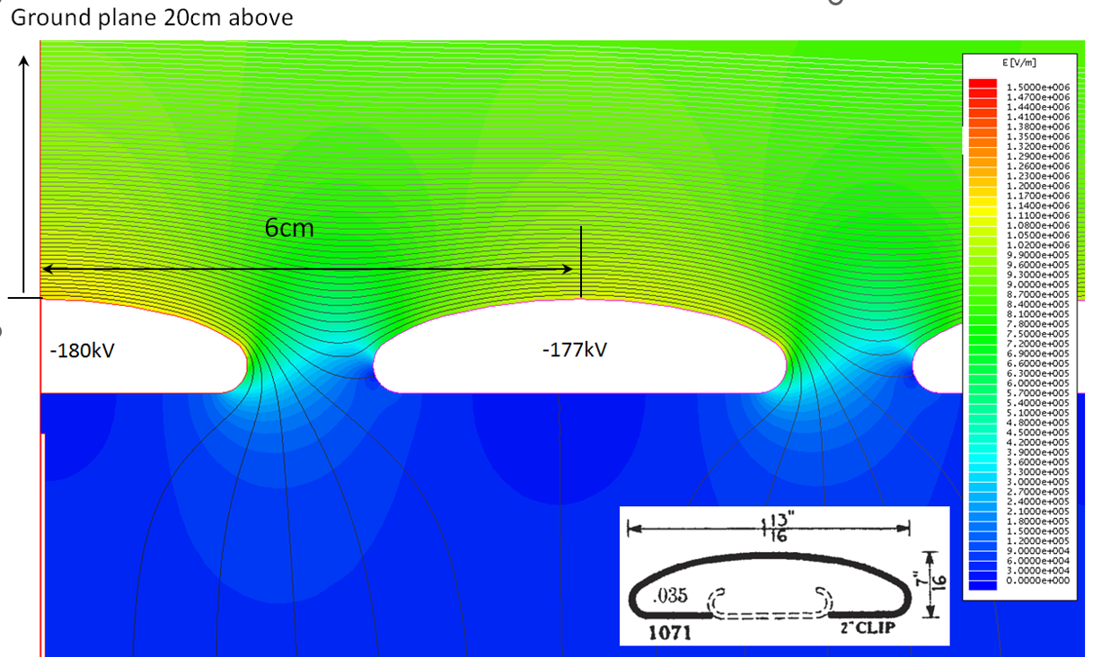
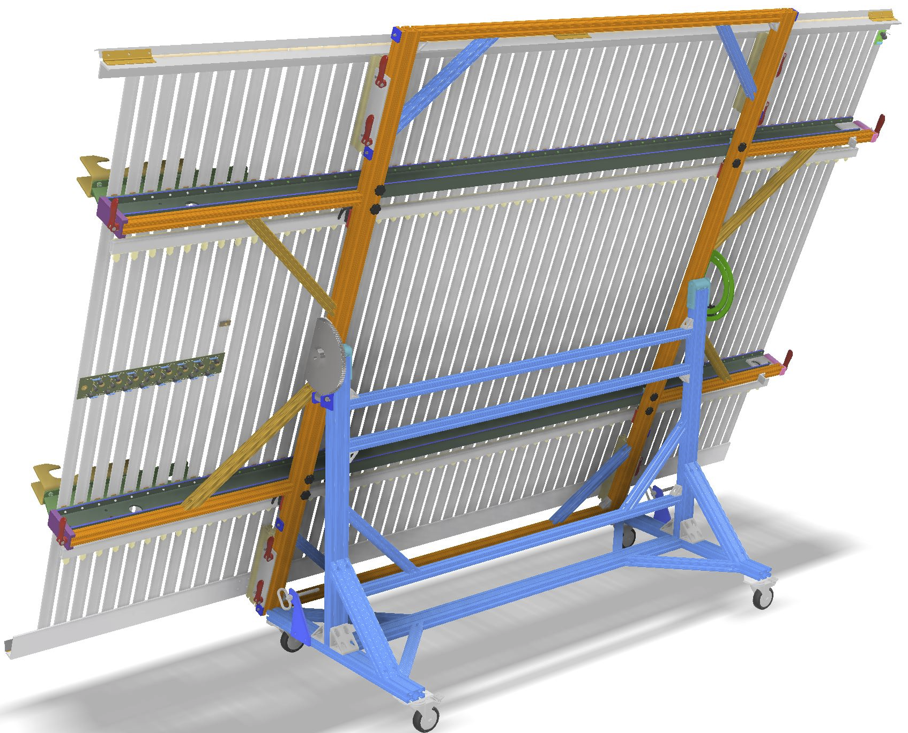
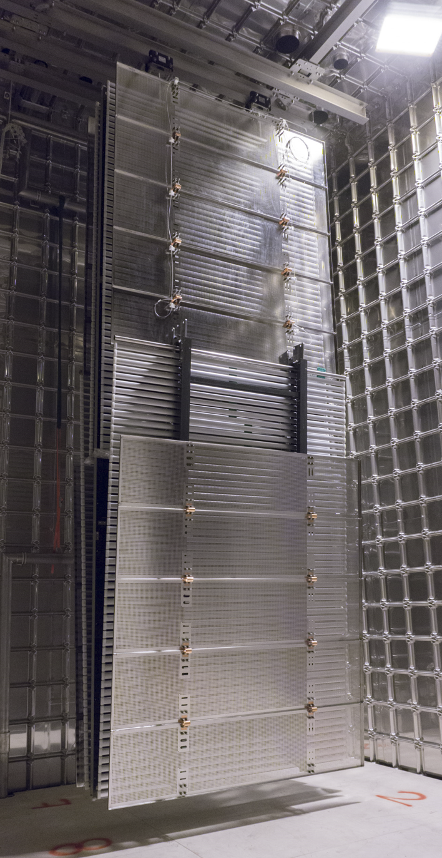
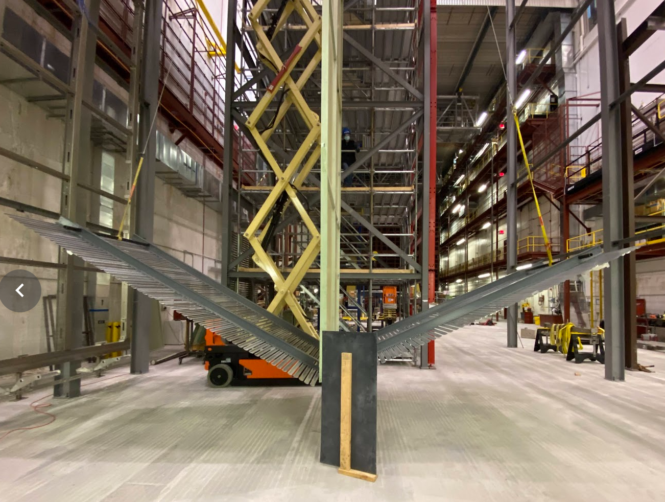
Modular Designs for the HV System
Voltage distribution on a CPA when a discharge occurs at its edge.
Study by S. Rescia
The DUNE FD1 cathode planes are constructed from arrays of highly resistive panels in G10 frames to provide equipotential surfaces, while maintaining a sufficiently large RC time constant to avoid the risk of damages to the FEE in a HV discharge.
A custom designed field cage profile provides lower surface E field compared to a round tube, and without the need of venting.
Symmetrical deployment of the bottom FC modules
Field cage assembly table constructed at Stony Brook Univ.

Slide 10
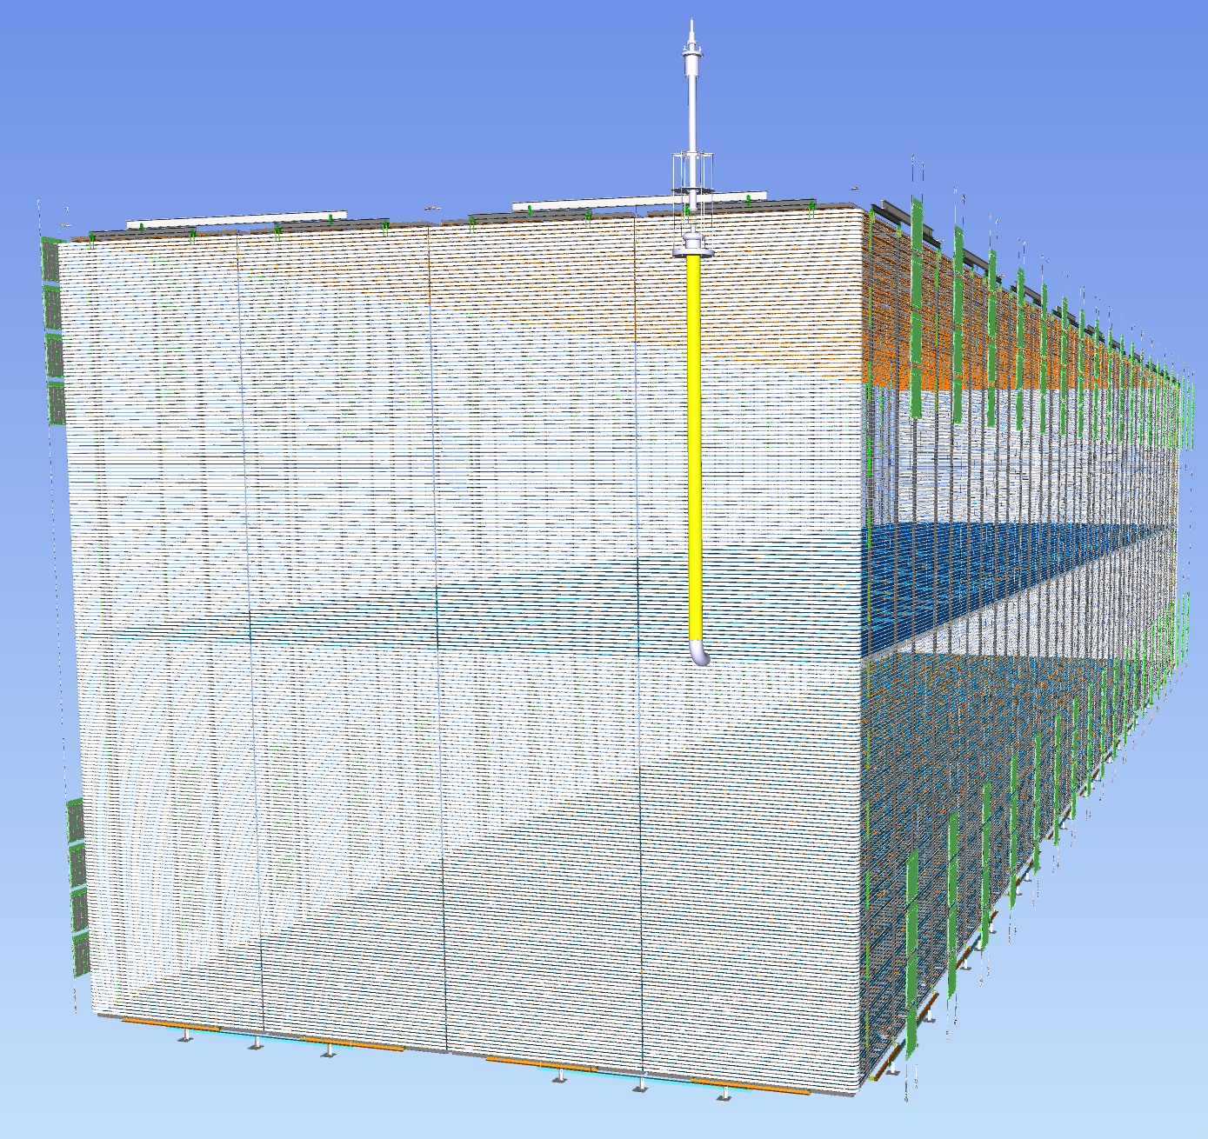
DUNE FD2 VD (Vertical Drift) TPC
10 kton fiducial cryostat has:
80 top CRPs, 80 bottom CRPs, 80 cathode modules, 1900 m² field cage coverage, 492k readout channels (2 types of readout electronics)
Active volume:
W: 13.5m, H: 13m, L: 60m
Top CRPs and cathodes form 16 superstructures suspended under the cryostat ceiling. Field cage independently supported under ceiling. Bottom CRPs on the floor.
Innovative features:
3 view perforated PCB anodes
Resistive cathode with integrated photon detectors powered and read out by fibers
Additional wall mounted PDs looking into 70% transparent field cage.
Cathode biased at ~ -300kV

Slide 11
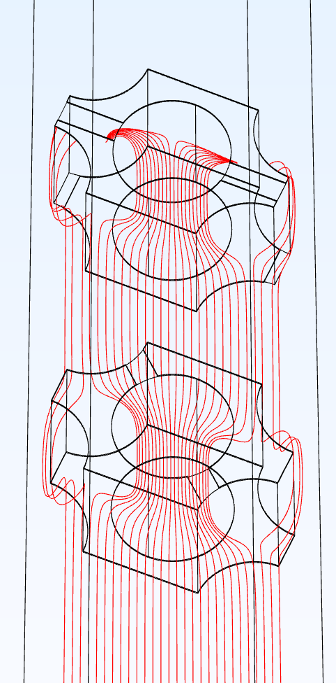
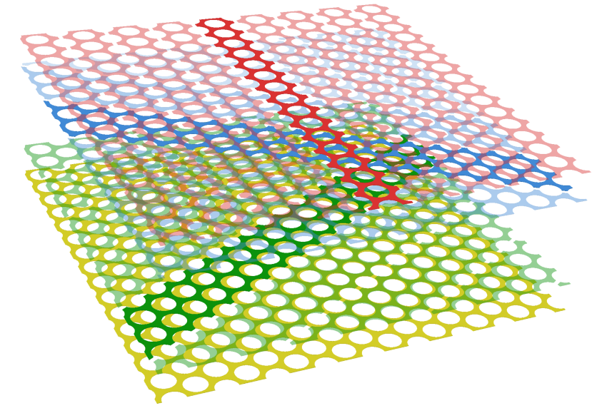
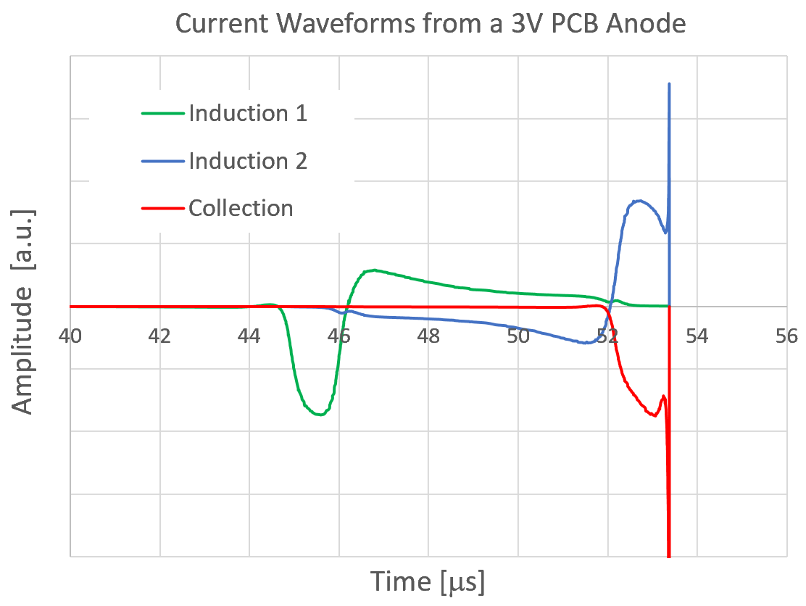
Multi-view Perforated PCB Anodes (CRPs)
E₂
Induced current waveforms from a strip in each view for a point charge passing through the middle of each strip.
A 3-view (+/-30°, 90°) strip readout. The substrate of the two PCBs are removed for clarity. One strip from each readout plane is highlighted.
V3=+900V
V2=0V
E₁
V1=-340V
e
V_{shield}=-1240V
The highly asymmetrical induced current signal minimizes charge cancellation, improves SNR.
E_{D}
The first plane facing the drift volume is not read out, it is used for shielding the readout strips from charge injection from the cathode.
With proper bias voltage on each plane, ionization electrons can be pulled through multiple planes (induction views) without loss and be collected on the last one (collection view).
Typical PCB thickness: ~3mm
PCB separation: ~1cm
Hole size: 2-3mm

Slide 12
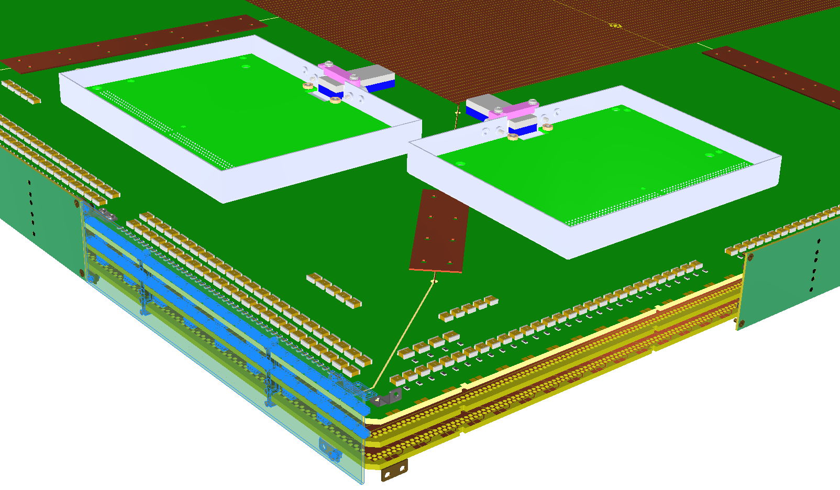
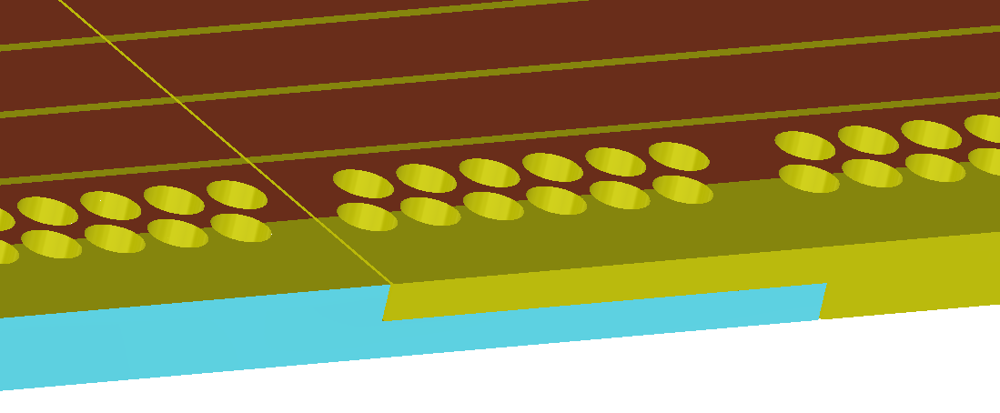
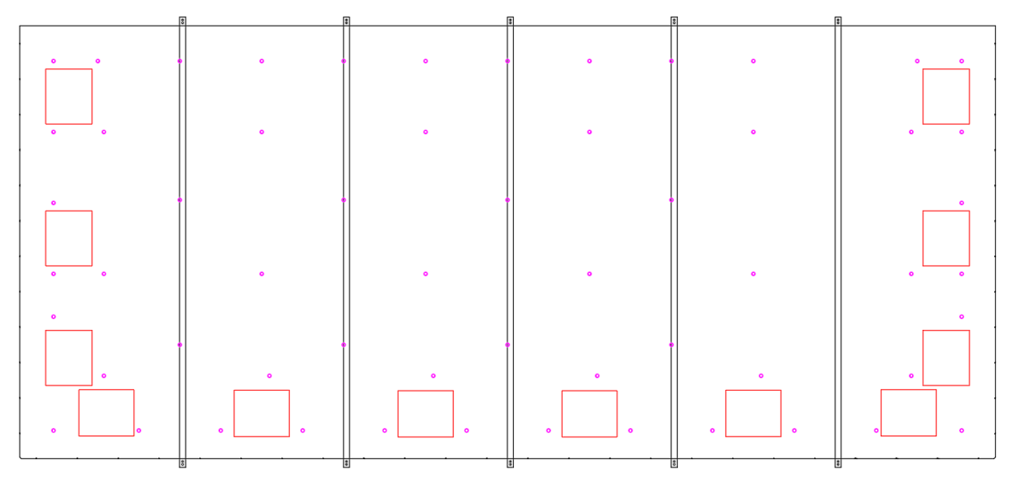
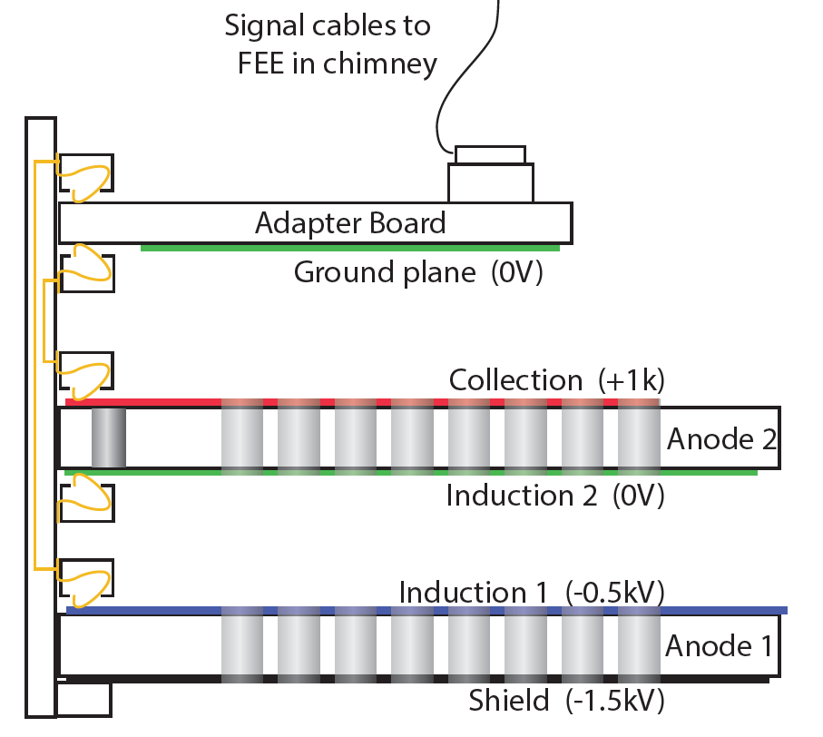
Building Large PCBs and Interface to FEE
Bonding the PCB segments using half lap joints
1.5m
We prototyped pogo pins, standard pin and socket connections to bring the signals from the anode to the FEE.
We settled on edge connectors to bring anode signal to the readout adapter boards. This eliminates the need to solder connectors on the large PCBs.
3.4m

Slide 13
Concluding Remarks
It has been fun for the past 15 years working on the various LArTPCs. The most exciting period has been the past ~4 years building ProtoDUNE I & II, and turn the PCB anodes concept into large scale prototypes. I am looking forward to working with the new technologies being developed for the future DUNE detector modules.
I am truly honored to receive this award, and extremely grateful for the recognition of my mundane contributions to the field of LArTPCs.
I’d like to thanks the DPF award committee, and the nomination letter writers for their confidence in my work. I’d like to acknowledge two people in particular: Dr. Veljko Radeka for his wisdom and guidance throughout my career, and Dr. Francesco Pietropaolo for his advices and collaboration to advance the LArTPC technology.

