Slide 1
Backward Detector Integration
Elke Aschenauer and Rolf Ent
Co-Associate Directors for the Experimental Program
ePIC GD/I Meeting
September 19th 2022

Slide 2
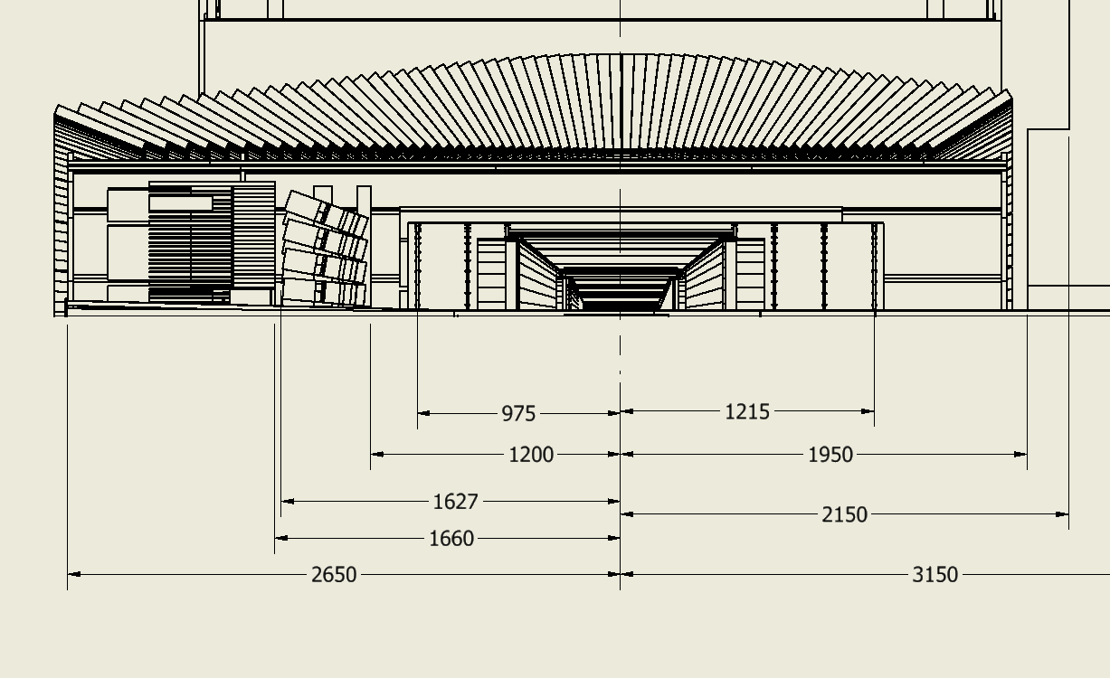
Backward Detector Integration
What we need to watch out for
Do we have enough space for the detector, its readout and services
Does a detector, i.e. its material, impact the performance of other ones
Overall integration model that we try to keep consistent with the geometry database
Topic of today: changes still to be made in geometry database
Information courtesy Roland Wimmer

Slide 3
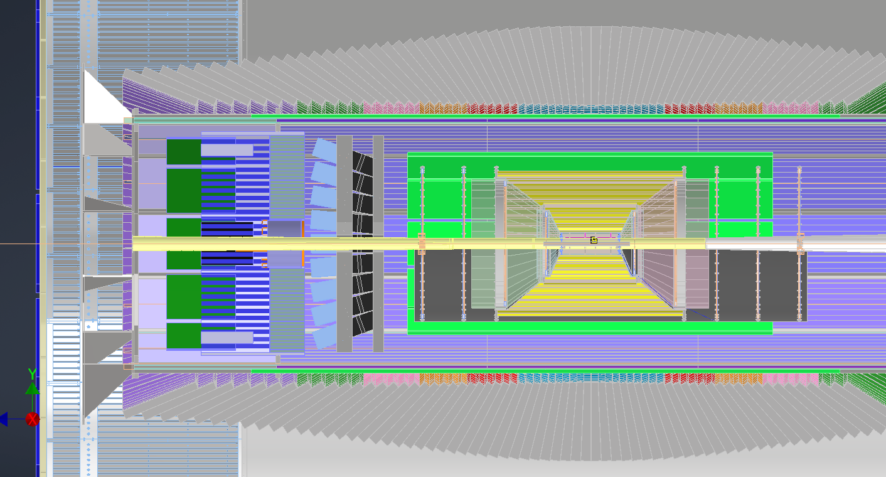
Backward (m)RICH Integration
Folds in detector information from GSU, readout needs estimate from Roberto P.
Information courtesy Alex Eslinger and Roland Wimmer
Barrel EMCal (extended in negative rapidity region by one glass layer
→ optimal overlap with eECAL)
Backward EMCal
mRICH, including ~20 cm for readout
Issues:
materials in front of crucial backward EMCal induced by SiPM cooling needs and AC-LGAD.
Plus by space available and heat induced by AC-LGAD Power
Note: AC-LGAD not yet included in layout

Slide 4
Backward AC-LGAD Info
Information courtesy Wei Li , slides of Aug. 29 TOF/PID WG meeting

Slide 5
Integration Progress – Backward Detectors
Backward EMCal is crucial for EIC, and we rely on it’s high-precision performance.
It has to be in a stable ambient temperature environment (< +/- 1º C)
Even if material at the front face will not affect performance much, materials further away will and have to be minimized.
AC-LGAD would provide both material and “a toaster” nearby…
Barrel EMCal
Backward EMCal
mRICH
Space for AC-LGAD? Plus heat issue…

Slide 6
Integration Progress - Iteration
Dear All,
I have some question to the sizes of the mRICH and pfRICH. What is currently modeled seems not fully correct in longitudinal.
So let me summarize my understanding of the sizes of the different components and you correct me please where I’m wrong.
So the mRICH
- front face of the box
- 3cm Aerogel
- fresnel lense (all three up to now integrated: 4 cm)
- 6 inch drift == 15. 5 cm
- SiPM readout + cooling 20 cm according to Roberto
- back face of box
the angle under which the boxes are inclined is 24^o
—> so total length: ~40 cm
the pfRICH:
- front face of the box
- 4 cm Aerogel
- thin plastic sheet < 0.5 cm (all three up to now integrated: 5 cm)
- expansion volume 40 cm
- SiPM readout + cooling 20 cm according to Roberto
- back face of box
—> so total length: ~65 cm
So the next question I have is for Alexander, can you please give us a number for the radiation length of the LAPPDs and I assume it is correct we do not need the same massive cooling as for the SIPMs.
Roberto why do you think we need 20 cm for the SiPM readout, for the fHCAL we think we can fit a SIP-board, FEB + digitizer or ASIC board all in 10 cm
Alexander I assume we can assume 10cm for an LAPPD readout
Let me say, I think we need to push for the mRICH and the pFRICH what ever we choose for a LAPPD as photon sensor, the massive cooling of the SIPMs and also the AC-LGAD with its enormous power needs are really not okay to place in-front of the eECal. With LAPPDs we also do not need the ToF anymore as we get it from the LAPPD.
6
6

Slide 7
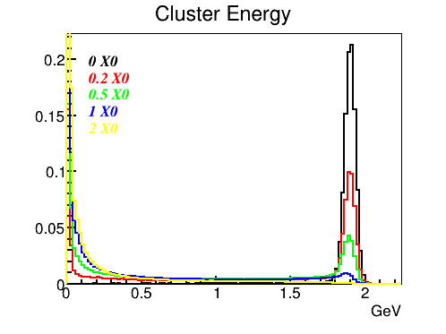
Effect of material on the way
Material on the way to EMCal is inevitable
  Other detectors, cables, pipes, frames, etc
It degrades the performance of the high resolution EMCal
  Photon conversion
  Bremsstrahlung radiation by electron
  Early shower
GEANT simulation for a single electron
2m
EMCal
Absorber
Collision
Point
Energy gets absorbed in the material
Energy gets distributed in the EMCal, e.g. due to Bremsstrahlung radiation by electron
  Single cluster reco leads to eff. loss
  The eff. can be recovered by radiated photon reco
  The closer material to the EMCal the smaller the effect
  The higher Bdl the larger the effect
  Rad. photons are localized in arcs with the same polar angle as a parent electron => topological search window
e, 2 GeV/c
Slides courtesy Alexander Bazilevsky

Slide 8
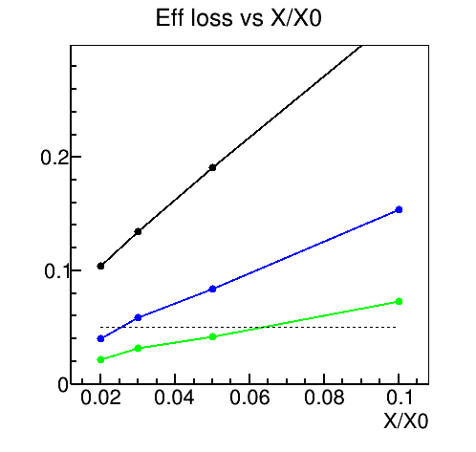
Effect of material on the way
The most extreme case:
Highest Bdl, lowest e momentum, close to coll. point
2m
Efficiency loss (with 2𝜎 cut) vs X/X₀
electron 1 GeV/c
B=3T
η=-1.5
EMCal
Absorber
Collision
Point
<100cm
10cm
<50%X₀ | <20%X₀ | <(3-6)%X₀
<30%X₀ | <10%X₀ | <10%X₀
Electron > 1GeV
Photon > 0.1GeV
5%
Exclusive requirements
(the whole effect assumed from one region) – % of whole effects are additive, i.e., if one has 10%X0 in the near-collision point region that is it!
e cluster energy
e cluster and rad 𝜸 energy from Ecl>50MeV
e cluster and rad 𝜸 energy from Ecl>50MeV and 𝜟η=±0.2, 𝜟𝜑=±0.5
The amount and localization of tolerable materials are formulated
Slides courtesy Alexander Bazilevsky

Slide 9
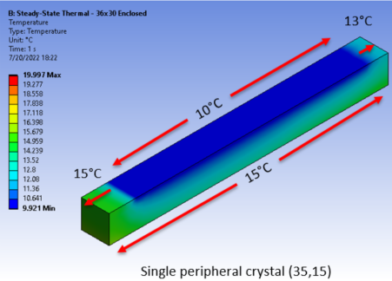
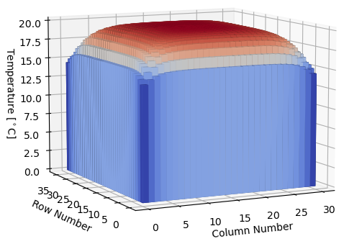
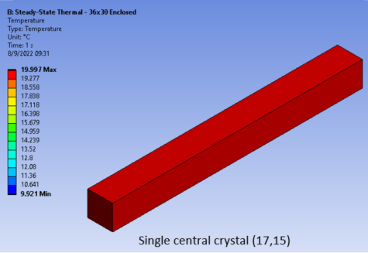
The Issue with Heat Near the PbWO4 Calorimeter
In this ANSYS/FLUENT calculation the ambient room temperature is 20º C and we apply a temperature of 10ºC on the outside periphery. Recall that the PbWO4 light yield has a temperature sensitivity of 2-2.5% per ºC. The precision relies on a stable temperature. This is for the NPS in Hall C, that has 30 x 36 PbWO4 crystals.
Requirements:
a stable ambient room temperature
no heat at the front of the crystals where the shower starts.
Slides courtesy Aaron Brown (JLab) based on work for the NPS

Slide 10
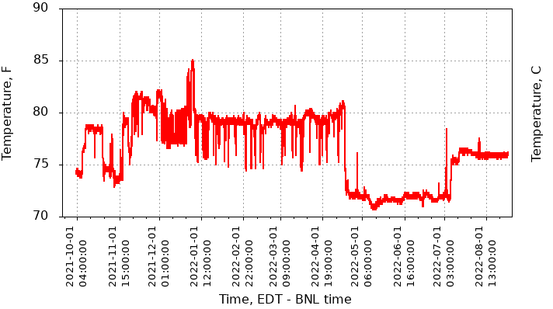
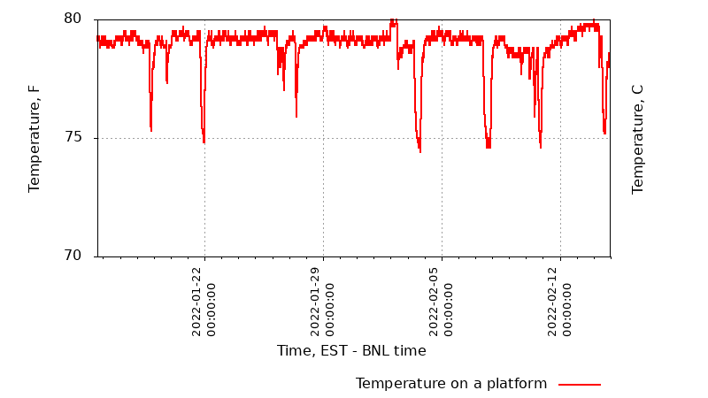
IP-6 Ambient Room Temperature
(first plot at dbplots: https://online.star.bnl.gov/dbPlots/#
Section Environment -> Platform)
During STAR operations,
November 2021 to mid of April 2022 it is stable to +/- 2F (1º C) and then if we turn off things it drops a lot
→ rely on stable ambient temperature supplemented by monitoring system.
5 F amplitude of temporary fluctuations
Information courtesy David Tlusty (BNL)

Slide 11
Alternative Solution Material Budget Estimate - LAPPD
I do not know either the density or the chemical composition of ceramic they presently use for the anode base plate. Same for the capillary glass array. So can give only an approximate estimate now.
Assuming a full ceramic body, and 10um pore MCPs, the essential layers are
quartz window - 5mm -> ~4% X/X0 (can probably be reduced to ~3%)
MCPs - 2x600um of a "standard" glass, roughly ~75% transparent -> small, <1% X/X0
anode base plate - 2mm thick ceramic-> few % X/X0
If a standard readout board is used, ~2mm thick, it is ~1% X/X0 more, and some amount of copper.
Ceramic walls will of course contribute to the material budget as well.
I think​ one can pack ASIC cards in a ~10cm space, but we have not yet looked into the details. The effective channel count per mm^2 and power consumption per channel will determine the cooling needs.
ECA/RE: roughly 6% X/X0, not including ASICs and cooling
Need of course carefully compare the performance of LAPPD vs. SiPM photon-detector
Information courtesy Alexander Kiselev

Slide 12
Summary
It is crucial we do not optimize detector systems in isolation but directly look at the integration issues, including service needs (readout, cabling, cooling, …).
The EIC science relies heavily on a high-resolution PbWO4-based electromagnetic calorimeter in the backward direction
  This has implications for the material budget for the other backward-region detectors in front of it – one must obey the total integrated amount and localization of tolerable materials, which are additive (as % of formulated regions).
  For example, if I need 10%X/X0 in the close-to-collision region, that’s all. If I use Cu tubing for cooling with 2 mm wall thickness near the PbWO4, that may be all.
  This has implications in that the backward EM calorimeter relies on a stable ambient temperature (+/- 1º C) to achieve high-precision performance, and thus prevents existence of large heat sources nearby.
Folding in realistic readout space needs for any backward RICH detector invokes space budget issues.
We suggest to consider study of a backward RICH detector based on LAPPD readout, even if there are also quantum efficiency issues to solve there, it may be the most practical solution compatible with EIC science needs and integration constraints.

Slide 13


