Slide 1
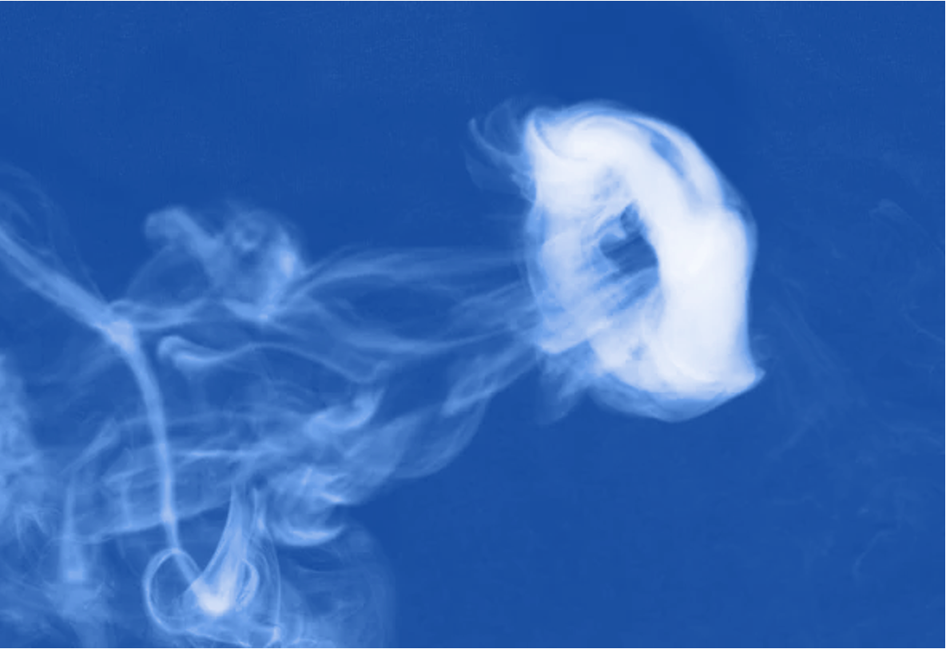
Subatomic Smoke Rings:
Polarization and toroidal vorticity in the QGP
Mike Lisa, Ohio State University
Notes:
Abstract: Since the discovery of global hyperon polarization in Au+Au collisions at RHIC about five years ago, there has been intense theoretical and experimental focus on the topic. After a brief review, I will discuss novel vortex structures that may be generated in two situations. The first is a p+A collision, which may produce droplets of QGP that develop toroidal vortex ("smoke ring") structure. Experimental observation of such a structure would provide compelling evidence supporting the hydrodynamic nature of this tiny system, a much-debated topic today. The other is an idealized "hot moving spot" that may result from thermalization of a jet in an expanding QGP; in this case, the "smoke ring" centers on the jet direction. In both cases, we suggest an experimental observable to measure the toroidal vortex structure, and present present full hydrodynamical simulations to make quantitative predictions. I will also discus next steps for more realistic calculations.
https://arxiv.org/abs/2101.10872
https://arxiv.org/abs/2102.11919

Slide 2
Outline
Interesting structures at forward rapidity in A+A – model calculations
  Ivanov, Soldatov, Toneev, Fu, Xu, Huang, Song, Baznat, Gudima, Sorin, Teryaev, Usubov, Deng, Wei, Xia, Li, Tang, Wang, Zinchenko…
Interesting, uncharted directions – hydro calculations
  p+A collisions - PRC104 (2021) 011901; arXiv:2101.10872
  jets in expanding QGP fluid – PLB820 (2021) 136500; arXiv:2102.11919
Summary
3C Collaboration:
J. Barbon, D. Chinellato, W. Serenone, C. Shen, J. Takahashi, G. Torrieri, MAL

Slide 3
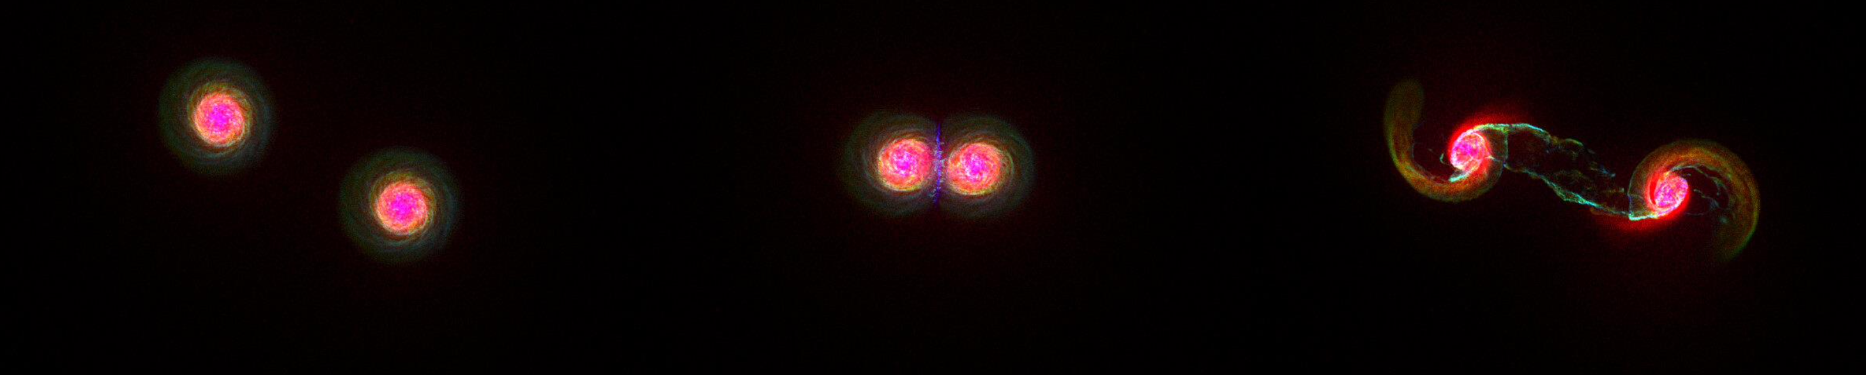
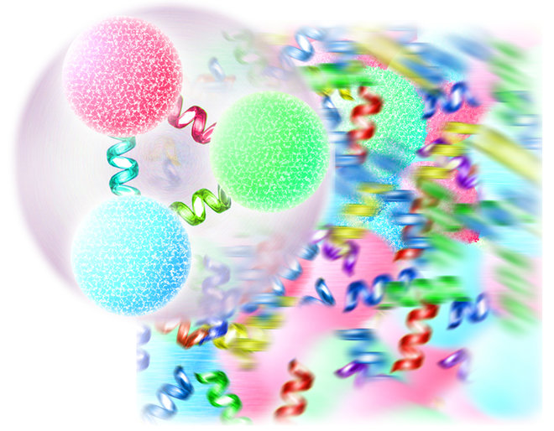
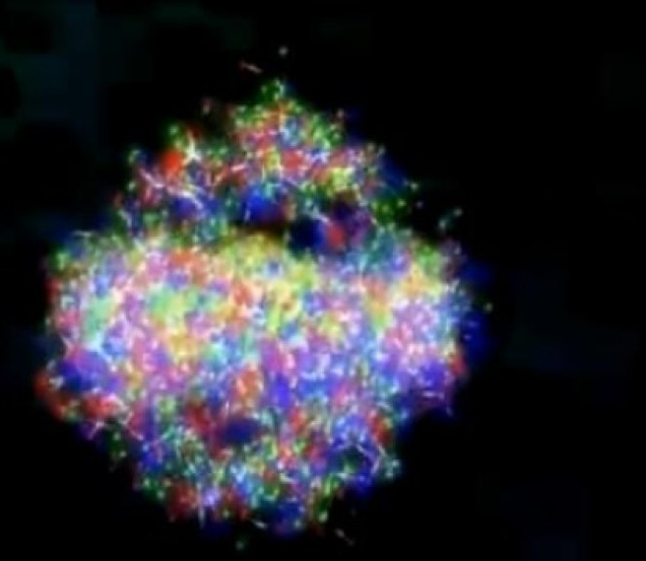
Rotational substructure of noncentral collisions
fluid
hadrons
flavors
yield
momentum
polarization
fluid cell
chemical potentials
temperature
collective velocity
vorticity
Dynamic evolution of locally equilibrated matter
Hadronization/freezeout driven by conservation laws (and…?)
emitted particles (measurable!) reflect properties of parent fluid cells
Yields
longitudinal, transverse distributions
azimuthal flow anisotropy
polarization
finer
detail
Becattini, Karpenko, MAL, Upsal, Voloshin, PRC 2017
Notes:
All of the previous movies etc could very well have been CENTRAL collisions! Angular momentum in principle irrelevant.

Slide 4
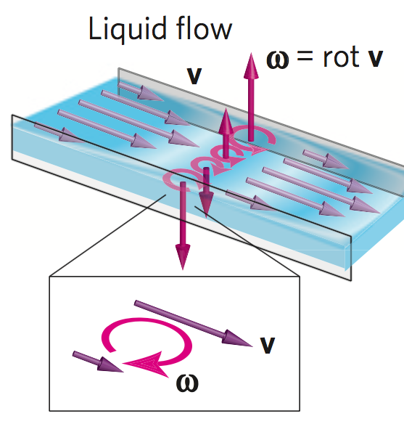
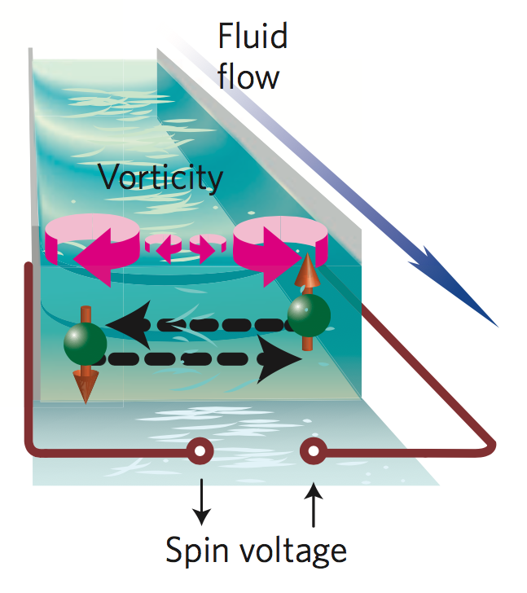
First observation of fluid vorticity-polarization coupling
“Spin hydrodynamic generation” Takahashi, et al. Nat. Phys. 12 (2016) 52
“This opens a door to the new field of fluid spintronics”
direction of vorticity known
atomic alignment measured
Takahashi knew direction of angular momentum
Friction with walls induces vorticity
Vorticity of bulk → polarization of constituents (& spin voltage etc)

Slide 5
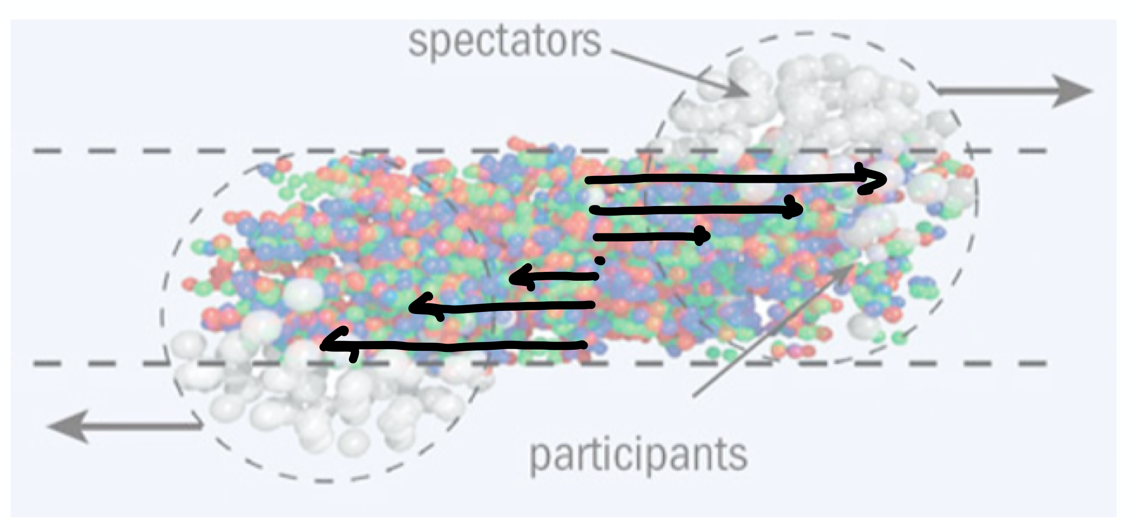
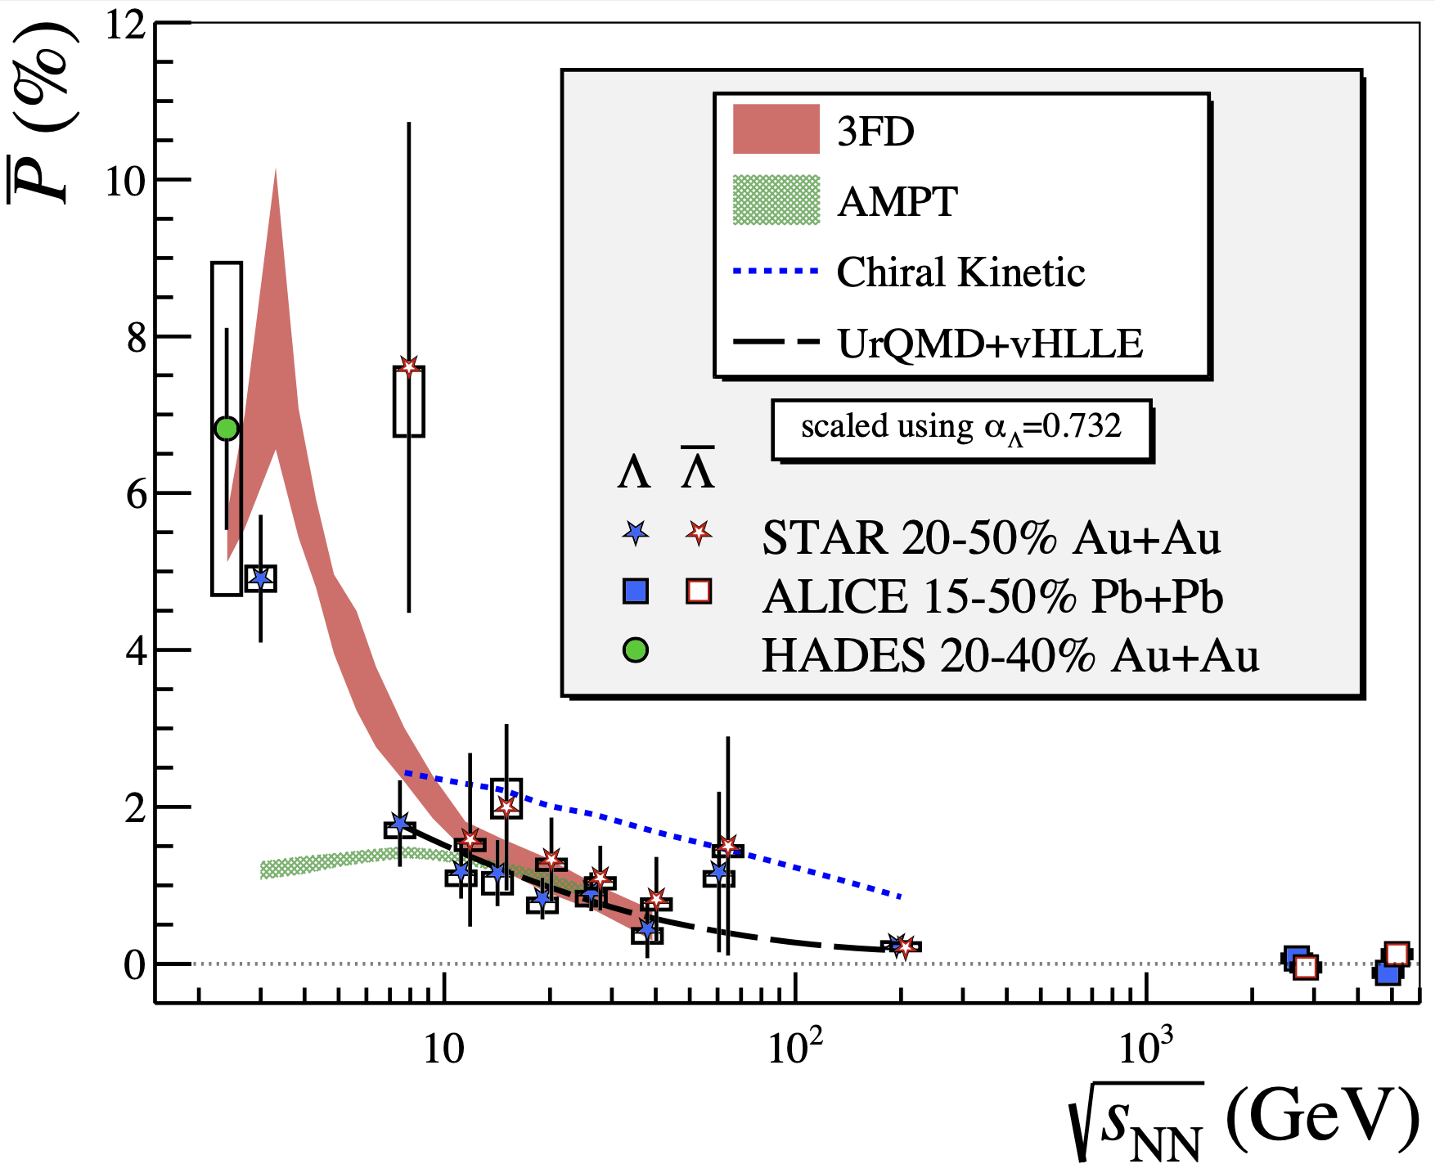
Second observation of fluid vorticity-polarization coupling
direction of vorticity known
atomic alignment measured
Takahashi knew direction of angular momentum
We “know” direction of global angular momentum J

Slide 6
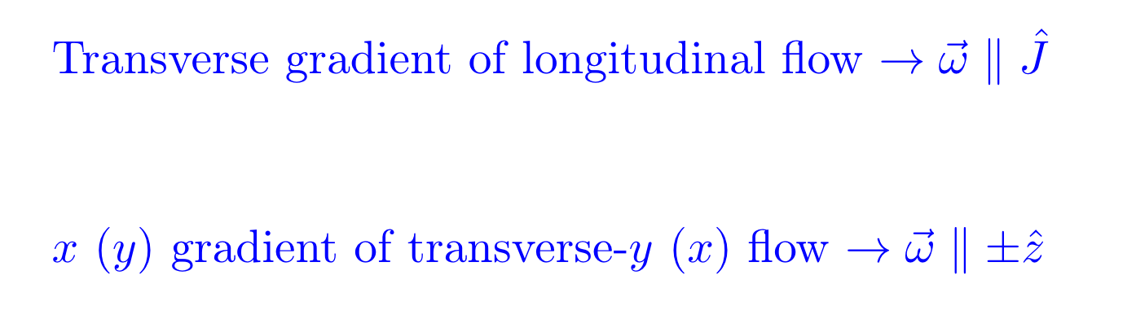
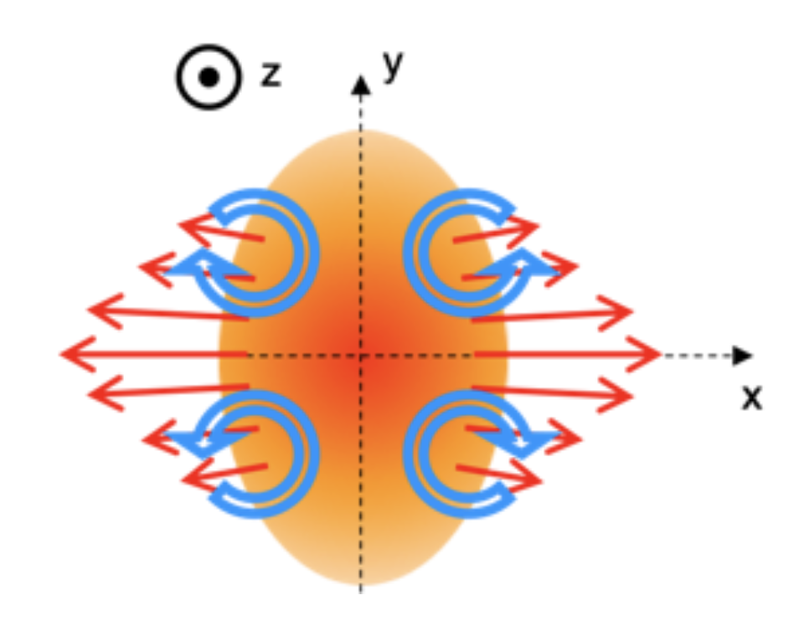
In another direction – longitudinal polarization
naïve cartoon
-
+
+
-
(By symmetry, must be quadrupole)

Slide 7
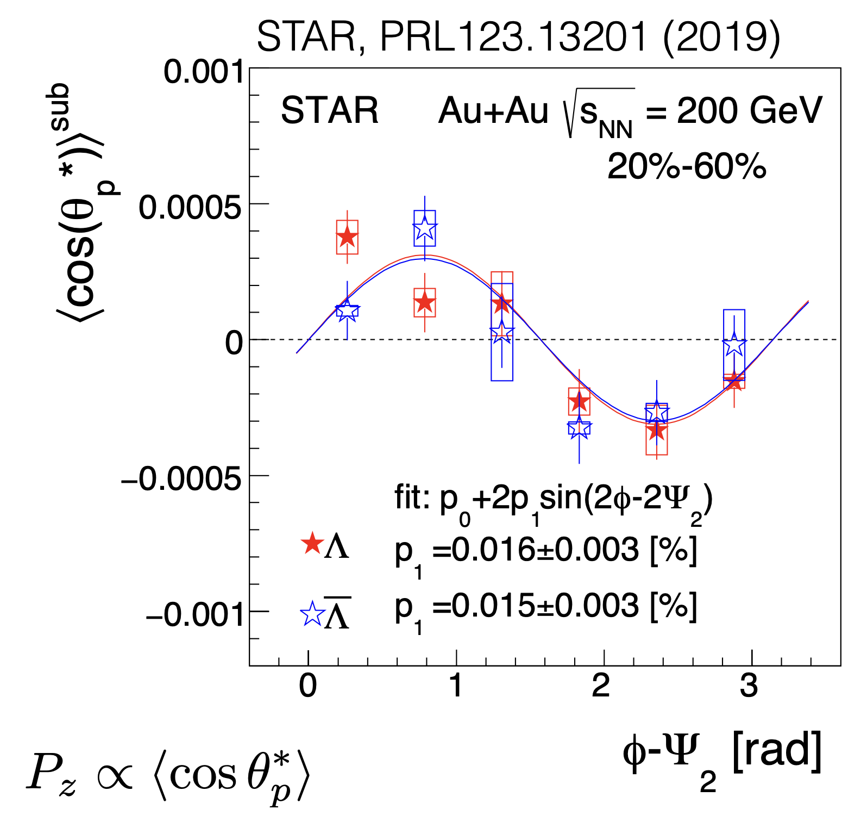
In another direction – longitudinal polarization
naïve cartoon
-
+
+
-
(By symmetry, must be quadrupole)

Slide 8
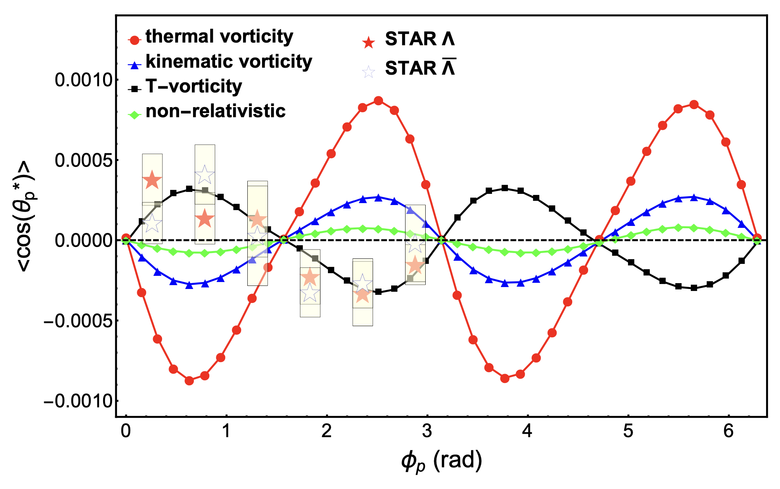
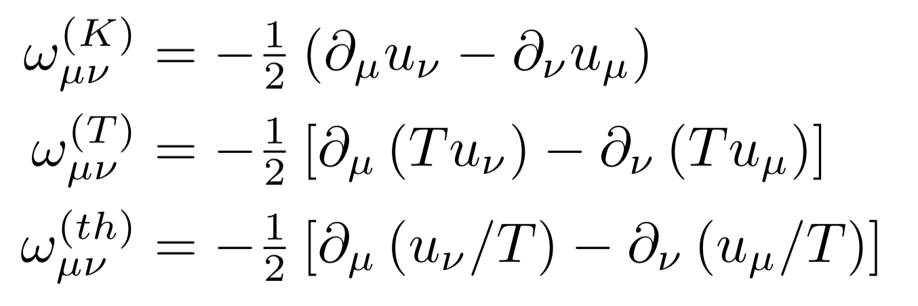
Tension… and insight?
AMPT+hydro Wu, Pang, Huang, Wang PR Res 1(2019)033058
“Which kind of vorticity” to use?
theoretically favored^{[1]}
“works”
[1] Becattini PRL108:244502 (2012)

Slide 9
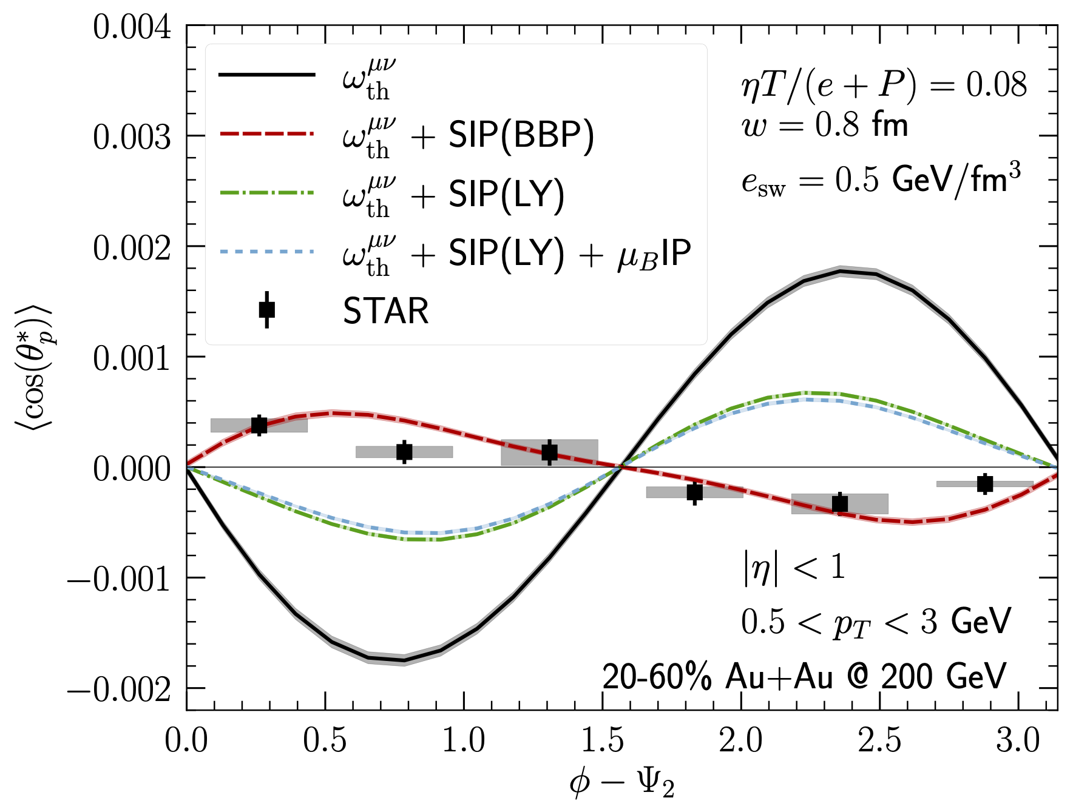
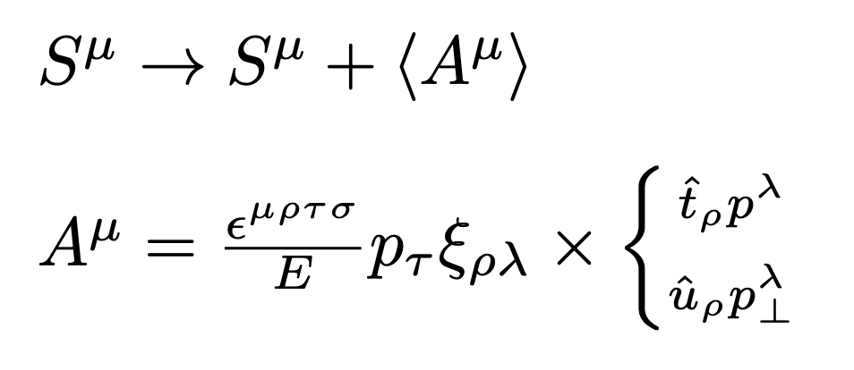
Tension… and insight?
Alzhrani, Ryu, Shen arxiv:2203.15718
AMPT+hydro Wu, Pang, Huang, Wang PR Res 1(2019)033058
New “shear-induced polarization” terms
“Which kind of vorticity” to use?
BPP
theoretically favored^{[1]}
LY
“works”
Becattini, Buzzegoli, Palermo PLB 820, 136519 (2021); arXiv:2103.10917
Liu and Yi Yin, JHEP 07, 188 (2021), arXiv:2103.09200
[1] Becattini PRL108:244502 (2012)

Slide 10
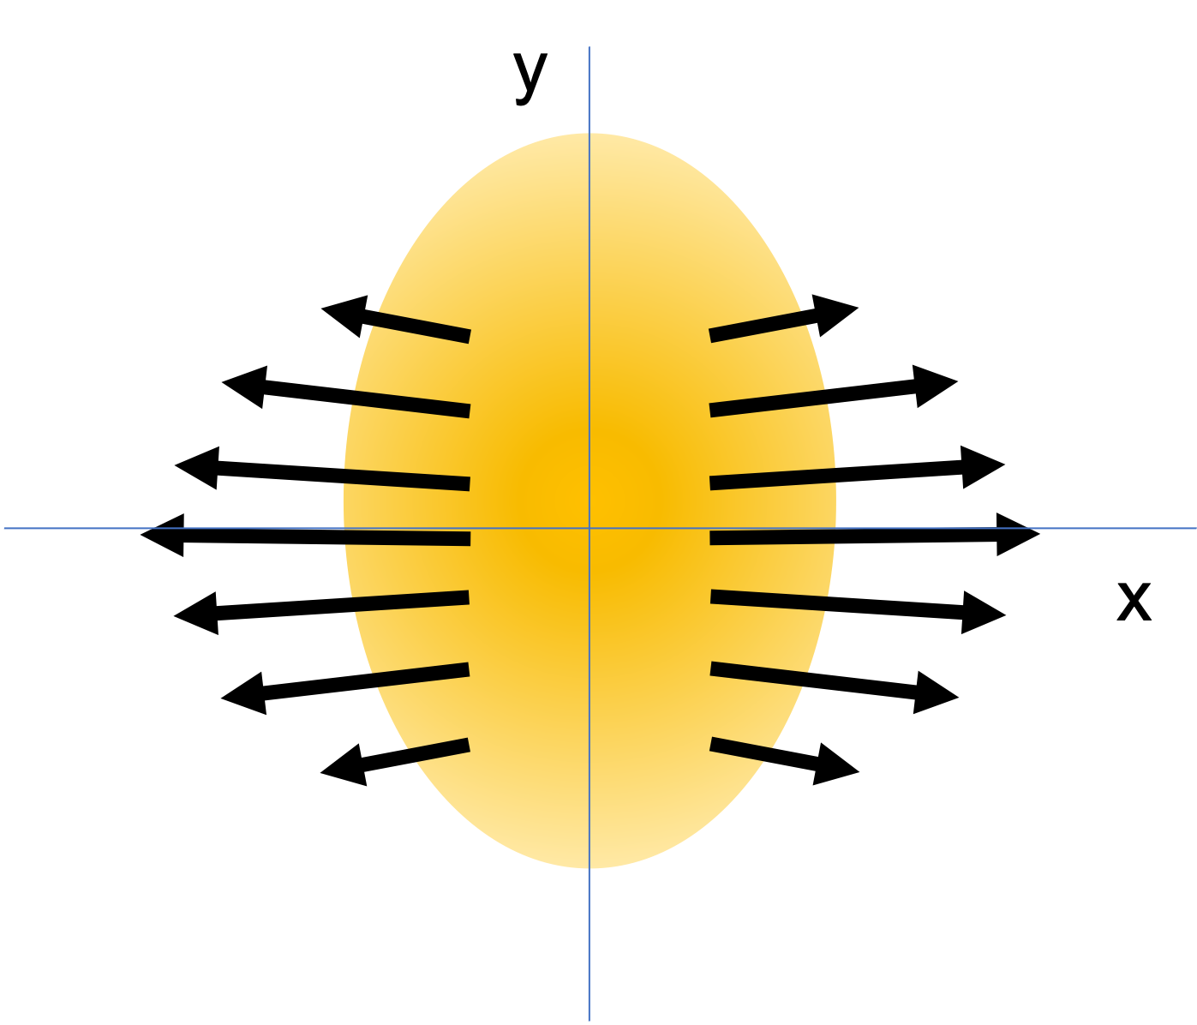
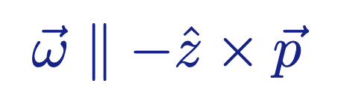
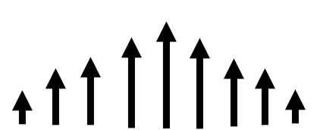
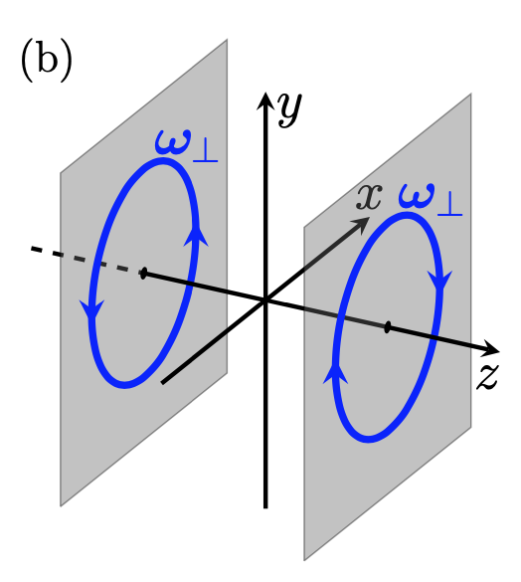
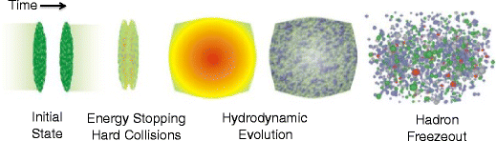
Circular polarization in central A+A
Xia, Li, Tang, Wang PRC 98, 024905 (2018)

Slide 11
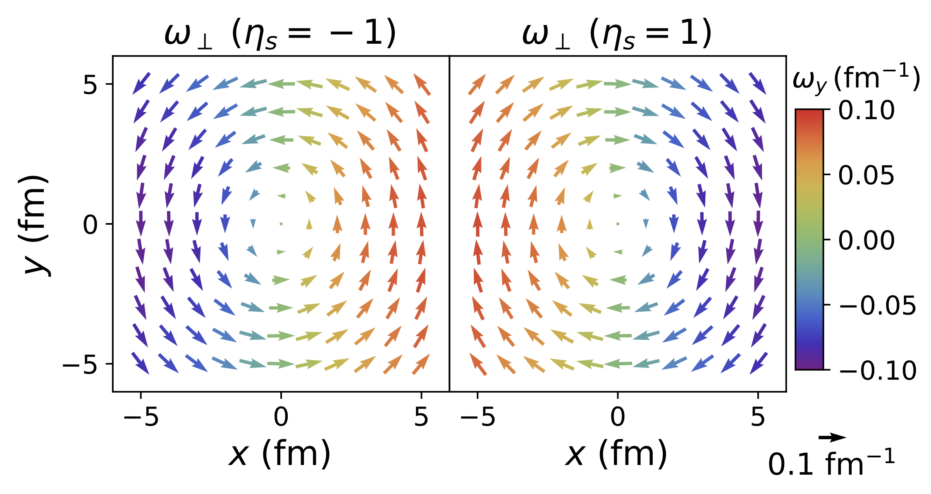
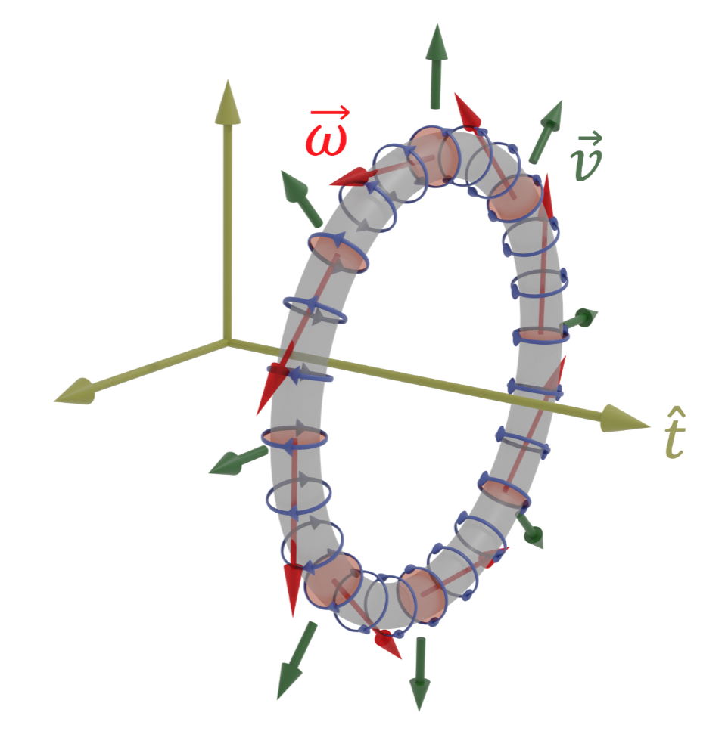
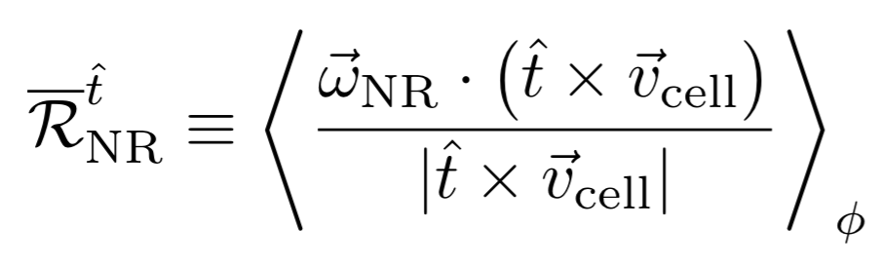
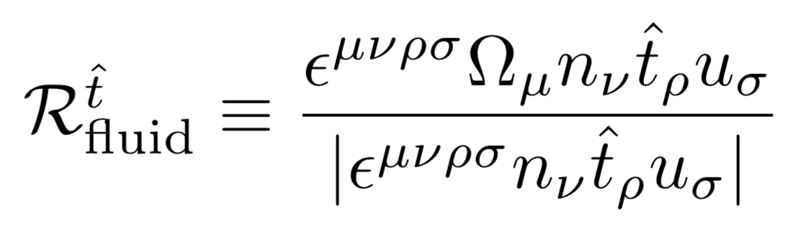
Circular polarization in central A+A
these are vorticity vectors, not flow velocities
quantifying smoke-ring structure
Xia, Li, Tang, Wang PRC 98, 024905 (2018)
PRC104 (2021) 011901
Xia, Li, Tang, Wang PRC 98, 024905 (2018)

Slide 12
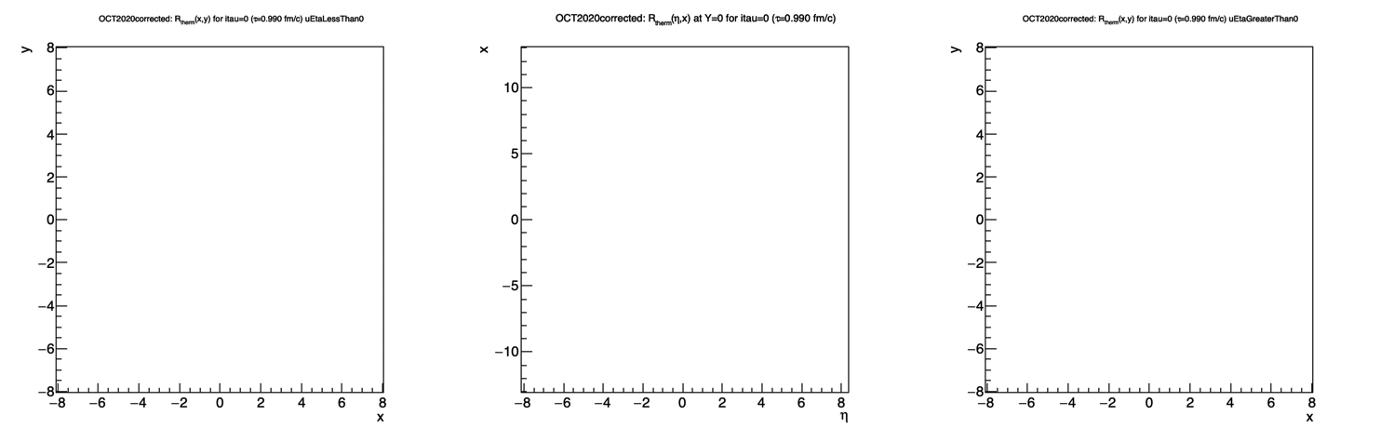

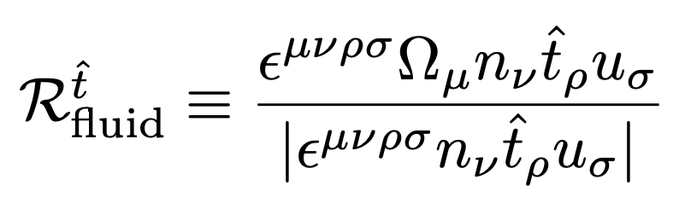
Development of toroidal vorticity in MUSIC
PRC104 (2021) 011901
Au+Au at 200 GeV
Bjorken flow profile
MUSIC hydrodynamics, with baryon currents
Schenke, Jeon, Gale PRC82 (2010) 014903
Schenke, Shen, Tribedy PRC102 (2020) 044905
color axis:

Slide 13
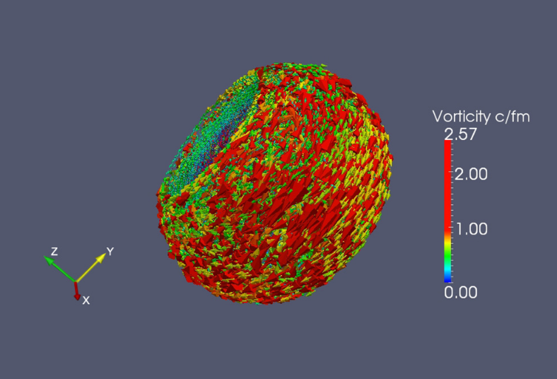
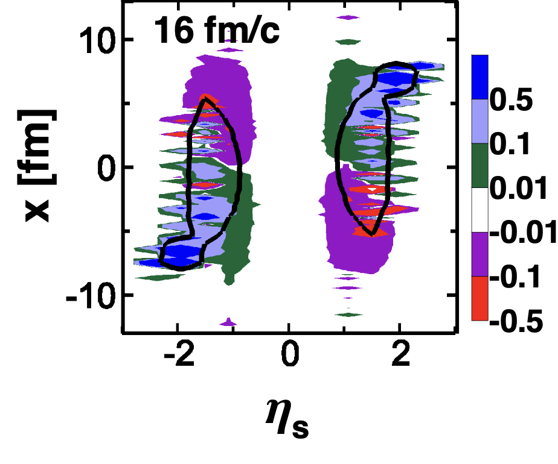
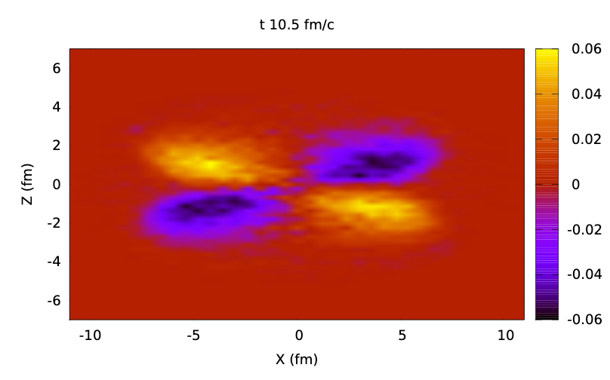
Rings predicted at all energies– can they be observed?
This is a unique predicted structure! Observation would represent a compelling demonstration of fluid structure at the extremes of rapidity & energy
Baznat, er al, PRC93, 031902(R) (2016)
Ivanov & Soldatov PRC97, 044915 (2018)
Teraev & Usubov PRC92 014906 (2015)
Xia, Li, Tang, Wang PRC98, 024905 (2018)
Focused forward
difficult at STAR@RHIC or ATLAS/CMS/ALICE@LHC without forward tracking upgrade
Focused forward
in principle possible at STAR with forward tracking upgrade
Observable at HADES, STAR FXT
(NICA)

Slide 14
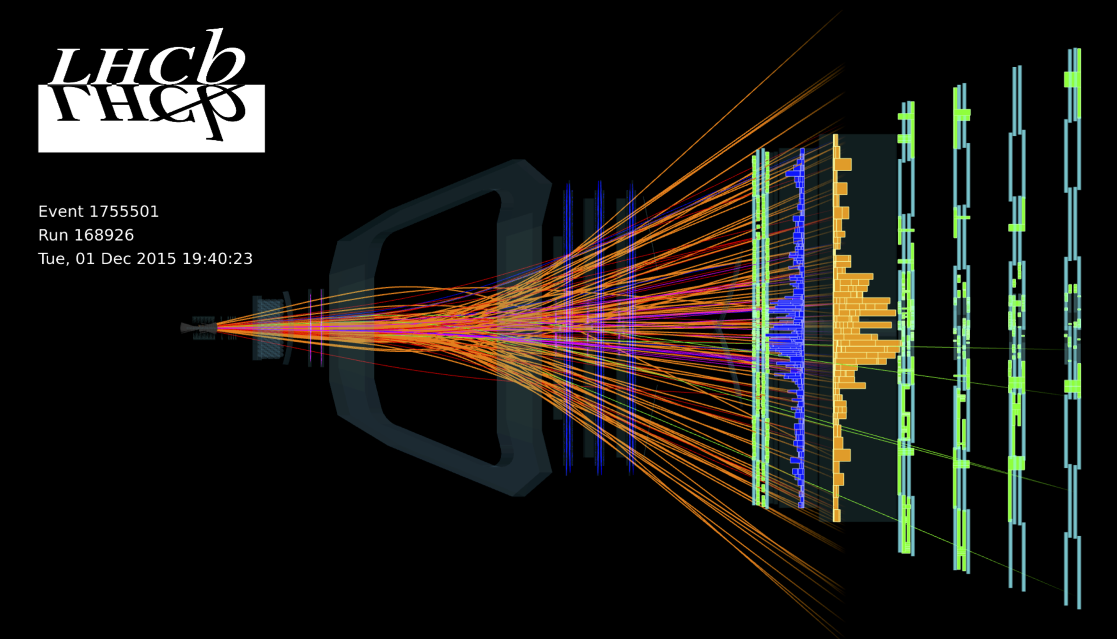
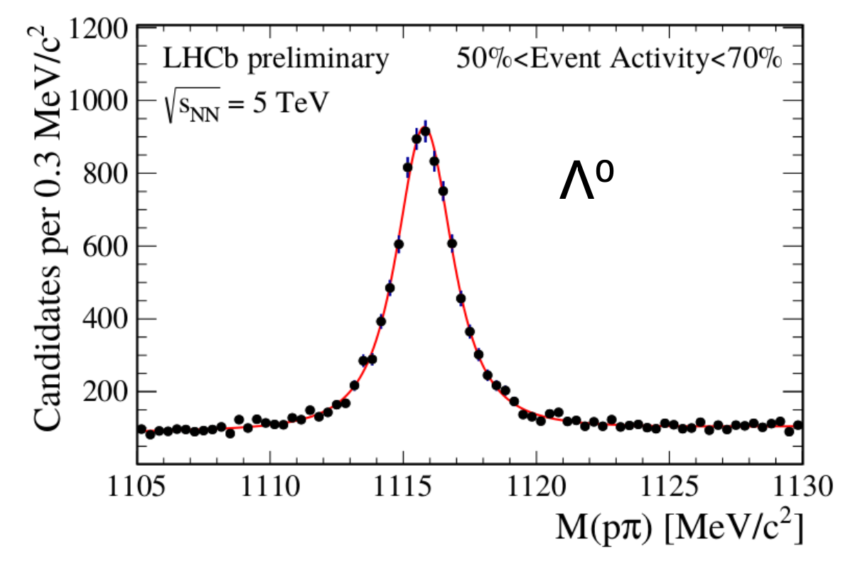
Seeing the rings
This is a unique predicted structure! Observation would represent a compelling demonstration of fluid structure at the extremes of rapidity & energy
Michael Winn, ERICE, 2016
Pb+Pb event
Focused forward
Difficult at STAR@RHIC or ATLAS/CMS/ALICE@LHC without forward tracking upgrade
LHCb ideal to observe this structure
Note: No Event Plane Necessary!

Slide 15
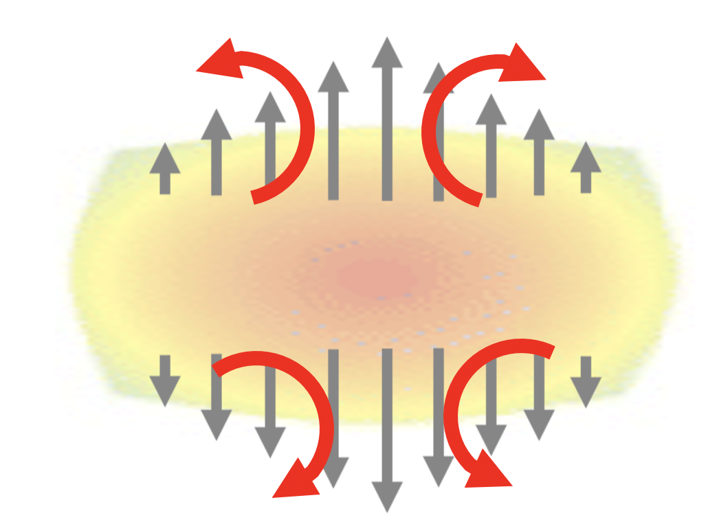
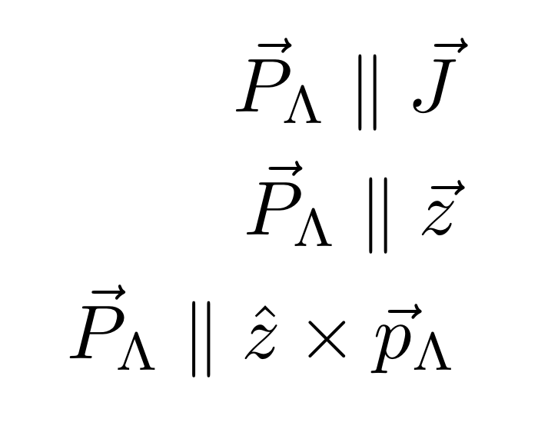
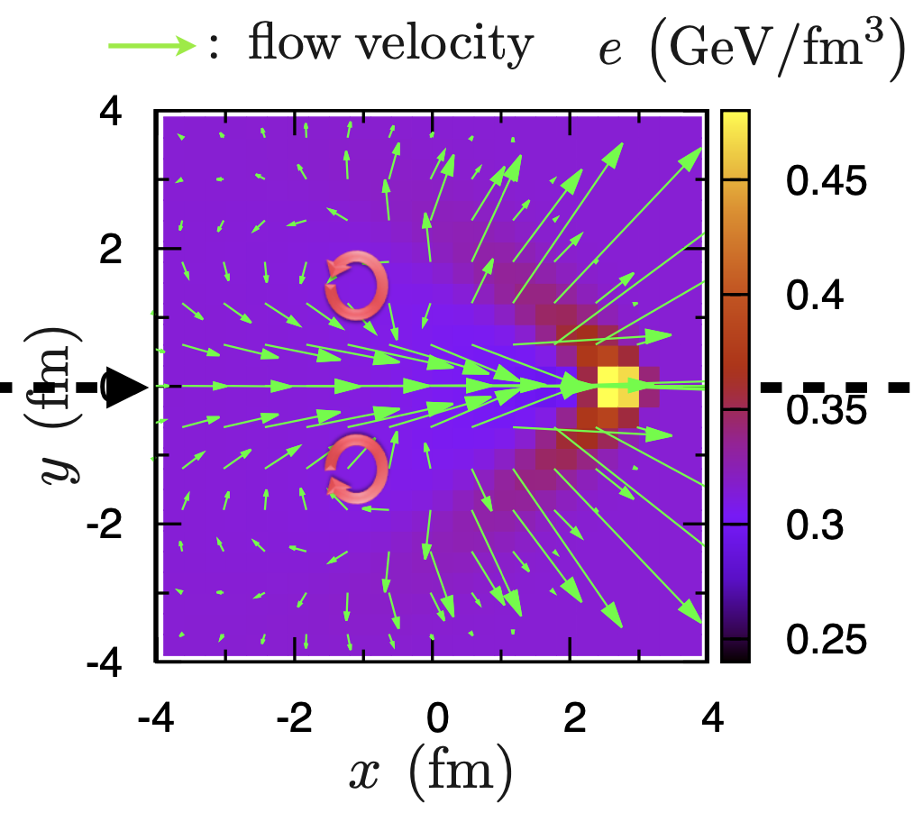
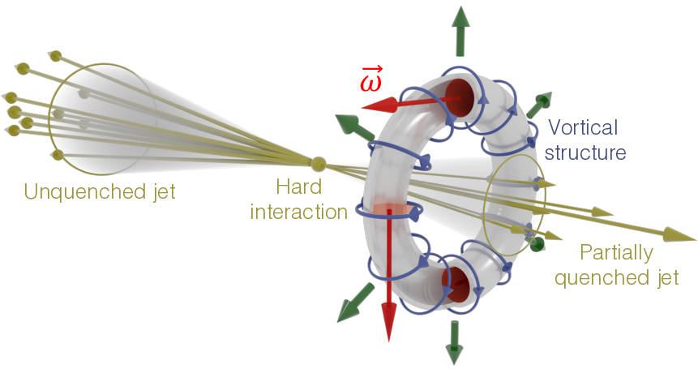
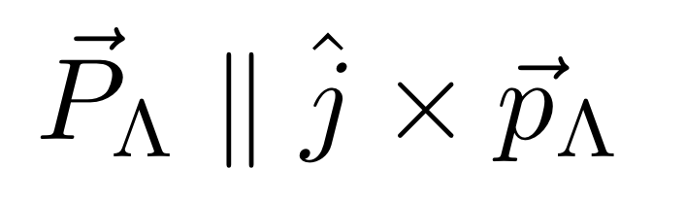
Polarization about a local disturbance
-
+
+
-
Helmholtz (1867): Persistent vortical toroids (smoke rings) are quintessential fluid behavior
Vortex rings about the jet direction:
Betz/Gyulassy/Torrieri, PRC76 (2007) 044901
Tachibana/Hirano, NPA904-905 (2013) 1023c
W. Matioli et al, PLB820 (2021) 136500

Slide 16
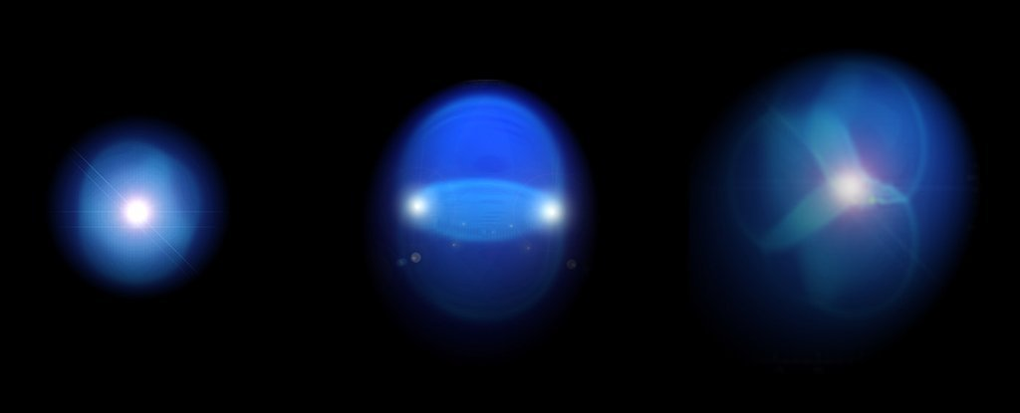
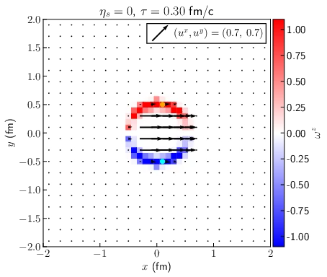
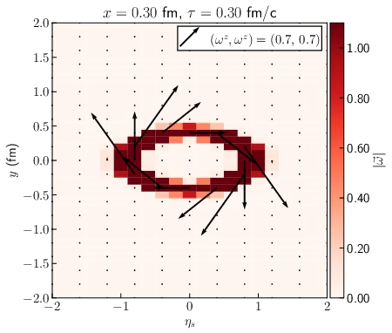
Jet-induced toroidal vorticity in MUSIC

Slide 17
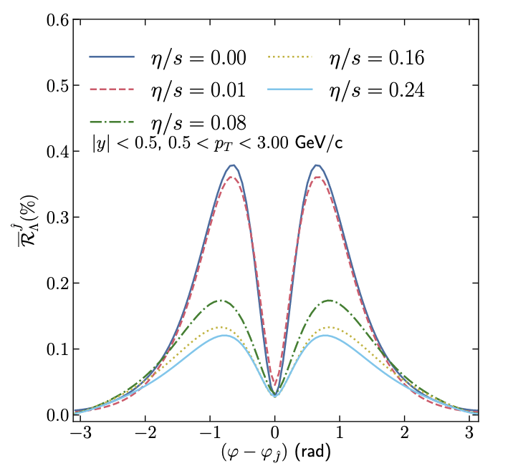
Jet-induced toroidal vorticity
Experimentally challenging, but potentially rich!
early-stage fluid behaviour?
nature of energy loss in fluid
sensitivity to transport coefficients
MUSIC hydro with embedded jet
Toroidal vorticity
t = jet direction
W. Matioli et al, PLB820 (2021) 136500
E_{jet}~59 GeV in Pb+Pb @ LHC

Slide 18
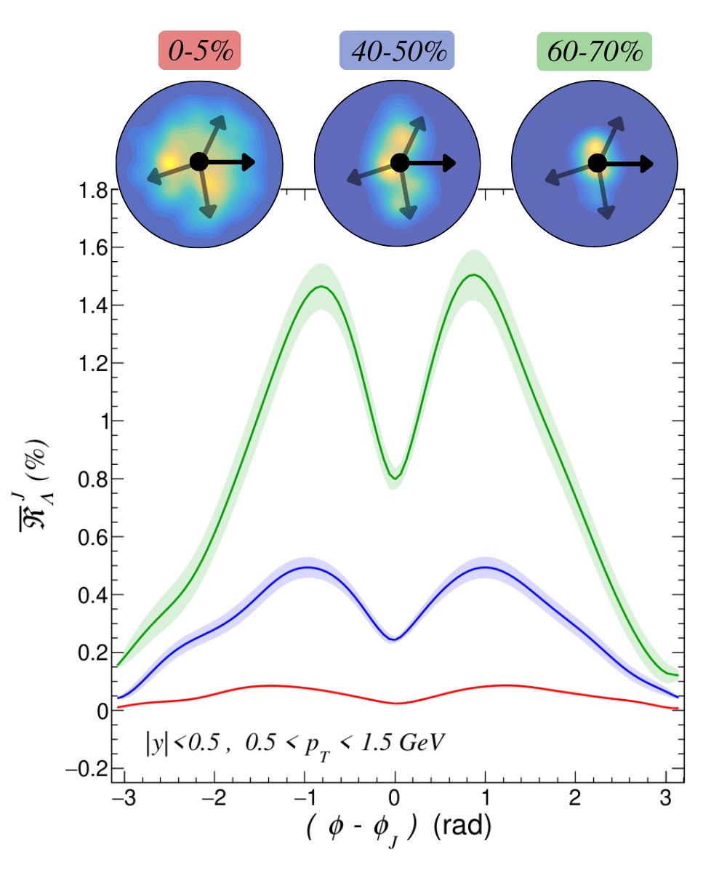
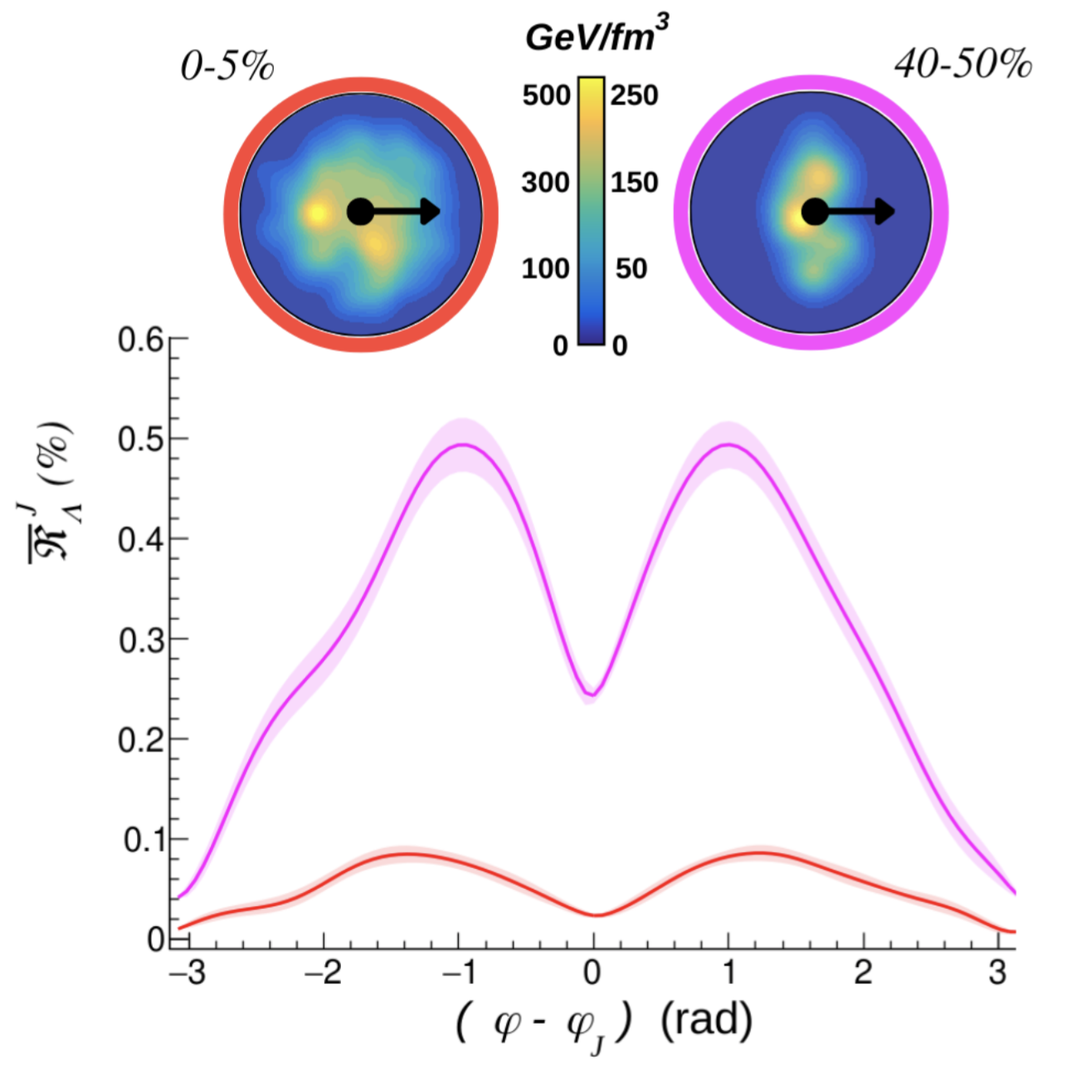
Jet-induced toroidal vorticity
E_{jet}~59 GeV in Pb+Pb @ LHC
Studies underway (Matiolio, Ribeiro, et al)
“bullets” in non-smooth, e-by-e system
Jetscape-modeled fragments equilibrating in non-smooth e-by-e system
signal persists

Slide 19
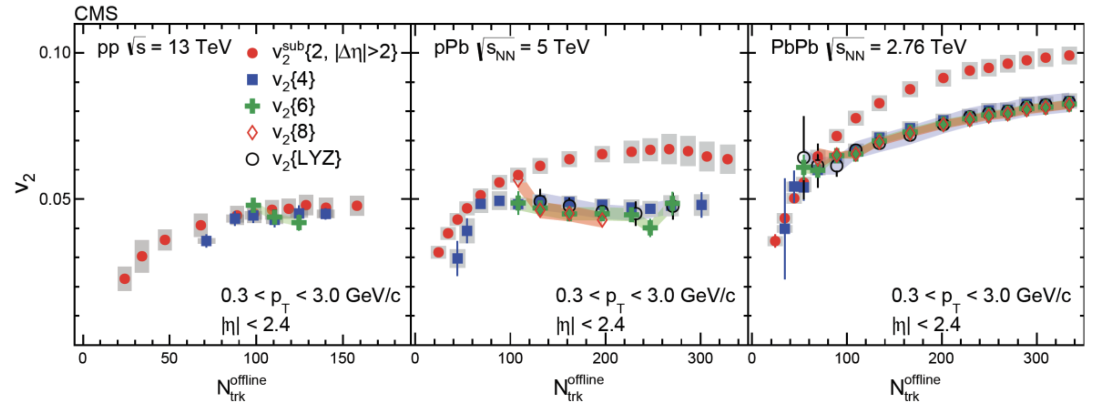
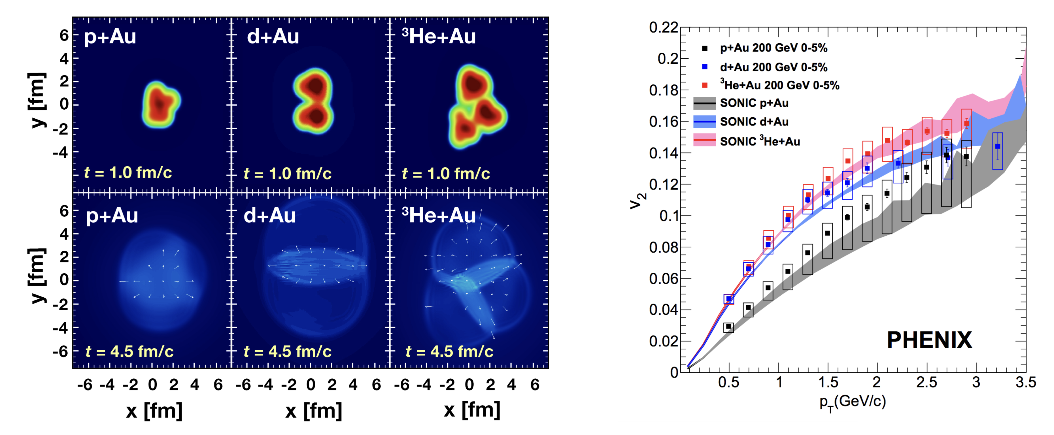
What about p+A collisions…?
Do such collisions really form “the smallest droplet of QGP?”
  multi-particle correlation →
  though… not uniquely hydro prediction,
  e.g.: Dusling et al, PRD 97, 016014 (2018)
  with well-chosen initial conditions and
  pre-equilibrium effects, hydro evolution
  seems to reproduce 2-particle anisotropy!
Nagle & Zajc, Ann.Rev.Nucl.Part.Sci. 68 (2018)

Slide 20
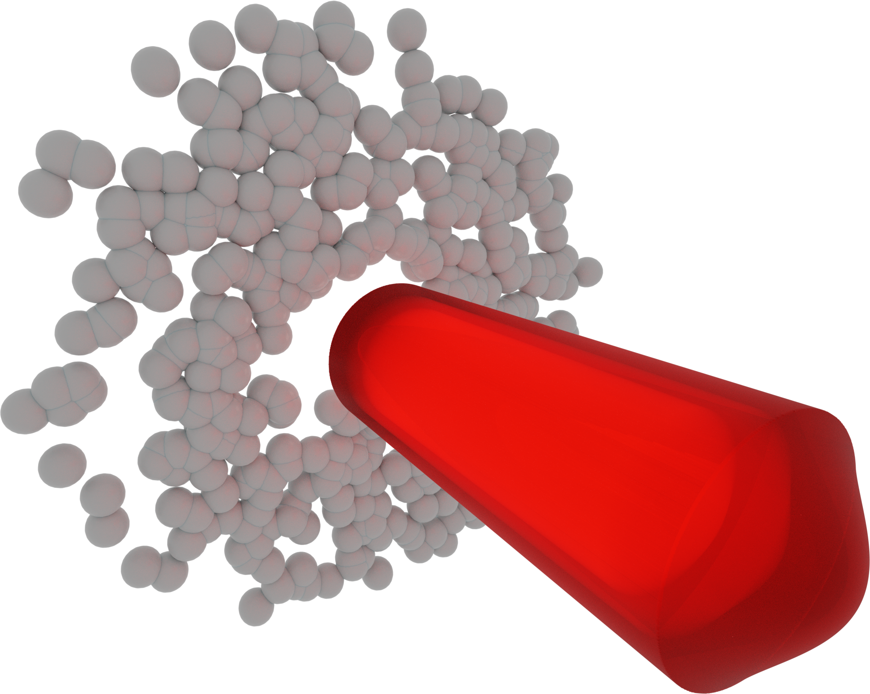
What about p+A collisions…?
Do such collisions really form “the smallest droplet of QGP?”
  if everything is hydro, are we confident that anything is hydro?
  much of the supporting evidence comes from v_{n}… can we find a novel, hydro-characteristic test?
“Every time you break a symmetry, you learn something”* (v2, v1, polarization!)
  broken forward/backward symmetry → potentially interesting initial state
* Urs Wiedemann
Au
p

Slide 21
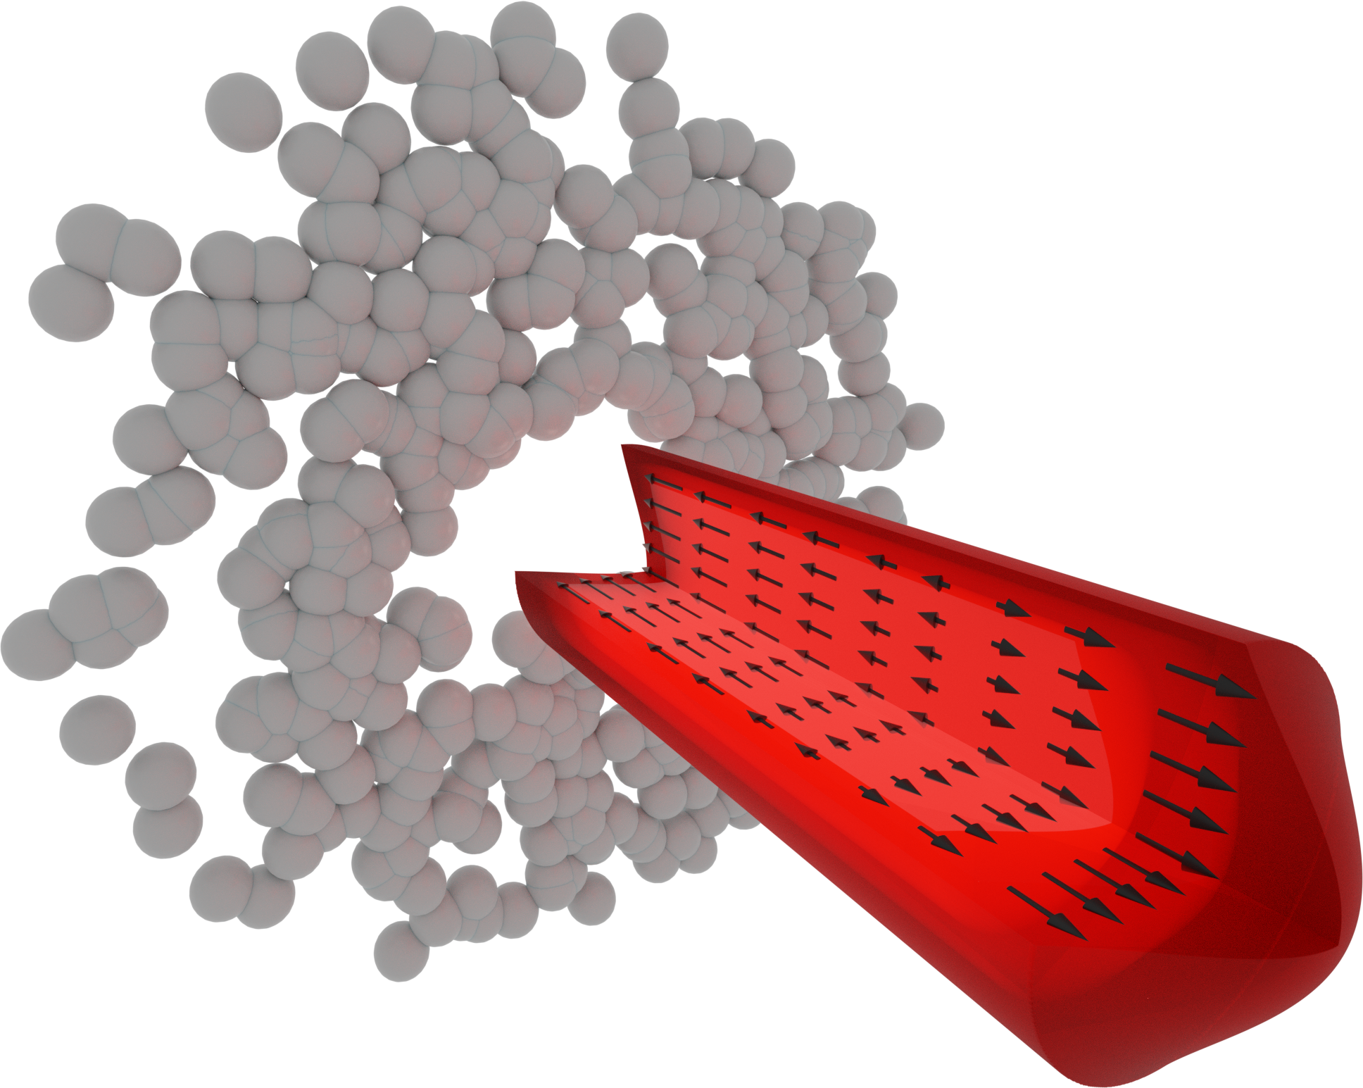
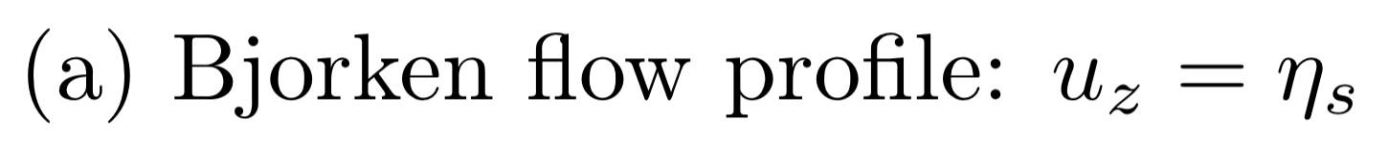
What about p+A collisions…?
Do such collisions really form “the smallest droplet of QGP?”
  if everything is hydro, are we confident that anything is hydro?
  much of the supporting evidence comes from v_{n}… can we find a novel, hydro-characteristic test?
“Every time you break a symmetry, you learn something”* (v2, v1, polarization!)
  broken forward/backward symmetry → potentially interesting initial state
* Urs Wiedemann
proton

Slide 22

What about p+A collisions…?
Do such collisions really form “the smallest droplet of QGP?”
  if everything is hydro, are we confident that anything is hydro?
  much of the supporting evidence comes from v_{n}… can we find a novel, hydro-characteristic test?
“Every time you break a symmetry, you learn something”* (v2, v1, asHBT, polarization!)
  broken forward/backward symmetry → potentially interesting initial state
* Urs Wiedemann
See also S. Voloshin, Hirschegg 2017 arxiv:1710.08934
(b) Radial-gradient flow profile

Slide 23
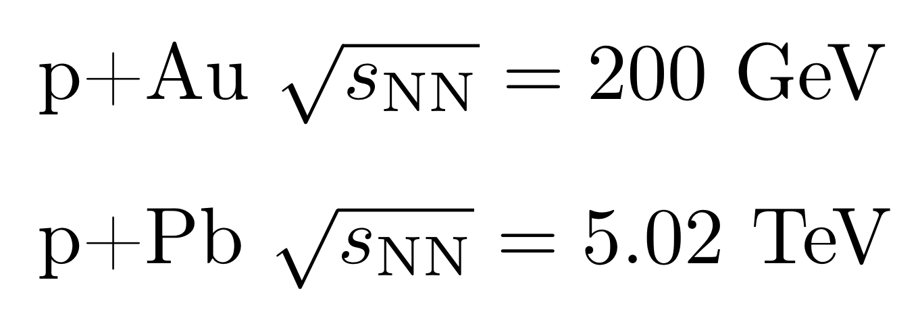
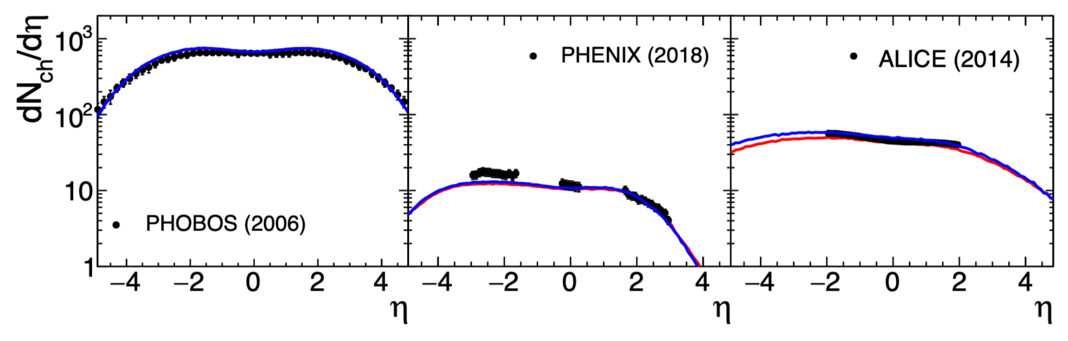
What about p+A collisions…?
Basic observables are ~identical in these scenarios
(a)
(b)
(b) Radial-gradient flow profile

Slide 24
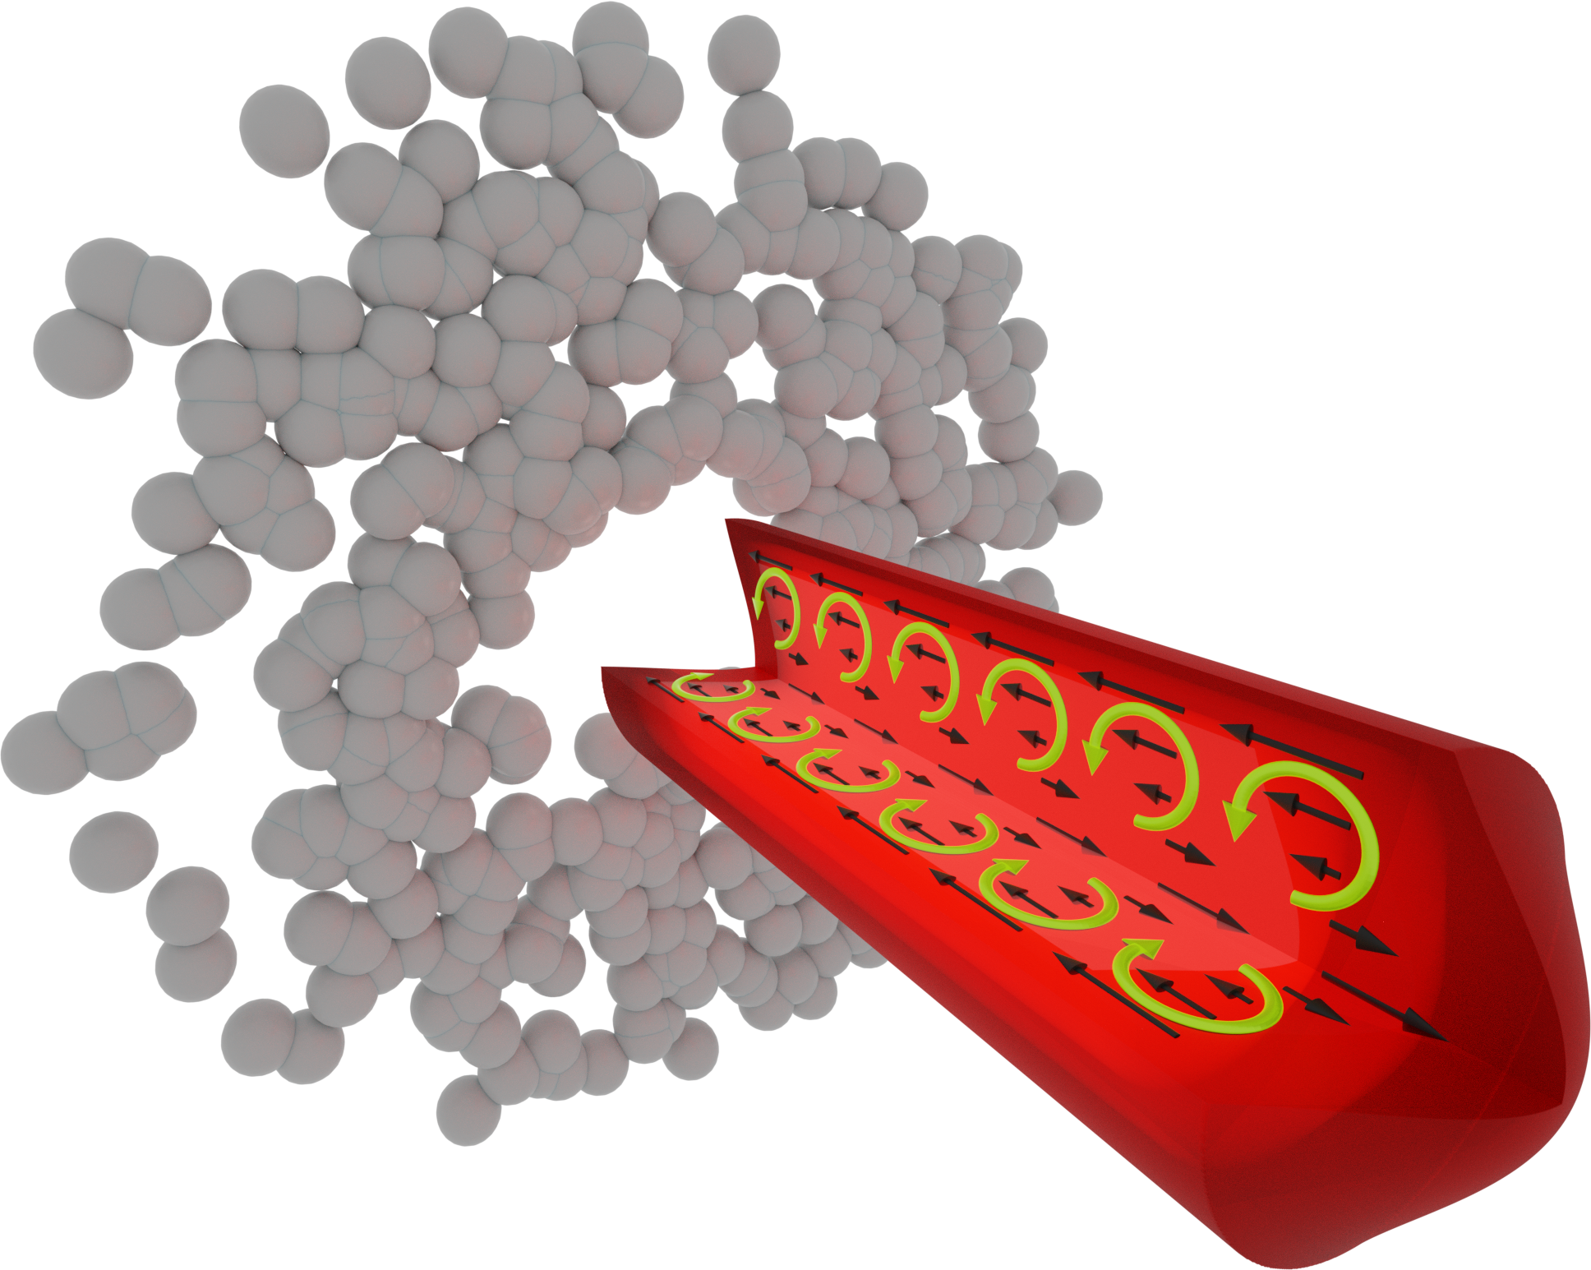
What about p+A collisions…?
Basic observables are ~identical in these scenarios
Vorticity is very different
(a)
(b)
See also S. Voloshin, Hirschegg 2017
(b) Radial-gradient flow profile

Slide 25

Relation to Takahashi geometry
The experimental geometry was not this
It was flow thru capillary tube:
(b) Radial-gradient flow profile

Slide 26


Jet-induced vorticity/polarization
-
+
+
-
small stuff blasting through stuff
Willian Serenone’s talk

Slide 27

color axis:
p+Au at 200 GeV
27
(a)
(b)
MUSIC hydrodynamics, with baryon currents

Slide 28

Snaphots
PRC104 (2021) 011901; arxiv: 2101.10872
smooth-on-smooth, b=0
collisions at RHIC

Slide 29







Fluid ➞ particles (vorticity ➞ polarization)
Cooper-Frye
for spin
Becattini et al, Annal. Phys. 338 (2013) 32
alternative vorticities…
non-vortical
symmetric shear
Becattini et al (2021)
Liu & Yin (2001)

Slide 30



Observing the ”smoke tubes”
PRC104 (2021) 011901; arxiv: 2101.10872
Ring vorticity observable
Bjorken flow profile
With radial gradients
similar effect for all vorticity “flavors”
hyperon and anti-hyperon are similar

Slide 31

Observing the ”smoke tubes”
Nontrivial dynamics for long lifetime
similar effect for all vorticity “flavors”
hyperon and anti-hyperon are similar
PRC104 (2021) 011901; arxiv: 2101.10872

Slide 32


fluctuating initial conditions
Chinellato, MAL, Serenone, Shen, Takahashi, Torrieri in preparation
Event-by-event calculation with lumpy initial conditions, following prescription in [1]
→ little difference with smooth initial conditions
reduced R_{spin} for more symmetric system
Schenke, Shen, Tribedy, PRC102 (2020) 044905
* note: p_{T}>500 MeV here, increasing R 0.04 → 0.06 in p+Au
[1] Shen, Alzhrani, PRC102 (2020) 014909 (2020)

Slide 33
Interpolating between the scenarios
Reality may lie between the extremes…
f=100%
Dialing in the non-Bjorken flow. Schematically….
(1-f)✖️
+ f✖️
f=15%
For Au+Au at 200 GeV (11 GeV), global polarization calls for f=15% (50%)
  Ryu, Jupic, Shen: 2106.08125
unclear whether this translates to p+A
Even with low f, substantial signal
f=0%
Chinellato, MAL, Serenone, Shen, Takahashi, Torrieri in preparation

Slide 34


Effect of shear terms
Chinellato, MAL, Serenone, Shen, Takahashi, Torrieri in preparation
[1]
[2]
[1] F. Becattini, M. Buzzegoli, and A. Palermo
Phys. Lett. B 820, 136519 (2021); arXiv:2103.10917
[2] Shuai Y. F. Liu and Yi Yin
JHEP 07, 188 (2021), arXiv:2103.09200
(c.f talks by Buzzegoli and Fu in session T02 Tuesday)
nontrivial / non-intuitive effect on R
Large difference in effects predicted by the two prescriptions
Effect at midrapidity remains

Slide 35





Experimental issues
c/o Joey Adams
STAR PRC104 (2021) L061901
Challenge: large topological dependence of efficiency
artifacts complicated and ~10% (or more)
will affect any tracking detector
must flip B-field to cancel artifact

Slide 36


Experimental issues
Challenge: large topological dependence of efficiency
artifacts complicated and ~10% (or more)
will affect any tracking detector
must flip B-field to cancel artifact
STAR PRC104 (2021) L061901
Advantage:
no event plane needed!
→ measuring ~1% toroidal polarization is much easier than 1% global polarization (for same stats)

Slide 37



Summary
A+A / p+A collisions generate complex flow structures; probed by vorticity at small scale
Circular vorticity pattern predicted for b=0 collisions at all energies
  LHCb – take a look!
  RHIC/STAR – forward upgrade!
A hydro system with p+A initial conditions could naturally generate a vortical toroid configuration
  similar to jet “blasting through”
  Helmholtz (1867): Persistent vortical toroids (smoke rings) are quintessential fluid behavior
  would be a compelling evidence for hydro nature of the smallest system
Experimentally observable (R)
  distinct from hadronic processes by particle/antiparticle similarity, eta dependence
  challenging to observe few % effect, but not daunting - flip B-field
We should explore this unique structure @ RHIC, LHC (while we can…)
João Prado Barbon, David Chinellato, MAL, Vitor Ribeiro, Willian Serenone, Chun Shen, Jun Takahashi, Giorgio Torrieri
(3C)

