Slide 1





Perspectives on the STAR isobar and gold-gold data
Chirality, Vorticity and Magnetic Field in Heavy Ion Collisions
UCLA Chirality Retreat
Fuqiang Wang
Purdue University

Slide 2
OUTLINE
Various methods to eliminate flow-induced backgrounds
Further background contamination from nonflow and genuine 3-particle correlations
Hint of CME in Au+Au, and upper limit in isobar
Summary & outlook

Slide 3
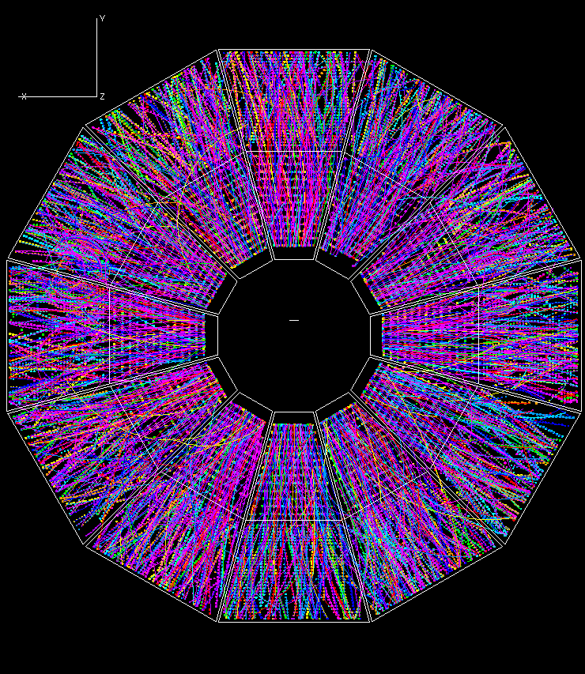
THE Δγ CORRELATOR
Voloshin, PRC 2004
Look for charge separation
STAR, PRL 2009, PRC 2010
π⁺
π⁺
Δγ
RP
π⁻
π⁻
Significant signal
Δγ ∼ 5 × 10⁻⁴

Slide 4
BACKGROUND IN Δγ CORRELATOR
Voloshin 2004; FW 2009; Bzdak, Koch, Liao 2010; Pratt, Schlichting 2010; …
Y
π⁺
π⁻
π⁺
ρ
π⁺
ρ
π⁻
X
ψ_{RP}
π⁺
Flow-induced charge-dependent background: nonflow coupled with flow
ρ
π⁻
π⁻

Slide 5
SLIGHTLY MORE FORMALLY…
2p
nonflow
CME
flow
3p
nonflow
flow-induced bkgd

Slide 6
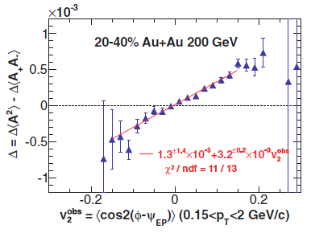
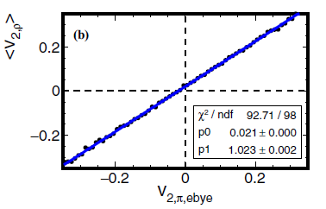
STATISITICAL EVENT-SHAPE-ENGINEERING
STAR, PRC 89 (2014) 044908
Still has residual background,
because background ∼ v_{2,ρ} not v_{2,π}
FW, Jie Zhao, PRC 95 (2017) 051901(R)
Here Δ is similar to
cos(α+β−2ψ) correlator
v_{2,ρ}
Engineering on stat. fluctuations
Background suppressed, but not totally eliminated
LHC does not have this issue as v₂ selection in different phase space
Primarily stat.
fluctuations
Event-by-event v₂ technique
v_{2,π}
final state
Yu Hu (STAR), QM’22

Slide 7
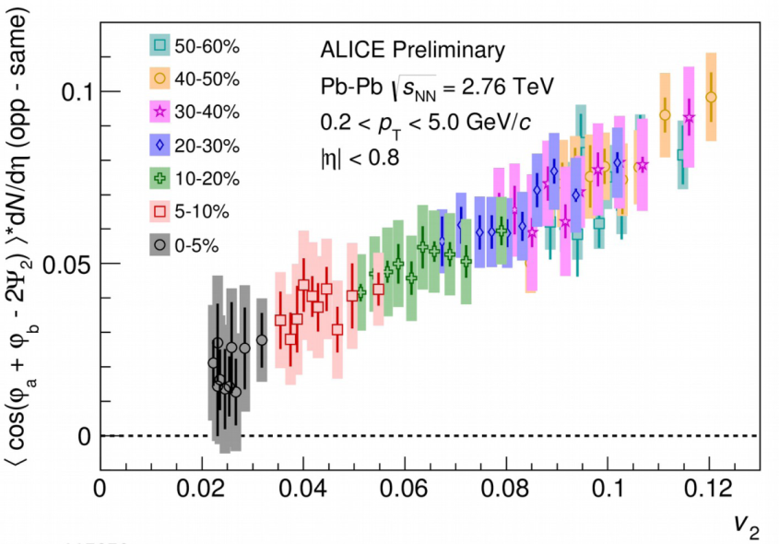
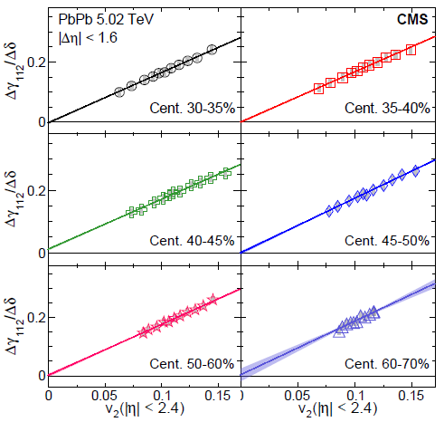
DYNAMICAL EVENT-SHAPE-ENGINEERING
Schukraft, Timmins, Voloshin, PLB 719 (2013) 394
ESE displaced from α, β phase space
ALICE, PLB 777 (2018) 151
CMS, PRC 97 (2018) 044912
v_{2,ρ}
v_{2,π}
final state
More sophisticated (model-dep.) assumption of B dependence on v2 within a given centrality
Upper limit 26%
Assume CME does not depend on v₂ within a given centrality
Upper limit 7%
Promising way to extract possible CME signal. Will need to assess nonflow effects

Slide 8
THE R OBSERVABLE
Ajitanand, Lacey, et al., PRC 83 (2011) 011901
Magdy, Lacey, et al., PRC 97 (2018) 061901(R)
Execution of R analysis:
Width of R(ΔS) distribution reduces to variance sin*sin, cos*cos → equivalently the Δγ variable
CW Robertson, DNP 2022
Normalized by
shuffled width:
Choudhury et al., CPC 46 (2022) 014101
v₂
Earlier claims of CME; many issues identified.
ESE studies indicate “v2-independence.” Latest claim by Lacey et al., arXiv:2203.10029: Scale by N, so isobar R compatible with CME. See Comment by FW, arXiv:2204.08450
Issue identified: Reuse of data in average causes autocorrelation, yielding non-zero intercept. Feng et al, PRC 103 (2021) 034912
Positive intercept not present in analysis with separate ΔS

Slide 9
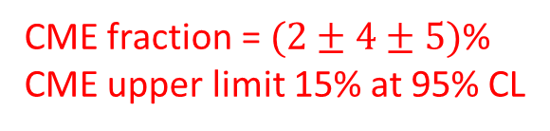
THE INVARIANT MASS DEPENDENCE
Zhao, Li, Wang, Eur.Phys.J.C 79 (2019) 168
STAR, PRC 106 (2022) 034908, arXiv:2006.05035
CME fraction = $(2±4±5)$%
CME upper limit 15% at 95% CL

Slide 10
SPECTATOR & PARTICIPANT PLANES
H.-j. Xu, FW, et al., CPC 42 (2018) 084103, arXiv:1710.07265
S.A. Voloshin, PRC 98 (2018) 054911, arXiv:1805.05300
INTRA-EVENT “CME-v₂ FILTER”
RP
BKG
BKG
BKG×a
CME
CME
CME
ψ_{SP}
PP
BKG
BKG
CME
CME×a
IN THE SAME EVENT

Slide 11
Au+Au Collisions at 200 GeV (2.4B MB)
STAR, PRL 128 (2022) 092301, arXiv:2106.09243

Slide 12
Au+Au Collisions at 200 GeV (2.4B MB)
STAR, PRL 128 (2022) 092301, arXiv:2106.09243
Peripheral 50-80% collisions: consistent-with-zero signal with relatively large errors
Mid-central 20-50% collisions: indication of finite CME signal with 1-3σ significance
How much is there remaining nonflow contamination?

Slide 13
REMAINING NONFLOW EFFECTS
Feng, FW, et al., PRC 105 (2022) 024913, arXiv:2106.15595
Nonflow in Δγ → negative f_{CME}
Nonflow in v₂ → positive f_{CME}

Slide 14
Feng, FW, et al., PRC 105 (2022) 024913, arXiv:2106.15595

Slide 15
Feng, FW, et al., PRC 105 (2022) 024913, arXiv:2106.15595

Slide 16
USE DATA WHEREVER POSSIBLE
Feng, FW, et al., PRC 105 (2022) 024913, arXiv:2106.15595
Zhao, Feng, et al. PRC 101, 034912 (2020)
STAR, PLB 745 (2015) 40
Au+Au data analysis is on the way to assess v2 nonflow contamination

Slide 17
NONFLOW ESTIMATES
Feng, FW, et al., PRC 105 (2022) 024913, arXiv:2106.15595
STAR, PLB 745 (2015) 40
Have to rely on Hijing model for 3-particle correlation estimate, but limited comparison to data can be done to assess model reliability
Rigorous v₂ nonflow analysis using large statistics Au+Au data is on the way

Slide 18
MODEL ESTIMATES
Feng, FW, et al., PRC 105 (2022) 024913, arXiv:2106.15595

Slide 19
MODEL ESTIMATES OF NONFLOW
Feng, FW, et al., PRC 105 (2022) 024913, arXiv:2106.15595
AMPT 2p estimates
v₂ nonflow data analysis ongoing
Limited-scope data comparison
ongoing
HIJING 3p estimates

Slide 20
IMPLICATIONS TO Au+Au DATA
STAR, PRL 128 (2022) 092301, arXiv:2106.09243
Feng, FW, et al., PRC 105 (2022) 024913, arXiv:2106.15595
(14.7 ± 5.0)%
(4.1 ± 4.8)%
(6.3 ± 5.6)%
(−5.0 ± 2.6)%
Net nonflow effect could be negative
There may indeed be hint of CME in the Au+Au data

Slide 21
REMAINING NONFLOW EFFECTS
STAR, PRL 128 (2022) 092301, arXiv:2106.09243
Feng, FW, et al., PRC 105 (2022) 024913, arXiv:2106.15595
Nonflow in v₂
→ positive f_{CME}
3p nonflow in Δγ
→ negative f_{CME}
Net effect could be neg. (model dep.)
There may indeed be hint of CME in the data

Slide 22
BACK TO ISOBAR DATA
Au+Au
Depending on the relative Ru+Ru/Zr+Zr difference of various nonflow effects, the baseline can be above, equal, or below unity
Final isobar conclusion requires detailed nonflow studies

Slide 23
REMAINING NONFLOW EFFECTS
FENG, Yicheng (STAR): QM’2022, SQM’2022
Feng, FW, et al., PRC 105 (2022) 024913, arXiv:2106.15595
Δγ/v₂
If N_{2p} ∝ N:
Kharzeev, Liao & Shi,
arXiv:2205.00120
f_{CME} = (6.8 ± 2.6)%
1.013±0.003±0.005
1.011±0.005±0.005

Slide 24
REMAINING NONFLOW EFFECTS
FENG, Yicheng (STAR): QM’2022, SQM’2022
Feng, FW, et al., PRC 105 (2022) 024913, arXiv:2106.15595
Δγ/v₂
1.013±0.003±0.005
1.011±0.005±0.005

Slide 25
REMAINING NONFLOW EFFECTS
FENG, Yicheng (STAR): QM’2022, SQM’2022
Feng, FW, et al., PRC 105 (2022) 024913, arXiv:2106.15595
Good cancelation of v2 nonflow and 3p correlation
Current total uncertainty:
0.4%⊕0.3%⊕0.5% = 0.7%
Assuming 15% B² diff:
δf_{CME} = 0.7%/15% = 5%
My conservative estimate:
f_{CME} < 10% at 98% CL
Δγ/v₂
1.013±0.003±0.005
1.011±0.005±0.005

Slide 26
ISOBAR SIGNAL MAY BE SMALL
Feng, Lin, Zhao & FW, PLB 820 (2021) 136549, arXiv:2103.10378
AVFD simulations in preparation for isobar blind analysis
Background ∝ 1/N
isobar/AuAu ∼ 2
Mag. field B ∼ A/A^{2/3} ∼ A^{1/3}
Δγ_{CME} ∼ B² ∼ A^{2/3}
Signal: AuAu/isobar ∼ 1.5
Could be x3 reduction in f_{CME} at the same n₅/s
If AuAu f_{CME}=10%, then isobar 3% (1σ effect)
Ru/Zr = 1 + 15%*3% = 1.005 (±0.004)
Caveats: Axial charge densities and sphaleron transition probabilities could be different
between Au+Au and isobar, e.g. AVFD-glasma μ₅/s: isobar/AuAu ∼ 1.5

Slide 27
SUMMARY, NEAR FUTURE, OUTLOOK
CME is a very important physics. Large efforts to eliminate backgrounds.
  Flow-induced background
  Nonflow contamination in v₂ measurements
  Genuine 3-particle correlation background
Isobar signal consistent with zero (not contradictory to Au+Au);
Stringent upper limit on the way.
Au+Au data (2.4 B MB events) hint at finite CME signal with small significance;
Rigorous nonflow data analysis on the way. Expect 20B Au+Au from 2023+25 runs.
Invariant mass depndence
Event-shape engineering
Isobar collisions
Spectator/participant plane comparison

