Slide 1


Event Shape Selection, CME Search with BES II Data and Future Perspective
Zhiwan Xu, Gang Wang and Huan Zhong Huang
UCLA
Supported in part by

Slide 2
Outline
Event Shape Selection (ESS) –
Selection on Fluctuations has limitations and how to be effective
Beam Energy Scan Data –
Low energy collisions can reliably suppress non-flow jet-like correlated background
Detector like EPD can measure spectator protons making ESS more effective
What BES II data tell us CME limit
Implications from BESII result of CME searches
Future Perspective

Slide 3
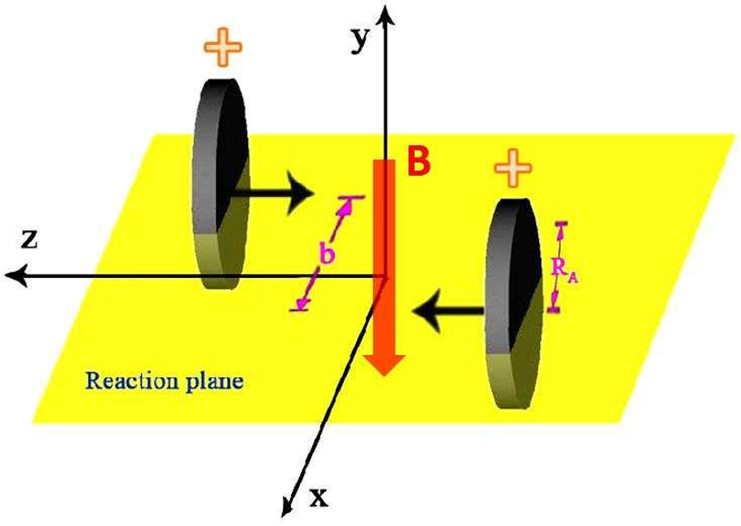
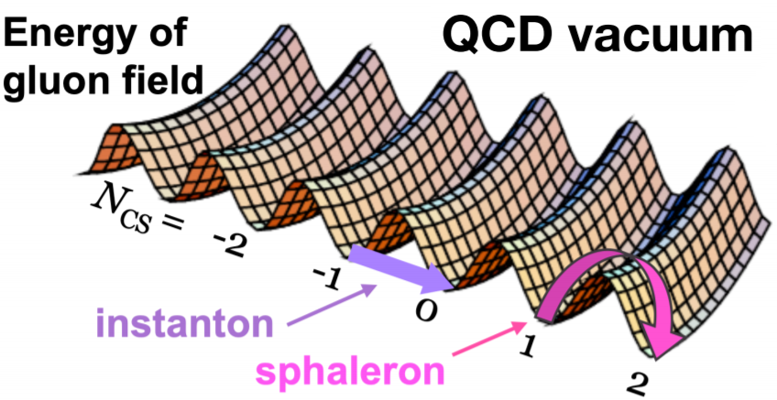
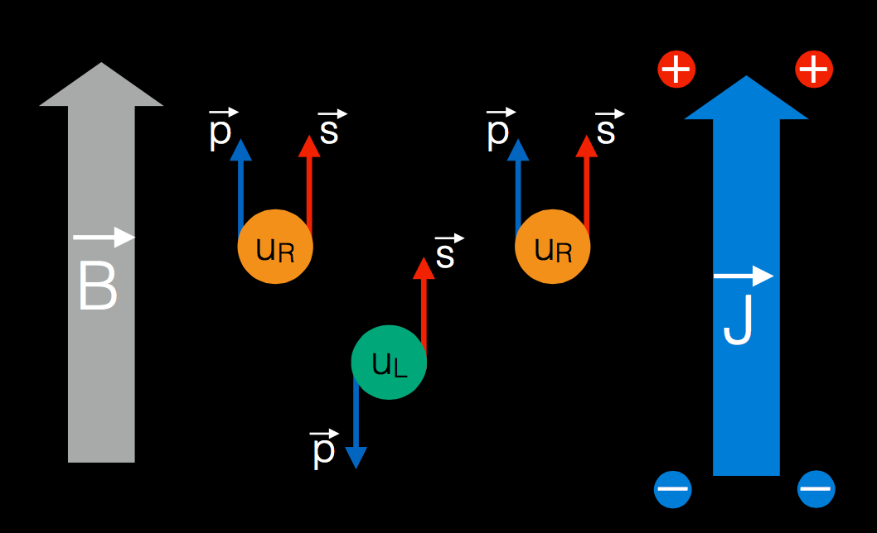
Chiral Magnetic Effect: J ∝ μ₅B
Chirality imbalance (finite μ₅, Local Parity Violation)
Strong magnetic field (B ~ 10¹⁸ Gauss)
Chiral Magnetic Effect (J || B)
Experimental manifestation:
charge separation along the B field direction
A Fundamental Nature of the QCD Arising from
non-Abelian Quantum Field Theory
3

Slide 4


Observables in search of CME
CME-sensitive observables:
γ correlaor
S.A. Voloshin, Phys. Rev. C,70, 057901 (2004)
And the CME signal could lead to --
This Δγ correlator, like many other proposed CME sensitive observables, can also have contributions from flow induced background, non-flow induced background, in addition to possible CME.
S. Choudhury et al.(STAR), Chinese Phys. C 46 (2022) 014101.
4

Slide 5
Event Shape Selection (ESS)
Event Shape Selection Analysis Goals:
Suppress background from --
Flow-related background ∝ v₂ (elliptic flow)
Nonflow-related background (di-jets)
Flow-related BKG can be reduced with --
selection of spherical event shape (v₂ ~ 0);
Nonflow can be suppressed – Low energy HIC and Spectator Plane.
(eta gap alone has limitations)
Event Shape variable:
q_{n}, the magnitude of flow vector

Slide 6
STAR Event Shape Selection (ESS)
STAR’s Best ESS Opportunity
Beam Energy Scan Data !
STAR Event Plane Detector (EPD):
has coverage for spectator protons for BES II;
not possible for high energy 200 GeV collisions.
Spectator Proton Plane – Determine Magnetic Field B
Use spectator protons or forward charged particles for event plane – reduce non-flow effect
Use TPC tracks in the region of interest for shape selection – choose a slice of matter with azimuthally isotropic emission (almost zero v₂) !

Slide 7
Previous Event Shape Selection Method
Previous ESS Approach
We found
Shape Observable flow vector q_{n} in region B
not effective in selecting shape for particles A
Flow vector q from B correlated to <v₂>
Extreme shape fluctuations are local, not
global feature! Why?
“Standard” ESS splits an event into 3 sub-events
(A) particles of interest (POI)
(B) particles to construct q_{n} shape
(C) particles to reconstruct EP
C
B
A
B
C
CMS, PRC 97(2018)044912
7

Slide 8
Event Shape Selection & Fluctuations
20-50% centrality events – on average participant matter has to be ellipsoidal shape
Event Shape Selection –
Fluctuation in participant drop shape
azimuthally round → round cylindrical shape → spanning a wide rapidity window
Fluctuation in particle emission pattern to be azimuthally round → local eta dependent
fluctuations (fluctuations in different eta windows not correlated)
Experimental Data indicated that the emission pattern fluctuations dominate –
the previous ESS method using observables from two different eta windows
not very effective

Slide 9
ESS with q^{A} (Particles in ROI)
When POIs are used to construct q_{n},
v_{n} approaches zero at zero q_{n},
The sub-event (A) appears spherical at zero q_{n}^{A} using either Event Plane or Reaction Plane !
This ESS method provides an effective approach to select the event shape.
(See the STAR talk by Zhiwan Xu)
Same AVFD data used as in STAR technical paper
S. Choudhury et al.(STAR), Chinese Phys. C 46 (2022) 014101
R. Milton et al, Phys. Rev. C 104 (2021) 064906
9

Slide 10
ESS with AMPT Events
R. Milton et al, Phys. Rev. C 104 (2021) 064906
Reaction plane
Participant plane
AMPT background
AMPT background
AMPT without CME shows considerable background.
With the same q₂² binning of event classes, we can plot Δγ vs q₂², v₂ or v₂Δδ.
The 3 shape observables give very similar intercepts.
Most flow-related BKG can be removed by ESS using q^{A} with the AMPT simulations
10

Slide 11
ESS with AVFD Simulations
Anomalous Viscous Fluid Dynamics (IU Liao group) can input finite CME signals.
zero CME
moderate CME
strong CME
In AVFD, a finite residue BKG could remain.
Our ESS approach reduces BKG by a factor of 5 or 6.
The curves represent the true CME signals.
R. Milton et al, Phys. Rev. C 104 (2021) 064906
11

Slide 12
An improved Event Shape Selection Method
Spherical event shape due to participant shape AND
local emission pattern fluctuations
particles must be from the same ROI
Event shape observable -- q vector
for single particles
or for particle pairs
(resonances and combinatorial BK)
We showed that this ESS approach is much more effective
than the previous method used in publications !

Slide 13
ESS Lessons
Search for CME in heavy-ion collisions requires Event Shape Selection Analysis to suppress flow-related and non-flow BKG.
Previous “Standard” event shape selection method suffers from technical issue with ineffective shape selection for relevant particles.
We propose to use POIs to construct the event shape variable q.
  v₂ approaches zero at q₂=0 – very effective in selecting event shape!
  AMPT simulations showed that almost all BKGs can be removed.
  AVFD simulations showed that a BKG reduction of factor 5 or 6 can be achieved.
Non-flow background can be significantly reduced with low energy heavy ion collisions
and with spectator proton event plane
STAR EPD – can measure spectator protons
better correlation with magnetic field direction
less sensitive to non-flow contribution
Works well for low energy HIC – BES II Data
13

Slide 14
Road Beyond Isobar Results
Shape analysis goal: suppress backgrounds from
● Flow-related background ∝ v₂ (elliptic flow)
● Nonflow-related background (di-jets)
Flow-related BKG can be reduced with --
      selection of spherical event shape (v₂ ~ 0);
Nonflow can be suppressed with –
      low-energy HIC and very forward EPs.
Event Shape variable:
q_{n}, the magnitude of flow vector
14

Slide 15
Appication of ESS to STAR data
Event shape variables:
single particle q₂² ~ primary particles
pair (parent) q₂² ~ resonance decay
  adding momenta of two particles to mimic decay kinematics
Z. Xu, DNP2022
Both q₂² variables can reach the region of zero v₂.
Both show finite intercepts in Δγ¹¹² vs v₂.
15

Slide 16
STAR data: 27 GeV Au+Au
2nd-order participant plane
Z. Xu, DNP2022
1st-order spectator plane
Short-range nonflow is significantly suppressed with the η gap.
Flow background is largely reduced with either ESS variable.
Finite Δγ¹¹²_{ESS} in mid-central events.
Spectator plane is more correlated to the magnetic field direction.
16

Slide 17
STAR data: 19.6 GeV Au+Au
2nd-order participant plane
Z. Xu, DNP2022
1st-order spectator plane
Very similar to the results at 27 GeV.
Short-range nonflow is significantly suppressed with the η gap.
Flow background is largely reduced with either ESS variable.
Finite Δγ¹¹²_{ESS} in mid-central events.
17

Slide 18
STAR data: ratio of Δγ¹¹²_{ESS} / <Δγ¹¹²>
2nd-order participant plane
1st-order spectator plane
Ratio of Δγ¹¹²_{ESS} / <Δγ¹¹²> is ~30% for mid-centrality range at both energies.
Flow (v₂-related) BKG and nonflow effects contribute at least 70% of <Δγ¹¹²>.
Remaining 30% fraction may indicate possible CME in Au+Au? Need further investigation!
Z. Xu, DNP2022
18

Slide 19
Future Perspective
Spectator proton tagging – spectator EP and B field Direction important
Works for BES data
What is the highest beam energy viable for STAR EPD?
Number of spectator proton tagging – same function & importance at isobar data
Is there a feasible technology for RHIC top energy?
Colliding Systems -- Minimum shape uncertainties – as spherical as one can choose
Z/N large (more spectator proton/neutron)
Sufficiently large A(Z,N) for collectivity (Xe?)
Non-flow contribution
eta gap limitation at high energy
Particle ID -- proton vs pi/K, we used pi/K only for now with BES
Theoretical guidance?
CME – correlation with spectator proton tagging (B field direction AND magnitude)

Slide 21
Backup slides
21

Slide 22
Isobar data (⁹⁶Ru+⁹⁶Ru and ⁹⁶Zr+⁹⁶Zr)
R. Milton et al, Phys. Rev. C 104 (2021) 064906
22

Slide 23
Improvement of f_{CME} in Au+Au
AVFD simulations of Au+Au collisions at 200 GeV (30-40% centrality)
f_{CME} is significantly improved using ESS, relative to the ensemble average, especially when participant plane is used,
and when the CME signal is weaker.
R. Milton et al, Phys. Rev. C 104 (2021) 064906
23

Slide 24
Improvement of f_{CME} in Ru+Ru
AVFD simulations of Ru+Ru collisions at 200 GeV (30-40% centrality)
The improvement of f_{CME} is more obvious in the isobar collisions,
especially when participant plane is used, and when the CME signal is weaker.
R. Milton et al, Phys. Rev. C 104 (2021) 064906
24

