Slide 1
Update from the EIC Project
E.C. Aschenauer (BNL)
R. Ent (JLab)
Co-Associate Directors for the Experimental Program
Meeting of the DAC
October 19th – 21st, 2022

Slide 2

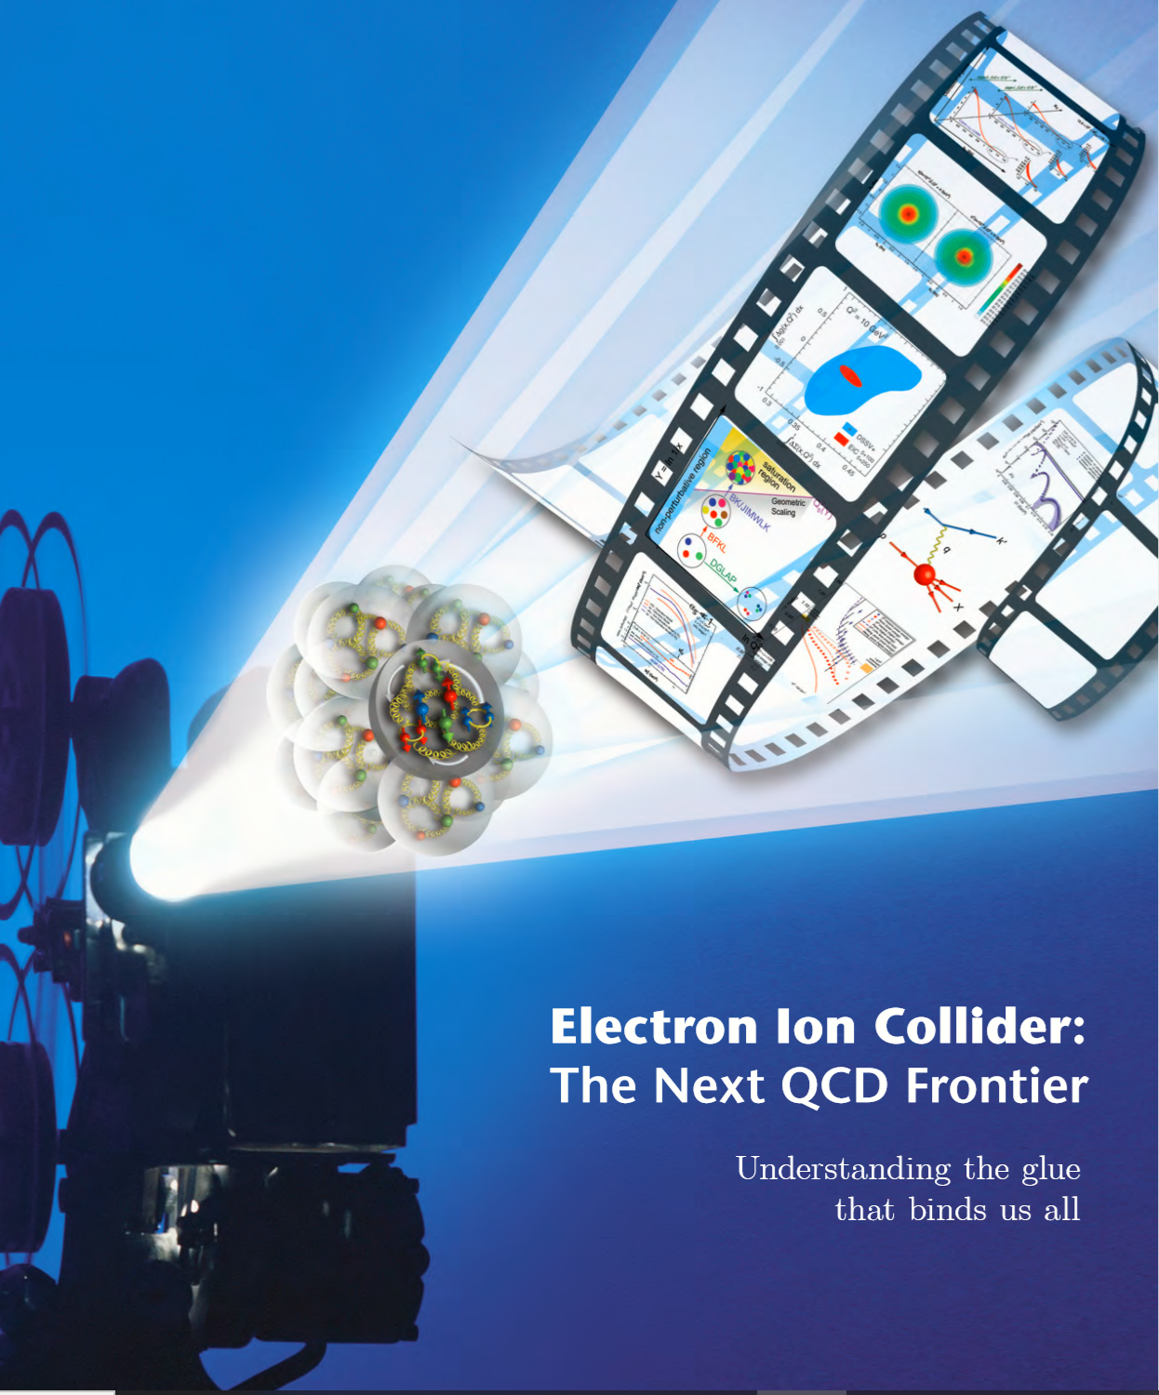
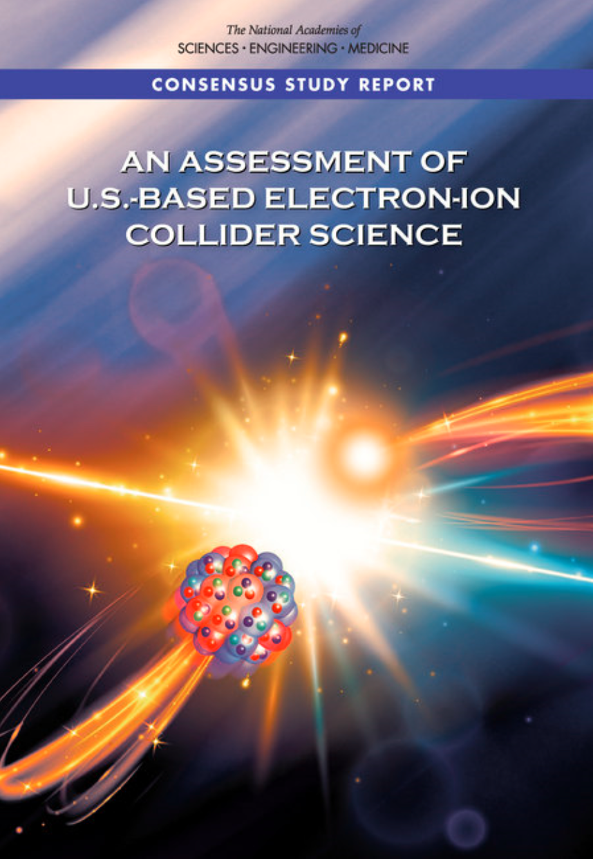

EIC Scope
Project Design Goals
High Luminosity: L= 10³³ – 10³⁴cm⁻²sec⁻¹, 10 – 100 fb⁻¹/year
Highly Polarized Beams: 70%
Large Center of Mass Energy Range: E_{cm} = 29 – 140 GeV
Large Ion Species Range: protons – Uranium
Large Detector Acceptance and Good Background Conditions
Accommodate a Second Interaction Region (IR)
IR-8
IR-6, ePIC Detector
IR-8
p/A beam
e beam
p: 41 GeV, 100 to 275 GeV
e: 5 GeV to 18 GeV

Slide 3
EIC Experimental program preparation
Year-long EIC User Group driven EIC Yellow Report activity
  Science Requirements and Detector Concepts for the EIC – Drives the requirements of EIC detectors
  arXiv:2103.05419 & Nucl. Phys. A 1026 (2022) 122447 – 372 citations (10/05/22)
BNL and TJNAF Jointly Leading Efforts Towards Experimental Program | BNL and TJNAF Jointly Leading Process to Select Project Detector
2020 | Call for Expressions of Interest (EOI) https://www.bnl.gov/eic/EOI.php | May 2020
 | EOI Responses Submitted | November 2020
 | Assessment of EOI Responses | On-going&
2021 | Call for Collaboration Proposals for Detectors https://www.bnl.gov/eic/CFC.php | March 2021
 | BNL/TJNAF Proposal Evaluation Committee | Spring 2021
 | Collaboration Proposals for Detectors Submitted | December 2021
2022 | Decision on Project Detector – “ECCE” | March 2022
 | Guide process to joint “Detector-1” Collaboration | Spring 2022
 | EPIC Collaboration* Formed – 160 institutions | July 2022
 | EIC Software Infrastructure Review | August 2022
 | Pre-Resources Review Board Meeting | October 2022
&Remains ongoing until formal agreements are in place – it originally led to confirmation that in-kind level assumed for the EIC detector was in range.
*Merger of two large ATHENA and ECCE proposals

Slide 4
DOE Project Decision Process
EIC
Preliminary Design ~50-60%; Final Design $≥$85%
Operating* Funds
Project Engineering and Design (PED) Funds
Construction & PED
Funds
Operating Funds
Initiation
Definition
Execution
Closeout
Conceptual Design
Preliminary Design
Final Design
Construction
    EIC Critical Decision Plan
    CD-2/3a January 2024
    CD-3 April 2025
    CD-4a early finish April 2031
    CD-4a April 2032
    CD-4 early finish April 2032
    CD-4 April 2034
Critical
Decisions
CD-0
Approve Mission Need
CD-1
Approve Alternative Selection
and Cost
Range
CD-2
Approve Performance Baseline (PB)
CD-3
Approve Start of Construction or Execution
CD-4
Approve
Start of Operations or Project Completion
CD-2 – Approve Performance Baseline: CD-2 is an approval of the preliminary design of the project and the baseline scope, cost, and schedule. What is most relevant is that CD-2 means there is now a definitive plan that the project will be measured against in cost, schedule and technical performance.
pre-TDR is required for CD-2
(pre-TDR = preliminary version of TDR)
CD-3 – Approve Start of Construction: CD-3 is an approval of the project’s final design and authorizes release of funds for construction. What is most relevant is that projects can now proceed with construction related procurements and activities. CD-3 is sometimes split in CD-3A in a tailored approach to approve start construction for long-lead procurements.
→ TDR is required for CD-3

Slide 5
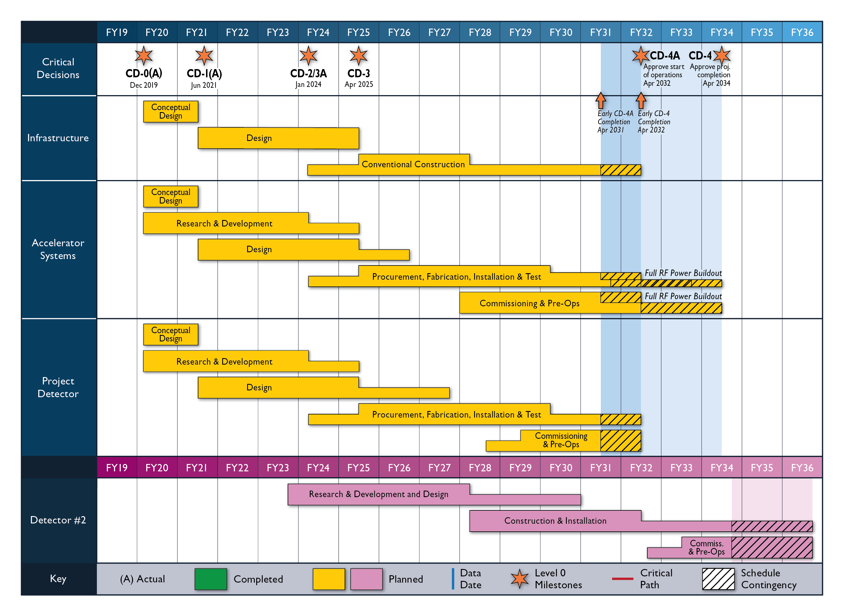
High Level Reference Schedule
The thinner bars indicate that R&D and design
can continue at a small level beyond CD-2 and CD-3
for LLP construction
starts at CD-2/3A
Notional Schedule
2nd IR and
Schedule
Generic Detector R&D
5

Slide 6
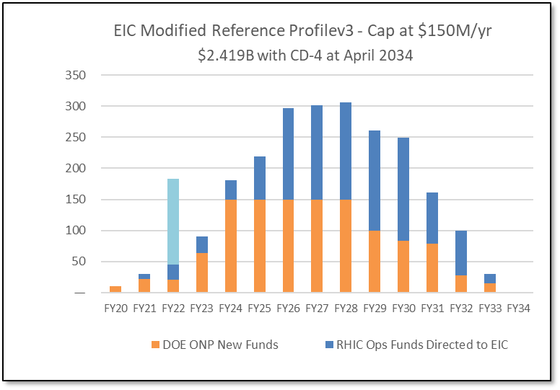
Latest News on the Funding and Schedule
Inflation Reduction Act:
$217M to Nuclear Physics in FY22 to be spent by FY27.
Includes EIC (to get to CD-2) – $138.24M.
(IRA funds can ONLY be used for project scope, but NOT to add scope)
Schedule: CD-2/3A = January 2024; CD-3 = April 2025; CD-4 Project Completion = 2034
RHIC operations conclude and EIC tunnel work starts in June 2025
Cost: CD-1 cost range of $1.7B-$2.8B
→ The DOE funding to ensure CD-2/3A timeline (baselining, start of long-lead procurement items) and CD-3 (start of construction) seems secured.

Slide 7
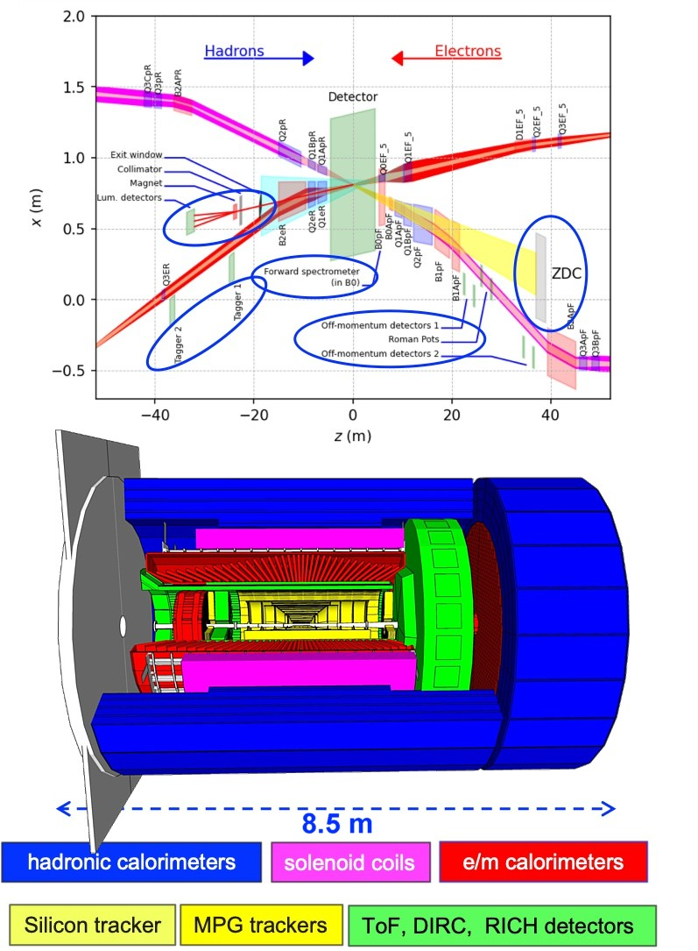
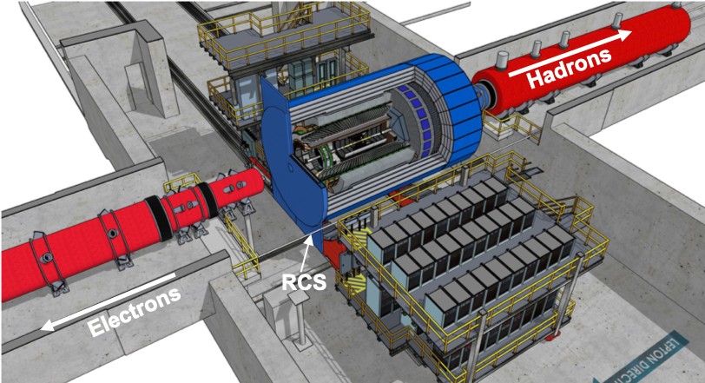
Recent Accomplishments
hadronic calorimeters
solenoid coils
ToF, DIRC,
RICH detectors
Finalized Project Detector selection process 8th of March 2022
→ General-purpose Detector around
a BaBAR like Solenoid
e/m calorimeters
MPG & MAPS trackers
Consolidation of ECCE and ATHENA in full swing, make integration of all groups as welcoming as possible
ePIC = ECCE + ATHENA
Combined Leadership Team formed
Combined Physics and Technical WG formed
named collaboration EPIC at July EICUG-meeting
EPIC institutional board formed
collaboration charter writing started
Elect collaboration management by November
Updated P6 cost and schedule based on ECCE as reference design
R&D rolled out to Users and P6 updated with respective milestones
Integration of ECCE reference detector in Interaction region (now morphed into EPIC reference detector)
Integration of ancillary detectors in wider IR (+/- 40 m)
Excellent progress on CAD based design of detector
Moving full speed to CD-2/3A
  technical reviews for all WBS level-3 systems
  move design to required design maturity
  define Long Lead Items

Slide 8
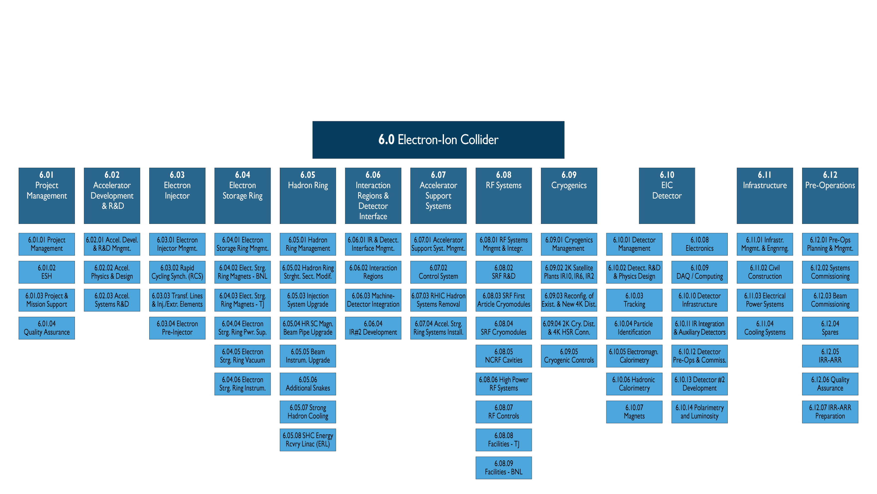
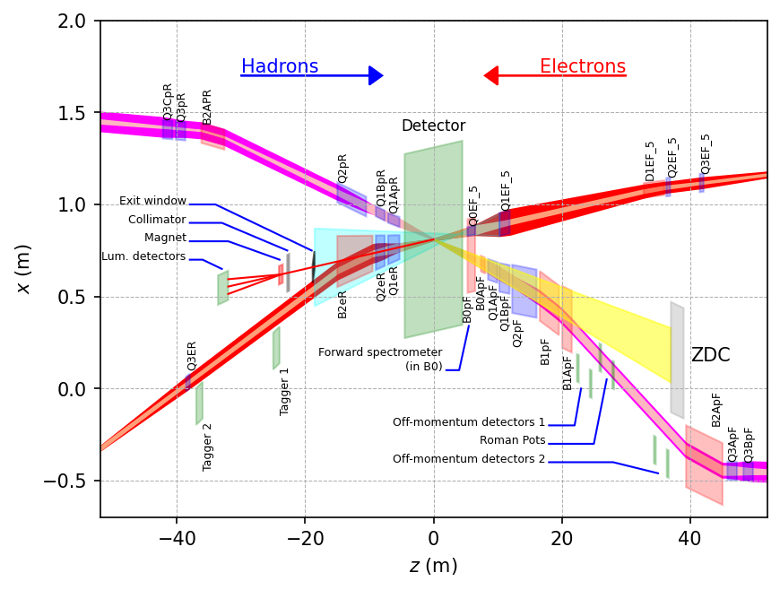
Scope Experimental Equipment
hadronic calorimeters
Solenoidal Magnet
e/m calorimeters
ToF, DIRC,
RICH detectors
MPG trackers
MAPS tracker
25 Subdetectors
incl. Polarimeters
provides coordination that
2nd detector remains possible

Slide 9
Collaboration – Project
6.10.04 Particle
Identification
Level-3
Rolf & Elke
Level-2
6.10.04.01 Backward RICH
Level-4
6.10.04.02 Barrel DIRC
Level-4
6.10.04.03 Forward RICH
Level-4
6.10.04.04 Time-of-Flight
Level-4
6.10.04.01.01
DIRC-Photon-sensors
Level-5
6.10.04.01.02 DIRC-Quartz-bars
Level-5
We need a control account manager (CAM) at each WBS level. WBS levels go down to where it is meaningful to accumulate cost and schedule variance. There can be many Work Packages below.
Integrating Collaborators:
In-kind partners integrated into the project delivery organization and responsible for their project deliverables
Close interaction between the project and the detector collaboration with collaborators taking lead roles on work packages and project deliverables
Fold in users/collaborators as
L3/L4/L5 point of contacts
Work Package owners

Slide 10
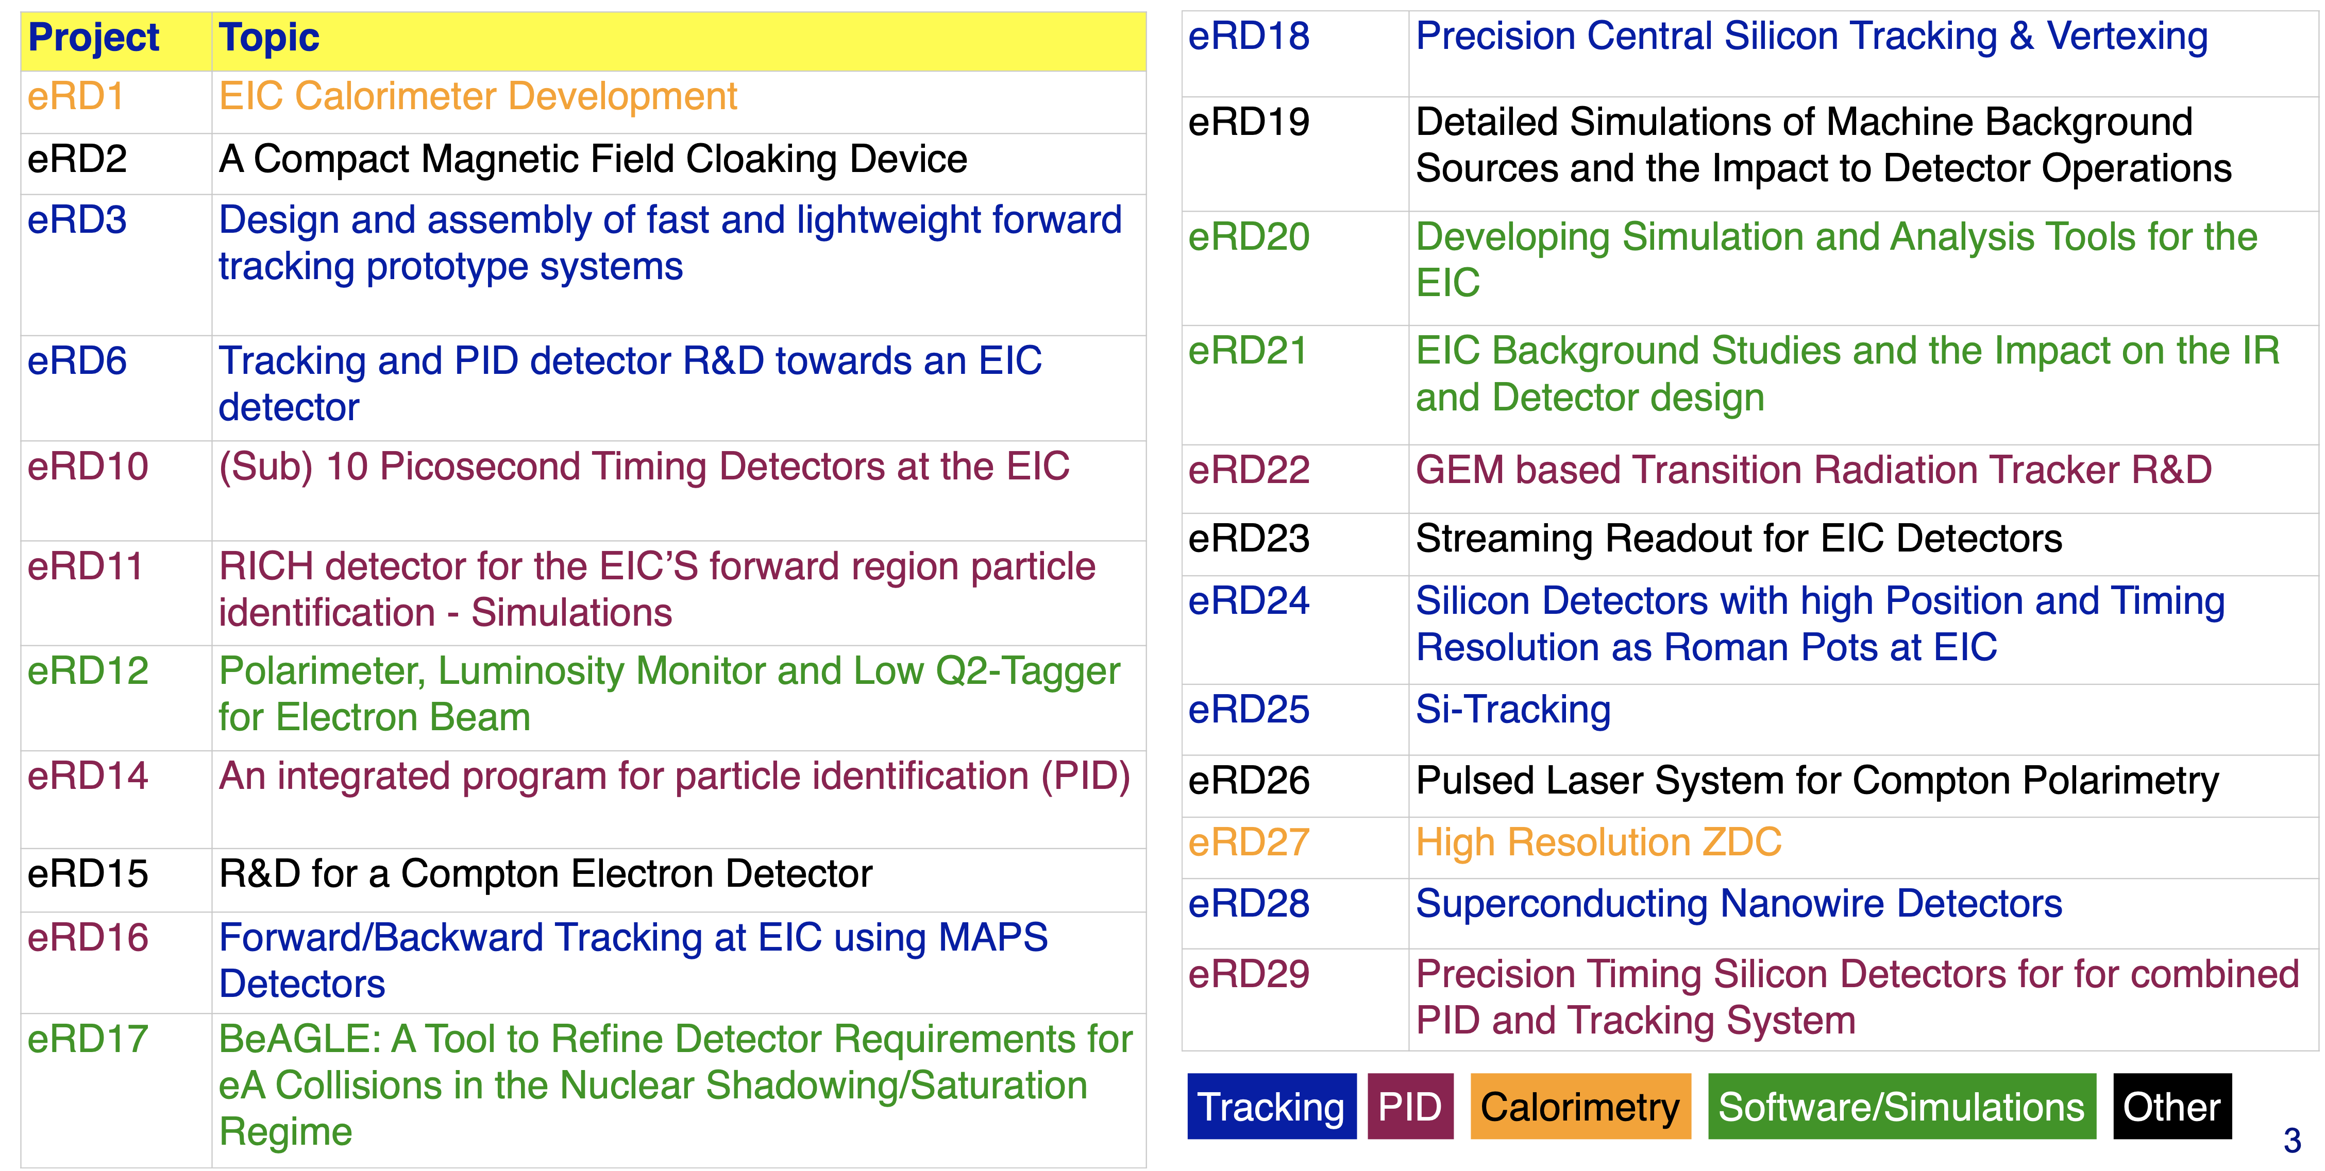
EIC Generic Detector R&D Program
Two tier Detector R&D program is critical for success of the EIC facility
Generic EIC Detector R&D program (2011 – 2021)
  Excellent experience (https://wiki.bnl.gov/conferences/index.php/EIC_R%25D)
  Reduced the overall Risk level of EIC detector technology to Low/Moderate
  Engaged 75 institutions (50% domestic, 50% international) from 10 countries
  Triggered significant in-kind contributions (domestic and international) through available resources, LDRD, and national funding
DOE/NP has restarted generic detector R&D program (https://www.jlab.org/research/eic_rd_prgm)
  relevant for alternate EIC detector technologies, upgrades, 2nd detector
  Great interest: 27 Proposals

Slide 11
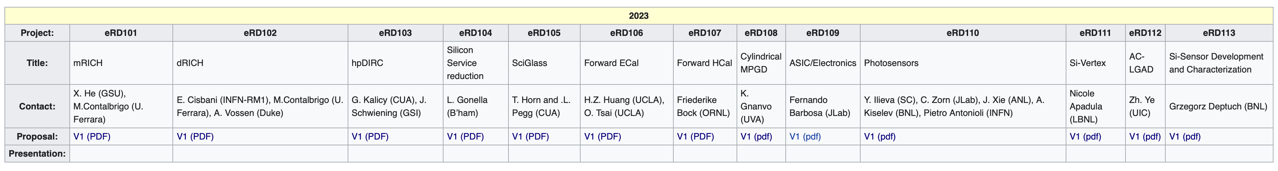
EIC Project Detector R&D Program
Large international components to EIC Project R&D:
https://wiki.bnl.gov/conferences/index.php?title=Proposals
INFN-Ferrara
Italy
INFN & Universities
India
GSI
IJCLab-Orsay, INFN-Ge, AANL/Armenia
IJCLAB/Omega/
Saclay , Taiwan
UK,
INFN
CEA Saclay
Erlangen, GSI, INFN: Bologna, Ferrara, Genova, Cosenza, Trieste
UK: Birmingham, Brunel, RAL,
Bari/INFN, Trieste/INFN, IMP, CCNU
Chinese EMCal
Consortium
UK: Birmingham, Daresbury, Lancaster, Liverpool,
INFN
Strong synergies with CERN
CERN – EIC R&D Day November 2021 https://indico.cern.ch/event/1063927/
MAPS: ALICE-3 – ITS-3 development
PID: LHC-b and ALICE-3
Photon-sensors: LAPPDs with LHC-b
MPGD: long-term CERN R&D program RD51
DAQ: strong developments on streaming DAQs for all LHC experiments
AI/ML and high-performance distributed computing

Slide 12
The Path to CD-2/3A
Form collaboration and define subsystem responsibilities
  → in-kind contributions need to be identified and agreements need to be in an advanced state (close to final)
  → Integrate collaboration in WBS – structure of detector
Finalize scope of EIC Project Detector
  all subsystem technologies defined by end of CY2022
Continuous refinement of subsystem requirements and interfaces
Refine cost, schedule and labor needs for each subsystem
  detailed documentation of basis – of – estimates
  Long Lead Procurement (LLP) items of the detector will be further refined
  define scope contingency items
Bring level of design on average to 50-60% @ CD2/3A, with LLP items needing to be at final design stage (~90%)
Produce pre-TDR*: 1st version of by May 2023
→ final version by October 2023
full TDR is needed by CD-3 about one year after CD-2

Slide 13
Pre-TDR outline
.
Working model will be similar as we used to create the CDR, Elke/Rolf with engagement of EPIC leadership, and a mix of the project CAMs and EPIC WG representatives. At the late phases the editing rights will become more restricted. We plan to use where we can input from the CDR, YR, proposals, technical notes, etc.
Chapter 2: Physics Goals and Requirements (should be short, < 50 pages)
2.1 EIC Context and History (like CDR 2.2 or YR section 1)
2.2 The Science Goals of the EIC and the Machine Parameters (like CDR 2.3)
2.3 The EIC Science (follow YR structure)
2.4 Scientific Requirements
Chapter 3: Interaction Region 6 Overview (Elke/Rolf contributing)
Chapter 8: Experimental Systems
8.1 Experimental Equipment Requirements Summary (like CDR 8.2)
8.2 General Detector Considerations and Operations Challenges (YR 10, CDR 8.3)
8.3 EIC Detector
8.4 Detector R&D Summary
8.5 Detector Integration
8.6 Detector Commissioning and Pre-Operations
Chapter 11: Commissioning (Elke/Rolf contributing)
Appendix-B: Integration of a Second Experiment
B.1 Interaction region definition and layout
B.2 Experimental complementarity
B.3 Outstanding issues

Slide 14
Plans for Design Maturity
System​​ | Estimated Design​​ % Complete​​ -----------------------​​ Now​​ | Estimated Design​​ % Complete​​ ------------------------​​ CD-2 / 3A​​ | Estimated Date for​​ Final Design Complete​​ | Comments
6.10.02 Detector R&D/Physics Design | 0% | 60% | 06/30/2026 | Project R&D just started
6.10.03 Tracking | 10% | 50% | 12/31/2026 | Need only late
6.10.04 PID | 15% | 50% | 03/31/2026 | hpDIRC well underway
6.10.05 EmCal | 20% | 85% | 12/31/2024 | eEMCAL far ahead
6.10.06 HCal | 15% | 70% | 06/30/2025 | Barrel Hcal reuse, rest delayed
6.10.07 Magnets | 30% | 100% | 12/31/2023 | LLP, completed 30% design
6.10.08 Electronics | 10% | 50% | 03/31/2027 | ASICs/electronics can come in late

Slide 15
Plans for Design Maturity
System​​ | Estimated Design​​ % Complete​​ -----------------------​​ Now​​ | Estimated Design​​ % Complete​​ ------------------------​​ CD-2 / 3A​​ | Estimated Date for​​ Final Design Complete​​ | Comments
6.10.09 DAQ/Computing | 5% | 50% | 03/31/2027 | DAQ/computing can come in late
6.10.10 Infrastructure | 15% | 40% | 06/30/2026 | Good start for reuse, but finals after detectors
6.10.11 IR Integration and Ancillary Detectors | 10% | 50% | 12/31/2025 | Know things fit, just do as we can, need B0 design
6.10.12 Pre-Ops and Commissioning | 0% | 30% | 12/31/2024 | Will have plan at CD-2/3A, develop more later
6.10.14 Polarimetry & Luminosity | 15% | 50% | 12/31/2025 | Know what we need to do, pace and completion driven by accel.

Slide 16
Upcoming Events
September 26 – EIC Advisory Board meeting
October 12-13 – “Resource Review Board”-like kickoff meeting
  https://indico.bnl.gov/event/17354/
October 18-19 – 60% Magnet Review @ JLab
  We implemented the design change to go to six layers of conductor – with thanks to our CEA Saclay colleagues to help us out. This should allow a robust 1.7 Tesla magnet with stretch goal of 2 T.
October 19-21 – Detector Advisory Committee meeting
October-December – EIC Subsystem Status Reviews on Tracking, Particle Identification Systems, Electromagnetic Calorimetry, Hadronic Calorimetry, Infrastructure/Installation, Polarimetry
  already completed
    Magnet Incremental Design and Safety Review – Preliminary 30% Design
    IR Integration and Ancillary detectors
    Electronics/Computing Subsystem Status Review (6.10.08 & 6.10.09)
OPA Status Review – end of January 2023
Preliminary Design Complete & Review May 2023
Final Design/Maturity Readiness for CD-3A Items May 2023

Slide 17
New 1.7 T Solenoid
Intensive tracking studies with a realistic tracker material setup showed that one cannot reach the YR requirements with the BaBAR magnet
New Solenoid with geometry consistent with BaBAR magnet
  allows reuse of barrel hadron calorimeter
  if geometry is changed BaBAR magnet cannot be realized as an opportunity (for example in case of issues with vendors for cladding Rutherford cable) as currently in the risk registry
  allows space for fringe field mitigation
Cost and Risk need to be manageable
  Guideline: conservative magnet design that can reach a robust 1.7 Tesla in the BaBAR magnet geometry.
High-level summary of 1.7T solenoid design:
  Increase number of conductor layers from 4 to 6 – this is possible within the geometry and given the present conductor choice ☺
  Actually, this has a plus in that the current requirement goes down to 4000 Amps which increase critical current margin – a magnet high-level design parameter. ☺ The temperature margin remains very safe. ☺
  The nuclear interaction lengths for the BaBar magnet is 0.4, for the new 1.7 T upto 2 T magnet it is 0.47 → this is acceptable ☺
  The stored power goes like field squared, so from 1.5 Tesla to 2 Tesla it goes up by a factor of 1.78. Cost goes roughly as stored power to the power 0.7, so cost would go up a factor of 1.5. That roughly equates to +5M$. ☹

Slide 18
Experimental Equipment Technical Progress
6.10
EIC Detector
Defined and documented system requirements down to L4
Define ASIC needs based on ECCE as reference detector
rolling out R&D contracts
Updating P6 & integrate milestones
Define requirements, for clock distribution, aggregator modules, new FELIX board
develop a technical solution to bake-out beam pipe with μ-vertex in-situ
develop beam pipe support to allow 1st μ-vertex layer as close to the IP as possible
Document the existing infrastructure at 1006, i.e. water, electricity, grounding
detail all the requirements for the next phase of the technical design
investigate a pressurized Argon based RICH can be realized
Full 3d layout of extended IR region including all auxiliary detectors
Impedance calculations
work on next phase of technical design on eEndcap ECal in collaboration with Orsay technical team
work on next phase of technical design of barrel SciGlass ECal
Move in parallel on 2nd IR layout and ensure all the experimental equipment can fit
Contract with Saclay to continue design for a 1.7 T BaBAR like Solenoid as Risk mitigation
Eased design as can use Cu-stabilized conductor
Update risk assessment of BaBAR Solenoid
ePol: Compton polarimeter is integrated in IR and layout and technical definition are further refined
HPol: integrated in new location at IP-4,

Slide 19
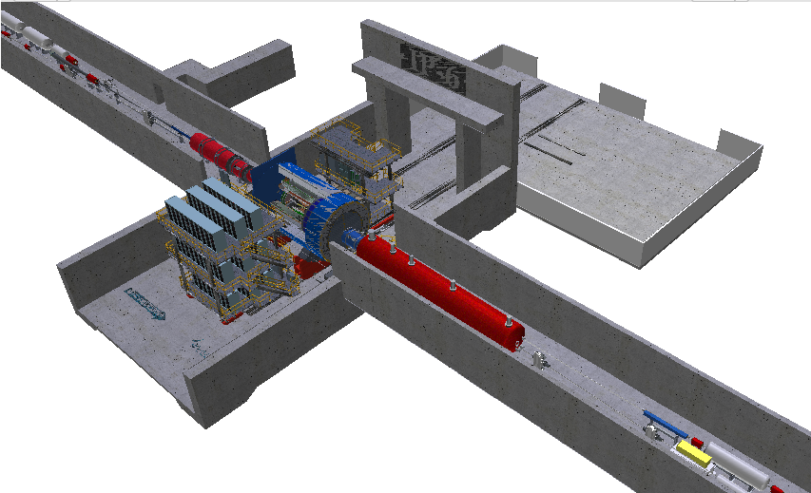
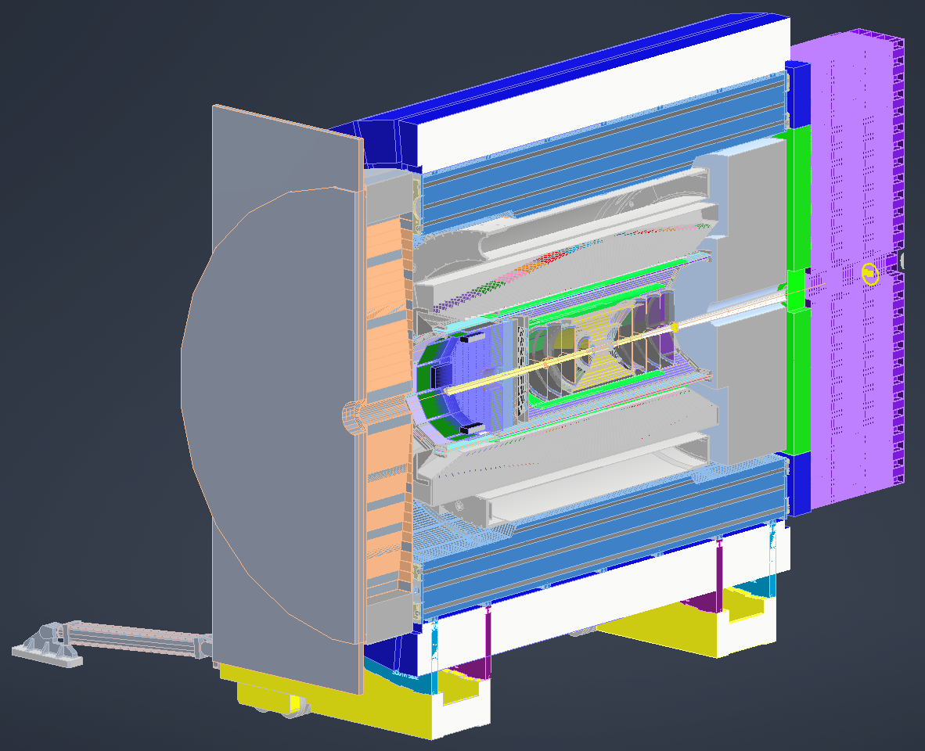
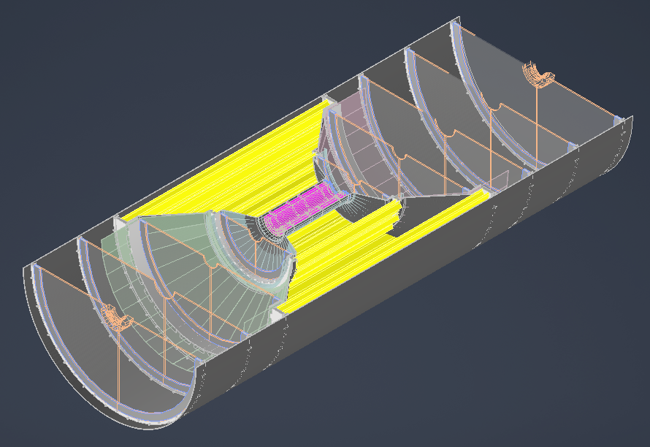
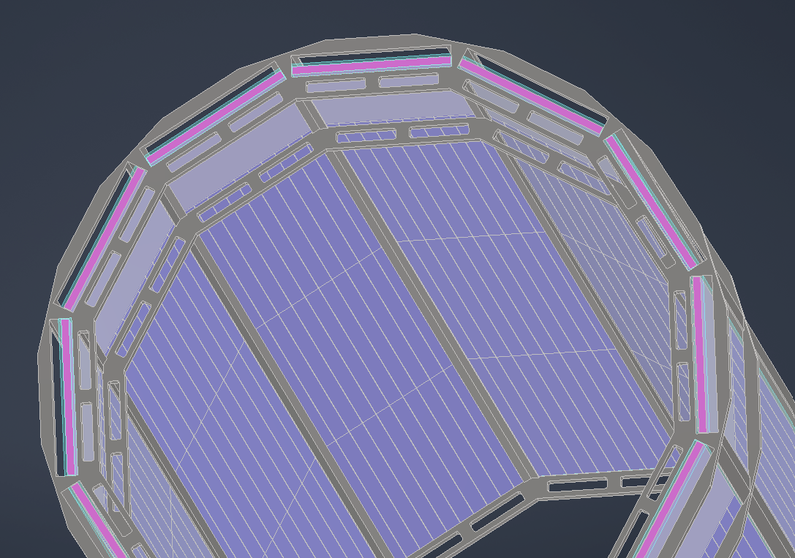
Central Detector Subsystem Integration
All subdetectors integrated in CAD
Develop geometry database to keep detector geometry for simulations and technical design in phase
Define Service needs (cabling, LV, cooling) are required to provide sufficient space for them, we need these in the next iteration of information provided for the detector designs
ePIC-CAD
MAPS - Tracker
DIRC + MPDG + Support
Carbon fiber segments to support the MAPS layers and disks, will have cutouts as needed for cables and cooling to be brought out

Slide 20
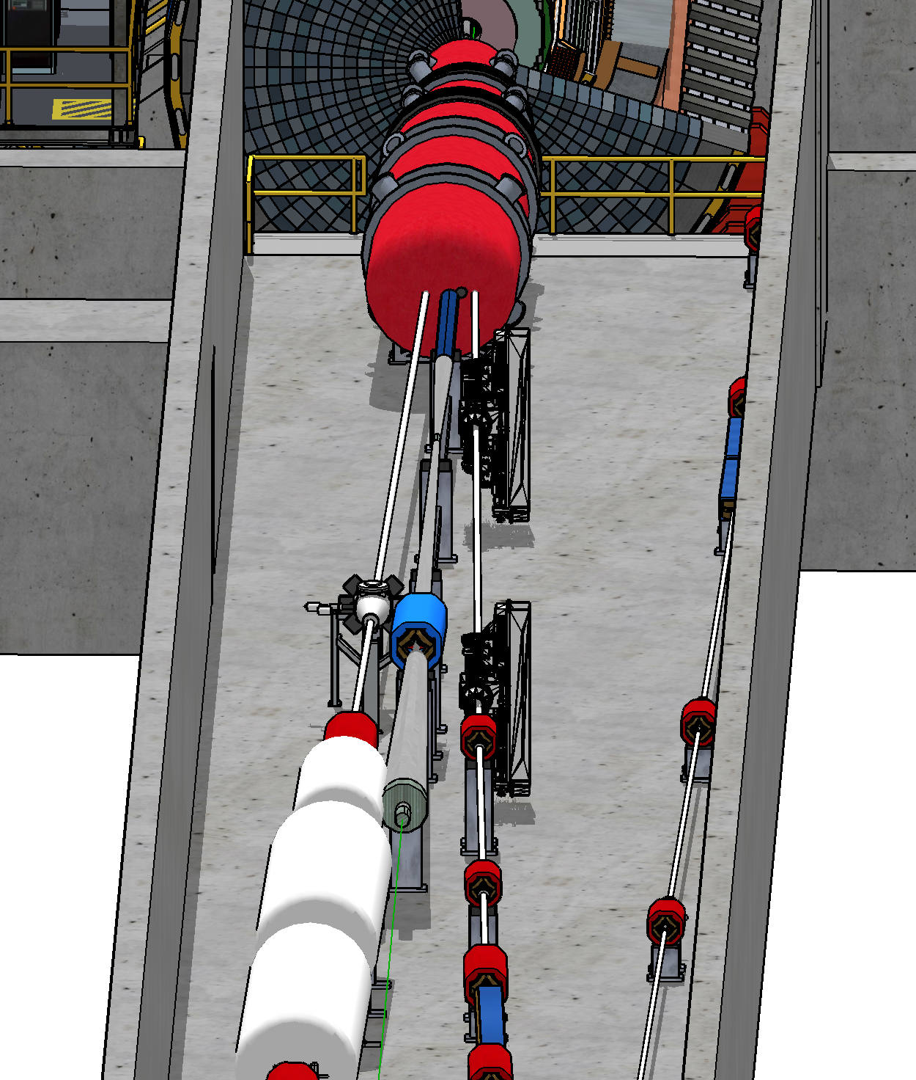
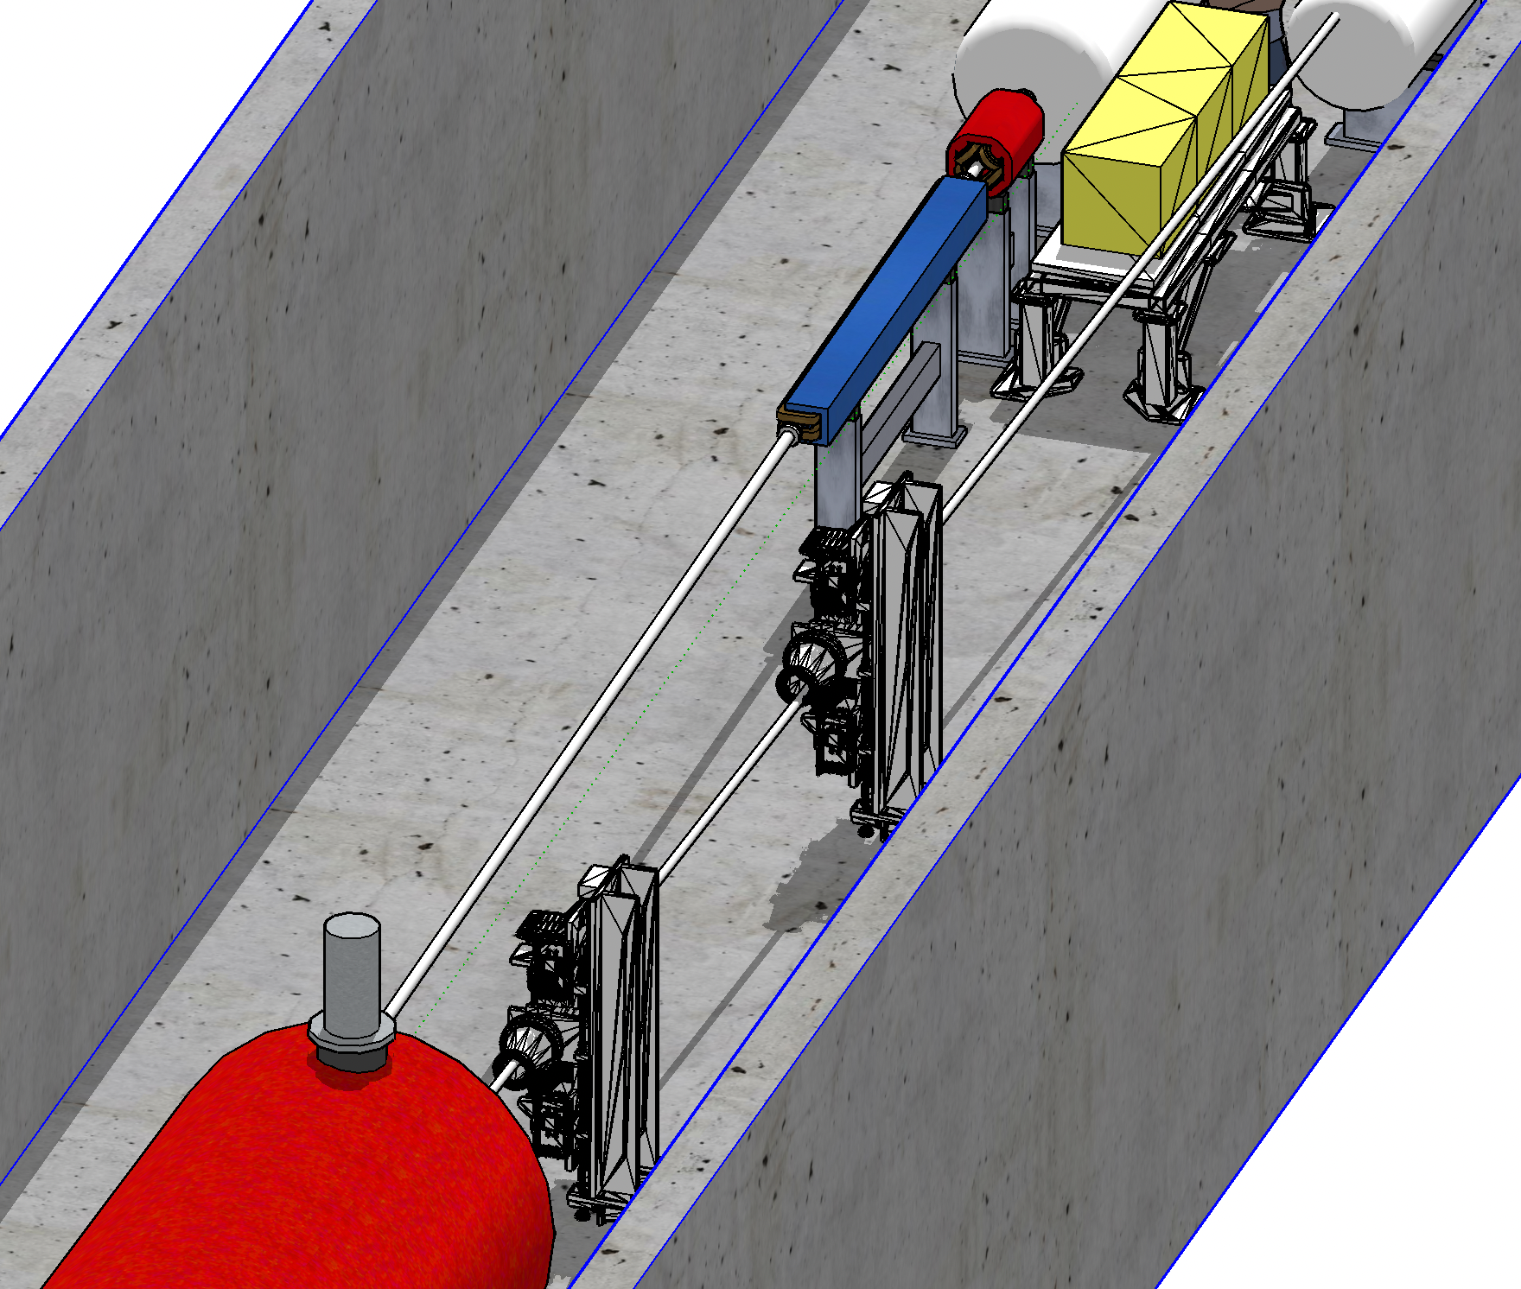
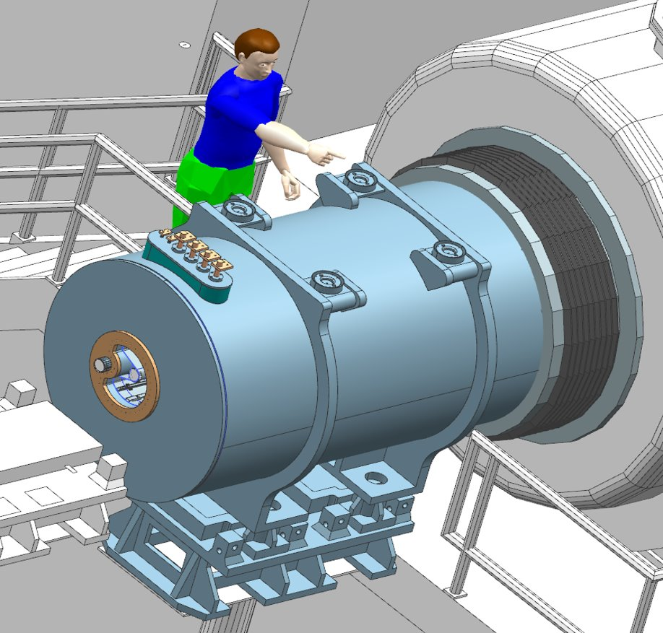
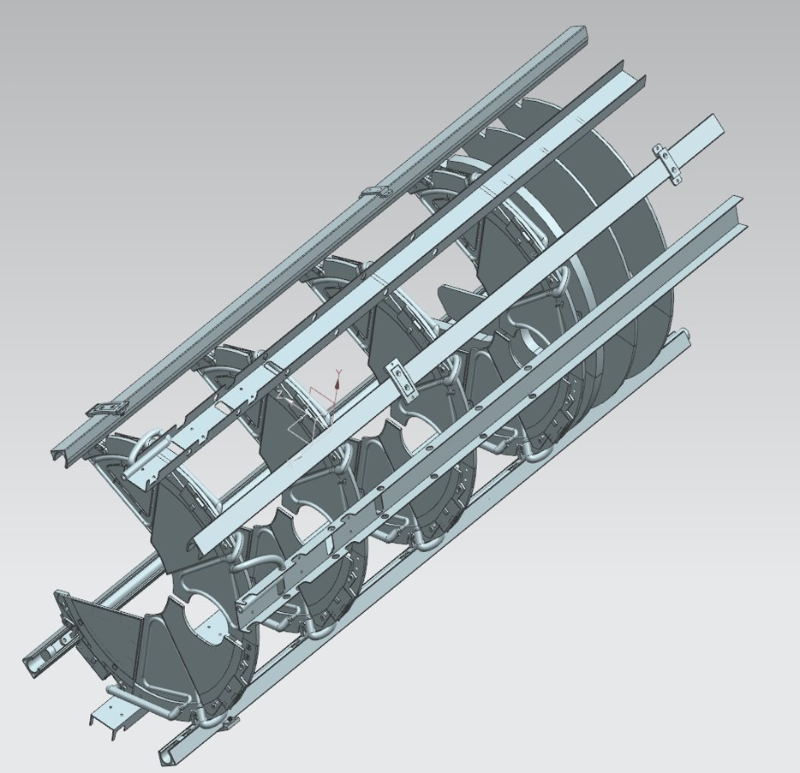
Progress on Integration
All far forward and backward subsystems are integrated in the Interaction region lattice
ZDC
BO
Tagger1
local
pC Polarimeter
Roman Pots
Pre-Shower
γ-detection
Lumi
Tagger2
Off-momentum
detector
Si-tracking
Planes

Slide 21
Charge and Agenda
For the October 2022 DAC meeting we welcome your guidance and advice on the following topics:
The status and progress of the EIC Project.
The status and progress of the EPIC detector and collaboration following the consolidation and optimization process after the DPAP.
The status, progress and plans for the EIC project detector R&D that has been initiated recently (eRD101-105, eRD108, eRD110-112).
The plans for the EIC project detector R&D that have not been started yet, for various reasons (eRD106-107, eRD109, and the new eRD113)
Further planning for the outyears of the EIC Project detector R&D as documented in the “Assessment of R&D Needs for an EIC Detector” (EIC Detector R&D) document.
What do you see as priorities for the proposed EIC-related Project detector R&D?
AGENDA:
https://indico.bnl.gov/event/17159/

Slide 22


Slide 23


Slide 24
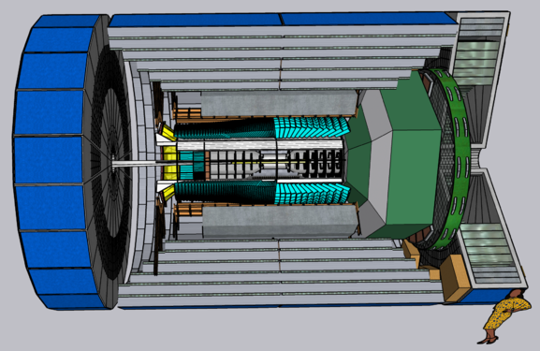
EIC Detector Proposals
EPIC = ATHENA + ECCE
(for ECCE the consolidation process has led to the ongoing design of an up to 2T magnet, and a detector length of ~9 meter)
(the EIC User Group has established a 2nd detector working group)
117 institutions
25 institutions
98 institutions
ATHENA
Location | IP6
Detector Length | 9.5 meter
Magnet Field | 3 Tesla
Magnet Bore | 3.2 meter
Magnet Length | 3.6 meter
CORE
Location | IP8 (or IP6)
Detector Length | 8 meter
Magnet Field | 3 Tesla
Magnet Bore | 2.0 meter
Magnet Length | 2.5 meter
ECCE
Location | IP6 (or IP8)
Detector Length | 8.5 meter
Magnet Field | 1.5 Tesla
Magnet Bore | 2.8 meter
Magnet Length | 3.51 meter

Slide 25
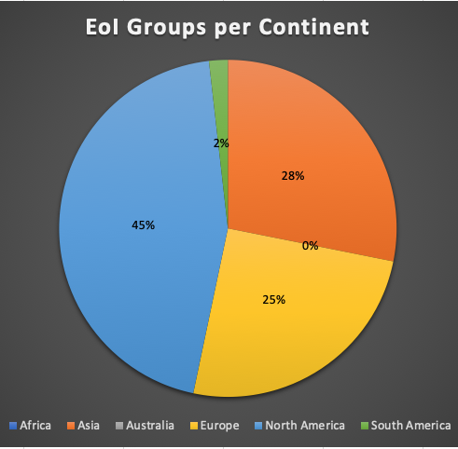
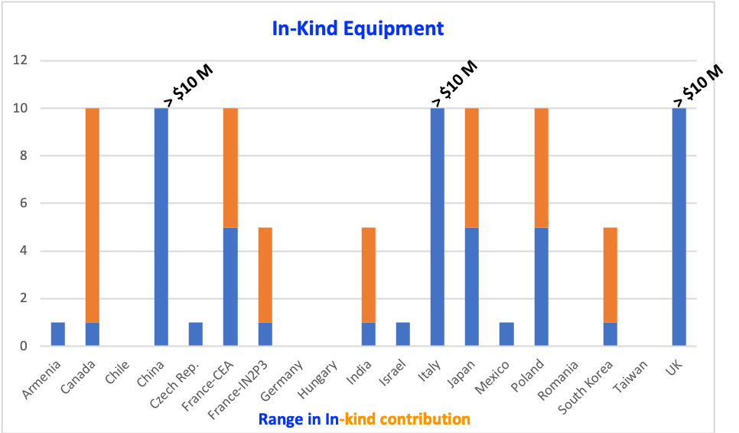
2020: Expressions Of Interest
Received 47 EoIs have been made public: https://indico.bnl.gov/event/8552/
Few-100 FTEs, including near-100 FTE technical (both numbers are averages per year)
(Some judgement factor involved)

Slide 26
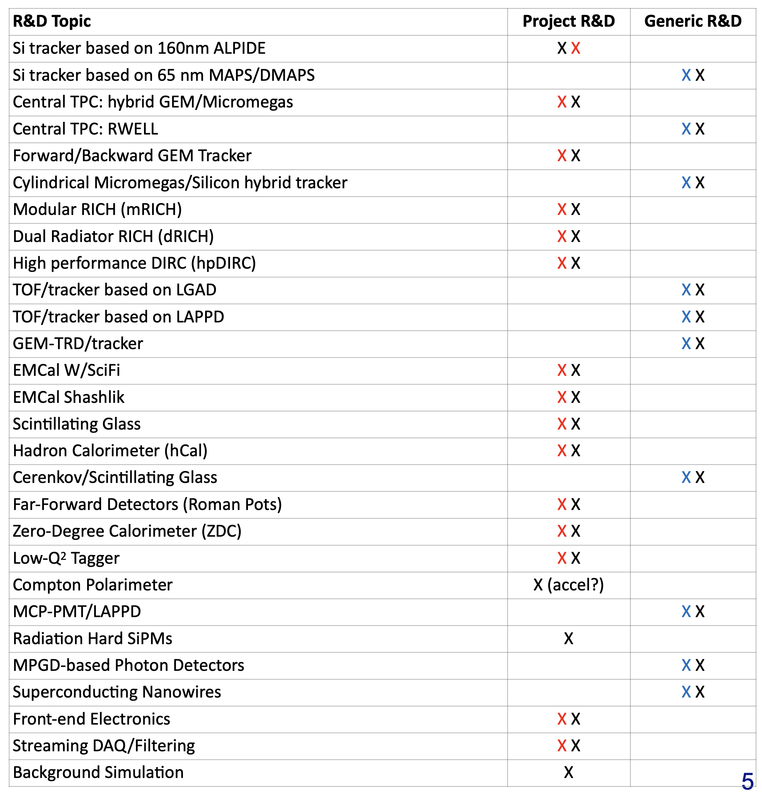
EIC Project Detector R&D Program
Project Detector R&D
Builds on the success of the generic detector R&D
Focus: R&D for systems in scope
  ensure feasibility
  reduce risk
  optimization
EIC Project DAC joined last generic EIC Detector R&D meeting (March 2021)
DAC concurred with all Project and Generic tasks; advised to add few topics
  This was folded into the Project Detector R&D plan
  We have initiated FY22 follow-up with user groups pursuing project-specific detector R&D common to all proto-collaboration EIC
  detector proposals
ECal & HCal R&D on hold to adjust to outcome of consolidation outcome
X = DAC
X = Project - Current R&D Plan (v3.6)
X = Generic - Current R&D Plan (v3.6)
  Special Meetings:
  LAPPD 21st March 2022 https://indico.bnl.gov/event/15059/
  SiPM Use and Needs at EIC https://indico.bnl.gov/event/14715/
  follow ups and new topics are in the planning

Slide 27
EIC Project Detector R&D Program
MAPS-Tracker:
Development of a full tracking detector solution composed of next generation MAPS sensors and based on the developments ongoing at CERN for the ALICE ITS
reduce the services material load
MPGDs:
Demonstrate with a small prototype that cylindrical μRWELL can be built and operated
Demonstrate a full (no acceptance gaps) light-weight modular Micromegas barrel tracker can be built
AC-LGAD:
Develop system including sensors, ASIC & services for auxiliary detectors and ToF
Photon-Sensors:
WBS 6.10.04 & 05 & 06
Reduce current risk associated with lack of reliable highly pixilated photodetectors working at high B-field and are radiation tolerant → Reduce cost
Electronics & DAQ/Computing
ASIC development → needs to be optimized now reference detector will be defined
develop aggregator and FELIX card equivalents to be streaming capable
PID-Detectors:
DIRC: minimize Risk by validating baseline design
mRICH: validate the detector concept can be realized and the performance needed
dRICH: validate performance through a full chain prototype
HCals:
optimize construction techniques
optimize longitudinal segmentation and increase LY
optimize readout and make high density
ECals:
Demonstrate that SciGlass is a viable solution as EIC precision calorimeter technology
Forward Calorimetry: finalize generic detector R&D on LY efficiency and uniformity and demonstrate needed read-out electronics density
Hadron Polarimetry:
R&D through Accelerator
use RHIC to validate concepts for suppressing background in H-Jet and pC
validate concepts to veto breakup of He-3
new targets for pC-polarimeters

Slide 28
Pre-TDR – more details on section on Experimental Systems
.
8.1 Experimental Equipment Requirements Summary (like CDR 8.2)
8.2 General Detector Considerations and Operations Challenges (YR 10 and CDR 8.3)
8.2.1 Beam Energies, Polarization, Versatility, Luminosities (like YR 10.1)
8.2.2 Rates and Multiplicities (like CDR 8.3.1)
8.2.3 Interaction Region Integration, Vacuum and Backgrounds (like CDR 8.3.2)
8.2.4 Systematic Uncertainties (like YR 10.5)
8.3 EPIC Detector CAM(s) and collaboration contact(s)
8.3.1 Magnet For each subsection end with R&D and design maturity
8.3.2 Tracking
8.3.3 Electromagnetic Calorimetry
8.3.4 Hadronic Calorimetry
8.3.5 Particle Identification
8.3.6 Far-Forward Detectors
8.3.7 Far-Backward Detectors
8.3.8 Polarimetry and Luminosity Detector
8.3.9 Readout Electronics and Data Acquisition
8.3.10 Software, Data Analysis and Data Preservation (EICUG SWG?)
8.4 Detector R&D Summary
8.5 Detector Integration (Walt, Rahul, Tim/Christian, Fernando, Roland, Elke, Rolf)
8.5.1 Experimental and Assembly Hall Infrastructure (like CDR 8.7.1, YR 13.1)
8.5.2 Interaction Region and Protection (include also YR 13.2)
8.5.3 Support Frames and Installation Fixtures (new, ask Roland and Walt to draft?)
8.5.4 Detector Alignment (like YR 13.4)
8.5.5 Schedule and Installation (like CDR 8.7.2, YR 13.3)
8.5.6 Access and Maintenance (like CDR 8.7.3, YR 13.5)
8.5.7 System Engineering and Interface Controls (links to later global Section 12 on System Engineering)
8.6 Detector Commissioning and Pre-Operations

Slide 29
International Engagement
EIC will be unique facility worldwide: there is no equivalent of the EIC science capabilities due to its versatility in energies, polarization, and ion species
Large international component of EIC User Group.
  Several representing functions: vice-chair of EICUG, vice-chair of IB, three further international members of Steering Committee.
Large international component of Yellow Report (417 authors of which 175 (42%) are non-US).
International interest and in-kind contributions to Detector R&D.
Strong component of to the detector proposal process
  At highest level, contact person roles of proto-collaboration
  Various WG lead roles (Canada, France, Italy, Israel, Japan, Korea, UK)
Interest in EIC scope indicated through ePIC Collaboration Survey
  Detailed feedback from different countries, see posted slides, very encouraging and shows complementarity in interest

Slide 30
Synergies with Projects around the World
EIC science program has complementarity and synergies with programs around the world:
LHeC, COMPASS/AMBER, LHCspin@LHC-b at CERN
UPC program at LHC & RHIC, polarized pp & pA RHIC program, JLab program
6.10
EIC Detector
ASIC development and compact FEE design compatible with streaming readout
Synergy with CERN EP R&D Program
https://indico.cern.ch/event/1063927/
Streaming readout → LHC & FAIR
Integrating AI/ML from the start
ALICE-3: ITS-3 development
MPGD utilized in many NP detectors
PANDA DIRC
LAPPD development → ALICE, LHC-B, FAIR
Development of pot-less Roman Pots → future hadron machines
Si-detectors in electron beam → future electron colliders
SciGlass based ECal → new cost-effective & high resolution → alternative to PbWO4
SciGlass based hadronic calorimetry → DOE SBIR
Compton polarimeter -> FCCee
Hadron polarimetry: Fixed target LHC program

Slide 31
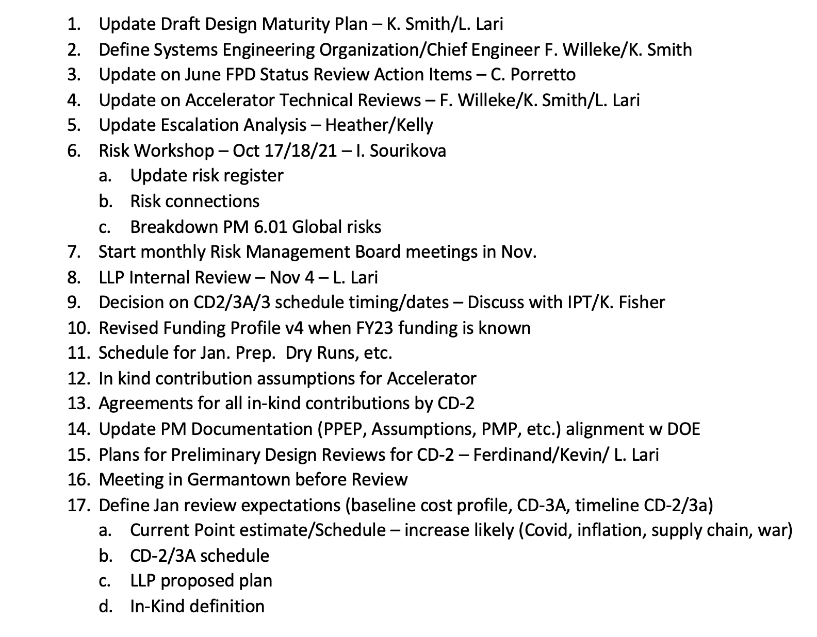
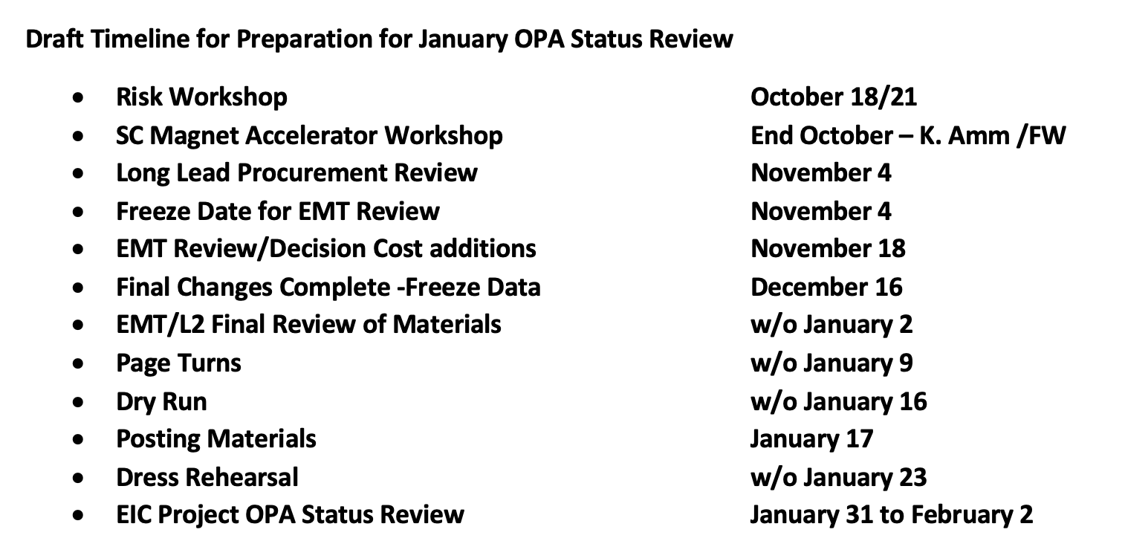
The next big Project Review
January OPA Status Review Preparation

Slide 32
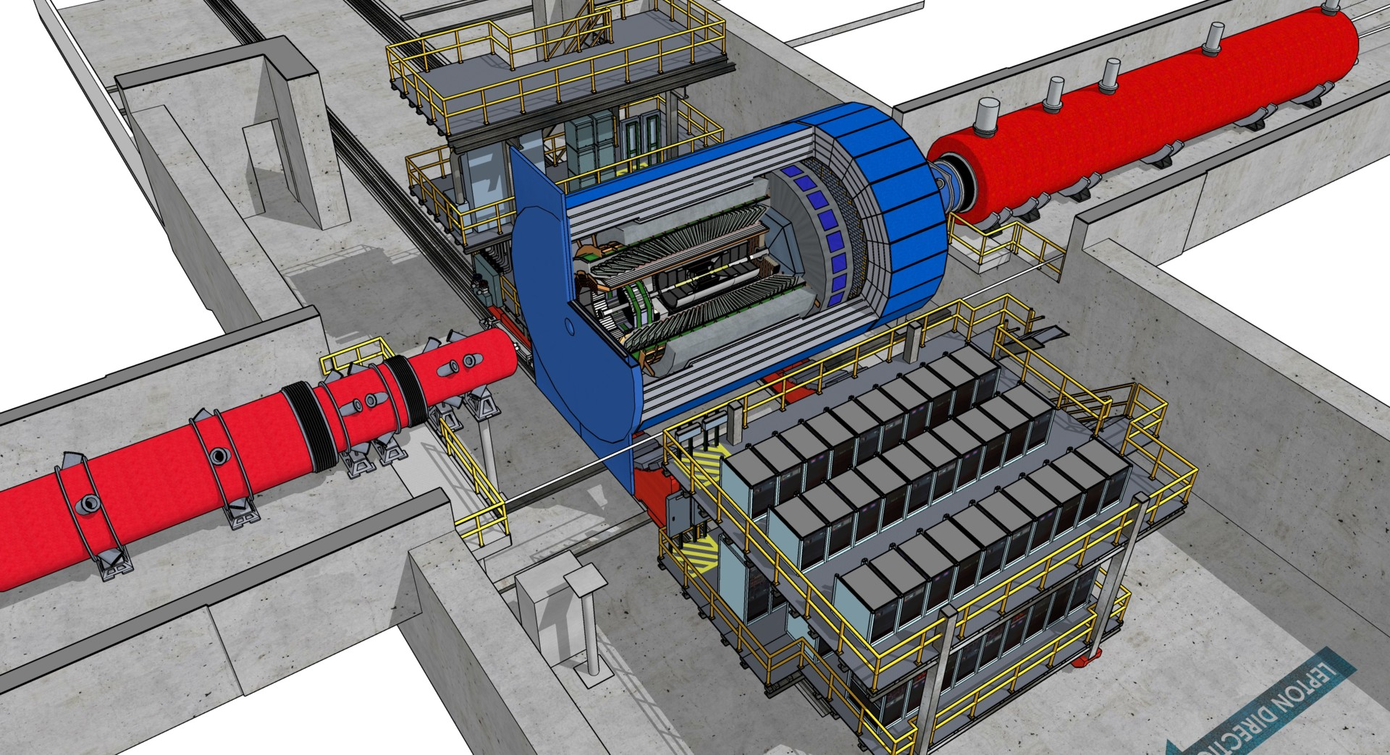
IR-Integration Requirements
Space constrains for ECCE:
-4.5 m – IP – +5m not negotiable
50 cm space to 1st IR-magnet occupied by vacuum pumps, valves, …..
IP moved 81 cm towards ring inside compared to RHIC;
y: 432 cm above floor
Hadrons
RCS
Electrons
9.5 m long detector does not fit through the door
  Door-Size: 823 cm x 823 cm
  endcap hadron calorimeters need to stay in collider hall, if detector rolls in
  assembly hall
RCS to IP: radial distance 335.2 cm at a height of 372 cm from floor
  Maximum outer radius ~ 3.2 m
Detector Solenoidal axis aligned with electron beam
Fringe field requirements for solenoid under development
Installation and Maintenance requirements defined

Slide 33
Determination of Beam Background at IR
electron beam:
Synchrotron radiation
  Backscattering
  Photo desorption
  → degradation of vacuum
Beam gas interactions
  Off momentum electrons
Higher order mode losses
  Local heating at injection and ramp (short bunches)
  degradation of vacuum
background due to de-excitation of beam if bunches are replaced
proton beam:
Low beam lifetime during
injection and ramping
Beam gas interactions, large
hadronic cross section
  Secondary interactions with
  aperture limitations, i.e. with
  magnets, beam pipe, masks
Requirement:
Keep beam backgrounds as low as possible
→ Careful design of interaction region, beam-pipe masks/absorbers/shielding and photon beam dump
Excellent vacuum system and vacuum pump placement
Fast response for the detector protection ( beam-position monitoring, etc)
continuous iteration between detector simulations to determine background impact and accelerator experts to further reduce the background (for details see Beam Background for Experiment)

