Slide 1
EIC Project Update
Elke Aschenauer and Rolf Ent
Co-Associate Directors for the Experimental Program
ePIC General Meeting
October 5th 2022

Slide 2
DOE Project Decision Process
EIC
Preliminary Design ~50-60%; Final Design $≥$85%
Operating* Funds
Project Engineering and Design (PED) Funds
Construction & PED
Funds
Operating Funds
Initiation
Definition
Execution
Closeout
Conceptual Design
Preliminary Design
Final Design
Construction
EIC Critical Decision Plan
CD-2/3a January 2024
CD-3 April 2025
CD-4a early finish April 2031
CD-4a April 2032
CD-4 early finish April 2032
CD-4 April 2034
Critical
Decisions
CD-0
Approve Mission Need
CD-1
Approve Alternative Selection
and Cost
Range
CD-2
Approve Performance Baseline (PB)
CD-3
Approve Start of Construction or Execution
CD-4
Approve
Start of Operations or Project Completion
CD-2 – Approve Performance Baseline: CD-2 is an approval of the preliminary design of the project and the baseline scope, cost, and schedule. What is most relevant is that CD-2 means there is now a definitive plan that the project will be measured against in cost, schedule and technical performance.
pre-TDR is required for CD-2
(pre-TDR = preliminary version of TDR)
CD-3 – Approve Start of Construction: CD-3 is an approval of the project’s final design and authorizes release of funds for construction. What is most relevant is that projects can now proceed with construction related procurements and activities. CD-3 is sometimes split in CD-3A in a tailored approach to approve start construction for long-lead procurements.
→ TDR is required for CD-3

Slide 3
Pre-TDR outline
.
Working model will be similar as we used to create the CDR, Elke/Rolf with engagement of EPIC leadership, and a mix of the project CAMs and EPIC WG representatives. At the late phases the editing rights will become more restricted. We plan to use where we can input from the CDR, YR, proposals, technical notes, etc.
Chapter 2: Physics Goals and Requirements (should be short, < 50 pages)
2.1 EIC Context and History (like CDR 2.2 or YR section 1)
2.2 The Science Goals of the EIC and the Machine Parameters (like CDR 2.3)
2.3 The EIC Science (follow YR structure)
2.4 Scientific Requirements
Chapter 3: Interaction Region 6 Overview (Elke/Rolf contributing)
Chapter 8: Experimental Systems
8.1 Experimental Equipment Requirements Summary (like CDR 8.2)
8.2 General Detector Considerations and Operations Challenges (YR 10, CDR 8.3)
8.3 EIC Detector
8.4 Detector R&D Summary
8.5 Detector Integration
8.6 Detector Commissioning and Pre-Operations
Chapter 11: Commissioning (Elke/Rolf contributing)
Appendix-B: Integration of a Second Experiment
B.1 Interaction region definition and layout
B.2 Experimental complementarity
B.3 Outstanding issues

Slide 4
Pre-TDR – more details on section on Experimental Systems
.
8.1 Experimental Equipment Requirements Summary (like CDR 8.2)
8.2 General Detector Considerations and Operations Challenges (YR 10 and CDR 8.3)
8.2.1 Beam Energies, Polarization, Versatility, Luminosities (like YR 10.1)
8.2.2 Rates and Multiplicities (like CDR 8.3.1)
8.2.3 Interaction Region Integration, Vacuum and Backgrounds (like CDR 8.3.2)
8.2.4 Systematic Uncertainties (like YR 10.5)
8.3 EPIC Detector CAM(s) and collaboration contact(s)
8.3.1 Magnet For each subsection end with R&D and design maturity
8.3.2 Tracking
8.3.3 Electromagnetic Calorimetry
8.3.4 Hadronic Calorimetry
8.3.5 Particle Identification
8.3.6 Far-Forward Detectors
8.3.7 Far-Backward Detectors
8.3.8 Polarimetry and Luminosity Detector
8.3.9 Readout Electronics and Data Acquisition
8.3.10 Software, Data Analysis and Data Preservation (EICUG SWG?)
8.4 Detector R&D Summary
8.5 Detector Integration (Walt, Rahul, Tim/Christian, Fernando, Roland, Elke, Rolf)
8.5.1 Experimental and Assembly Hall Infrastructure (like CDR 8.7.1, YR 13.1)
8.5.2 Interaction Region and Protection (include also YR 13.2)
8.5.3 Support Frames and Installation Fixtures (new, ask Roland and Walt to draft?)
8.5.4 Detector Alignment (like YR 13.4)
8.5.5 Schedule and Installation (like CDR 8.7.2, YR 13.3)
8.5.6 Access and Maintenance (like CDR 8.7.3, YR 13.5)
8.5.7 System Engineering and Interface Controls (links to later global Section 12 on System Engineering)
8.6 Detector Commissioning and Pre-Operations

Slide 5
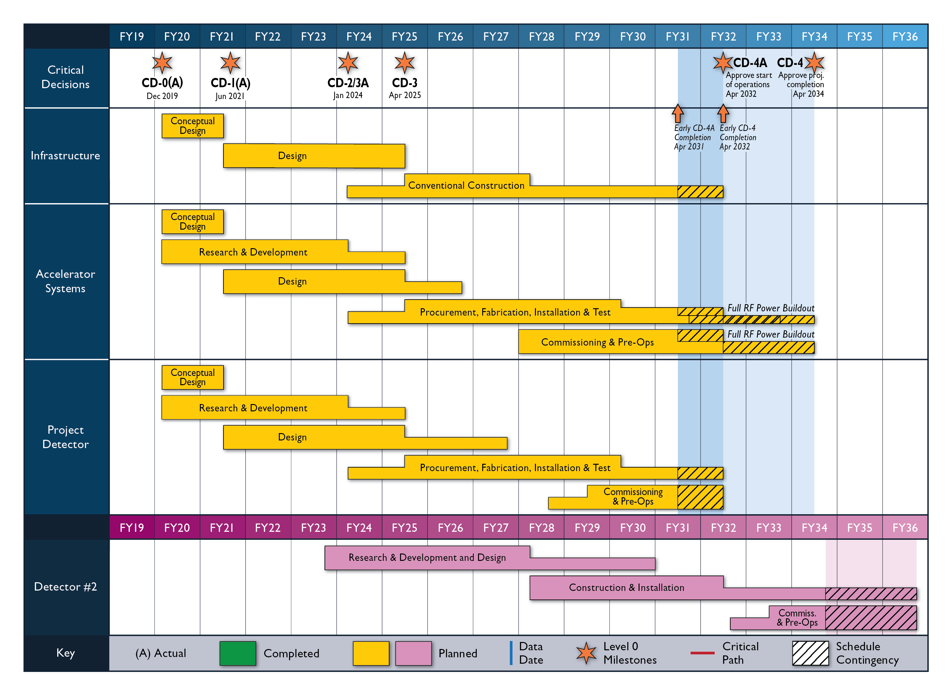
High Level Reference Schedule
The thinner bars indicate that R&D and design
can continue at a small level beyond CD-2 and CD-3
for LLP construction
starts at CD-2/3A
Notional Schedule
2nd IR and
Schedule
Generic Detector R&D

Slide 6
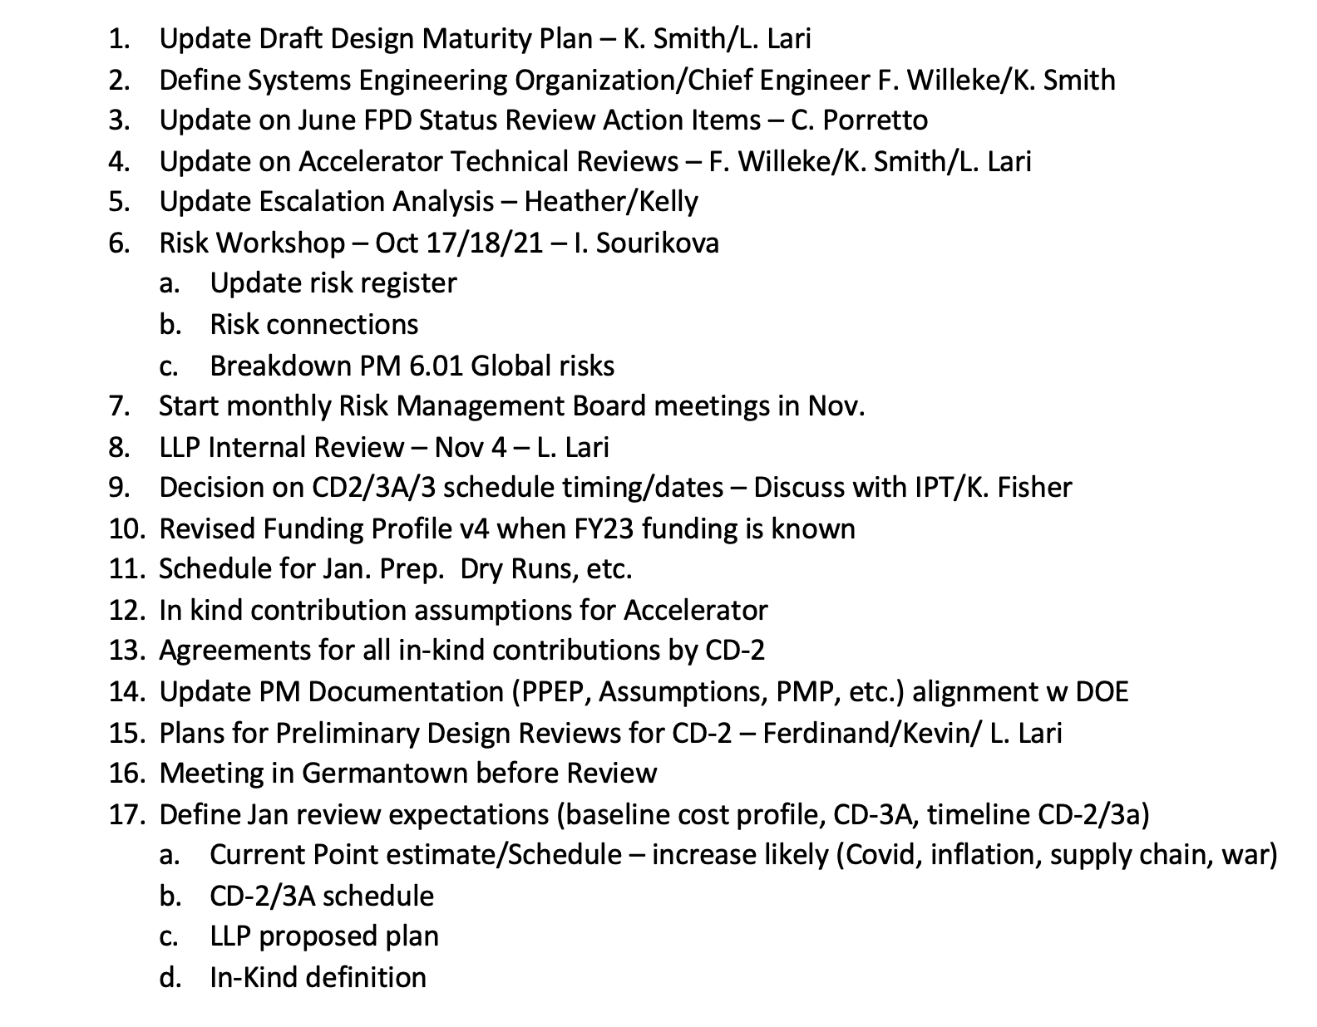
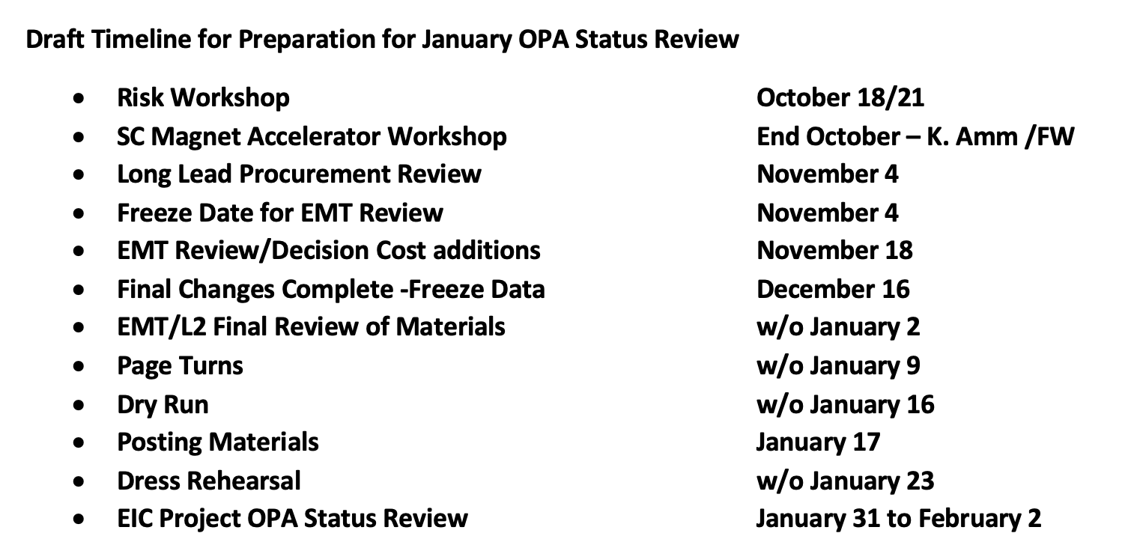
The next big Project Review
January OPA Status Review Preparation
An enormous amount of work for
everybody working for the project
→ this is also benefits all of you,
so EIC progresses towards CD-2

Slide 7
Upcoming Events
September 26 – EIC Advisory Board meeting
October 12-13 – “Resource Review Board”-like kickoff meeting
https://indico.bnl.gov/event/17354/
October 18-19 – 60% Magnet Review @ JLab
We implemented the design change to go to six layers of conductor – with thanks to our CEA Saclay colleagues to help us out. This should allow a robust 1.7 Tesla magnet with stretch goal of 2 T.
Five engineers from CEA Saclay plan to attend. The meeting will be hybrid as the reviewers and further engineers/designers will be remote.
The reviewers will be the same as for the earlier 30% design review and are confirmed – Ruben Fair (PPPL) –chair, Vladimir Kashikhin (FNAL), GianLuca Sabbi (LBNL).
October 19-21 – Detector Advisory Committee meeting
EIC project update
Update on the EPIC detector, the steps following the DPAP process
and as main part of the meeting reports on the status of the various project detector R&D projects and FY23 plans/requests
October-December – EIC Subsystem Status Reviews on Tracking, Particle Identification Systems, Electromagnetic Calorimetry, Hadronic Calorimetry, Infrastructure/Installation, Polarimetry

Slide 8
NuPECC Document Submitted
In response to NuPECC LRP Call
Submitted on behalf of BNL & JLab
Posted on EICUG webpages
Separate document to be submitted by European EIC Users

Slide 9
The Path to CD-2/3A
Form collaboration and define subsystem responsibilities
→ in-kind contributions need to be identified and agreements need to be in an advanced state (close to final)
→ Integrate collaboration in WBS – structure of detector
Finalize scope of EIC Project Detector
all subsystem technologies defined by end of CY2022
Continuous refinement of subsystem requirements and interfaces
Refine cost, schedule and labor needs for each subsystem
detailed documentation of basis – of – estimates
Long Lead Procurement (LLP) items of the detector will be further refined
define scope contingency items
Bring level of design on average to 50-60% @ CD2/3A, with LLP items needing to be at final design stage (~90%)
Produce pre-TDR*: 1st version of by May 2023
→ final version by October 2023
*TDR is needed by CD-3, about one year later

Slide 10
What Does a Preliminary Design mean
Example: dRICH
need to define the sub-detector technology to a level of detail that we can baseline cost, schedule and workforce and functional requirements needs
what do we build: a CF-gas + Aerogel RICH or is the CF-gas replaced with a pressurized or cooled Argon
vessel design needs to be well advanced
geometry of the subsystem and how it is integrated in the overall detector
photon-sensor technology and # of readout – channels
what is the front-end electronics, what ASIC will be used
define mirror - system
what needs to be cooled and how
3d-CAD of the detector with details how the detector will be assembled, drawings of the different components but not on fabrication quality
design of gas system
slow control and monitoring of hardware systems are needed, how do we realize it
A worked-out concept (but no detailed plan) of assembly and service needs
There can still be some open questions (but not affecting costs and schedule in major way), further engineering design to be done, detailed drawings to be done, etc.
This was an example. EPIC leadership has requested such a bullet list for each subsystem on 08/19/22 with a reminder on 09/30/22 as it gives a good feel of where one needs to be at CD-2/3A stage (~50-60% design maturity).

Slide 11
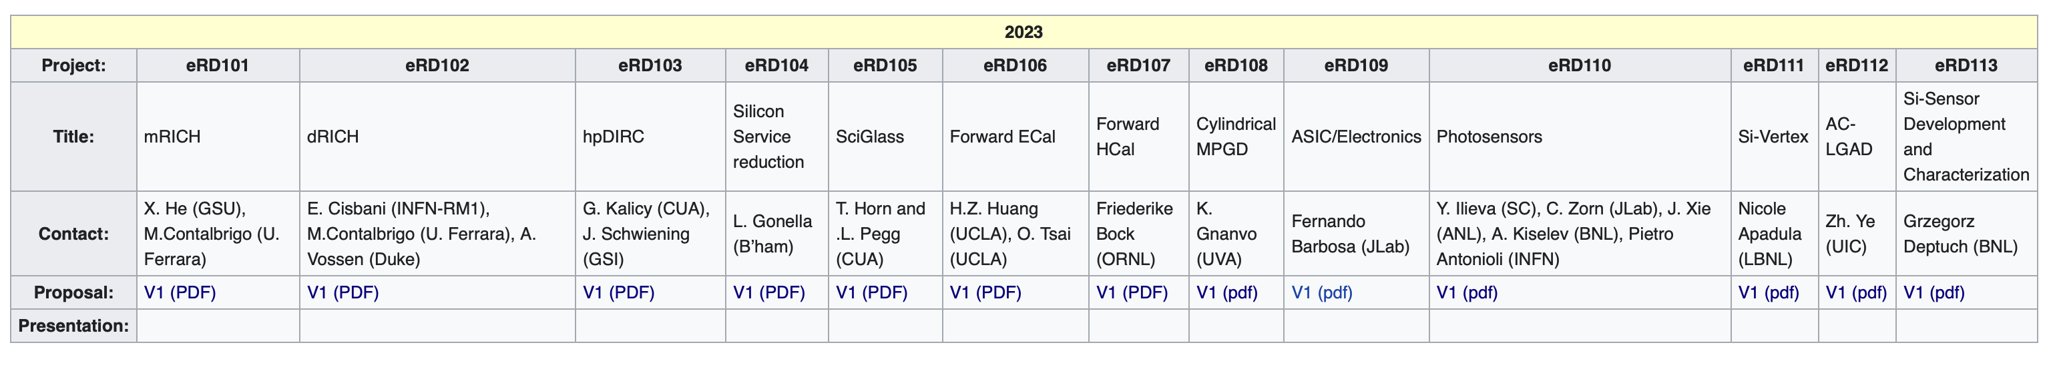
Project Detector R&D Proposals
Most proposals were submitted by October 1st, all proposals were submitted by October 3rd (compilation of ASICs/electronics proposals took extra time).
See https://wiki.bnl.gov/conferences/index.php/ProjectRandDFY23
DAC Meeting October 19-21: https://indico.bnl.gov/event/17159/

Slide 12
Generic Detector R&D Update – info by Dave Mack
Status/timeline in next slide
“Please let them know we take their proposals very seriously and are trying to make wise decisions. From one point of view, it's taking too long. But from another point of view, the generally high quality and importance of these proposals, plus the extremely competitive environment* means we can't take short-cuts.”

Slide 13
EIC-related generic detector R&D: Status of 2022 Startup and Reviews
Date | What Happened
July 25 | Deadline for proposals. Received 27 documents (arguably 30 proposals when one unpacks the silicon consortium document).
Aug 1 | Proposals and spreadsheet summary became available on website. Asked EIC and DOE managers to check whether all proposals were appropriate for this program.
 | EIC and DOE managers confirmed: these were all bona fide generic R&D proposals. Hence all proposals had to be read and evaluated. But it’d be too much workload for a committee of 10, and impractical to have 30 presentation in a 2 day meeting. So: 1) had to increase the size of committee to 16 during the peak vacation season of August (which happily allowed us to expand badly needed expertise in fast silicon, fast gaseous detectors, and machine learning). 2) had to add a time-consuming 1st cuts process to reduce the number of presentations. (Needless to say, early August was stressful as all the Chair’s preliminary schedules went out the window.)
Aug 17 | Final reader assignments were sent out (after resolving a few declared conflicts of interest). There are 2-3 readers per proposal. Each committee member got 4 proposals to read.
Sept 16 | 1st cuts Zoom meeting on first tranche of proposals. (a little over half the proposals were “ready” i.e. with 2 readers reporting back)
Sept 29 | All reading done, essentially all scores and preliminary reports submitted to Chair
Sept 30 | 1st cuts Zoom meeting on final tranche of proposals.
Oct 6 | This week: Chair is finalizing cuts with the committee by email, while beginning to schedule the smartest/busiest 16 people in the world for a 2 day meeting with ~21 presentations. The review is taking longer than expected, but the end is in sight.
“Soon” | Once the presentation meeting date is set (probably in November before Thanksgiving), the Chair will notify all proponents, and send them the committee’s questions which must be addressed during the presentations.

Slide 14
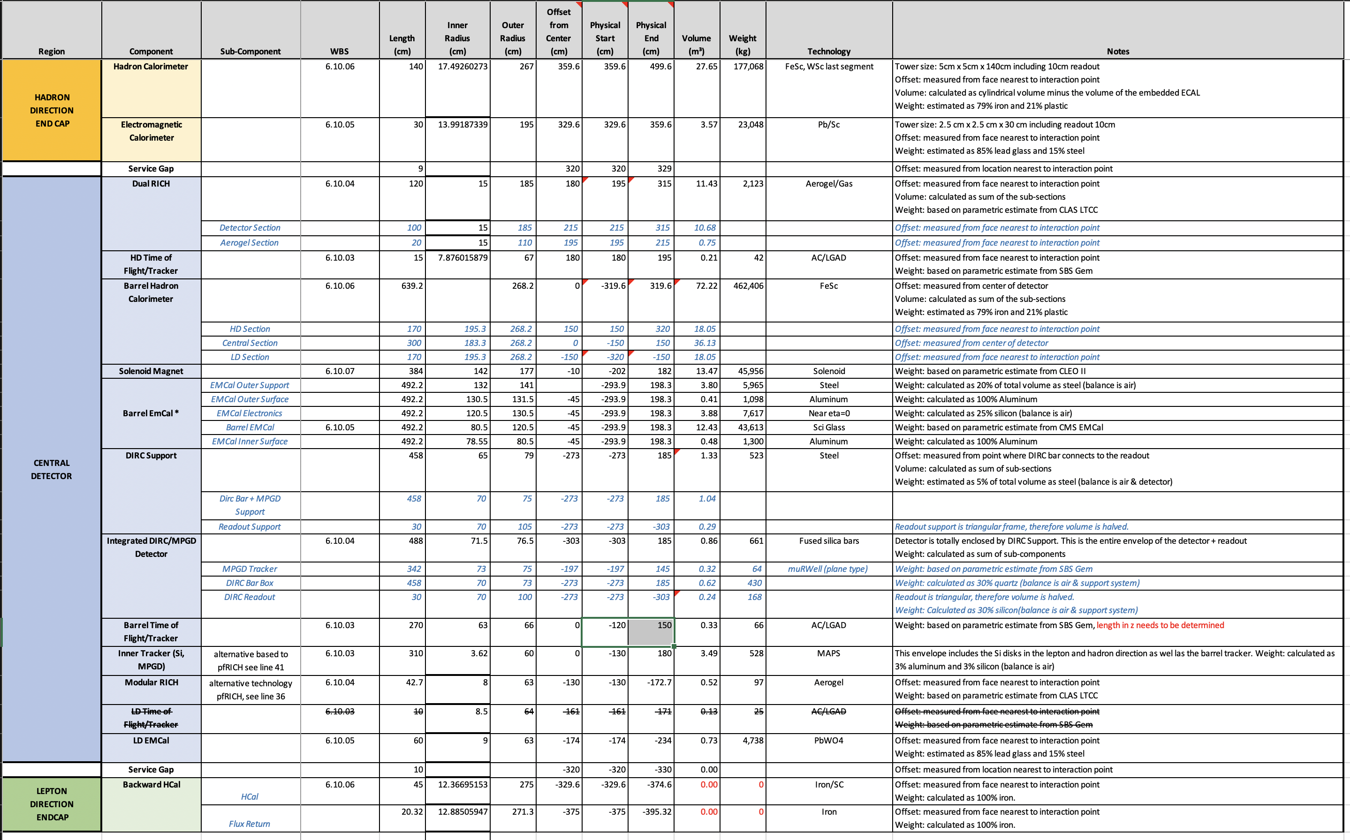
Update of Geometry Data-Base
What we did watch out for
Do we have enough space for the detector, its readout and services
→ https://eic.jlab.org/Geometry/Detector/
Implemented alternatives Barrel: SciGlas & Imaging Calo -- mRICH & pfRICH
Next big step collect all the cables and services of subdetectors

Slide 15
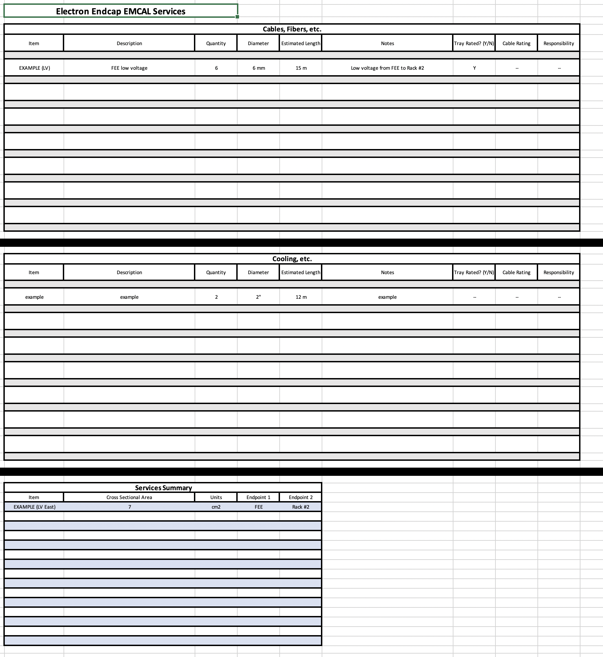
Update of Geometry Data-Base
What we did watch out for
Do we have enough space for the detector, its readout and services
→ https://eic.jlab.org/Geometry/Detector/
Implemented alternatives Barrel: SciGlas & Imaging Calo -- mRICH & pfRICH
Next big step collect all the cables and services of subdetectors
→ unified form to collect information
@ https://wiki.bnl.gov/EPIC/index.php?title=Project_Information#Documents%3A

Slide 16


Slide 17


Slide 18
Plans for Design Maturity
System​​ | Estimated Design​​ % Complete​​ -----------------------​​ Now​​ | Estimated Design​​ % Complete​​ ------------------------​​ CD-2 / 3A​​ | Estimated Date for​​ Final Design Complete​​ | Comments
6.10.02 Detector R&D/Physics Design | 0% | 60% | 06/30/2026 | Project R&D just started
6.10.03 Tracking | 10% | 50% | 12/31/2026 | Need only late
6.10.04 PID | 15% | 50% | 03/31/2026 | hpDIRC well underway
6.10.05 EmCal | 20% | 85% | 12/31/2024 | eEMCAL far ahead
6.10.06 HCal | 15% | 70% | 06/30/2025 | Barrel Hcal reuse, rest delayed
6.10.07 Magnets | 30% | 100% | 12/31/2023 | LLP, completed 30% design
6.10.08 Electronics | 10% | 50% | 03/31/2027 | ASICs/electronics can come in late

Slide 19
Plans for Design Maturity
System​​ | Estimated Design​​ % Complete​​ -----------------------​​ Now​​ | Estimated Design​​ % Complete​​ ------------------------​​ CD-2 / 3A​​ | Estimated Date for​​ Final Design Complete​​ | Comments
6.10.09 DAQ/Computing | 5% | 50% | 03/31/2027 | DAQ/computing can come in late
6.10.10 Infrastructure | 15% | 40% | 06/30/2026 | Good start for reuse, but finals after detectors
6.10.11 IR Integration and Ancillary Detectors | 10% | 50% | 12/31/2025 | Know things fit, just do as we can, need B0 design
6.10.12 Pre-Ops and Commissioning | 0% | 30% | 12/31/2024 | Will have plan at CD-2/3A, develop more later
6.10.14 Polarimetry & Luminosity | 15% | 50% | 12/31/2025 | Know what we need to do, pace and completion driven by accel.

