Slide 1
Barrel ladder test using the FELIX system
G. Nukazuka(RBRC),
R. Nouicer, R. Pisani, R. Cecato(BNL)

Slide 2
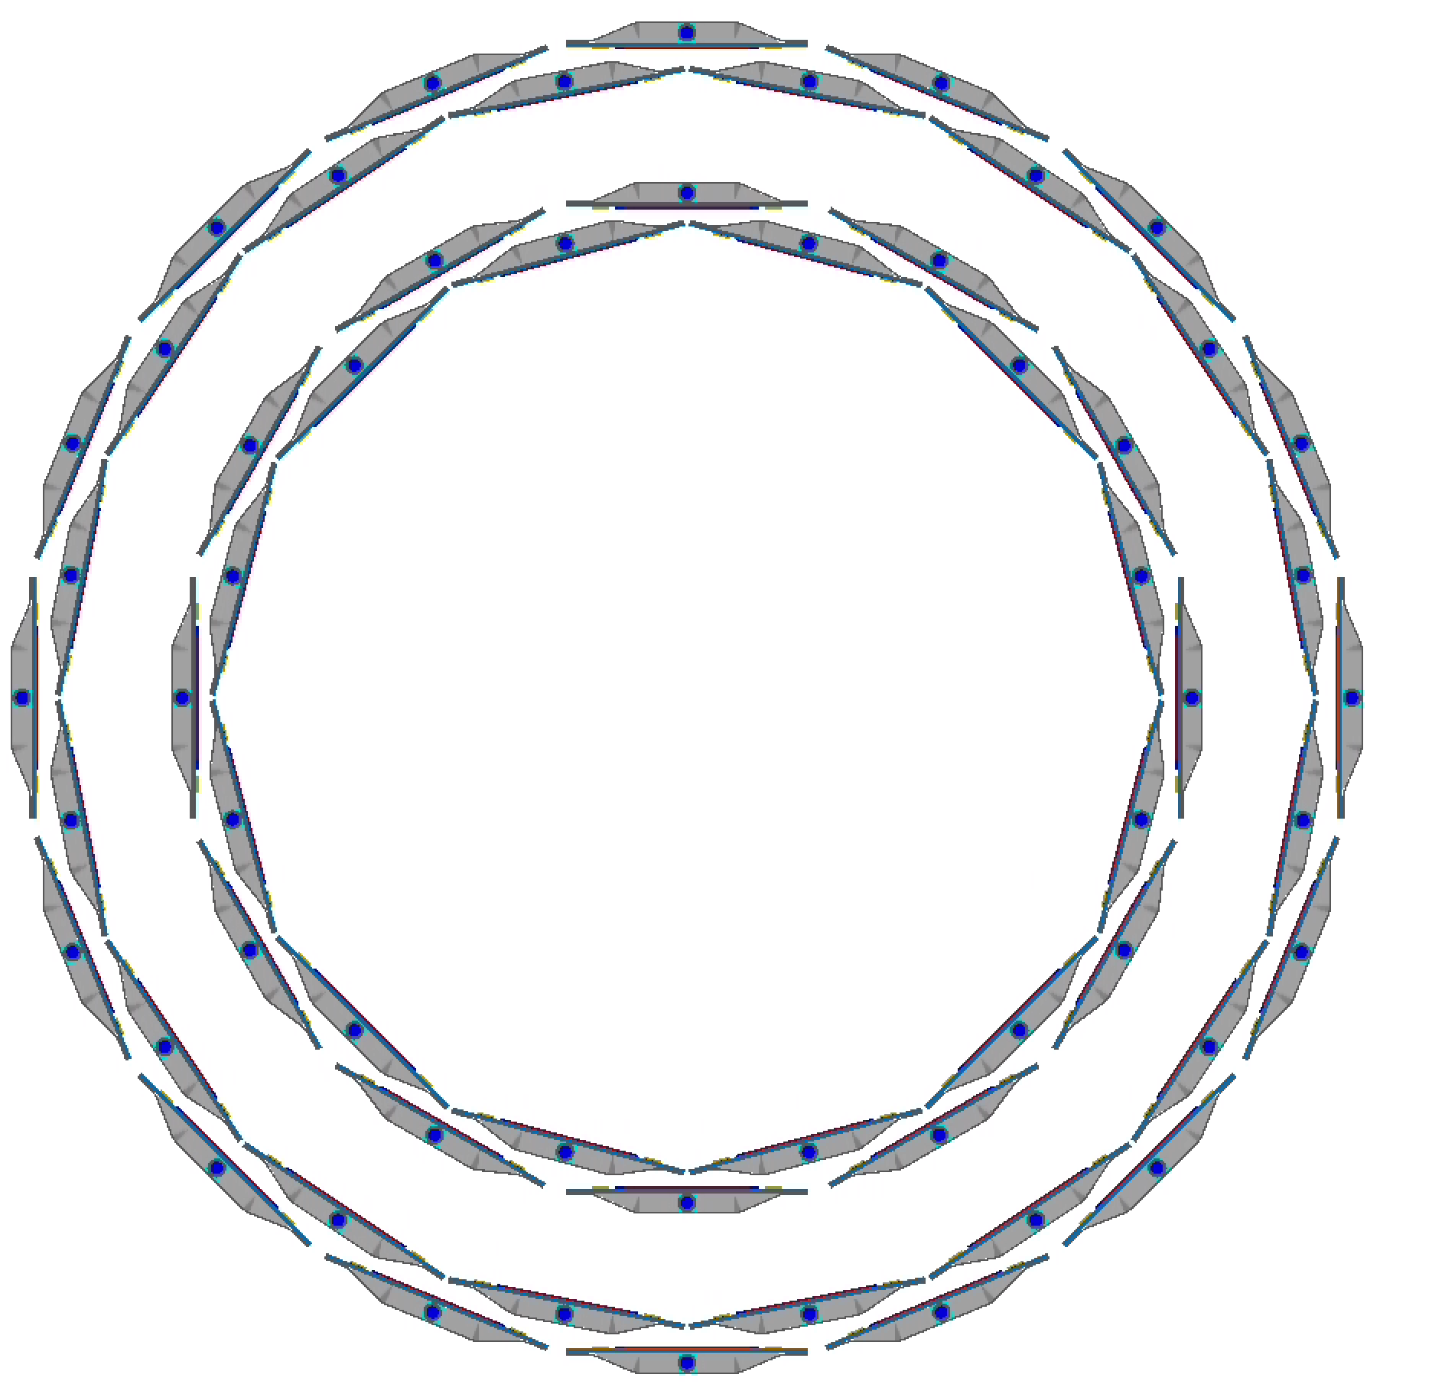

Barrel ladder tests with Felix system
y (vertical)
The barrel ladder tests were successfully done with the FEM/FEM-IB system.
Tests using the Felix should be performed as well.
Now the Felix system can handle everything by itself:
Slow control
BCO and start clock signals
high-speed data readout
2 ladders were tested:
B1L104 south side
B1L105 south side: not done yet….
West
z
East
x
(horizontal)
B1L104
B1L105

Slide 3
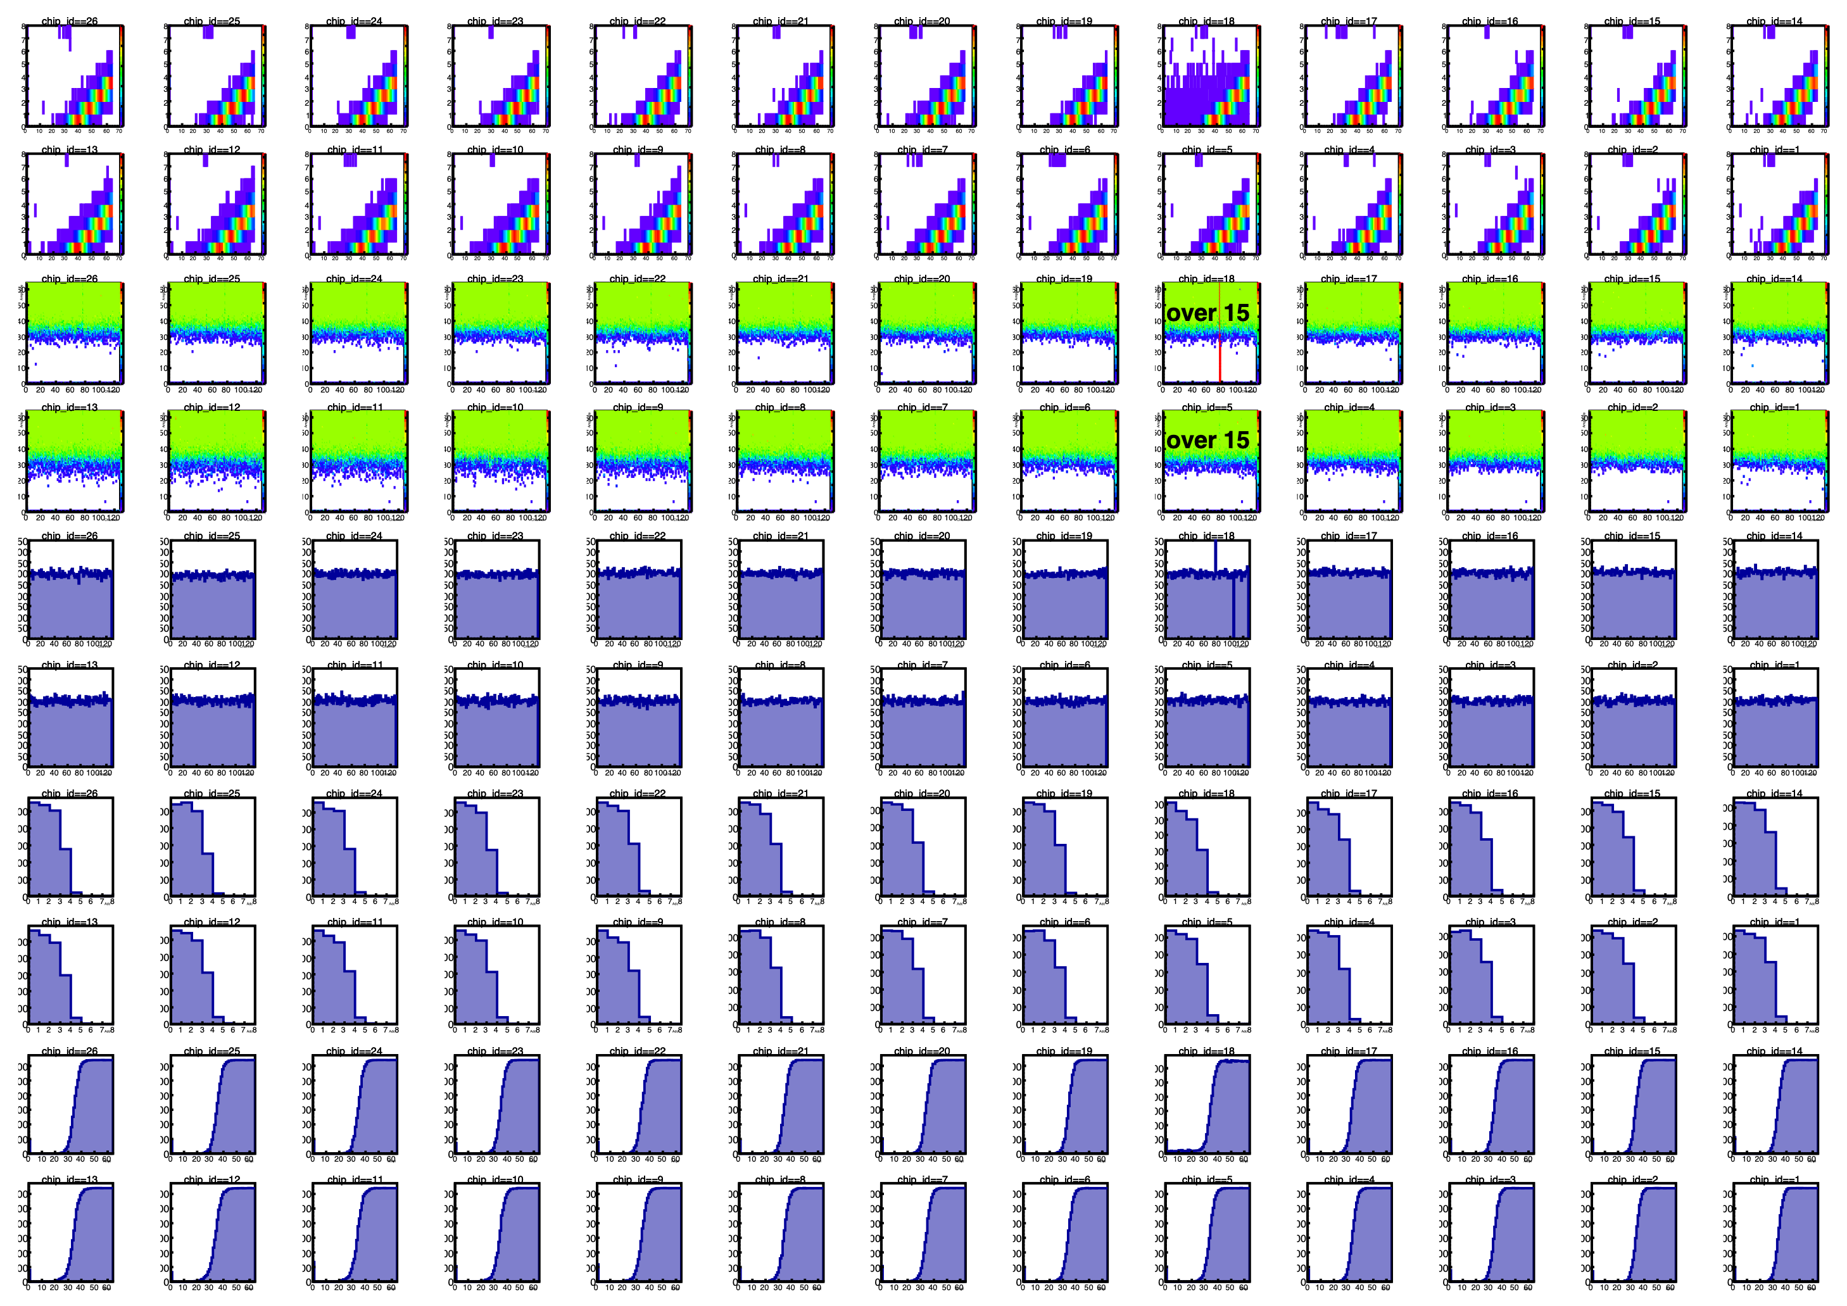
Results: B1L104S, FEM/FEM-IB
Calibration results of B1L104S with the FEM/FEM-IB system
Data: fphx_raw_20220914-1830_0.dat
ROC: port C3
Bias: A = 320 nA, B = 385 nA
chip18 ch77 : noisy
chip18 ch105: dead

Slide 4
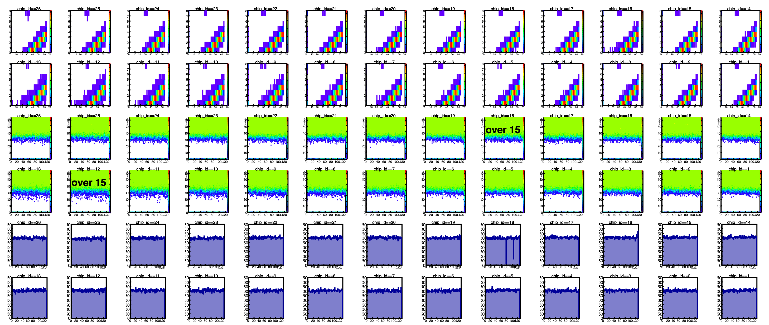
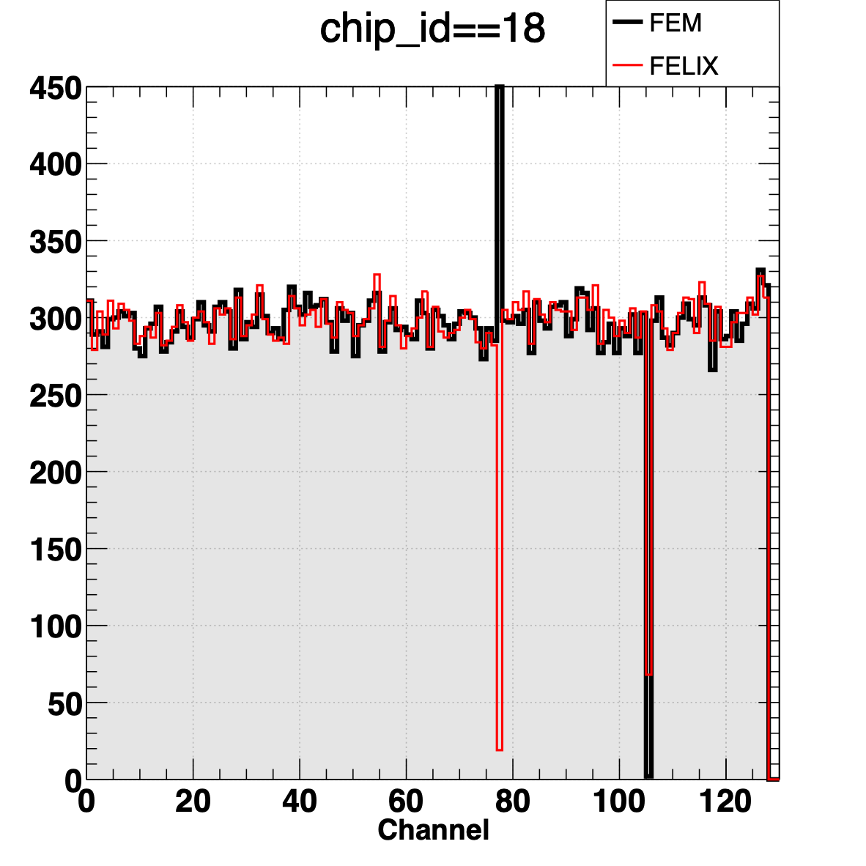
Results: B1L104S, FELIX
Calibration results of B1L104S with the FELIX system
Data: calib_packv1_220927_1700.dat
ROC: port C3
Bias: A = ? nA, B = ? nA
chip18 ch77 : dead
chip18 ch105: dead
?

Slide 5
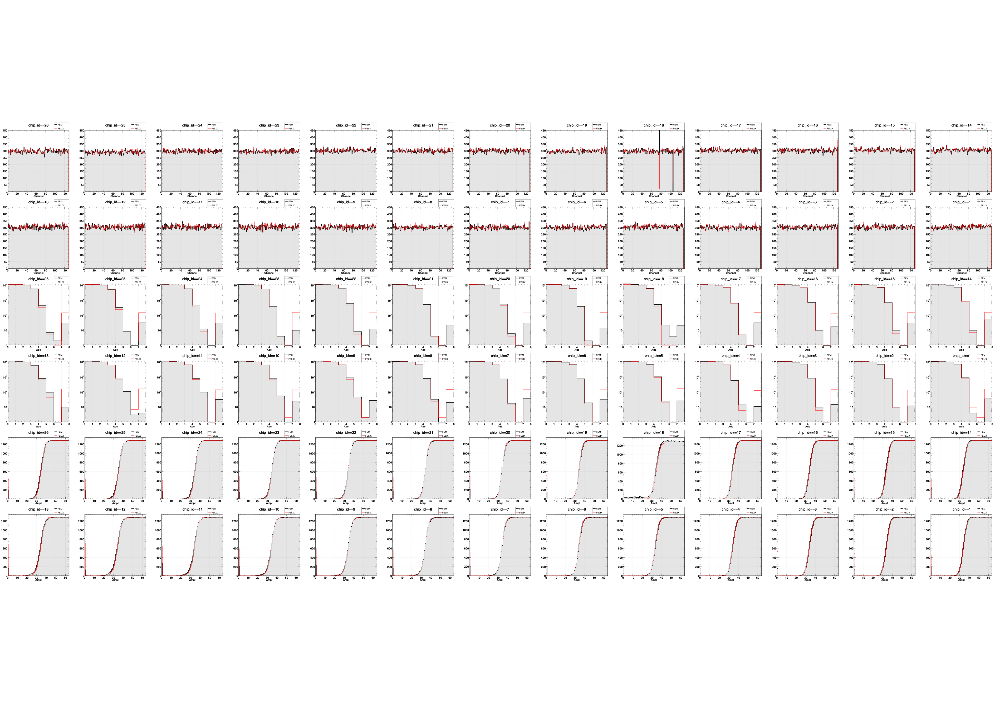
Results: Comparison
Channel dist.
ADC dist.
Amplitude dist.

Slide 6
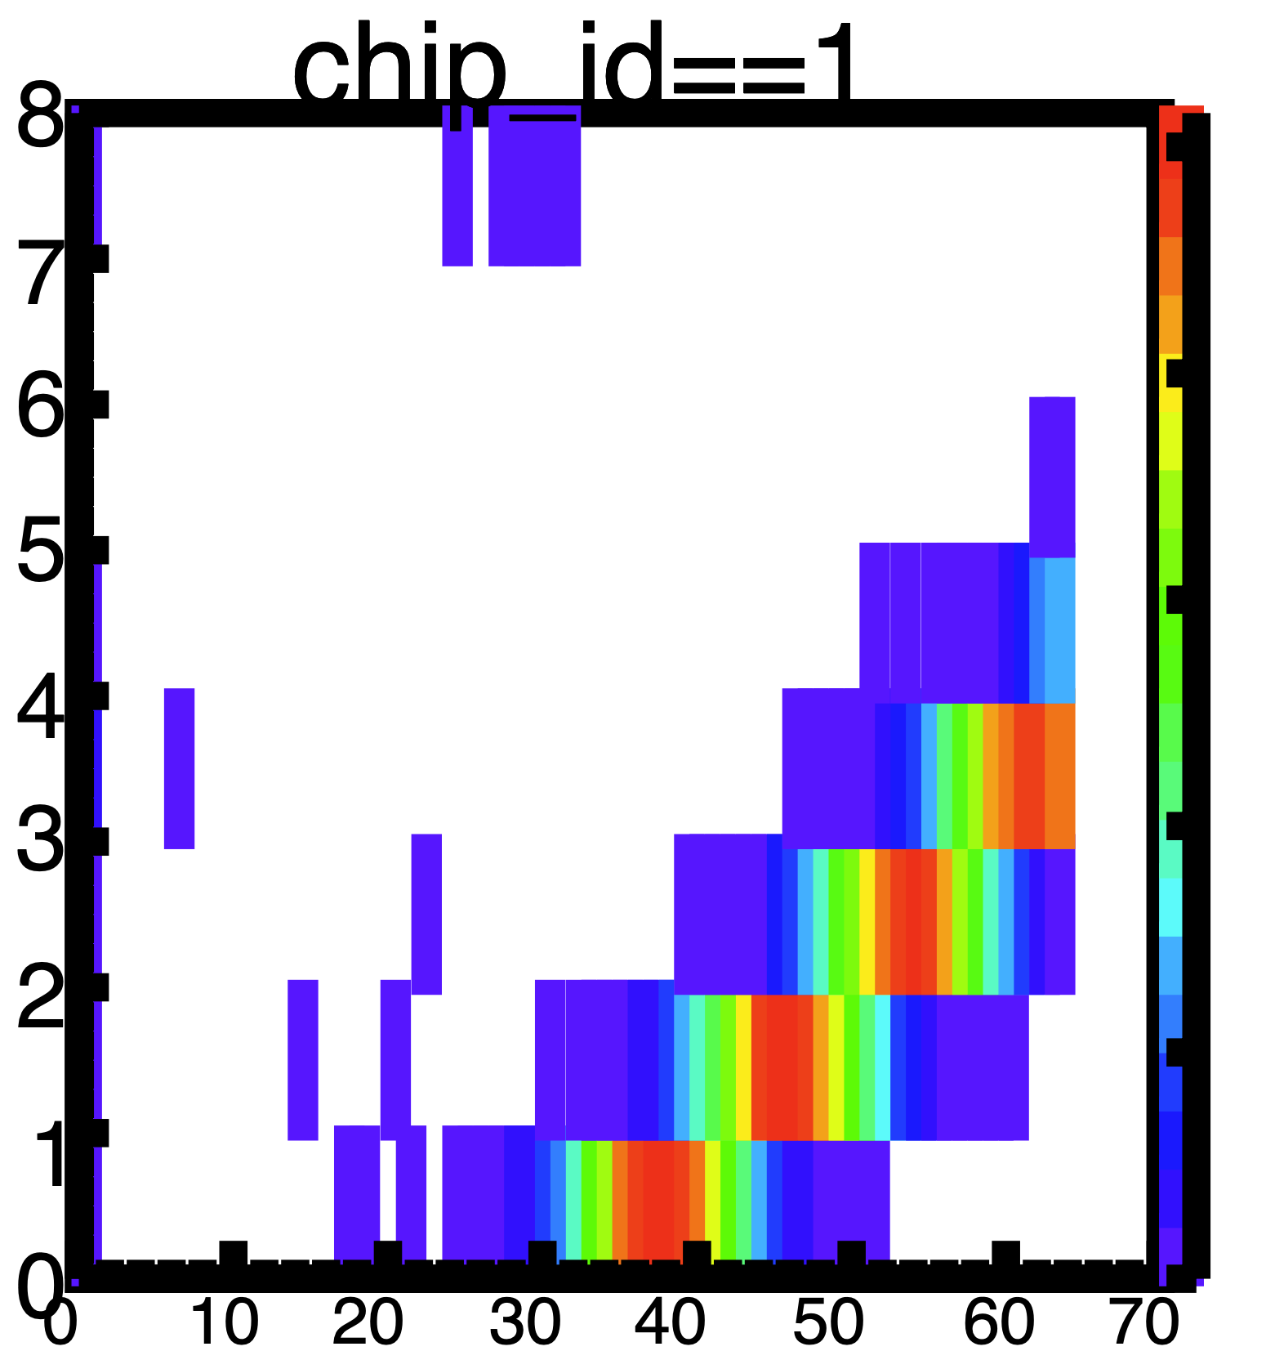
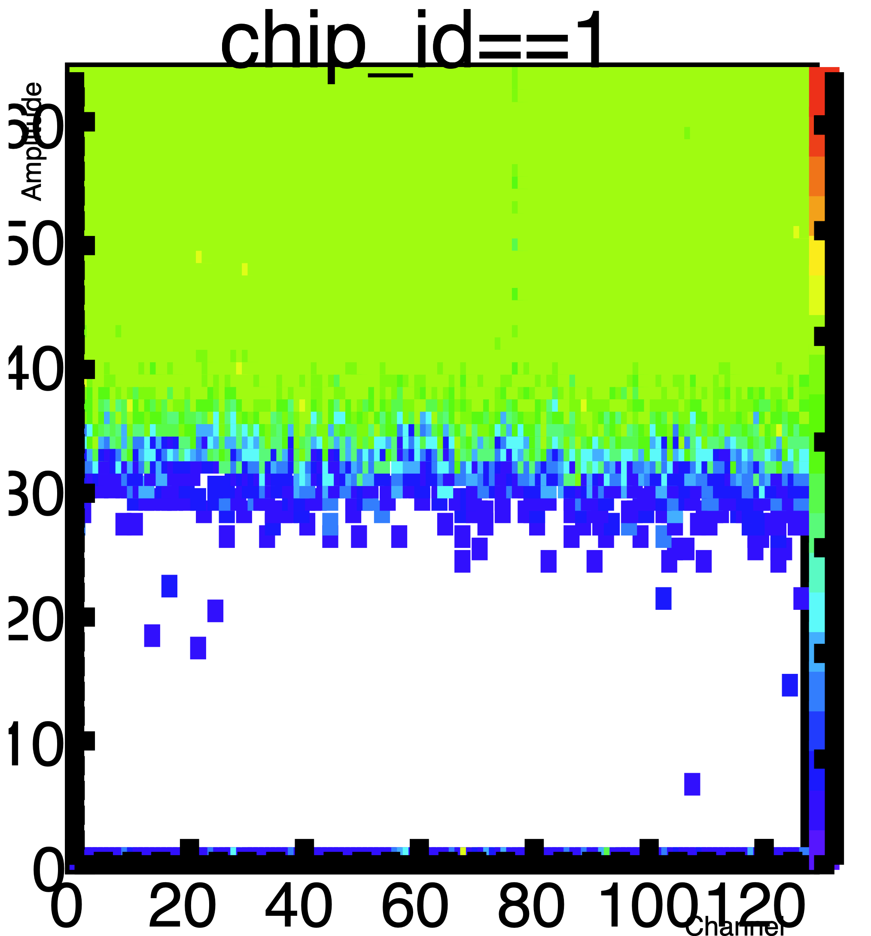
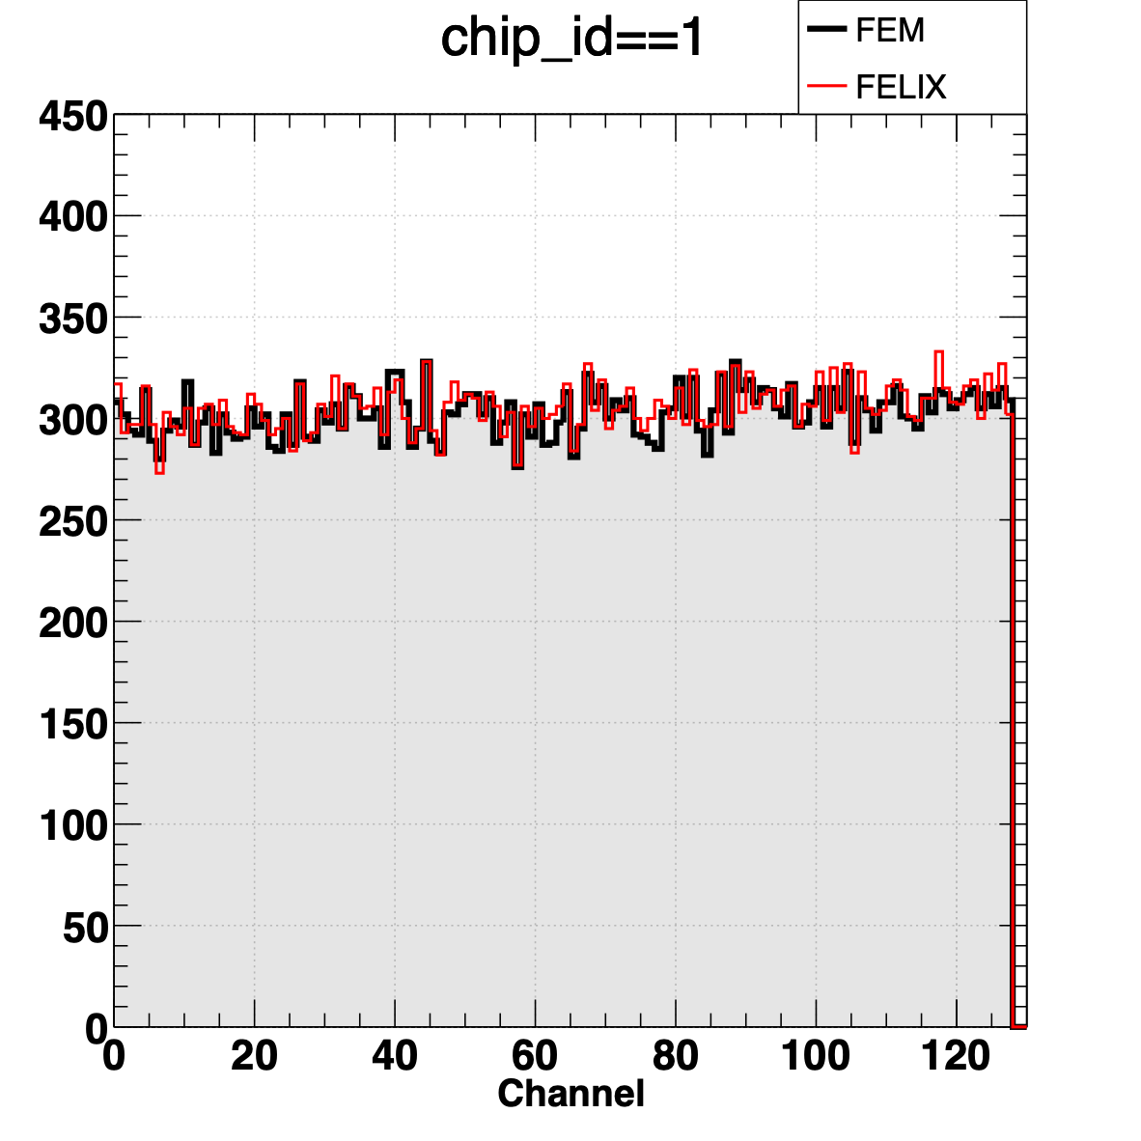
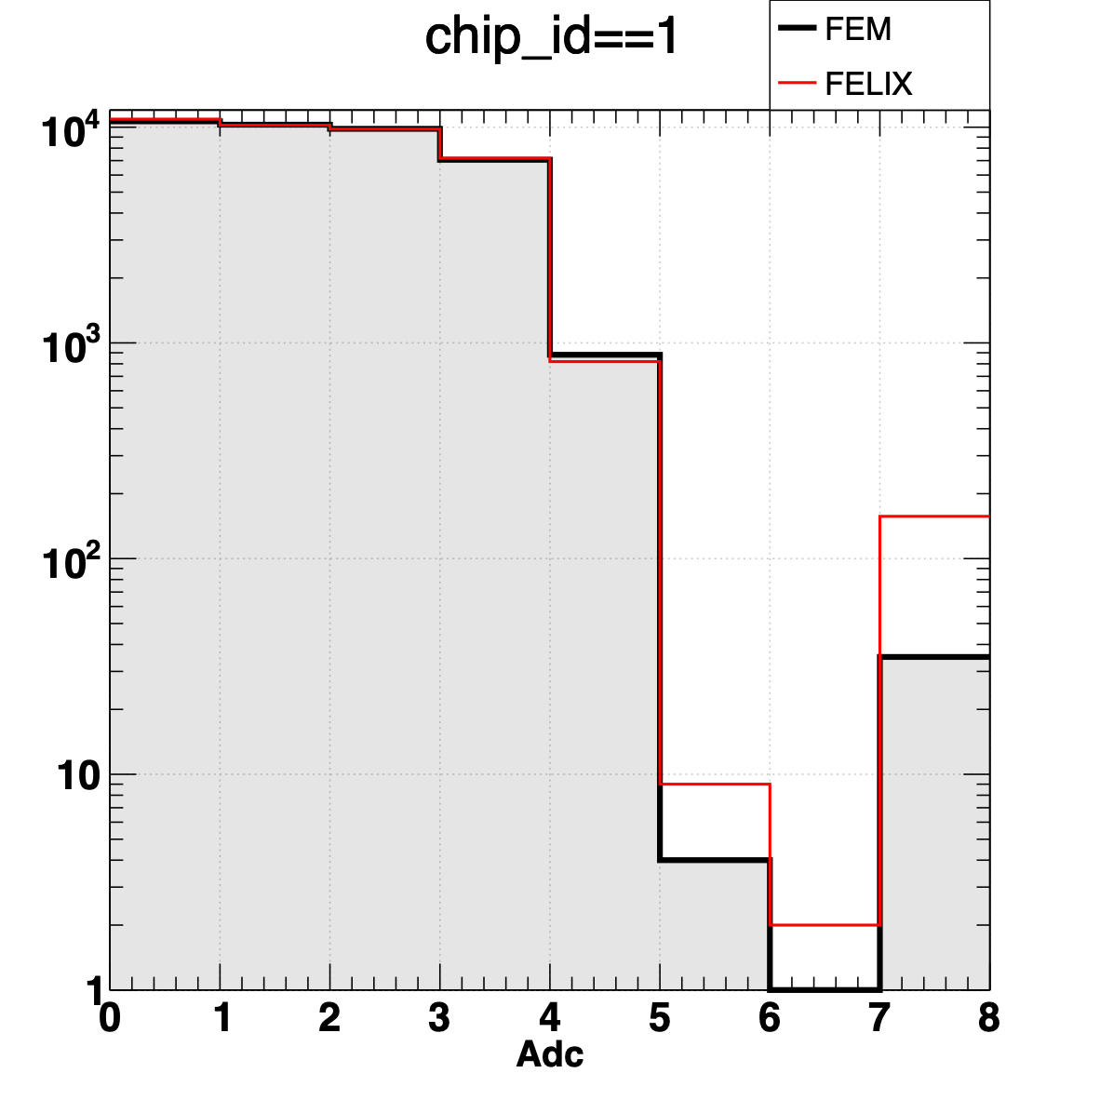
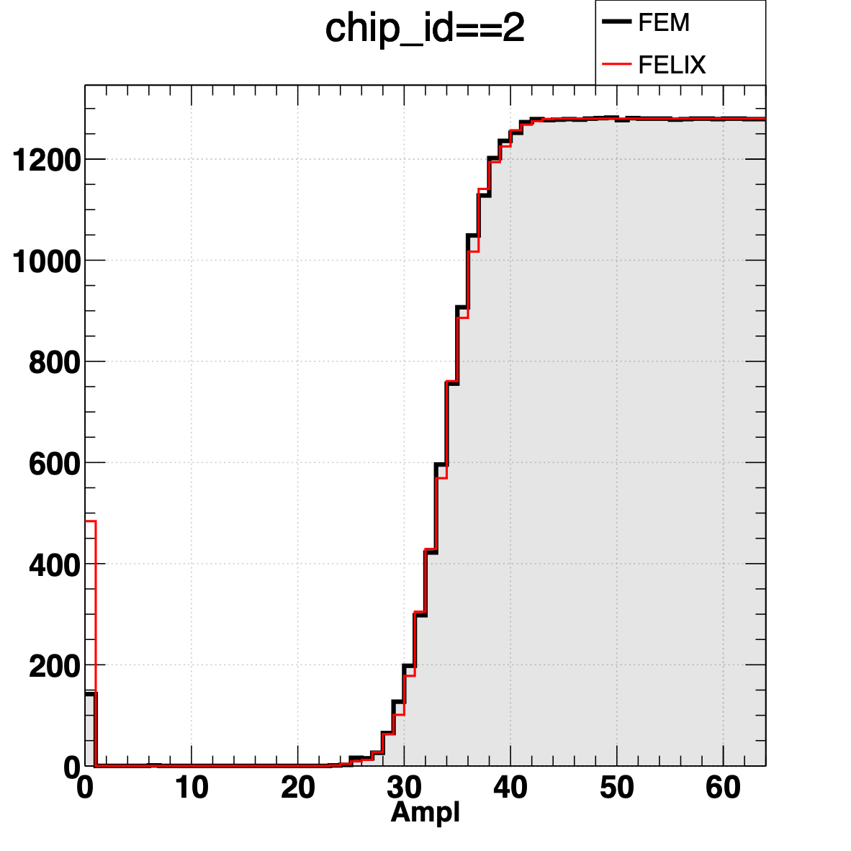
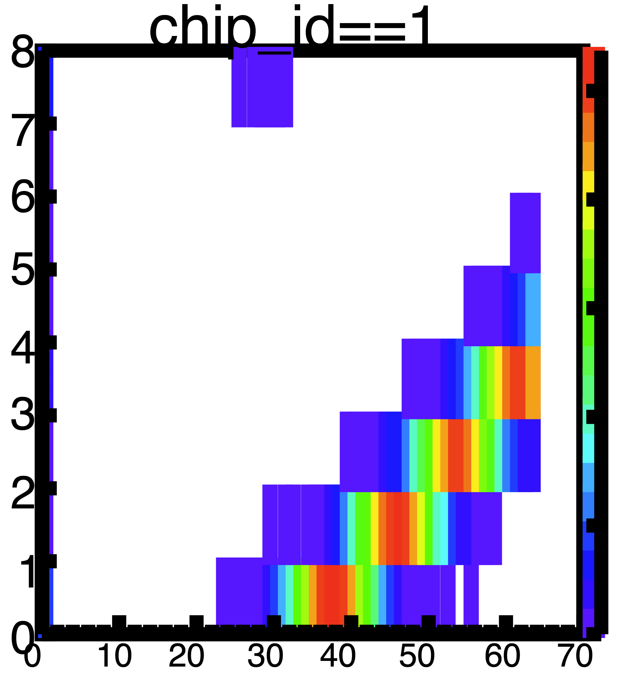
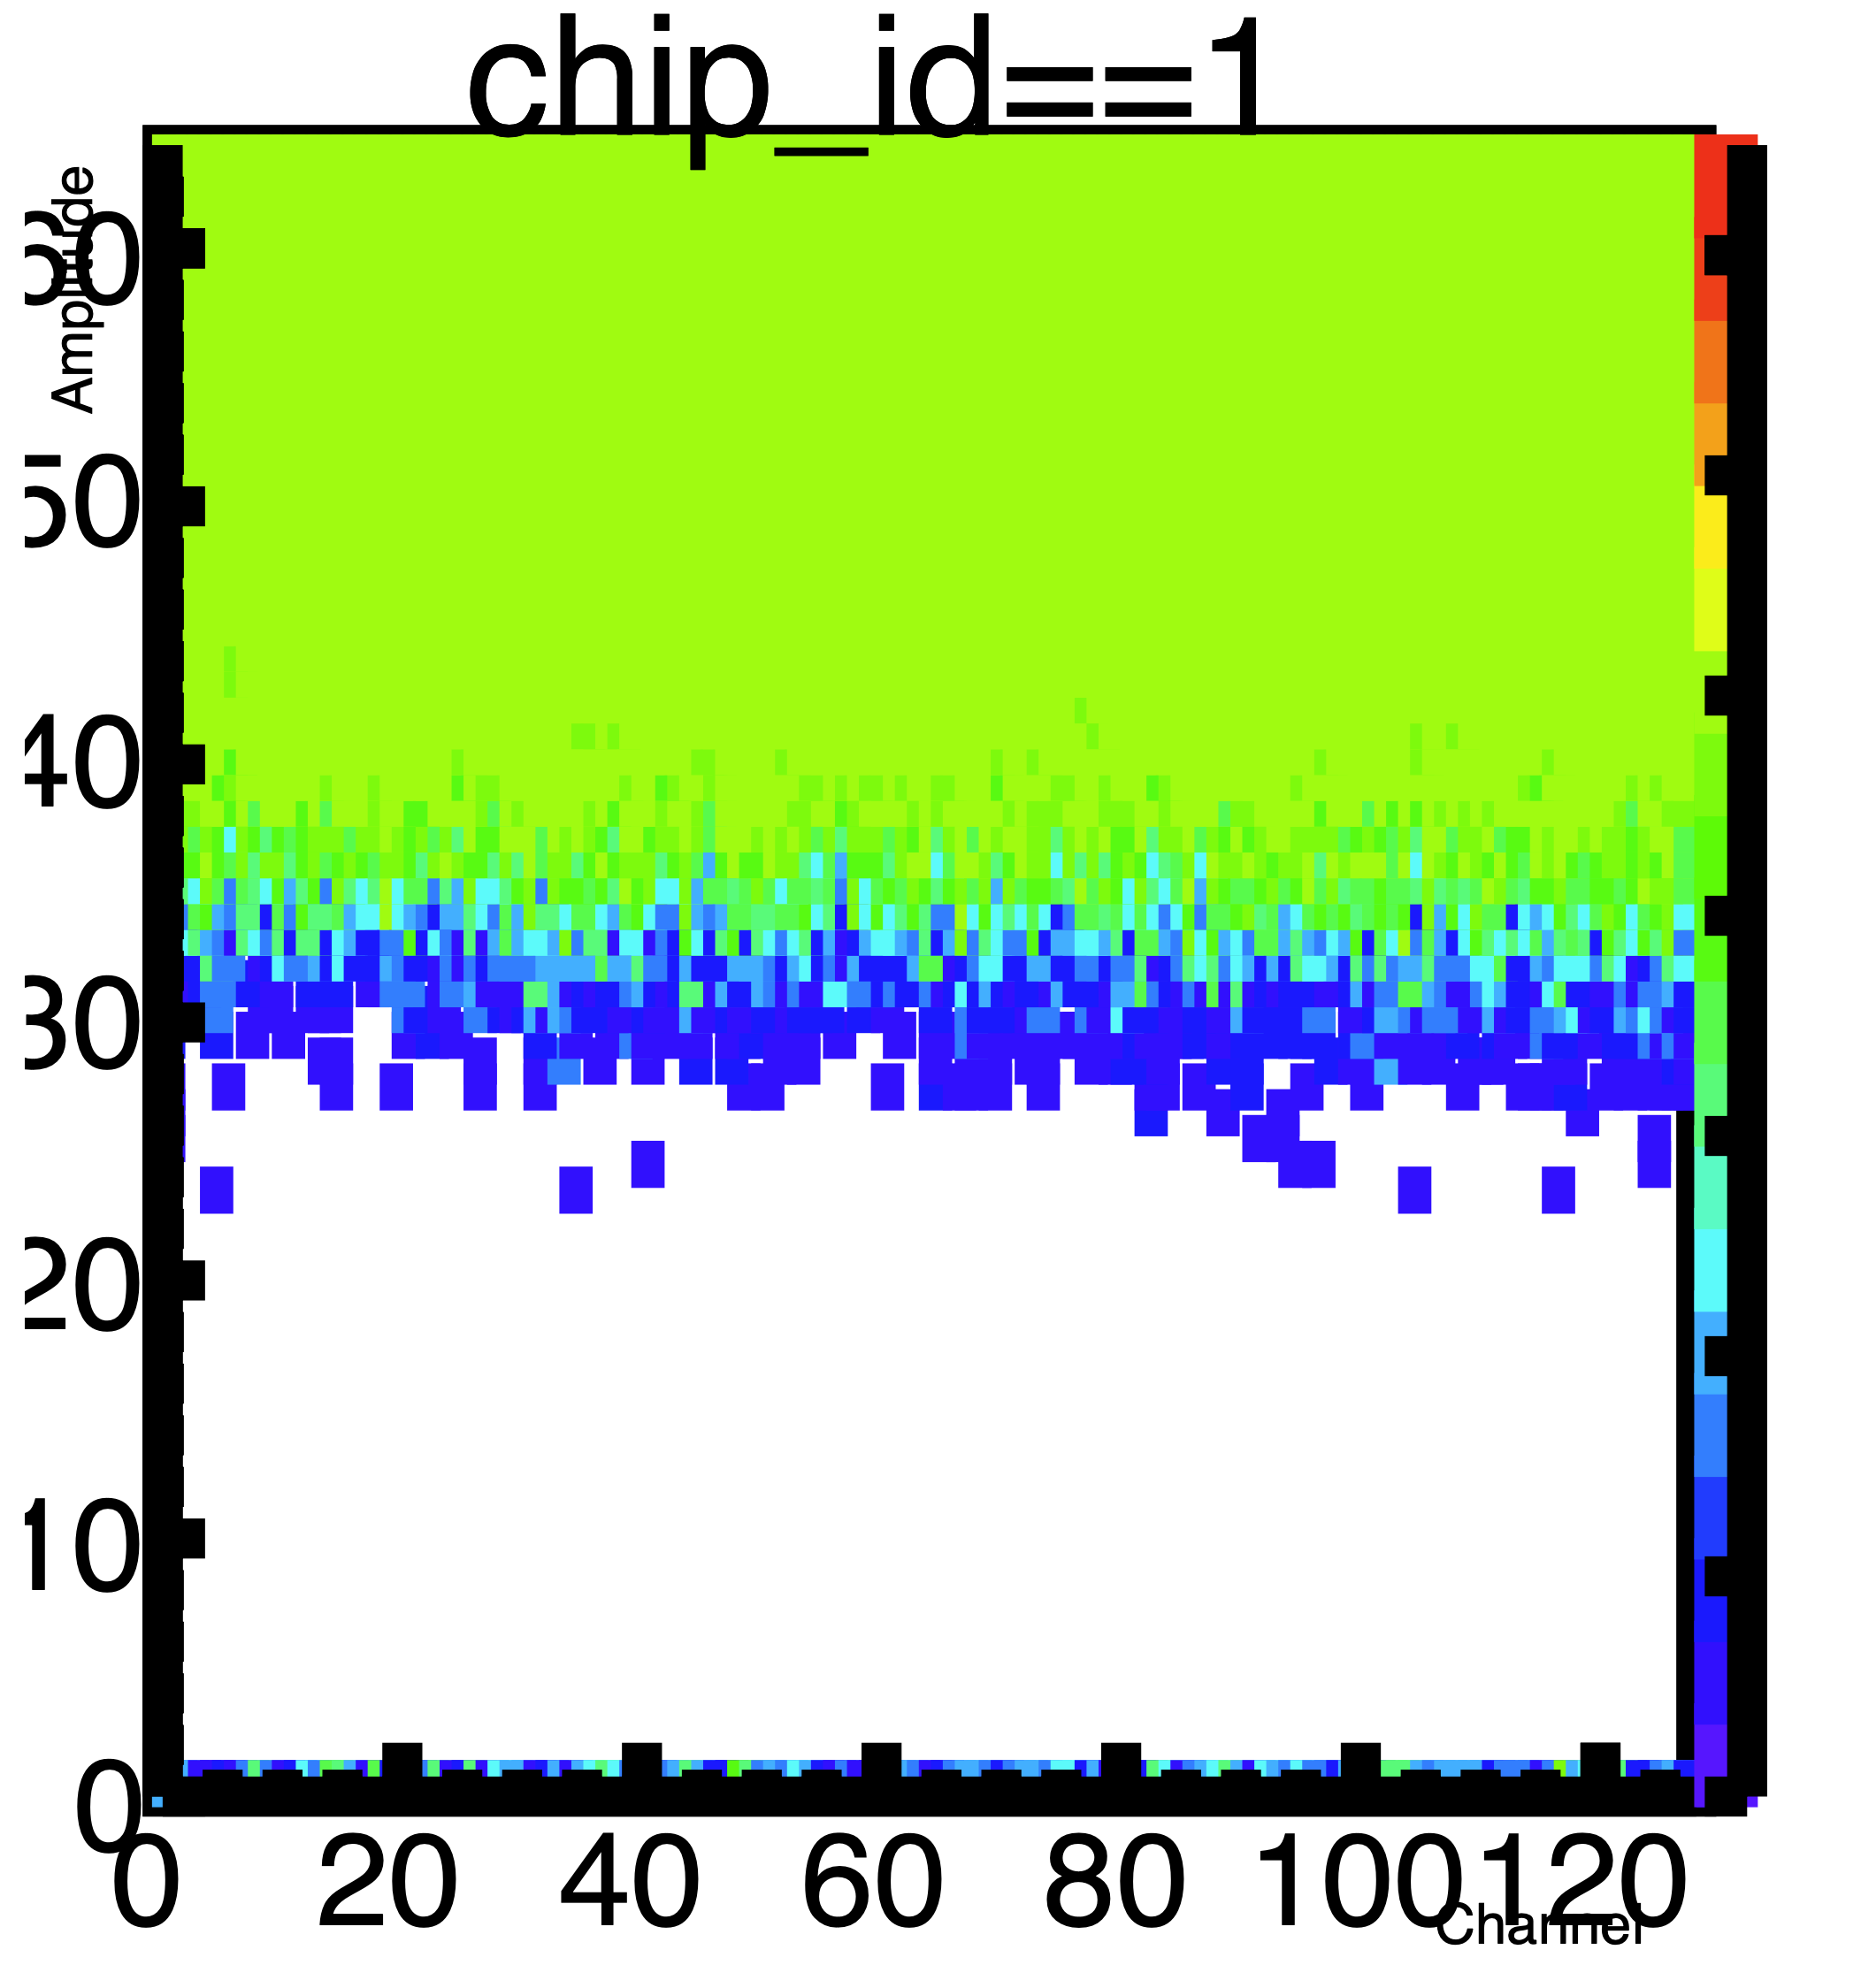
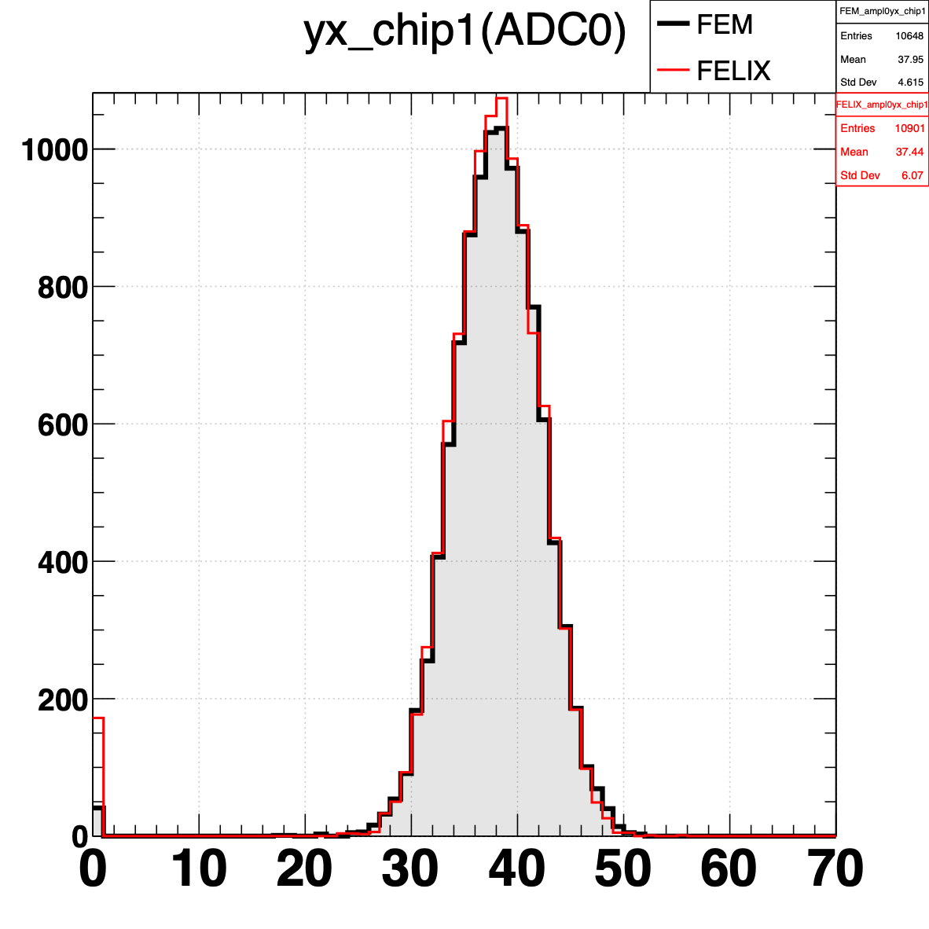
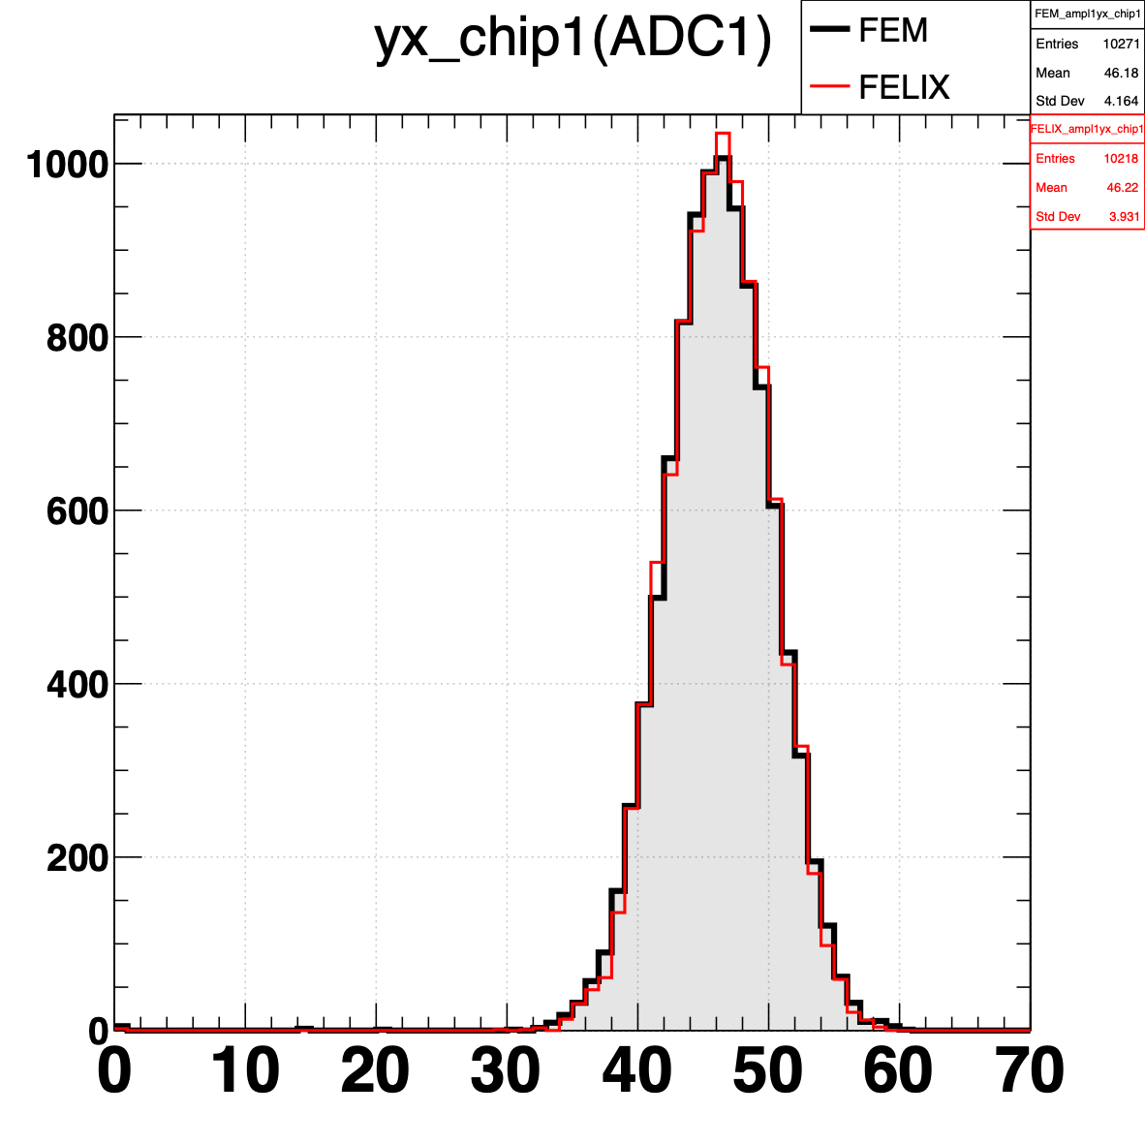
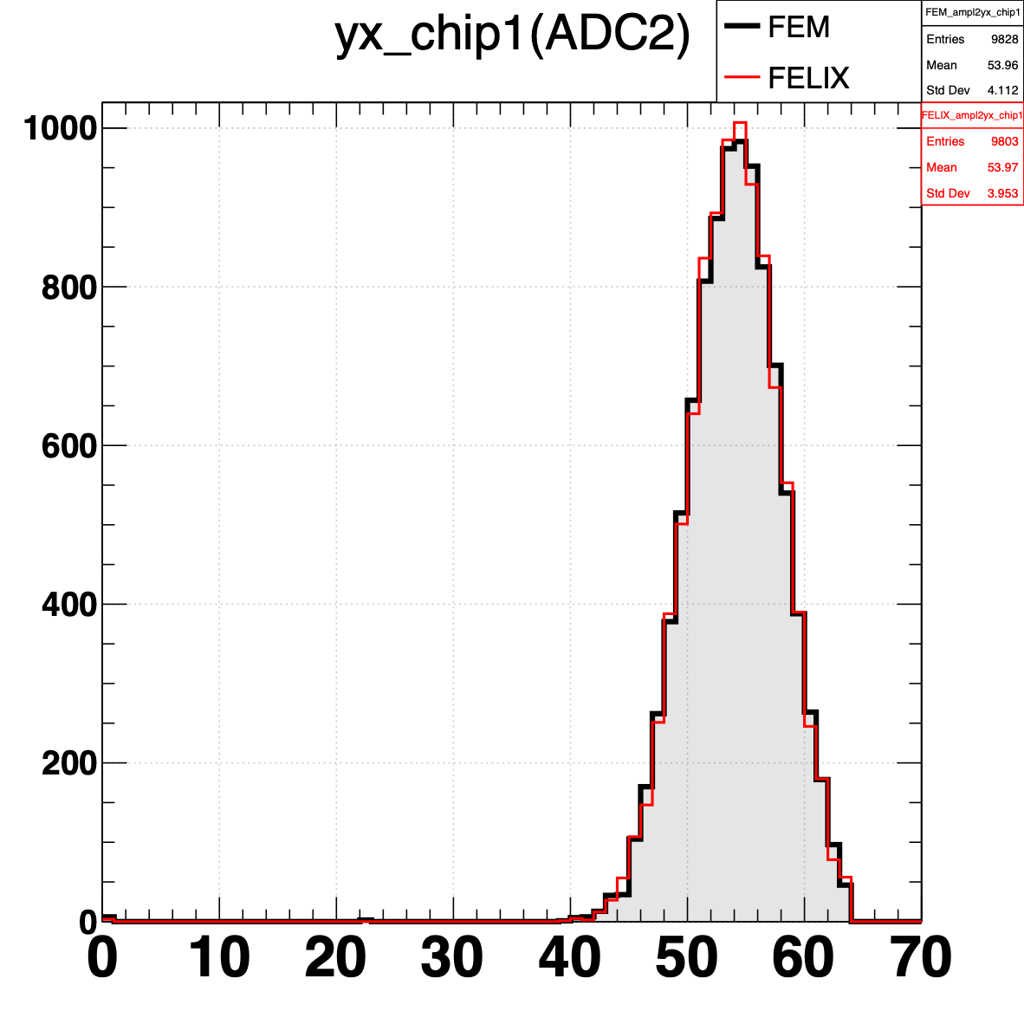
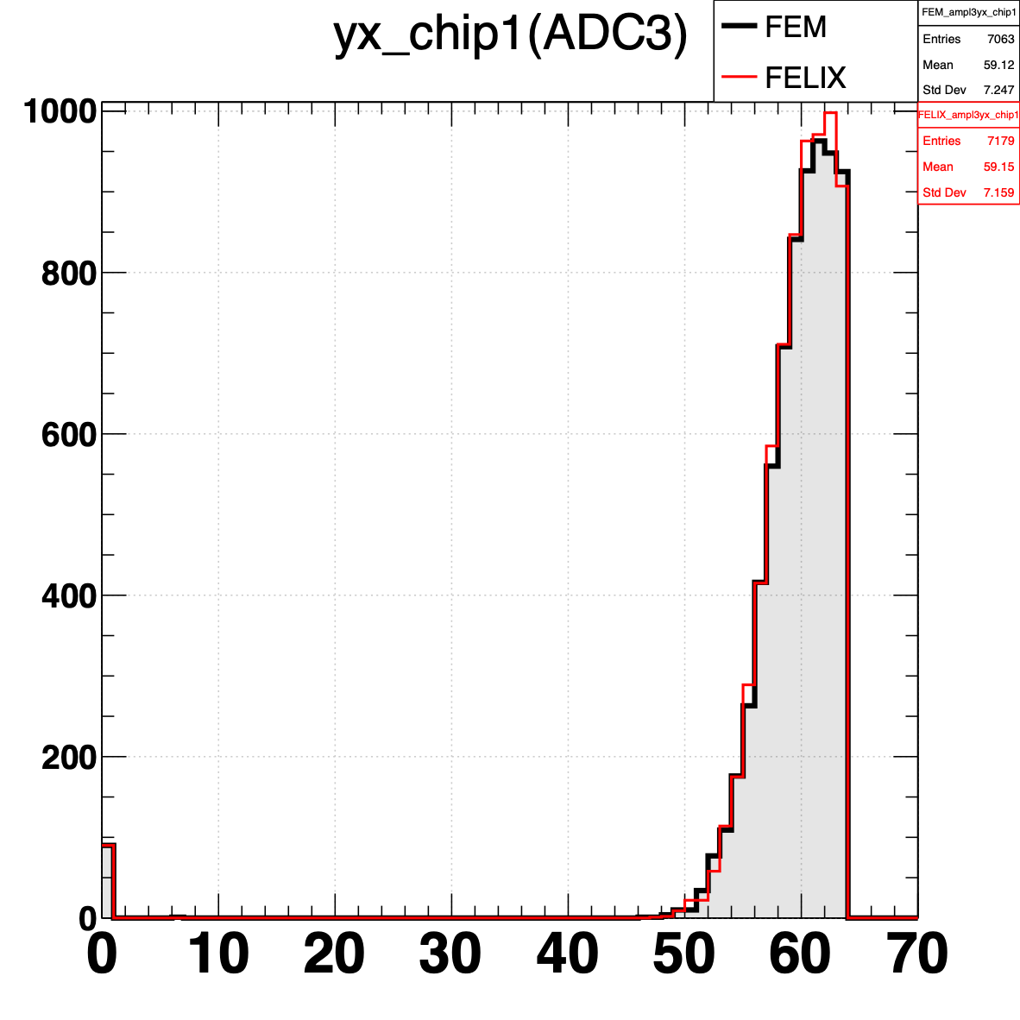
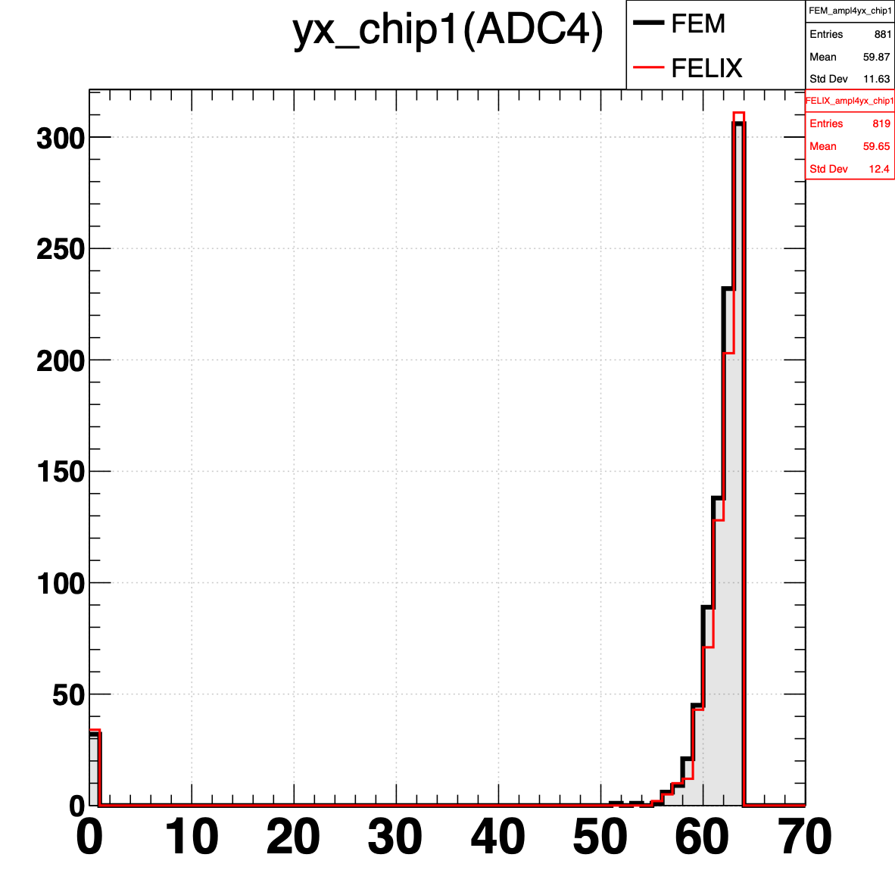
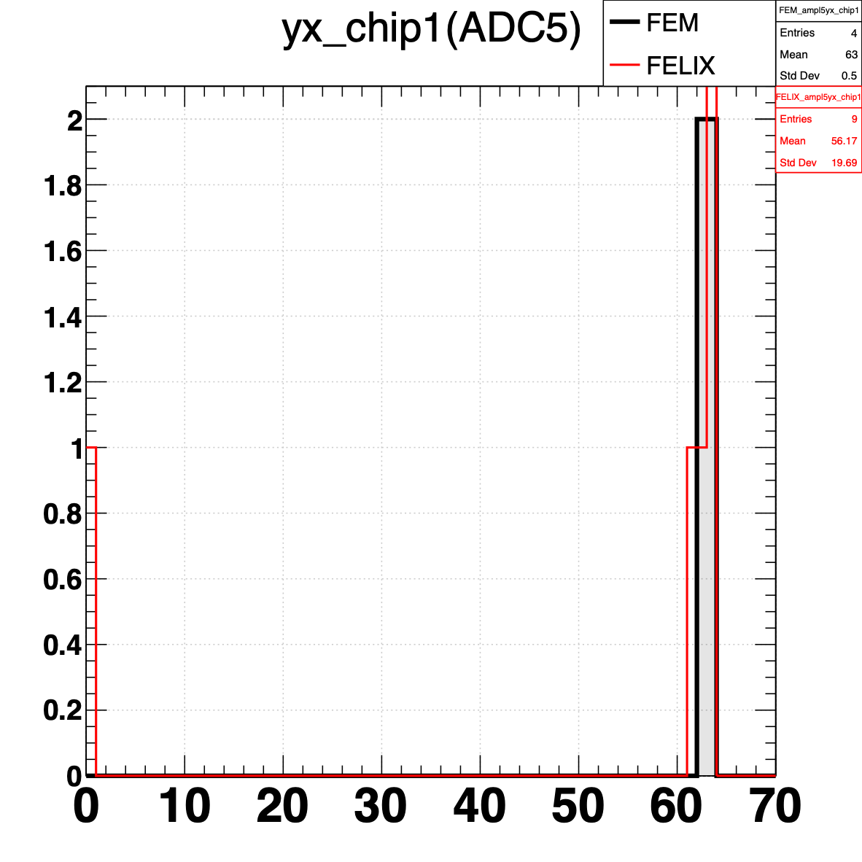
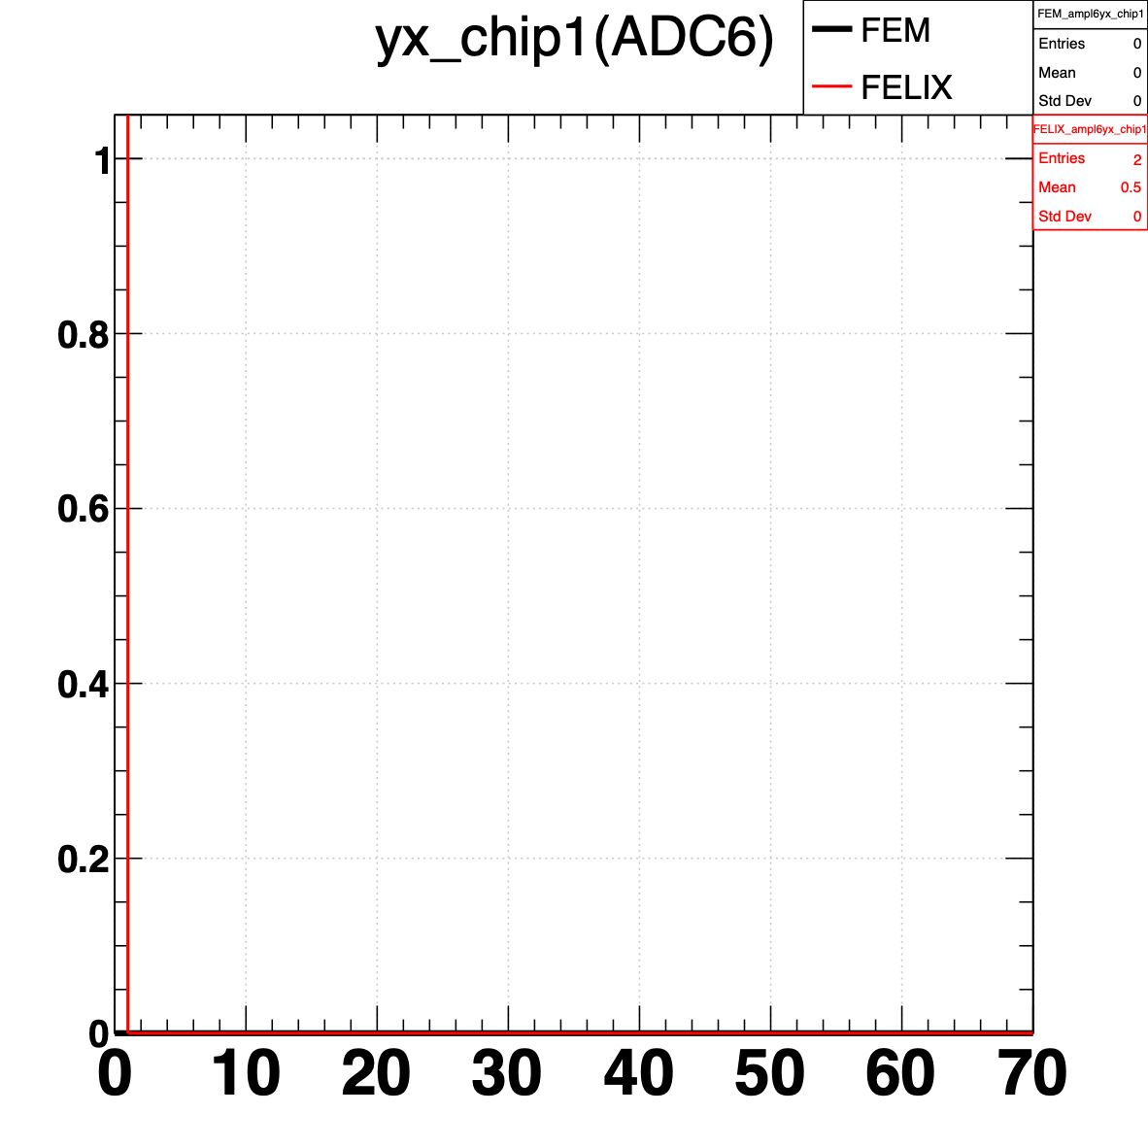
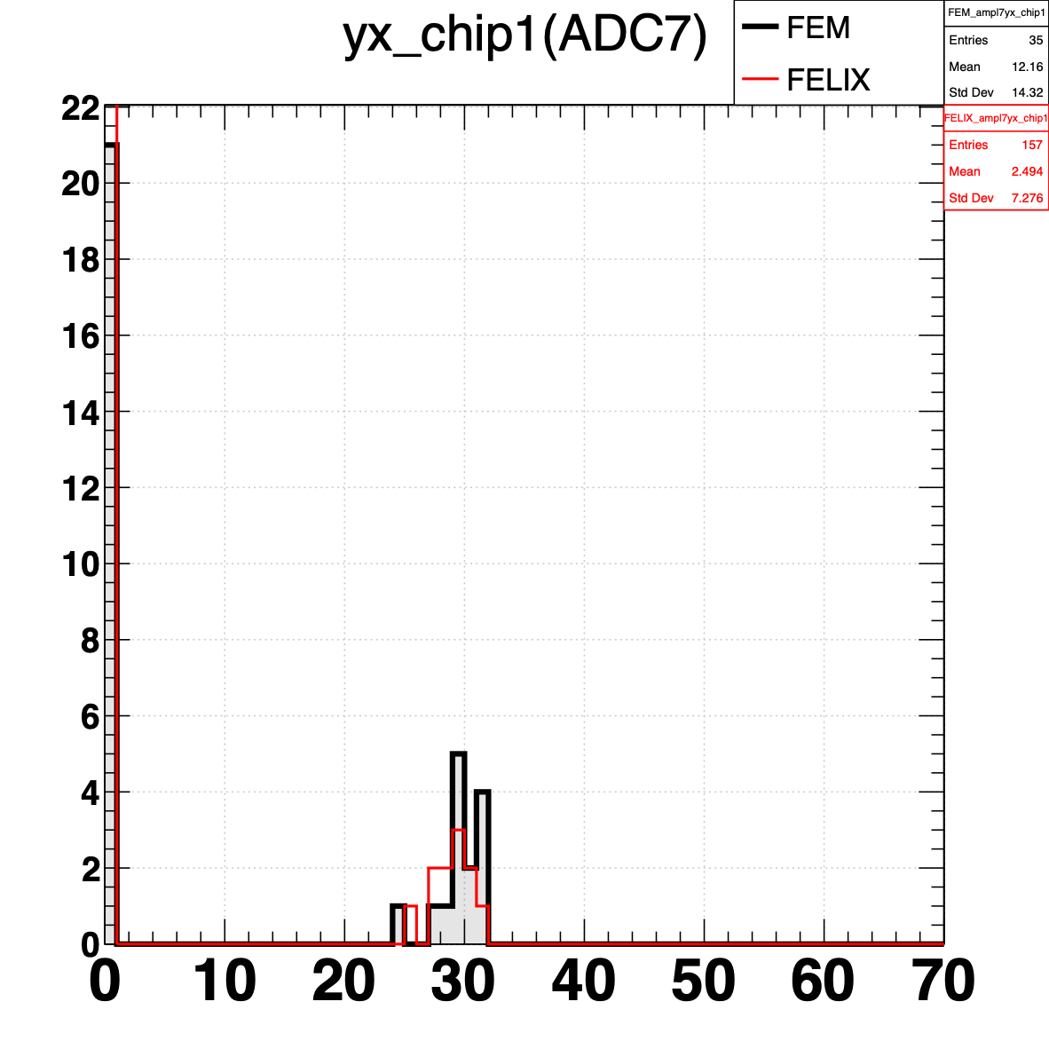
Results: Comparison, focusing on Chip1
FEM
FELIX
FEM
FEM
Felix
Felix
Amplitude vs ADC
Channel vs Amplitude
Channel dist.
ADC dist.
Amplitude dist.
ADC0
ADC1
ADC2
ADC3
ADC4
ADC5
ADC6
ADC7
Amplitude distributions with ADC selection
The results from the FELIX system are consistent with FEM’s.

Slide 7
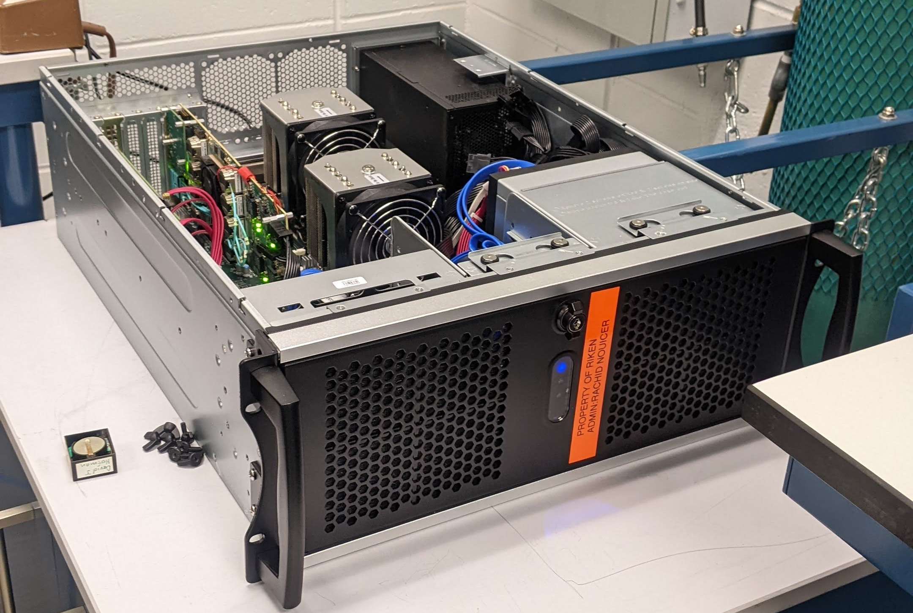
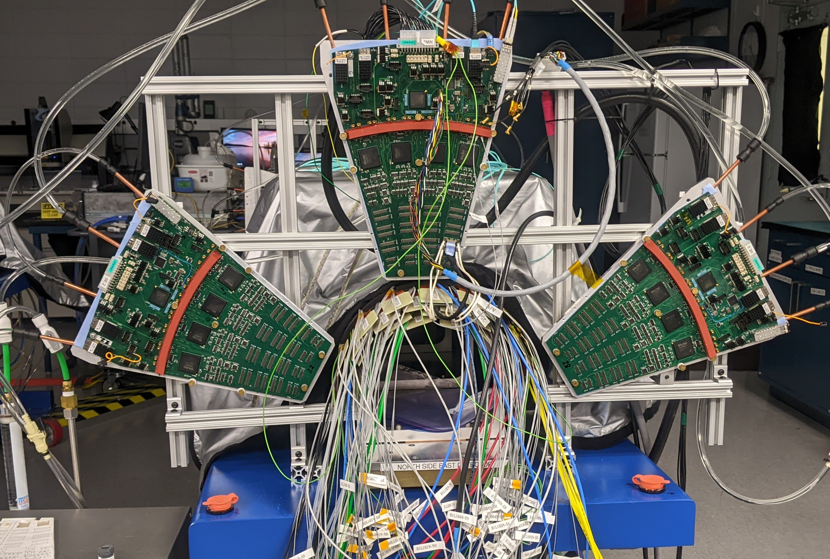
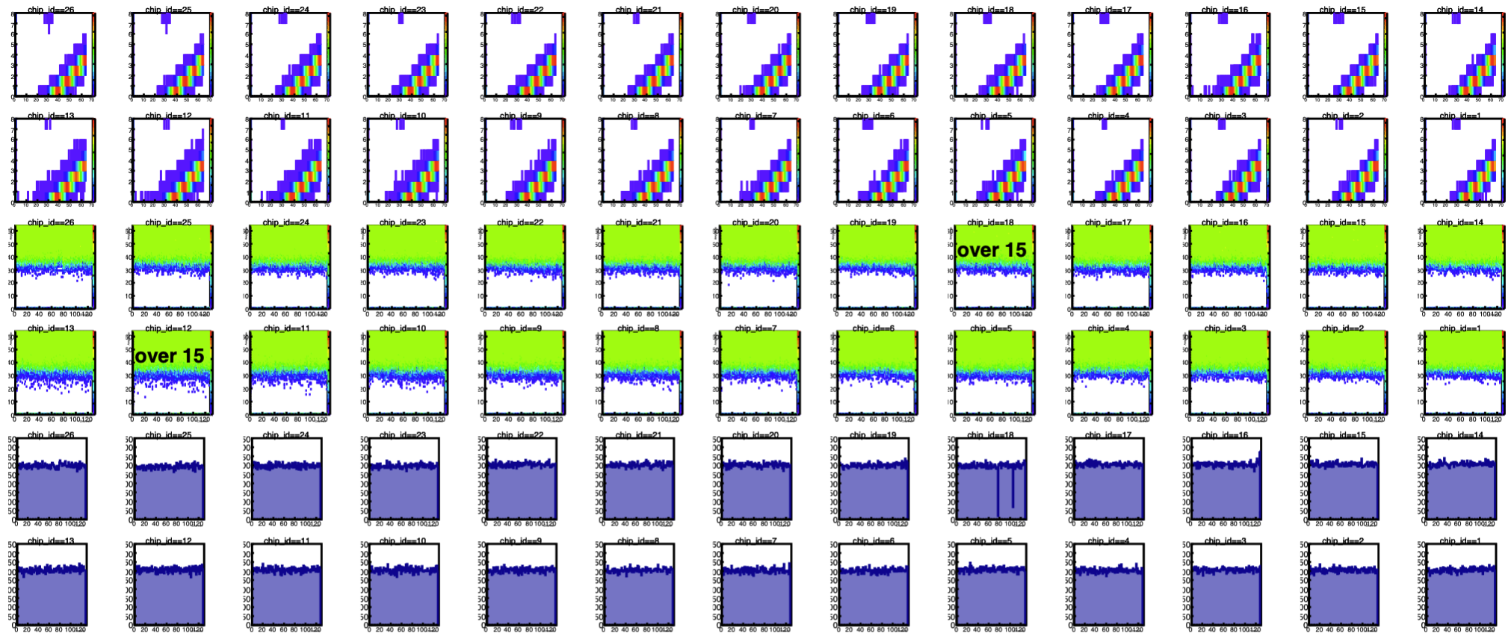
Preparation of the 2nd Felix server
2nd Felix Server
Basic configuration was done
Output from the FELIX
Python dictionary
ROOT file
TTree
- FELIX DAQ: READY
- GUI: NOT READY
File conversion script by Python
READY
Slow Control, BCO, Start
and DATA fibers
ROOT macro for plots
READY
2nd Felix server is almost ready. GUI is needed.

