Slide 1
dRICH Vessel Analysis
Engineer: C. Taylor
Approver: P. Orfin
Date: 25 Aug 2021

Slide 2
Outline
Summary
Technical Requirements
Analysis
Closed Form Calculation
Material Comparison
Analysis w/ Beam Tube
Division 1 PV Code
Analysis w/ Div. 1 Geometry
Recommendations

Slide 3
Summary
dRICH Vessel Analysis

Slide 4
Executive Summary
A conceptual study was performed to determine the structural requirements of a vacuum vessel containing sensitive equipment used in the dRICH and analyzed for feasibility.
The space envelope of the vessel defined by the ATHENA P-0.0 configuration is roughly Ø4.00m x 1.30m in length with flat ends.
ANSYS and closed form calculations show that the wall thickness for an aluminum vessel would be roughly 10.0cm and weigh 11 tons! This result is driven mainly by the deformation limit required to reduce the impact of alignment errors induced by backbone deformations.
PV Elite concluded that a 316 stainless steel vessel with 9cm thick ends with a 1.14cm thick cylinder wall weighing 21 tons would be required to meet the conservative division 1 code.
Alternative geometries were investigated along with various material selections with the goal of reducing the material required for the vessel. It was determined that the preferred geometry using two torispherical ends would NOT fit within the required space envelope. For this reason, a combination of one flat and one torispherical end was investigated.

Slide 5
Executive Summary – cont’d
The PV Elite results for the flat and torispherical end combination resulted in a 316 stainless steel vessel with a flat end wall thickness of 9.8 cm, torispherical wall of 1.4 cm and a cylinder wall of 1.0 cm weighing 13.4 tons.
Recommendations are provided at this end of this report.

Slide 6
Technical Requirements
dRICH Vessel Analysis

Slide 7
Specifications
Source: S. Dalla Torre, 11 August 2021 Presentation
Entrance and exit walls can deform up to 1-2 cm
Entrance and exit wall deformation should not induce backbone deformations
Lateral walls can be thick and rigid (sensor – backbone interface)
Gas radiator pressure <= 3 bar (absolute)
Sensor operating temperature = 30-40°C
Material must be nonmagnetic

Slide 8
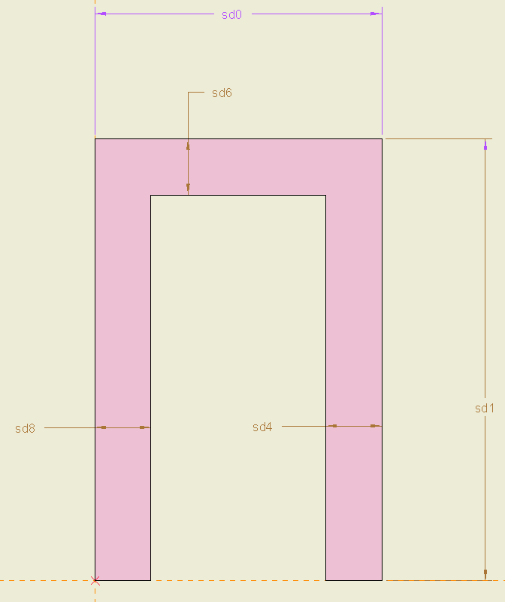
Geometry
Vessel Shape
I.D. | Value (cm) | Description
sd0 | 130 | Length
sd1 | 200 | Radius
sd4 | Varied | Endcap
sd6 | Varied | Wall
sd8 | = sd4 | Endcap
Beam Tube

Slide 9
Analysis
Static Structural using Design of Experiments in ANSYS 2021 R2

Slide 10
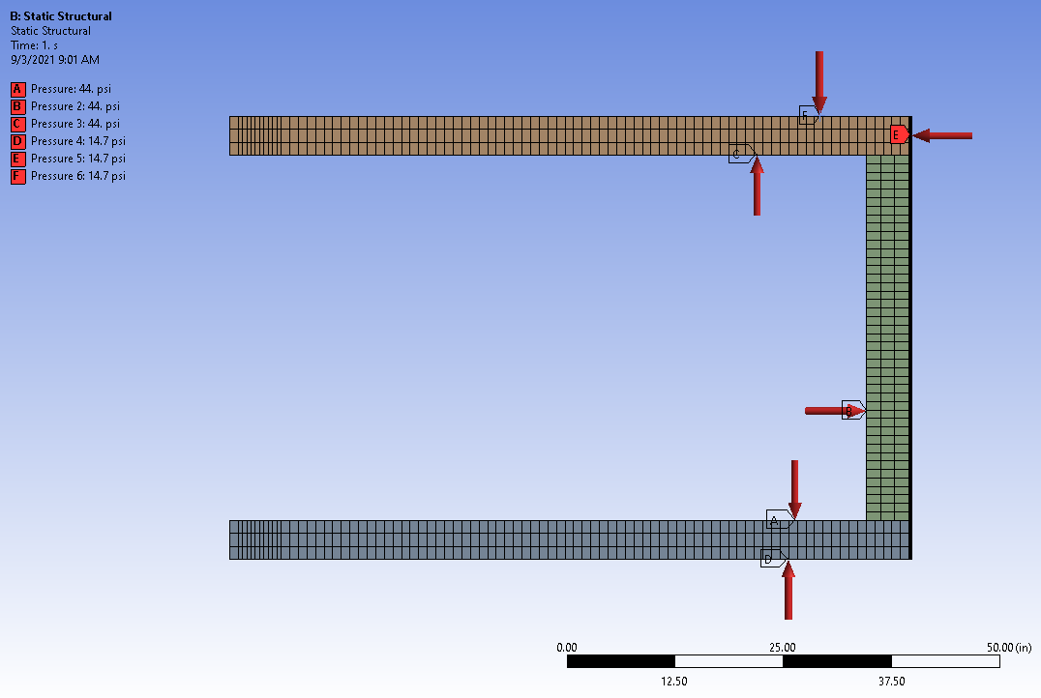
Load Conditions
Cyclic Region Symmetry
Analysis was performed using a 5° wedge divided into 3 sections such that the endcap and vessel wall could be analyzed individually
Weak springs were allowed for this analysis
3 elements through the wall thickness were maintained as dimensions were varied
Analysis does not include gravity
14.7 psi
Beam Tube
3 bar (absolute)

Slide 11
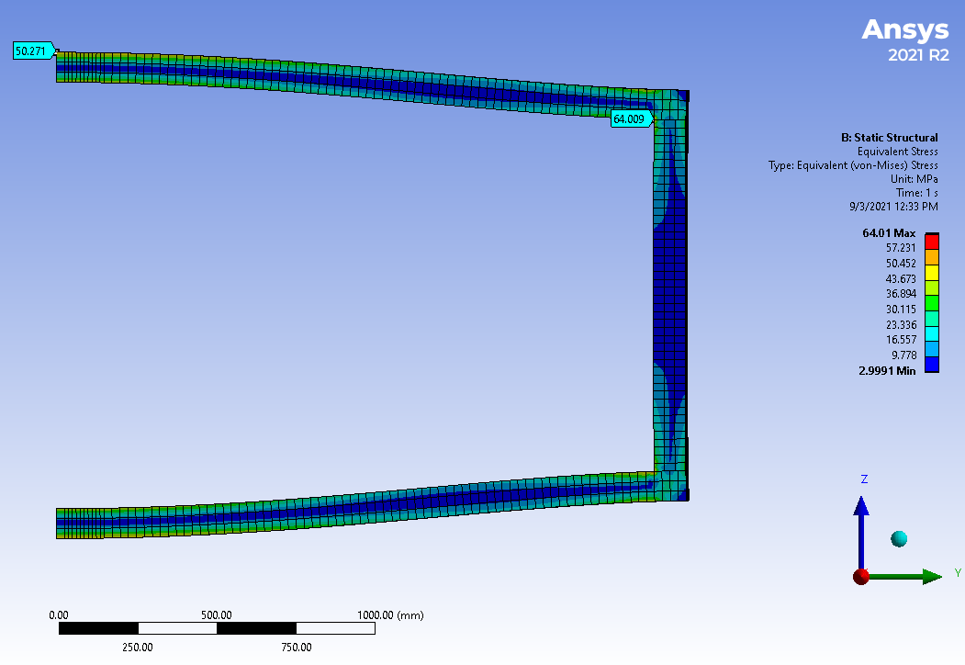
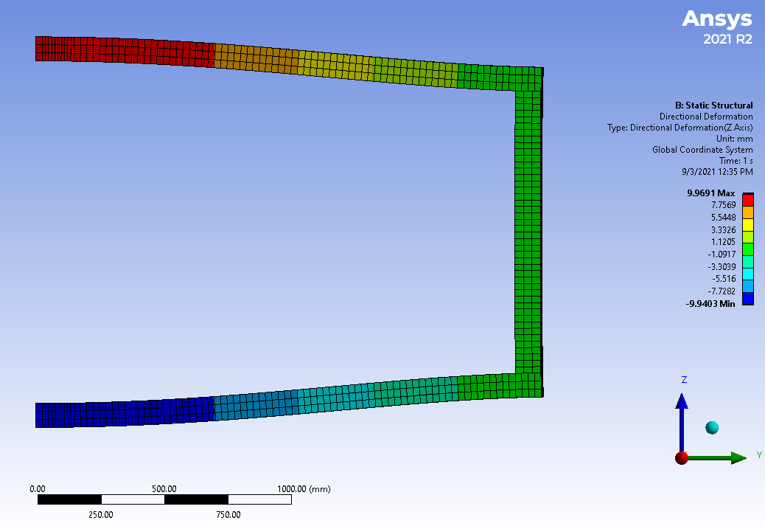
Static Structural Results
Beam Tube
Beam Tube
σ_{max} = 64.0 MPa , σ_{center} = 50.3 MPa
Δ_{Z-dir} = +/- 1.0 cm
Note: Results are shown for a 11.1 ton Aluminum 6061-T6 vessel with 9.5 cm [3.74 in] endcaps and a 10.0 cm [3.94 in] wall thickness

Slide 12
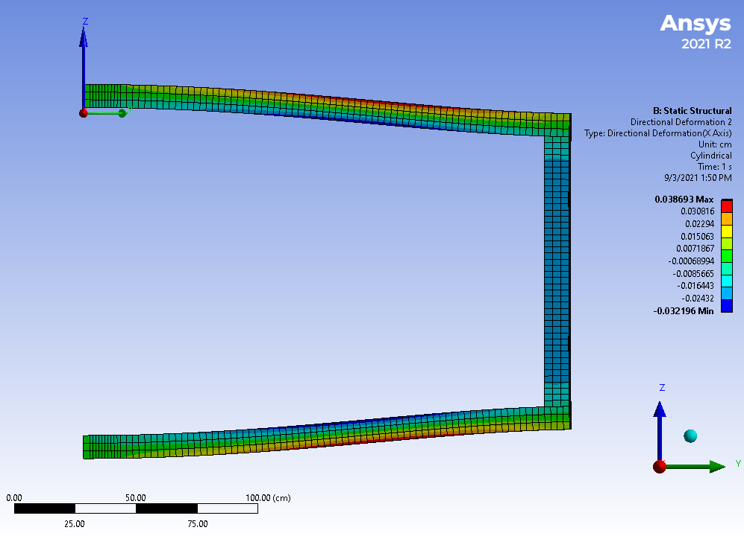
Radial Deformation
Cylindrical CSYS
The maximum radial deflection of the vessel wall is .039 cm when analyzing an aluminum vessel with 9.5 cm thick endcaps and 10.0 cm thick vessel walls. This will need to be considered when designing the backbone support.
Deformation is measured in the X-Dir on a cylindrical coordinate system.
Deformation
Beam Tube

Slide 13
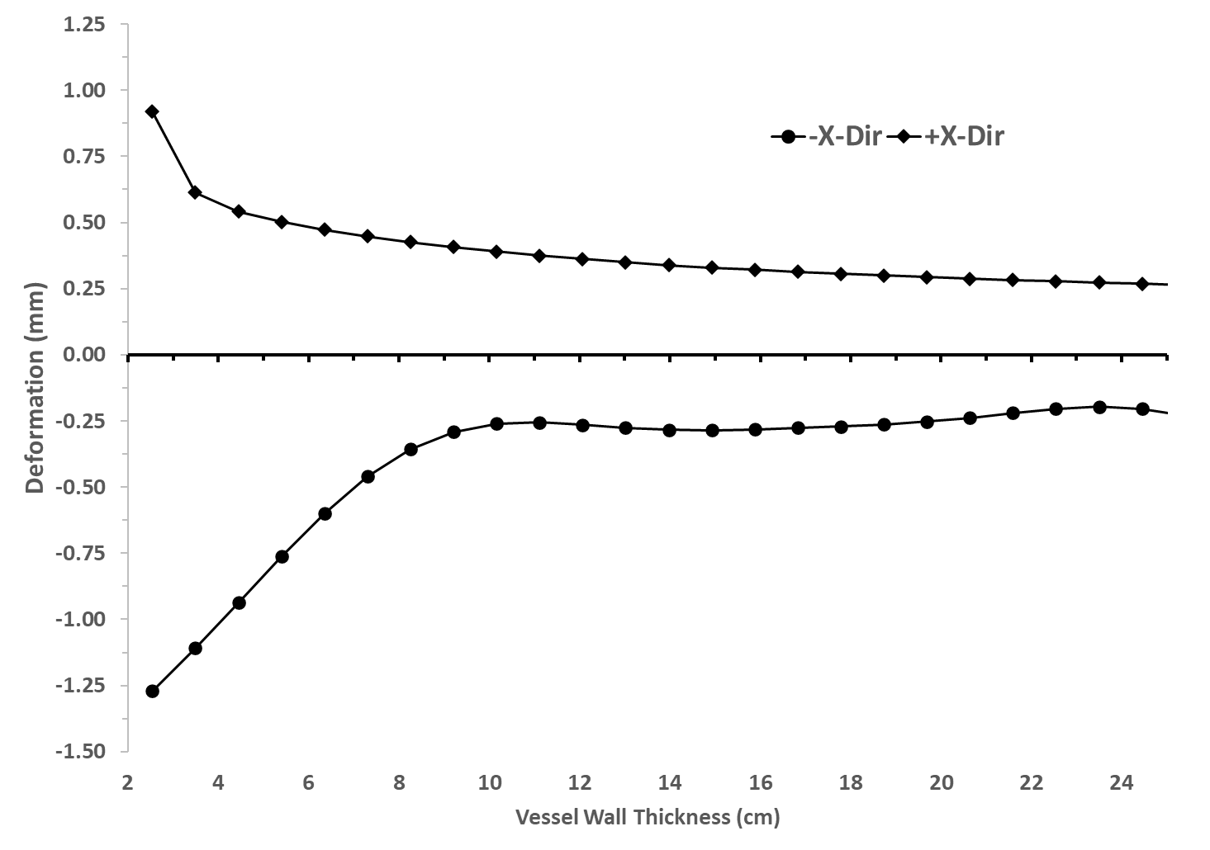
Radial Deformation vs. Wall Thickness
A 10 cm thick aluminum vessel wall was selected as a baseline for comparison

Slide 14
Closed Form Calculation
ANSYS results are verified using Mathcad

Slide 15
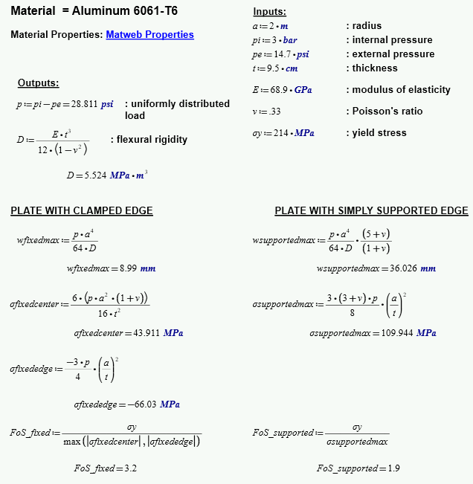
Calculations
ANSYS results agree with closed form calculations bounded by 2 different sets of boundary conditions, fixed edge and simply supported. Results align more closely with fixed edge as expected suggesting a factor of safety of ~ 3 for an aluminum endcap 9.5 cm thick.
 | ANSYS | Mathcad | %Diff
Deflection (cm) | 1.00 | 0.90 | 10%
Center Stress (MPa) | 50.3 | 43.9 | 13%
Fixed Edge Stress (MPa) | 64.0 | 66.0 | -3%

Slide 16
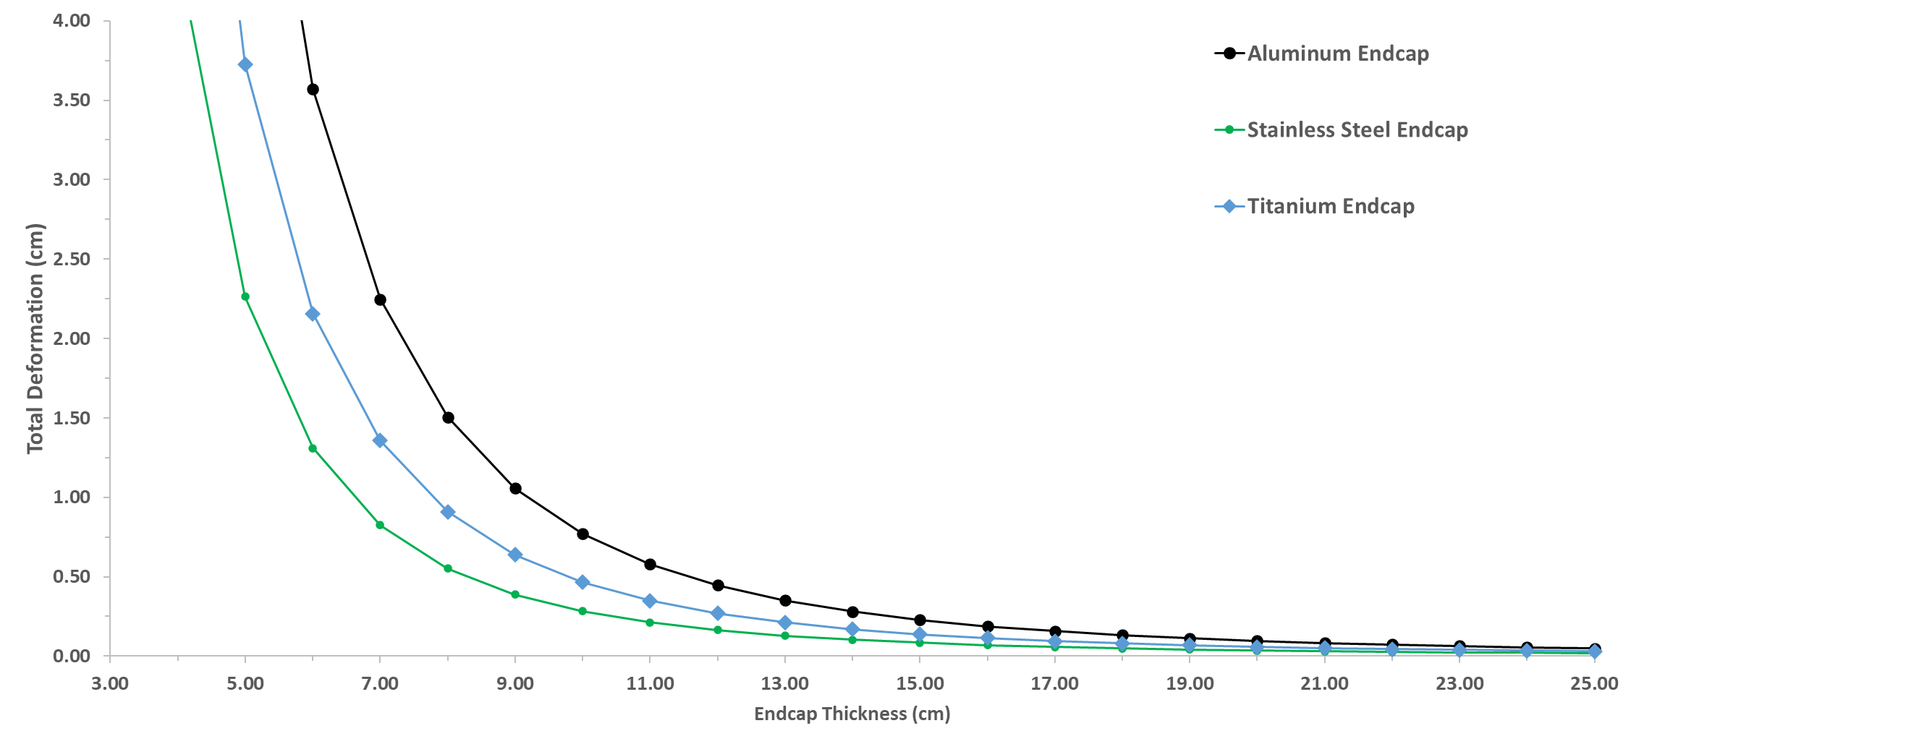
Endcap thickness vs. Deformation
Specified allowance

Slide 17
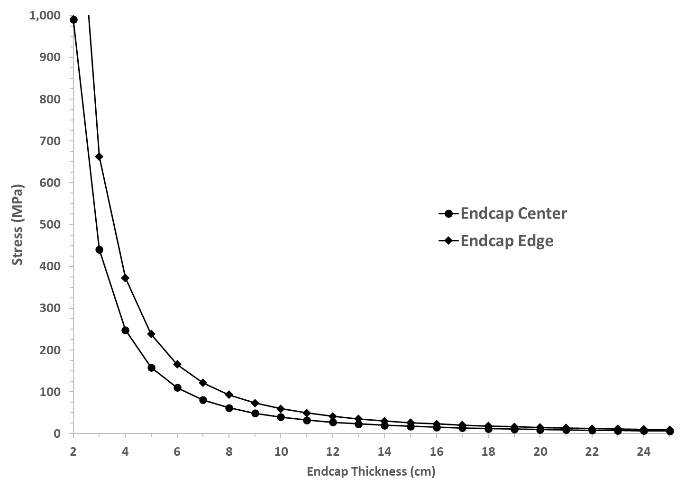
Endcap Thickness vs. Stress
Titanium Ti-6Al-4V (Grade 5) Yield Stress
Titanium (Grade 12) Yield Stress
Aluminum 6061-T6 Yield Stress
304 Stainless Steel Yield Stress

Slide 18
Material Comparison
Material properties were obtained from MatWeb.com

Slide 19
Strength to weight comparisons
Radius | 200 | cm
Endplate Thickness | 9.5 | cm
Vessel Wall Thickness | 10 | cm
Length | 130 | cm
Volume | 3.75 | m^3
 | Density | Weight |  | Yield Strength
 | (kg/m^3) | (kg) | (sh.tn.) | (MPa)
Aluminum 6061-T6 | 2698.8 | 10114.0 | 11.1 | 276
Titanium Ti-6Al-4V (Grade 5) | 4428.8 | 16597.3 | 18.3 | 880
Titanium (Grade 12) | 4511.8 | 16908.5 | 18.6 | 380
304 Stainless Steel | 7999.5 | 29978.9 | 33.0 | 215

Slide 20
Analysis w/ Beam Tube
Static structural analysis repeated with Ø8.00 x 1.00 thick beam tube included using Ansys 2021 R2

Slide 21
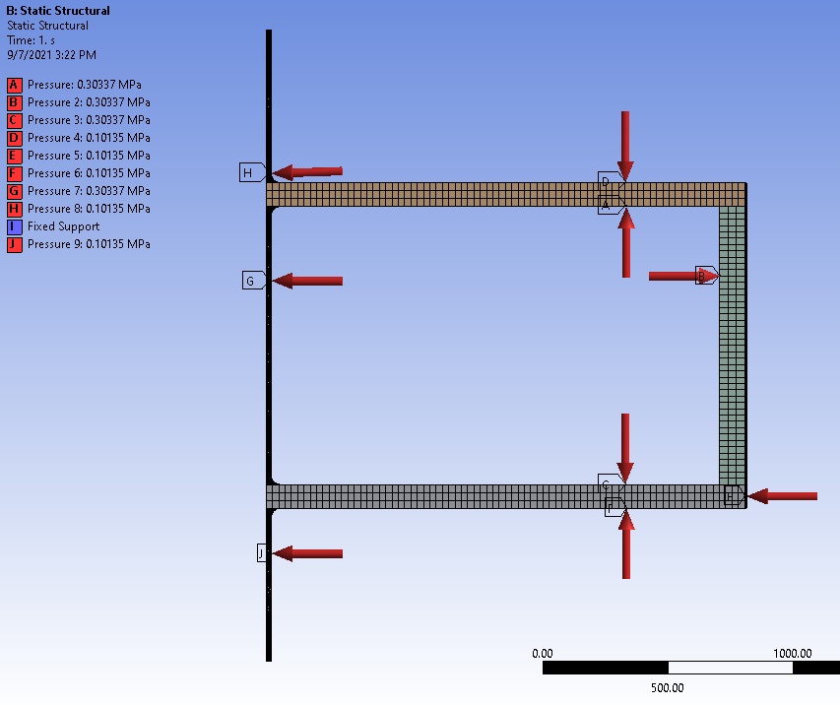
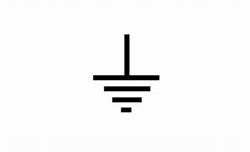
Load Conditions
Cyclic Region Symmetry
Analysis was performed using a 5° wedge divided into 3 sections such that the endcap and vessel wall could be analyzed individually
Weak springs were allowed for this analysis
3 elements through the wall thickness were maintained as dimensions were varied
Analysis does not include gravity
14.7 psi
3 bar (absolute)
Ultra-High Vacuum

Slide 22
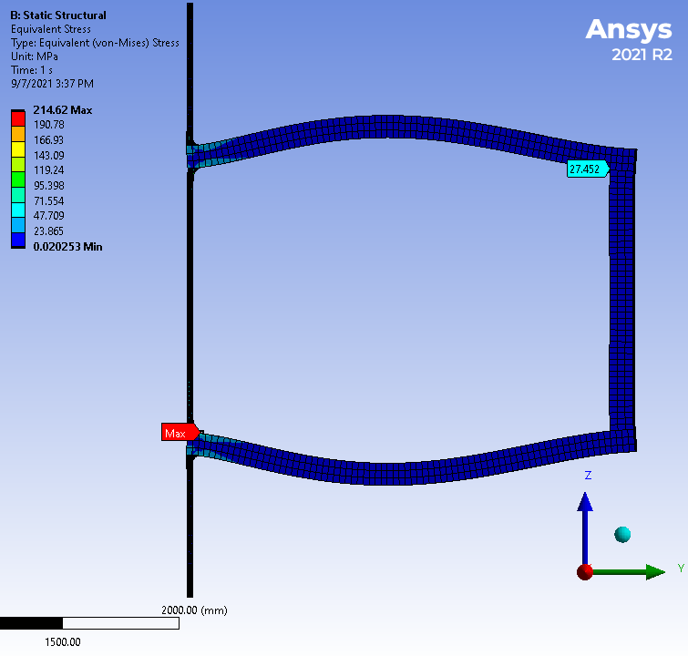
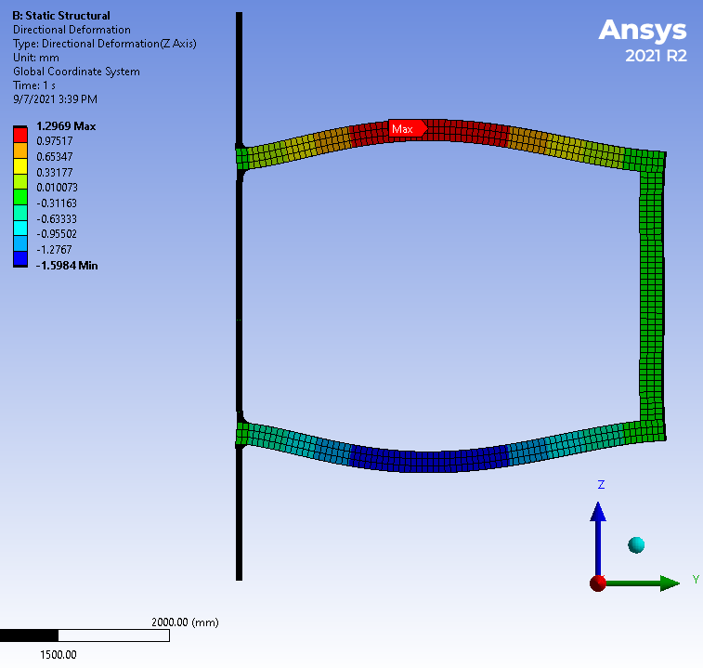
Static Structural Results
Beam Tube
Beam Tube
σ_{max} = 215 MPa
Δ_{Z-dir} = +/- 0.13 cm
Note: Results are shown for an aluminum 6061-T6 vessel with 9.5 cm [3.74 in] endcaps and a 10.0 cm [3.94 in] wall thickness including an Ø8.00 x 1.00 thick 304 stainless steel beam tube

Slide 23
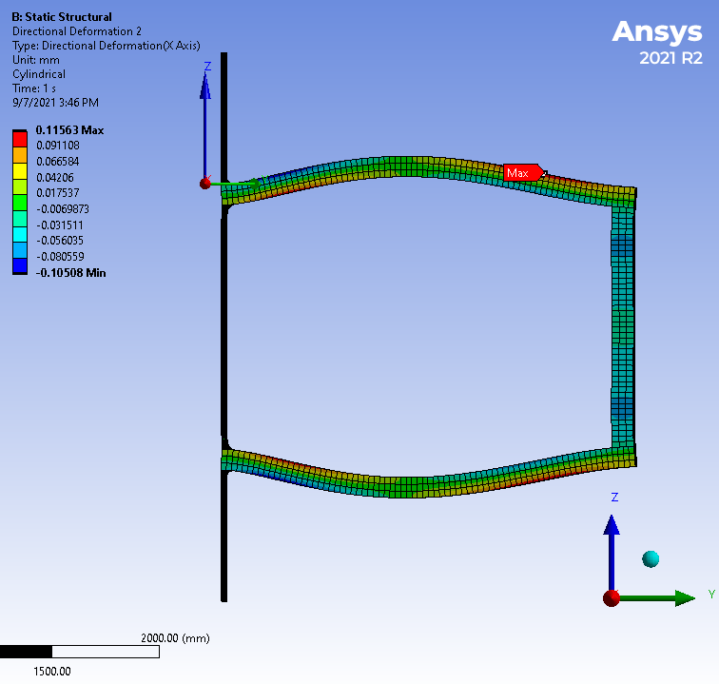
Radial Deformation
Cylindrical CSYS
The maximum radial deflection of the vessel wall is .012 cm when analyzing an aluminum vessel with 9.5 cm thick endcaps and 10.0 cm thick vessel walls. This will need to be considered when designing the backbone support.
Deformation is measured in the X-Dir on a cylindrical coordinate system.
Deformation
Beam Tube

Slide 24
Division 1 PV Code
Minimum material thickness was determined using PV Elite per Division 1 pressure vessel code requirements

Slide 25
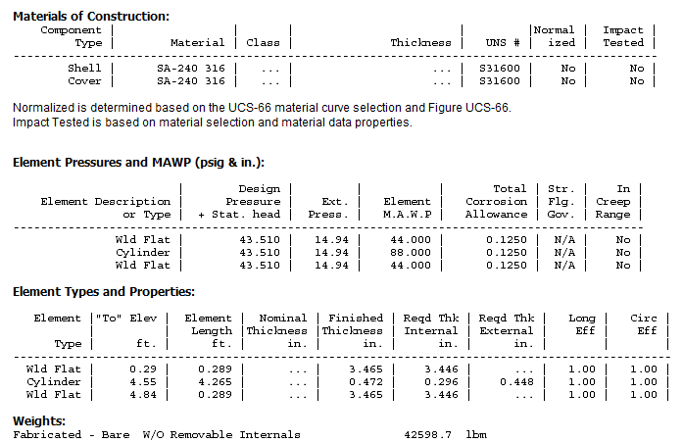
Welded Flat End Results
Beam Tube

Slide 26
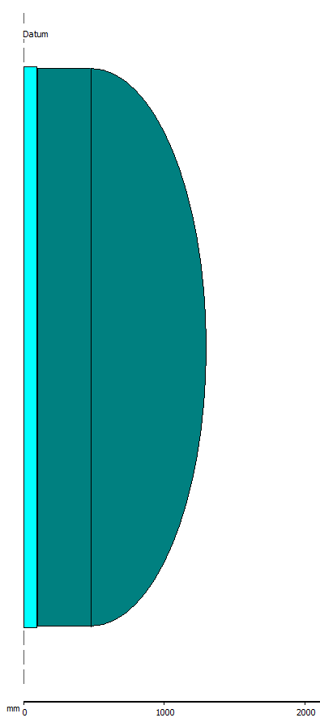
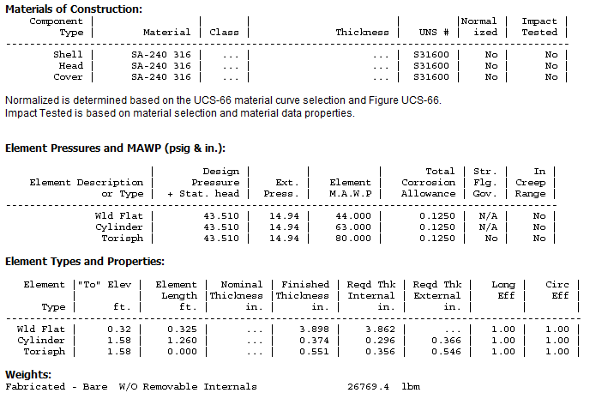
Welded Flat & Torispherical End Results
r = 0.1*D
R = 0.9*D
Beam Tube
W_{316 SST} =
[ 13.4 tons]
W_{titanium} = 15,097.0 lbm [ 7.6 tons]
Note: Aluminum is not advised to to deformations being 3x greater than that of SST

Slide 27
Analysis w/ Div. 1 Geometry
Static structural analysis repeated with geometry determined by PV Elite using Ansys 2021 R2

Slide 28
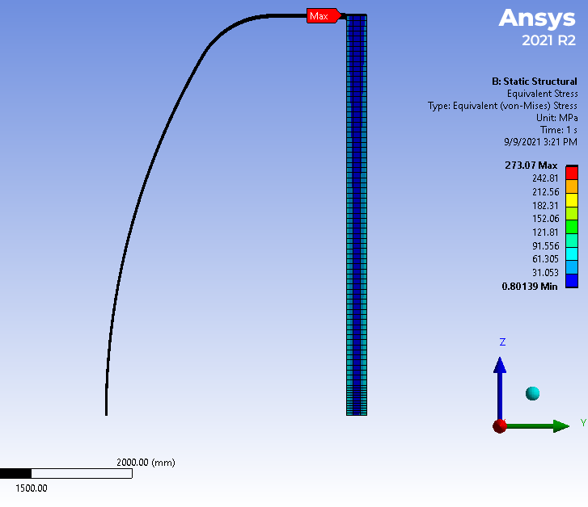
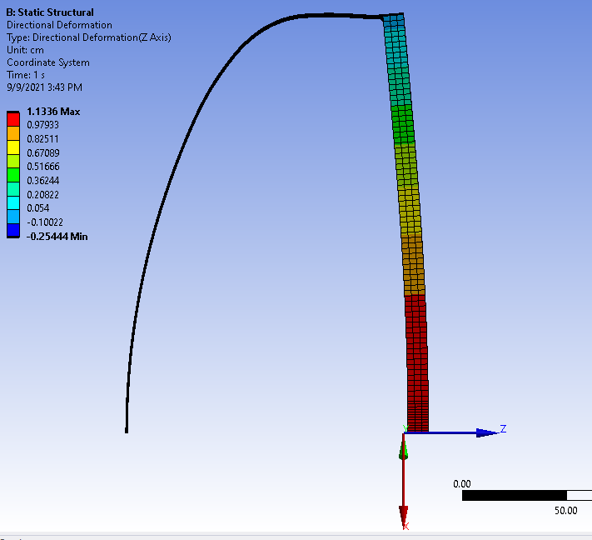
Welded Flat & Torispherical End Results
Beam Tube
Beam Tube
σ_{max} = 273 MPa
Δ_{Z-dir} = +1.13 / -0.25 cm
Note: Results are shown for a 316 stainless steel vessel. Actual maximum stress will be lower due to welds distributing the stress more evenly at the vessel wall and flat plate transition.

Slide 29
Recommendations

Slide 30
Things to consider
Incorporating two torispherical ends would greatly reduce the material requirement however, this would require an increase in the existing space envelope. Further investigation would be necessary to determine the exact amount needed.
Internal structural supports such as ribs would decrease the deformation significantly resulting in a lighter, more optimized vessel. One possible alternative could be strategically integrating the mirror support frame as part of an internal vessel support structure.
Titanium alloys provide an optimal blend of material properties for this application (i.e., strength to weight ratio). A cost vs. benefit analysis would need to be performed to justify this alternative.
Questions / Comments?

Slide 31
Analysis v.2 – 25 Aug 2022 (Ribs Added)
Static Structural using Design of Experiments in ANSYS 2022 R2

Slide 32
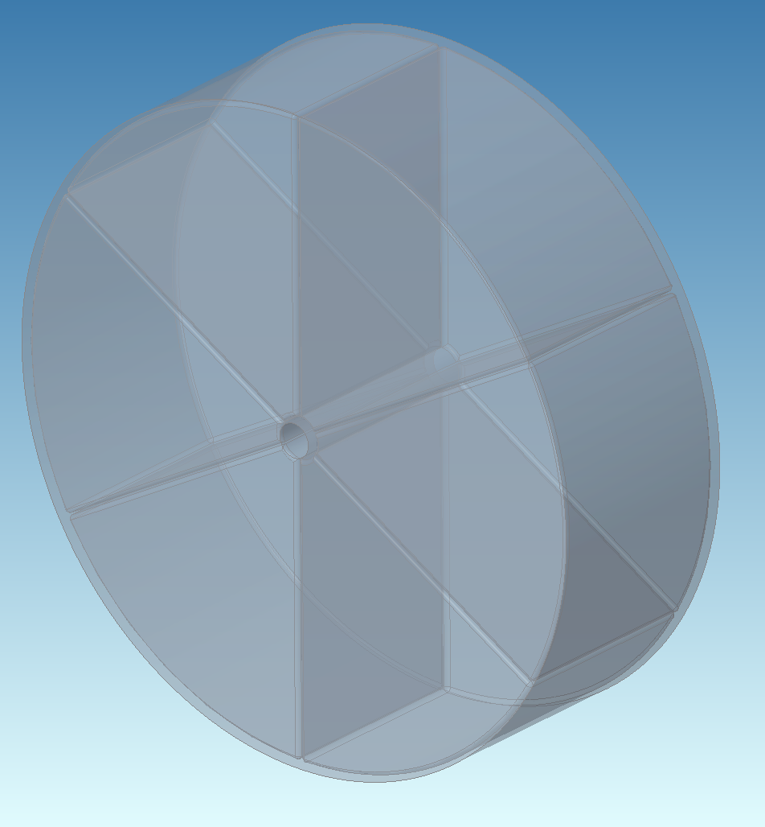
Geometry
sd1
sd0
Vessel Shape
I.D. | Value (cm) | Description
sd0 | 130 | Length
sd1 | 200 | Radius
sd2 | 10.5 | Beam Tube ID
sd3 | Varied | Beam Tube Wall
sd4 | Varied | Endcap
sd5 | Varied | Wall
sd6 | Varied | Rib
sd3
sd4
sd2
sd6
sd5

Slide 33
Load Conditions
Mirror Symmetry
14.7 psi
Analysis was performed using a 60° wedge
Analysis does not include gravity
3 bar (absolute)
Vacuum
(Beam Tube)
Cyclic Region Symmetry

Slide 34
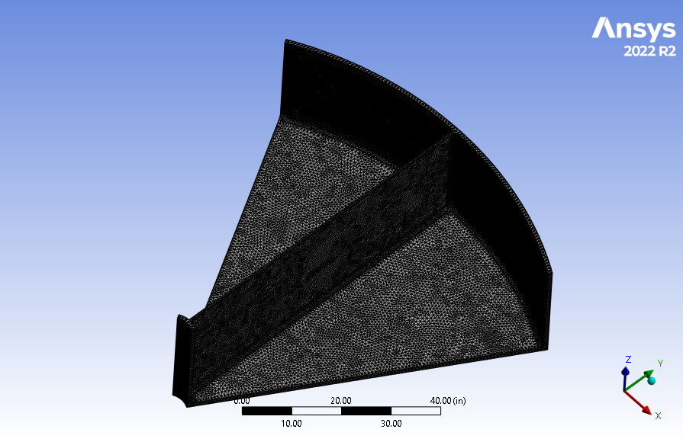
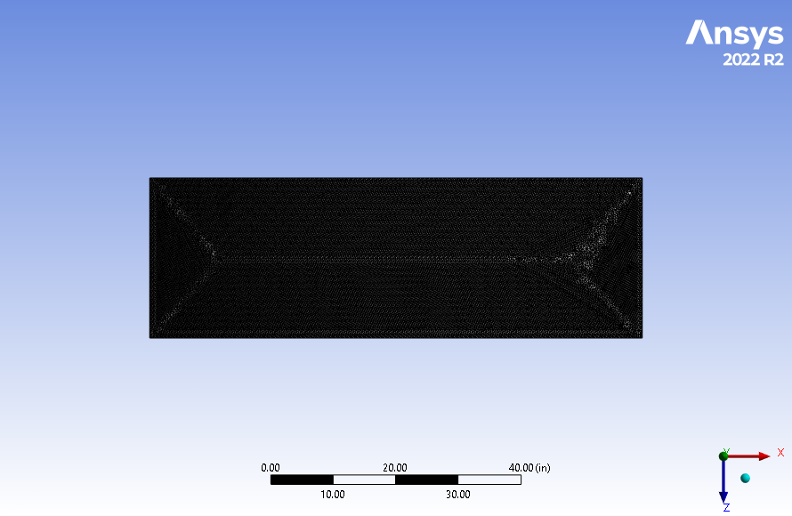
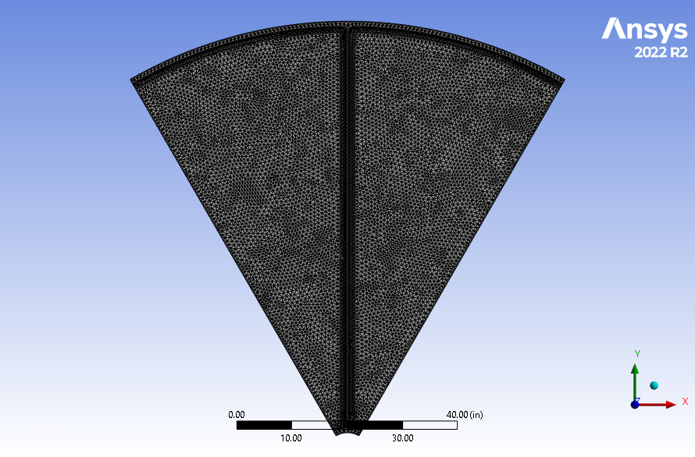
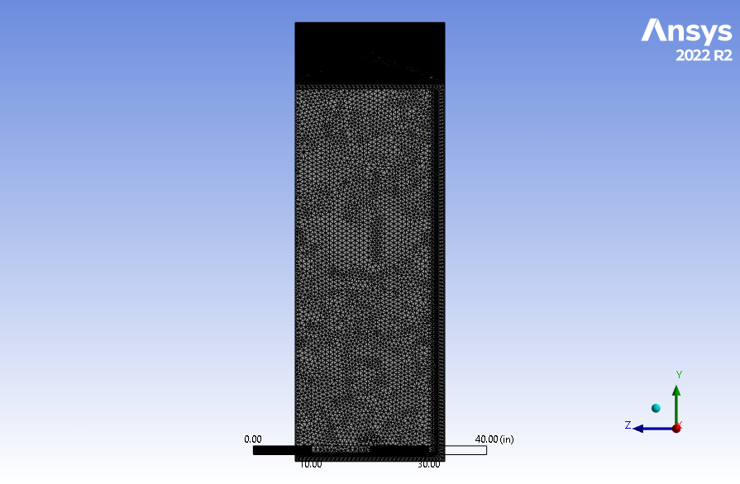
Mesh Details

Slide 35
Mesh Study
Used for this study

Slide 36
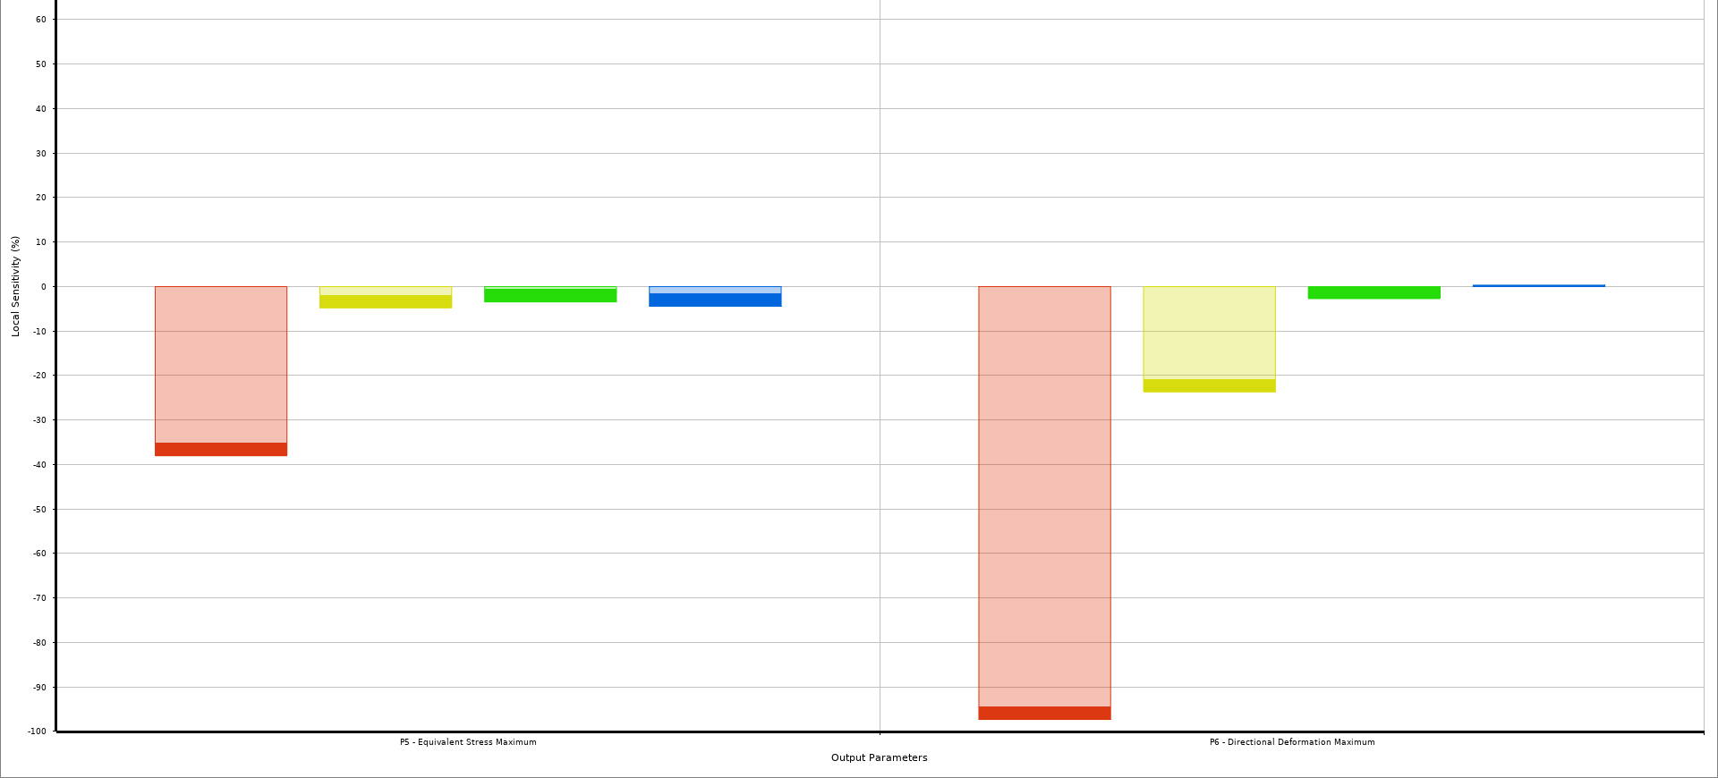
Sensitivity of Thicknesses
Endcap
Wall
Rib
Beam Tube
Endcap
Wall
Rib
Beam Tube
Local Sensitivity (%)
Max Stress
Max Deformation (Z-dir)
The endcap thickness is the main contributor to results

Slide 37
Endcap Thickness vs. Stress
Titanium Ti-6Al-4V (Grade 5) Yield Stress
(Previous Analysis)
Titanium (Grade 12) Yield Stress
Aluminum 6061-T6 Yield Stress
304 Stainless Steel Yield Stress

Slide 38
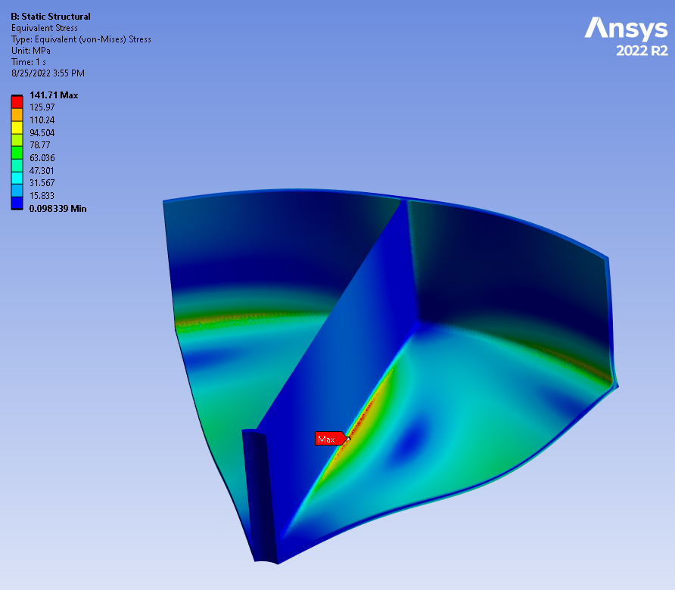
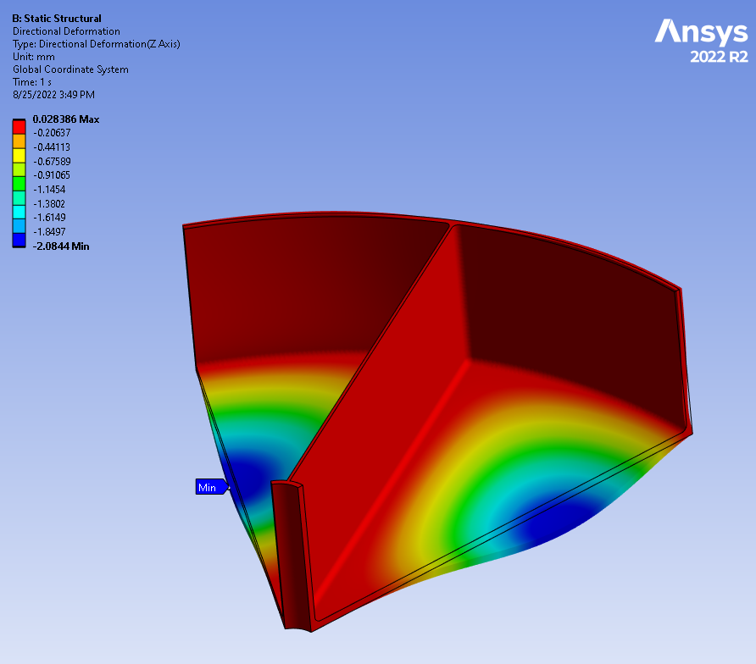
Static Structural Results
Note: Results are shown for a 304 stainless steel vessel with 3 cm [1.2 in] endcaps and a 2.5 cm [1.0 in] wall thickness including an Ø21.0 I.D. x 2.5 cm thick beam tube. Weight as shown is 22,800 lbs. (1,900 x 6 sections x 2 halves).
σ_{max} = 142 MPa
Δ_{Z-dir} = +0 / - 0.21 cm
Max stress is the limiting factor for the thickness required

Slide 39
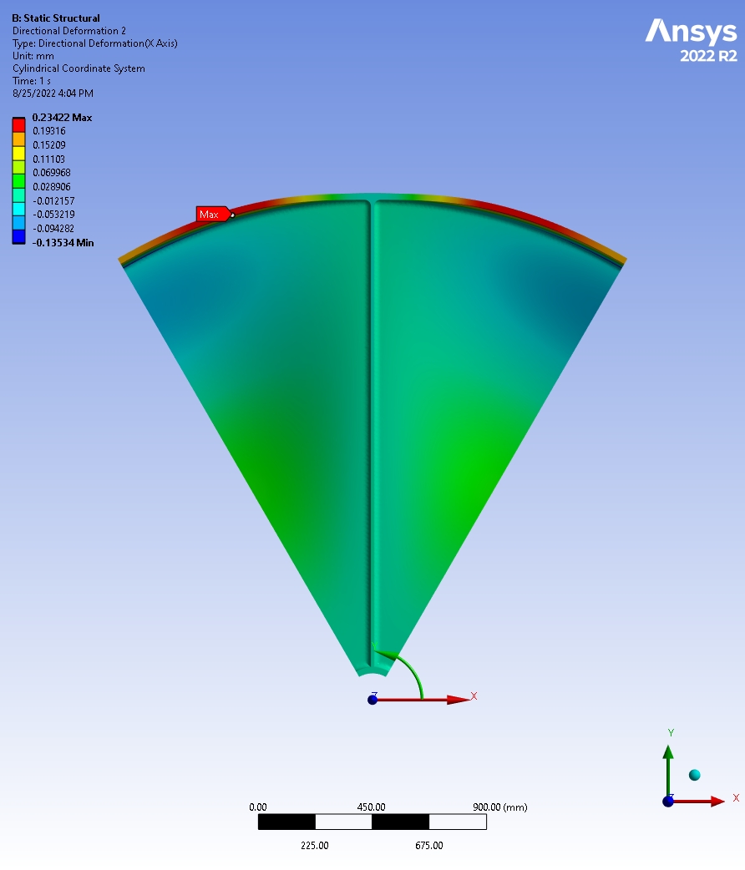
Radial Deformation
Deformation
The maximum radial deflection of the vessel wall is 0.02 cm when analyzing a stainless steel vessel with 3.0 cm thick endcaps and 2.5 cm thick vessel walls.
Deformation is measured in the X-Dir on a cylindrical coordinate system.
Cylindrical CSYS

Slide 40
Things to consider
The ribs can be optimized to remove the material not participating in the stress distribution further light weighting the design.
Titanium alloys provide an optimal blend of material properties for this application (i.e., strength to weight ratio). A cost vs. benefit analysis would need to be performed to justify this alternative.
Questions / Comments?

