Slide 1
Modular RICH Detector Simulation -- Detector Geometry
Cheuk-Ping Wong
Georgia State University
02-29-2015

Slide 2
This Week
Detector geometry
Add thickness on detector holder box
Modify four corners of Fresnel lens
Modify material of aerogel
Refractive index=1.03
Add Rayleigh Scattering property (more study needed)
Updated GEMC to version 2.3

Slide 3
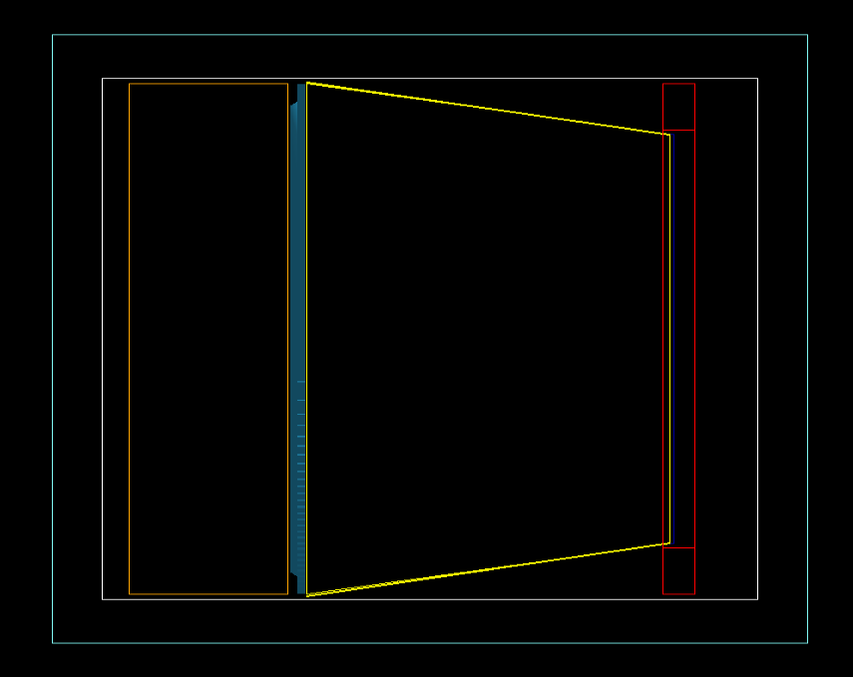
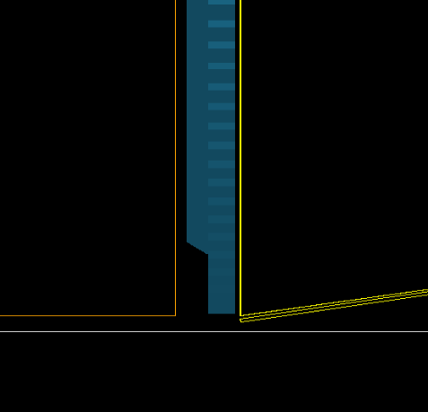
Detector Geometry
hollow
3/8 inches
Detector holder box
3/8 inches
Hollow: solid box made by opt_air
Aerogel
0.06 inches

Slide 4
Next
Change aerogel thickness to 3.3cm
Study the acrylic detector holder box effect on particles transmission
Rayleigh Scattering

