Slide 1
pfRICH Design
Alex Eslinger (Jlab)

Slide 2
Background
Model represents information from GMDL file from Chris Dilks, slides from Alexander Kiselev, and trying to keep similar dimensions to the mRICH design.
https://indico.bnl.gov/event/15835/contributions/63524/attachments/41063/68723/ayk-2022-05-20-pfrich-cherenkov-pid-wg-meeting-pfrich.pdf
https://indico.bnl.gov/event/16208/contributions/64911/attachments/41521/69577/20220613-CherenkovPID_EICDetector1_backwardRICH.pdf

Slide 3
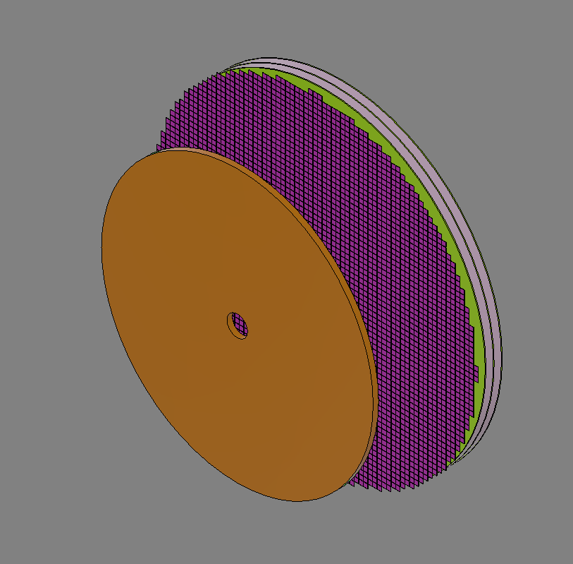
GMDL File

Slide 4
Current Iteration

Slide 5
Some Details
Front face to origin = 118.75cm
OAL from front face to back of the readout clearance = 53.95cm
Inner Radius (to clear beampipe) = 5.9cm
Outer Radius to clear DIRC support = 68.1 cm
Number of SiPM sensors (24x24mm, 1.2mm gap between) to cover sensor plane = 2156
Assuming 4 sensors per cooling block, 539 would be needed.
Expansion Volume = 30cm
Readout Clearance = 15.02 cm
Cooling and Readout stack up (PCB, Cooling Plate, Cooler, Cooling Block, Readout Clearance) = 19.32 cm

Slide 6
Still Unknown
Sensor type to be used: LAPPD or SiPM
Cooling requirements
Does 30mm expansion volume work
Expansion volume details – encapsulated? Need to withstand regulated pressure? Gas type? Considered a “pressure system”?

Slide 7
Design Work Still Needed
Aerogel Segmentation (currently a single disc)
Support Frame (dependent on final weight… which may be dependent on sensor choice)
Sensor Cooling Design (currently just tiled representation)
PCB Design (currently just a disc)
Sensor Layout (currently just tiled representation)

Slide 8
Questions?
Let me know if you’d like to walk through any piece of the current design.

