Slide 1
High Performance FPGA Embedded System for Machine Learning Based Tracking and Trigger in sPhenix and EIC
Dantong Yu, New Jersey Institute of Technology
Mingxiong Liu, Los Alamos National Laboratory
Jin Huang, Brookhaven National Laboratory

Slide 2
Outline
Nuclear Physics Background
Cluster, Tracking and Trigger Algorithm and End-To-End Pipeline Description
Hardware Description
Performance Report of Accuracy and Throughput
Accomplishments, Future years’ Plan

Slide 3
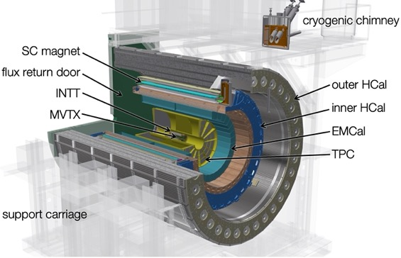
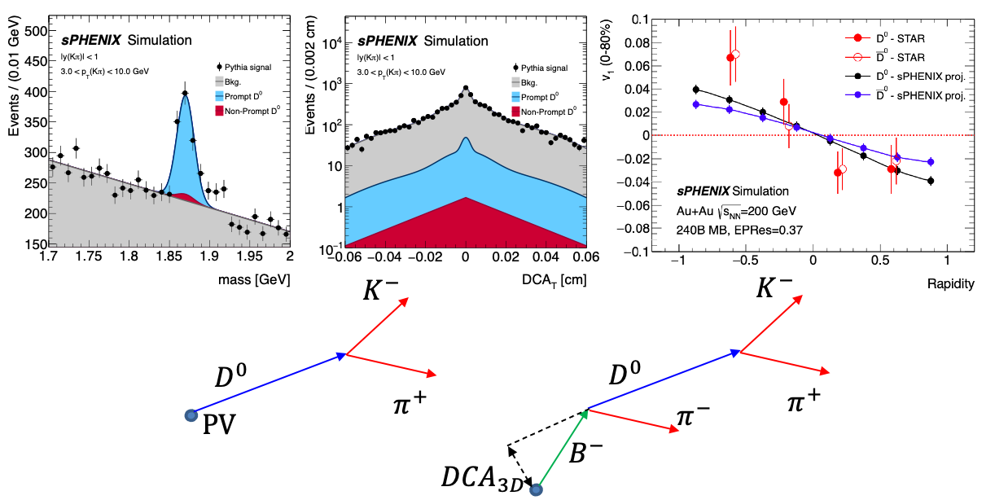
The Readout Challenge for High Luminosity Physics
The readout challenge
  Raw data volume >> hardware bandwidth/storage
  Only a small fraction of data will be recorded to tape
sPHENIX: DAQ trigger rate, 15kHz
  AuAu collisions
    Max collision rate ~50kHz
    Can collect all central collisions, OK
  p+p and p+Au
    Collisions on each beam crossing, ~9.4MHz
    Okey for high energy jet program with triggers
    Lose most of the low pT physics events
AI-based Triggering: filter events to reduce data rates for data archive and offline processing
sPhenix Trigger ➔ TPC (Time Projection Chamber)➔ Data Acquisition
Our project focuses on designing, building, simulating, and benchmarking a prototype AI-based fast online data processing and autonomous detector control system that meets the physics and engineering requirements.
sPHENIX experiment under construction at RHIC:
- Day-1 physics in 2023

Slide 4
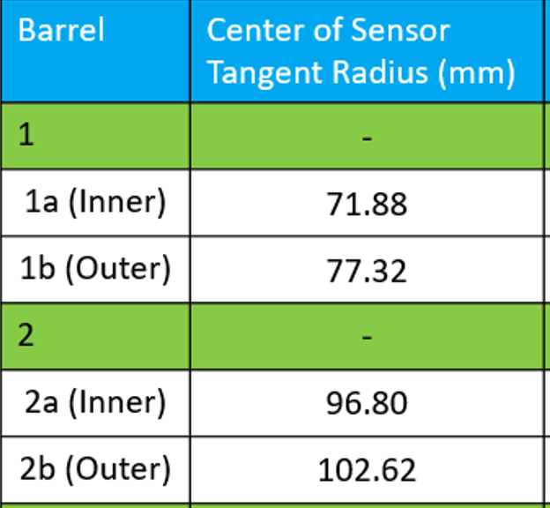
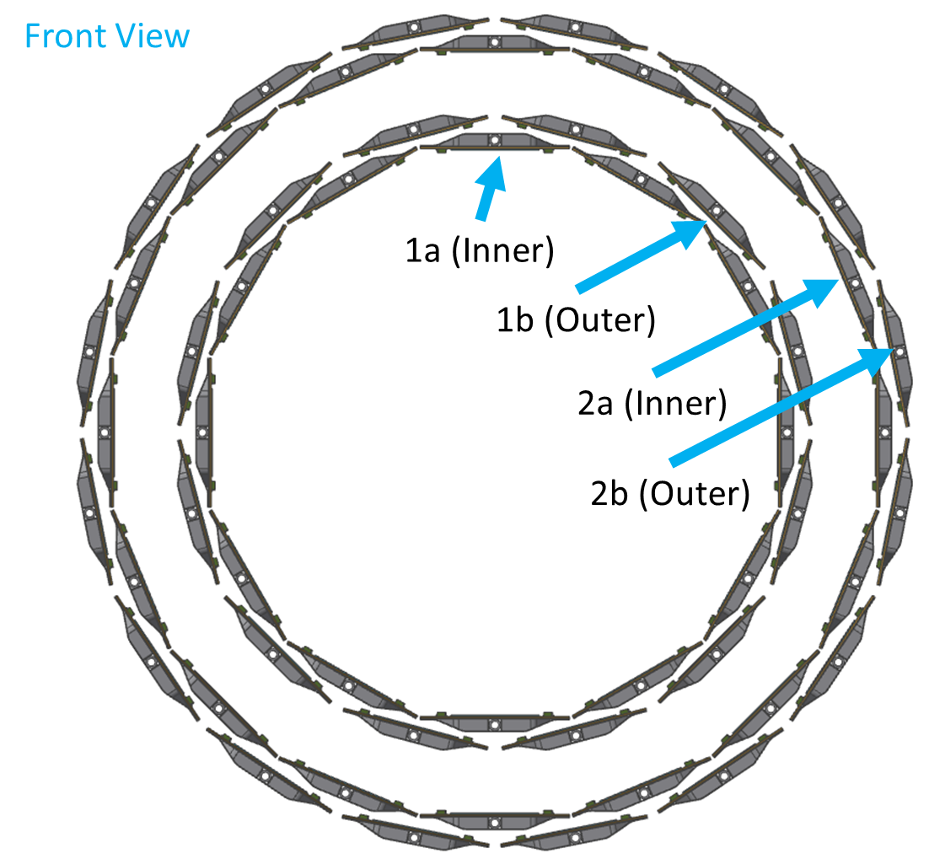
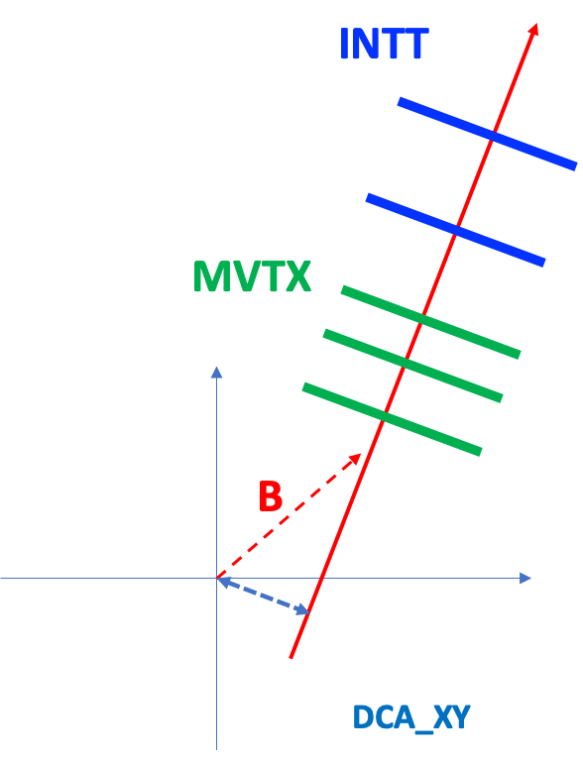
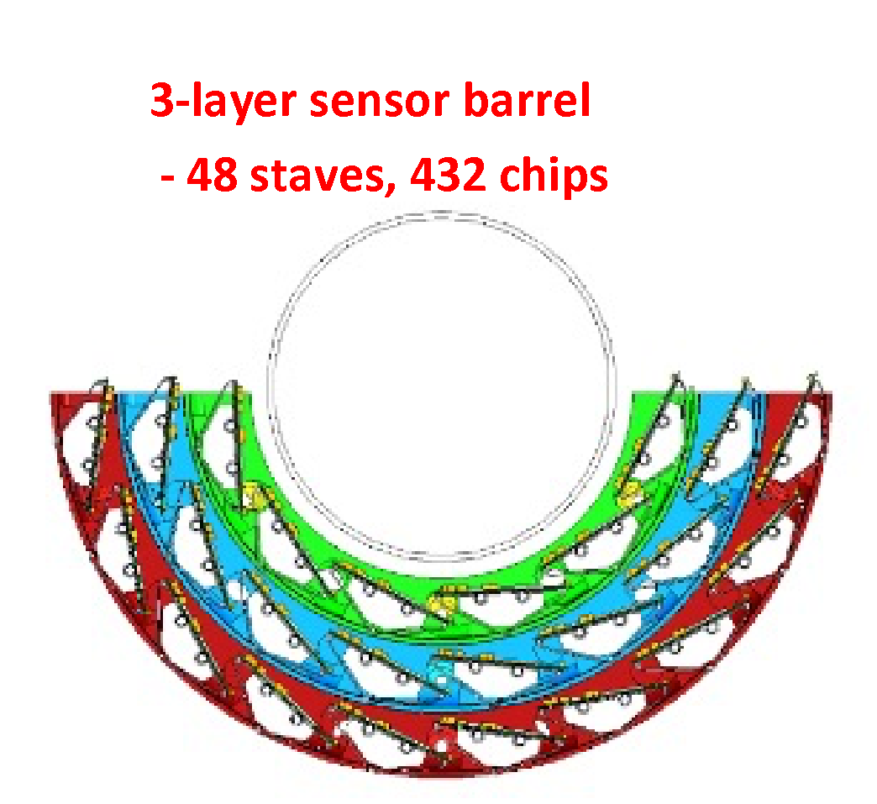
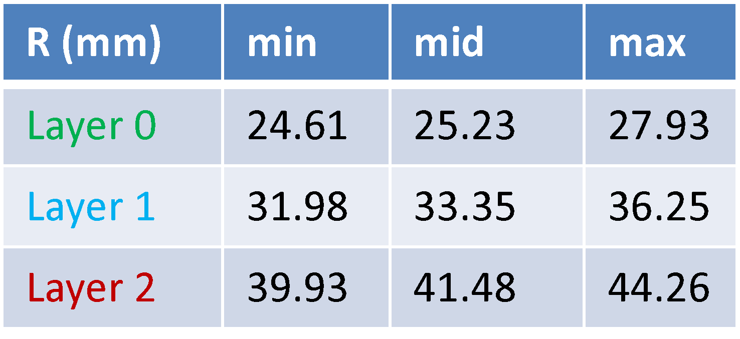
MVTX + INTT: 3 + 2 layers
INTT
Silicon Strips:
78um x 16mm (A)/20mm (B)
R=9.8cm
7.4cm
4.1cm
MVTX
Silicon pixels:
27um x 29um
R=2.5cm

Slide 5
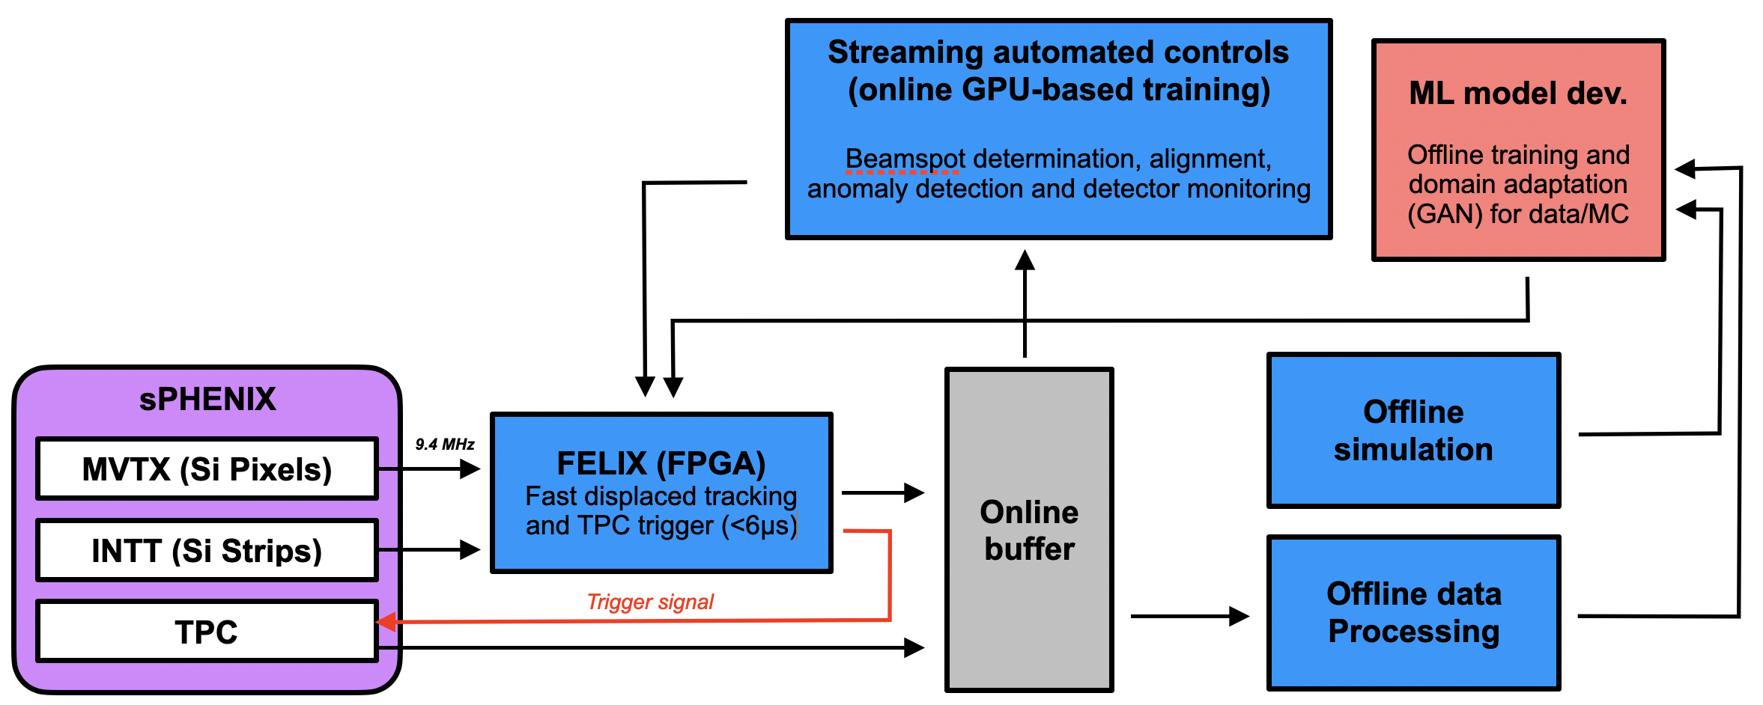
HF AI Trigger: sPHENIX as a Test Ground
Sensor hit readout time:
MVTX: ~3us
INTT: ~0.4us (4 BC)
SRO
sPHENIX DAQ & Trigger integration challenge

Slide 6
Timeline
2021
2022
2023
2024
2030+
Project started
Initial simulations constructed
First data for algorithm training
MVTX & INTT
Fast tracking algorithms in place
GPU feedback machine R&D
Initial FPGA bitstream
Refine interface between system and detectors
Improve algorithms with latest data stream
Pre-commissioning
Deploy device at sPHENIX
pp/pA run
Design updated system for EIC
Take advantage of new technology if required
Deploy device at EIC

Slide 7
Objectives
Project Focus:
  Real-time AI technologies will be applied to the very high-rate data streams from detectors.
  Accelerate GNN on FPGA, one of the first work that attempts to accelerate GNN prediction.
  Play the central role in sPhenix and Future EIC detectors running under trigger systems and in-situ streaming analysis for event selections.

Slide 8
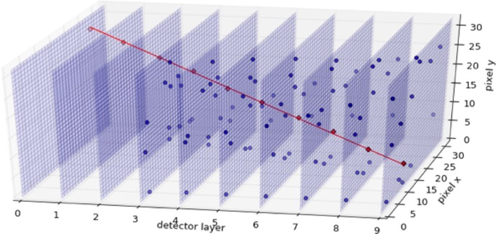
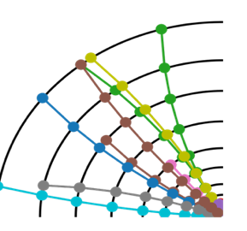
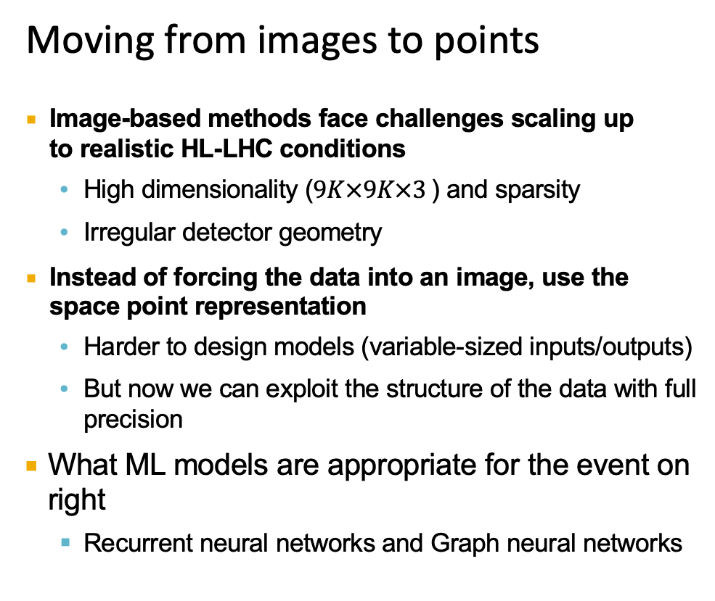
Event Data Descriptions
Moving from images to points
Image-based methods face challenges scaling up to realistic HL-LHC conditions
  High dimensionality ($9K×9K×3$) and sparsity
  Irregular detector geometry
Instead of forcing the data into an image, use the space point representation
  Harder to design models (variable-sized inputs/outputs)
  But now we can exploit the structure of the data with full precision
What ML models are appropriate for the event on right
  Recurrent neural networks and Graph neural networks

Slide 9
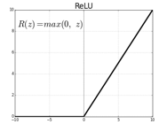








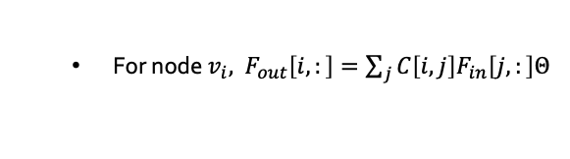










Graph Neural Networks
Graph Convolutions
Graph Convolutions
Node Features
Representations
Activation Function
Graph-level
MLP
MLP
Denote $C={\tilde{D}}^{−\frac{1}{2}}\tilde{A}{\tilde{D}}^{−\frac{1}{2}}$
Node-level
$$F[3,:]$$
$$v_{3}$$
$$v_{4}$$
$$F[4,:]$$
  Then $F_{out}=$ ${CF}_{in}Θ, C represents the networks and Θ represents the MLP$
$$F[1,:]$$
  For node $v_{i},$ ${ F}_{out}\left[i,:\right]=\sum_{j}{C\left[i,j\right]F_{in}\left[j,:\right]Θ}$
$$v_{1}$$
$$F[2,:]$$
$$v_{5}$$
$$F[5,:]$$
Observe that:
$$v_{2}$$
$$v_{8}$$
$$F[8,:]$$
$$F[6,:]$$
  $C[i,j]=0$ for $v_{j}∉N\left(v_{i}\right)∪\left\{v_{i}\right\}$
$$v_{6}$$
Feature transformation
$$v_{7}$$
Aggregation
$$F[7,:]$$

Slide 10
Trigger Software Pipeline
  Fetch events from event buffer to FPGA (Work in Progress)
  Data Pre-processing Clustering (FPGA implements)
  Tracking + Outlier hits Removal (FPGA)
  Triggering (Done in FPGA, need performance tuning)
  Triggers on TPC (Interface and integration with sPhenix Detector)

Slide 11
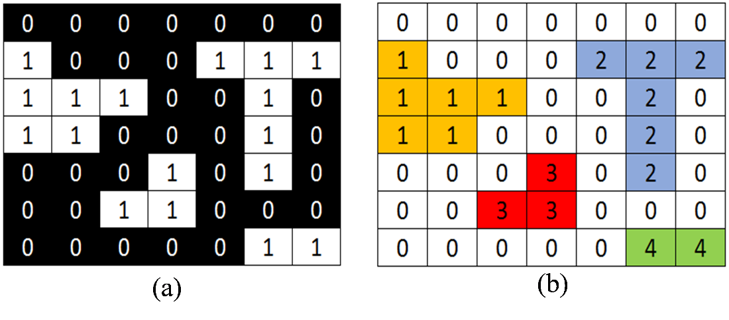
Data Pre-Processing-Clustering
Particles leave a blob of hits in detectors
The goal of the clustering algorithm is to reduce the amount of data being processed in the machine learning models, in order to improve inference times
Connected Components.
Simple Algorithms, challenging to have fast parallel algorithms on FPGA
  Grow Clusters by traversing neighbors.
  Zero-Skipping Architecture to find a neighbors
  Achieved a latency of 15,000 cycles on average, or 150 us (@ 100MHz clock)
  Resource utilization of 15%
  Reduction of data by 85%

Slide 12
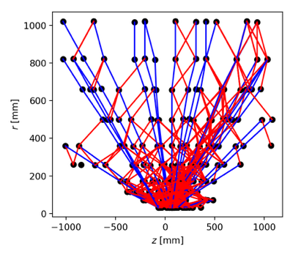
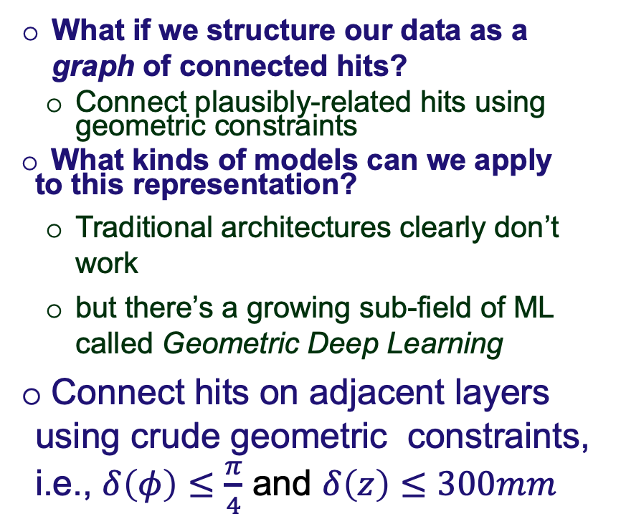
Graph Tracking and Outlier Removal
What if we structure our data as a graph of connected hits?
  Connect plausibly-related hits using geometric constraints
What kinds of models can we apply to this representation?
  Traditional architectures clearly don’t work
  but there’s a growing sub-field of ML called Geometric Deep Learning
Connect hits on adjacent layers using crude geometric constraints, i.e., $δ\left(φ\right)≤\frac{π}{4}$ and $δ\left(z\right)≤300mm$

Slide 13
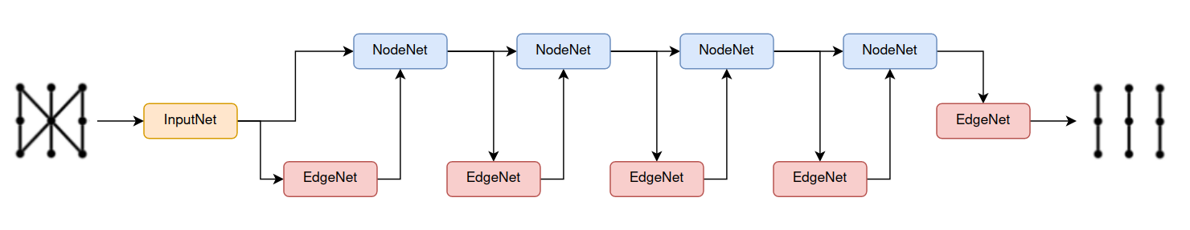




Tracking Algorithm
Agg
VpNet
GlobalVIPNetwork
Virtual
Point
EdgeNetwork
EdgeNet
$$e_{ij}^{(k)}$$
NodeNetwork
NodeNet
Layer i-1
Layer i
Layer i+1
Message Passing GNN Block
Iteration K times

Slide 14
Tracking Performance

Slide 15
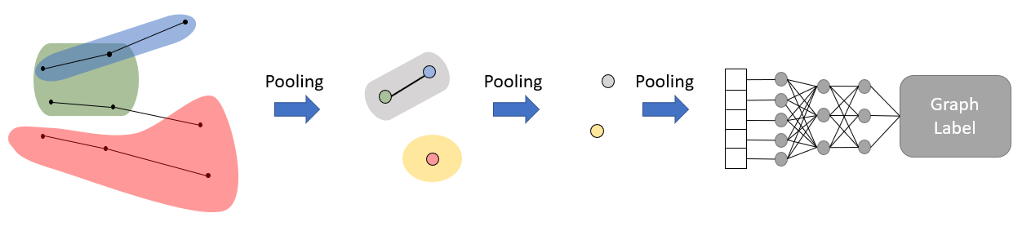
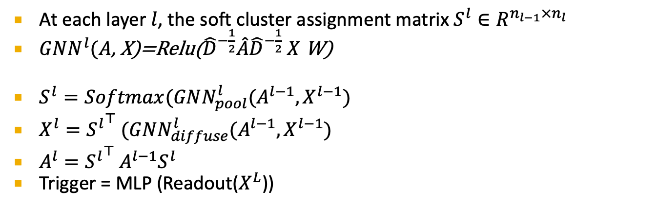
Trigger Detection
At each layer $l$, the soft cluster assignment matrix $S^{l}∈R^{n_{l−1}×n_{l} }$
$GNN^{l}(A$, X)=Relu(${\hat{D}}^{−\frac{1}{2}}\hat{A}{\hat{D}}^{−\frac{1}{2}} X$W)
$S^{l}=Softmax(GNN_{pool}^{l}(A^{l−1}, X^{l−1})$
$X^{l}={S^{l}}^{⊤} (GNN_{diffuse}^{l}(A^{l−1}, X^{l−1})$
$A^{l}={S^{l}}^{⊤} A^{l−1}S^{l}$
Trigger = MLP (Readout($X^{L}$))

Slide 16
Trigger Performance with GNN+Pooling

Slide 17
Problems with the implementation
Hits information will propagate within tracks.
Single Global Variable is not capable to keep track of all event information
No information is shared across different tracks.
An event consists of “inter-dependent tracks” that share the same origin. This should be considered in the beginning stage of event pipeline.
Pooling algorithm has some problem, local pool, such as DiffPool, brings marginal to no benefits to the clustering of tracks and ultimately trigger detection
Rethinking pooling in graph neural networks, NeurIPS 2020

Slide 18
Trigger Detection Algorithm (2)
A two-stage GNN-based trigger system to decide whether to record the events or not, with the processed track information retrieved from the captured 3D sparse images by the sPHENIX detectors.

Slide 19
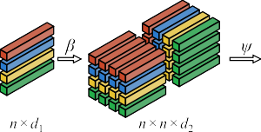
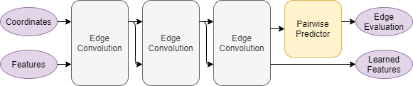
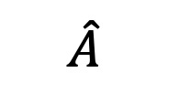
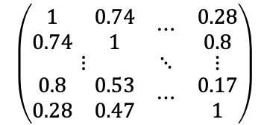
Model Architecture (1st Stage)
$$\hat{A}$$
$$\left(\begin{matrix}\begin{matrix}1 & 0.74 \\ 0.74 & 1\end{matrix} & ⋯ & \begin{matrix}0.28 \\ 0.8\end{matrix} \\ ⋮ & ⋱ & ⋮ \\ \begin{matrix}0.8 & 0.53 \\ 0.28 & 0.47\end{matrix} & ⋯ & \begin{matrix}0.17 \\ 1\end{matrix}\end{matrix}\right)$$
Link prediction
Two tracks are connected if they
have the same original vertex
Here $β, ψ$ are MLP to map tracks into network nodes
Notes:
This figure is the summary of model for cluster tracks based on particle net at the first stage.
(2’03’’)

Slide 20
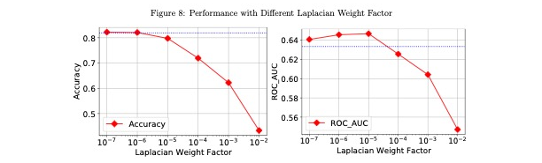

Loss Function
$L=L_{CE}^{∗} +α⋅ L_{Laplacian}$
$L_{CE}^{∗}=\sum_{i}{\sum_{j}{−[y_{ij}⋅ log {\hat{y}}_{ij} + \left(1−y_{ij}\right)⋅\log\left(1−{\hat{y}}_{ij}\right)] }}$
$L_{laplacian}= trace(O^{⊤}\left(\tilde{D}−\tilde{A}\right)O)$
where $\text{O}∈R^{n×3}$ is the ground truth coordinate matrix of the secondary vertex of each track.

Slide 21
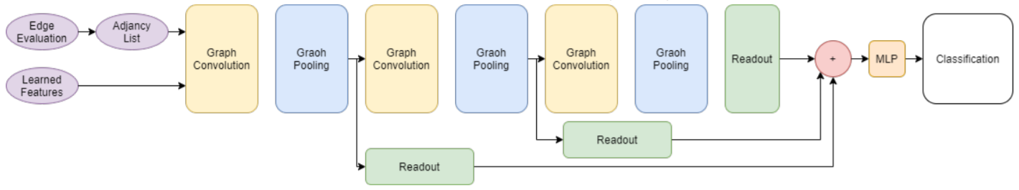
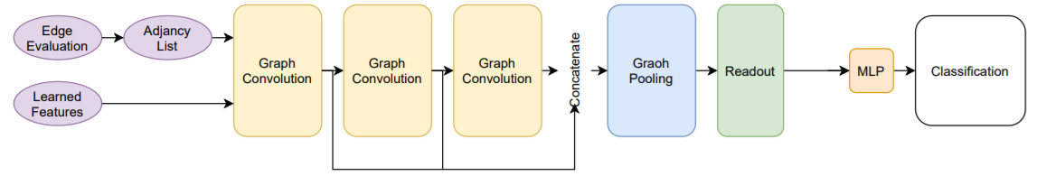
Trigger Prediction via SAG (2nd Stage)
Trigger Prediction via SAGPool
  Hierarchical
  Global
Notes:
We take the output from the first stage and feed them into the second stage as the graph shown.
In constrast to DiffPool, SAGPool uses graph convolution to calculate the self-attention scores and considers both node features and graph topology with only moderate time and space costs.
There are 2 types of SAGPool. One is with hierarchical pooling structure and the other is with global pooling structure.

Slide 22
Experiment
Dataset
  Our experiment data set consists of simulated sPHENIX p+p collision at 200 GeV c.m. energy with only MVTX detector readout.
  3 layer structure
  Track:
    coordinates of the three hits in each layer
    length of the edges
    angle between these two edges
    total track length
    coordinate of the geometric center of all the hits in the graph
    complementary
Notes:
The dataset we used consists of simulated sPHENIX p+p collision.
The three-layer structure with interleaved detector strips generates short tracks.
The input vector for each track consists of the coordinates of the three hits in each detector layer.
The others are calculated as complementary features to ease the downstream learning task.
(4’15’’)

Slide 23
Experiment Results
Notes:
For the result of the experiment, we only show the best setting for each model in the table. ParticleNet shows 4% better accuracy compared to Set2Graph. SAGPool is efficient, converging three times faster than Diffpool, and reaches a peak performance almost 1% better. SAGPool with global preserves 47% triggers while rejecting 90% events. It has the highest roc_auc score which indicates that it is a preferred model to distinguish between triggering and non-trigger events.
(4’52’’)

Slide 24
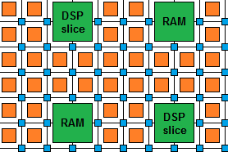
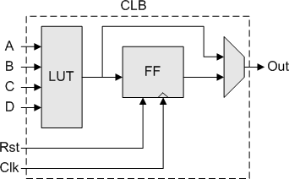
FPGAs
5us latency to decide whether acquire event data in TPC
  ASIC and FPGA
Field-programmable gate arrays are a common solution for fast-computing
Building blocks:
  Multiplier units (DPSs) [arithmetic]
  Look Up Tables (LUTs) [logic]
  Flip-flops (FFs) [registers]
  Block RAMs (BRAMs) [memory]
Algorithms are wired onto the chip
Programming traditionally done in Verilog/VHDL
  Low-level hardware languages
Possible to translate C to Verilog/VHDL using High Level Synthesis (HLS) tools
Alveo U280 FPGA
9024 Multipliers 1.4 M LUTs
2.6 M FFs
8G HBM
53MB Block RAM
Virtex 7 XCKU 115
5520 Multipliers 663K LUTs
1.3 FFs
72 MB BRAM

Slide 25

Programming Environment for FPGA
XiLinx DPU
Only handles CNN
A predefined set of deep learning modules
Does not support Matrix operations.
Does not work for GNN
Inefficient for large pipelines require CPU to handle I/O and coordinate FPGA
Not appropriate for trigger detection with sparse images
hls4ml is a software package for creating HLS implementations of neural networks–
https://hls-fpga-machine-learning.github.io/hls4ml/
Supports common layer architectures and model software
Highly customizable output for different latency and size needs
Simple workflow to allow quick translation to HLS
Design model with standard software tools (Keras, Tensorflow, PyTorch)
Pass network architecture and weights/biases along with configuration parameters to hls4ml (creates HLS project)

Slide 26
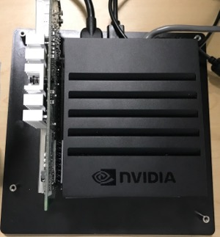
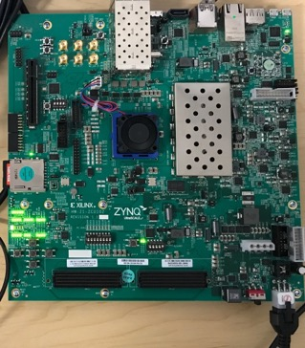
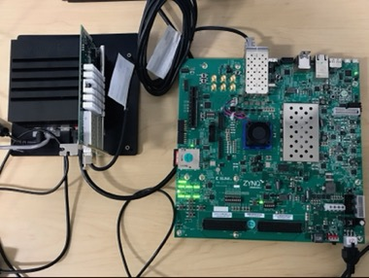

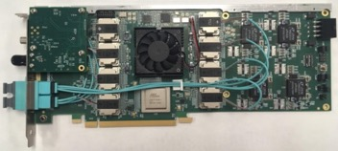
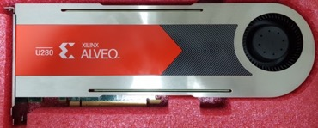
Programming in FPGA Universe
Automatic Generated Python
Stage 1:
Off-line Training
Stage 2: On-line Training
/Transfer Learning
Stage 3: Real-Time Inference
Stage 4: Light-Weight Real-Time Deep Learning & Inference Engine
Stage 5: Real-Time Sensing & Decision Making Engine
1
2
3
4
➔
+
=
NVIDIA GPU Cloud
➔
High Performance Computing Edge Computing Embedded System Controller
Electricity Cost High Electricity Cost Medium Electricity Cost Low

Slide 27
FPGA Results

Slide 28
FPGA Speed Up

Slide 29
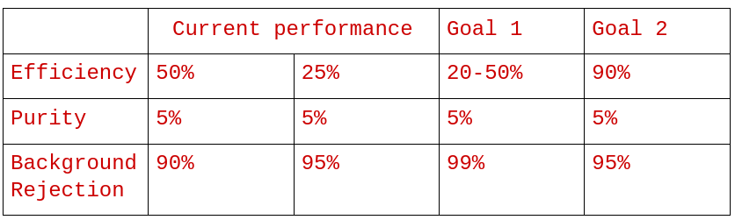
Performance Analysis: Accuracy and Throughput
Accuracy for Track Reconstruction
Accuracy for Trigger Detection
F1 and AOC for Trigger Detection
Given the percentage of trigger events in original dataset and background rejection rate, calculate the efficiency and purity of the detected triggers

Slide 30
Performance Analysis: FPGA Throughput
Accuracy for Track Reconstruction
Accuracy for Trigger Detection
F1 and AOC for Trigger Detection
Given the percentage of trigger events in original dataset and background rejection rate, calculate the efficiency and purity of the detected triggers

Slide 31
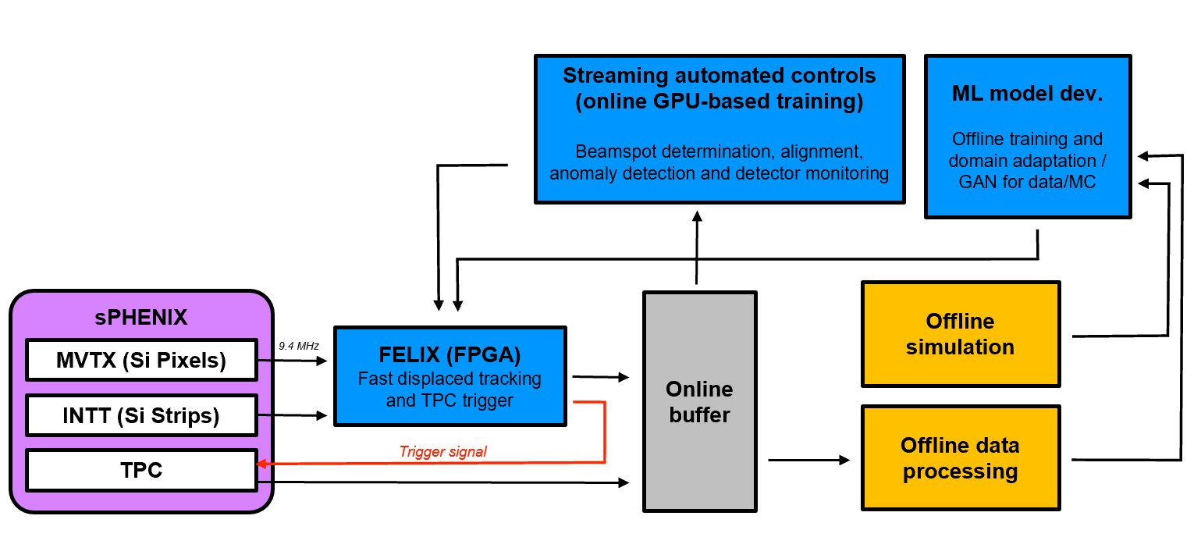
Future Plan: sPHENIX Readout Upgrade
AI-based real-time system: Fast Data Processing and Autonomous Detector Control
Identify heavy quark events in p+p and p+Au collision events
Autonomous detector & beam position misalignment monitoring and correction

Slide 32
Parallel Processing
FLX-readout
MVTX/INTT
FLX-readout
MVTX/INTT
FLX-readout
MVTX/INTT
FLX-readout
MVTX/INTT (100kHz or 10us)
Event Tagging - w/ RF tagging /INTT (100 events, or 10us)
Send RF-tagged event to each FELIX/Trigger hardware , ~5us processing time
FPGA-Trigger-1
>100kHz
(10kHz achieved)
FPGA-Trigger-2
FPGA-Trigger-100
>100kHz, ~5us processing
Final Trigger Decision (“OR” of all triggers)

Slide 33
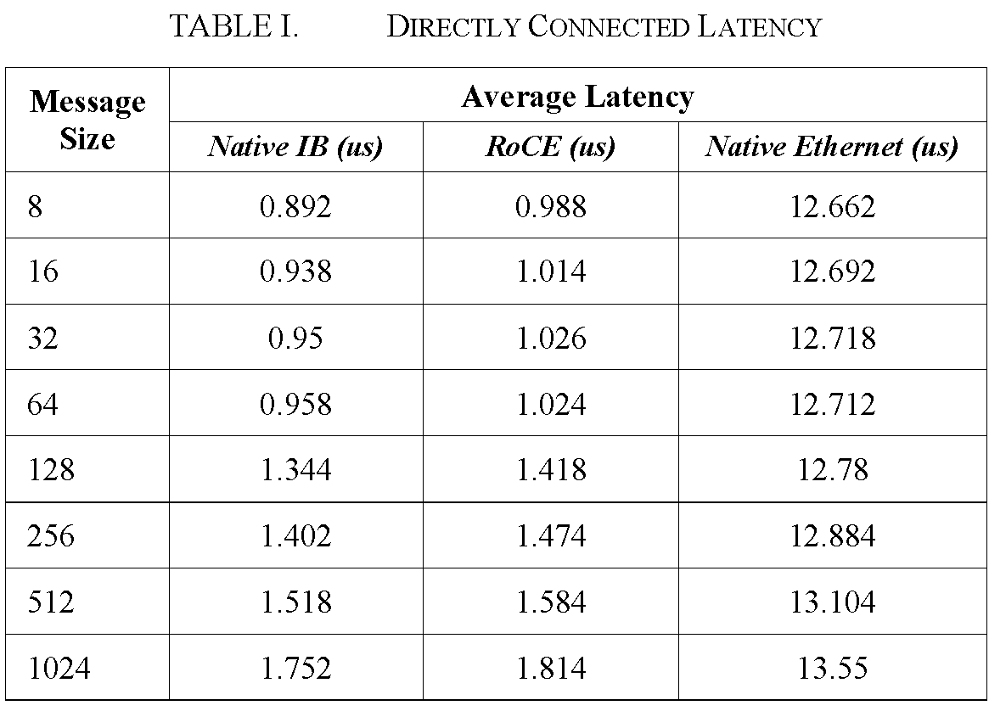
Data Interface with Detector
Triggering Mode:
  Need to make triggering decision
  5us after events
  2us to move one event from detector Felix card to ML FPGA
  3us to run inference and trigger
Streaming Mode:
  Streaming all events to online RAM
  Filter events based on trigges
  15 KHz/second triggering decision.
Ethernet and TCP/IP are too slow
IB and RDMA over Converged Ethernet

Slide 34
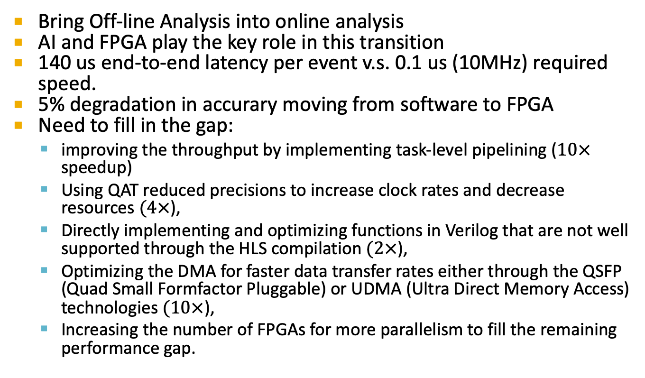
Conclusion and Future Works
Bring Off-line Analysis into online analysis
AI and FPGA play the key role in this transition
140 us end-to-end latency per event v.s. 0.1 us (10MHz) required speed.
5% degradation in accurary moving from software to FPGA
Need to fill in the gap:
  improving the throughput by implementing task-level pipelining ($10×$ speedup)
  Using QAT reduced precisions to increase clock rates and decrease resources $(4×$),
  Directly implementing and optimizing functions in Verilog that are not well supported through the HLS compilation $(2×$),
  Optimizing the DMA for faster data transfer rates either through the QSFP (Quad Small Formfactor Pluggable) or UDMA (Ultra Direct Memory Access) technologies $(10×$),
  Increasing the number of FPGAs for more parallelism to fill the remaining performance gap.

Slide 35

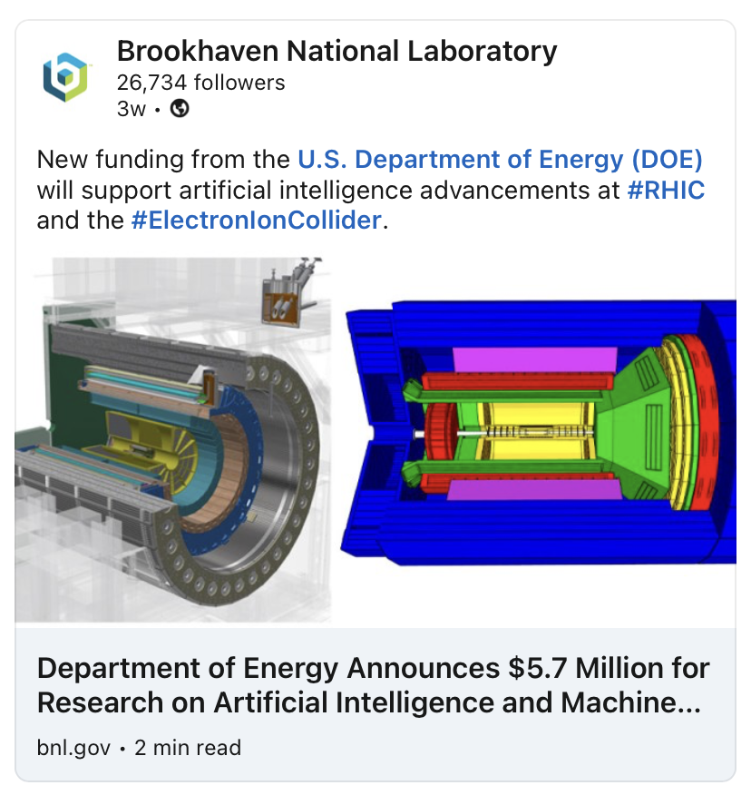
DOE Awards Announced 12/2/2021
$1.5M for our proposal
FY22-23

Slide 36
DOE funded Team Members
LANL (NP)
  Yasser Corrales, Cameron Dean, Zhaozhong Shi, Noah Wuerfel, Kun Liu, Cesar da Silva, Hugo Pereira da Costa, Ming Liu … new PDs
MIT (NP, HEP)
  Gunther Roland, Philip Harris (HLS4ML), Yen-Jie Lee, Or Hen, Cristiano Fanelli et al
FNAL(HEP)
  Nhan Tran(HLS4ML), Engineer, Yu-Dai Tsai (Theorist, ML) et al
NJIT(CS)
  Dantong Yu, students + PDs

