Slide 1
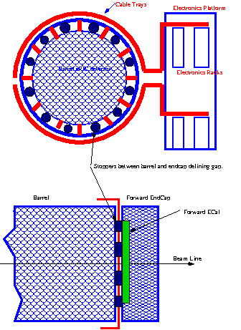
Forward ECal cabling.
Assumptions:
Stoppers which defines gap between Barrel and EndCap are part of the Barrel Structure.
Cable Trays from inside –out located between stoppers
There are no stoppers in horizontal plane where Cables from forward Ecal will be routed to outside of the detector. This is required due to opening of EndCap.
Volume per half of EndCap:
Power cables 3 cm x 4 cm ( 50 cables, 20 mm x 1mm)
Signal Cables from Insert 4cm x 3cm (80 cables diameter 4 mm)
Cables from FEE to DAM 144 cm^2 (500 cables diameter 6 mm)
MCW cooling copper pipes 6 x ¼
Air Blowers pipepes 15 cm x 4 cm
Two cable trays for
fECal (part of endcap)

