Slide 1
Introduction MuonID at the 2nd Detector

Slide 2
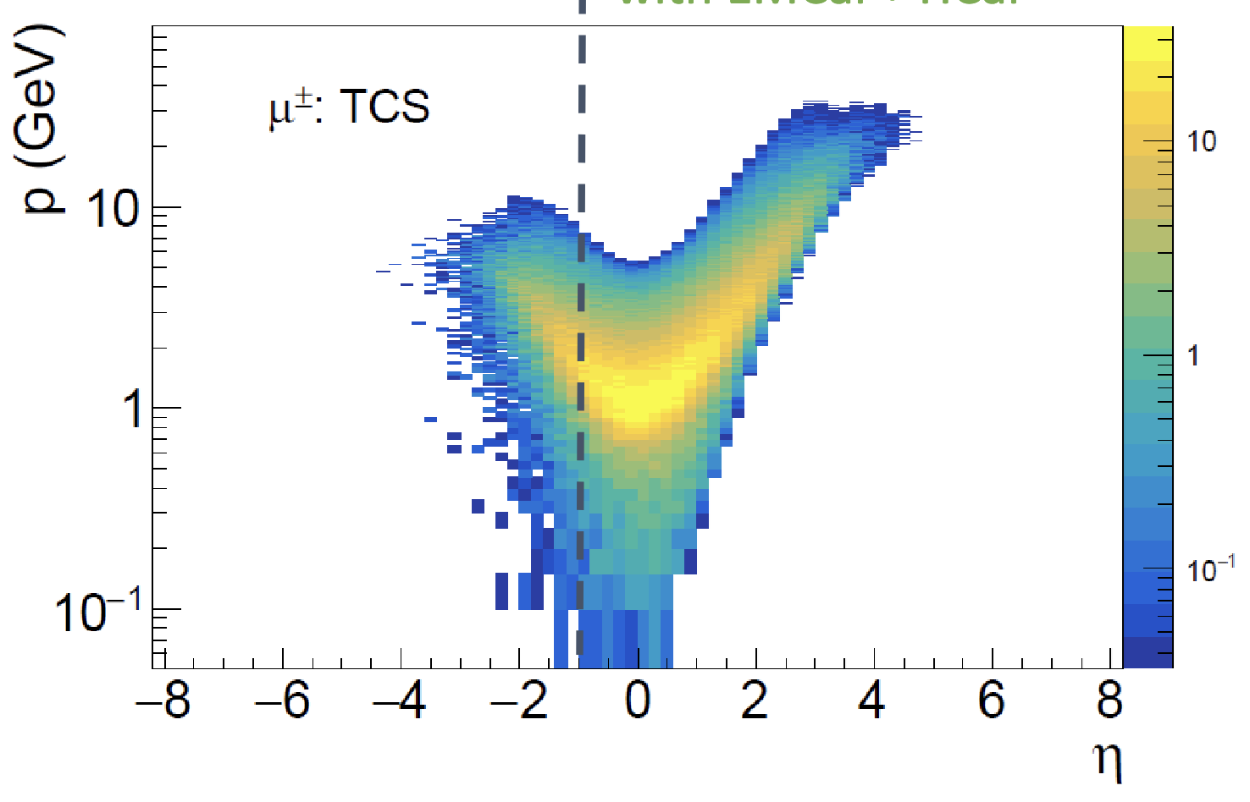
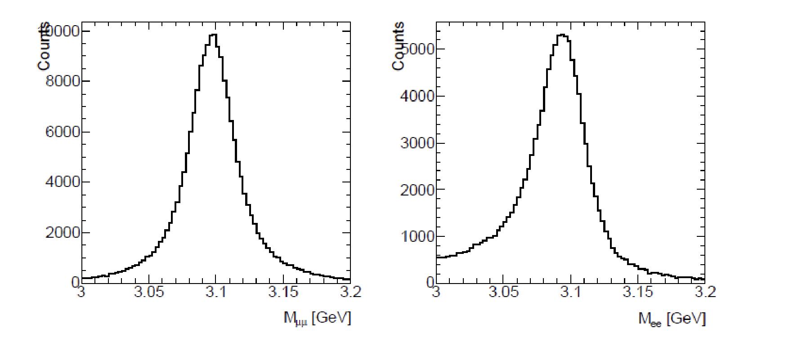
Overview
Muon id & reconstruction is a possible area of complementarity for between 2nd detector and project detector
Technology →See Will’s talk
Phase space enabled by technology, material and acceptance
Physics→see Simonetta’s talk
General
Double statistics
Radiative tails in electron modes
TCS, DDVCS
electron channels more challenging due to scattered lepton overlap with decay leptons
Quarkonium production
electron channels less challenging since more separated from scattered electron
More ideas?
Carlo Munoz Camacho at workshop “Muon detection and quarkonium reconstruction at the EIC’ 4/2022

