Slide 1
IAEA CIELO Evaluations for ^{235,238}U
A.Trkov, R.Capote
International Atomic Energy Agency
Vienna, Austria

Slide 2
Basis
Advanced nuclear model calculations with the Empire code
Standards_2016 (preliminary)
Recent experimental data:
²³⁵U capture by Jandel
²³⁸U/²³⁵U and ²³⁸U/¹⁹⁷Au capture ratios by Wallner
Criticality benchmarks from ICSBEP

Slide 3
Procedures
Standards_2016 caused severe perturbation to criticality prediction, in spite of relatively small changes, compared to “beta-2”
Re-tuning of Empire calculations
Improvements in cross sections were sought, making use of:
DICE sensitivity profiles
Experimental data
while respecting the Standards_2016, to improve performance in integral benchmarks

Slide 4
Example:
Wallner capture measurements at around 25 keV
U8/U5 = 0.60 +/- 0.03 (~5%)
U8/Au = 0.63 +/-
x.s. from Standards_2016 for U8/Au in Excellent agreement with Wallner
U8/U5 ratio from Jandel data low by ~6%
Lowering U5 capture → large impact on criticality
Solution:
Adopt IRMM data directly for U8 capture (+2% max.), raising Wallner measured U8/Au ratio by 0.7%, decreasing U8/U5 ratio to ~5%

Slide 5
Final tuning
Nu-bar of ²³⁵U decreased by 0.1% in the range 0.5-2.0 MeV w.r.t. ENDF/B-VII.1
Nu-bar of ²³⁸U increased, peaking to 1.5% at 2 Mev

Slide 6
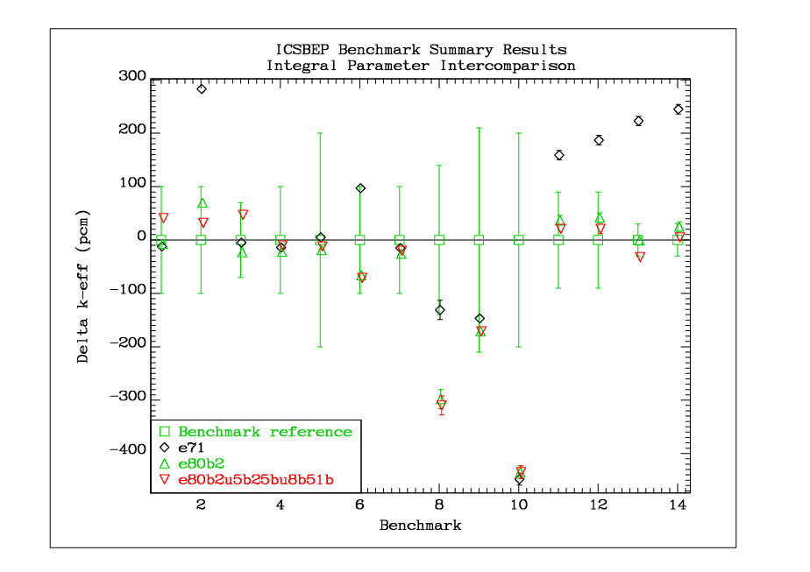

Slide 7
List of “main” benchmarks
1 HEU-MET-FAST-001 hmf001 Godiva
2 HEU-MET-FAST-028 hmf028 Flattop-25
3 IEU-MET-FAST-007 imf007d Big_Ten(detailed)
4 PU-MET-FAST-001 pmf001 Jezebel
5 PU-MET-FAST-002 pmf002 Jezebel-240
6 PU-MET-FAST-006 pmf006 Flattop-Pu
7 U233-MET-FAST-001 umf001 Jezebel-U233
8 U233-MET-FAST-006 umf006 Flattop-23
9 PU-MET-FAST-022 pmf022 Bare(98
10 PU-MET-FAST-029 pmf029 Bare(88
11 IEU-MET-FAST-001 imf001-001 Jemima-1
12 IEU-MET-FAST-001 imf001-002 Jemima-2
13 IEU-MET-FAST-001 imf001-003 Jemima-3
14 IEU-MET-FAST-001 imf001-004 Jemima-4

