Slide 1
CIELO Data Validation and Benchmarking Activities at the IAEA
A. Trkov, R. Capote
International Atomic Energy Agency
Vienna, Austria

Slide 2
Acknowledgement
The work presented herein is the result of contributions from several IAEA consultants and voluntary contributions from external collaborators…

Slide 3
Overview
Scope of data testing at the IAEA with examples
Pitfalls in the use of figures of merit (FoM)
Discrepancies in integral benchmarks
Uncertainties due to data processing and self-shielding treatment

Slide 4
Scope of data testing
Strategy – taking ²³⁵U as an example:
Start with clean bare configurations
Proceed with thermal solutions
Include well-tested reflected systems
More complex assemblies and broad scope testing

Slide 5
Bare ²³⁵U configurations
Observations:
Large discrepancies in predicted reactivity, which is unreasonable since sensitivities to nuclear data are similar. Examples:
Caliban: 1% over-prediction (MCNP and TRIPOLI), 0.5% inconsistency in mass of fissile material, neglecting measured abundances of B, etc.)
ORNL spheres predicted high compared to cylinders
Discrepancies in the Russian benchmarks (0.5%)…
→ There is a need to resolve the discrepancies

Slide 6
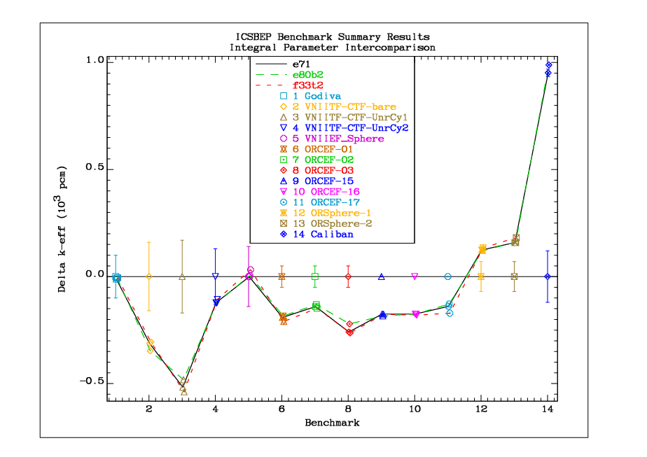
Bare ²³⁵U configurations

Slide 7
HEU Thermal Solutions
Traditionally, the “above-thermal leakage fraction” (ATLF) is an established parameter for characterising solution assemblies
To save time, representative cases were chosen that span the wide range of values
With “beta-2” good performance is preserved
Again, there is large scatter in some groups of benchmarks

Slide 8
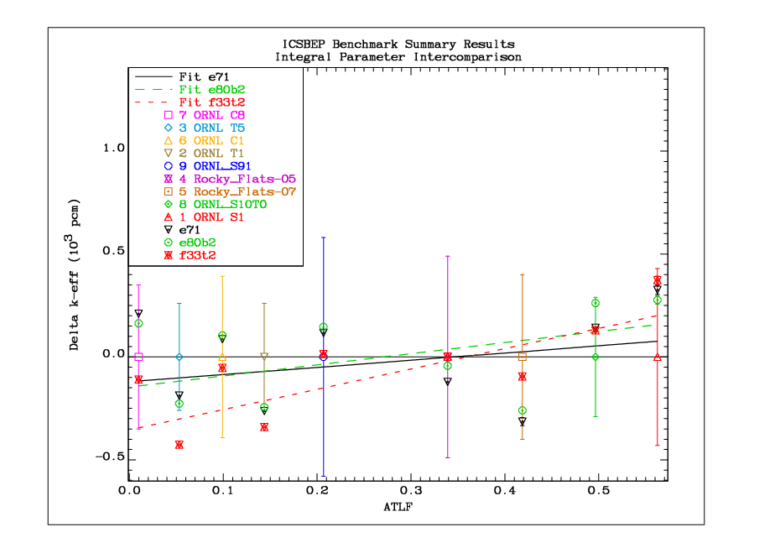
HEU Thermal Solutions

Slide 9
Reflected assemblies
Preference for simple configurations with few materials that have well-known cross sections
A selection of traditionally used assemblies was collected into the so-called “main” list

Slide 10
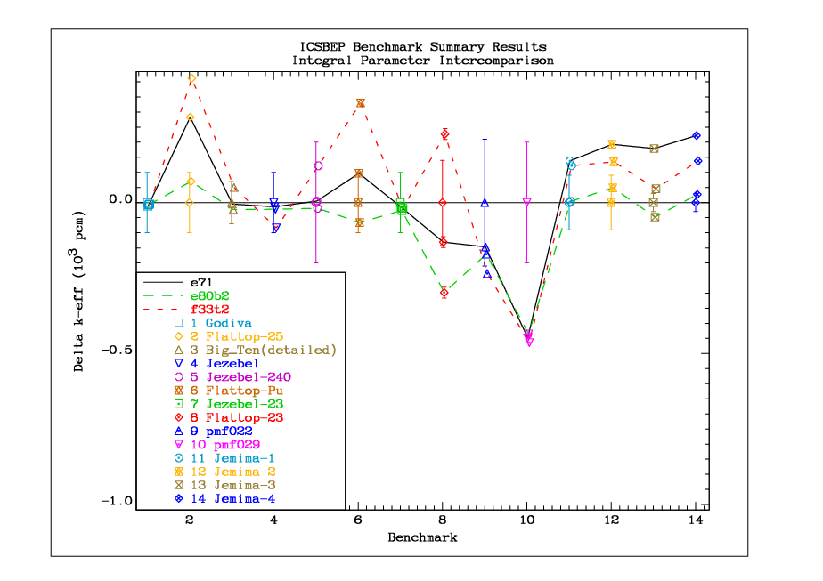
Reflected and other assemblies (main)

Slide 11
List of “main” benchmarks
1 HEU-MET-FAST-001 hmf001 Godiva
2 HEU-MET-FAST-028 hmf028 Flattop-25
3 IEU-MET-FAST-007 imf007d Big_Ten(detailed)
4 PU-MET-FAST-001 pmf001 Jezebel
5 PU-MET-FAST-002 pmf002 Jezebel-240
6 PU-MET-FAST-006 pmf006 Flattop-Pu
7 U233-MET-FAST-001 umf001 Jezebel-U233
8 U233-MET-FAST-006 umf006 Flattop-23
9 PU-MET-FAST-022 pmf022 Bare(98
10 PU-MET-FAST-029 pmf029 Bare(88
11 IEU-MET-FAST-001 imf001-001 Jemima-1
12 IEU-MET-FAST-001 imf001-002 Jemima-2
13 IEU-MET-FAST-001 imf001-003 Jemima-3
14 IEU-MET-FAST-001 imf001-004 Jemima-4

Slide 12
Broad scope testing
Benchmarking depends on:
Availability of input models
Computer resources
Capacity to analyse the results
Different sets are used at various places (NRG, LANL, CEA…)
Example:
Los Alamos suite of 119 ICSBEP benchmarks

Slide 13
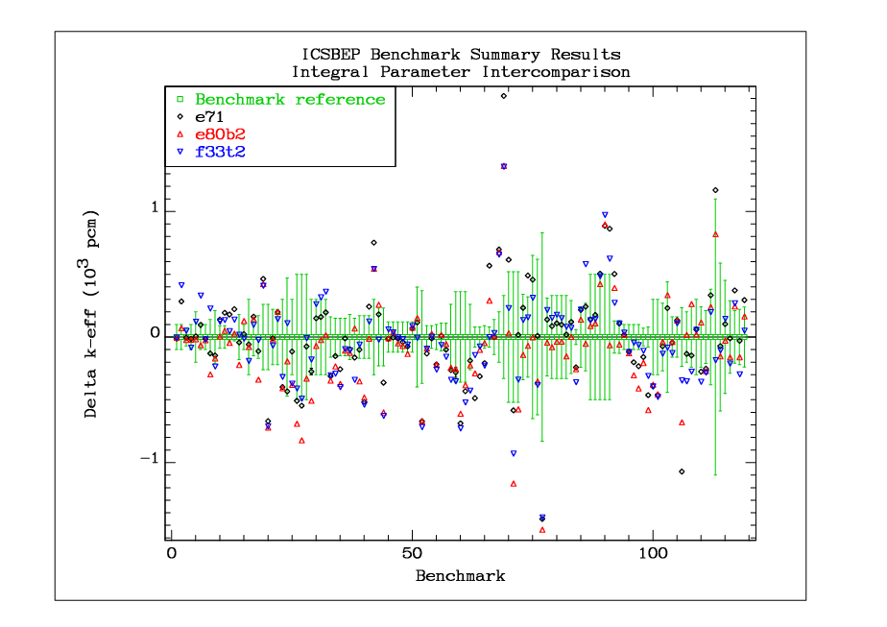
Broad scope testing
Hard to extract useful information!
Notes:
One cannot extract useful information.

Slide 14
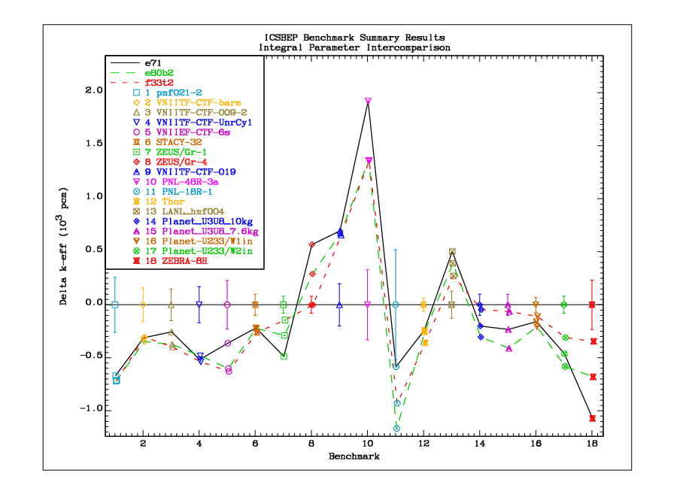
Broad scope testing (2σ outliers e80b2)
Presenting 2-sigma outliers only
Notes:
Focusing on outliers – some are better, some are worse.
There could be dependence on less-well known materials
The assigned uncertainties of some benchmarks are unreasonably small.

Slide 15
Pitfalls in the use of FoM
Different possibilities for defining Figures of Merit (FoM) exist:
r.m.s. Delta-k – equal weight to all, including cases of low accuracy
Χ²/DoF – sensitive to cases with unrealistically small uncertainties
… other

Slide 16
Cumulative contribution to Χ²/DoF
Zeus
“main” benchmarks
Jemima
umf003,004
²³³U, ²³⁸U
Notes:
From FoM alone, JEFF-3.3T2 is the winner, but there is more to it.

Slide 17
Discrepancies in integral benchmarks
As illustrated in the case of bare ²³⁵U assemblies, discrepancies of several hundred pcm (parts per 100 000) for cases with similar spectra and sensitivity profiles are more likely caused by bad description or bad benchmark models
A strong effort is needed to resolve such discrepancies

Slide 18
Data processing and methods
Monte Carlo codes can treat geometry accurately
Starting from the same data source they should give the same result
Differences occur due to:
Data processing (e.g. resonance reconstruction)
Methods (e.g. self-shielding in the unresolved resonance range (URR))
Other …

Slide 19
Resonance reconstruction
Example:
Make an ACE file with NJOY
Convert back to ENDF
Process the same library with PrePro with 0.1% reconstruction tolerance and same temperature
Compare the two files
Study the impact of differences on benchmarks
E.g. NJOY, PrePro, GRUCON (preliminary, ACE files provided by V. Sinitsa)

Slide 20
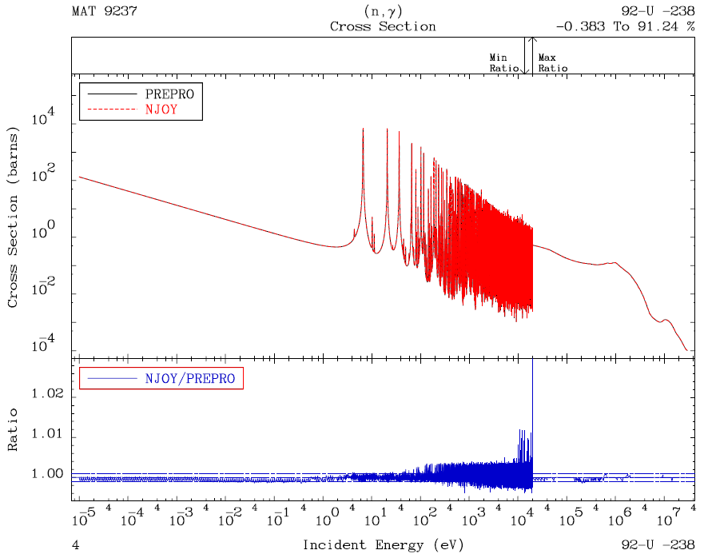
²³⁸U Resonance reconstruction
²³⁸U is a good case, that can be fixed by input

Slide 21
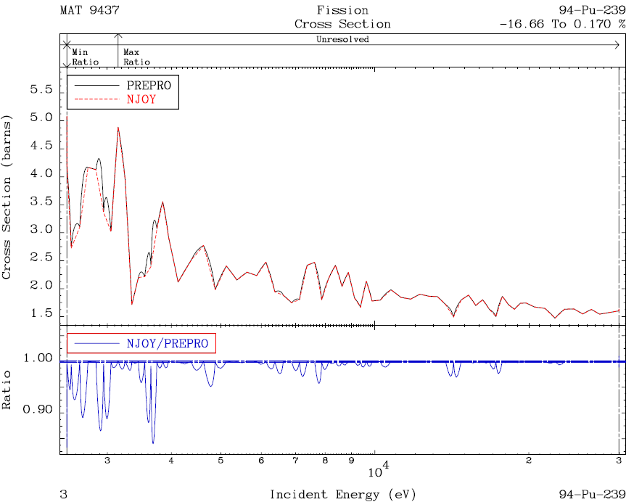
²³⁹Pu Unresolved resonance range
²³⁹Pu (NJOY) deviates from ENDF-6 rules in URR
Switching to LSSF=1 representation can help

Slide 22
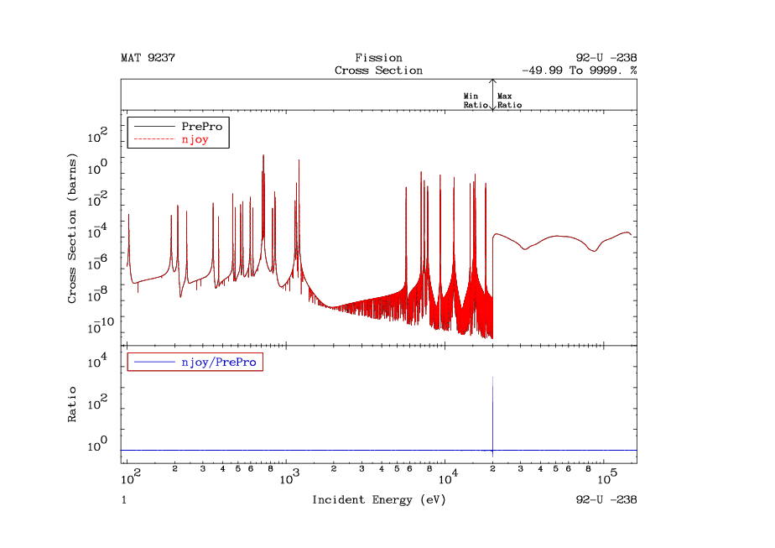
²³⁸U Fission Cross Section

Slide 23
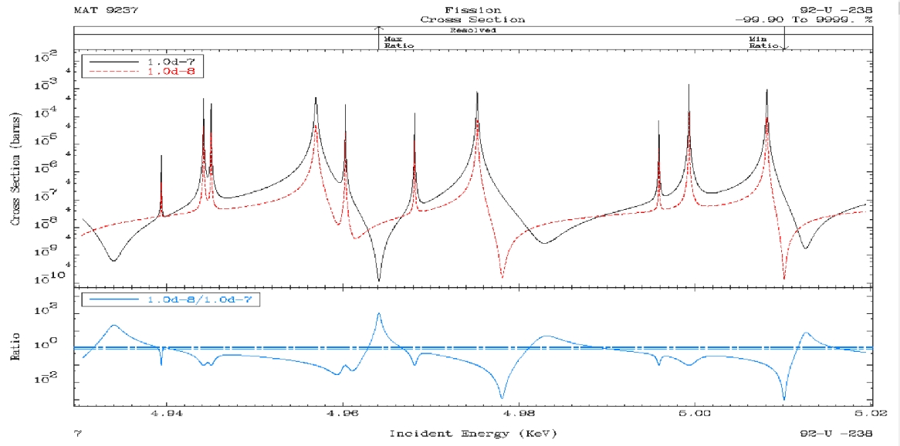
²³⁸U Fission Cross Section
(Provided by D.E. Cullen)

Slide 24
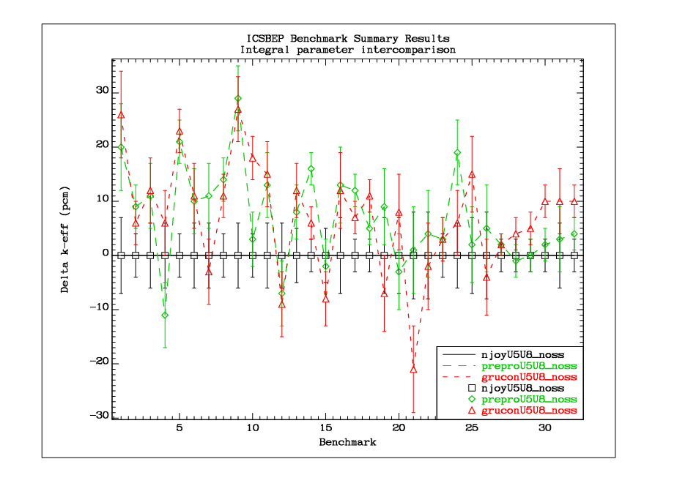
Impact on selected ICSBEP benchmarks
Only ²³⁵U and ²³⁸U x.s. changed
Notes:
There seems to be some bias in NJOY results, consistent with the observed lower precision in reconstructing the cross sections.
Note the scale, however!

Slide 25
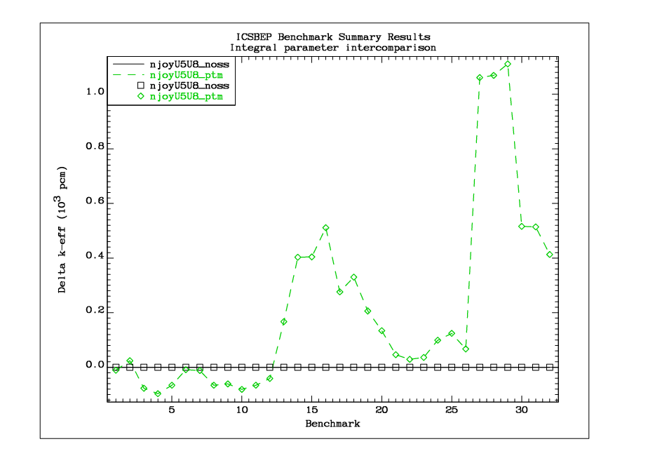
Self-shielding in the URR - importance
Only ²³⁵U and ²³⁸U x.s. changed

Slide 26
Self-shielding in the URR - methods
NJOY probability table method (PTM)
PrePro multi-band parameters
GRUCON average parameters (preliminary , ACE files provided by V. Sinitsa)
Analysis is limited to ²³⁵U and ²³⁸U, the rest is taken from the generic MCNP library)

Slide 27
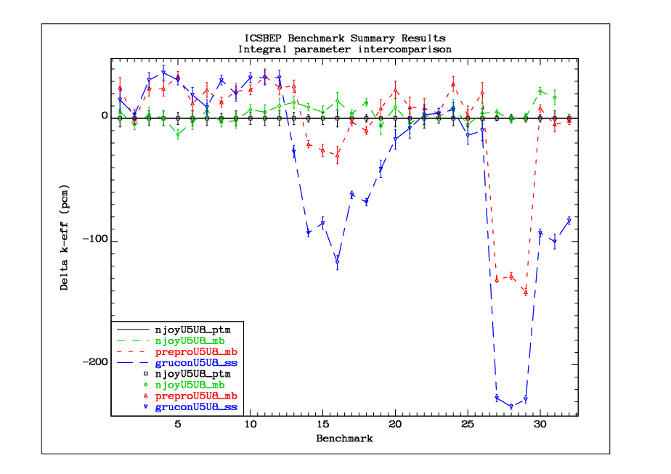
Self-shielding in the URR - methods
Only ²³⁵U and ²³⁸U x.s. changed

Slide 28
Conclusions
Discrepancies in integral benchmarks with similar spectra and sensitivities should be resolved
One should be careful in the interpretation of FoM
MC calculations are NOT exact – be aware of uncertainties due to data processing and due to methods

Slide 29
Conclusions (cont.)
With current data libraries we are converging for well-defined benchmarks; tight convergence criteria are needed
Detailed benchmark models should be used whenever possible to avoid ambiguities

Slide 30
List of benchmarks in the study of methods
1 HEU-MET-FAST-001 hmf001 Godiva
2 HEU-MET-FAST-002 hmf002-2 Topsy-2
3 HEU-MET-FAST-003 hmf003-01 Topsy-U_2.0in
4 HEU-MET-FAST-003 hmf003-02 Topsy-U_3.0in
5 HEU-MET-FAST-003 hmf003-03 Topsy-U_4.0in
6 HEU-MET-FAST-003 hmf003-10 Topsy-W_4.5in
7 HEU-MET-FAST-003 hmf003-11 Topsy-W_6.5in
8 HEU-MET-FAST-014 hmf014 VNIIEF-CTF-DU
9 HEU-MET-FAST-032 hmf032-1 COMET-TU1_3.93in
10 HEU-MET-FAST-032 hmf032-2 COMET-TU1_3.52in
11 HEU-MET-FAST-032 hmf032-3 COMET-TU1_1.742in
12 HEU-MET-FAST-032 hmf032-4 COMET-TU1-0.683in
13 IEU-COMP-FAST-004 icf004 ZPR-3/12
14 IEU-MET-FAST-007 imf007 Big_Ten
15 IEU-MET-FAST-007 imf007d Big_Ten(detailed)
16 IEU-MET-FAST-010 imf010 ZPR-6/9(U9)
17 IEU-MET-FAST-012 imf012 ZPR-3/41
18 IEU-MET-FAST-013 imf013 ZPR-9/1
19 IEU-MET-FAST-014 imf014-2 ZPR-9/2
20 IEU-MET-FAST-022 imf022-01 FR0_3X-S
21 IEU-MET-FAST-022 imf022-02 FR0_5-S
22 IEU-MET-FAST-022 imf022-03 FR0_6A-S
23 IEU-MET-FAST-022 imf022-04 FR0_7-S
24 IEU-MET-FAST-022 imf022-05 FR0_8-S
25 IEU-MET-FAST-022 imf022-06 FR0_9-S
26 IEU-MET-FAST-022 imf022-07 FR0_10-S
27 MIX-MISC-FAST-001 mif001-01 BFS-35-1
28 MIX-MISC-FAST-001 mif001-02 BFS-35-2
29 MIX-MISC-FAST-001 mif001-03 BFS-35-3
30 MIX-MISC-FAST-001 mif001-09 BFS-31-4
31 MIX-MISC-FAST-001 mif001-10 BFS-31-5
32 MIX-MISC-FAST-001 mif001-11 BFS-42

