Slide 1
Miscellaneous ENSDF topics

Slide 2
ENSDF workflow options

Slide 3
Prolog Front Page

Slide 4
Summary Page

Slide 5
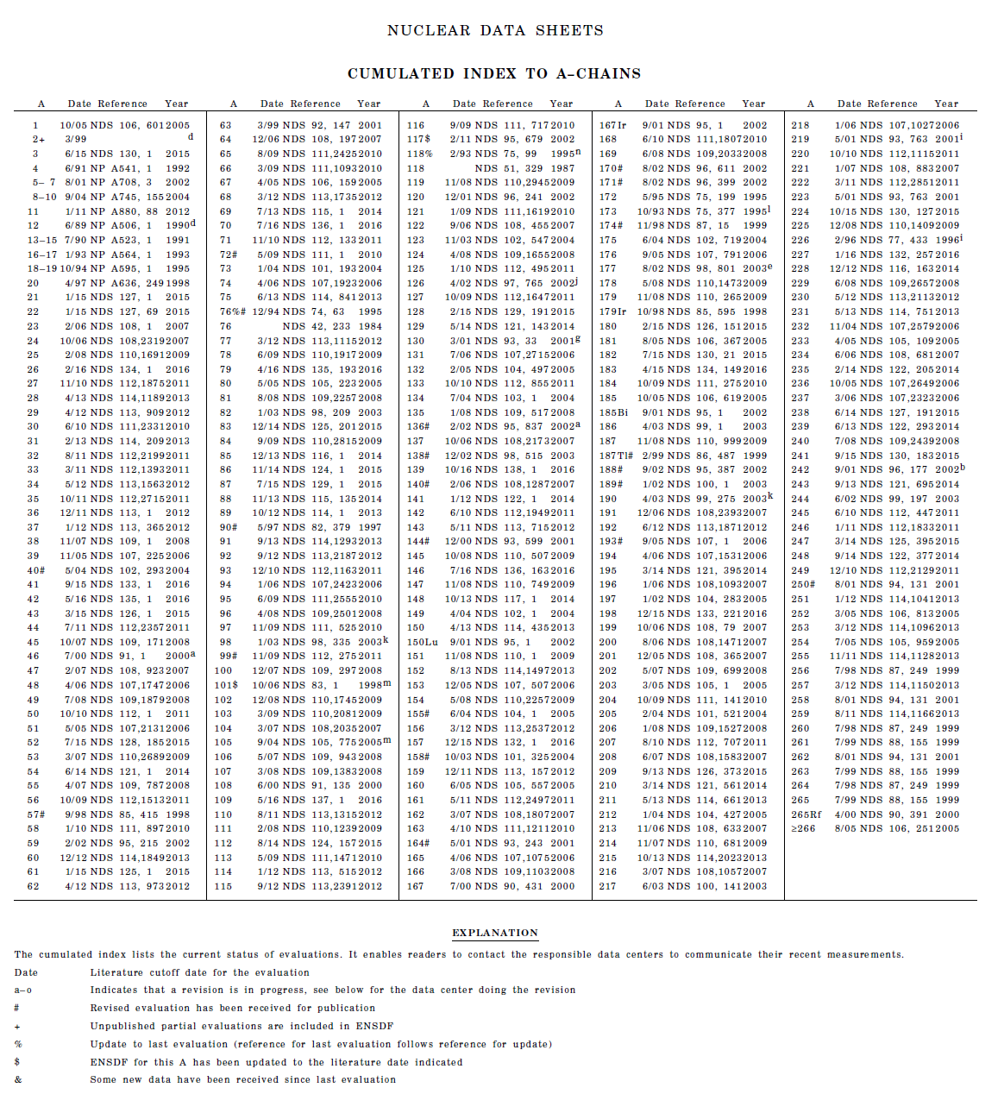
Index Page

Slide 6
Is there interest?
Runs smoothly on internal BNL server
Potential to make available to outside world
Is there significant added benefit to evaluators?

Slide 7
Reviewing

Slide 8
Proposed changes to review policies
Reviews will be counted when they are turned in
(as opposed to when they were requested)
Editorial review will be conducted immediately following peer review, both set of comments provided back to evaluator
In terms of metrics, reviews will be counted as
0.X * nuclides and 0.X * Adopted Levels
(My vote is X=1 to 2)

Slide 9
Citations

Slide 10
Very basic citation requests
In Abstract: refer to all prior ENSDF evaluations
In cut-off: refer to NSR reference
In Acknowledgements: mention XUNDL
(from Balraj’s A=139 evaluation)

Slide 11
Additional Request for Abstract
Any ENSDF evaluation yields :
Inconsistencies
Deficiencies
Questions
List is filtered then posted to “Structure” High Priority Website
A first step :
Evaluator generates summary list of “issues” relating to the evaluation
Quantity | Value | Ref (s) | Comments
B(M1) | 50 W.u. | 2010Ka25 | Too large

Slide 12
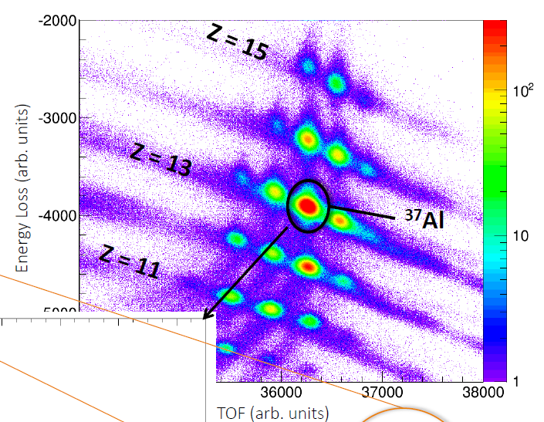
An example
Most likely not all will be analyzed…
But if researchers knew there was a reason to, they could investigate
From Heather Crawford, ND meeting talk

