Slide 1
A few Words on ¹²C (some highlighted literature)
John Kelley

Slide 2
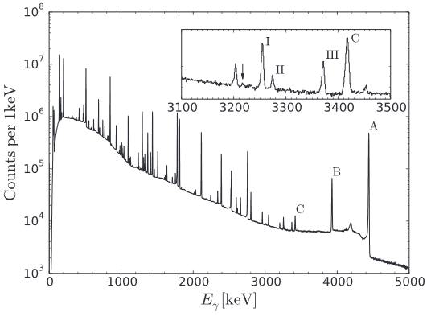
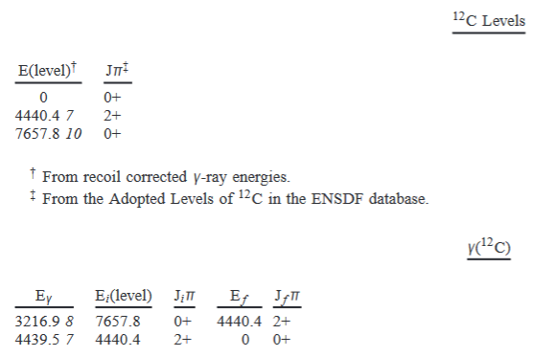
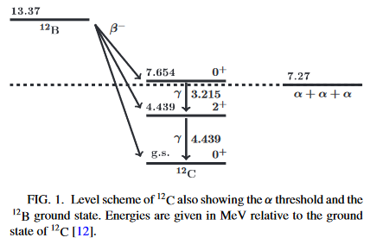
Ex=4438.91 pm 0.31
Since FAS 1980

Slide 3
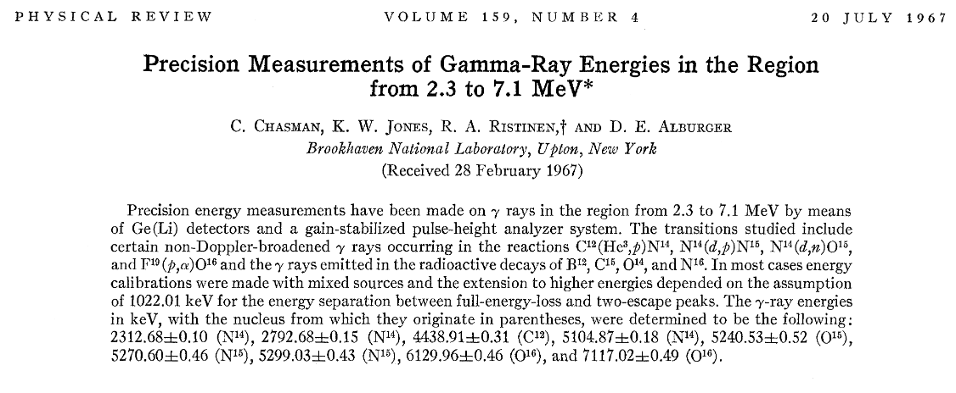
Disagreement solved

Slide 4
Ex=7654.07 pm 0.19
Nolen/Austin 1976

Slide 5
Disagreement persists:
Gammasphere Ex=7657.8 pm 1.0

Slide 6
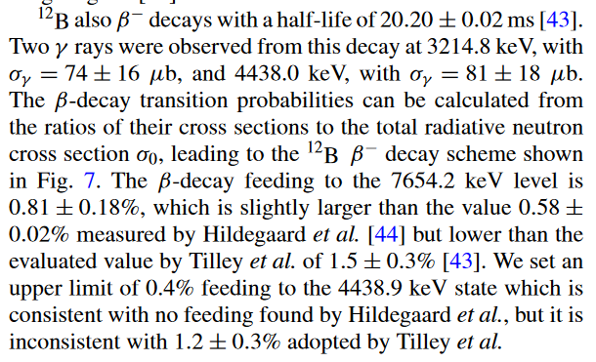
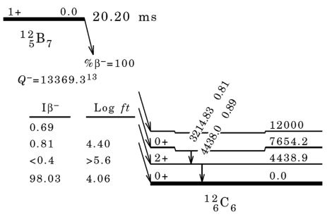
Something from Left Field
Γ_{γ}/Γ~10⁻⁴

Slide 7
