Slide 1
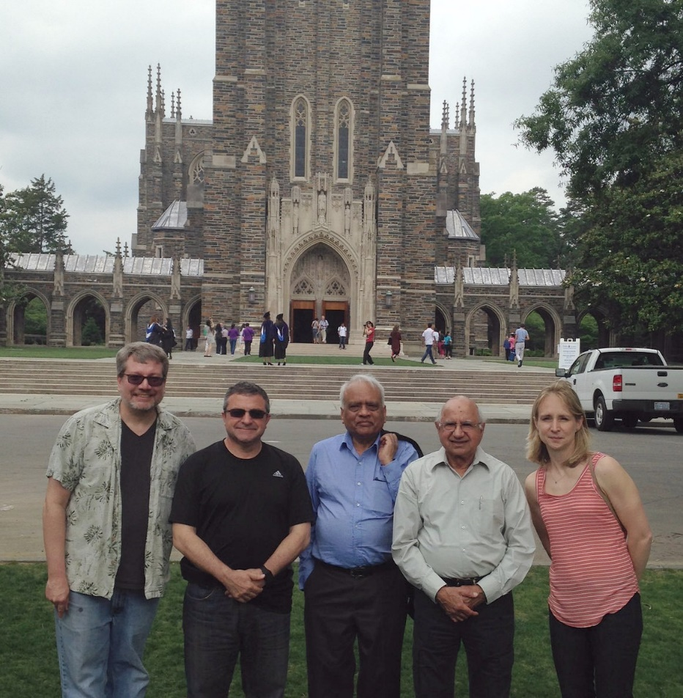
Workshop on validation and implementation of NDS-Java Triangle Universities Nuclear Laboratory Secretary: J.H. Kelley May 9-11, 2016
Participants: Balraj Singh, Jun Chen, Jagdish Tuli, Libby McCutchan, Filip Kondev, Shamsu Basunia, Grace Sheu, John Kelley.

Slide 2
Objectives
The first order of business was to clarify the objectives. The aim was to arrive at the final description of changes in the NDS-Java code that will describe the appearance of the .pdf output file produced by Latex’ing the NDS-Java code output. We concluded the focus would be on verifying the completeness of the output, the legibility of the information and the aesthetic presentation.

Slide 3
Agenda: as developed at the meeting
Discussion on General Structure of the Output
Tables
Drawings
Comments (including flagged footnotes)
References
Translation
Execution of the program
Distribution/installation
Control file
Specialized comments
Implementation

Slide 4
Implementation
Next major version is expected in July, with a major update to follow in August (to implement more difficult suggested changes in drawings).
XUNDL submissions will be used to evaluate NDS-Java performance.
NSDD/NDS submissions will utilize NDS-Java for the review process starting in August.
Aim for January transition to publish Nuclear Data Sheets manuscripts using NSD-Java.

Slide 5
Summary of the workshop findings
The move from NSD-pub to NDS-Java is favored.
All present are agreeable to the new format with the suggested tweaks added. Prior to the workshop, the attendees had sought input from users that critiqued the proposed new presentation. Those comments carried a clear favorability toward the changes present in the NDS-Java output.
Jun and Balraj have done an outstanding job

