Slide 1
JAVA-NDS

Slide 2
New submission policy
With JAVA-NDS, evaluators can easily generate their own pdf
Propose to eliminate the “pre-review” stage
Evaluator’s generate pdf using default JAVA-NDS settings, send pdf and .ens file to NNDC
This copy will be sent to reviewer without any
processing by NNDC

Slide 3
Prior to submission
Run FMTCHK
Run Pandora
Check references
Check bands
Check band labels

Slide 4
At publication stage
NNDC will assume responsibility for processing
Help with typos, bands, references, bugs, etc

Slide 5
Band drawings
Adopted Levels --- Bands only
Decay Datasets --- Level Drawings
High-spin Datasets --- No drawings (by request)
Low-spin Datasets --- No drawings (by request)
On index page, indicate L or B next to dataset you’d
like to have level or band drawing

Slide 6
Attempts to be more transparent
From Rick Casten’s talk at ND meeting:
Most users know how to use one or two narrow aspects of the site – in nuclear structure, this is often (for me as well) the evaluated data (Adopted levels and gammas) for individual nuclei.
Example: In a small poll, only about 1 in 4 had even heard of the “word” XUNDL !!
The NNDC and NDS should be transparent to the average casual user (impossible but aim for it)

Slide 7
Minor (major) changes
Is cross reference flag the best name?

Slide 8
Minor (major) changes
Data Sets (DS)
DS

Slide 9
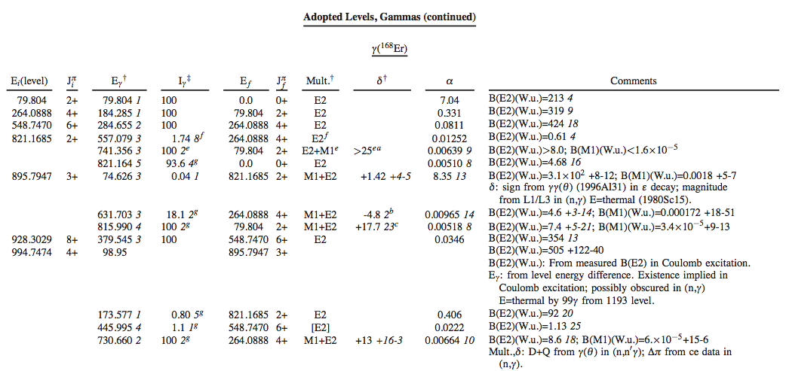
Alpha
What are these α? Very confusing – poll (??)
Answer: theoretical
Example -- Caution: [M1,E2] with alpha = 1.37 (20)
What does this mean? Where did alpha come from?
Again borrowed from Rick Casten’s talk

Slide 10
Minor (major) changes
JAVA-NDS automatically generates a footnote
@
Balraj’s suggestion:
@ Theoretical conversion coefficients from BrIcc v2...(date) (2008Ki07) with "Frozen Orbital“ approximation. Uncertainty given is 1.4% of the value which represents the accuracy of the theory and its numerical interpolation.

