Slide 1
Nuclear Data Activities at the IAEA 2015-2016
Paraskevi (Vivian) Dimitriou
Nuclear Data Section,
International Atomic Energy Agency,
Vienna, Austria

Slide 2
What have we done in 2015-2016 and what next?
European effort
Training
Codes
Contracts/Consultancies
CRPs
Future plans
22nd NSDD Meeting

Slide 3
European NSDD Effort 2015-2016
Recommendation of 21st NSDD Meeting 2015: European NSDD members and advisors should hold a special meeting to discuss European NSDD shortfall

Slide 4
History
Data Centers | Year
 | 1981 | 1986 | 1996 | 2008 | 2015 | 2015:FTE
North America | 6 | 6 | 6 | 6 | 7 | 6.9
Europe | 6 | 5 | 4 | 1->0 | 2 | 0.9
Russia | 2 | 2 | 2 | 1 | 1 | 0.2
Japan | 1 | 1 | 1 | 1 | 1 | 0.2
China | - | - | 1 | 2 | 2 | 0.4
Rest of the world | 1 | 1 | 1 | 3 | 2 | 0.8
 |  |  |  |  | Total | 9.4

Slide 5
Meeting recommendations
Liaise with ESF Nuclear Physics European Collaboration Committee (NuPECC) to promote NSDD evaluation in Europe
Promotion of European NSDD at conferences
Expand European NSDD Consortium
Document sent to all NuPECC members (IAEA)
NSDD presentation at NuPECC meeting (Oct.2016)
Contribution to NuPECC Long Range Plan ACCEPTED
European NSDD effort presented at ND2016 (Negret),
INPC2016 (Dimitriou), UK CARM2016 (Dimitriou)
Aim to create an inclusive European NSDD Consortium to enhance
support across Europe – MoU is being sent out

Slide 6
More actions…
AIM: make nuclear data more visible in Europe by engaging with European Nuclear Structure community on many levels:
UK Nuclear Data Network (funded by UK)
official launch at CARM2016
European CERN-Medicis facility/program on medical isotope production
Engage European nuclear structure community in IAEA nuclear data projects (ICTP workshops, CRPs, meetings)

Slide 7
Training activities
BRNS Workshop on
Evaluation of NSDD
ICTP-IAEA Workshop
Homi Bhabha Centre for
Science Education
Tata Institute for Fundamental Research,
Mumbai, India
29.2 – 4.3 2016

Slide 8
BNRS Workshop on Evaluation of NSDD
Homi Bhabha Centre for Science Education, Mumbai: 29. Feb.-4 March 2016
35 students (PhD students, post-docs, junior researchers)
Lecturers: J. Tuli, A.K. Jain, G. Mukherjee, S. Kumar,
S. Ganesan, S.S. Dhindsa, R. Plait, P. Joshi, P. Dimitriou
Lectures on nuclear structure theory, experimental
techniques, ENSDF methodology, spin-parity assignment, averaging methods
Practical courses: evaluation of mass chain A=223 (India DC responsibility)

Slide 9
BNRS Workshop on Evaluation of NSDD
Homi Bhabha Centre for Science Education, Mumbai: 29. Feb.-4 March 2016
35 students (PhD students, post-docs, junior researchers)
Lecturers: J. Tuli, A.K. Jain, G. Mukherjee, S. Kumar,
S. Ganesan, S.S. Dhindsa, R. Plait, P. Joshi, P. Dimitriou
Lectures on nuclear structure theory, experimental
techniques, ENSDF methodology, spin-parity assignment, averaging methods
Practical courses: evaluation of mass chain A=223 (India DC responsibility)
Workshop funded by India National Data Centre
Potential for locally funded XUNDL workshops

Slide 10
Joint ICTP-IAEA Workshop on Nuclear Structure and Decay Data: Experiment, Theory and Evaluation, 22 Aug.-2 Sept. 2016, Trieste
Directors: P. Dimitriou, E. McCutchan, M. Thoennessen
Lecturers:
E. McCutchan (BNL)
M. Thoennessen (MSU)
H. Sakurai (RIKEN)
P. Regan (Surrey)
P. Van Isacker (GANIL)
J. Tuli (BNL)
F. Kondev (ANL)
B. Singh (McMaster)
T. Kibedi (ANU)
S. Basunia (LBL)
M. Verpelli (IAEA)
V. Zerkin (IAEA)

Slide 11
Joint ICTP-IAEA Workshop on Nuclear Structure and Decay Data: Experiment, Theory and Evaluation, 22 Aug.-2 Sept. 2016, Trieste
Emphasis on experimental techniques, facilities and new data
Detailed demonstration/use of ENSDF Analysis and Checking codes, ENSDF editor, data retrieval (Nudat, LiveChart)
Compilation of XUNDL data sets: 22 new data sets
Evaluation of mass chain A = 217 (ongoing)
13 paid participants (budget constraints)
Only 1 from ‘developed’ country (UK)
Background/level: high

Slide 12
Joint ICTP-IAEA Workshop on Nuclear Structure and Decay Data: Experiment, Theory and Evaluation, 22 Aug.-2 Sept. 2016, Trieste
Lectures were excellent: but more emphasis needed on comparison of various experimental techniques
Demo of analysis+checking codes/retrievals was the most appreciated
XUNDL+ENSDF is better
All lecture notes and questionnaire are available on:
http://indico.ictp.it/event/7641/

Slide 13
Joint ICTP-IAEA Workshop on Nuclear Structure and Decay Data: Experiment, Theory and Evaluation, 22 Aug.-2 Sept. 2016, Trieste
Feedback:
Learn more at this workshop than
at any other
Lectures were excellent: but more emphasis needed on comparison of various experimental techniques
Demo of analysis+checking codes/retrievals was the most appreciated
XUNDL+ENSDF is better
Message to USNDP:
PLEASE send your young researchers or
PhD students to this workshop !!!
All lecture notes and questionnaire are available on:
http://indico.ictp.it/event/7641/

Slide 14
Coordinated Project on Improvement of Analysis Codes for NSDD Evaluation
JGAMUT (to produce adopted Levels and Gammas): released BUT improvements underway (Birch/Singh)
ALPHAD_new: incorporates r0 tables for all nuclides (odd-odd, odd-A): READY to BE RELEASED (Singh/Kumar/Singh)
Beta Shape (beta decay spectra): released on DDEP website (Mougeot, LNHB)
ENSDF Editor: NEW
NEW Web-based tree-level editor: ensdf± (Zerkin) is AVAILABLE for testing

Slide 15
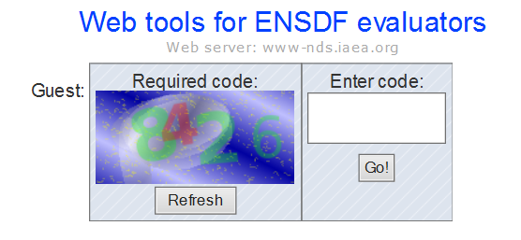
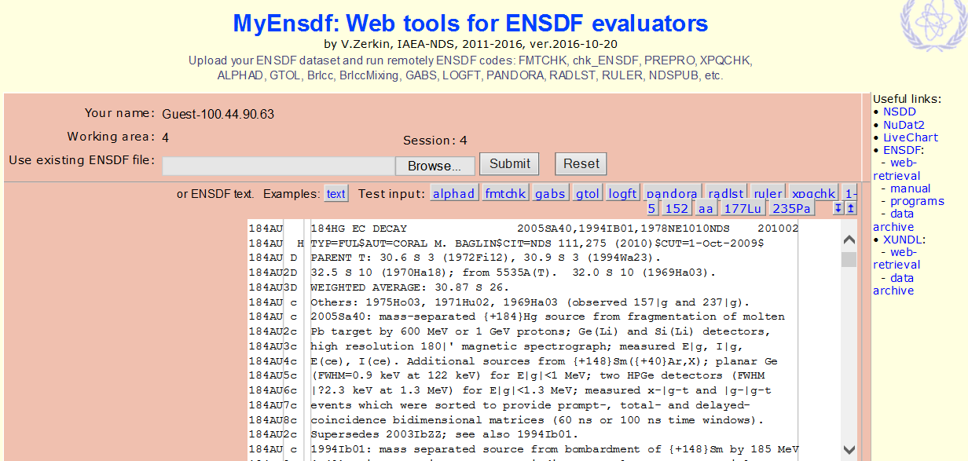
New ENSDF editor

Slide 16
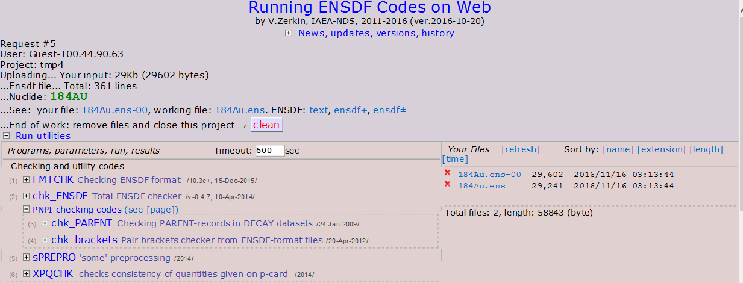
New ENSDF editor

Slide 17
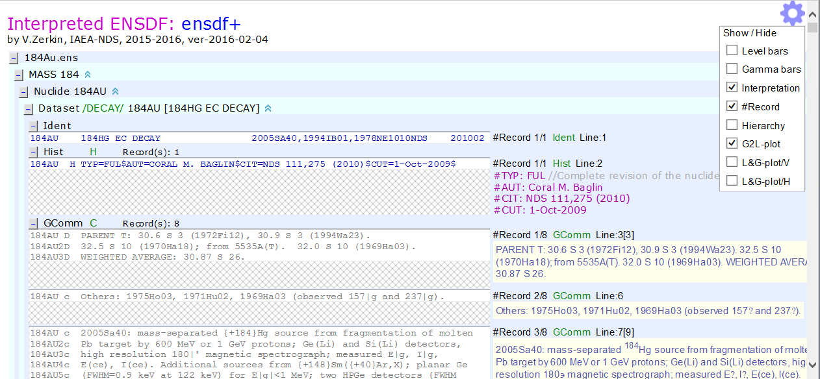
ENSDF editor interpreted: ensdf+

Slide 18
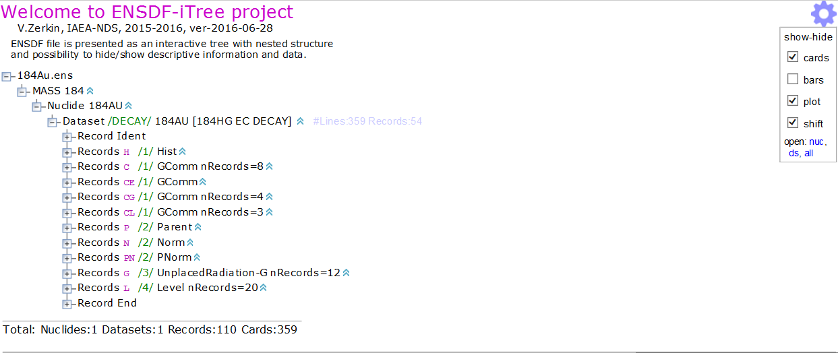
ENSDF-iTree editor

Slide 19
Consultancy Visits 2015-2016
Paddy Regan (UK): European NSDD effort
Filip Kondev (USA): LiveChart development/improvement
Georges Audi (France): NUCLEUS software (to be disseminated by IAEA) + AME mirror site
Rodionov, Shulyak (Russia): ENSDF dictionariy for ENSDF±
Financial Support 2015-2016
Mass chains (2015-2016)
Abusaleem (JOR) to end 2016
Dhindsa (IND) to end 2016 (includes support for codes)
Pascu (ROM) to start 2017
Other contracts
Singh (beta-delayed neutrons)
Audi (NUCLEUS)

Slide 20
Coordinated Research Projects
CRP on Nuclear Data for Charged-particle Monitor Reactions and Medical Isotope Production (2012-2016):
https://www-nds.iaea.org/relnsd/vcharthtml/MEDVChart.html
CRP on Reference Database for Beta-Delayed Neutron Emission (2013-2017): http://www-nds.iaea.org/beta-delayed-neutron/
CRP on Photonuclear Data and Photon Strength Functions (2016-2020):
http://www-nds.iaea.org/CRP-photonuclear/
CRP on Testing and Improving the International Reactor Dosimetry and Fusion File (IRDFF) (2013-2017): https://www-nds.iaea.org/IRDFFtest/
CRP on Primary Radiation Damage Cross Sections (2013-2017):
http://www-nds.iaea.org/CRPdpa/

Slide 21
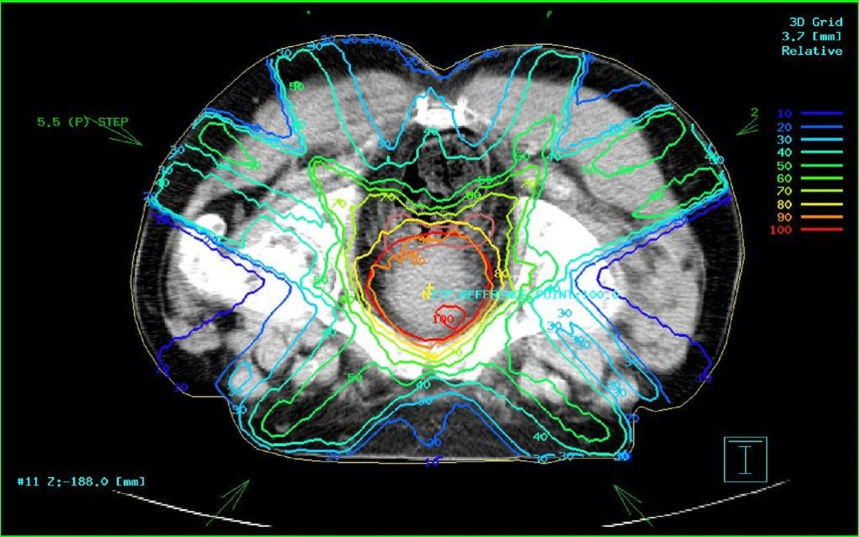
CRP on Nuclear Data for Charged-particle Monitor
Reactions and Medical Isotope Production: 2012-2016
Diagnosis Cancer therapy
Beneficiaries: patients, medical physicists, radioisotope producers, …….
Objectives: improve data for medical radioisotope production, and for patient dose delivery calculations in radiotherapy
c/o: Alan Nichols

Slide 22
Intermediate-term Nuclear Data Needs for Medical Applications:
Cross Sections and Decay Data
Technical Meeting, 22-26 August 2011, IAEA report INDC(NDS)-0596
also impact of 2012-2017 CRP: IAEA reports INDC(NDS)-0675 and 0717
Predominantly charged-particle cross sections: measurements and evaluations in CRP
Decay data: mainly evaluations in CRP
green – considered/no recommended action; black – required/included in CRP; red – required/not in CRP (too many requests for one CRP)
Diagnostic gamma emitters:
Cross sections – ⁵¹Cr, ^{64,67}Cu, ^{90,90m}Y, ⁹⁹Mo/^{99m}Tc, ⁹⁷Ru, ¹¹¹In, ¹²¹I, ¹²³I, ¹²³Xe, ¹²³Cs,
¹⁴⁷Gd (MRI+SPECT), ^{186,188}Re, ^{200,201,202m}Pb, ²⁰³Pb
Decay data ‒ ⁶⁷Cu, ^{99m}Tc (Auger electrons), ¹²³I (Auger electrons), ¹¹¹In (Auger electrons),
¹⁴⁷Gd (MRI+SPECT), ²⁰³Pb
Positron emitters:
Cross sections ‒ ¹¹C, ¹³N, ^{14,15}O, ³⁰P, ^{34m}Cl, ³⁸K, ⁴³Sc, ⁴⁵Ti, ⁴⁸V, ⁴⁹Cr, ⁵¹Mn, ^{52,52m}Mn (MRI+PET), ⁵²Fe, ⁵⁵Co, ⁵⁷Ni, ⁶¹Cu, ⁶⁴Cu, ^{66,68}Ga, ⁷²As, ⁷³Se, ⁷⁵Br, ⁷⁶Br, ⁷⁷Kr, ^{81,82m}Rb, ⁸³Sr, ⁸⁶Y, ⁸⁹Zr, ⁹⁰Nb, ^{94m}Tc, ⁹⁵Ru, ^{110m}In, ¹²⁰I, ¹²¹I, ¹²⁴I, ¹⁵²Tb
Decay data – ⁴³Sc, ^{52,52m}Mn (MRI+PET), ⁵²Fe, ⁵⁷Ni, ⁶⁴Cu, ⁶⁶Ga, ⁶⁸Ga, ⁷²As, ⁷³Se, ⁷⁵Br, ⁷⁶Br, ⁷⁷Kr, ^{81,82m}Rb, ⁸³Sr, ⁸⁶Y, ⁸⁹Zr, ^{94m}Tc, ⁹⁵Ru, ¹²⁰I, ¹²¹I, ¹²⁴I, ¹⁵²Tb
Positron emitters, generator systems:
Cross sections – ⁴⁴Ti/⁴⁴Sc, ⁵²Fe/^{52m}Mn (MRI+PET), ⁶²Zn/⁶²Cu, ⁶⁸Ge/⁶⁸Ga, ⁷²Se/⁷²As, ⁸²Sr/⁸²Rb, ¹¹⁰Sn/^{110m}In, ¹¹⁸Te/¹¹⁸Sb, ¹²²Xe/¹²²I, ¹²⁸Ba/¹²⁸Cs, ¹⁴⁰Nd/¹⁴⁰Pr (radiotherapy+PET)
Decay data – ⁴⁴Ti half-life, ⁵²Fe/^{52m}Mn (MRI+PET), ⁶²Zn/⁶²Cu, ⁷²Se/⁷²As, ¹⁴⁰Nd/¹⁴⁰Pr
c/o: Alan Nichols

Slide 23
Intermediate-term Nuclear Data Needs for Medical Applications:
Cross Sections and Decay Data
Technical Meeting, 22-26 August 2011, IAEA report INDC(NDS)-0596
also impact of 2012-2017 CRP: IAEA reports INDC(NDS)-0675 and 0717
Predominantly charged-particle cross sections: CRP measurements and evaluations
Decay data: CRP mainly evaluations
green – considered/no recommended action; black – required/included in CRP; red – required/not in CRP (too many requests for one CRP)
Therapeutic beta and X-ray/gamma emitters:
Cross sections – ⁴⁷Sc, ⁶⁷Cu, ¹⁰³Pd, ¹³¹Cs, ¹³¹Ba, ¹⁶¹Gd/¹⁶¹Tb, ¹⁶⁶Dy/¹⁶⁶Ho, ¹⁶⁹Er, ¹⁷⁵Yb,
¹⁹¹Os/^{191m}Ir (radiotherapy+SPECT), ¹⁹¹Pt/^{191m}Ir
Decay data – ⁴⁷Sc, ⁶⁷Cu, ¹⁰³Pd/^{103m}Rh, ¹³¹Cs, ¹³¹Ba, ¹⁶¹Tb, ¹⁶⁶Ho, ¹⁶⁹Er, ¹⁷⁵Yb, ¹⁹¹Pt (parent of ^{191m}Ir)
Therapeutic Auger-electron emitters:
Cross sections – ⁶⁷Ga, ⁷¹Ge, ⁷⁷Br, ^{99m}Tc, ¹⁰³Pd, ¹¹¹In, ¹²³I, ¹³¹Cs, ¹³¹Ba/¹³¹Cs, ¹⁴⁰Nd, ¹⁷⁸Ta, ¹⁷⁸W/¹⁷⁸Ta, ^{193m,195m}Pt, ¹⁹⁷Hg
Decay data – ⁶⁷Ga, ⁷¹Ge, ⁷⁷Br, ^{99m}Tc, ¹⁰³Pd/^{103m}Rh, ¹¹¹In/^{111m}Cd, ¹²³I, ¹²⁵I, ¹³¹Cs, ¹⁴⁰Nd, ¹⁷⁸Ta, ^{193m,195m}Pt, ¹⁹⁷Hg
Therapeutic alpha emitters:
Cross sections – ¹⁴⁹Tb, ²¹¹At/²¹¹Po, ²²⁹Th/²²⁵Ac/²¹³Bi, ²²⁷Ac/²²⁷Th/²²³Ra, ²³⁰U/²²⁶Th
Decay data – ¹⁴⁹Tb, ²¹¹Ac/²¹¹Po, ²²⁵Ac/²¹³Bi, ²²⁷Ac/²²⁷Th/²²³Ra, ²³⁰U decay chain
Monitor reactions:
Cross sections – ^{22,24}Na, ⁴⁶Sc, ⁴⁸V, ^{56,58}Co, ^{62,63,65}Zn, ^{66,67}Ga, ^{96,96m}Tc (reconsider ⁵¹Cr, ⁵⁷Ni, ⁶¹Cu)
Decay data – ⁶¹Cu, ⁶²Zn, ⁶³Zn
c/o: Alan Nichols

Slide 24
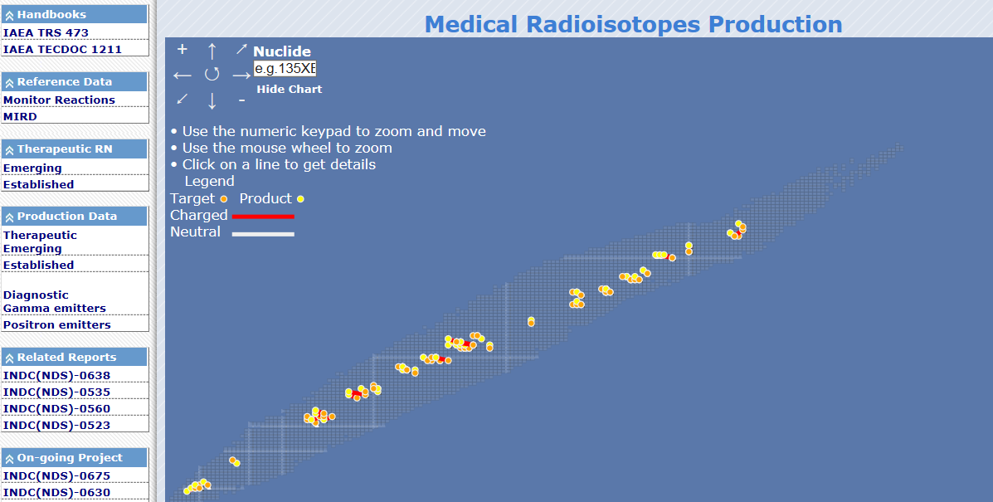
Where can we find these data? Medical Portal: www-nds.iaea.org/medportal/

Slide 25
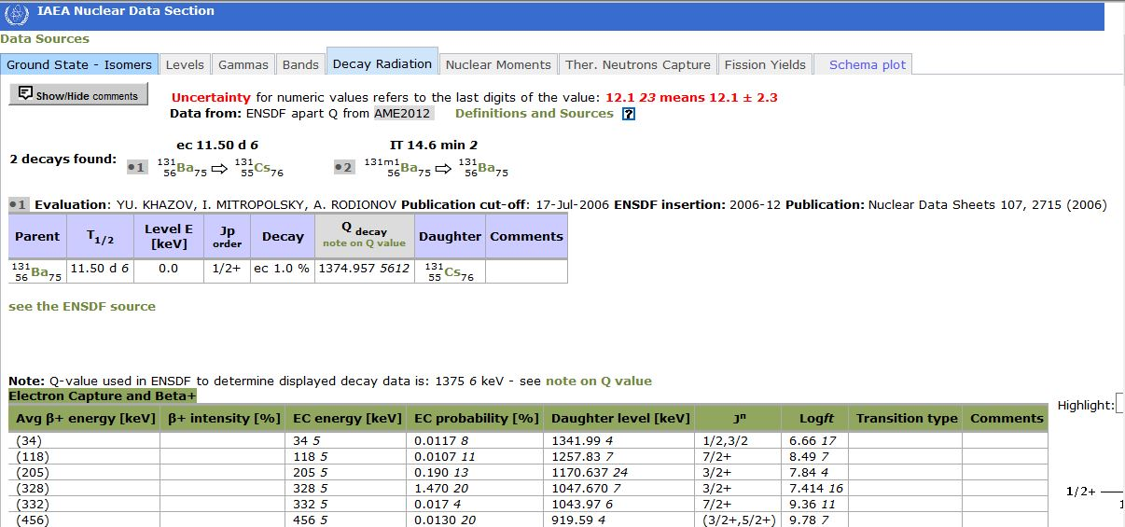
Medical Portal https://www-nds.iaea.org/relnsd/vcharthtml/MEDVChart.html

Slide 26
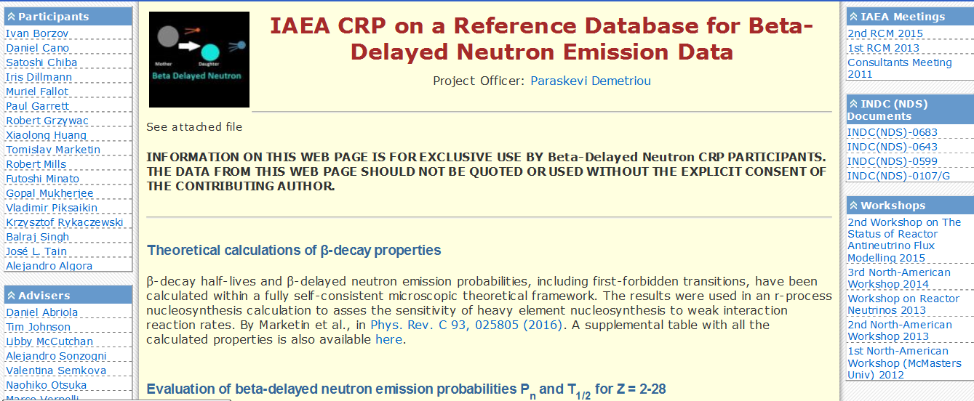
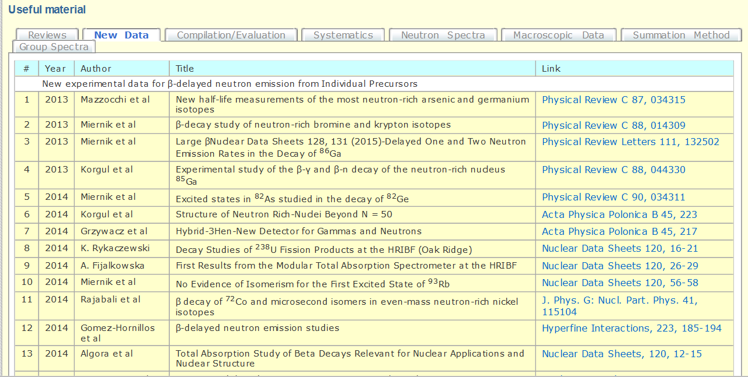
http://www-nds.iaea.org/beta-delayed-neutron/
Objective:
Create a Reference Database for Beta-Delayed Neutron Emission that contains both a compilation of existing data as well as recommended data for individual precursors and aggregate quantities (nu-bars, group constants)

Slide 27
Work done: 2nd RCM 23-27 March 2015:
INDC(NDS)-0683, July 2015
Compilation and evaluation microscopic data for Z = 2-28
M. Birch, et al., First Compilation and Evaluation of Beta Delayed-neutron Emission Probabilities and Associated Half-lives for A ≤ 72 Nuclei, Nucl. Data Sheets 120 (2014) 66-69.
M. Birch, et al., Evaluation of Beta Delayed-neutron Emission Probabilities and Half-lives for Z = 2-28, Nucl. Data Sheets 128 (2015) 131-184.
DN spectra: analysis by J-L. Tain, INDC(NDS)-0683;
Digitization by VECC (Banerjee/Mukherjee); NDS-IAEA
Systematics
E.A. McCutchan, et al., Improving Systematic Predications of β⁻ Delayed-neutron Emission Probabilities, Phys. Rev. C86 (2012) 041305.
E.A. McCutchan, et al., A New Approach to Estimating the Probability for β⁻ Delayed-neutron Emission, Nucl. Data Sheets 120 (2014) 62-65.
Theoretical calculations
Marketin et al, PRC 93 (2016) 025805;
Minato, JPS Conference Proceeding Vol.6 030053 (2015)
Sensitivity studies of macroscopic quantities: nu-bars, DN spectra
V.M. Piksaikin, et al., IAEA report INDC(NDS)-0646, October 2013; INDC(NDS)-0689, June 2015.

Slide 28
Work in progress (3rd RCM 12-16 June 2017)
Compilation and evaluation of microscopic data for → Z = 29-57 and Z > 57 (about 200 nuclides) (Singh, Birch, Huang, Banerjee, Dillmann, Algora, Abriola)
Pn standards and reference spectra (digitization of all available spectra) (Tain, Banerjee, Singh, IAEA)
New Systematics on evaluated data (McCutchan, Sonzogni, Miernik)
Theory → Density Functional Theory (Marketin), HFBCS (Minato), cQRPA (Borzov)
Benchmarking of Pn wrt macroscopic DN properties: nu-bars, DN spectra (Mills, Piksaikin, Sonzogni, Cano-Ott, Chiba)
Re-evaluation of group constants for neutron yield decay curves (Piksaikin, Mills)
Measurements:
RIKEN (2016-2017)
1. first measurement of P_{1n} → ⁷⁶Co, ^{78,79}Ni, ^{80,81}Cu, ^{83,84,85}Zn, ^{85,87}Ga, ⁸⁷⁻⁹⁰Ge, ⁸⁸⁻⁹¹As, ^{90,92}Se
first measurement of P_{2n} → ^{80,81,82}Cu, ^{83,84}Zn, ^{84,85,87}Ga, ^{87,88}Ge, ⁸⁸⁻⁹¹As,
2. first measurement of P_{1n}, P_{2n}, P_{3n} → ¹²¹⁻¹²⁷Rh, ^{128,129}Pd, ^{130,131}Ag, ^{133,134}Cd, ^{135,136}In, ^{138,139, 140}Sn, ^{140,141}Sb, ^{142,143}Te, ^{144,145,146}I, ^{147,148}Xe, ^{149,150,151}Cs, ^{150,151,152}Ba
ISOLDE (July/Oct 2015): ⁴⁰⁻⁵³K, ^{130,131,132}Cd
CARIBU (2015-2018): ^{109,110}Mo, A=136,137, ^{98m,99-103}Y, ^{134,135,136}Sn
TRIUMF (2015-2016): ⁹Li, ⁴⁹K, ^{130,131,132}Cd, ^{133,134}In, ^{145,146}Cs
ALTO (2015-2016): ¹³⁰⁻¹³⁴In, ^{133,134,136}Sn

Slide 29
Work in progress (3rd RCM 12-16 June 2017)
Compilation and evaluation of microscopic data for → Z = 29-57 and Z > 57 (about 200 nuclides) (Singh, Birch, Huang, Banerjee, Dillmann, Algora, Abriola)
Pn standards and reference spectra (digitization of all available spectra) (Tain, Banerjee, Singh, IAEA)
New Systematics on evaluated data (McCutchan, Sonzogni, Miernik)
Theory → Density Functional Theory (Marketin), HFBCS (Minato), cQRPA (Borzov)
Benchmarking of Pn wrt macroscopic DN properties: nu-bars, DN spectra (Mills, Piksaikin, Sonzogni, Cano-Ott, Chiba)
Re-evaluation of group constants for neutron yield decay curves (Piksaikin, Mills)
These data will be available from an
online IAEA database
Question: will they be incorporated in
ENSDF?
Measurements:
RIKEN (2016-2017)
1. first measurement of P_{1n} → ⁷⁶Co, ^{78,79}Ni, ^{80,81}Cu, ^{83,84,85}Zn, ^{85,87}Ga, ⁸⁷⁻⁹⁰Ge, ⁸⁸⁻⁹¹As, ^{90,92}Se
first measurement of P_{2n} → ^{80,81,82}Cu, ^{83,84}Zn, ^{84,85,87}Ga, ^{87,88}Ge, ⁸⁸⁻⁹¹As,
2. first measurement of P_{1n}, P_{2n}, P_{3n} → ¹²¹⁻¹²⁷Rh, ^{128,129}Pd, ^{130,131}Ag, ^{133,134}Cd, ^{135,136}In, ^{138,139, 140}Sn, ^{140,141}Sb, ^{142,143}Te, ^{144,145,146}I, ^{147,148}Xe, ^{149,150,151}Cs, ^{150,151,152}Ba
ISOLDE (July/Oct 2015): ⁴⁰⁻⁵³K, ^{130,131,132}Cd
CARIBU (2015-2018): ^{109,110}Mo, A=136,137, ^{98m,99-103}Y, ^{134,135,136}Sn
TRIUMF (2015-2016): ⁹Li, ⁴⁹K, ^{130,131,132}Cd, ^{133,134}In, ^{145,146}Cs
ALTO (2015-2016): ¹³⁰⁻¹³⁴In, ^{133,134,136}Sn

Slide 30
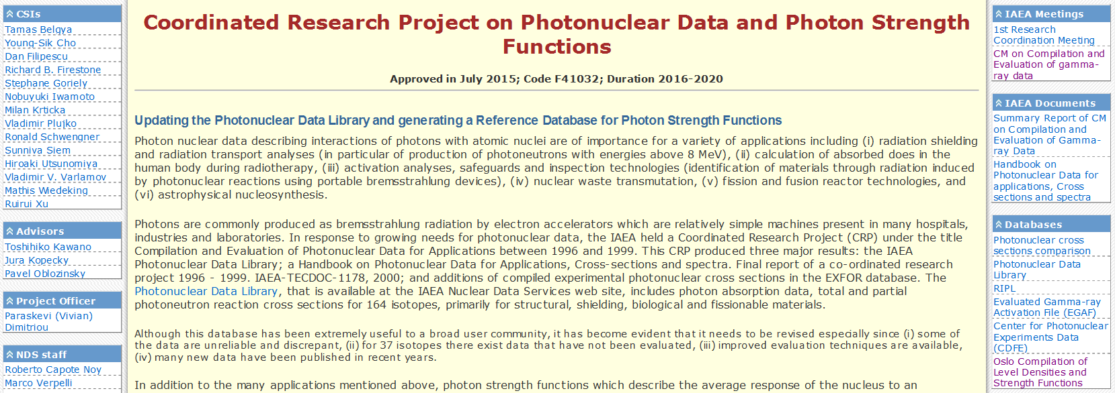
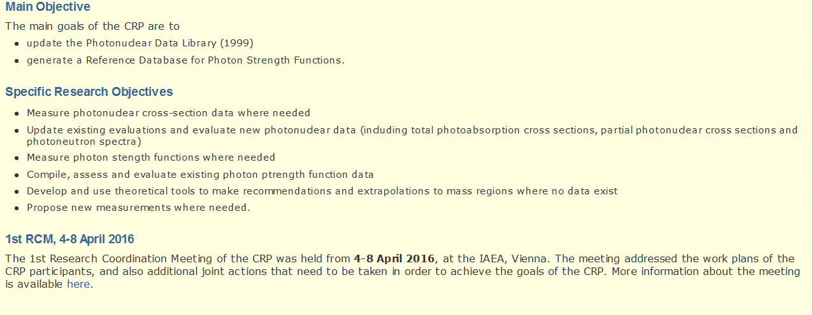
CRP on Photonuclear Data and Photon Strength Functions 2016-2020

Slide 31
CRP on Photonuclear Data and Photon Strength Functions 2016-2020
Photonuclear
Photon Strength Functions
Re-evaluation of all 164 isotopes of 1999 Photonuclear Data Library using new method
Include 37 new isotopes for which data exist
New measurements of (γ,xn) cross sections to clarify relative contributions
Compilation and assessment of existing data and methods (Oslo method, NRF, n-capture etc)
Global models (SM, HFB-QRPA, and empirical parameterization
Recommendation of best values

Slide 32
Future: charged-particle reactions
2nd CM on R-matrix codes for charged-particle reactions in
the resolved-resonance-region, 5-7 December 2016
Compare R-matrix codes (AZURE, SAMMY, FRESCO, EDA, AMUR etc)
Establish translatability of input parameters
Discuss statistical analysis and uncertainty treatment
Agree on an evaluation methodology
Produce evaluated data files for dissemination
Users, beneficiaries: Ion Beam Analysis, Nuclear waste Management,
Nuclear Astrophysics, …
The evaluated data will be disseminated in ENDF-6 format through the
ENDF library and also through the IAEA IBANDL
Participants: Thompson (LLNL), Paris (LANL), deBoer (Notre-Dame),
Arbanas (ORNL), Kunieda (JAEA), Leeb (TUW), Chen (China)

Slide 33
Future: charged-particle reactions
2nd CM on R-matrix codes for charged-particle reactions in
the resolved-resonance-region, 5-7 December 2016
Compare R-matrix codes (AZURE, SAMMY, FRESCO, EDA, AMUR etc)
Establish translatability of input parameters
Discuss statistical analysis and uncertainty treatment
Agree on an evaluation methodology
Produce evaluated data files for dissemination
Need resonance energies and widths
What and how is it evaluated in ENSDF?
Need up-to-date data in ENSDF
Users, beneficiaries: Ion Beam Analysis, Nuclear waste Management,
Nuclear Astrophysics, …
The evaluated data will be disseminated in ENDF-6 format through the
ENDF library and also through the IAEA IBANDL
Participants: Thompson (LLNL), Paris (LANL), deBoer (Notre-Dame),
Arbanas (ORNL), Kunieda (JAEA), Leeb (TUW), Chen (China)

Slide 34
Future: Nuclear Moments
CM on Evaluation of Nuclear Moments, 27-30 March 2017
Purpose: produce a table of recommended magnetic dipole
moments based on all available experimental data
For longer lived :
Laser Resonant spectroscopy (547)
NMR on polarised samples (162)
Atomic beam resonance (126)
Conventional NMR (stable isotopes) (110)
Mossbauer Effect (54);
For shorter lived:
Time dependent angular correlation (TDPAC)
and time dependent angular distribution (TDPAD) (386)
Usually less accurate methods:
short-lived: Transient field (TF) (401) and Recoil – in - Vacuum (RIV) (37)
Goal: seek uniform treatment of certain errors, corrections and calibrations which have been applied in different ways by individual experimenters in their analyses to obtain a consistency of treatment where possible

Slide 35
Future: Fission Product Yields
Summary Report INDC(NDS)-0713 is available

Slide 36
Recommendation for CRP
Objective: improve existing evaluated Fission Product Yields (FPY)
Scope (for 235,238U, 239Pu and 252Cf):
Compilation of all new FFY and FPY experimental data
Improve systematics and models
Incorporate new knowledge in FPY evaluations: correct errors and inconsistencies, update evaluations (decay data+isomeric yields)
provide reliable estimate of uncertainties
Agree on treatment of covariances, provide FPY covariance data and propose suitable format for inclusion in ENDF-6
Validation of new evaluations
Participant countries: Belgium, China, Finland, France, Germany, India,
Japan, Russia, Sweden, UK, USA

Slide 37
Recommendation for CRP
Objective: improve existing evaluated Fission Product Yields (FPY)
Scope (for 235,238U, 239Pu and 252Cf):
Compilation of all new FFY and FPY experimental data
Improve systematics and models
Incorporate new knowledge in FPY evaluations: correct errors and inconsistencies, update evaluations (decay data+isomeric yields)
provide reliable estimate of uncertainties
Agree on treatment of covariances, provide FPY covariance data and propose suitable format for inclusion in ENDF-6
Validation of new evaluations
International Nuclear Data Committee (Advisory body)
endorsed this proposal at INDC meeting in June 2016
Participant countries: Belgium, China, Finland, France, Germany, India,
Japan, Russia, Sweden, UK, USA

Slide 38
22nd Technical Meeting of the international network of Nuclear Structure and Decay Data evaluators
Where? Lawrence Berkeley National Laboratory, CA
When? 22-26 May 2017
Who? All Data Centres and active NSDD evaluators, responsibles for horizontal evaluations/compilations
Information: https://www-nds.iaea.org/nsdd/
http://nssc.berkeley.edu/events/22nd-technical-meeting-of-the-nsdd/

Slide 39
22nd Technical Meeting of the international network of Nuclear Structure and Decay Data evaluators
Proposal for meeting structure:
Mon-Tue: reporting (DCs, horizontal compilations/evaluations, organizational review)
Wed: Actions Lists (careful review of previous, thorough discussion of newly proposed)
Thu: Analysis/checking codes (new codes, demonstration, exercises)
Fri: Evaluators workshop (technical issues, questions on policies, implementation of policies)

Slide 40
22nd Technical Meeting of the international network of Nuclear Structure and Decay Data evaluators
Proposal for contributions:
Reports will be submitted and uploaded on meeting web site at least 2 weeks before the meeting
Proposals for discussion will be submitted and uploaded on at least 1 week before the meeting:
Proposal title
Reason
Proposed solution+example

Slide 41
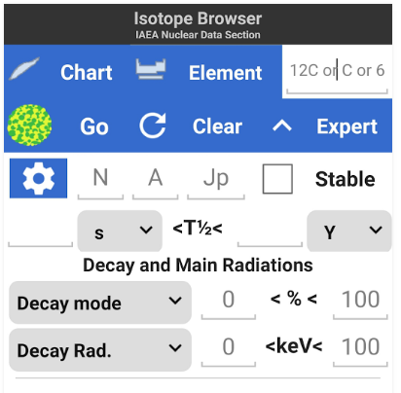
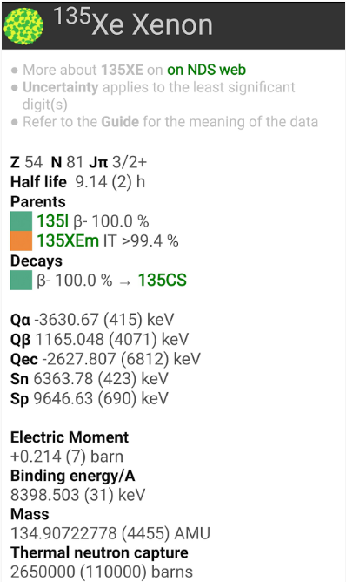
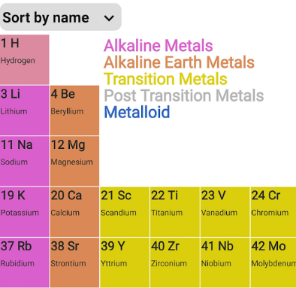
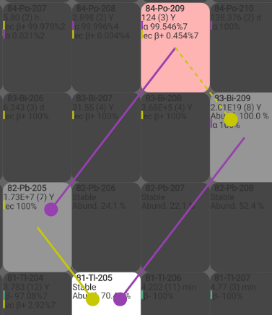
IAEA Isotope Browser – for mobile devices
Ongoing: translation to
Chinese, French, Russian, Spanish, Arabic,
and
Italian, Slovenian, Dutch, Greek
ENSDF + other NS data
Query tool
Chart with decay path
c/o: M. Verpelli, IAEA

Slide 42
Thank you!
Notes:
Thank you!

Slide 43
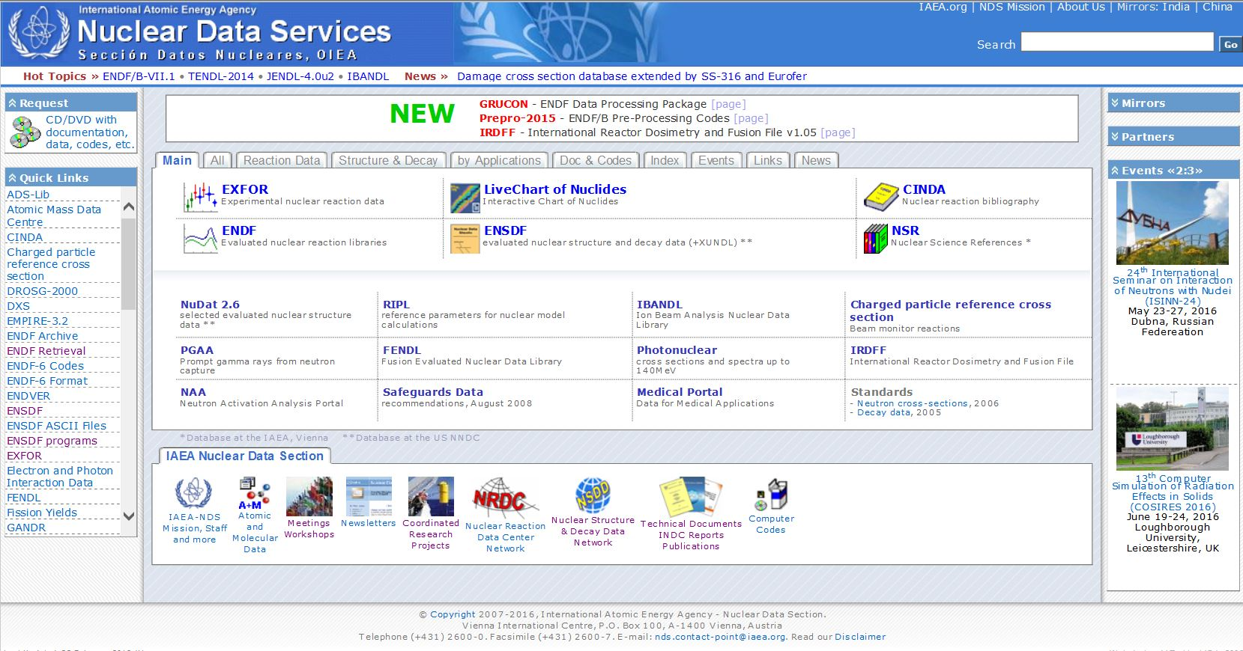
Web site: http://www-nds.iaea.org/

