Slide 1
Uncertainty of %Iγ: ENSDF vs. Dissemination
Shamsuzzoha Basunia
LBNL, Berkeley, CA
USNDP meeting, Nov 16-18, 2016, BNL, NY

Slide 2
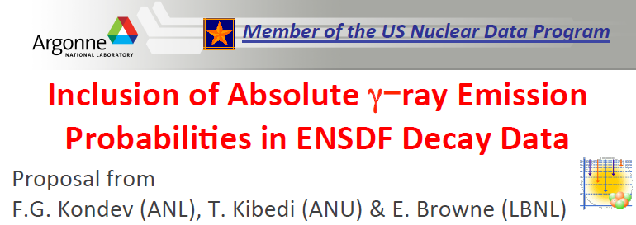
Known Problem
%Iγ related issues in decay data sets

Slide 3
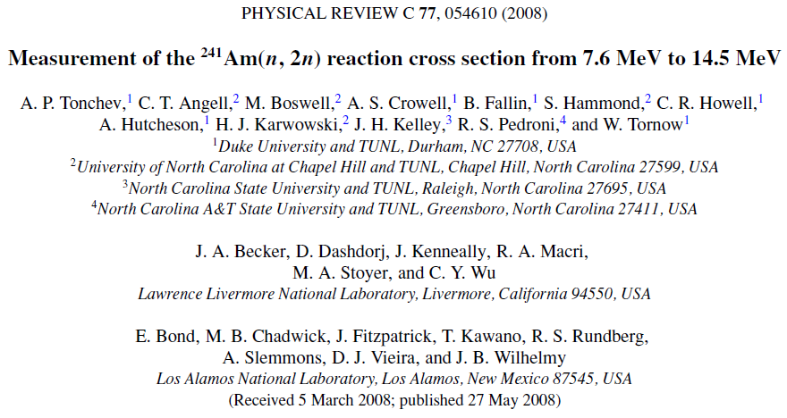
2008To06: 1st case
USNDP meeting, BNL, Nov 16-18, 2016

Slide 4
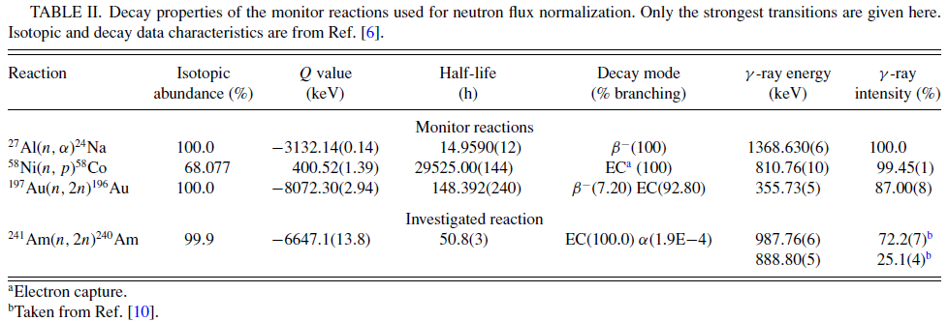
2008To06: 1st case cont’

Slide 5
Dissemination: 1st case
%Iγ for 987.7γ (From ²⁴⁰Am EC decay to ²⁴⁰Pu)
ENSDF/NDS: 72.2 (4)%
NuDat: 72.2 (4)%
Live Chart: 72.2 (13)% ??
USNDP meeting, BNL, Nov 16-18, 2016

Slide 6
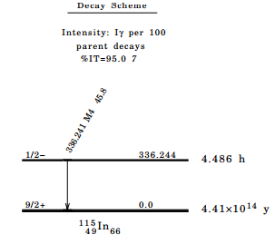
¹¹⁵In IT Decay (4.486 H): 2nd case
Cross section measurements using DD neutron generator at UCB
%Iγ - 45.9 ± 2.2
Uncertainty 4.8%
NDS 113, 2391 (2012)
USNDP meeting, BNL, Nov 16-18, 2016
6

Slide 7
¹¹⁵In IT Decay (4.486 H): 2nd case (Cont’)
Measured value (1974He39): 45.9 ± 1 - %uncertainty – 0.2%
NDS, ENSDF, NuDat, Live Chart – 45.8 ± 2.2: Uncertainty – 4.8% (Since 1980)
NuDat – 45.8 ± 4 - %uncertainty – 0.9% - after fixing the N,PN records!!
115IN G 336.241 25 45.9 1 M4 1.073 14
115IN2 G %IG=45.9 1
USNDP meeting, BNL, Nov 16-18, 2016

Slide 8
Conclusions:
It is important to report %Iγ as an independent quantity, i.e. without multiplication factor of RI*NR*BR
Currently NuDat retrieves %Iγ, if given in a ‘2 G’ record. However, LiveChart (IAEA) will be set up to do the same.
GABS is expected to list of %Iγ data in a ‘2 G’ record, when used. Current version is not doing it.
Main problem: Listing of authors measured %Iγ values, i.e. both in ‘RI’ field and in ‘2 G’ record
Then the same value will appear in Iγ column and in comments - Confusing!!!
New policy is urgently needed for %Iγ data entry
USNDP meeting, BNL, Nov 16-18, 2016

Slide 9
Thank You

