Slide 1
Revisiting Grodzins Systematics of B(E2) values
Boris Pritychenko
National Nuclear Data Center, BNL, Upton, NY 11973
Michael Birch, Balraj Singh
Department of Physics & Astronomy, McMaster University, Hamilton, Ontario L8S 4M1, Canada

Slide 2
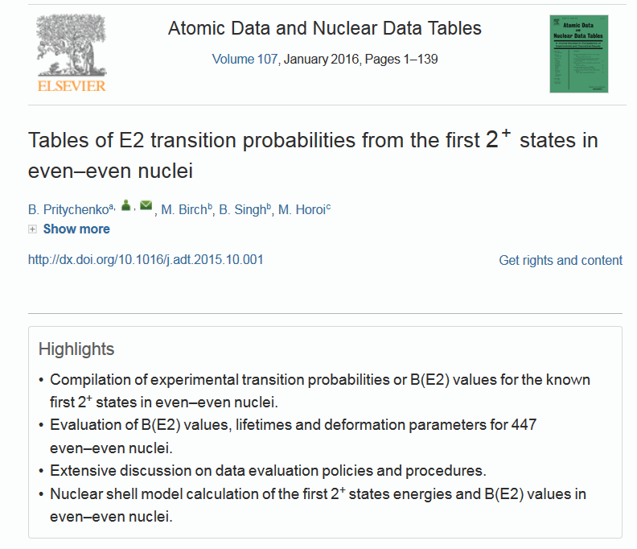
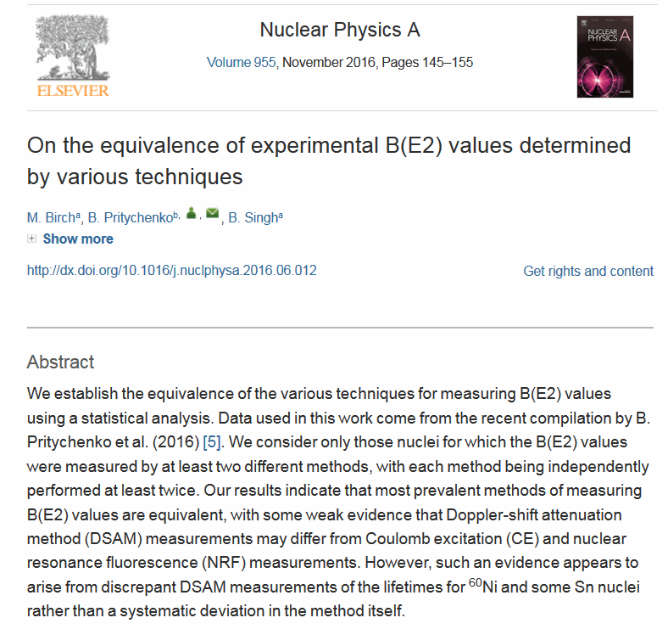
Introduction
B(E2;0⁺→2⁺) values serve an important benchmark in nuclear structure physics.
Recently the compilation and evaluation of B(E2)↑ values and investigation of experimental methods of all even-even nuclei have been published in ADNDT and NPA journals, respectively.
These findings and associated database laid the ground for the further work on nuclear systematics.

Slide 3
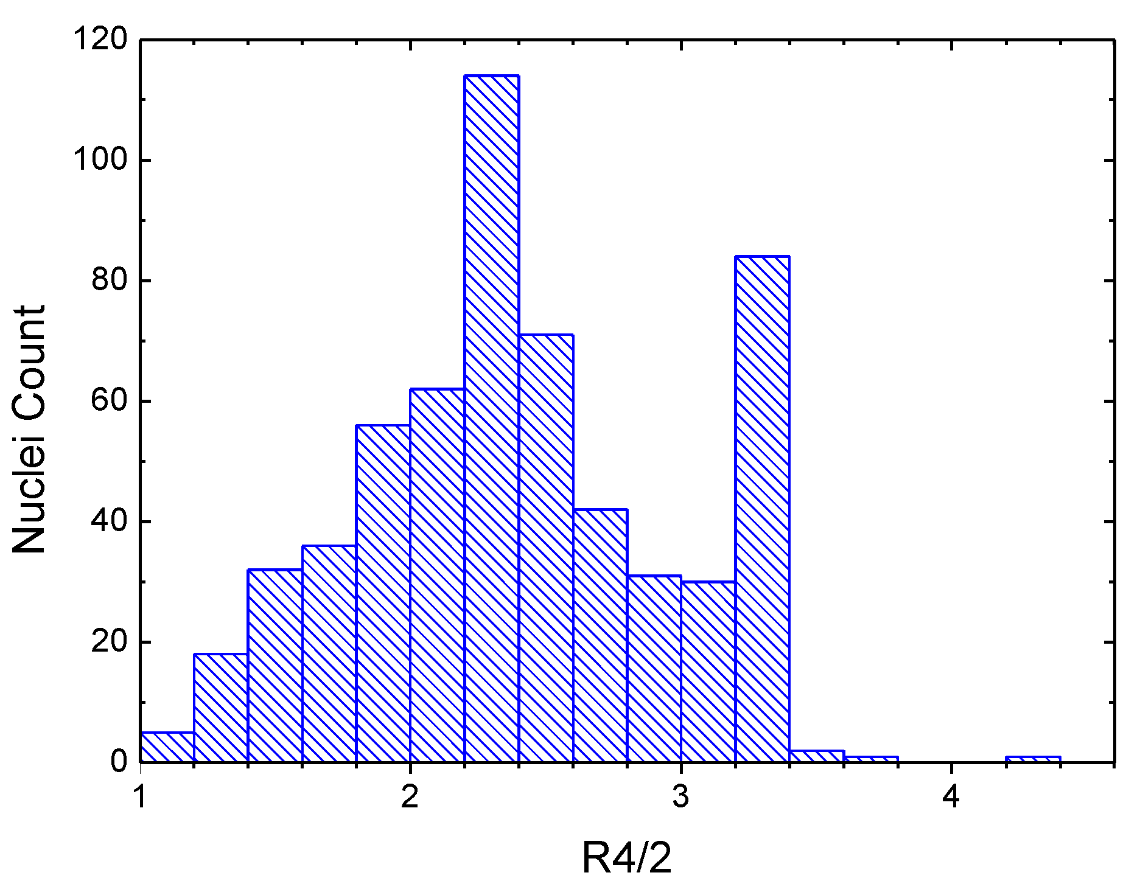
Variety of Atomic Nuclei
The B(E2)↑ database includes compilation and evaluation of reduced transition probabilities and transition energies for 447 and 646 even-even nuclei, respectively.
These nuclei can be sorted using the energy ratio R_{4/2}=E₄₊/E₂₊.
Casten's formalism is helpful for understanding of nuclear structure effects in atomic nuclei:
Shell configurations: R_{4/2}<2
Vibrational: R_{4/2}~2.0-2.2
Transitional: R_{4/2}~2.7
Rotational: R_{4/2}~3.33
It is naïve to assume that all these nuclei could be described by a single global fit and local fits could be more reliable.

Slide 4
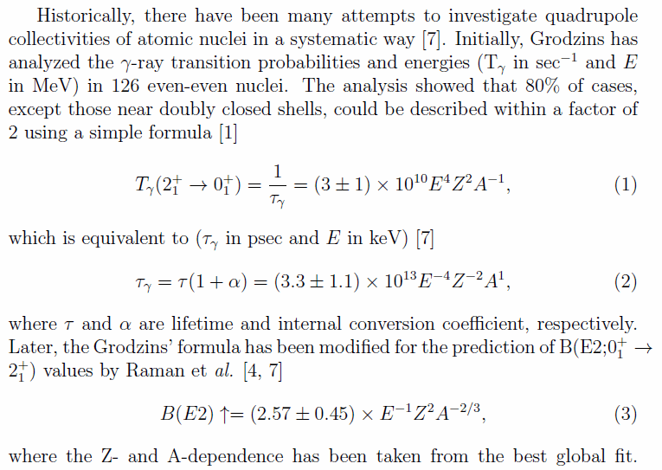
B(E2) Semi-empirical Formulae

Slide 5
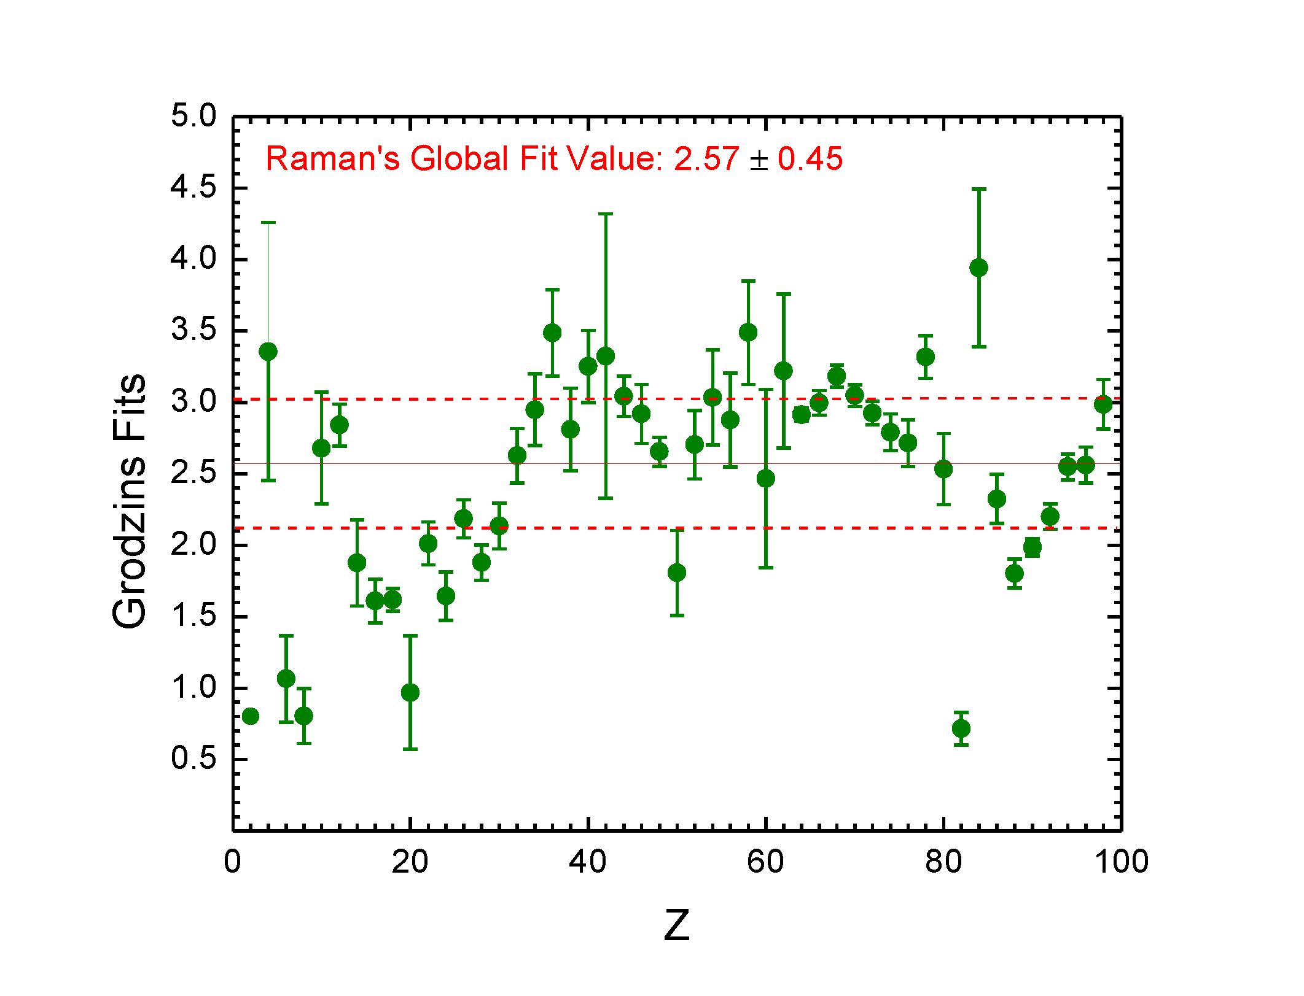
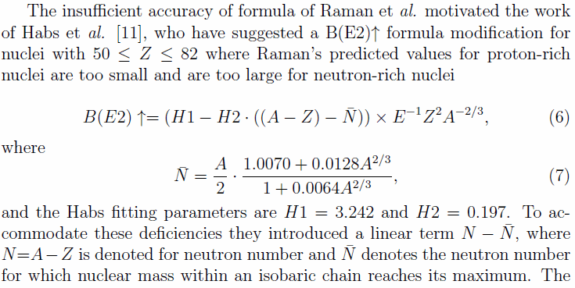
Elemental Fit using Raman’s Formula
The elemental (grouped by Z) Raman’s formula B(E2)↑fits show the impact of nuclear structure effects.
These results show limitations of the 2001 Raman’s global fit value that fails to reproduce a large number of nuclei.
The

Slide 6
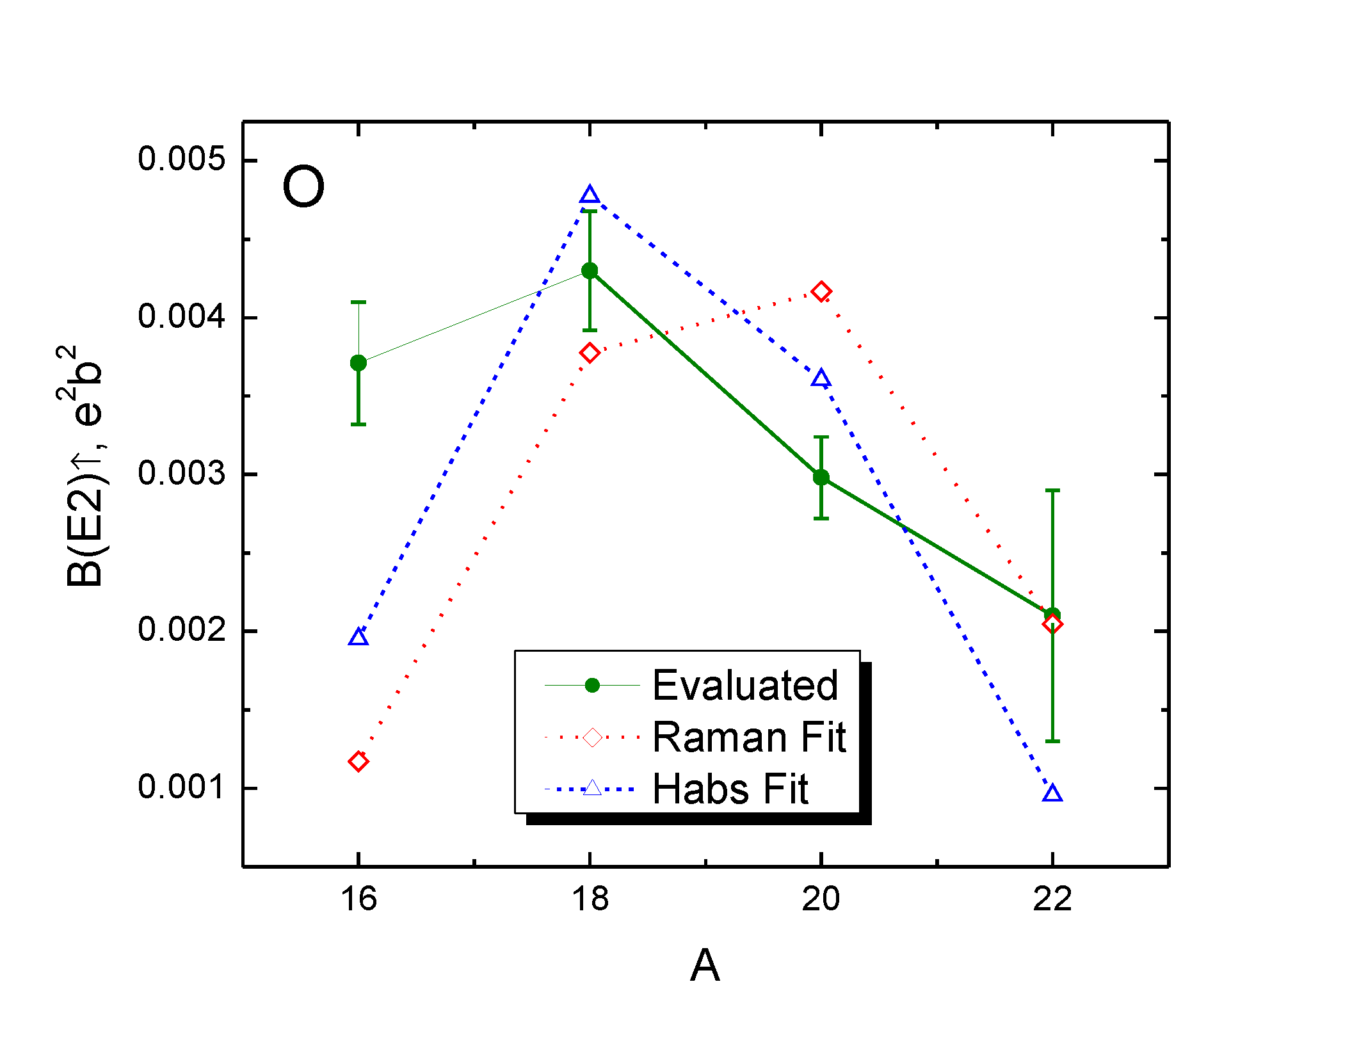
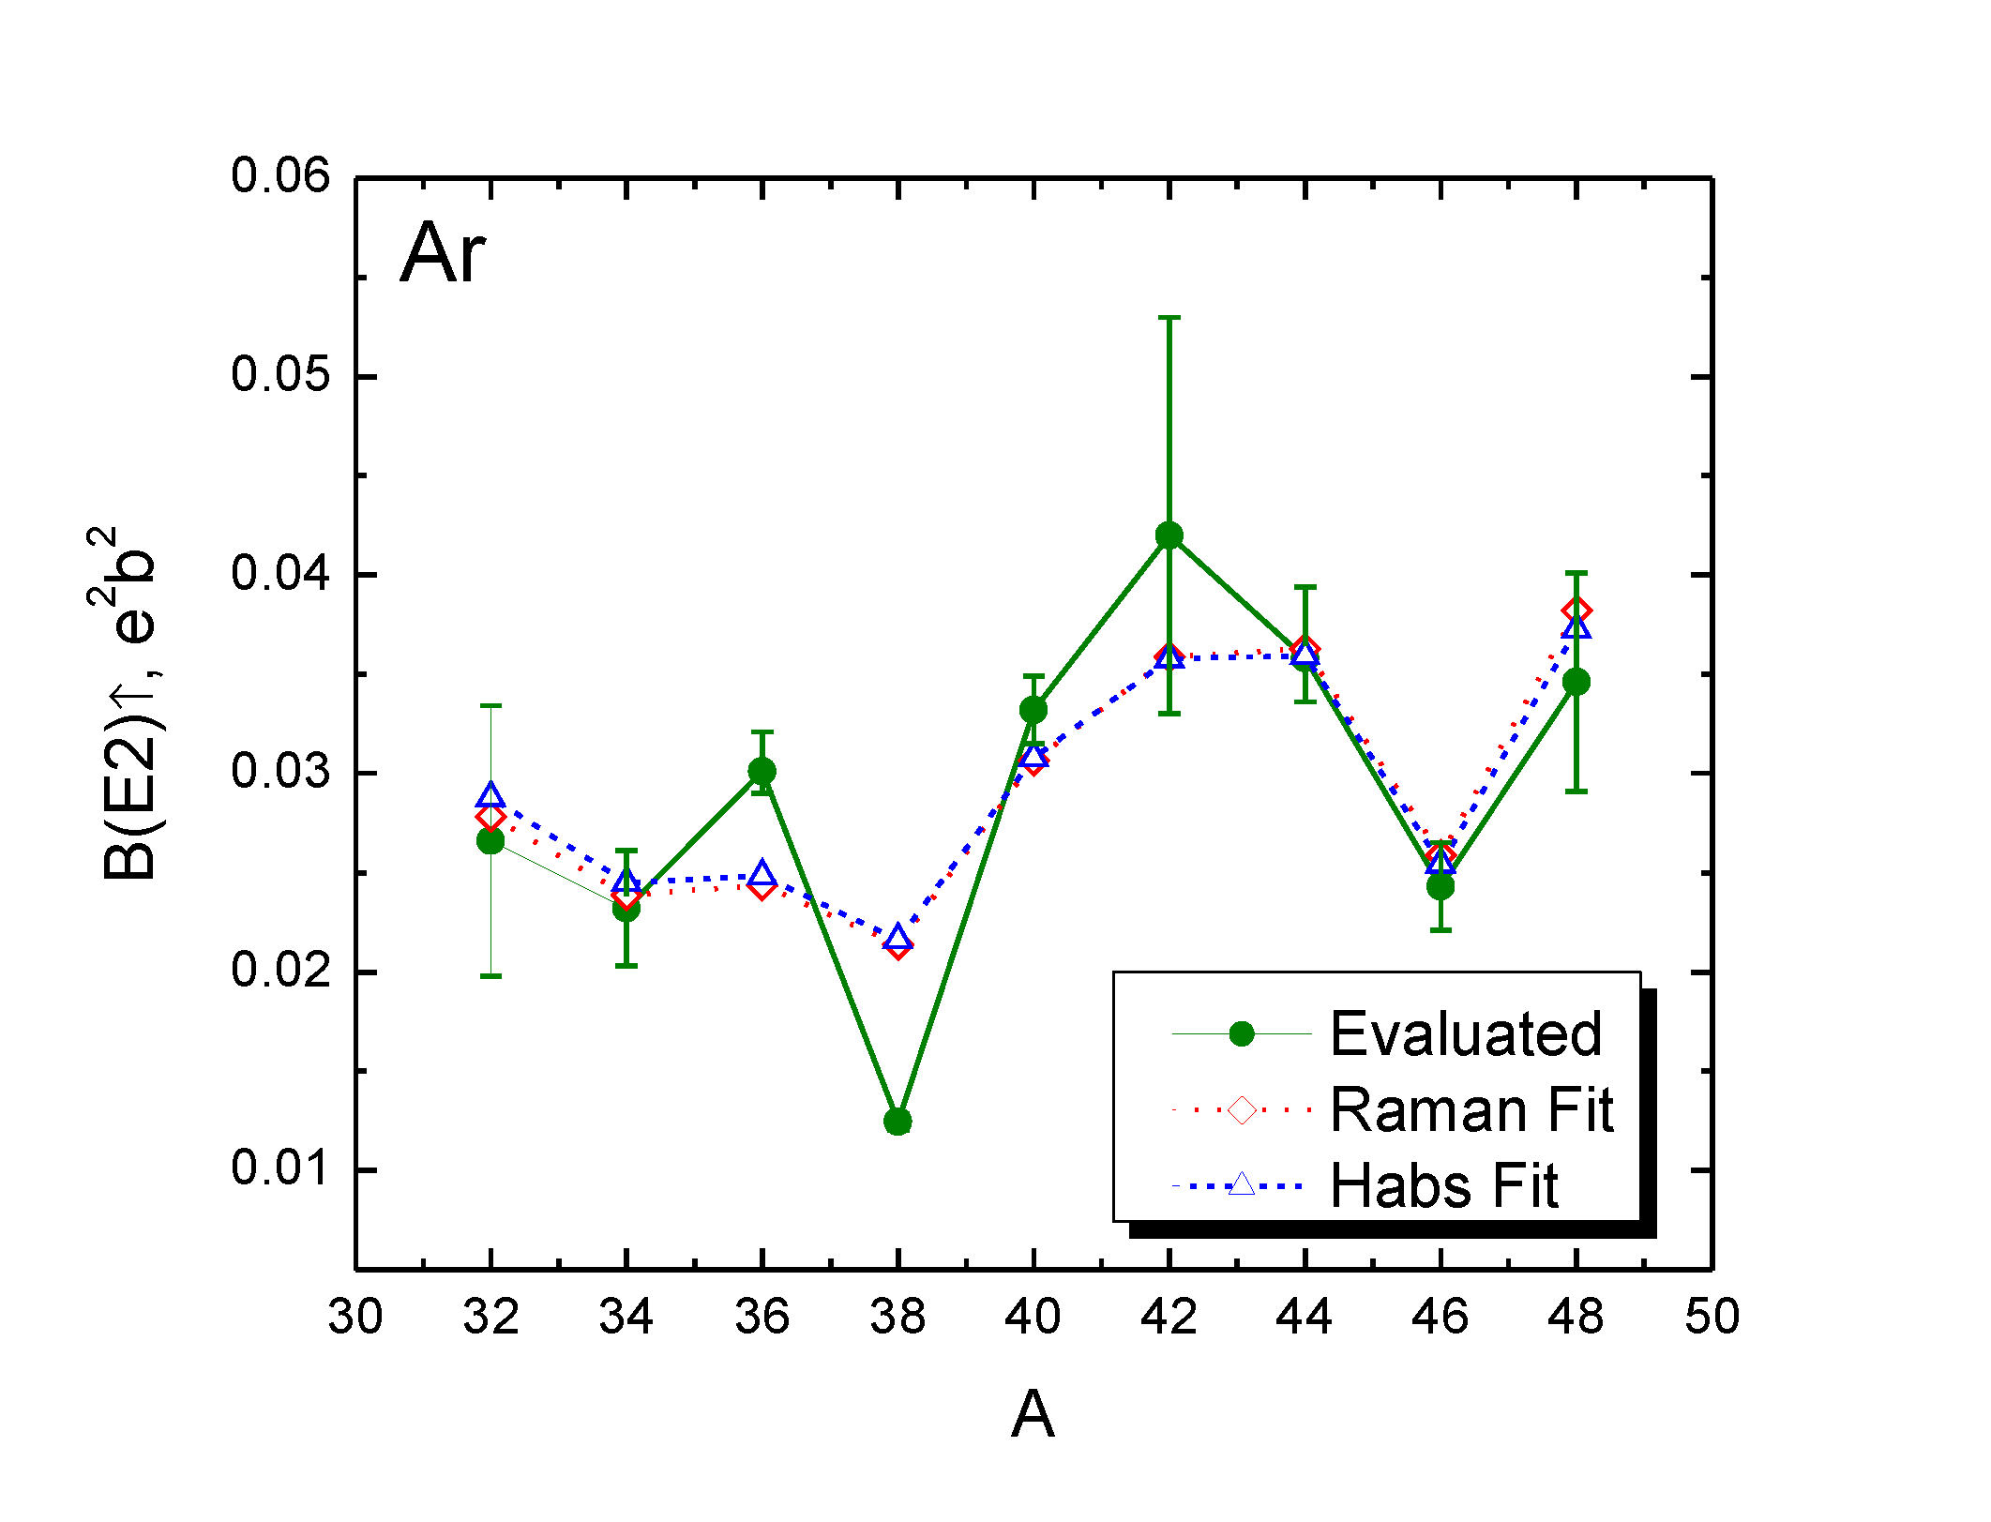
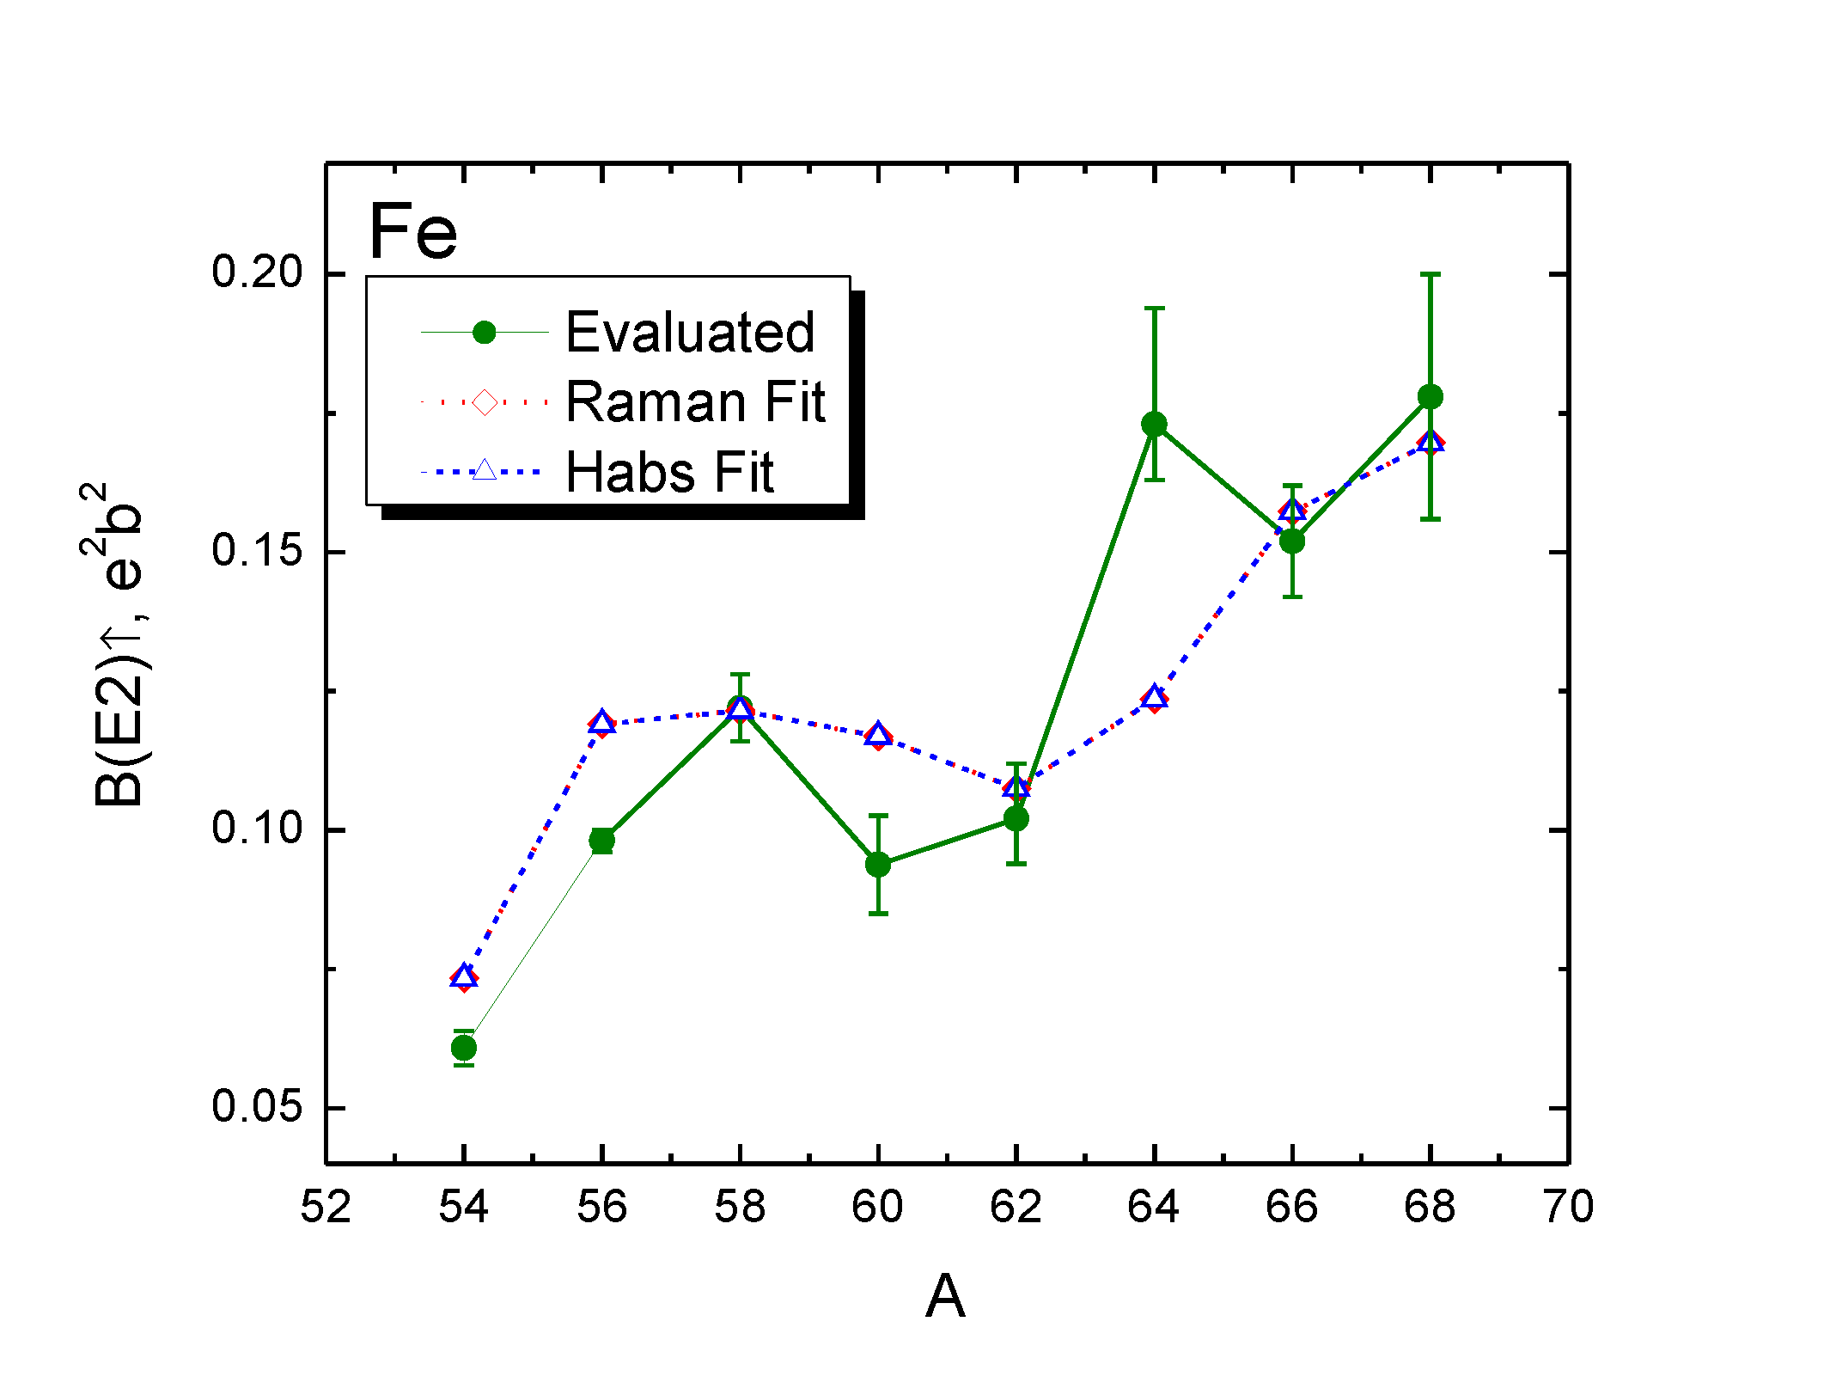
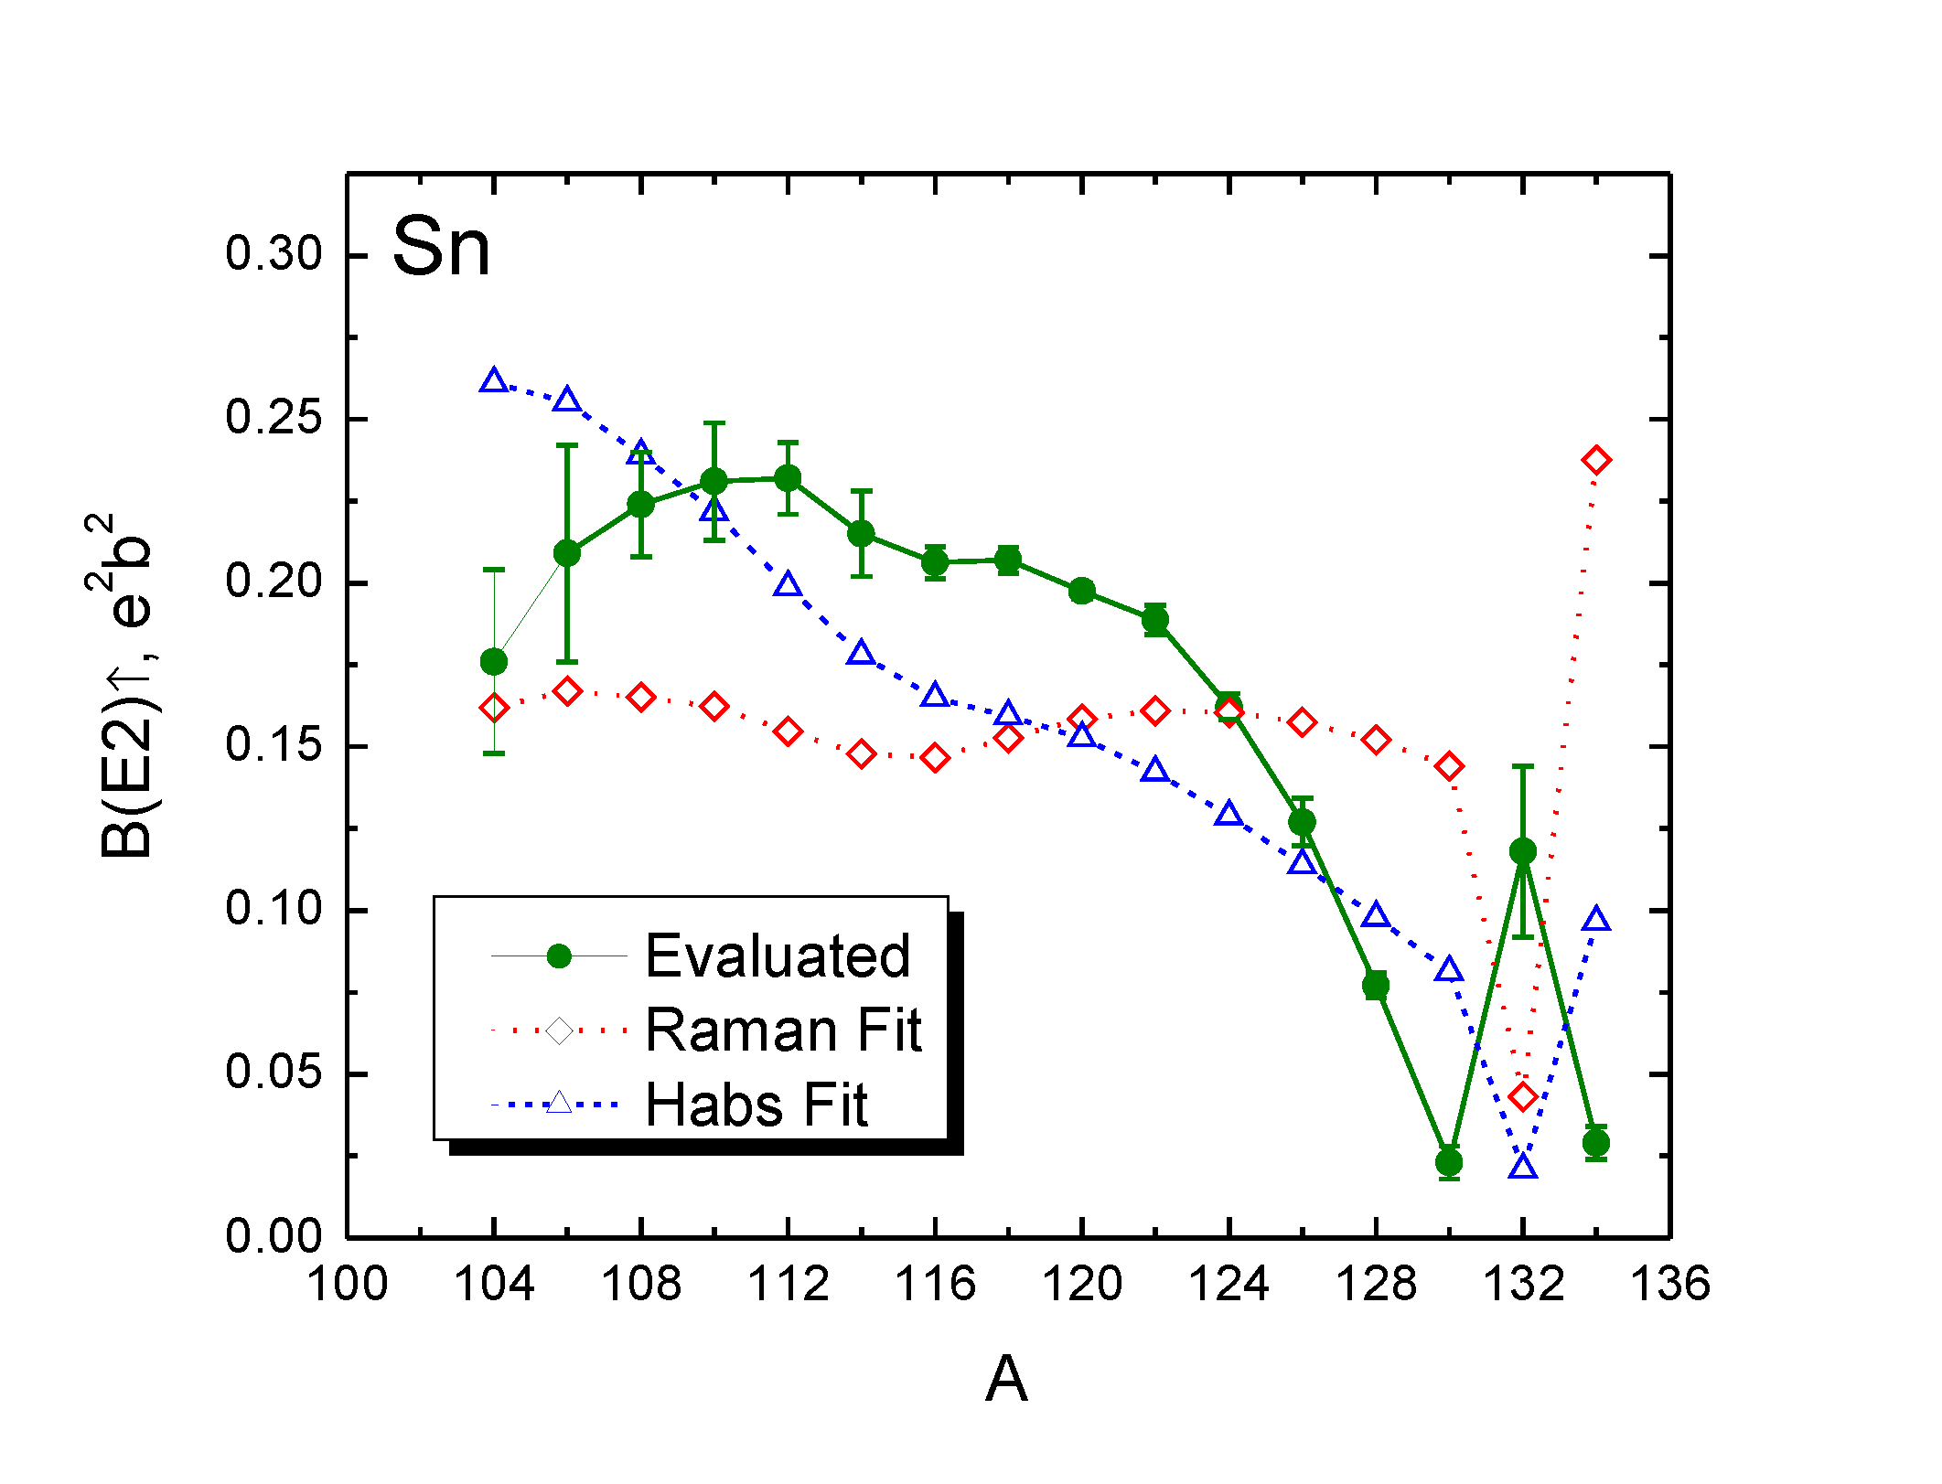
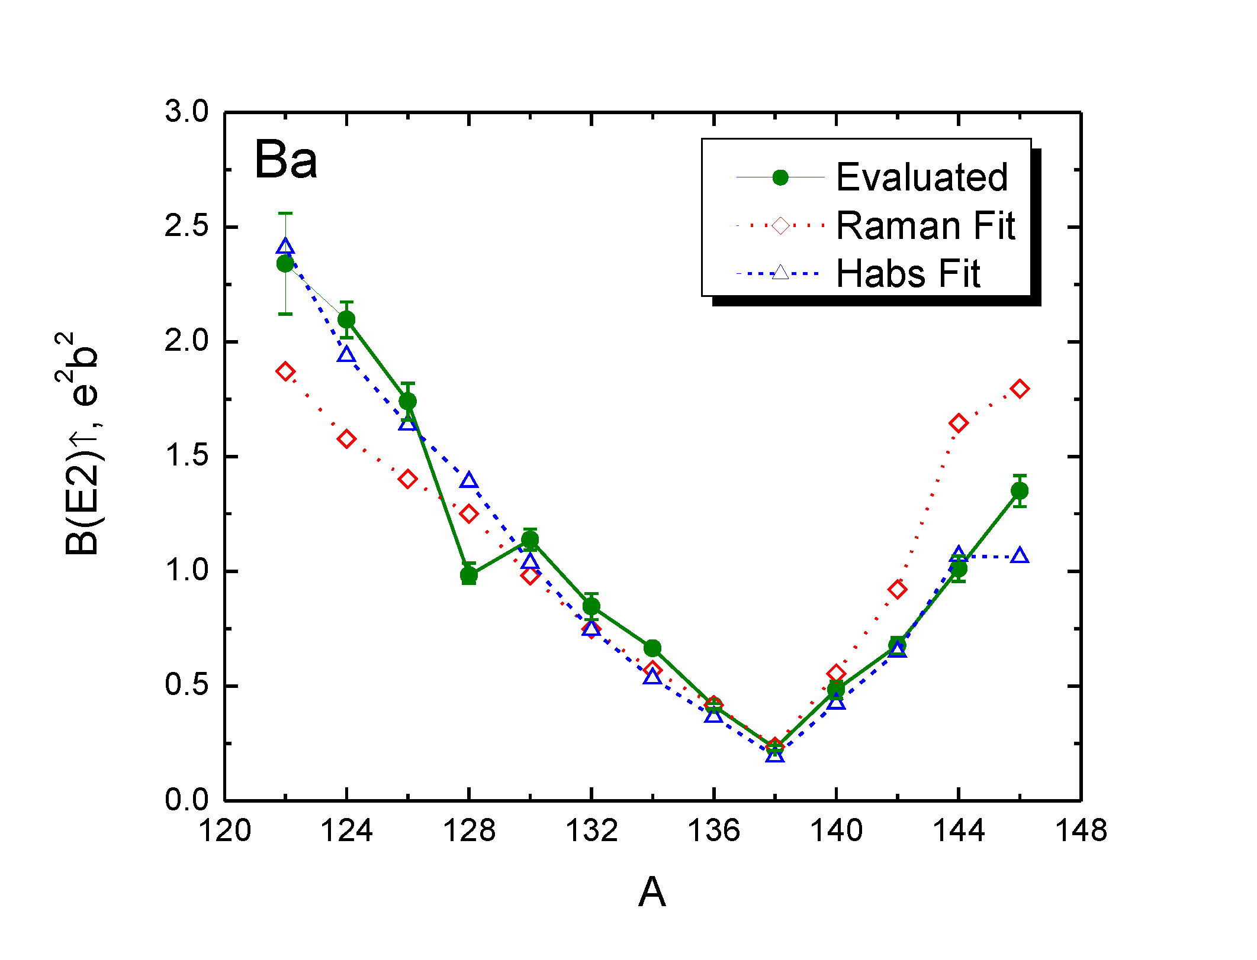
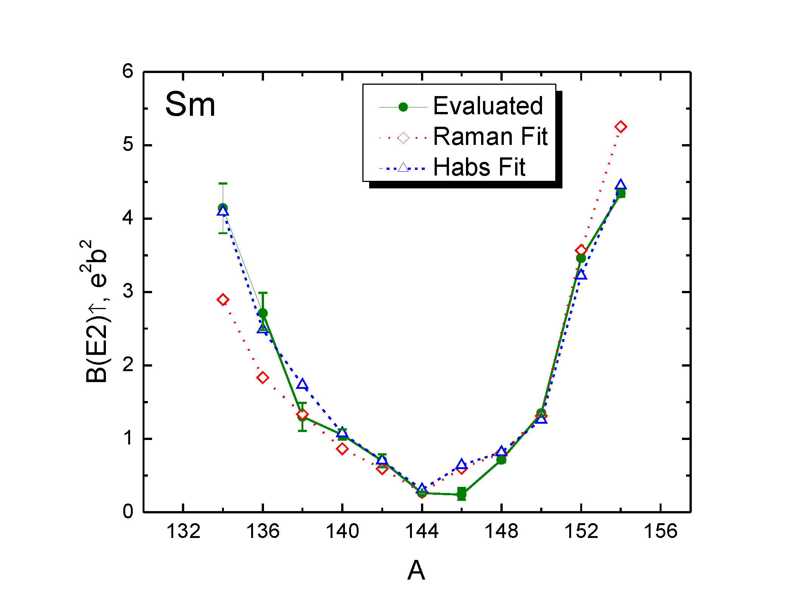
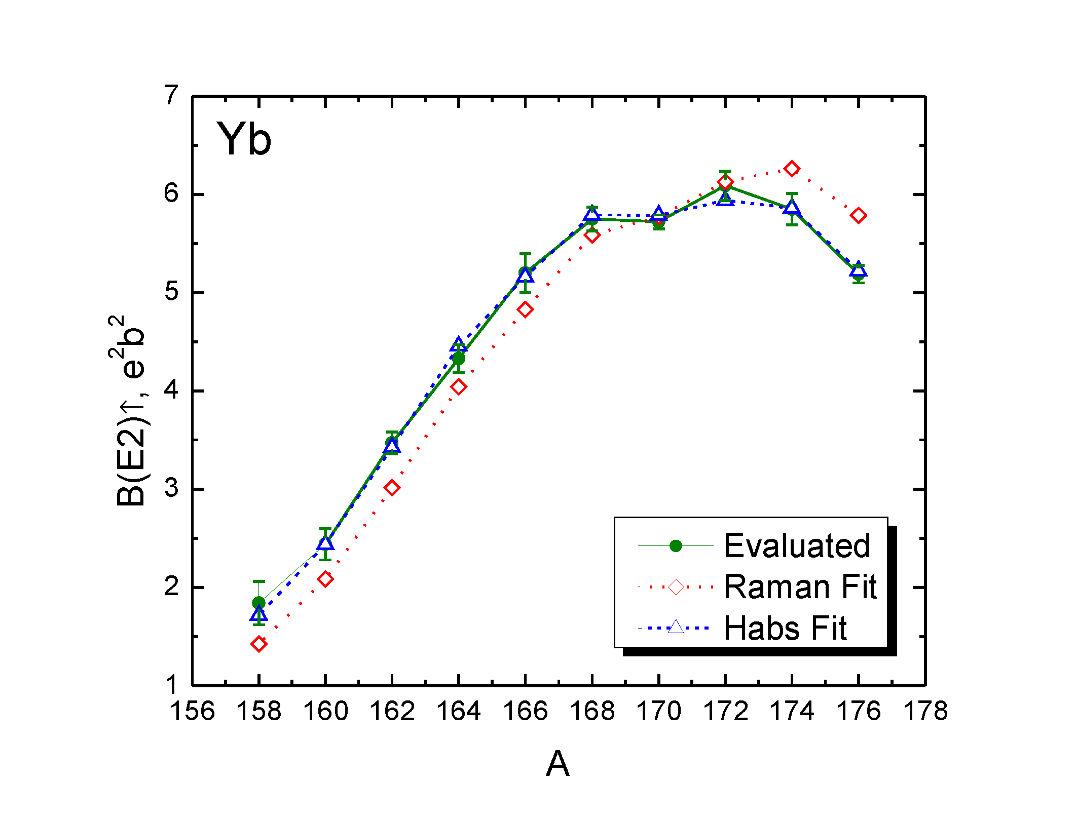
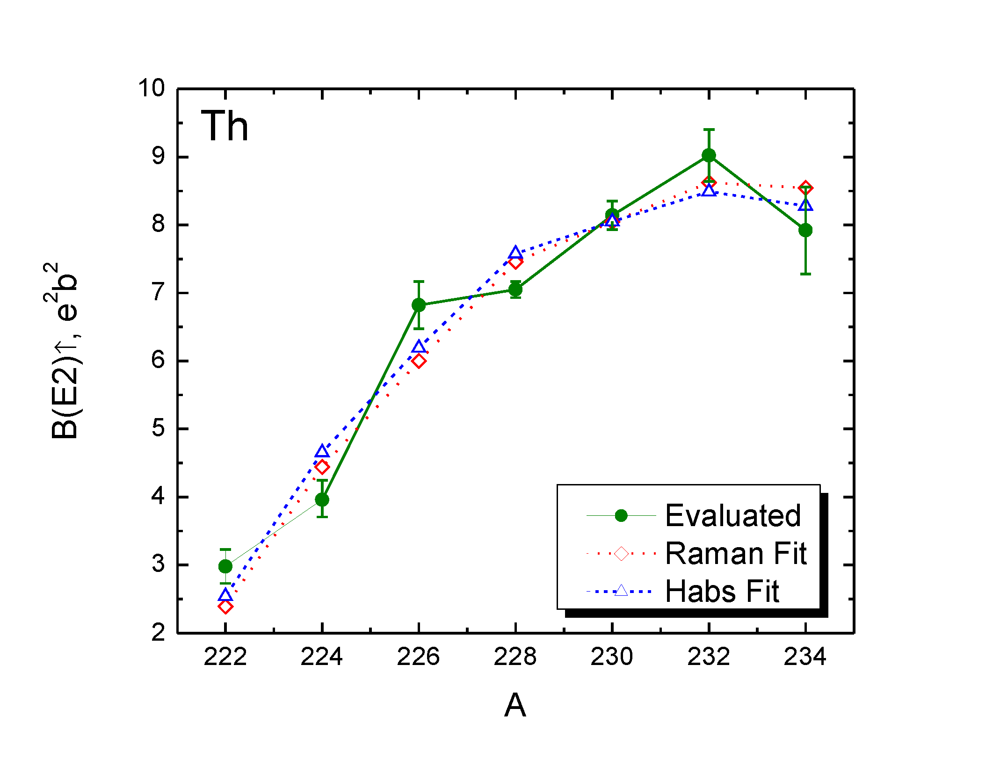
Elemental (Grouped by Z) Fits
To overcome limitations of a low predictive power global fits we fitted smaller sets of B(E2)↑ values.
In this case we do not have to exclude closed shell nuclei because O fit results do not affect Ar or Fe.
Certain elemental fits (Sm,Yb, Th..) are excellent, others ….
An observed deviation of ¹²⁸Ba B(E2)↑ value helped to find a typo in the original evaluation and produce an erratum. This fact brings credibility to the method.

Slide 7
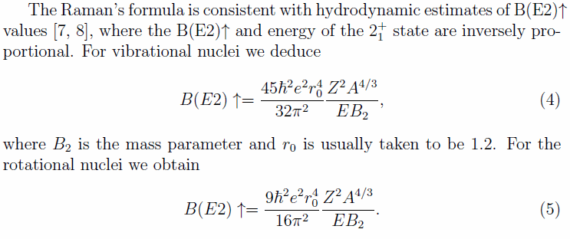
Hydrodynamic estimates of B(E2)↑ values
Raman’s formula has an inverse dependence between B(E2)↑ and transition energy.
The
We can assume that it would describe well rotational and vibrational nuclei.

Slide 8
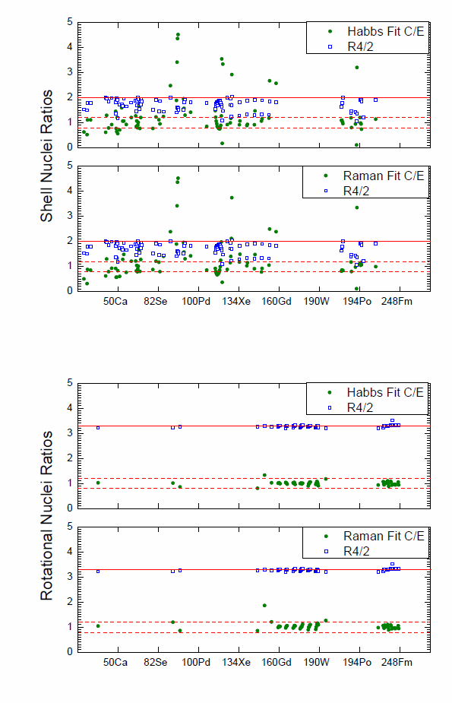
Elemental Fits for Shell and Rotational Nuclei
Hydrodynamic estimates predict good fits for rotational and vibrational nuclei.
Previously we have observed that fits for Yb, Sm, Th, … are very good while closed shell nuclei O, Sn, … are rather poor.
The observed ratios of Raman’s and Habs’ calculated to evaluated B(E2)↑ values are close to unity for rotational nuclei while results for shell ordering nuclei are discrepant.
Results show limitations of Grodzins fits and provide preference for the local (grouped by Z) fits rather than global fits.

Slide 9
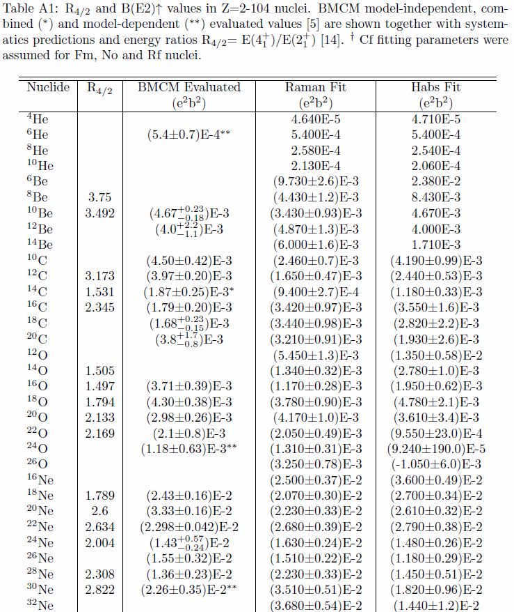
Table of Systematic Values for All Known Even-Even Nuclei
Table of 646 fitted values with uncertainties have been produced using the data on 447 evaluated nuclei.
Raman’s fit is not always the most accurate, however it is robust.
Habs’ fit is often more accurate in a 50 ≤ Z ≤ 82 region; it may result in negative B(E2)↑ values outside the region: ²⁶O, ^{214,216,218}Po.
The calculated B(E2)↑ values provide important benchmarks for theoretical and experimental studies.

Slide 10
Conclusions
B(E2)↑ values for all even-even nuclei have been analyzed in a systematic way and a table of Raman’s and Habs’ fits for 646 nuclei has been produced.
The results of elemental fits indicate good agreement between calculated and evaluated rotational and vibrational nuclei while results for shell ordering nuclei are rather poor.
B(E2) ↑ fitted values helped to find a problem with ¹²⁸Ba evaluation and the potential experimental deficiencies for ^{90,92,94}Sr, ¹²⁶Ce, ¹⁴⁶Sm, ²⁰²Po, ²²²Ra. The last seven nuclei have been measured just once.
Further analysis of elemental fits shows limitations of Habs’ fit and provide preference for a robust Raman’s fit.
These findings provide foundation for the understanding of limitations of the Grodzins’ systematics of atomic nuclei, highlight potentially deficient experiments and provide complementary data points for nuclear structure calculations.

