Slide 1
New J-GAMUT code
Michael Birch and Balraj Singh
Department of Physics and Astronomy,
McMaster University, Hamilton, Canada

Slide 2
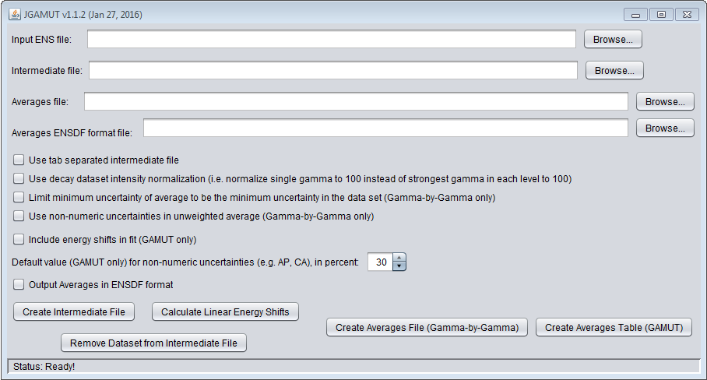
JGAMUT: Adopted Levels and Gammas
JGAMUT: designed to handle gamma-ray energies and intensities
Available from http://www.physics.mcmaster.ca/~birchmd/codes/JGAMUT_release.zip

Slide 3
JGAMUT: Adopted Levels and Gammas
Program flow
ENSDF Datasets (input)
Intermediate File (user editable)
Gamma-by-Gamma Averages
GAMUT Algorithm Results

Slide 4
JGAMUT: Adopted Levels and Gammas
Intermediate file
Grouping of gamma-ray data from all input datasets into a tabular format
Warning: this grouping is not perfect and requires verification by evaluator
Gamma-by-gamma averages
Performs a weighted average (or NRM or unweighted average, depending on the discrepancy of the data) of the measurements for each gamma ray
GAMUT algorithms (based on procedure by R.B. Firestone, LBL-Report 26024 (1991))
Energy algorithm performs a least-squares fit to level scheme (similar to GTOL)
Intensity algorithm performs a chi-square minimization

Slide 5
JGAMUT: Additional Features
Preprocessing of the data
Can correct calibration differences between datasets through linear systematic shifts of the measured energies
Can remove all measurements from an entire dataset from the intermediate file (allows evaluator to exclude faulty measurements)
Output can be in the format of an adopted levels and gammas dataset
Warning: this output is not perfect and requires verification by the evaluator
Mathematical detail of all features is given in the user manual

