Slide 1
Current status of the NSR project
Boris Pritychenko
National Nuclear Data Center, BNL, Upton, NY 11973

Slide 2
NSR Database Scope
We compile all low- and intermediate-energy references for broad use, not just nuclear structure and decay as before 90ies.
Nuclear Reactions papers
CINDA database is no longer supported
Consequently NSR is filling the gap for NRDC network
Extended keywords allow to extract statistics using bibliography metadata
Theoretical papers
NSR is the only USNDP database where nuclear theory papers are systematically compiled

Slide 3
NSR Compilations in FY2016
NSR team: 1.5 NNDC, 2 contractors and 1 IAEA collaborator.
Our goal is provide the coverage for current publications; however, due to many historical and technical reasons a substantial number of articles was missed in the past and we are we are proactively recovering these references.
Our major requirement is speed, prompt creation of entries for ENSDF.
NSR Quality Assurance: Manager + Users + Evaluators + Compilers inputs. We do not have a bug database, we just fix bugs immediately.
Direct communication with Phys. Rev. C: ~15% of authors submit keywords to NSR.
NSR database is updated 2-3 times a week (Most frequently-updated nuclear database).

Slide 4
FY 2016 NSR Statistics
NSR References:
3263 new article entries, total NSR: 222684 (10 times bigger than EXFOR)
859 modified (bug fixes) article entries
1856 keyworded article abstracts
NSR Dictionary updates:
1750 new authors, total NSR: 96685
7 new journals, total NSR: 516
225 new reactions, total NSR: 7904
408 new nuclides, total NSR: 6415
NSR Database updates: 117 in FY 2016
NSR Web retrievals: 442175

Slide 5
Oak Ridge Library for NSR Users
NSR like ENSDF has been started at Oak Ridge National laboratory and transferred to Brookhaven in 1980.
Oak Ridge library had many unique and valuable publications that of importance for ENSDF evaluations.
In May of 2016, NSR technical staff member Joann Totans travelled to Oak Ridge and recovered unique publications: 35 boxes of reports, private communications and theses that have been published prior to 1980. Oak Ridge employee C. Nasaraja has helped Joann.
These publications have been shipped to NNDC, and J. Totans is presently processing them as time permits.
We are planning to add these publications to a common PDF database. V. Zerkin (IAEA) is working with J. Totans.

Slide 6
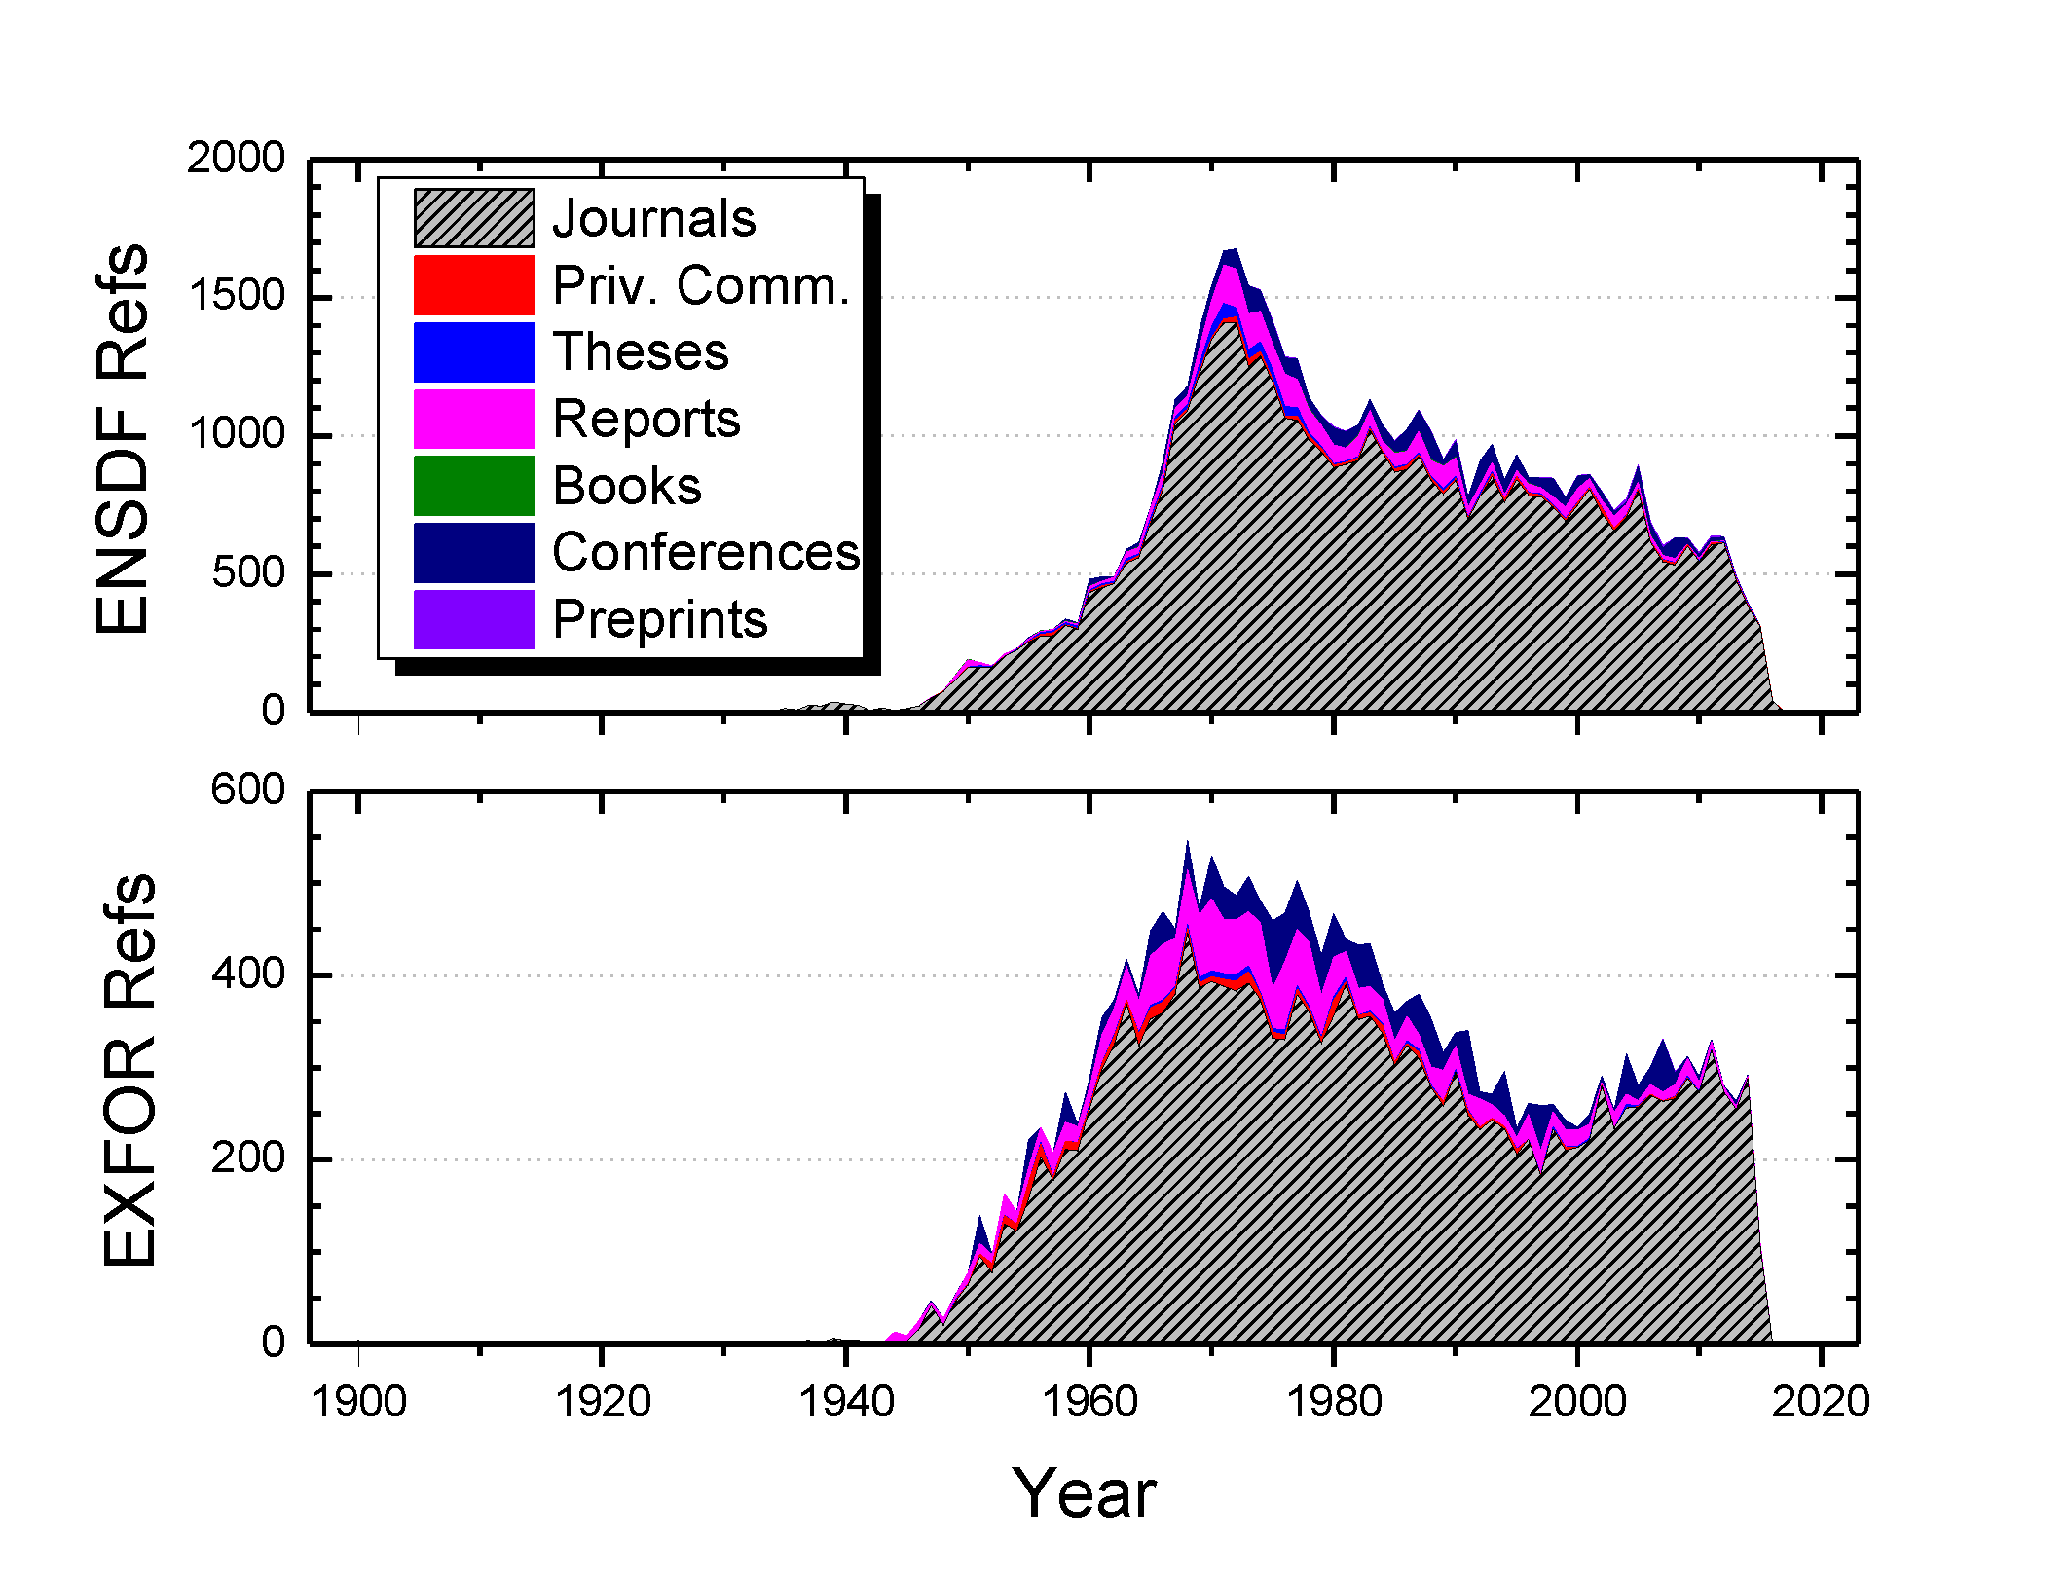
Reference Type Code: CODEN
Originally results have been published mostly in journals.
Over the years, the overall volume of research exceeded the journal capacities and many unique results have been published as laboratory reports or conference proceedings.
Later the volume of nuclear physics research has dwindled while the latest computer technologies have helped to increase the journal volumes.
Presently, journals could accommodate almost all major findings.

Slide 7
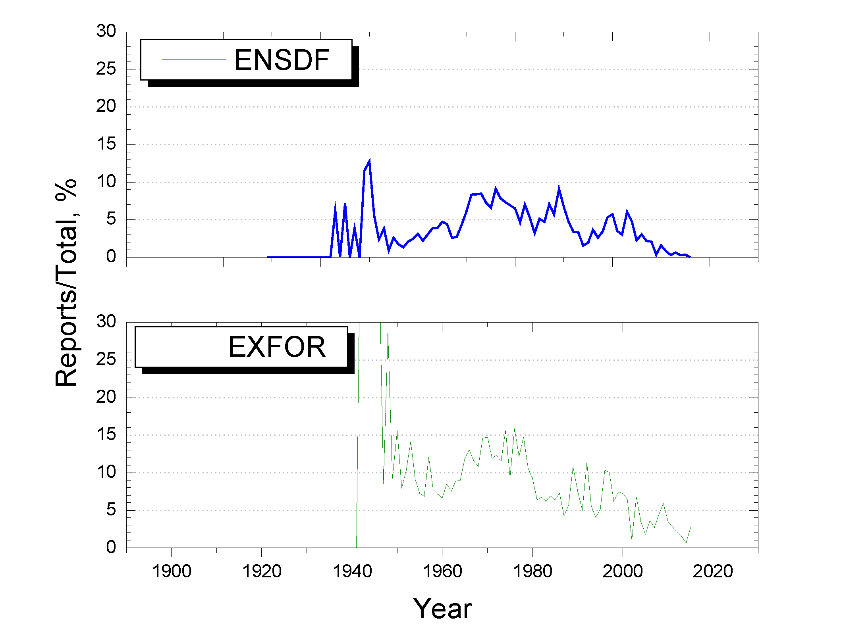
Unique Contents: Laboratory Reports
Fractional contribution of laboratory reports to ENSDF and EXFOR databases provides a powerful testimony to the impact of typewriter-style publications.
These reports played a major role in the XXth century as the final destination for new results and lost this function nowadays in favor of other dissemination tools.

Slide 8
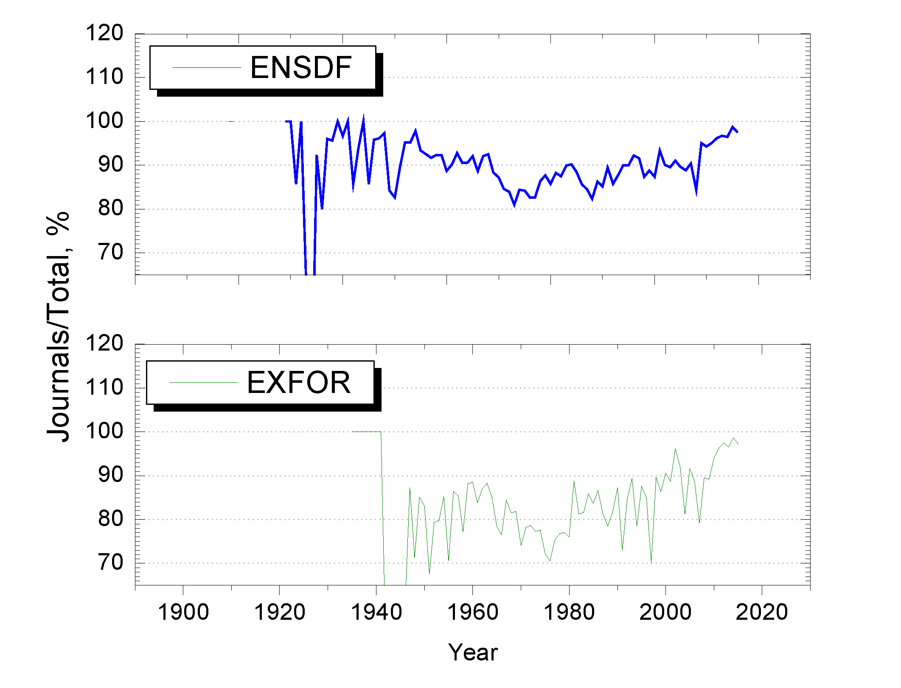
Unique Contents: Journals
Initially, the large volume nuclear reaction data sets (EXFOR database) could not be accommodated by journal publications.
Later, the computer and Web dissemination technologies have evolved and adapted to large volumes of data that are presently published as supplementary Web files.
Today, almost everything is published in journals.

Slide 9
Compilation Suggestions
In light of the previous analysis of NSR and EXFOR databases we have to compile journals, private communication and theses.
Other secondary publications such as lab reports and conference proceedings are not the final sources of experimental data and can be ignored.
????

Slide 10
Conclusions
NSR project is in a good shape.
We will continue to support nuclear structure evaluations and do our best to support nuclear reactions and theory.
We will keep NSR website http://www.nndc.bnl.gov/nsr current and up-to-date.
We will continue to improve NSR completeness and address research needs.
We have started the import of missing references from EXFOR database.
We have started to work on a joint E-library for EXFOR and NSR.

