Slide 1
XUNDL

Slide 2
General Comments
Thank you to Balraj for passing on this wonderful job
No one can fill Balraj’s shoes
Thank you to compiler’s for patience and understanding

Slide 3
Author Correspondences
(and more supplemental information)
Balraj kept extensive Microsoft Access Database
Attempt to extend and make more accessible

Slide 4
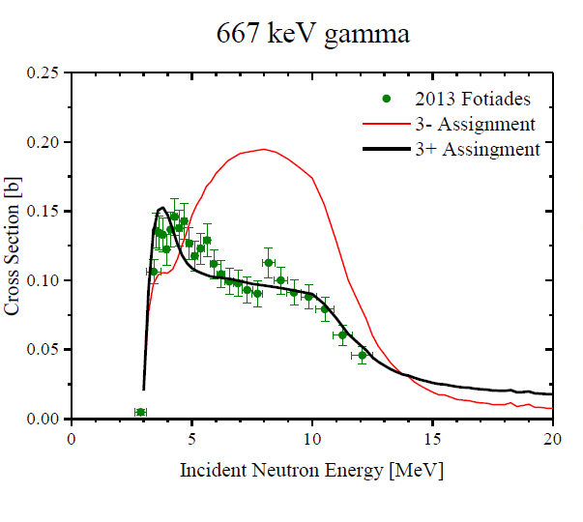
ENSDF Supplemental
XUNDL author correspondences
Supplemental info from user’s
Can eventually link to web… if good case for added benefit
Inelastic neutron scattering partial gamma data
Jπ=(3) in ENSDF

Slide 5
How to advertise XUNDL?
From Rick Casten’s talk at ND meeting:
Most users know how to use one or two narrow aspects of the site – in nuclear structure, this is often (for me as well) the evaluated data (Adopted levels and gammas) for individual nuclei.
Example: In a small poll, only about 1 in 4 had even heard of the “word” XUNDL !!
The NNDC and NDS should be transparent to the average casual user (impossible but aim for it)

Slide 6
A few reminders
Run FMTCHK
Run PANDORA, if dataset contains large number of levels and g-ray transitions
Input file into a program which has spell checking capabilities
Generate pdf file and check
Keynumbers.
Band drawings (if applicable)
Scan compilation for formatting problems, typos, etc.

Slide 7
An XUNDL Policy (guidelines)
General description
OR
Or does it matter?

Slide 8
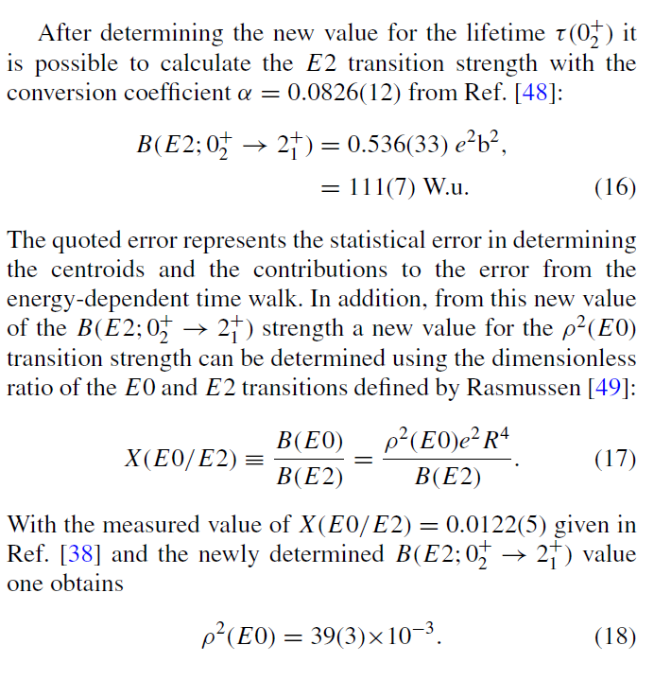
Derived quantities
Do we include, if yes?
Do we recalculate, if yes?
Which value is adopted and which is comment?

Slide 9
Proposed policy
Compiler’s derive quantities given by authors
Transition strengths, beta feedings, normalizations, HF, etc
If similar, give author’s values with compiler values either in comment or general note.
If different (and you know you are correct) give compiler value with author’s value as comment

Slide 10
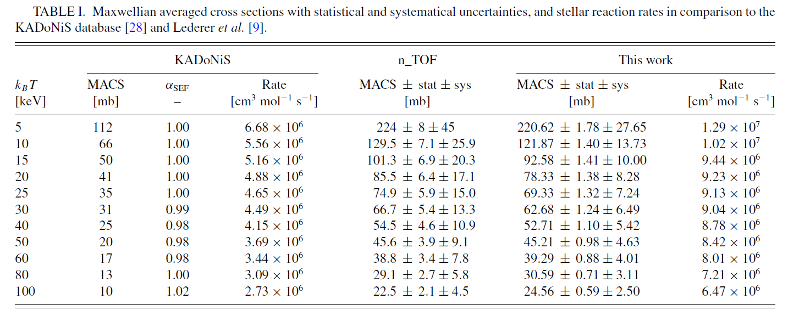
Derived quantities not in ENSDF

Slide 11
BACKUPS

Slide 12
XUNDL Developments
Coordinator change, E.A. McCutchan (NNDC) filling in for B. Singh (McMaster) as of October 2015
G. Gurdal under contract for compilations
New distribution scheme utilizing Google Drive
MSU
Coordinator Review
Coordinator Scan
Available papers
ORNL
LBNL
XUNDL compilations used as training exercise at IAEA-ICTP workshop

Slide 13
XUNDL statistics
Compiled 550 datasets from 289 papers
(FY15 was 630 datasets from 360 papers)
Center | Papers | Datasets
McMaster | 84 | 189
TUNL | 43 | 58
ORNL | 26 | 39
MSU | 29 | 57
LBNL | 11 | 34
Millsaps | 40 | 59
BNL | 39 | 75
ANL | 7 | 26
UCB | 8 | 10
International | 2 | 2
300 papers per year is reasonable estimate for effort assessment
Full database is 6956 datasets for 2406 nuclides

Slide 14
XUNDL Productivity
From NDAC Report:
Use Gulhan Gurdal Contract as “Metric”
Budget was based on 0.1 FTE = 40 compiled papers
Gave her some easy papers at beginning, so realistically
Fair effort assessment is 0.1 FTE = 30 compiled papers
(Keep in mind that contract comes at a much reduced cost)

Slide 15
XUNDL Productivity
0.1 FTE = 30 compiled papers (my guessestimate)
Most contribute 0.1 -0.2 FTE, so 0.1 FTE is convenient unit
Compiler | Papers /0.1 FTE | Datasets/0.1 FTE
 | 43 | 58
 | 42 | 94
 | 40 | 59
 | 31 | 61
 | 29 | 57
 | 16 | 28
 | 14 | 52
 | 11 | 34
 | 8 | 10
 | 6 | 9
60 papers at 0.75 FTE

Slide 16
XUNDL Effort Rearrangement
More people interested in XUNDL contract
Most notably: Chris Chiara
Well trained and highly recommended by Filip
Now at DOD, overhead is 3% !!!
Would like contract at 0.2 FTE, exactly covers 60 papers
Following Notre Dame meeting, additional requests to be involved in Data Program activities
Proposal: $30K to cover XUNDL contract for Chiara

Slide 17
Author Correspondences
1425+776=2201
970+409=1379
1790
We have partially reanalyzed the data on 168Yb and tried to resolve the problems. In your email you have raised two problems, concerning the levels at 1790 and 2110 KeV. Let me first start with the second level.
The main problem was the level at 1790 keV. After reanalyzing the data we came to the conclusion that this level does not exist. However, the gamma-rays which were supposed to decay from this level …
The future: Offer this critical review PRIOR to publication

