Slide 1
Enhancing the Nation’s Nuclear Data Effort at FRIB
Propose data effort at MSU/FRIB that integrates
  Nuclear structure evaluation
  Nuclear astrophysics data evaluation and dissemination
  Theory data evaluation and dissemination
Addresses diverse nuclear data needs in the FRIB area
  Consistency, continuity, and rapid turnaround
  Takes full advantage of synergies between data efforts in nuclear structure, reactions, astrophysics, and theory
  Maximizes scientific impact and enables discoveries
Aligned with conclusions from 2016 Data Workshop at Low Energy Community Meeting
Complements existing efforts, integrated with NNDC
Takes advantage of leverage opportunities with MSU and JINA-CEE
  Need 0.5 FTE for each, structure, astrophysics, and theory

Slide 2
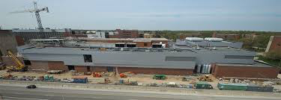
Background and Context
DOE SC-NP is investing in FRIB as a new scientific user facility. FRIB will be the world’s most powerful facility in low-energy nuclear physics.
FRIB will enable groundbreaking discoveries by providing unique nuclear structure and nuclear astrophysics data. It will also drive advances in nuclear theory, which will in turn provide large theoretical data sets for structure and astrophysics research.
To achieve the full scientific and societal impact of FRIB, we propose to initiate the necessary evolution of the US nuclear data effort so that it addresses the needs of the community in the FRIB era.

Slide 3
Data Compilation and Evaluation are an Essential Part of the Research Cycle

Slide 4
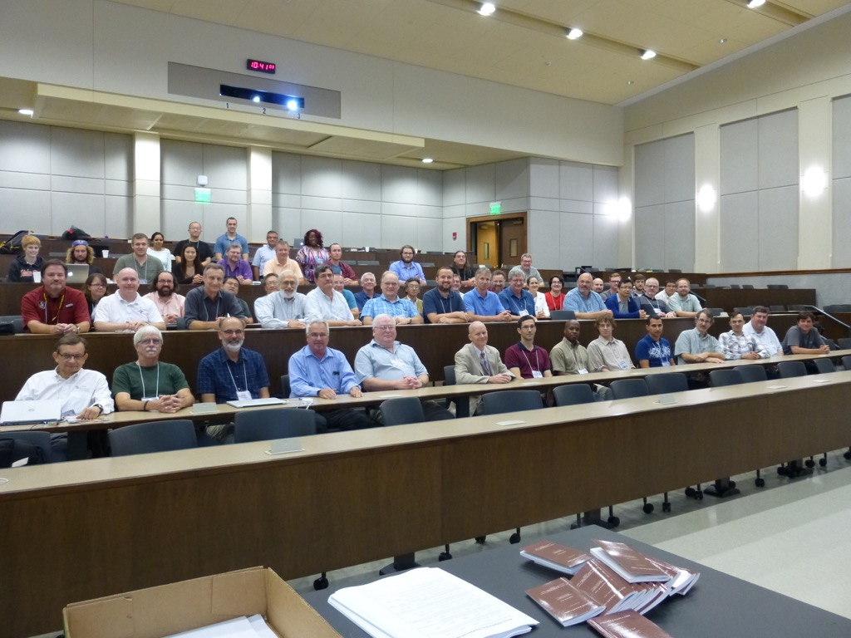
Aligned with Conclusions of 2016 LECM Community Data Workshop at Notre Dame
The USNDP is central to experiment and theory in basic nuclear science and nuclear astrophysics
The evaluation, archival, dissemination aspects of the program is critical
There is a need for expanding the data program for astrophysics
There is a need for an expansion of the effort to include theory
In the FRIB era significant new data is coming – How do we archive and make it available? How do we identify what is important?
Must deal with the complexity of new experiments, correlated data (understanding and evaluating errors), continuous quantities, etc.

Slide 5


Proposed FRIB Focused Nuclear Data Effort
US Data Effort
NNDC
Other
Facilities
Nuclear
Scientists
Structure
Theory
Computation
Discoveries
Theory
Astro
Astro-physicists
JINA-CEE
JINA-CEE
Nuc Astro Theory
Other Evaluations
Other Nuc Astro Facilities
Proposed
Observations

Slide 6
Nuclear Structure Data (0.5+0.5 FTE)
We propose to add another nuclear structure data evaluator at MSU to ensure the proper and timely compilation (XUNDL) and subsequent evaluation (ENSDF) of FRIB data.
In the FRIB era, it will be important that the data evaluation effort adjusts to the data produced, and that the turnaround is rapid to facilitate discoveries.
We will align data evaluation activities in anticipation of upcoming FRIB experiments and campaigns. The proximity of the evaluators to FRIB will enable us to address this need.

Slide 7
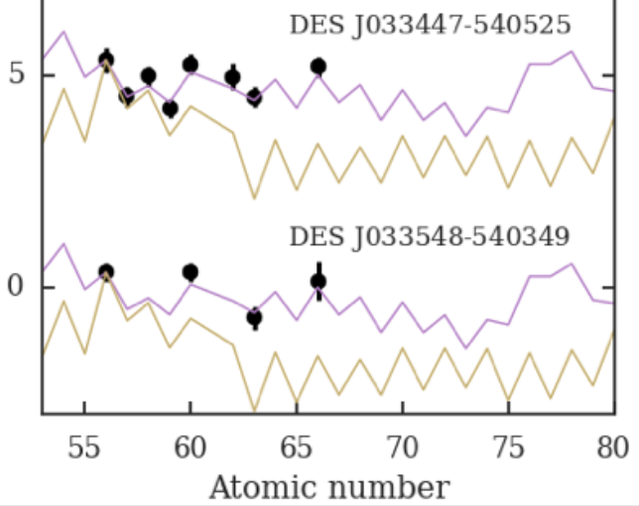
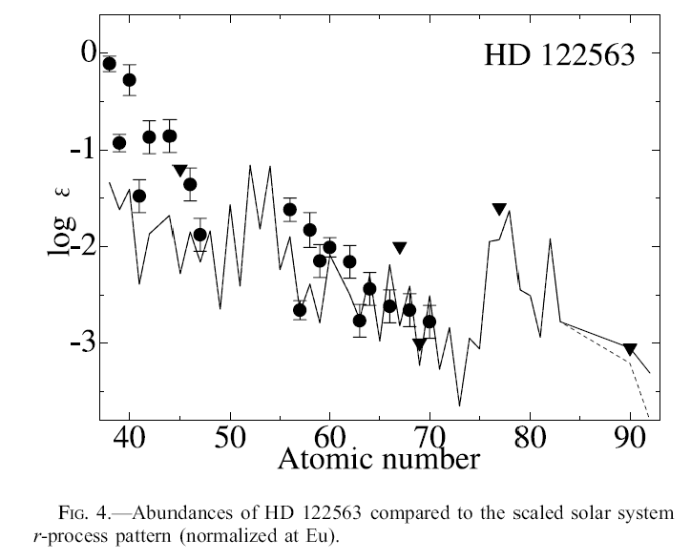
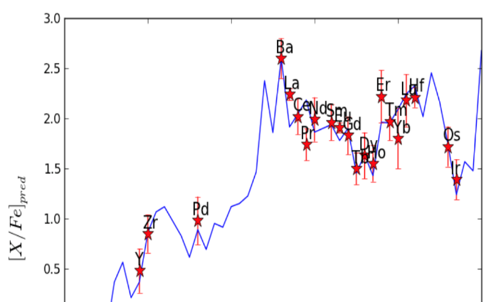


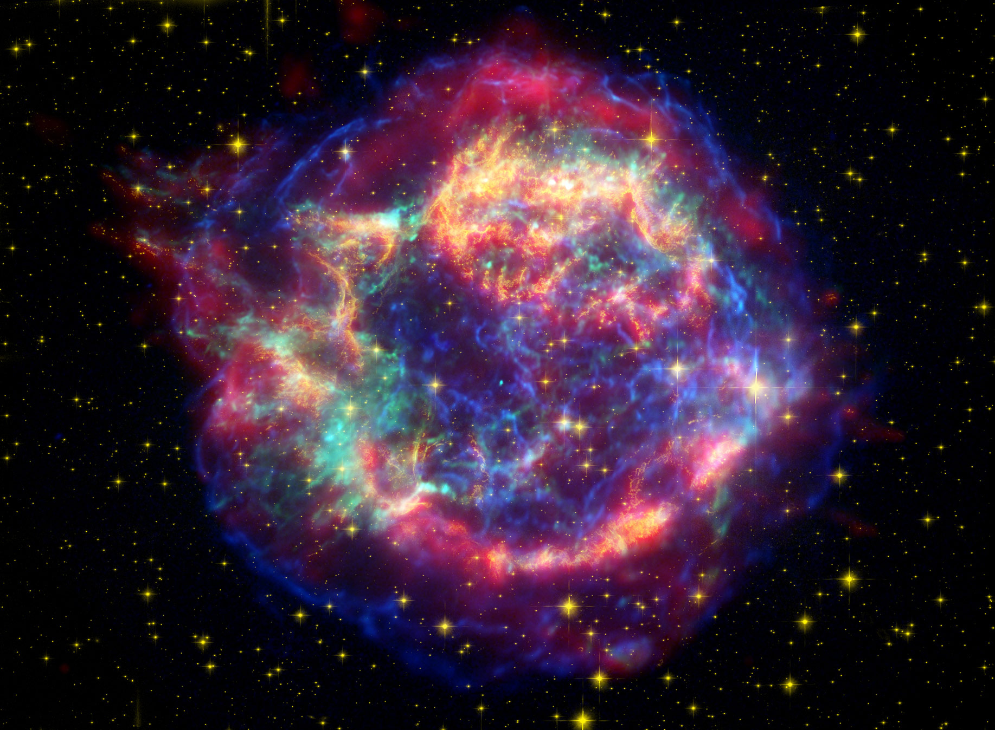
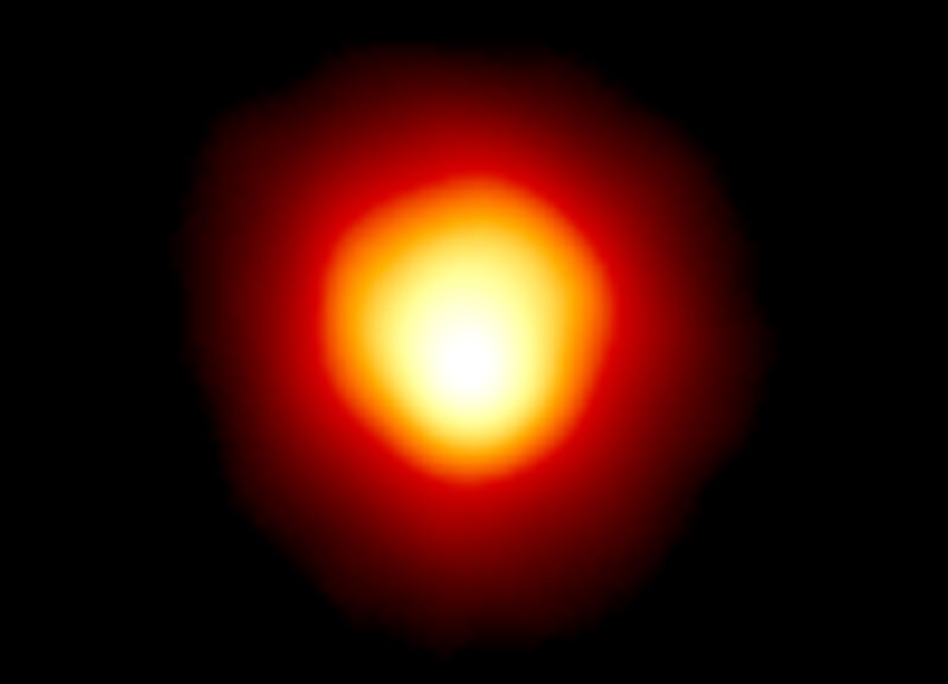
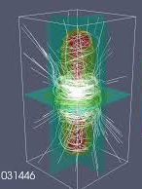
Origin of the Elements: Nuclear Data are Key for Identifying the Sites for Observed Sources of Elements
Observations now reveal the signatures of the element creating processes in Nature
Strontium
Zirconium
Log abundance
Ji et al. 2016
Honda et al. 2009
Dardelet et al. 2015
Nuclear data connect astrophysical sites and processes with these observations
Nuclear data are therefore essential to unravel the origin of the elements
Magnetic
Supernova?
Neutron Star Merger?
Core Collapse Supernova?
Red Giant Star?
Notes:
Get back to LEPP
We know what they make but not what they are
Current guess, only emerged in the last 1-2 years or so
In 2007 NASA’s Spitzer infrared silica in Cassiopeia A. Cyan is remnant of star
Betelgeuse first direct image with HST

Slide 8
Nuclear Astrophysics Data Needs
Nuclear data are key for understanding the origin of the elements and to quantitatively interpret neutron star observations
Nuclear data must be evaluated and processed to have any scientific impact in astrophysics:
  Combine experimental data, experimental constraints, nuclear theory
  Apply theoretical corrections for astrophysical environment
  Calculate astrophysical reaction rate in format that can be used by astrophysicists
Must address the considerable evaluation backlog – many nuclear data are not used in astrophysics
FRIB will produce significant amounts of nuclear astrophysics data (SECAR) and so will other new FRIB era facilities.
Need capacity, consistency and continuity in evaluation and dissemination of nuclear astrophysics data in the FRIB era

Slide 9
Proposal: Nuclear Astrophysics Data Evaluation at MSU/FRIB (0.5 + 0.5 FTE)
Focus on reaction rate data evaluation combining structure data, reaction data, theory data and theory tools
Build on and expand JINA-CEE Reaclib infrastructure for dissemination and link to ORNL tools as well as other evaluation efforts
Now is the time to start: JINA-CEE can help jumpstart the effort
  Facilitate community engagement (including workshops, working groups etc)
  Facilitate close collaboration with other evaluation efforts
  Provide leverage
Connection to USNDP and proposed Structure/Theory data efforts
  Provides continuity and consistency
  Enables to take advantage of synergies:
    More comprehensive and faster use of nuclear structure, nuclear reaction, and theory data for astrophysics.
    Provides a natural connection of structure and reaction efforts
  Enhances impact of USNDP

Slide 10
Science 354, 180 (2016)
For more than a century, materials scientists have accumulated experimental data on the structures of chemical compounds and the thermal, electronic, and mechanical properties that they exhibit. These data have been a cornerstone in the development, selection, and design of materials. In the past decade, experimental data have been augmented by an explosion of computational data from quantum-mechanical calculations, which can be obtained more quickly and in some cases with comparable accuracy.
The computational databases supplement the experimental ones mainly by providing additional systematic information about materials, but they also provide information about the properties of materials that do not occur naturally or that have never been synthesized in a laboratory.
Computational materials scientists apply a range of different codes that all solve the same fundamental equations of DFT but apply diverse numerical approaches. In a large community effort, it was recently shown that in simple situations, like the calculation of the equation of state of elemental crystals, agreement between different codes can be established.
Computational databases mainly contain entries for bulk solids in simple crystal structures, primarily because calculation times grow quickly with the number of atoms N in the unit cell (typically as N to a power between 2 and 3). However, many materials properties are determined by defects, such as vacancies, atoms in interstitial sites, or impurities, or by grain boundaries or surfaces. For many applications, the simple materials described in the databases are not directly relevant, and more complex structures and materials must be included.

Slide 11
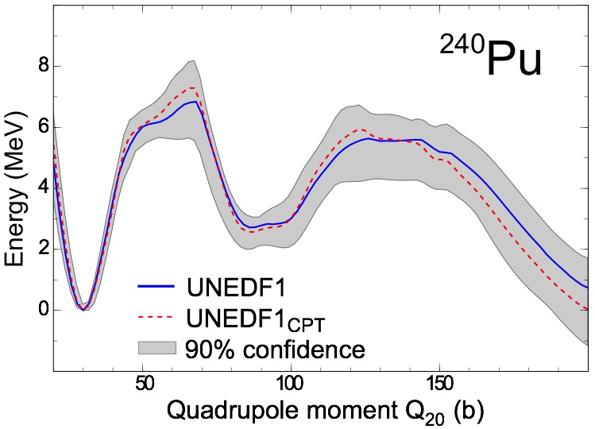
Uncertainty Quantification
http://iopscience.iop.org/journal/0954-3899/page/ISNET
Regression analysis
Bayesian inference
Extrapolations
Model mixing
Information content of new measurements
Bivariate posterior distributions of energy density functionals from Bayesian analysis
PRL 114, 122501 (2015)
Fission barrier
PRC 89, 054314 (2014)

Slide 12
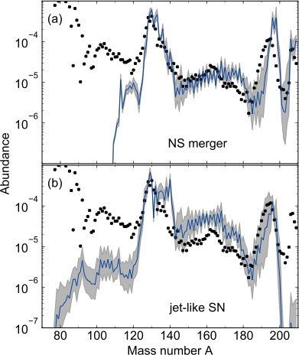
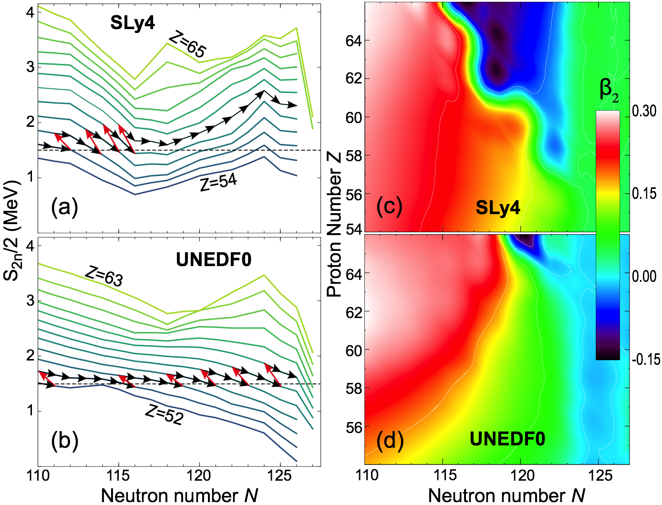
Impact of Nuclear Mass Uncertainties on the r Process
In many cases, nuclear modeling MUST involve massive extrapolations...
Such extrapolated results are used, together with existing data, in simulations.
Phys. Rev. Lett., 116, 121101 (2016)

Slide 13
Proposal: A New Database
(0.5 + 0.5 FTE)
Initially, content primarily produced by large-scale simulations
  Large-scale surveys of nuclear observables produced by SciDAC programs
  Data needed for further uncertainty quantification (covariance matrices, posterior distributions of parameters) also stored
Examples
  Ground-state properties of even-even nuclei: https://massexplorer.frib.msu.edu
  Spectroscopic overlaps: https://www.phy.anl.gov/theory/research/overlap/
The long-term perspective is to interface theoretical database with ENDSF to be able to directly compare theory with experiment
In short: provide a theoretical counterpart to ENDSF, fully integrated with NNDC.

