Slide 1
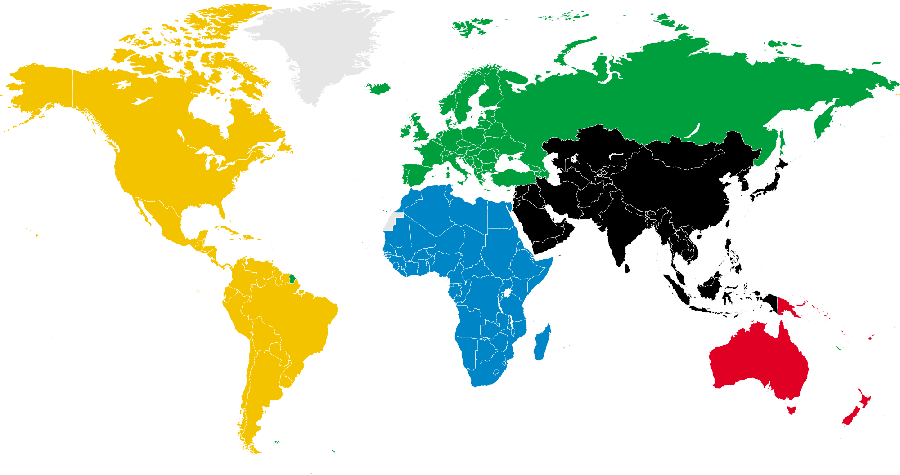
International Network of Nuclear Structure and Decay Data Evaluators
Since 1974 under auspices of
Nuclear Data Section
International Atomic Energy Agency
15 NSDD centres

Slide 2
Distribution of effort
74%
26%
NSDD centres

Slide 3
NEW: MSU Data Center → FRIB data
NEAR FUTURE: RIKEN Data Center → RIKEN data

Slide 4
NSDD evaluation vs Usage
FTE contribution to ENSDF
Downloads (%) from Nuclear Data Sheets

Slide 5
A bit of History
Data Centers | Year
 | 1981 | 1986 | 1996 | 2008 | 2015 | 2015:FTE
North America | 6 | 6 | 6 | 6 | 7 | 6.9
Europe | 6 | 5 | 4 | 1->0 | 2 | 0.9
Russia | 2 | 2 | 2 | 1 | 1 | 0.2
Japan | 1 | 1 | 1 | 1 | 1 | 0.2
China | - | - | 1 | 2 | 2 | 0.4
Rest of the world | 1 | 1 | 1 | 3 | 2 | 0.8
 |  |  |  |  | Total | 9.4

Slide 6
More history
c/o: A. Negret

Slide 7
European NSDD Effort 2015-2016
Recommendation of 21st NSDD Meeting 2015: European NSDD members and advisors should hold a special meeting to discuss European NSDD shortfall

Slide 8
Meeting recommendations
Liaise with ESF Nuclear Physics European Collaboration Committee (NuPECC) to promote NSDD evaluation in Europe
Promotion of European NSDD at conferences
Expand European NSDD Consortium
Document sent to all NuPECC members (IAEA)
NSDD presentation at NuPECC meeting (Oct.2016)
Contribution to NuPECC Long Range Plan ACCEPTED
European NSDD effort presented at ND2016 (Negret),
INPC2016 (Dimitriou), UK CARM2016 (Dimitriou)
Aim to create an inclusive European NSDD Consortium to enhance
support across Europe – MoU is being sent out

Slide 9
More actions…
AIM: make nuclear data more visible in Europe by engaging with European Nuclear Structure community on many levels:
UK Nuclear Data Network (funded by UK)
official launch at CARM2016
European CERN-Medicis facility/program on medical isotope production
participation in IAEA nuclear data projects (ICTP workshops, CRPs, meetings)
Decay Data Evaluation Project (DDEP), Joint European Fission and Fusion file (JEFF)

Slide 10
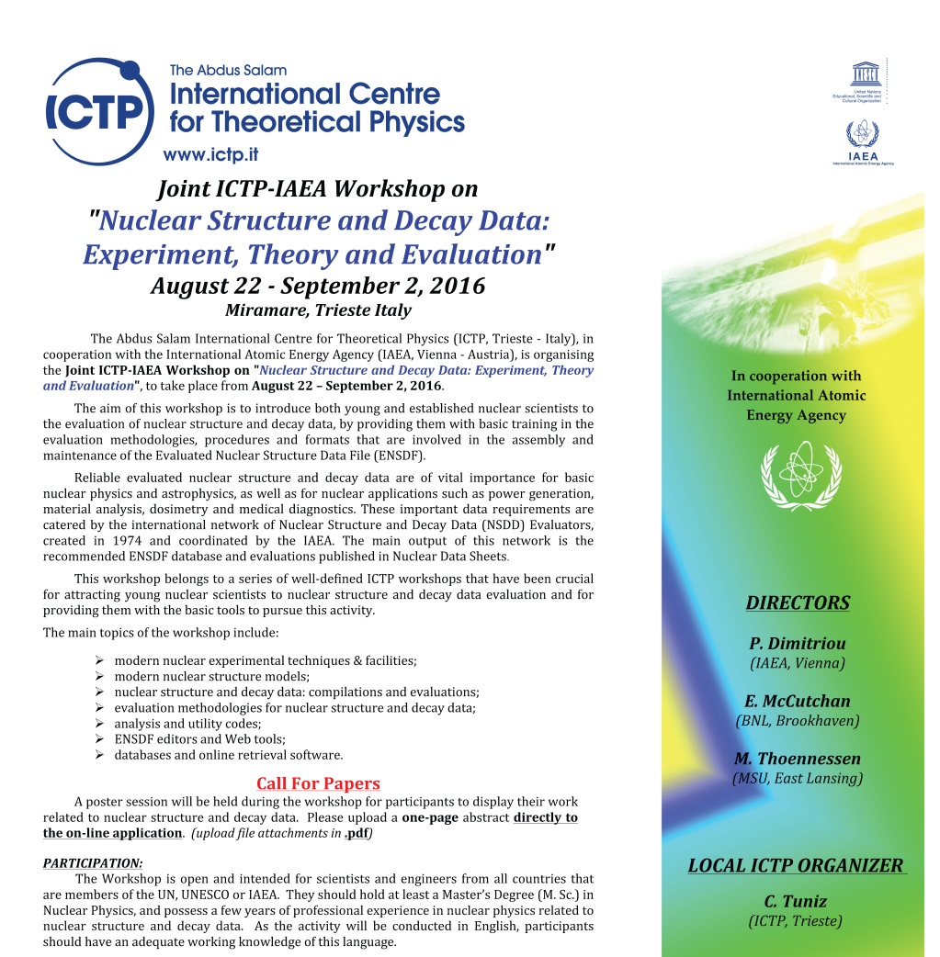
Joint ICTP-IAEA Workshop on Nuclear Structure and Decay Data: Experiment, Theory and Evaluation, 22 Aug.-2 Sept. 2016, Trieste
Directors: P. Dimitriou, E. McCutchan, M. Thoennessen
Lecturers:
E. McCutchan (BNL)
M. Thoennessen (MSU)
H. Sakurai (RIKEN)
P. Regan (Surrey)
P. Van Isacker (GANIL)
J. Tuli (BNL)
F. Kondev (ANL)
B. Singh (McMaster)
T. Kibedi (ANU)
S. Basunia (LBL)
M. Verpelli (IAEA)
V. Zerkin (IAEA)
Lectures and Hands-on courses: XUNDL+ENSDF

