Slide 1
USNDP
Nuclear Structure and Decay Data
Shamsuzzoha Basunia, LBNL
November 16-18, 2016
USNDP Meeting, BNL

Slide 2
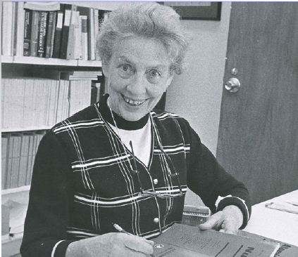
Structure & Decay Databases:
Nuclear Data Sheets (NDS)
  Initiated by Katherine Way at ORNL in 1948. NDS published by Academic press since 1966 and later by Elsevier
Evaluated Nuclear Structure Data File (ENSDF)
  Input format – for NDS
  Initial effort – only in the US
  International network NSDD formed through the IAEA in 1974
  Consistent contributors – US + Canada (McMaster, since 1980)
Nuclear Science Reference (NSR)
  An essential resource for ENSDF
Experimental Unevaluated Nuclear Data List (XUNDL)
  Since 1998 - Timely compilation – useful for many reasons – ENSDF, contact with authors for data related issues (if any), and listing additional data (when available)
Katherine Way
Credit: Jagdish Tuli
2
USNDP Meeting, BNL,16-18 Nov, 2016

Slide 3
ENSDF status and trend:
ENSDF
Evaluated 220 nuclides in FY 2016, including 12 (non-US)
11-year average: 244 nuclides
Nuclear Data Sheets (NDS): Published 16 and submitted 12 mass chains in FY 2016
11-year average: 17 publications and 17 submissions
ENSDF FTE:
FY2006: 6.7 (US) (5.4 permanent+ 1.3 temp) + 3.5 (non-US)=10.2
FY2015: 6.5 (US) (4.4 permanent +2.1 contract) + ~1 (non-US)=~7.5
3
USNDP Meeting, BNL,16-18 Nov, 2016

Slide 4
ENSDF status and trend: Con’t
Target: Average lifetime of a mass chain: 5 to 5.5 years (10-year revision cycle)
In reality: Average lifetime
  6.9 years in FY2004
  8.3 years in FY2015
Total ENSDF size:
  148 MB in FY2004
  209 MB in FY2015
  About 41% increase
Evaluation: Could take average time or longer or shorter – many issues –
disagreement, dealing older data, new policies, size increase, etc.
4
USNDP Meeting, BNL,16-18 Nov, 2016

Slide 5
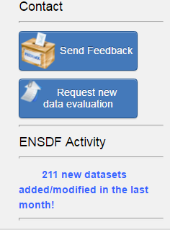
Mass-chain/Nuclide/Dataset:
Many different components:
Mass-chain – a good unit – consistent treatment for decay datasets
  Longer and consistent effort
  Most general publication unit for Nuclear Data Sheets
Nuclide/dataset evaluation/update
  Ongoing – at limited scale, when identified
On-request evaluations:
  Ongoing – as per request
  Need more of it – to serve the community
5
USNDP Meeting, BNL,16-18 Nov, 2016

Slide 6
ENSDF codes:
IAEA-led code development project:
  Coordinated meetings, status, update, etc.
  JAVA-NDS v1.5 in good standing – J. Chen (MSU) and B. Singh (McMaster)
  J-GAMUT, V.AveLib – available for evaluators - M. Birch and B. Singh (McMaster)
  GABS (rewritten), new code for Auger electron data – T. Kibedi (ANU)
  ALPHAD revision - India and McMaster
  RULER – known for bugs – not fixed yet
Other codes/software: (foreseen item – discussion ongoing)
  Parser for ENSDF to XML
    Personal initiative – Hurst (LBNL/UCB)
      NDWG item for infrastructure modernization
    JAVA-NDS – sets example of parsing from ENSDF - LaTeX
6
USNDP Meeting, BNL,16-18 Nov, 2016

Slide 7
Bright Spots:
XUNDL+ENSDF contains a nearly complete up-to-date nuclear structure data of the literature
At least one new generation evaluator at each center in the US
Experienced (retired) evaluators are making valuable contributions
Horizontal evaluation – evaluator expertise in topical activities
Development/update of codes with IAEA
  IAEA-ICTP NSDD workshop for outreach and training since 2003
  Experimental activities, NDNCA (Berkeley, 2015), NDNCBS (Notre Dame, 2016), formation of NDWG, etc.
Note from Brad Sherrill at NDNCBS, Notre Dame, 2016

Slide 8
Challenges/Concerns:
ENSDF, NDS
      Evaluation of ~300 nuclides/year with a reduced level of international support
      NDS publication – Mass chain dependent
        Includes horizontal evaluations – but no nuclides in recent years
      Evaluation unit: Mass-chain/Nuclide/Dataset – ongoing
        Request from users - fewer – effective use of effort
Maintenance of Analysis and Utility codes:
      Fortran language – fewer expertise
      Coordinated efforts - through IAEA
Rapid execution of any policy changes:
      For whole database – hands-on effort
Workforce
      Experience evaluators will not be available for ever
      Need to add ~2 FTE for ENSDF (US) by 2019
        Training at National Labs for new evaluators - ongoing
      International involvement is crucial

Slide 9
Future Plans/Activities:
ENSDF
      Mass Chain: Select with multiple criteria – ongoing
      Nuclide: Update ENSDF and NDS publication if significant
      New- Timely update of any subgroups? (Discussion topic)
        For example - Decay datasets following AME publication (where needed)
      New – Adopted Decay Datasets? (Discussion topic)
      Outreach for input/need from community
        Prepare to address needs for future FRIB
NDS
      One issue: For reactions
      Other issues: For Mass Chain, Nuclide, Horizontal evaluation, items (Discussion topic)
Citation:
      NDS vs. ENSDF (Sometimes data in ENSDF changes prior to next NDS)
      Database snapshot could help (Discussion topic)
http://www.nndc.bnl.gov/ensarchivals/
9
USNDP Meeting, BNL,16-18 Nov, 2016

Slide 10
Summary
ENSDF
      Notre Dame (NDNCBS) workshop highlights critical use and its role for basic science: An up-to-date ENSDF database is vital
      Average life: ~7 years (FY2004), ~8 years (FY2015)
        Due to many factors – increase of database size (41% - as of 2015), change of guards, some changes in policies, etc.
      Challenge remains to maintain the evaluation rate - however – evaluation practices, fixing items in the database (ENSDF update), NSD publication, etc. are important for effective use of limited effort
      Future plan: Timely upgrade of subgroups, Adopted Decay Datasets, Citation (Discussion topics), etc.
NSR and XUNDL
      Progressing well
Workforce
      At least ~2 FTE effort (ENSDF) required by 2019 to maintain the US level.

Slide 11

The 22nd NSDD Int. Meeting at LBNL (May 22-26, 2017)
You are invited
11
USNDP Meeting, BNL,16-18 Nov, 2016

Slide 12
Backup slides

Slide 13
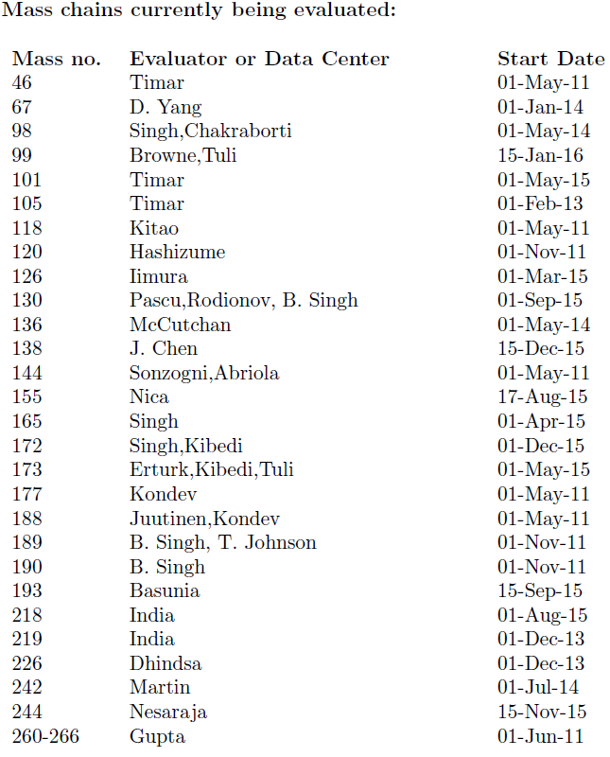
ENSDF Monthly Report:
USNDP Meeting, BNL,16-18 Nov, 2016

Slide 14
21st NSDD report (2015): INDC(NDS)-0687
2.5
0.1
4.4
2.2
~1
USNDP Meeting, BNL,16-18 Nov, 2016

Slide 15
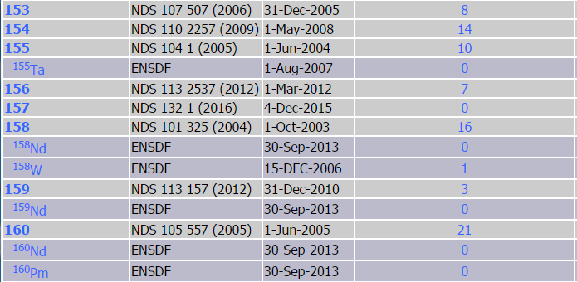
Index of ENSDF and # XUNDL since cut-off
http://www.nndc.bnl.gov/ensdf/ensdf/ensdfindices.jsp
USNDP Meeting, BNL,16-18 Nov, 2016

