Slide 1
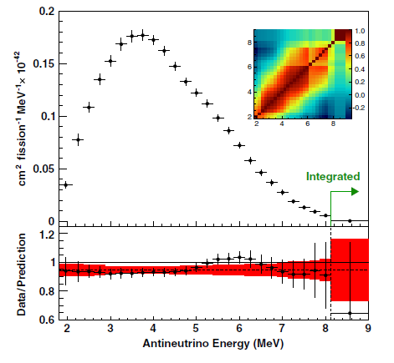
Neutrinos are hot now!
Latest Daya Bay Antineutrino Spectrum
Missing 5.4% of the total number of electron antineutrinos at around 500m from the reactor with respect to the Huber-Mueller predictions.
This deficit is not accounted for in the three flavors oscillations.
There is a distortion in the energy spectrum with respect to the Huber-Mueller prediction.
F.P. An et al, PRL 116, 061801 (2016)

Slide 2
Possible sources of disagreement between Daya Bay and Huber-Mueller
Assuming that the ILL electron spectra data are correct (most likely), then the disagreement is due to:
²³⁸U spectra, the least known, is wrong, see A.C. Hayes et al, Phys. Rev. D92, 033015 (2015).
Z_{effective} vs end-point energies function is not correct.
Additional correction terms are needed in beta spectrum shapes.
Something new…

Slide 3
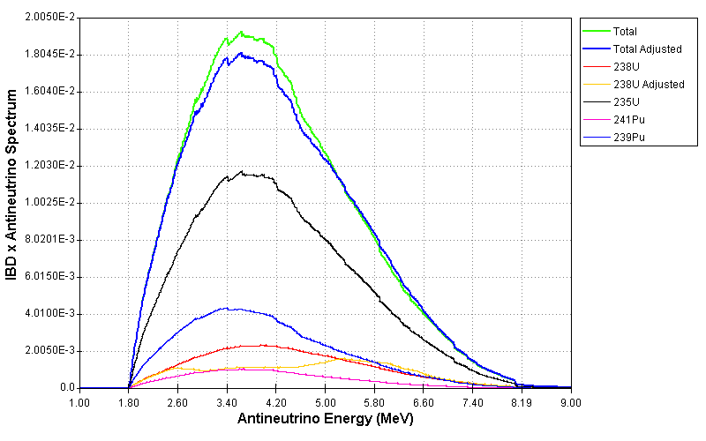
Adjusting the ²³⁸U antineutrino spectrum
Changes to the ²³⁸U antineutrino spectrum to fit the data, that is, to solve the anomaly and spectrum distortion:

Slide 4
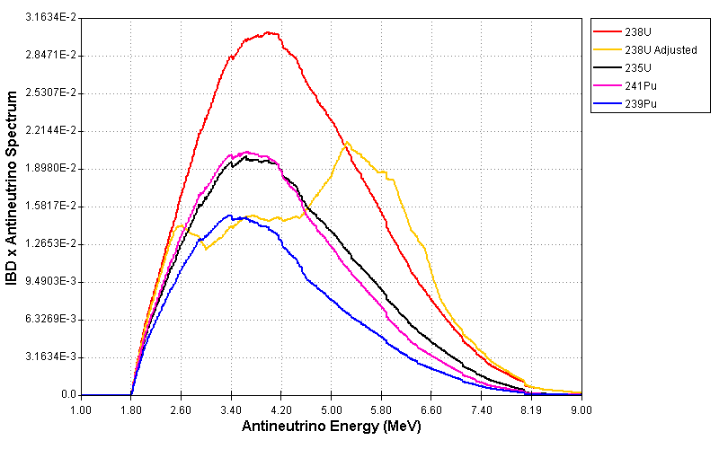
Adjusting the ²³⁸U antineutrino spectrum
Adjusting the ²³⁸U spectrum leads to a result that is unphysical

Slide 5
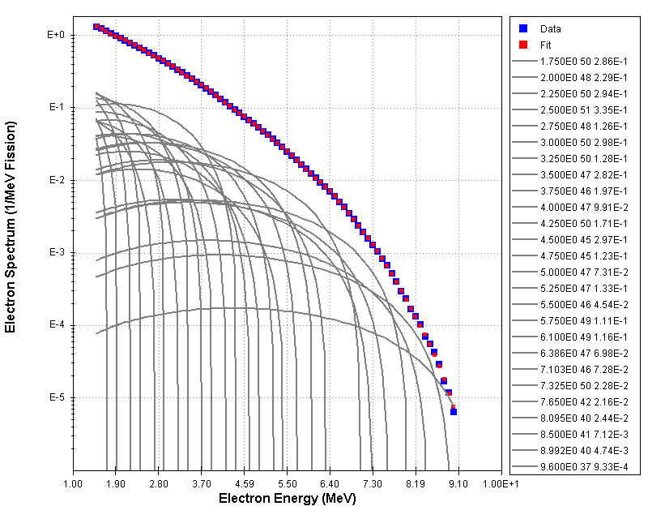
Conversion Method
Q_{i}
Z_{i}
I_{i}
Fit a number of average decay branches to the measured electron spectrum to derive the antineutrino spectrum.
²⁴¹Pu

Slide 6
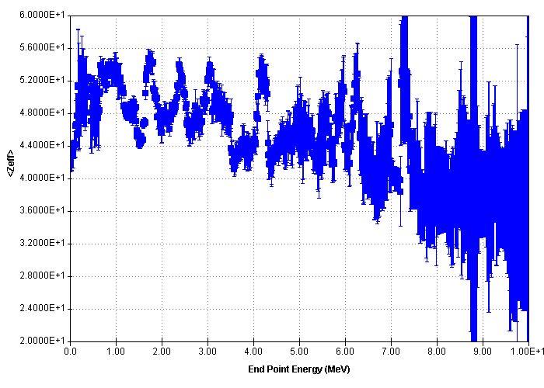
Conversion Method
It turns out that Z_{i} is not constant. It is calculated as:
where:
²³⁵U
Uncertain due to the CFY data

Slide 7
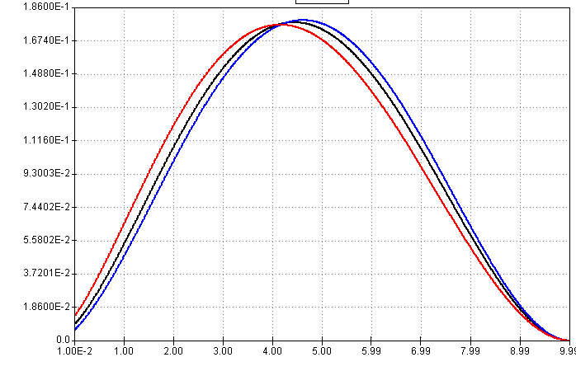
Adjusting the Z-effective to match the data
The electron/antineutrino spectrum is shifted to lower/higher energies for higher Z values:
Electron Spectrum
Z=47
Z=27
Z=67

Slide 8
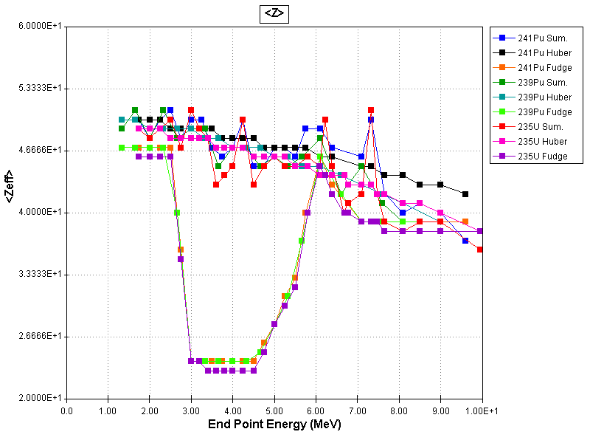
Adjusting the Z-effective to match the data
Unphysical changes to Z_{eff} are needed to match the data

Slide 9
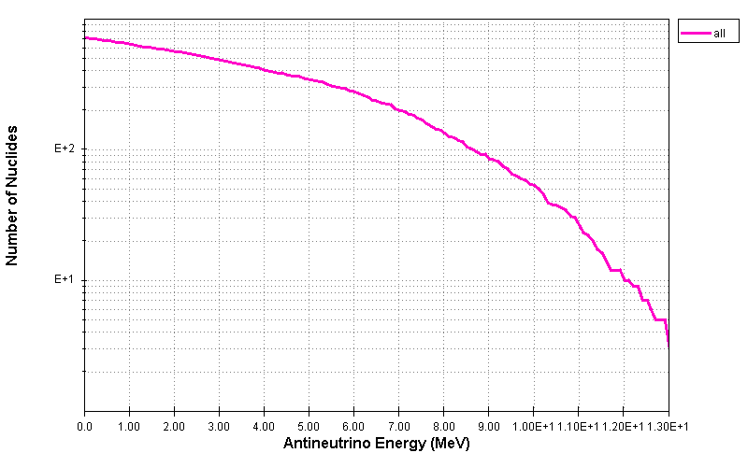
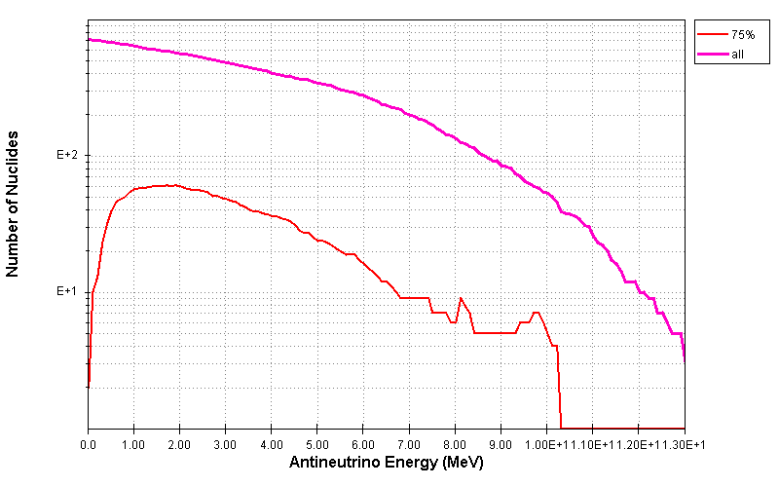
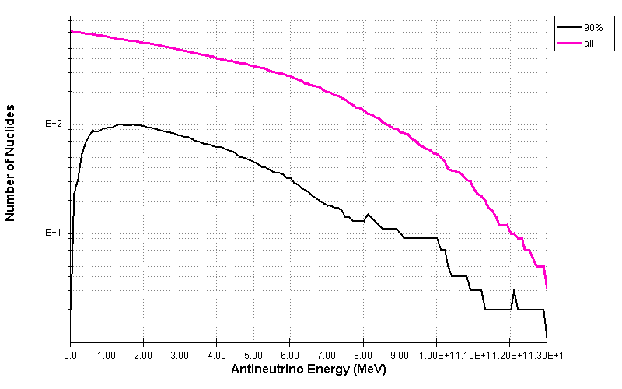
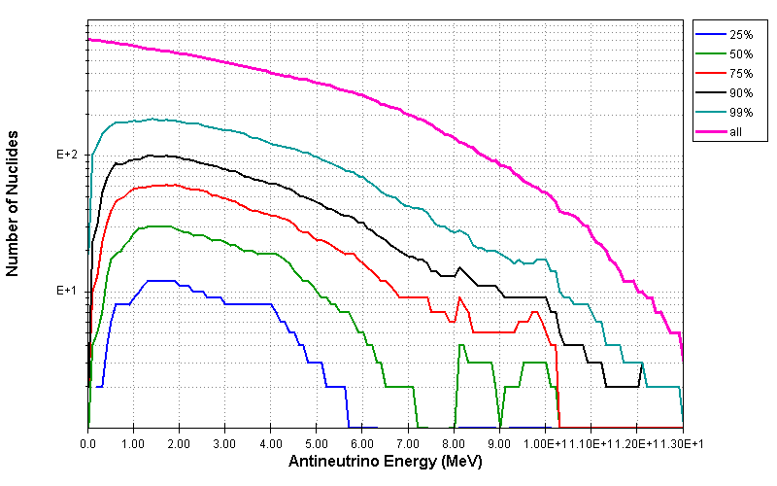
Number of nuclides in Daya Bay spectrum
~100
~50
<10
<10
3 – 5 MeV region
8 – 3 nuclides contribute 25%
22 – 10 nuclides 50%
50 – 25 nuclides 75%

Slide 10
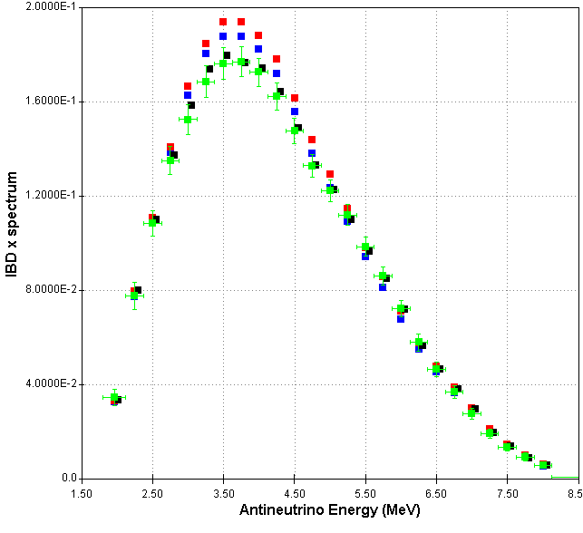
Additional shape factors
C_{exp} =1+a₁W+a₂W+a₃W+b₁/W
Adjust to match Daya Bay
Data
ILL-Vogel
Huber-Mueller
Conversion
a₁=0.03 in 3-6 MeV
From X. Mougeot, PRC91, 055504 (2015), for allowed transitions
Nucleus | Q | C_{exp}
¹³⁰I | 1005 | 1+0.04W
¹³⁰I | 587 | 1+0.04W
¹³¹I | 606 | 1+0.02W
a₁=0.03 is not a crazy value!
Shape factors are not included in ENSDF!

Slide 11
Conclusions
If we had highly precise decay data as well as electron spectra and yields following the fission of ²³⁵U, ²³⁸U, ²³⁹Pu and ²⁴¹Pu, we could tell if there is physics behind the standard model.
We have explored the sensitivity of the recently published data to different nuclear data quantities
²³⁸U antineutrino spectrum
Z_{effective} of the ²³⁵U and ^{239,239}Pu antineutrino spectra
Shape factors due to weak magnetism, first-forbidden transitions, 2nd order corrections.

