Slide 1
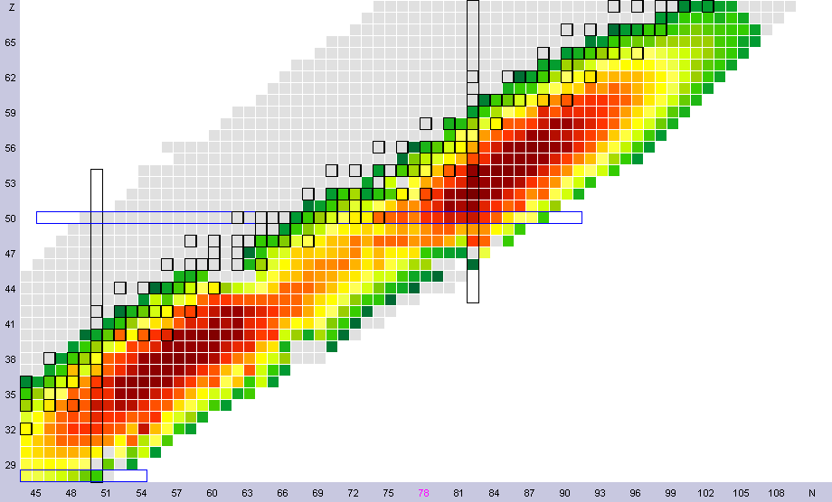
Fission Yields
Independent fission yields give the probability that a given level is populated following fission

Slide 2
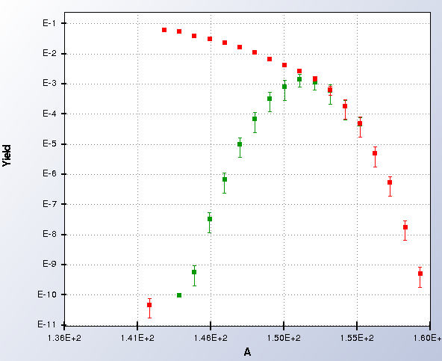
Cumulative fission yields are recursively defined as:
CFY_{i}=IFY_{i}+Σ b_{ki} CFY_{k}
where b_{ki} is the probability of the level k decaying to the level i
Z=60
Cumulative
Independent

Slide 3
Fission Yields
Currently two independent fission yields library, ENDF/B and JEFF.
The code GEF by K.-H. Schmidt and B. Jurado has been developed in the last few years and shows considerable capabilities.
Most of ENDF/B yields were released in 1992, with the exception of the ²³⁹Pu 2 MeV data.
Data published in the last 25 years have not been incorporated in the library.
ENDF/B-VII.1 yields are not fully compatible with modern decay data.
Many experiments are taking data and more will start taking data soon, which should be incorporated in the libraries.

Slide 4
Fission Yields
Workforce shortage is an issue. During his plenary talk in ND2016, Tokio Fukahori considered fission yields evaluators all but extinct.
ENDF-6 format doesn’t include yields as function of Z and A, as well as nubar as function of A.
Covariances of fission yields have been developed, but can’t be accommodated in the ENDF-6 format either.
Consultants meeting organized by the IAEA, May 23-26, 2016. INDC-NDS-0713 report by P. Dimitriou, F.-J. Hambsch and S. Pomp.
Possible evaluation of ^{235,238}U, ^{239,241}Pu and ²⁵²Cf yields as a world effort. It will take considerable amount of funds to get it done.
Next slides: Some of our recent work.

Slide 5
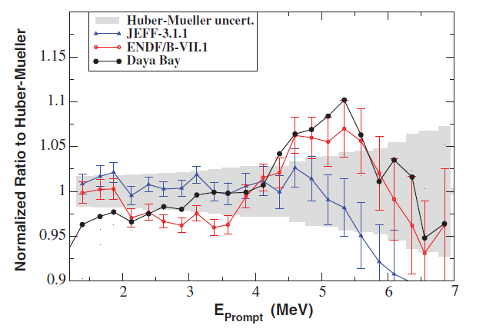
Fission Yield Effects in antineutrinos
It has been known for a while that ENDF/B and JEFF fission yields were producing different results
A.C. Hayes et al, PRD 92, 033015 (2015)
We performed corrections to the ENDF/B yields to account for: a) better decay data,
b) improved isomeric ratios,
c) anomalous yields.

Slide 6
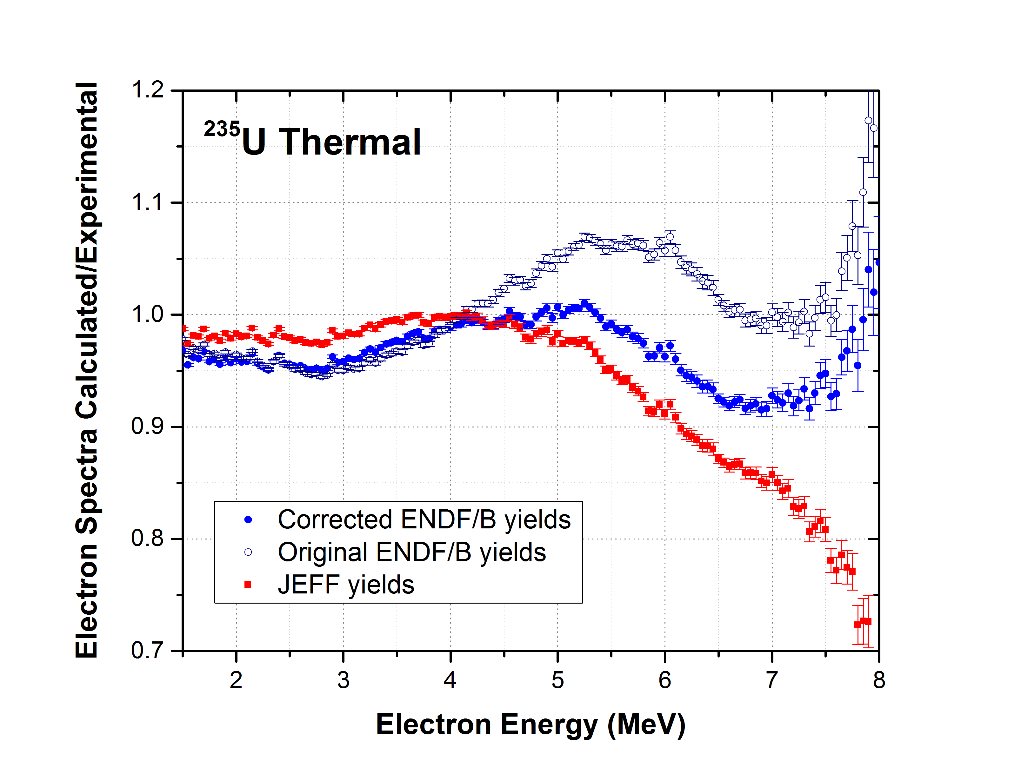
Thermal ²³⁵U electron spectrum
Corrected yields:
No electron excess.
Better agreement with JEFF.
A.A. Sonzogni, E.A. McCutchan, T.D. Johnson, P. Dimitriou, PRL 116, 132502 (2016).

Slide 7
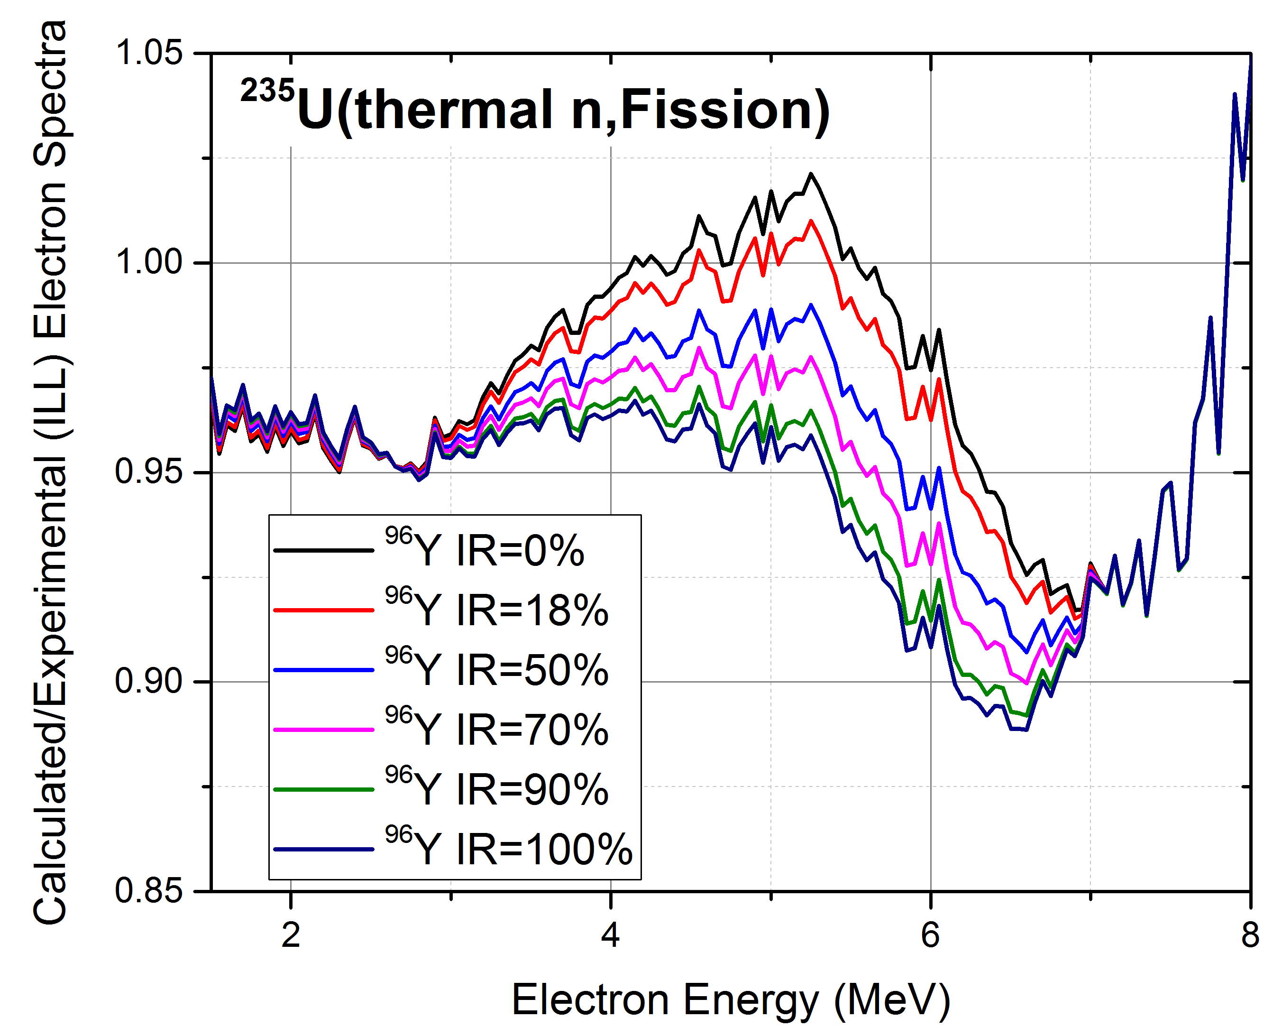
⁹⁶Y – Isomeric Ratio Effect
⁹⁶Y Isomeric Ratio:
CFY ~ 0.05
At about 5.2 MeV, changing IR from 0 to 100% changes the calculated to experimental ratio by 7%.
Very recent Experiment in ILL (France), IR=0.5
Recent Penning Trap in Jyvaskyla, IR=0.5
There is no journal publication of IR. Estimates vary from 18% to 70%.
Next slides: some inconsistencies

Slide 8
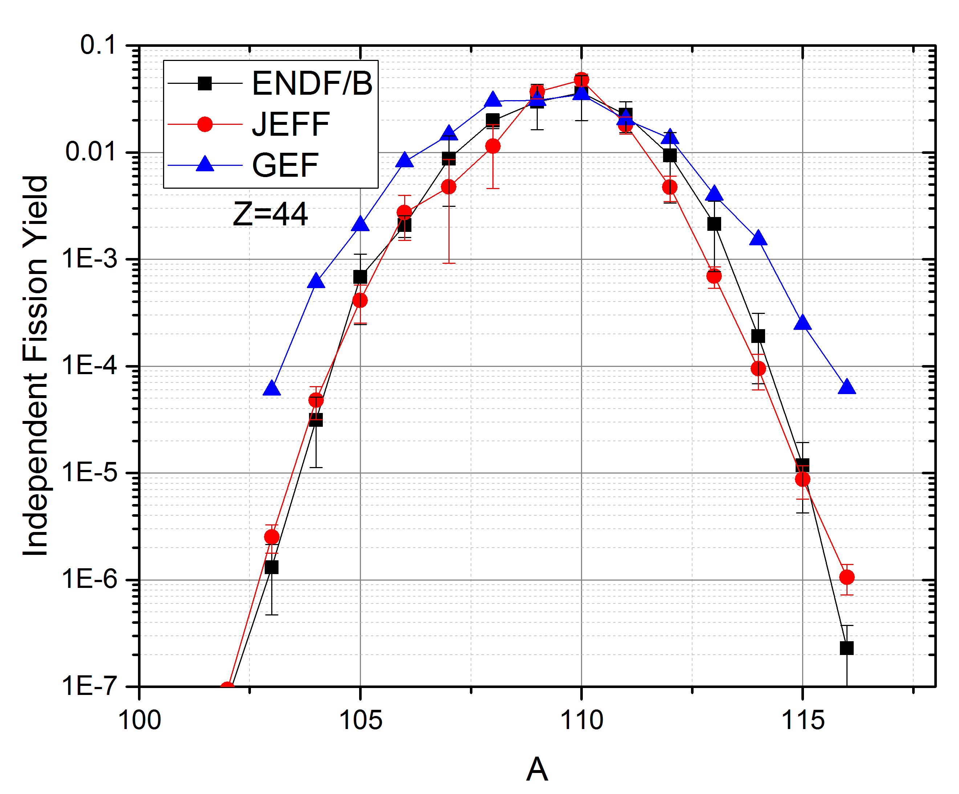
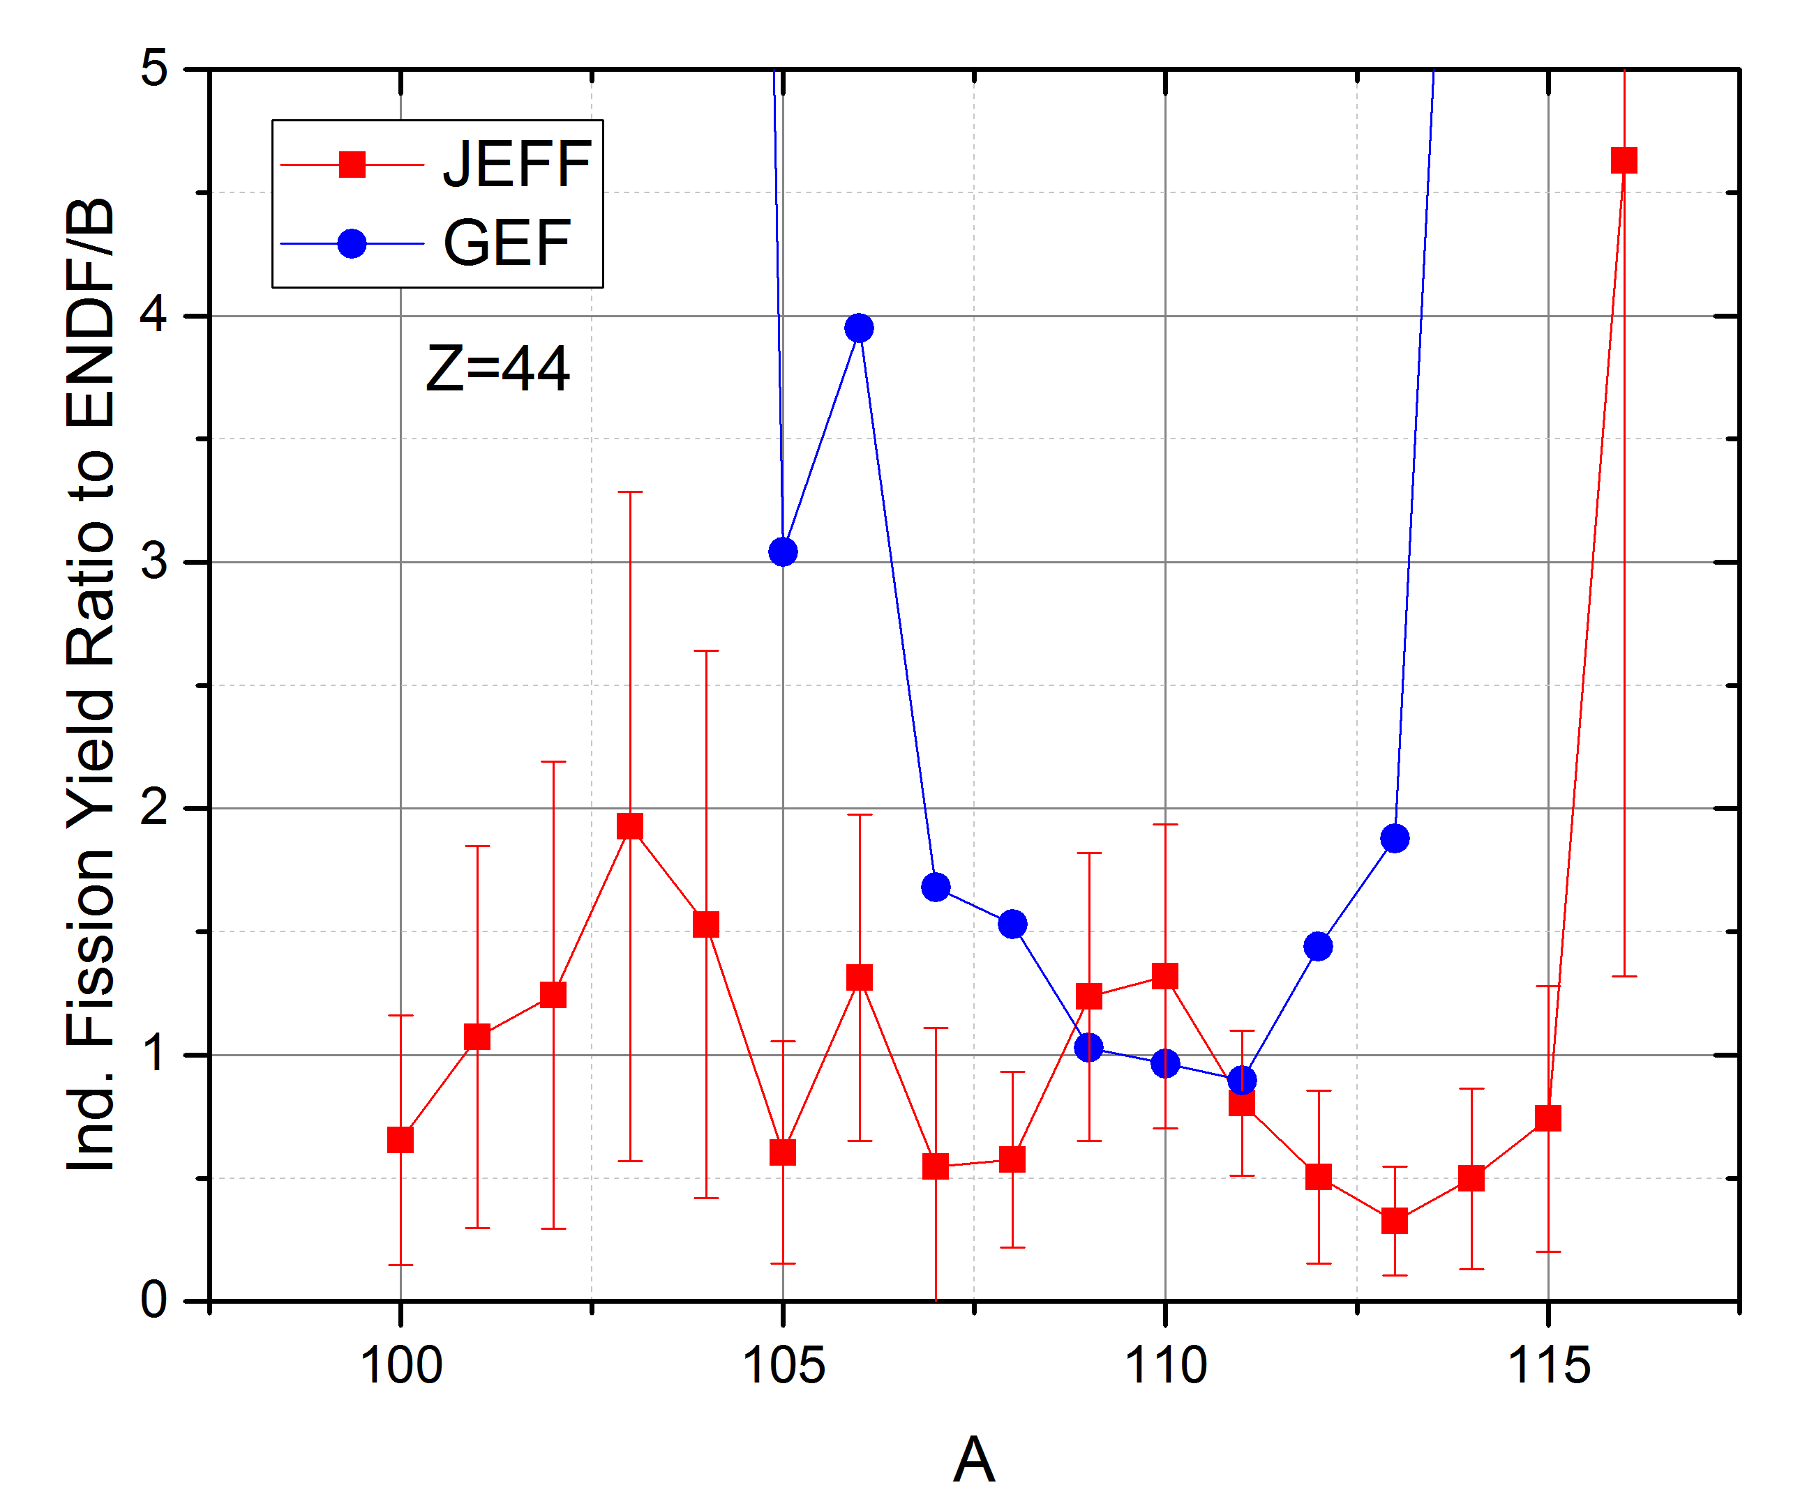
²⁵²Cf ENDF/B vs JEFF vs GEF yields
As example, Z=44, with IFY(110Ru)=0.036 (highest in LFF)
We should expect good agreement between them
²⁵²Cf JEFF yields are consistently lower than ENDF/B for nuclides on the right of the maximum
Using summation method we obtain:
Delayed nubar ENDF/B=8.3E-3, Delayed nubar JEFF=6.6E-3

Slide 9
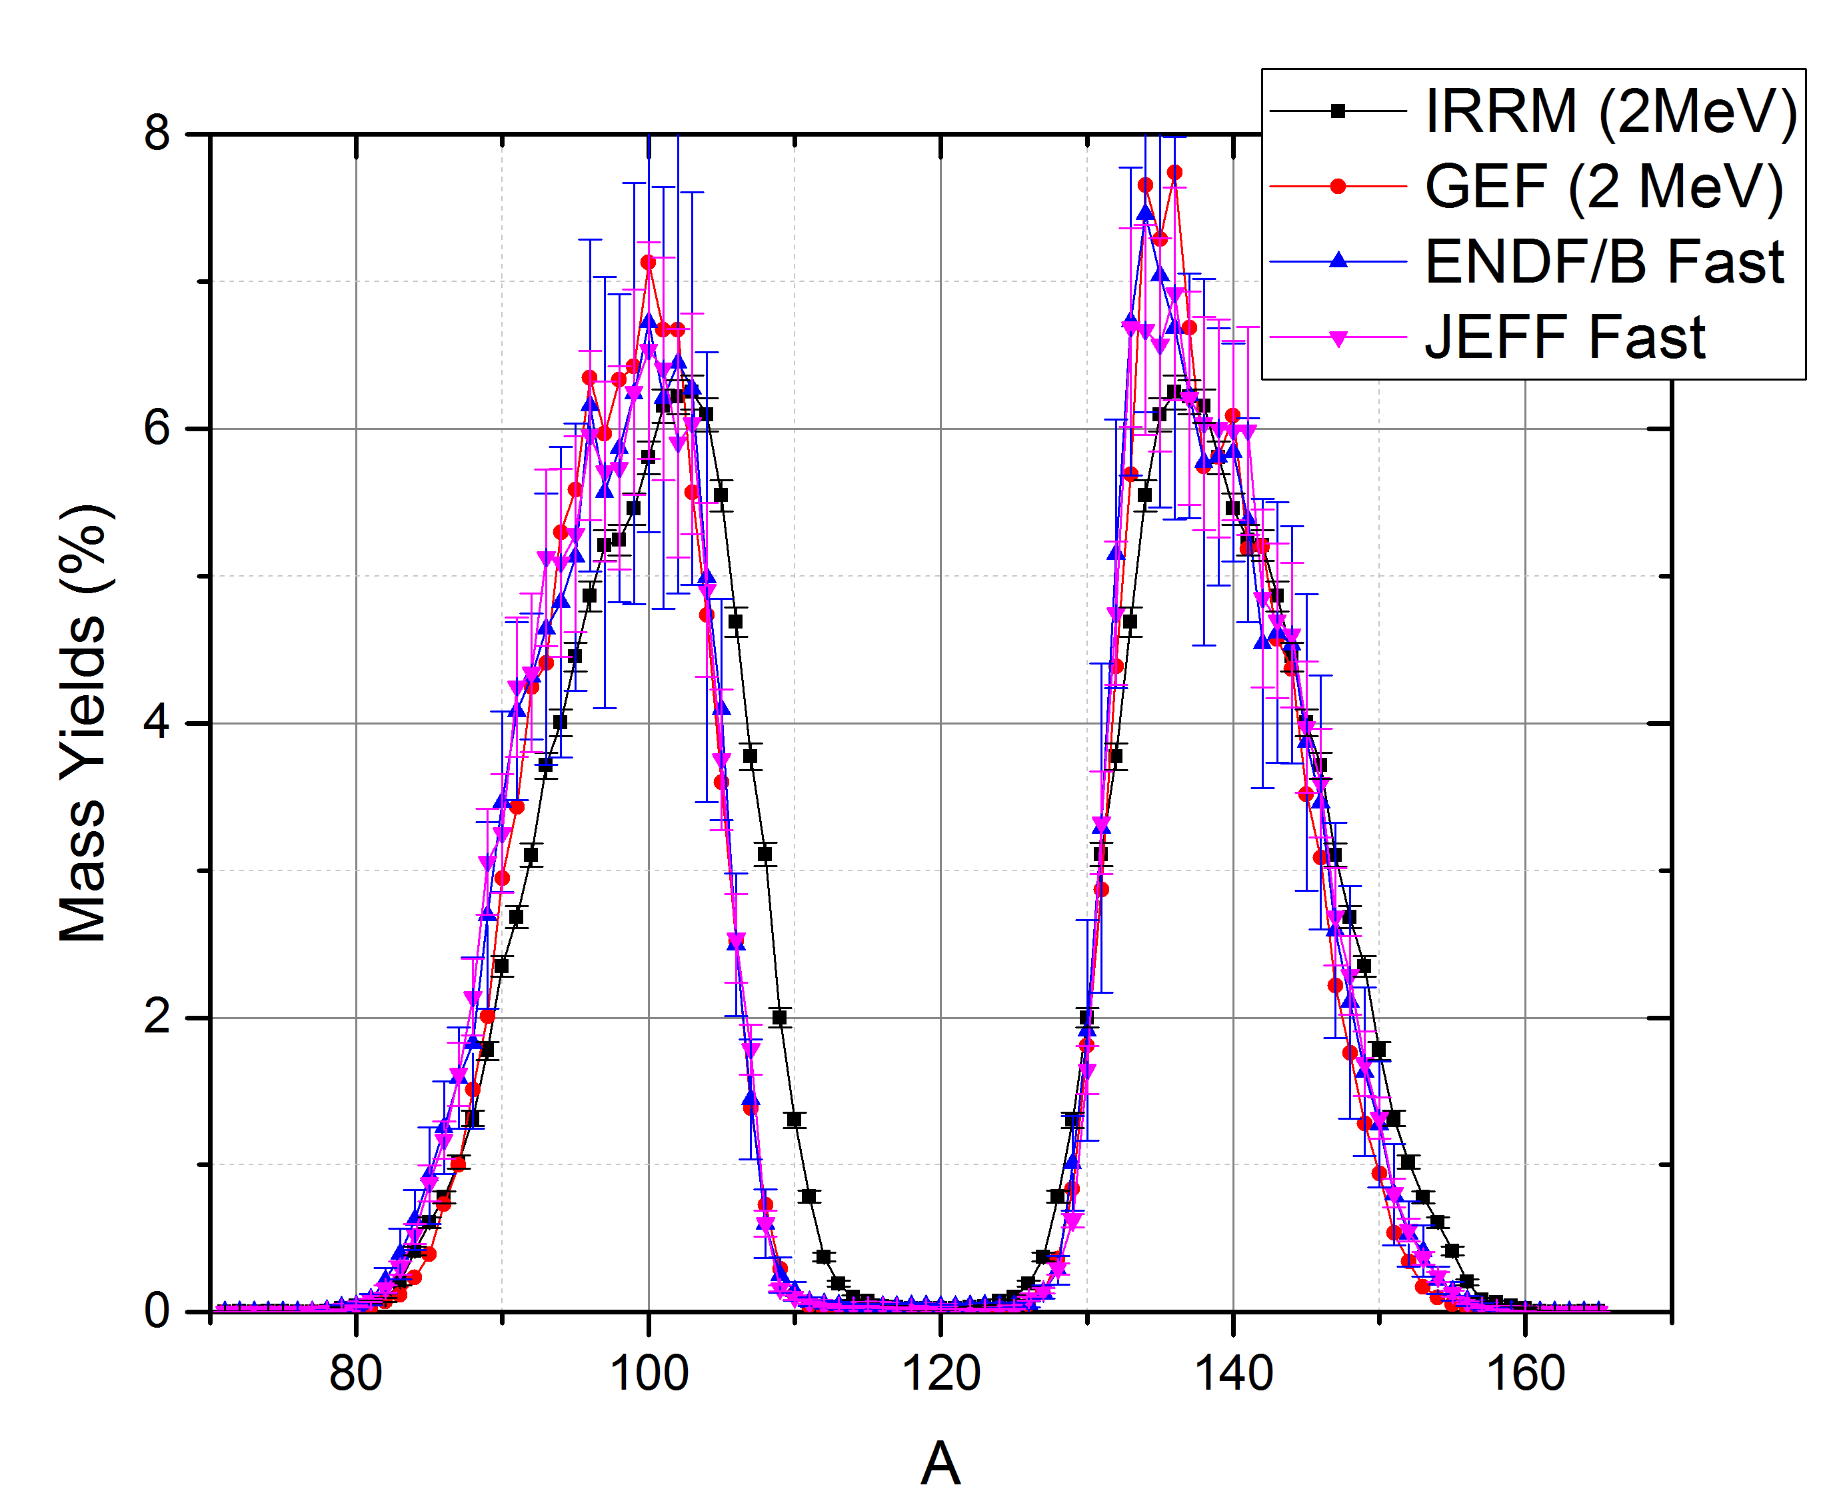
²³⁸U Yields ENDF/B vs JEFF vs GEF vs recent data
Disagreement in ²³⁸U Mass Yields
²³⁸U
?
Data: F-J Hambsch, private comm.

Slide 10
Future NNDC Activities
Requiring no extra funding:
Participate in Isomeric Ratios experiments.
Explore effect on antineutrino spectra calculations.
Wish list:
Rebuild experimental fission yields database
Develop least-squares methods to obtain recommended yields and correlations in cooperation with other national labs.
This will require considerable funding, several FTEs for about 5 years.

